Slide 1
Risks of Internationalization

Slide 2
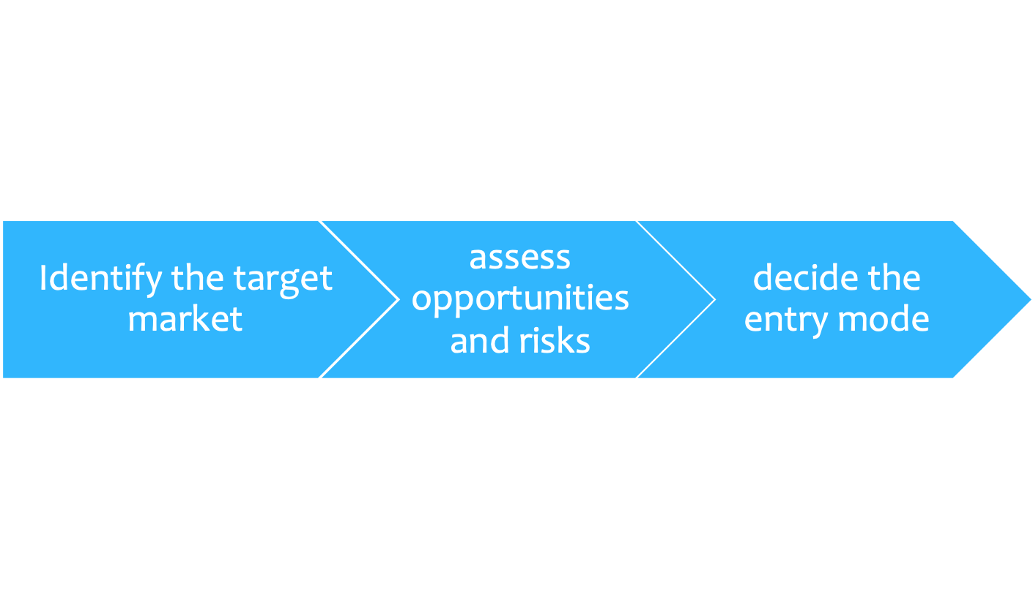
The risks of internationalization
Firms need to consider:
The psychological distance
the gap in the development level
the social context
the institutional context

Slide 3
Analysis of what?
Macroeconomic factors
GDP
Pro-capite GDP
Unemployment rate
Inflation
State’s role
Laws facilitating or limiting entrance
Demographic data
  customers’ and workers’ profiles
  Soft factors
  beliefs and values
  work ethic
  inclination to international cooperation

Slide 4
1. Political risk
  The unanticipated likelihood that a business’s foreign investment will be constrained by a host government’s policies
It’s connected to:
Terrorism
Expropriation
Indigenization
  Transfer risk: Government policies that limit the transfer of capital, payments, production, people, and technology in and out of country
  Operational risk: Government policies that constrain management and performance of local operations
  Ownership control risk: Government policies or actions that inhibit ownership or control of local operations

Slide 5
2. Country risk
It’s a broader case of counterpart risk.
Credit risk expresses the possibility that the counterpart of an obligation does not respect the deadline and/or the conditions for payment.
longer delays in making payment
the depreciation of the credit portfolio
increasing of instability
It affects:
The capacity of local debtors to honour their debts
the ability to recoup the investment

Slide 6
3. Financial risks
Risks connected to the variability of market process of financial activities (exchange rates, commodity prices, interest rates) Market risks
It’s a two way risk
Firms need to protect from unfavourable variation
But also to to consider the opportunity cost of any hedging
The aim is transforming unpredictable events in calculated risks

Slide 7
The financialization
At the macroeconomic level: development of financial markets and disconnection between financial and real flows.
Development of ICT
Deregulation
Globalization
From an atomistic to a systemic vision
Speculation and arbitrages

Slide 8
Financialization
At the microeconomic level: increasing focus on financial assets and financial investments
Transfer of liquidity and capitals
Optimization of accounting
New sources of profits
Hedging
BUT
Risk to detach resources from the core activities
Risk to consider comparative advantages as sources of competitive advantages

Slide 9
The Financial Function
Firms must:
plan medium- and long-term financial flows
choose the sources and types of financing;
choose the criteria for assessing the current and prospective conduct
manage the multi-currency treasury
manage the cash surplus/deficit generated by financial movements;
choose the hedging techniques;
exploit the anomalies of financial markets; taking advantage of different tax

Slide 10
It’s important to understand that the exposure to financial (and counterpart risks) depends on:
the relevant sector, its structure, and therefore the intensity of competition;
the regulations, in the markets of origin, of the productive inputs
the regulations, in the host market, of market outputs
the entry mode

Slide 11
The supervision nodes
The renvoicing centers are in charge of international procurement
Cost reduction
Possibility to concentrate the currency risk on procurements
Renvoicing centers develop the transfer price policies
criteria of the cost
criteria of the market
Fiscal arbitrage

Slide 12
The main goals
Earning, through higher transfer prices of the goods, low profits where the tax system is more rigorous;
Seek to earn higher profit where the tax system is less rigorous, in this case by transferring lower prices;
Attenuating the effects of restrictions on movements of capital, dividends, and royalties;
Reducing the effects of nationalization, should this take place;
Reducing the effects of duties.
Intra-organizational problems and tax systems integration

Slide 13
Currency risks
Three main forms:
Transaction risk: exchange variation impacts the debts owed to and by companies in foreign currency;
Translation risk: The variation in the exchange rate also impacts the actual countervalue of the financial statement items related to transactions in foreign currency;
Economic risk: the exchange variation may impact the company’s competitive position in a given market
Countervalue effect
Currency flow effect

Slide 14
Hedging instruments
Traditional instruments
Invoicing in reporting currency
Insurance
Currency basket
the establishment of an eschange cap and/or an exchange floor
Derivatives
Currency future
Currency option
Currency swap
What is the variation feared by European importers?
What is the variation feared by the European exporters?

Slide 15
Price risks
It’s connected to the volatility of commodity prices
Three main forms:
Transaction risk: possibility that an increase (decrease) in
the commodities’ quotations might force the buyer (seller) to pay (collect) an amount greater (less) than that estimated
Replacement risk: possibility that an increase in prices
might shift demand towards replacement products;
Competitive risk: possibility that the increase
(decrease) in prices might be to the disadvantage of a company but not its competitors that purchased (sold) at more affordable prices.

Slide 16
Hedging instruments
Real instruments
Agreement at a fix price
speculative inventory
Financial instruments
Cap and floor
Collar
Commodity option
Commodity future
…..
What are the factors affecting the possibility to develop speculative inventory?

Slide 17
Credit, Country and Systemic risks
Credit risk expresses the possibility that the counterparty in a financial service might fail to meet its obligation by the deadlines and under the conditions established by contract
Country risk involves responsibilities that fall within the sphere of government and, moreover, may be realized regardless of the insolvency of the individual counterparty, when the authority’s will to repay foreign debt, public or private, ceases.
Systemic risk: there is a high possibility that a defaulting party’s crisis situation will spread by “domino effect” to other operators (it exists for both credit and country risk)
.

Slide 18
Hedging instruments
For counterparts risks, firms can use:
Loans (Financing for suppliers and purchasers, finance for export credits)
Insurance
Documentary credits
Credit Derivatives

Slide 19
Credit Derivatives
Agreement according to which one party, upon payment of a single or periodic commission, is hedged against the credit risk connected to the activity of reference
The hedge consists of the counterparty’s commitment to perform a counterservice if the event occurs
The counter-service may consist of a cash payment, the payment the difference between the initial value of the activity of reference and that following, or by the physical delivery of the activity of reference.

Slide 20
Default risk swap
Partner A
Seller
Partner B
Purchaser
Libor + X basis points
Libor + Y basis points
Bond
Credit payment
Institutional Investor
X > Y

Slide 21
Future
They seem similar to forward, but:
Forward are over the counter
Forward are not standardized
  Price and deadlines depend on arrangements
Forward can concern:
  a terminable sell
  Convenience depends on the difference (F-X)
  a terminable purchase
Convenience depends on the difference (X-F)

Slide 22
The main elements
Denomination (or Cut -T): standardized quantity of underlying activity represented by a contract.
Number (N)of futures , it depends on the ratio between the capital to be invested and the denomination.
Quotation (Q): the forward price of the underlying activity in the futures market.
Nominal value = NxT
Face value = countervalue of the nominal value.
Initial margin (MI) = percentage of VF that operators pay at the moment of signing in order to open the margin account.
22
22

Slide 23
The marking to the market mechanism
Two positions:
Long = commitment to purchase;
Short = commitment to sell.
every day, the subscribers’ positions are crossed with opposite positions in order to verify any crediting or debiting of the margin of variation (MV).
MV = VF(t) - VF(t-1)
  Long x Short: MV is credited if VF has increased
  Short x Long: MV is credited if VF has decreased
Margin call = 75% of the initial margin (MI)

Slide 24
Future is a speculative technique
The aim is gaining the MV
Subscribers bet on the events they are afraid of, so that they can gain financial incomes if events happen.
Hedging price risk:
  the seller subscribes a short position
  the buyer subscribes a long position

Slide 25
Example
A big jeweller producer wants to cover from the
increasing price of gold on stock markets.
He subscribes 2 Futures on gold for delivery in
December, Cut = 100 ounces; Q0 = $ 400 per ounce
VF₀ = 400 × 200 = 80000 $
M.I. = $ 2000 (5% VF₀ )
Position?

Slide 26
In the following 4 days we have
Q1 = 397 VF1 = 397 × 2 × 100 = 79400$
Q2 = 402 VF2 = 402 × 2 × 100 = 80400$
Q3 = 398 VF3 = 398 × 2 × 100 = 79600$
Q4 = 394,5 VF4 = 394,5 × 2 ×100= 78900$
Margin Account $
4000 m.i.
t=1 600
B alance₁ = 3400
1000 t=2
Balance₂ = 4400
t=3 800
Balance₃ = 3600
t=4 700
Balance₄ = 2900
1100 Recall
26

Slide 27
Currency Future
The underlying activity is the foreign currency
– the denomination is the standardized quantity of foreign currency (e.g. $50.000)
– the quotation is the forward price of the foreign currency.
To decide the position we need to know:
What is the variation feared by the subscriber?
How is the Q? Is it like the exchange rate or opposite?
What is the relationship between the VF and Q? Direct or indirect?

Slide 28
Example
An Italian exporter is owed a $50,000 debt by US customers,
and wishes to cover itself with a future having the following
characteristics:
T = $10,000
Q = $1.2 7
Which Position does he choose?

Slide 29
The exporter fears an increase in the euro/dollar exchange;
The quotation is expressed as the exchange;
The exporter wagers precisely on the increase in Q.
We may calculate the number of futures
N=50,000/10,000 = 5
Let us use the proportion to calculate VF.
€1:$1.27=VF:VN.
VF = 50,000/1.27
increase in the quotation would entail a decrease of the VF short position

Slide 30
Option
Options are contracts with which the right (not obligation) is taken on to purchase (call) or sell (put) a certain quantity of underlying activity (currency or commodities) at a pre-established price or by a pre-established deadline
There are American and European Options
They can be standardised or over the counter (OTC)
The can be classified as:
  in the money
  at the money
  out of the money

Slide 31
The main elements
Strike price (X): It’s the pre-established (forward) price at which the subscriber of the call (put) may buy (sell) the underlying activity;
Premium (Vo): It’s the price at which the subscriber may subscribe the option and is always owed by the operator when the contract is signed. It expresses the value of the option.
In the call option, the maximum loss is the Premium, while the convenience depends on the difference St-X
In the put option, the maximum loss is the Premium, while the convenience depends on the difference X-St
31
31

Slide 32
Currency Option
The underlying activity is the foreign currency
We need to convert all the elemnts in €
X = 1/SP, where SP is the strike price
St* = 1/Cpa, where Cpa is the spot exchange expected by the operator for maturity
St = 1/Cps, where Cps is the spot exchange at maturity
Vo can be in €, otherwise we have V€=Vo/Cp

Slide 33
Currency Option Call
Importer’s hedge
Ex ante: St∗ −X −Vo> 0
The operator subscribes the call (SP>Cpa)
At the maturity: St −X > 0
The operator removes the premium (SP>Cps)
Ex post: St −X −Vo> 0
The operator has gained an advantage because it has saved, on the purchase of the foreign currency, an amount greater than the premium it paid.

Slide 34
Currency Option Put
Exporter’s hedge
Ex ante: X −St* − Vo> 0
The operator subscribes the call (SP<Cpa)
At the maturity: X − St > 0
The operator removes the premium (SP<Cps)
Ex post: X − St − Vo> 0
The operator has gained an advantage because it has saved, on the purchase of the foreign currency, an amount greater than the premium it paid.

Slide 35
Swap
These are contracts signed between two parties, through which each party takes on the obligation to make fixed or variable periodic payments. They serve mainly to hedge against interest risk or currency risk
  IRS:
    Fix vs variable rate
    Variable vs fix rate
    Savings on interest: Fix vs fix – variable vs variable
  Cross-currency swap: payments of interest flows in different currencies

Slide 36
Currency Swaps
Commitment to a pair of opposing operations on the same notional capital (foreign currency)
The elements are all known, so operators can make a calculation in advance in order to verify the benefit of the operation
Hedging: operators may plausibly choose, as a forward operation, the one that serves as a hedge.
The importer will verify the benefit of making a spot sale and a forward purchase of foreign currency.
The exporter will verify the benefit of making a spot purchase against a forward sale of foreign currency.

Slide 37
Importer’s hedge
Example 1: Spot sale of dollars and forward purchase of dollars
Supposing that the underlying activity is $1,
R= 1/Cp - 1/Ct + (1/ Cp ) i€t - (i$ t) 1/ Ct
Where :
1/Cp is the counter-value in euros of $1 calculated at the
exchange Cp
– 1/Ct is the counter-value in euros that the importer pays for the forward purchase of $1.
–i€ is the interest rate on euros
– I$ /Ct (i$ t 1/Ct) is the counter-value in euros of the interest in dollar he looses
37
37

Slide 38
Exporter’s hedge
Example 2: Spot purchase of dollars and forward sell of dollars
Supposing that the underlying activity is $1,
R= - 1/Cp + 1/Ct – I€ +I$
Where :
1/Cp is the counter-value in euros that the exporter pays to by the dollar
1/Ct is the counter-value in euros that the exporter obtains selling the dollar
I€ is the amount of interest that the exporter looses because of the purchasing (or financing)
I$/Ct is the counter-value in euros of the interest in dollars he gains
38
38

Slide 39
Some evidence in the airline sector
Rising oil prices have led many airlines to hedge prices
Fuel is these companies’ second largest cost tem.
Jet fuel price hedging increases the value of airlines throughout the world
Some airlines simply pass price increases along to the final customers
Effects on competition??

Slide 40
Which hedging technique?
Jet fuel can only be traded OTC;
oil, which can be traded on the regulated markets NYMEX (United States) and IPE (Europe).
  Derivatives on Jet fuel are less liquid!
Companies use:
Forward contracts traded OTC which fix proce and quality (jet fuel seller)
  counterparty risk?

Slide 41
Futures contracts, designed both to hedge fuel risk and to provide protection from counterparty risk.
  In the US, fewer than 1% of contracts end with the physical shipment of the underlying asset
  Each futures contract that is signed corresponds to 1000 barrels of petroleum (West Texas Intermediate or Brent Crude Oil).
  They may be signed every month, up to two years in advance and with a duration of up to three years
  position?

Slide 42
Jet fuel options OTC.
Brent gas oil and crude oil options on the IPE regulated market
Which option?
Collar: A call option is purchased for protection against price
increases, and at the same time a put option is purchased to protect also against the risk of the market going in the opposite direction.
  The premium of the call option is higher than the put option,
  where the call is exercised, the profit lies in the difference between what is collected by exercising the call option and the lost premium on the put option.
  If the market trends in the reverse, the put option is exercised, and the earnings will partially hedge the loss paid on the call.

Slide 43
Swaps
customized futures contracts through which airlines lock in the fuel price.
  The airline purchases a swap at a given strike price for a given quantity of jet fuel per month.
  The current price is compared every month with the strike price.
  Where the current price is higher than the strike price, the airline receives the added value in comparison with the strike.
  When it’s lower, the airline will pay the counterparty the loss on the strike where the price is lower that month.

