Slide 1
Design Driven Innovation
a new theory of innovation
Cabirio Cautela
Titolo presentazione
sottotitolo
Milano, XX mese 20XX

Slide 2
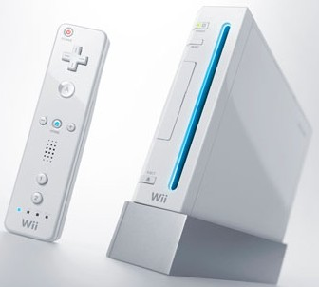
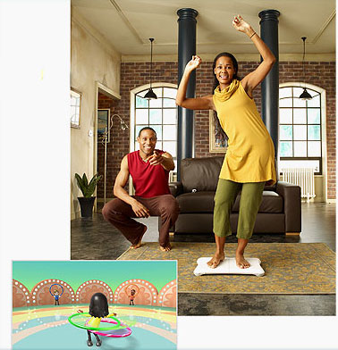
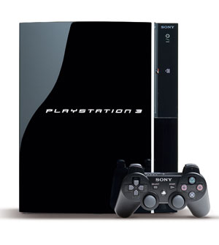
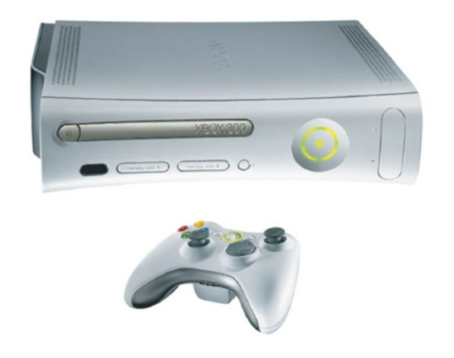
Nintendo Wii (2006)
Drivers / Motivation | What is the motivation for this project? What are the challenges and opportunities? Is there a recognized driver of change? In society? In competition? A new technology?
Objective | Why are we doing this project. Which sustainable outcomes do we want to achieve in the long run
Scope | The boundaries of the project. What we want to innovate and what we do not want to. Which economic factors should be taken into account?
Output | The result of the project. A concept for a product? A concept for a process? A business plan? A roadmap?
People | The target user(s)
Context | In which context the product is used? Which geographical area? Which context of life (home, street, office…)
Nintendo Wii, 2006
Sony Playstation 3, 2006
Microsoft Xbox, 2005

Slide 3
Innovation of Meaning in the console game industry:
Nintendo Wii
FROM …
… game consoles as passive immersion in a virtual world for young adepts
TO …
… game consoles as
active physical entertainment for everyone

Slide 4
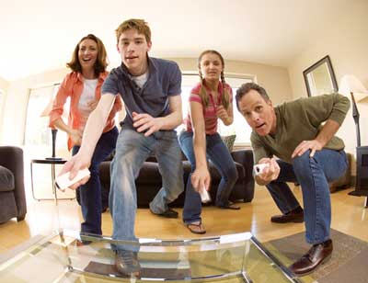
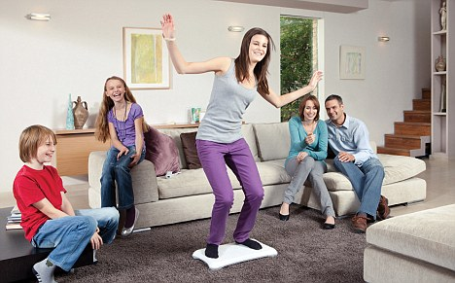

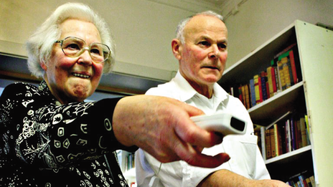
Nintendo Wii: competitive performances
The number of employees increased during the 2000s from 2.900 to 4.700
  On average, 30% of the employees were involved in research and development activities
In the 2000s, Nintendo invested approximately 4% of its annual revenues in research and development activities each year (excluding salary costs for employees involved in R&D activities)
From 2006 to 2010, the competitive performance achieved by Nintendo demonstrated incredible growth: revenues (+219%), EBIT (+342%), EBITDA (+334%)

Slide 5
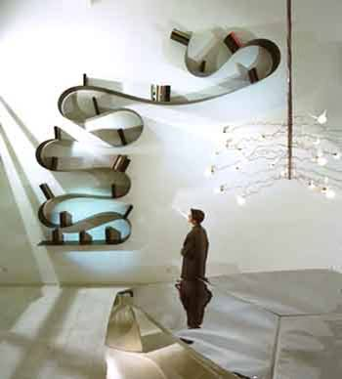
Kartell Bookworm (1994)
The research carried out by our R&D department to develop Bookworm was enormous and very difficult. To find the material with the right technical characteristics and the right mould able to embed the concept proposed by Arad was an incredible challenge. Not even Bayer guaranteed the result
Giulio Castelli, Honorary President and founder of Kartell

Slide 6

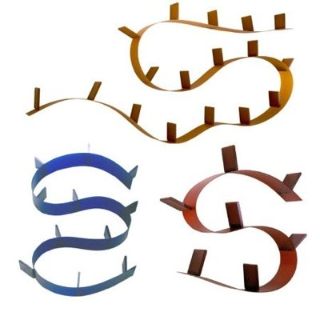
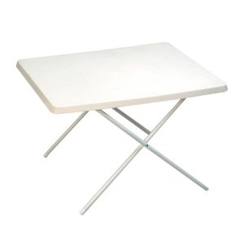
Innovation of Meaning in the furniture industry:
Kartell Bookworm
FROM …
… plastic used for low-end and cheap pieces of furniture
TO …
… plastic used to ennoble and enrich pieces of furniture

Slide 7
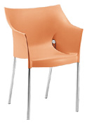
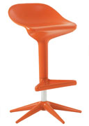
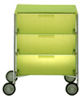


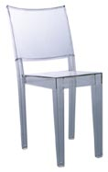
Kartell Bookworm: competitive performances
The number of employees during the 1990s increased from 60 to 80:
  Only 3-4 employees were exclusively dedicated to design activities (although the CEO was significantly involved)
  In the 1990s, the average number of external designers equaled approximately half of the employees
In the same period, Kartell invested approximately 5.0% of its annual revenues in design activities annually
From 1995 to 1999, the competitive performance of Kartell demonstrated incredible growth: revenues (+75%), EBIT (+300%) and EBITDA (+107%)

Slide 8
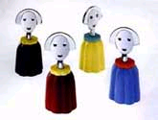

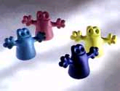
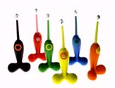
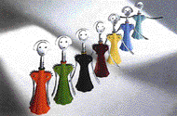
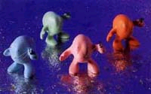

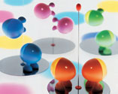
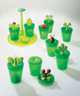



Alessi Family Follows Fiction (1993)
We were aware of … having come to the end of the world of design as it has been used up till then. At last the route to be followed for the new workshop - that of "the object-toy" - became clear.
And it would be conceived beyond aesthetics and style.
“In a room full of objects a child chooses one to relieve his boredom and solitude; why that object in particular?”
Alberto Alessi, CEO of Alessi

Slide 9
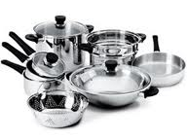
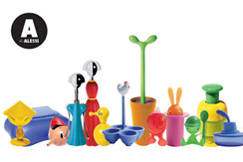
Innovation of Meaning in the kitchenware industry:
Alessi Family Follows Fiction
FROM …
… kitchenware as serious and functional tools
TO …
… kitchenware as ironic and playful objects to interact with

Slide 10
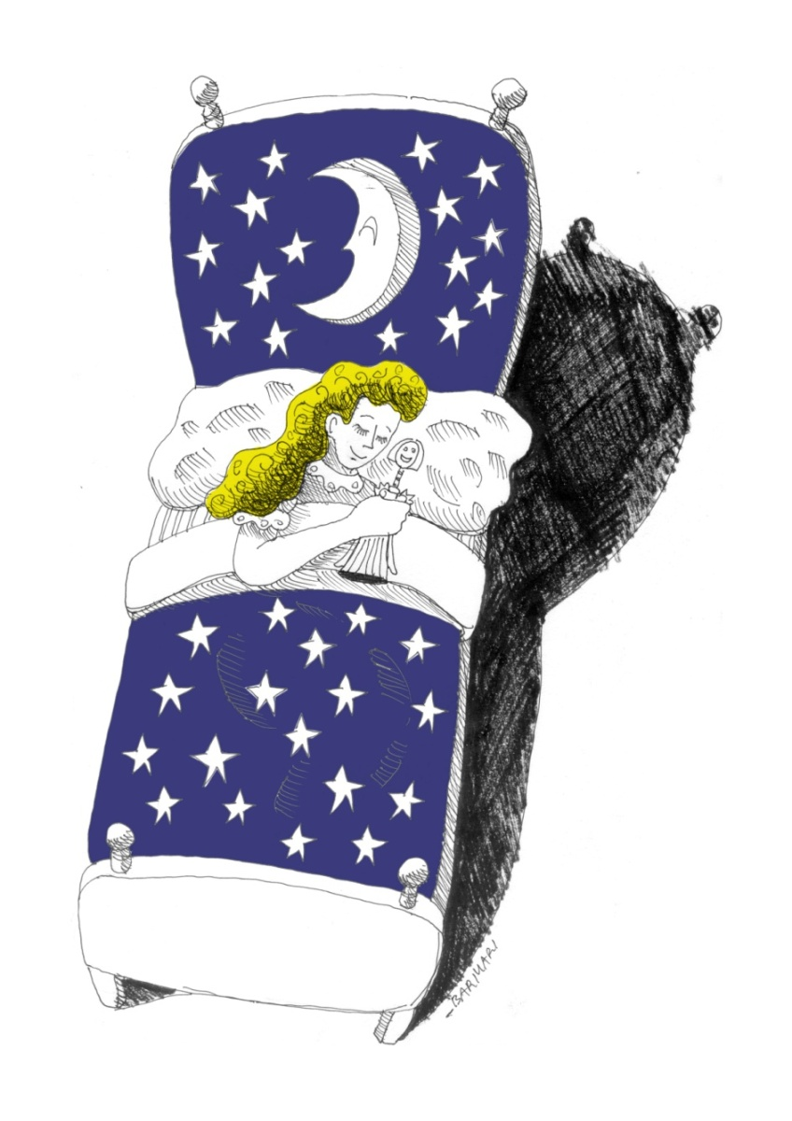
Alessi Family Follows Fiction: competitive performances
The number of employees during the 1990s increased from 320 to 570:
  Only 1 employee was exclusively dedicated to design activities (although the CEO was significantly involved)
  Alessi collaborated with approximately 400 external designers
In the 1990s, Alessi invested approximately 4.7% of its annual revenue in design activities each year
From 1994 to 1998, Alessi’s revenues grew significantly (+78%)

Slide 11
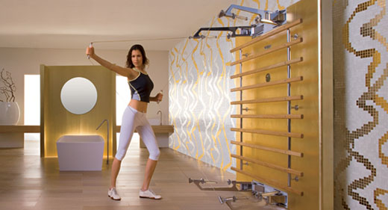
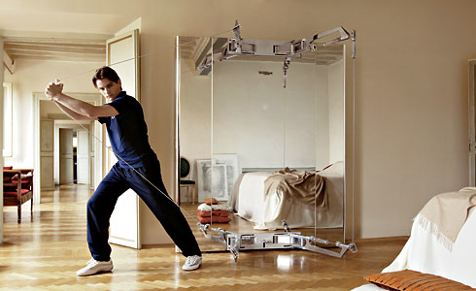
Technogym Kinesis (2005)
Wellness, the philosophy of living well, is expanding at every level: young people, women, seniors, in gyms or at home, during leisure time or during a short break at work. We sell especially to fitness clubs, but families are growing a lot. There has been a change in culture: today people who train at home demand the same quality and technological standards of a gym
Nerio Alessandri, President of Technogym

Slide 12

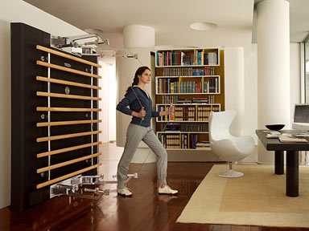
Innovation of Meaning in the fitness equipment industry:
Technogym Kinesis
FROM …
… complex and intimidating fitness equipment
TO …
… friendly, personalized and intuitive Wellness equipment

Slide 13
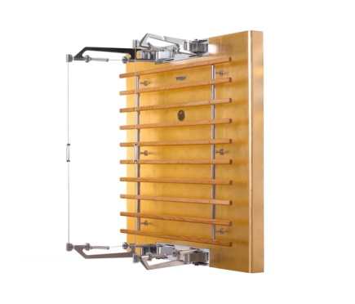
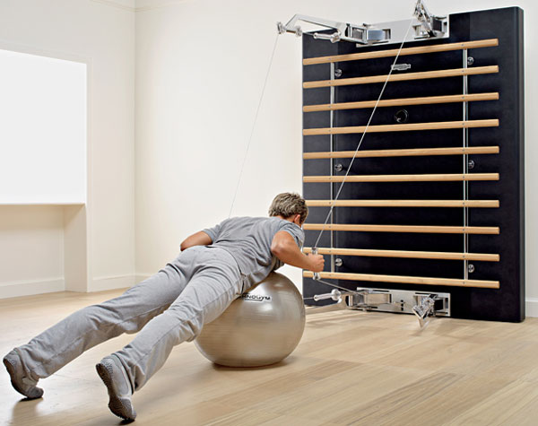
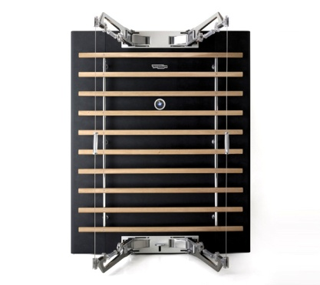
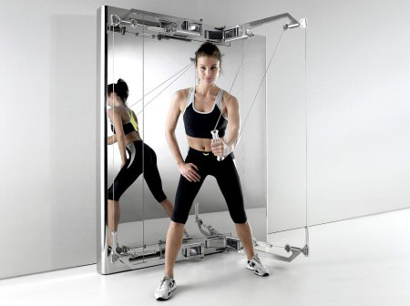
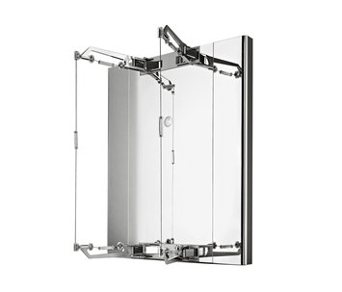
Technogym Kinesis: competitive performances
The number of employees during the 2000s increased from 600 to 1.700
  On average, 15% of the employees were involved in research and development activities, and Technogym developed a few collaborations with furniture designers and architects (e.g., Antonio Citterio) based on royalties (3%)
In 2000s, Technogym invested approximately 15% of its annual revenues in research and development activities annually
From 2006 to 2010, the competitive performance achieved by Technogym demonstrated significant growth: revenue increased by 19%. Since 2006, Technogym has ranked as the first fitness company in Europe and the second worldwide in terms of revenue

Slide 14
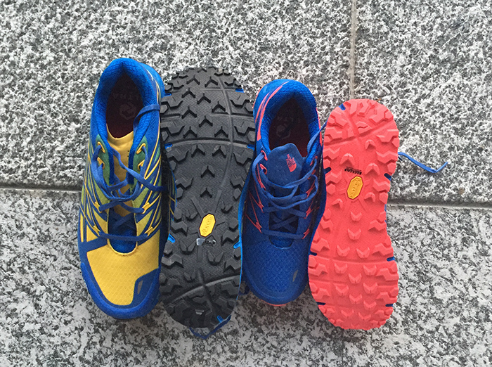
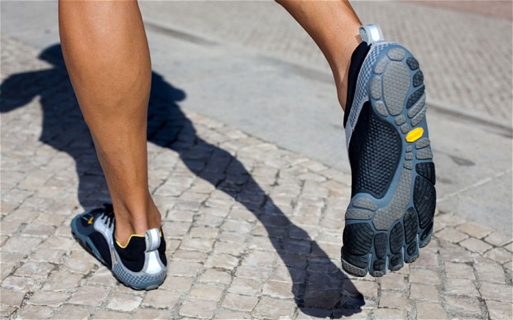
Innovation of meaning in sportive Industry: the case Vibram
FROM …
…tools to protect and support
TO …
…adhering “second skin” to have a better grip with the ground

Slide 15
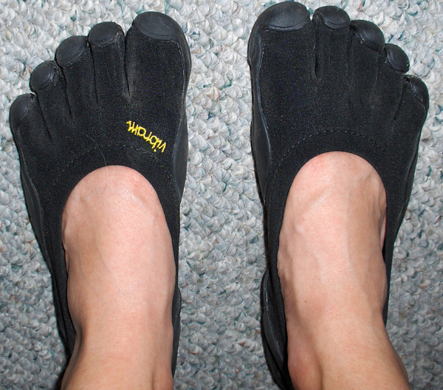
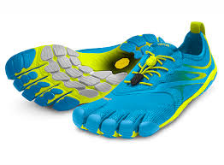

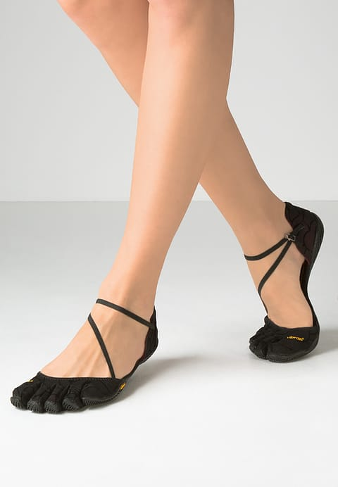
Vibram: competitive performances
Business has gone from zero to approximately 80 million Euro since launch, with triple digit growth in fiscal 2011
FiveFingers gained (negative) popularity as one of the first minimalistic shoes and pertained to the “barefootlike running” movement
Sales of its FiveFingers have tripled every year since they were introduced in 2006

Slide 16
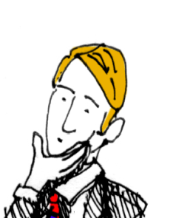
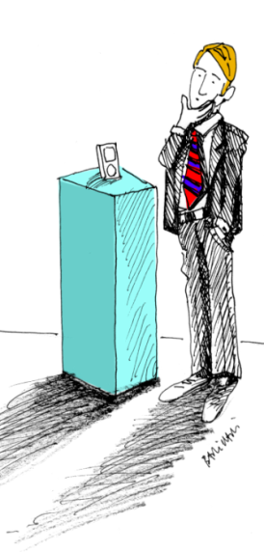
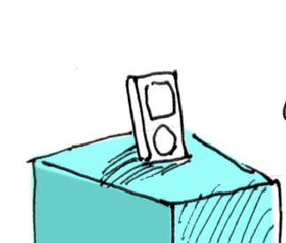
Innovation
People
Meaning
Utilitarian – Symbolic – Emotional
WHY?
Solution
Product – Service – Process
HOW?

Slide 17
Innovation of Meaning
People
Innovation
Meaning
Utilitarian – Symbolic – Emotional
WHY?
Solution
Product – Service – Process
HOW?

Slide 18
Innovation of Solution
People
Meaning
Utilitarian – Symbolic – Emotional
WHY?
Innovation
Solution
Product – Service – Process
HOW?

Slide 19
From solution to meaning
Meaning
Existing
New
Solution
User

Slide 20
Innovation of Solutions vs Innovation of Meaning
Innovation of Solutions | Innovation of Meanings
How | Why
Need (An answer: I need this) | Purpose (A discovery: This is meaningful to me)
User | People
Better | Delightful
Compete on Performance | Compete on Love
Increasing relevance of Innovation of Meaning
Always happened
More frequent and relevant now
Rapid change of problems
Individualist postmodern society
Global competition
Technology accessible
Abundance of ideas

Slide 21
The “new” contribution of design
The etymology of design goes back to the latin de + signare and means making something, distinguishing it by a sign, giving it significance, designating its relation to other things, owners, users.
Based on this original meaning, one could say:
design is making sense (of things)
Klaus Krippendorff, 1989

Slide 22
Innovation strategies
INNOVATION OF MEANING
Radical improvement
TECHNOLOGY
DRIVEN
Technology
(HOW)
DESIGN THINKING
(user driven)
Incremental improvement
Reinforce
Change
Meaning
(WHY)
Creative
Problem Solving
Visionary
Interpretation

Slide 23
Going back to the Nintendo Wii case study …
FROM …
… game consoles as passive immersion in a virtual world for young adepts
TO …
… game consoles as
active physical entertainment for everyone

Slide 24
The contribution provided by STMicroelectronics
If a client asks for a specific feature or component, it means that someone else has already created it
Bruno Murari, scientific advisor for MEMS, STMicroelectronics
We started to envision possible applications in different fields. The basic idea was to think more abstractly of what MEMS could provide in final products: information on movement and position. This can be used for automation, or, even more interestingly, for simplifying human interfaces. Then we proposed our envisioned applications directly to the most innovative engineers of potential clients in current or new markets
Aldo Romano, CEO of STMicrolectronics Italy

Slide 25


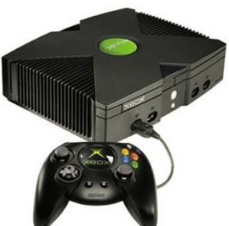
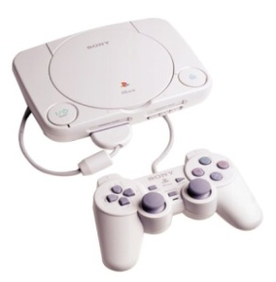
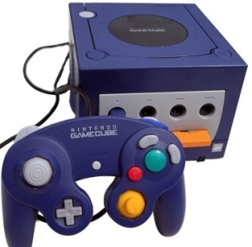
Technology Epiphany enabled by STMicrolectronics
FROM …
… game consoles as passive immersion in a virtual world for young adepts
TO …
… game consoles as
active physical entertainment for everyone
Radical
improvement
Graphic
Speed
Technology
(HOW)
MEMS
accelerometers
Incremental improvement
Reinforce
Change
Meaning
(WHY)

Slide 26
Technology Epiphanies
TO …
… existing or immediate meaning
Technology Epiphany
TO …
… quiescent meaning
Radical
improvement
Technology
(HOW)
Technology Substitution
Technology Epiphany
Incremental improvement
FROM …
… existing meaning
Reinforce
Change
Technology Screening
Meaning
(WHY)

Slide 27
Technology Epiphanies
When a breakthrough technology emerges, it embeds many potential meanings. Some are immediate, usually promoted by those who have initially guided technological development
Other meanings are quiescent, but sooner or later they become manifest
A company that sees innovation strategy as monodimensional—that is, consisting only of technological innovation—will not search for the quiescent meaning
This approach leads to two myopic behaviors:
  If the most immediate meaning of a new technology does not fit with the existing meaning in the market, companies will likely screen that technology off and consider it irrelevant to competition (Technology screening)
  If the most immediate meaning of the new technology does fit the existing meaning, a company will invest by substituting the new technology for current technologies (Technology substitution)

Slide 28
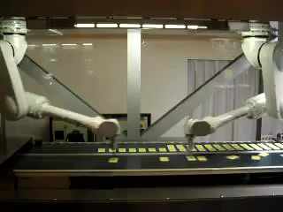
Robotics industry: existing meaning
FROM …
… existing meaning

Slide 29
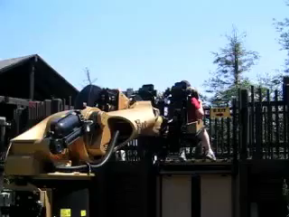
Robotics industry: quiescent meaning
TO …
… quiescent meaning

Slide 30
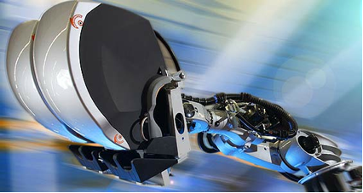
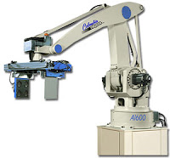
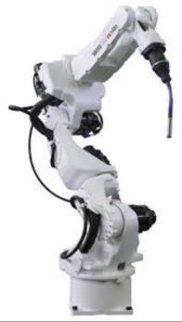
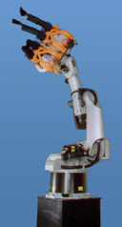
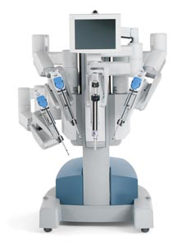
Innovation of Meaning in the robotics industry:
KUKA Robocoaster (2003)
FROM …
… robots as substitute of humans
TO …
… robots in touch with humans

Slide 31

Technology Epiphany developed by KUKA
FROM …
… robots as substitute of humans
TO …
… robots in touch with humans
Radical
improvement
More agile and dexterous. Easier to program and control
Technology
(HOW)
Passenger-Carrying Capabilities
Incremental improvement
Reinforce
Change
Meaning
(WHY)

Slide 32




Philips Ambient Experience (2004)

Slide 33

Innovation of Meaning in the imaging industry:
Philips Ambient Experience
FROM …
… advanced and precise imaging scanners
TO …
… relaxing and friendly imaging scanners

Slide 34

Technology Epiphany developed by Philips
FROM …
… advanced and precise imaging scanners
TO …
… relaxing and friendly imaging scanners
Radical
improvement
More sophisticated devices that can capture more data in less time
LED displays, Video animation, RFID, Sensors, Sound-control systems
Incremental improvement
Reinforce
Change

Slide 35



Philips Ambient Experience: competitive performances
Ambient Experience has strengthened Philips’s €3.27billion imaging business around the world, allowed it to realize higher prices, and improved its profitability
Thomas van Elzakker, General Manager for New Ventures of Philips
In 2011 more than 260 Hospitals around the world adopted the Ambient Experience suite
Ambient Experience has
  Cut the time required to conduct computed tomography (CT) from 15% to 20%
  Reduced the number of children under the age of three who need to be sedated for a CT scan by 30% to 40%
  Slashed the amount of radiation they receive by 25% to 50%

Slide 36
Innovation
People
WHY?
VISIONARY INTERPRETATION
1. Re-interpretation
2. Gifting people
3. Embodied
Meaning
Utilitarian – Symbolic – Emotional
HOW?
CREATIVE
PROBLEM SOLVING
1. Ideation
2. Understanding users
3. Outsourced
Solution
Product – Service – Process

Slide 37

Innovation
People
Fresh ideas come faster in a fun place
David Kelley, IDEO
Meaning
Utilitarian – Symbolic – Emotional
HOW?
CREATIVE
PROBLEM SOLVING
1. Ideation
2. Understanding users
3. Outsourced
Solution
Product – Service – Process

Slide 38




Creativity
This is where the crazy lives.
This is where we do our work. It’s different.
We are weird and we are proud of it.
Fresh idea come faster in a fun place.
You really encourage that kind of craziness, because sometimes it leads to the right thing.
It’s focused caos.
David Kelley, IDEO

Slide 39
Innovation of Solutions vs Innovation of Meanings
 | Ideation | Re-Intepretation
Output | Answers, Idea | Interpretation, Vision
Process | Speed, Brainstorming | Depth, Research
Quality metrics | N° of ideas | Robustness of vision
Method | Optimization | Hermeneutics
Vision of society | Culturally neutral | Strong perspective

Slide 40

Innovation
People
By looking at what users do, we learn how to design a better shopping kart
David Kelley, IDEO
Meaning
Utilitarian – Symbolic – Emotional
HOW?
CREATIVE
PROBLEM SOLVING
1. Ideation
2. Understanding users
3. Outsourced
Solution
Product – Service – Process

Slide 41



User-Driven Innovation
By looking at what users do, we learn how to design a better shopping kart
David Kelley, IDEO

Slide 42

Understanding user needs OR Making proposals?
We have a lot of customers, and we have a lot of research into our installed base. But in the end, for something this complicated, it’s really hard to design products by focus groups. A lot of times, people don’t know what they want until you show it to them
Steve Jobs, Apple

Slide 43

Understanding user needs OR Making proposals?
Market? What Market? We do not look at market needs. We make proposals to people
Ernesto Gismondi, President, Artemide

Slide 44

Understanding user needs OR Making proposals?
We don't use consumer focus groups.
We got a lot of feedback from developers in the industry
Shigeru Miyamoto,
Senior Marketing Director, Nintendo
When we showed a glimpse of it at the Tokyo Game Show in September, 2005, there was a stunned silence. It was as though the audience didn't know how to react
Satoru Iwata, President and CEO, Nintendo

Slide 45
Understanding user needs OR Making proposals?
Users do not always know what they need … We propose new visions instead of simply following market needs.
I use the metaphor of the good father: he is not who gives his children what they want, but what is more meaningful. A father pursues a vision
Stefano Marzano, CEO and Chief Creative Director of Philips Design

Slide 46
Interpreters
Source: Verganti R (2009). Design Driven Innovation. Harvard Business Press, Boston, USA

Slide 47
Thank you for your attention!
cabirio.cautela@polimi.it

