Slide 1
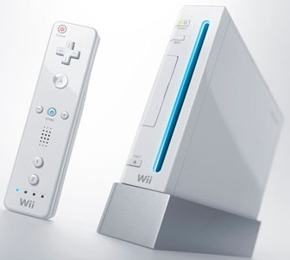
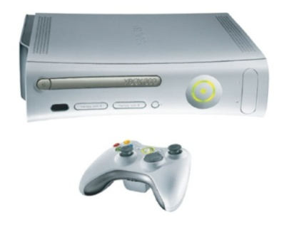
Understanding Innovation of Meaning: Example
Incumbent
Innovator
Meanings
[embodied by the Incumbent]
Meanings
[proposed by the Innovators]
Let’s compete
Let’s party
For adepts
For everyone
Digital competition
Face2Face socialization

Slide 2
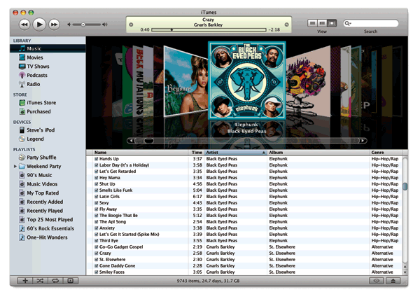
Understanding Innovation of Meaning: Case 1
Incumbent
Innovator

Slide 3
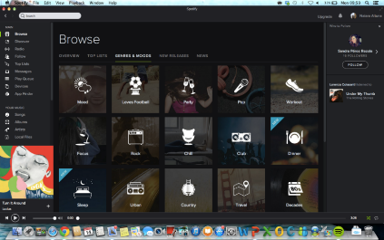
Understanding Innovation of Meaning: Case 1
Incumbent
Innovator
Meanings
[embodied by the Incumbent]
Meanings
[proposed by the Innovators]

Slide 4
Understanding Innovation of Meaning: Case 2
Incumbent
Innovator

Slide 5
Understanding Innovation of Meaning: Case 2
Incumbent
Innovator
Meanings
[embodied by the Incumbent]
Meanings
[proposed by the Innovators]

Slide 6
Understanding Innovation of Meaning: Case 3
Incumbent
Innovator

Slide 7
Understanding Innovation of Meaning: Case 3
Incumbent
Innovator
Meanings
[embodied by the Incumbent]
Meanings
[proposed by the Innovators]

Slide 8
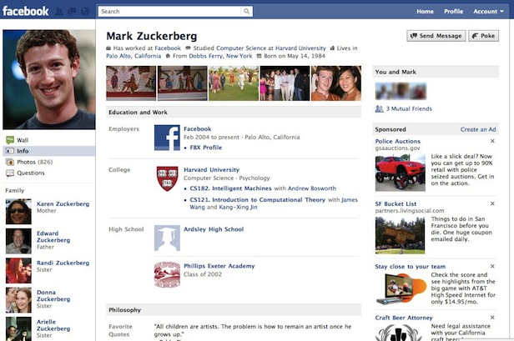
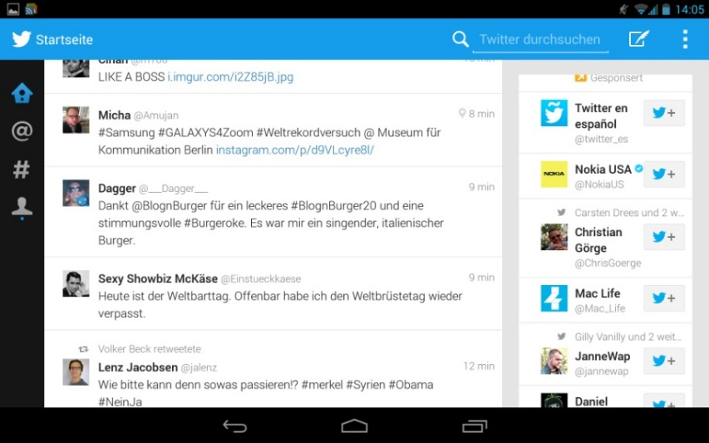
Understanding Innovation of Meaning: Case 4
Incumbent
Innovator

Slide 9
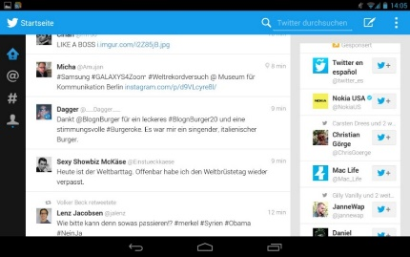
Understanding Innovation of Meaning: Case 4
Incumbent
Innovator
Meanings
[embodied by the Incumbent]
Meanings
[proposed by the Innovators]

Slide 10
Understanding Innovation of Meaning: Case 5
Incumbent
Innovator

Slide 11
Understanding Innovation of Meaning: Case 5
Incumbent
Innovator
Meanings
[embodied by the Incumbent]
Meanings
[proposed by the Innovators]

Slide 12
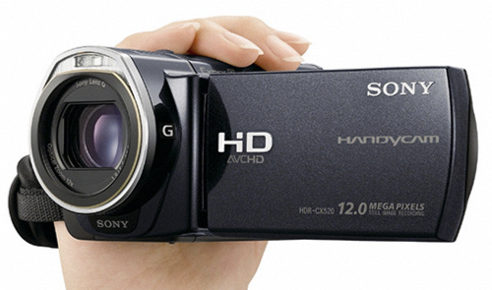
Understanding Innovation of Meaning: Case 6
Incumbent
Innovator

Slide 13
Understanding Innovation of Meaning: Case 6
Incumbent
Innovator
Meanings
[embodied by the Incumbent]
Meanings
[proposed by the Innovators]

