Slide 1
Design Thinking Logics, principles and evolutions Cabirio Cautela

Slide 2
Cabirio Cautela
Professor of Design management and Strategic Design
@ Design School, Politecnico di Milano
(@innovation strategies, design strategies @ product-service system Design)
CEO of POLI.design
The post-graduate school of Politecnico di Milano
Director of the Design Thinking for Business Observatory
@Department of Design, Politecnico di Milano

Slide 3
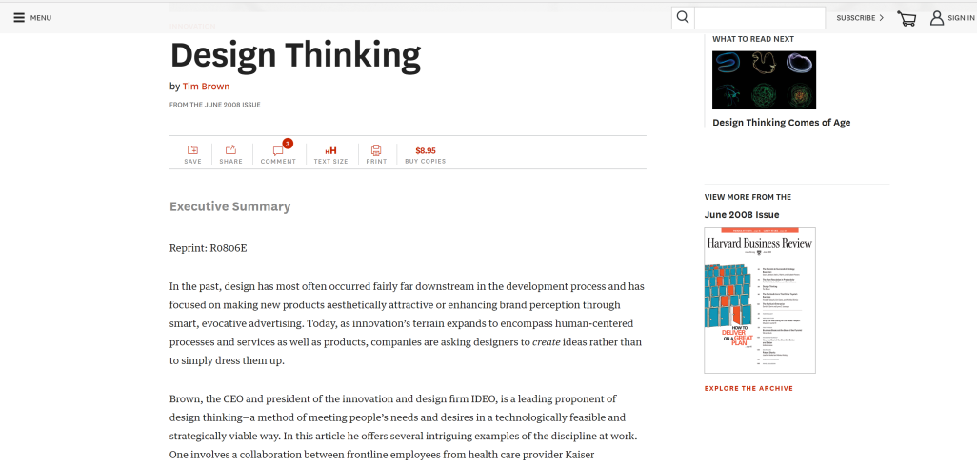
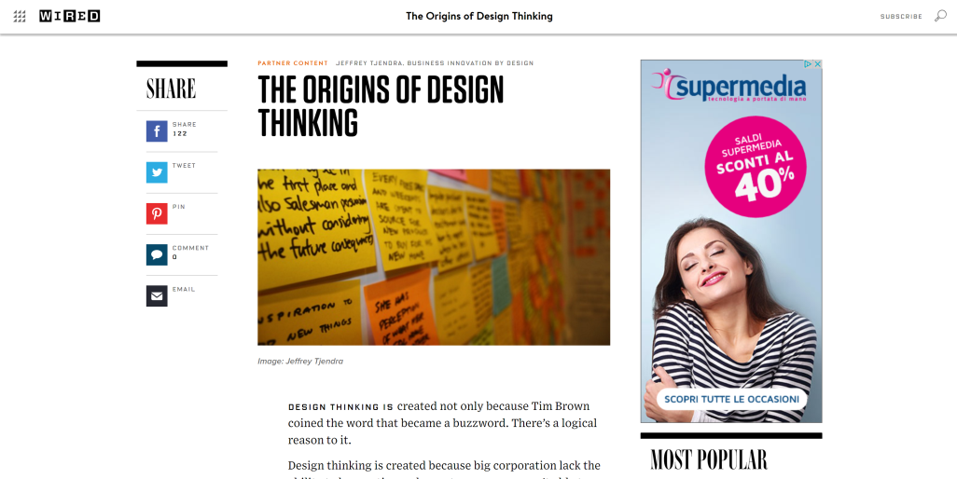
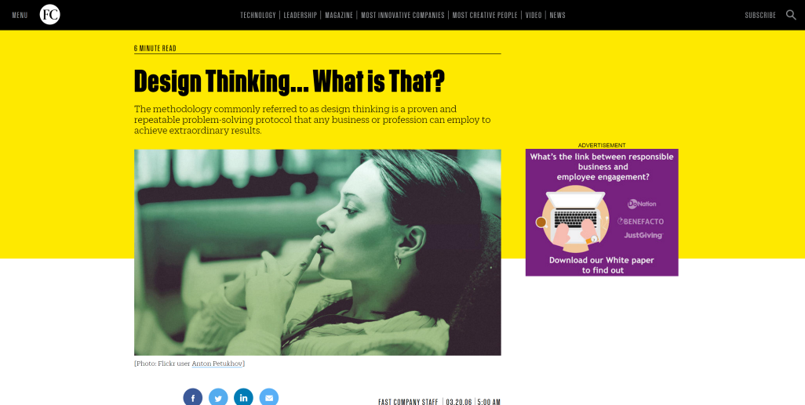
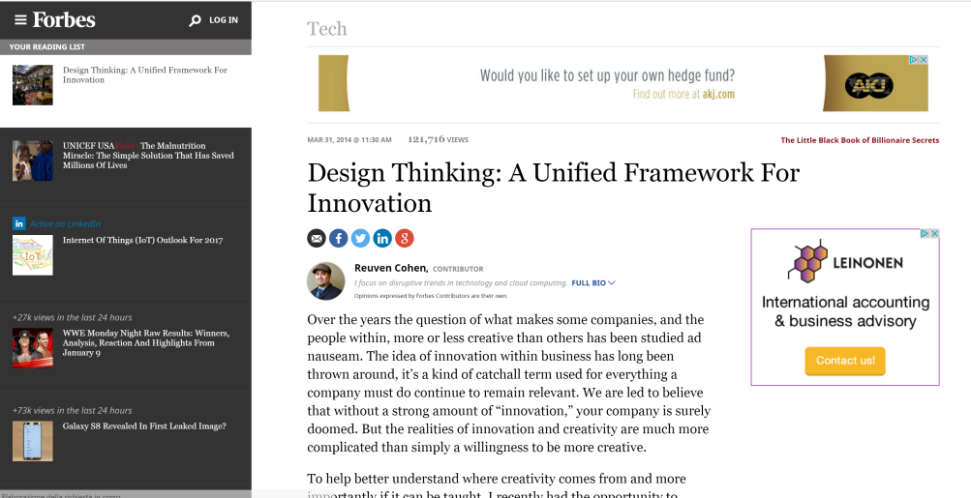
2010s … explosion of the Design Thinking: Press
Harvard Business Review
Wired
Fast Company
Forbes

Slide 4
2010s … explosion of the Design Thinking: Acquisitions
2011
2012
2013
2014
2015
Buyer
Acquired
Notes:
https://www.wired.com/2013/05/accenture-fjord/

Slide 5
What is the most diffused
metaphor of innovation?

Slide 6
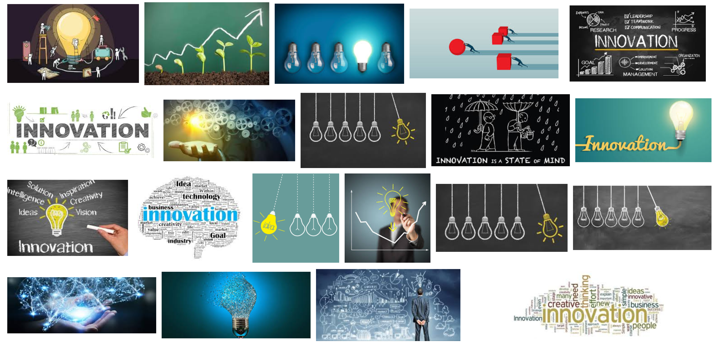
Searching for «innovation» by Google Images

Slide 7
Innovation needs Ideas → Creativity

Slide 8
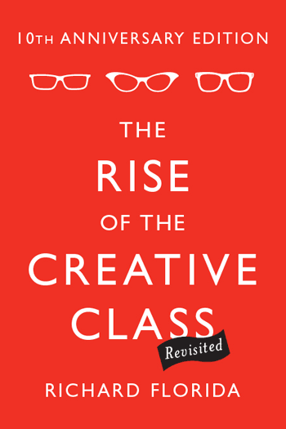
Creativity

Slide 9
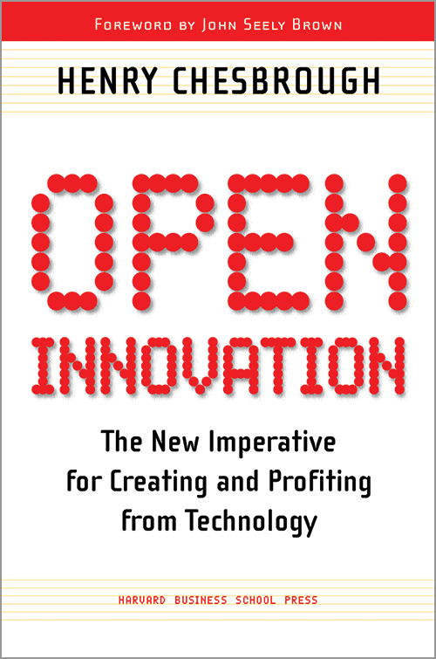
Open Innovation

Slide 10
Creativity + Open Innovation
Intermediaries for Innovation
Crowdsourcing Platforms
Contests
Call for Ideas
Hackathons

Slide 11
Design Thinking (1.0) as Creative Problem Solving
1990
2000
2010
2020
Design Thinking 1.0 as
creative problem solving
Ideating
New
Opportunities
New
Products
Developing

Slide 12
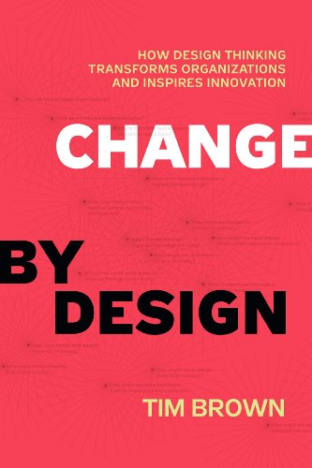
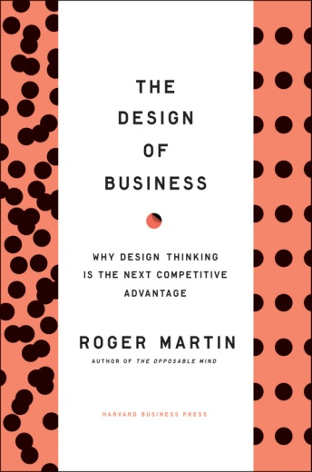
Creative Problem Solving: Theoretical Background
1990
2000
2010
2020
Design Thinking 1.0 as
creative problem solving
“The way I think about design thinking is it is in a halfway house between analytical thinking, for the purely deductive and inductive logical thinking that utilizes quantitative methodologies to come to conclusions, and intuitive thinking, knowing without reasoning. And design thinking is the kind of thinking that takes the best of both sides”
Roger Martin – Rotman School of Management at the University of Toronto

Slide 14
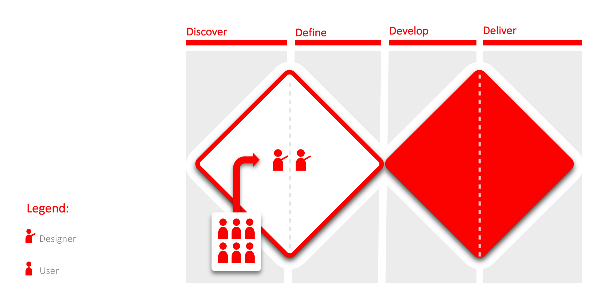
Design Thinking (1.0) as Creative Problem Solving
PRINCIPLES
Aim | Solve problems
Thinking | Ideating
Direction | Outside-in (users at the beginning)
PRACTICES
Learning | Prototypes
Participation | Naïve mind
“The adoption of the human-centered design methodology allows developing several interesting ideas and solutions. This happens through ideation workshops where designer and clients can co-create the final solutions.”
Creative Director, Design Studio
Notes:
Processo creativo inteso come capacità di generare idee fresche e numerose
Centralità dell’utente come detentore della conoscenza da cui derivare l’innovazione

Slide 15
Creative Problem Solving The representation of CPS: the Double Diamond
THE CONTEXT OF THE PROBLEM
THE CONTEXT OF THE SOLUTION

Slide 16
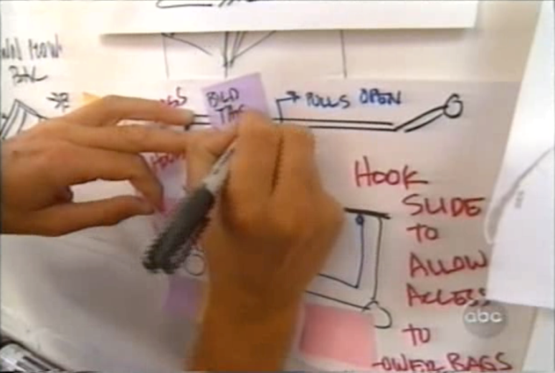
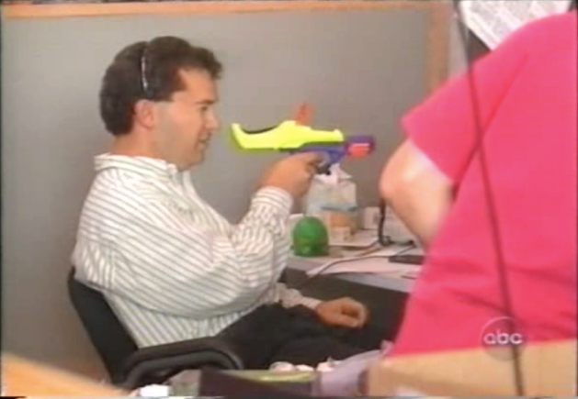
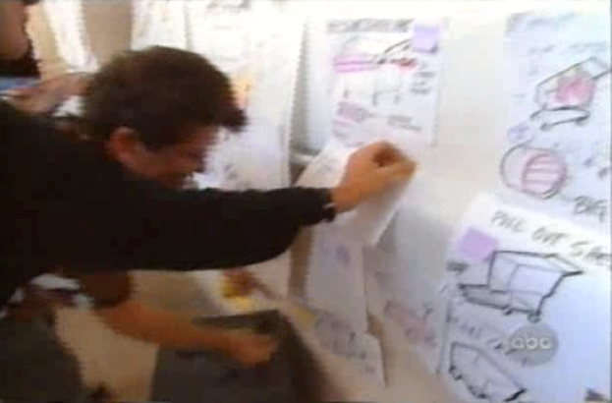
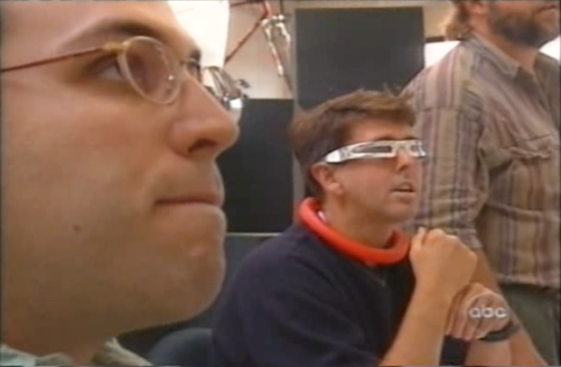
Creative Problem Solving Principles and Practices
PRINCIPLES
Aim | Solve problems
Thinking | Ideating
Direction | Outside-in (users at the beginning)
PRACTICES
Learning | Prototypes
Participation | Naïve mind

Slide 17
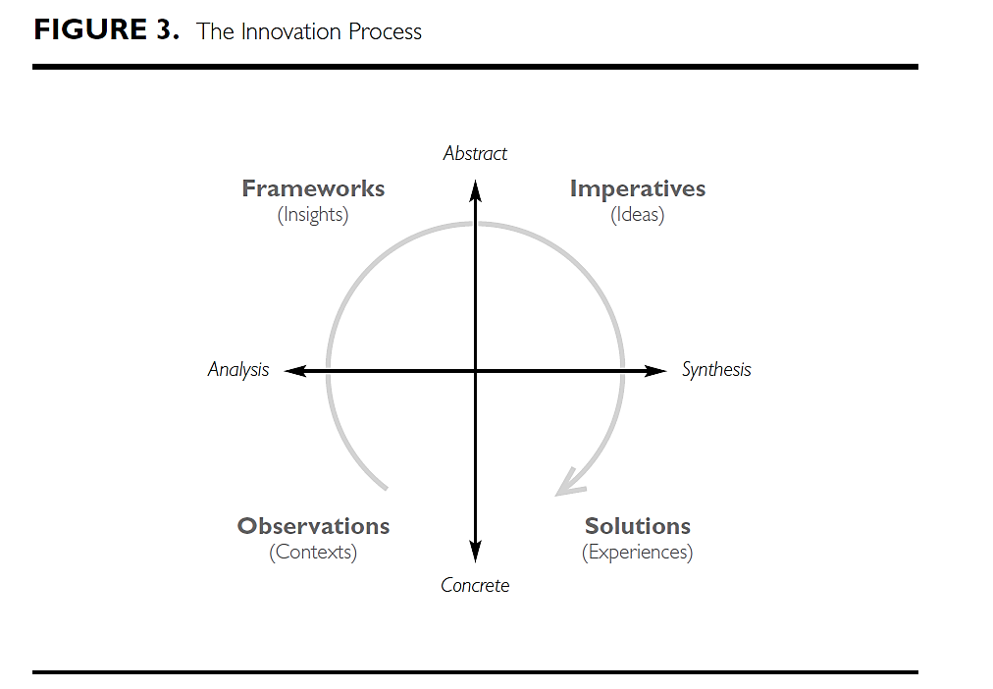
Creative Problem Solving Principles and Practices
Abstract conceptualization
Reflective
Observation
Active
Experimentation
Concrete Experience

Slide 18
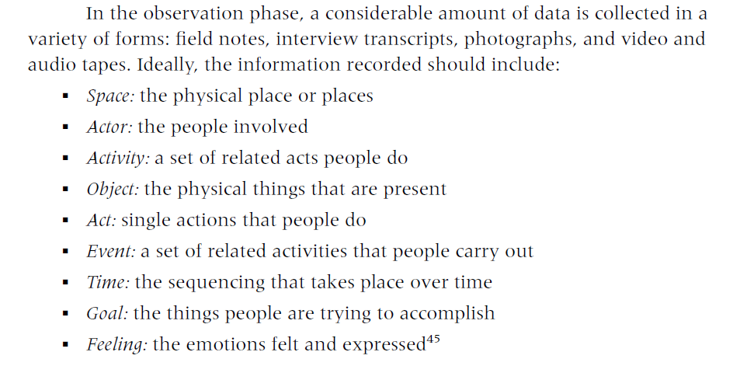
Creative Problem Solving Principles and Practices

Slide 19
Creative Problem Solving Principles and Practices
«AEIOU» Model =
Activities – Environment – Interactions – Objects -Users

Slide 20
Creative Problem Solving Main ingredients in CPS
Abductive
Reasoning
(Brown, 2008; Fraser, 2009; Lockwood, 2009; Martin, 2009; Sato, 2009)
Divergence and
Convergence
(Boland and Collopy, 2004; Drews, 2009; Sato et al., 2010)
Human-centered Design
(Brown, 2008; Holloway 2009; Ward et al., 2009)
Learning by Doing
(Boland and Collopy, 2004; Lockwood, 2009; Rylander, 2009)
Optimistic Mentality
(Brown, 2008; Fraser, 2009; Gloppen, 2009)
Framing and
Re-Framing
(Boland and Collopy, 2004; Drews, 2009; Dorst, 2011)
Holistic
Approach
(Dunne and Martin, 2006; Fraser, 2009; Sato, 2009)
Trial and Error
Approach
(Brown, 2008; Fraser, 2009; Holloway, 2009)
Play with Ambiguity
(Boland and Collopy, 2004; Dew, 2007)
Visualization
(Carr et al., 2010; Drews, 2009; Ward et al., 2009)

Slide 21
Creative Problem Solving The concept of «ill defined» problem
Well defined problems: clear problem area, we are able to define initial, final and intermediate status (e.g. algorythms)‏
Badly defined problems: “sticky” problem area, countless options available.
Design thinking deals with badly defined problems and follows an euristic path (uncertain objectives, wide-reaching answers, absence of a precise procedure)‏
The design process reaches out to give a definition while the problem proceeds and to solve it by shaping an artifact that does not exist yet.
In this process of trying and making mistakes, an important role is played by the creative capability.

Slide 22
Reframing: Example
Problem Space
Solution Space
«The elevator is too slow»
Source: Wedell-Wedellsborg, 2017

Slide 23
Reframing: Example
Problem Space
Solution Space
«The elevator is too slow»
«Make the elevator faster»
Install a new lift
Upgrade the motor
Improve the algorithm
Naive solutions
Source: Wedell-Wedellsborg, 2017

Slide 24
Reframing: Example
Problem Space
Solution Space
«The elevator is too slow»
«The elevator is too slow»
«Make the elevator faster»
Install a new lift
Upgrade the motor
Improve the algorithm
Naive solutions
Reframing
the problem
«The wait is annoying»
«The wait is annoying»
Source: Wedell-Wedellsborg, 2017

Slide 25
Reframing: Example
Problem Space
Solution Space
«The elevator is too slow»
«Make the elevator faster»
Install a new lift
Upgrade the motor
Improve the algorithm
Naive solutions
Reframing
the problem
«The wait is annoying»
«Make the wait feel shorter»
Provide infotainment content
Play music
Install hand sanitizers
Creative solutions
Source: Wedell-Wedellsborg, 2017

Slide 26
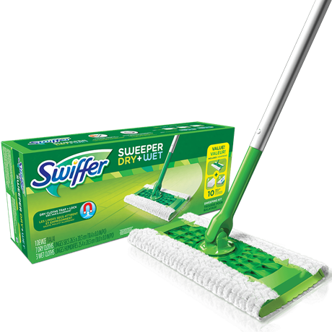
Creative Problem Solving The swiffer challenge and (re-)framing
Framing:
Attract dust and animal hair
Design Challenge:
“Provide a better cleaning tool than a mop, with less time spent cleaning”_Insight: People spend more time to clean the mop than to clean the floor

Slide 27
Creative Problem Solving Philips Design Avent challenge and (re-)framing
Framing:
Separating the moment of production by the moment of consumption
Design Challenge:
“Provide a way to help mothers to breastfeed better for their children”_Insight: Mothers produce more and better milk when they are in a comfortable situation

Slide 28
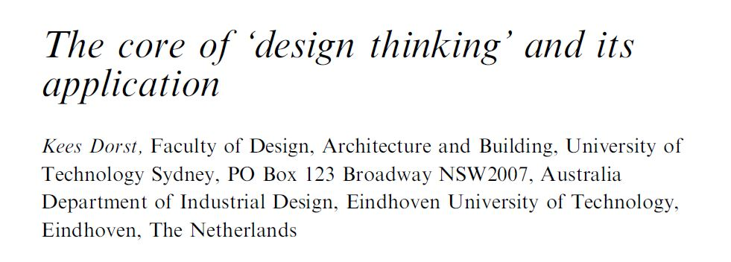
Creative Problem Solving The concept of framing and reframing
“Framing is, perhaps, the most difficult of the tasks in the innovation process. It requires taking in a lot of data, and making sense of that data. It requires the ability to see patterns, to parse the important information from the less important information, and to create models that yield insights that can be shared across an innovation team. It often requires an innovation team to reframe, moving it away from its original perception of what the innovation project is about to a new focus.” (Dorst, 2011)

Slide 29
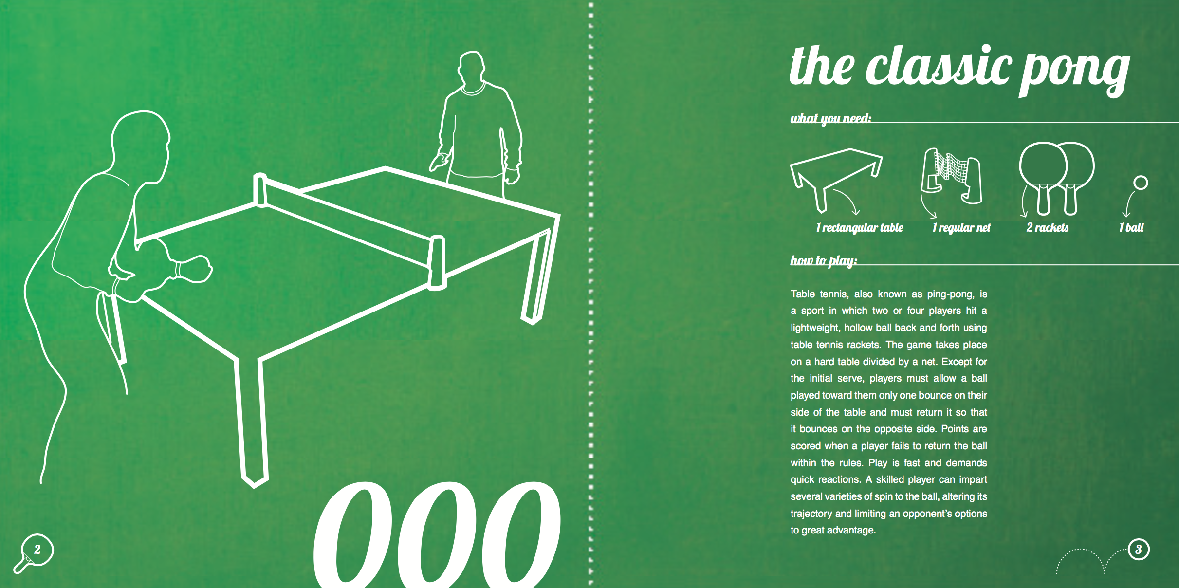
Creative Problem Solving Principles and Practices

Slide 30
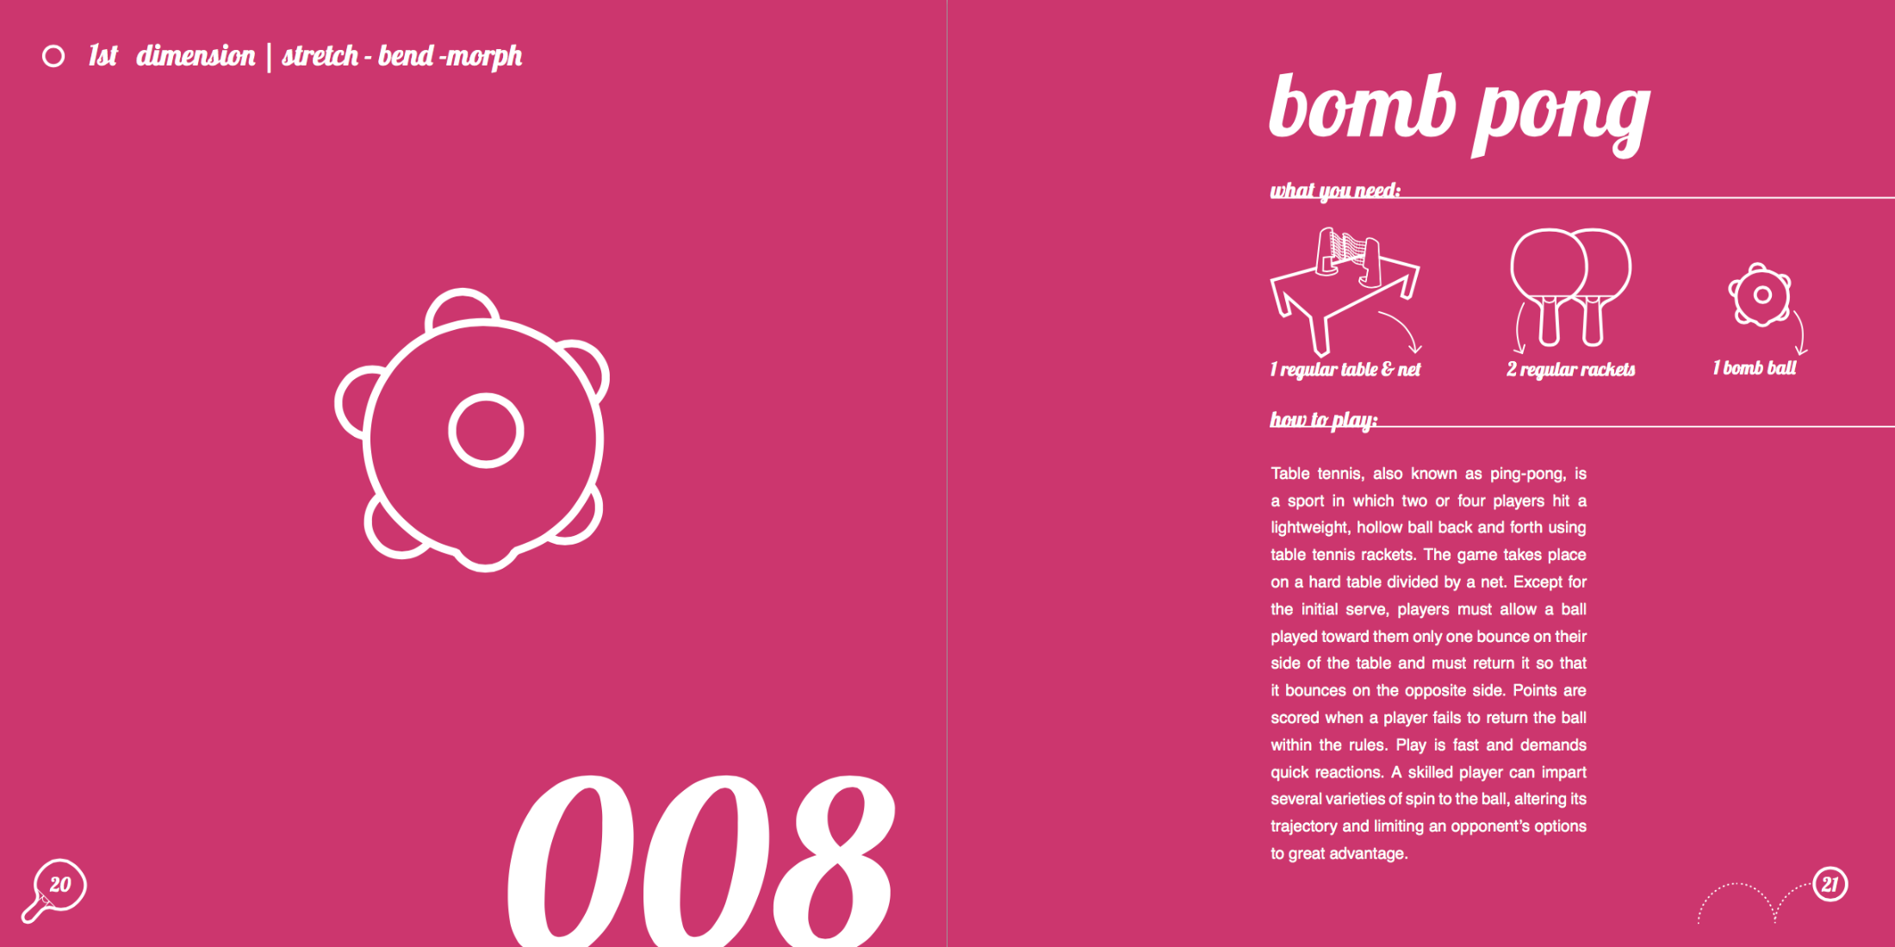
Creative Problem Solving Principles and Practices

Slide 31
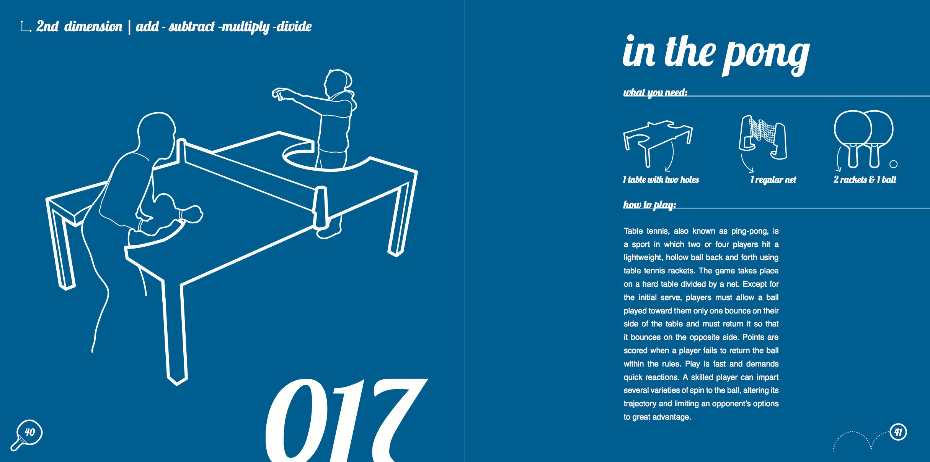
Creative Problem Solving Principles and Practices

Slide 32
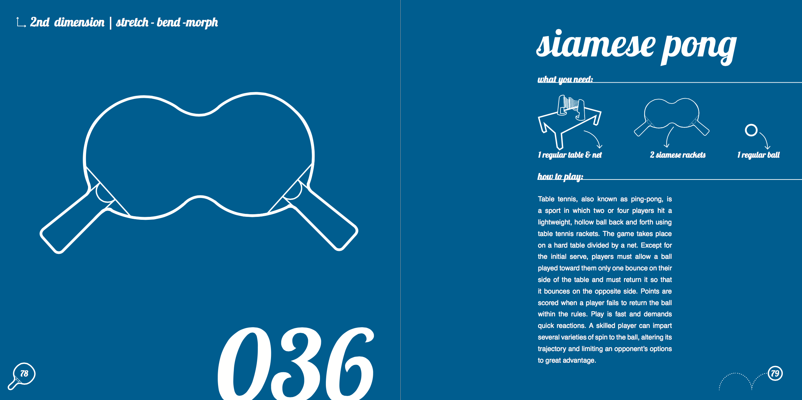
Creative Problem Solving Principles and Practices

Slide 33
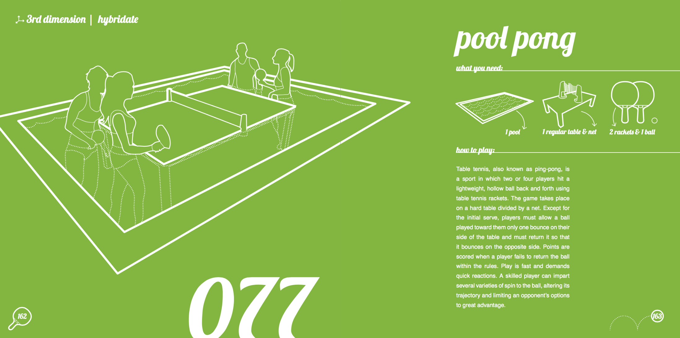
Creative Problem Solving Principles and Practices
From: “Thinkpong: 100 ways (and more) to innovate the game of ping pong” (Pierandrei Associati)

Slide 34
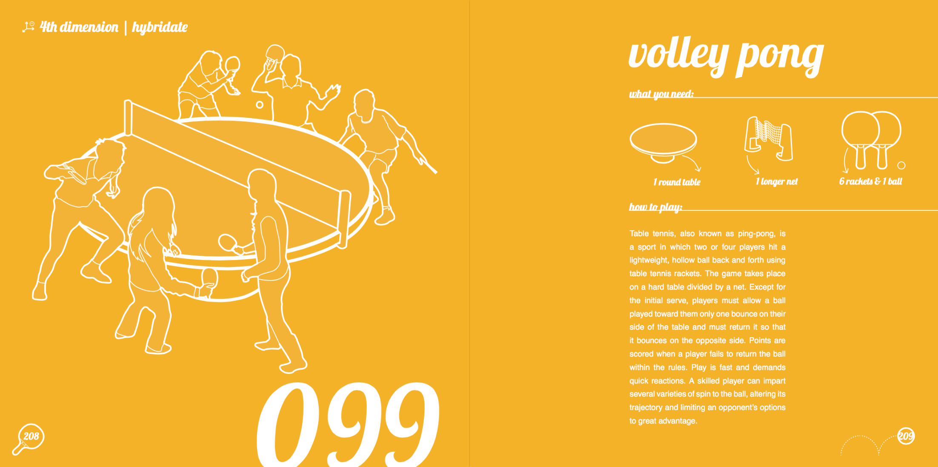
Creative Problem Solving Principles and Practices

Slide 35
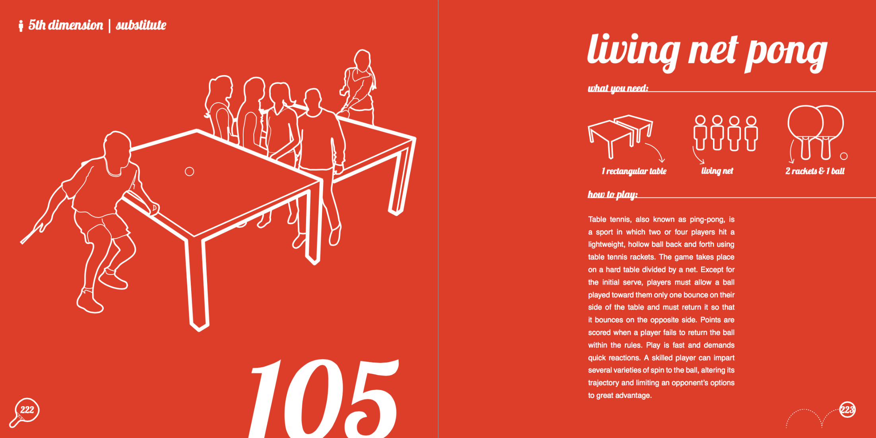
Creative Problem Solving Principles and Practices

Slide 36
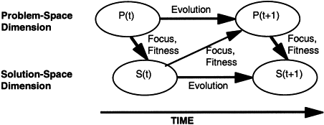
Creative Problem Solving Problem space and Solution space relationship
A co-evolutionary relation between problem-space and solution space (Dorst and Cross, 2001)

Slide 37
Thank you!

