Slide 1
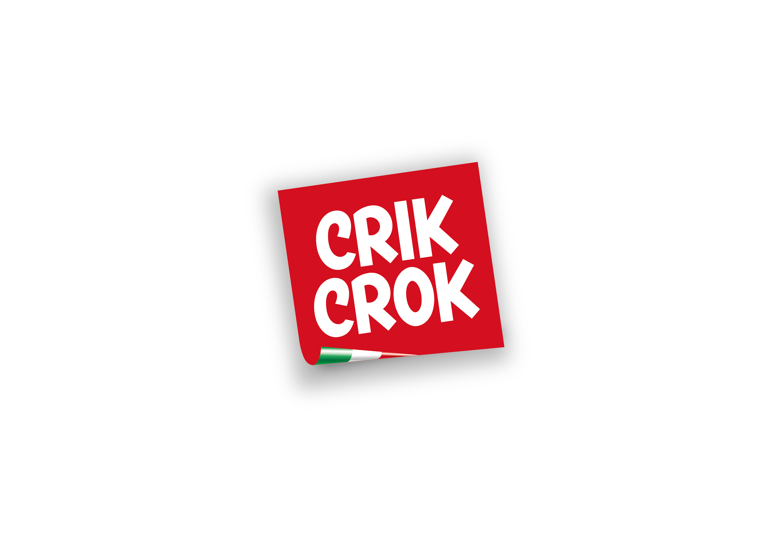
07.12.2023 – Crik Crok for MEIM

Slide 2
PROBLEM
Crik Crok needs to change a bit the recipe of Puff. The goal is to reach a full and round taste, like if some cheese is explonding in your mouth <<puff>>.
WHAT IF
What if Puff goes back to the original recipe? Will people love it or not? What is their profile? How to communicate this change so people feel eager to buy and try the new/old Puff?
To make a launch proposal, after profiling puff-lovers and haters, and asking for opinions online, listen to conversations about what are the most popular expressions used in the snacks and chips sector by the most successful global (and comparable) brands.
07.12.2023 – Crik Crok for MEIM

Slide 3
Why it’s called PUFF?
It starts with a blend of corn flours and ends like <<puff>>, with a cheesy explosion!
07.12.2023 – Crik Crok for MEIM

