Slide 1
MASTER MEIM 2021-2022
BIG DATA ANALYTICS
Cohort III - 2023/2024
Unsupervised Learning for Innovation
Giuseppe Scandurra
Professor of Economic Statistics @ Parthenope University

Slide 2

BIG DATA ANALYTICS
“Without big data analytics, companies are blind and deaf, wandering out onto the Web like deers on a freeway.”
Geoffrey Moore’s tweet (2012)

Slide 3

Big Data: The New 007
In Spectre movie, 007 infiltrates Spectre, a secret organisation that is hacking into government databases. They know everything about everyone. You can’t help but leave the cinema wondering whether big data is such a good thing, and whether the government’s recent metadata retention legislation is something to worry about.
We know that data is crucial for advertisers. When media choice was limited we could place ads on TV, reach millions and hope for the best. Now, with almost one billion websites around the world, we need data to help reach the right people. The scatter gun approach doesn’t work anymore.

Slide 4
Big Data: The New 007
Data is increasingly important, not just for the cost efficiencies of targeting. Sending ads to the wrong audiences, for whom the content is irrelevant, simply annoys people. Nielsen’s ‘Global Trust in Advertising Report’ shows that less than half of us trust ads we see online. They trust TV advertising more. That’s a telling statistic that the industry needs to work on improving.
…. The government might want to know who you are. Spectre wants to know who you are. But advertisers don’t care who you are, they just want to send you relevant ads.

Slide 5
Big Data: The New 007
Please, read:
https://www.linkedin.com/pulse/big-data-new-007-lauren-haefling

Slide 6
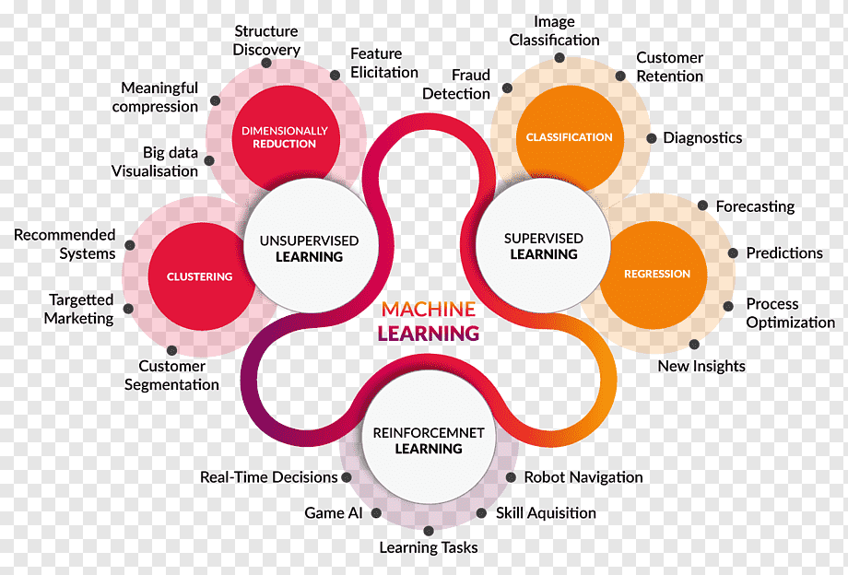
Statistical Learning
Supervised Learning
Regression: linear, polynomial, spline
Classification: logistic regression, k-nearest neighbors
Decision trees (classification and regression trees)

Slide 7
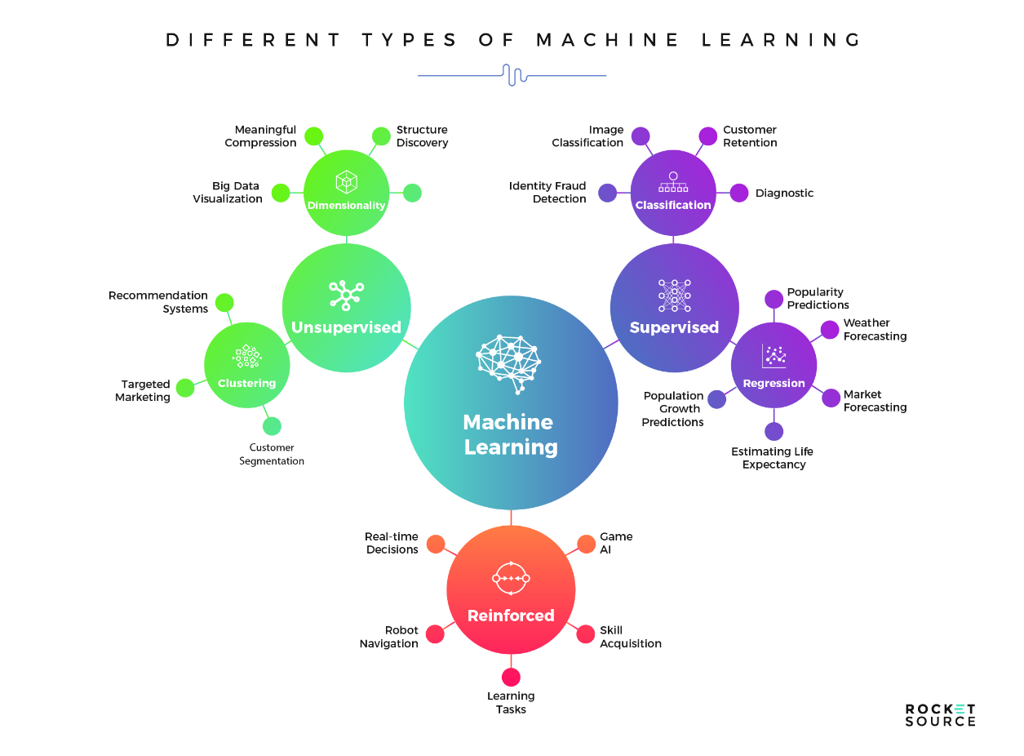
Statistical Learning
Unsupervised Learning
Dimensionality reduction (e.g., Principal Component Analysis, Exploratory Factor Analysis)
Cluster analysis

Slide 8
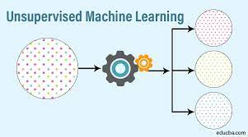
Statistical Learning
Goals of Unsupervised Learning
Consider a set of features X₁, X₂, …, X_{p}.
Lack of outcome variable, Y.
We are not interested in prediction, because we do not have an associated response variable Y .
The goal is to discover interesting things about the measurements:
Is there an informative way to visualize the data?
Can we discover subgroups among the variables or among the observations?

Slide 9
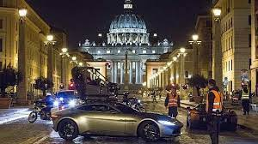
or…
…. The government might want to know who you are. Spectre wants to know who you are. But advertisers don’t care who you are, they just want to send you relevant ads.

Slide 10
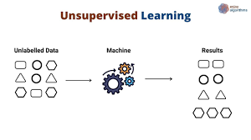
Unsupervised Learning
Methods
We introduce various methods:
Principal Components Analysis (PCA), a tool used for data visualization or data pre-processing before supervised techniques are applied;
Exploratory Factor Analysis (EFA), a family of techniques to assess the relationship of constructs (concepts) in surveys;
Clustering, a broad class of methods for discovering unknown subgroups in data.

Slide 11
Unsupervised Learning
The Challenge
Unsupervised learning is more subjective than supervised learning, as there is no simple goal for the analysis, such as prediction of a response.
Techniques for unsupervised learning are of growing importance in a number of fields:
subgroups of breast cancer patients grouped by their gene expression measurements;
groups of shoppers characterized by their browsing and purchase histories;
movies grouped by the ratings assigned by movie viewers.
eg, Suominen et al. (2017) use unsupervised learning to create an overall view of patenting within the industry, and to forecast future trends.
(Suominen A., Toivanen, H., Seppänen, M. (2017). Firms' knowledge profiles: Mapping patent data with unsupervised learning, Technological Forecasting and Social Change)

Slide 12
Unsupervised Learning
In unsupervised learning we do not know the outcome groupings but attempt to discover them from structure in the data. For instance, we might explore a direct marketing campaign and ask:
“Are there groups that differ in how and when they respond to offers? If so, what are the characteristics of those groups?”
We use the term clustering for this approach.

Slide 13
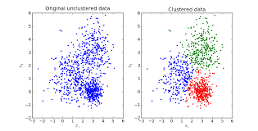
Unsupervised Learning
Clustering
The cluster analysis is an important method belonging to the unsupervised learning techniques family;
Clustering is one of the biggest topics in data science.
Clustering refers to a very broad set of techniques for finding homogeneous subgroups, or clusters, in a dataset.
When we cluster the observations of a dataset, we seek to partition them into distinct groups so that the observations within each group are quite similar to each other, while observations in different groups are quite different from each other.
Of course, to make this concrete, we must define what it means for two or more observations to be similar or different
The subtopic of text clustering is no exception.

Slide 14
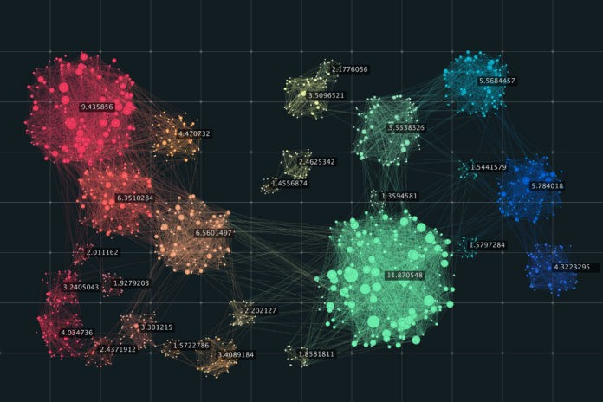
Unsupervised Learning
Goals of Clustering
The goal of cluster analysis is to ascertain, on the basis of the variables X₁, X₂ . . . , X_{n}, whether the observations fall into analysis relatively distinct groups.
For example, in a market segmentation study we might observe multiple characteristics (variables) for potential customers, such as zip code, family income, and shopping habits. We might believe that the customers fall into different groups, such as big spenders versus low spenders; or
To individuate the clusters of innovative firms.
To boost the innovation (eg, OECD, Boosting Innovation - The Cluster Approach )

Slide 15
Unsupervised Learning
Cluster Analysis
Many application of clustering arises in marketing.
We may have access to a large number of measurements (e.g. household income, occupation, distance from nearest urban area, and so forth) for a large number of people.
Our goal is to perform market segmentation by identifying subgroups of people who might be more receptive to a particular form of advertising, or more likely to purchase a particular product.
Performing market segmentation amounts to clustering the people in the dataset. Stakeholders often view segmentation as discovering groups in the data in order to derive new insight about customers.
If the information about each customer’s spending patterns is not available, we can try to cluster the customers on the basis of the variables measured, in order to identify distinct groups of potential customers.
Identifying such groups can be of interest because it might be that the groups differ with respect to some property of interest, such as spending habits.

Slide 16
Unsupervised Learning
Selection of data for analysis
Selection of the variables
Clusters analysis in practise
Data Selection
Variables Selection
Scaling Variables
Dissimilarity
Aggregation Criterion
Identification
Calculation of the dissimilarity matrix
Scaling
Choice of a grouping criterion
Identification of groups

Slide 17
Unsupervised Learning
Selection of data for analysis
Clusters analysis in practise
A topic we do not address is how to determine what data to use for clustering, the observed basis variables that go into the model. That is primarily a choice based on business need, strategy, and data availability.
Selection of the variables

Slide 18
Unsupervised Learning
Clusters analysis in practise
Rescaling the data
Why scale the data?
The value of distance measures is intimately related to the scale on which measurements are made. Therefore, variables are often scaled (i.e. standardized) before measuring the inter-observation dissimilarities. This is particularly recommended when variables are measured in different scales (e.g: kilograms, kilometers, centimeters, . . . ); otherwise, the dissimilarity measures obtained will be severely affected.
The goal is to make the variables comparable. Generally variables are scaled to have i) standard deviation one and ii) mean zero.
We might also want to scale the data when the mean and/or the standard deviation of variables are largely different.

Slide 19
Unsupervised Learning
Clusters analysis in practise
Rescaling the data
Why scale the data?
Given a variable X₁ with mean µ₁ and standard deviation σ₁ its standardization is given by
The mean of Z₁ is null, that is equal to 0.
The variance (and the standard deviation) of Z₁ is equal to 1.

Slide 20
Unsupervised Learning
Clusters analysis in practise
Calculation of the dissimilarity matrix
We have an idea of the distance between pairs of observations, but how do we define the distance between two clusters or one observation and a cluster?
Actually, the idea of distance between a pair of observations needs to be extended to a pair of groups of observations.
This extension is achieved by developing the notion of linkage, which defines the distance between two groups of observations.

Slide 21
Unsupervised Learning
Clusters analysis in practise
Calculation of the dissimilarity matrix
The classification of observations into groups requires some methods for computing the distance or the (dis)similarity between each pair of observations. The result of this computation is known as a dissimilarity or distance matrix.
Properties of the distance
Generic distance d_{ij} between unit i and unit j has the following properties:
1. Non-negativity: d_{ij} ≥ 0
2. Identity: d_{ij} = 0 if i = j
3. Simmetry: d_{ij} = d_{ji}
4. Triangular inequality: d_{ij} ≤ d_{is} + d_{sj}

Slide 22
Unsupervised Learning
Calculation of the dissimilarity matrix
Clusters analysis in practise
There are many methods to compute the distance information. Here, we describe the common distance measures (providing R codes for computing and visualizing distances).
The best-known method is the Euclidean distance.

Slide 23
Unsupervised Learning
Calculation of the dissimilarity matrix
Distance matrix
Starting from n units whse distances have been computed, we can define the distance matrix of order n x n (n rows, n columns)

Slide 24
Unsupervised Learning
Distance matrix –
How to compute distances?
Calculation of the dissimilarity matrix
Euclidean distance can be computed when the variables are quantitative.
Euclidean distance between unit i and unit j according to the variable X₁ is given by
Euclidean distance between unit i and unit j according to the (standardized) variables X₁ and X₂ is given by

Slide 25
Unsupervised Learning
Distance matrix –
How to compute distances?
Calculation of the dissimilarity matrix
Manhattan distance:
Other dissimilarity measures exist such as correlation-based distances.
The choice of distance measures is very important, as it has a strong influence on the clustering results. For most common clustering software, the default distance measure is the Euclidean distance

Slide 26
Unsupervised Learning
Distance matrix –
How to compute distances?
Calculation of the dissimilarity matrix
DATA: USArrests data (only a subset of the data will be used, by taking 15 random rows among the 50 rows in the data set. This is done by using the function sample()).
Next, we scale the data using the function scale():
# Subset of the data
set.seed(123)
ss <- sample(1:50, 15) # Take 15 random rows
df <- USArrests[ss, ] # Subset the 15 rows
df.scaled <- scale(df) # Standardize the variables
To compute Euclidean distance, you can use the R base dist() function, as follow:
dist.eucl <- dist(df.scaled, method = "euclidean")
round(as.matrix(dist.eucl)[1:3, 1:3], 1)
To make it easier to see the distance information generated by the dist() function, you can reformat the distance vector into a matrix using the as.matrix() function.

Slide 27
Unsupervised Learning
Distance matrix –
How to compute distances?
Calculation of the dissimilarity matrix
When we have p variables, some quantitative, some categorical, Gower distance is usually adopted.
Gower distance is given by
δ_{ij,h} takes value 1 if the units i and j can be compared with respect to the h-th variable and 0 otherwise (if the phenomenon is absent in both units, e.g. no-no).
For quantitative variables
There are many R functions for computing distances between pairs of observations:
1. dist() R base function [stats package]: Accepts only numeric data as an input.
2. get_dist() function [factoextra package]: Accepts only numeric data as an input.
Compared to the standard dist() function, it supports correlation-based distance
measures including “pearson”, “kendall” and “spearman” methods.
3. daisy() function [cluster package]: Able to handle other variable types (e.g. nominal, ordinal, (a)symmetric binary). In that case, the Gower’s coefficient will
be automatically used as the metric.

Slide 28
Unsupervised Learning
Distance matrix –
How to compute distances for mixed data?
library(cluster)
# Load data
data(flower)
head(flower, 3)
str(flower)
dd <- daisy(flower)
round(as.matrix(dd)[1:3, 1:3], 2)

Slide 29
Unsupervised Learning
Visualizing distance matrices
library(factoextra)
fviz_dist(dist.eucl)

Slide 30
Unsupervised Learning
Selection of data for analysis
Selection of the variables
Clusters analysis in practise
Data Selection
Variables Selection
Scaling Variables
Dissimilarity
Aggregation Criterion
Identification
Calculation of the dissimilarity matrix
Standardization
Choice of a grouping criterion
Identification of groups

Slide 31
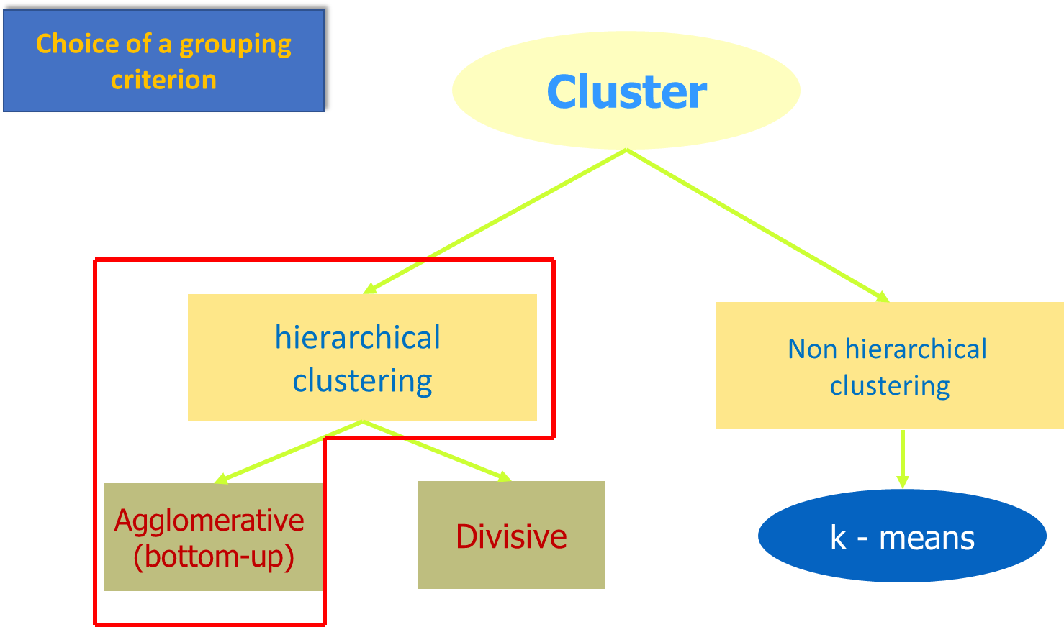
Unsupervised Learning
Choice of a grouping criterion
There exist a great number of clustering methods.
We focus on the two most popular clustering methods:
1. (agglomerative) hierarchical clustering
2. K-means clustering

Slide 32
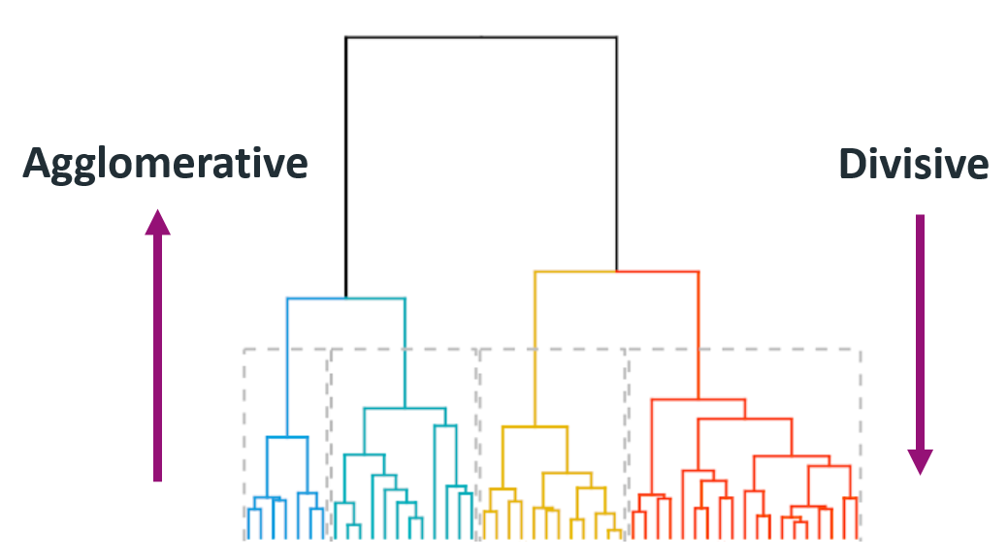
Unsupervised Learning
Hierarchical clustering
Hierarchical clustering does not require to pre-specify the number of clusters K.
Hierarchical clustering results in an attractive tree-based representation of the observations, called dendrogram.
Observations can be subdivided into groups by cutting the dendrogram at a desired similarity level.
Let’s describe the bottom-up or agglomerative clustering.
This is the most common type of hierarchical clustering.
Let’s try to interpret a dendrogram and then show how hierarchical clustering is actually performed (how the dendrogram is built).

Slide 33
Unsupervised Learning
Hierarchical clustering
Let’s describe the bottom-up or agglomerative clustering.
This is the most common type of hierarchical clustering.
Let’s try to interpret a dendrogram and then show how hierarchical clustering is actually performed (how the dendrogram is built).

Slide 34
Unsupervised Learning
Hierarchical clustering
The hierarchical clustering dendrogram is obtained via an extremely simple algorithm.
At the beginning, each of the n observations are treated as its own cluster (n observations = n clusters).
Use distance between each pair of observations.
The two observations that are most similar to each other are then fused so that there now are n − 1 clusters.

Slide 35
Unsupervised Learning
Hierarchical clustering
Next the two clusters that are most similar to each other are fused again, so that there now are n − 2 clusters.
And so on….
The algorithm proceeds in this fashion until all of the observations belong to one single cluster, and the dendrogram is complete.

Slide 36
Unsupervised Learning
Hierarchical clustering
Linkage Functions
There are different possible linkages:
1. Single linkage (or nearest neighbour)
2. Complete linkage (or furthest neighbour)
3. Average linkage (mean distance)
4. Centroid linkage

Slide 37
Unsupervised Learning
Hierarchical clustering
Linkage Functions
Maximum or complete linkage: The distance between two clusters is defined as the maximum value of all pairwise distances between the elements in cluster 1 and the elements in cluster 2. It tends to produce more compact clusters.
Minimum or single linkage: The distance between two clusters is defined as the minimum value of all pairwise distances between the elements in cluster 1 and the elements in cluster 2. It tends to produce long, "loose" clusters.
Mean or average linkage: The distance between two clusters is defined as the average distance between the elements in cluster 1 and the elements in cluster 2.
Centroid linkage: The distance between two clusters is defined as the distance between the centroid for cluster 1 (a mean vector of length p variables) and the centroid for cluster 2.

Slide 38
Unsupervised Learning
Agglomerative Hierarchical Clustering
Choice of a grouping criterion
DATA: USArrests data
set.seed(123)
ss <- sample(1:50, 15) # Take 15 random rows
df <- USArrests[ss, ] # Subset the 15 rows
df.scaled <- scale(df) # Standardize the variables
dist.eucl <- dist(df.scaled, method = "euclidean")
res.hc<- hclust(d=dist.eucl, method=“single”)

Slide 39
Unsupervised Learning
Dendrogram
It corresponds to the graphical representation of the hierarchical tree generated by the function hclust()
In R:
# cex: label size
library("factoextra")
fviz_dend(res.hc, cex = 0.5)

Slide 40
Unsupervised Learning
Dendrogram
Each leaf corresponds to one object. As we move up the tree, objects that are similar to each other are combined into branches, which are themselves fused at a higher height.
The height of the fusion, provided on the vertical axis, indicates the (dis)similarity/distance between two objects/clusters. The higher the height of the fusion, the less similar the objects are. This height is known as the cophenetic distance between the two objects

Slide 41
Unsupervised Learning
Selection of data for analysis
Selection of the variables
Clusters analysis in practise
Data Selection
Variables Selection
Scaling Variables
Dissimilarity
Aggregation Criterion
Identification
Calculation of the dissimilarity matrix
Standardization
Identification of groups
Choice of a grouping criterion

Slide 42
Unsupervised Learning
Cut the dendrogram

Slide 43
Unsupervised Learning
Cut the dendrogram
We can cut the hierarchical tree at a given height in order to partition data into clusters.
# Cut in 4 groups and color by groups
fviz_dend(res.hc, k = 4, # Cut in four groups
cex = 0.5, # label size
k_colors = c("#2E9FDF", "#00AFBB", "#E7B800", "#FC4E07"),
color_labels_by_k = TRUE, # color labels by groups
rect = TRUE # Add rectangle around groups
)

Slide 44
Unsupervised Learning
Cut the dendrogram
Using the function fviz_cluster() [in factoextra], we can also visualize the result in a scatter plot. Observations are represented by points in the plot, using principal components. A frame is drawn around each cluster.
# Cut tree into 4 groups
grp <- cutree(res.hc, k = 4)
head(grp, n = 4)
# Get the names for the members of cluster 1
rownames(df)[grp == 1]
fviz_cluster(list(data = df, cluster = grp),
palette = c("#2E9FDF", "#00AFBB", "#E7B800", "#FC4E07"),
ellipse.type = "convex", # Concentration ellipse
repel = TRUE, # Avoid label overplotting (slow)
show.clust.cent = FALSE, ggtheme = theme_minimal())

Slide 45
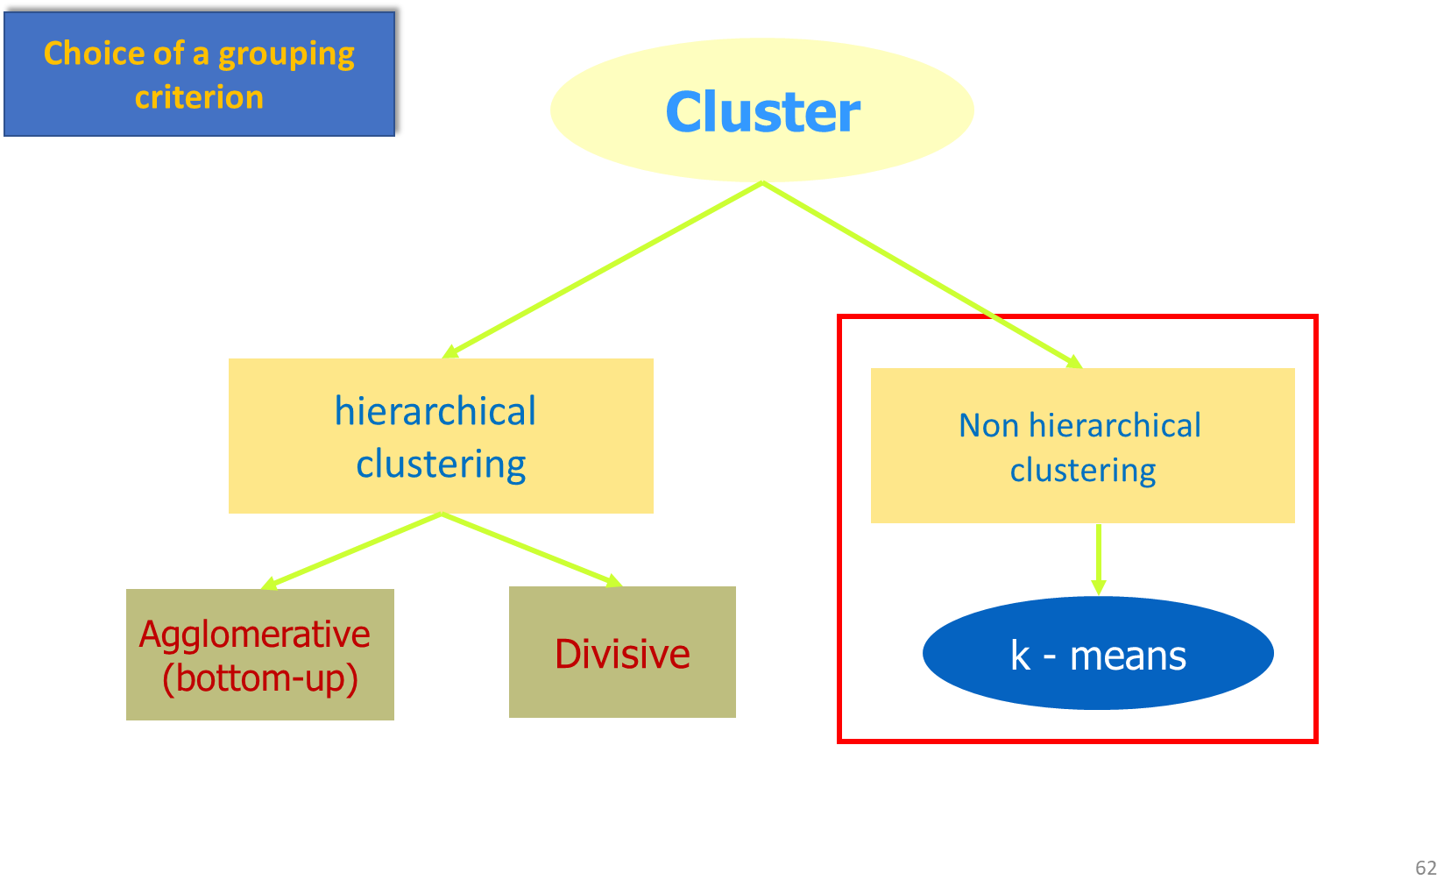
Unsupervised Learning
Choice of a grouping criterion
There exist a great number of clustering methods
We focus on the two most popular clustering methods:
1. (agglomerative) hierarchical clustering
2. K-means clustering

Slide 46
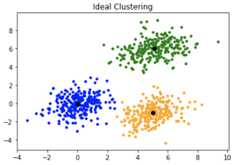
Unsupervised Learning
Non-Hierarchical clustering
k-means
We will now look at the most famous vector-based clustering algorithm out there: k-means.
What k-means does is returning a cluster assignment to one of k possible clusters for each object.
K-means clustering is a simple approach for partitioning a data set into K distinct, non-overlapping clusters.
To perform K-means clustering, we must first specify the desired number of clusters K; then the K-means algorithm will assign each observation to exactly one of the K clusters.
If the i-th observation is in the k-th cluster, then i ∈ C_{k}.

Slide 47
Unsupervised Learning
Non-Hierarchical clustering
k-means
The idea behind K-means clustering is that a good clustering is one for which the within-cluster variation is as small as possible.
The within-cluster variation for cluster C_{k} is a measure of the amount by which the observations within a cluster differ from each other.
The total within-cluster variation, summed over all K clusters, has to be as small as possible.
So, we need to define the within-cluster variation. There are many possible ways to define this concept, but the most common choice involves squared Euclidean distance.

Slide 48
Unsupervised Learning
Non-Hierarchical clustering
k-means
The within-cluster variation for the k-th cluster is the sum of all of the pairwise squared Euclidean distances between the observations in the cluster, divided by the total number of observations in the cluster.
Objective: to minimize the total within-cluster variation.
The use of Euclidean distances implies that:
1. standardization has to be carried out in presence of differente scale of measurements;
2. categorical variables are not allowed

Slide 49
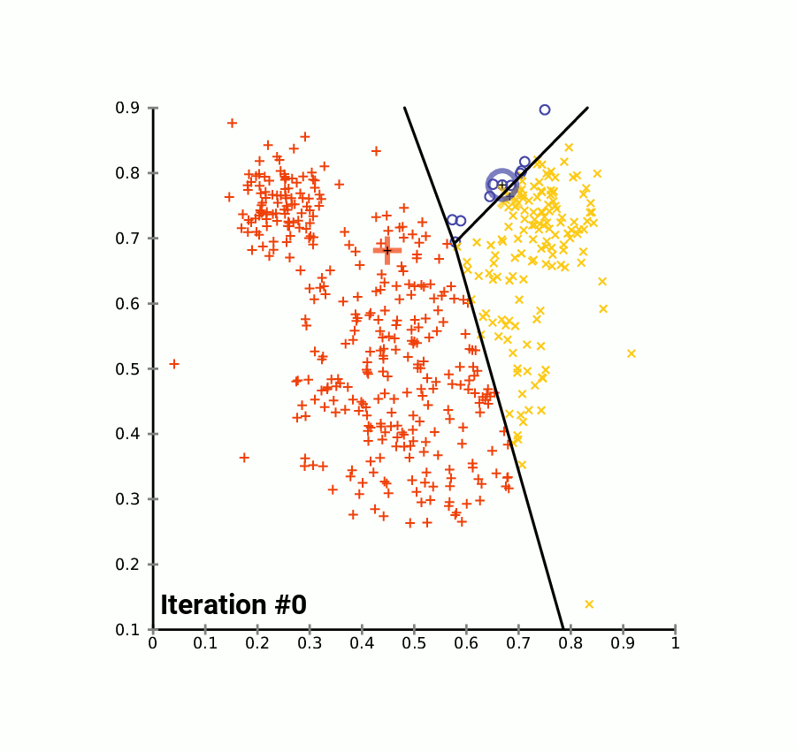
Unsupervised Learning
Non-Hierarchical clustering
k-means
The algorithm starts randomly assigning a cluster, from 1 to K, to each of the observations.
For each of the K clusters, the cluster centroid is computed.
Then, each observation is assigned to the cluster whose centroid is closest.
This means that as the algorithm is run, the clustering obtained will continually improve
When the result no longer changes, we have reached the final clustering.

Slide 50
Unsupervised Learning
Non-Hierarchical clustering
k-means

Slide 51
Unsupervised Learning
Non-Hierarchical clustering
k-means in R
data("USArrests") # Loading the data set
df <- scale(USArrests) # Scaling the data
# View the firt 3 rows of the data
head(df, n = 3)
library(animation)
set.seed(534)
kmeans.ani(df)
The standard R function for k-means clustering is kmeans() [stats package], which simplified format is as follow:
kmeans(x, centers, iter.max = 10, nstart = 1)

Slide 52
Unsupervised Learning
Non-Hierarchical clustering
k-means in R
The k-means clustering requires the users to specify the number of clusters to be generated.
One fundamental question is:
How to choose the right number of expected clusters (k)?
Different methods exist.
Here, we provide a simple solution. The idea is to compute k-means clustering using different values of clusters k. Next, the wss (within sum of square) is drawn according to the number of clusters. The location of a bend (knee) in the plot is generally
considered as an indicator of the appropriate number of clusters.

Slide 53
Unsupervised Learning
Non-Hierarchical clustering
k-means in R
library(factoextra)
fviz_nbclust(df, kmeans, method = "wss") +
geom_vline(xintercept = 4, linetype = 2)

Slide 54
Unsupervised Learning
Non-Hierarchical clustering
k-means in R
As k-means clustering algorithm starts with k randomly selected centroids, it’s always
recommended to use the set.seed() function in order to set a seed for R’s random number generator.
# Compute k-means with k = 4
set.seed(123)
km.res <- kmeans(df, 4, nstart = 25)
# Print the results
print(km.res)

Slide 55
Unsupervised Learning
Non-Hierarchical clustering
k-means advantages and disanvantages
1. It assumes prior knowledge of the data and requires the analyst to choose the
appropriate number of cluster (k) in advance.
2. The final results obtained is sensitive to the initial random selection of cluster
centers. Why is this a problem? Because, for every different run of the algorithm on the same data set, you may choose different set of initial centers. This may lead to different clustering results on different runs of the algorithm.
3. It’s sensitive to outliers.
4. If you rearrange your data, it’s very possible that you’ll get a different solution
every time you change the ordering of your data.

Slide 56
Unsupervised Learning
Non-Hierarchical clustering
k-means advantages and disanvantages
1. Solution to issue 1: Compute k-means for a range of k values, for example
by varying k between 2 and 10. Then, choose the best k by comparing the
clustering results obtained for the different k values.
2. Solution to issue 2: Compute K-means algorithm several times with different
initial cluster centers. The run with the lowest total within-cluster sum of
square is selected as the final clustering solution.
3. To avoid distortions caused by excessive outliers, it’s possible to use PAM
algorithm, which is less sensitive to outliers.

Slide 57
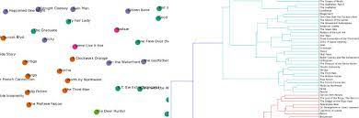
Text clustering
Word clustering
Text clustering is the process of grouping a set of unlabeled texts so that those in the same cluster are more similar than those in other groups.
Text clustering algorithms examine the text to see if there are any natural clusters (groups) in the data.
Process of clustering text is often messy and marked by many unsuccessful trials. However, if you tried to draw it in an idealized, linear manner, it might look like this:
.

Slide 58
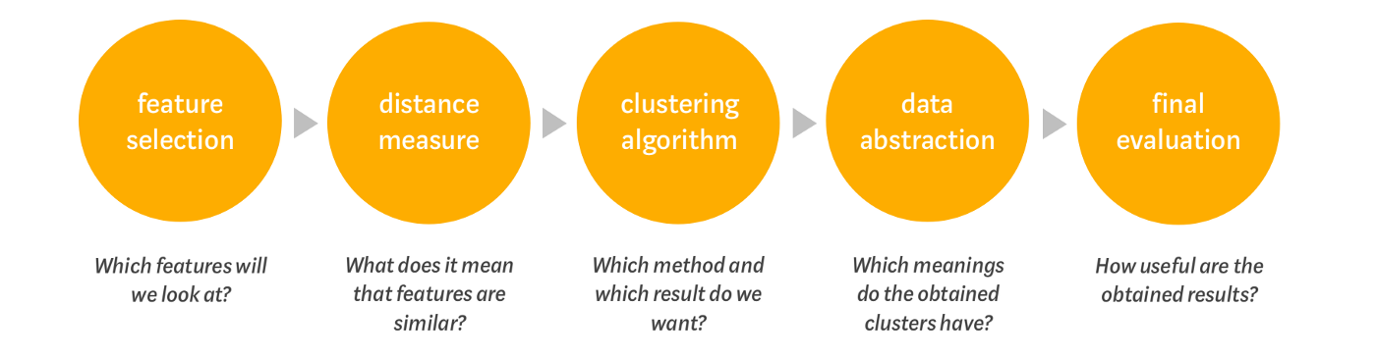
Text clustering
Word clustering

Slide 59
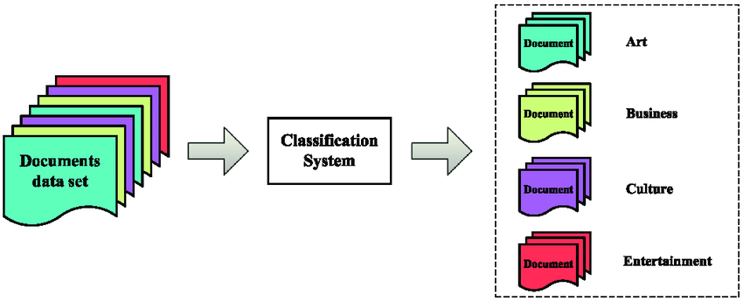

Text clustering
Word clustering
In the next few paragraphs, we will look at clustering methods for words. Let’s look at the following set of them:
To us it immediately becomes apparent which words belong together. There should obviously be one cluster with animals containing the words Aardvark and Zebra and one with adverbs containing on and under. But is it equally obvious for a computer?
.

Slide 60
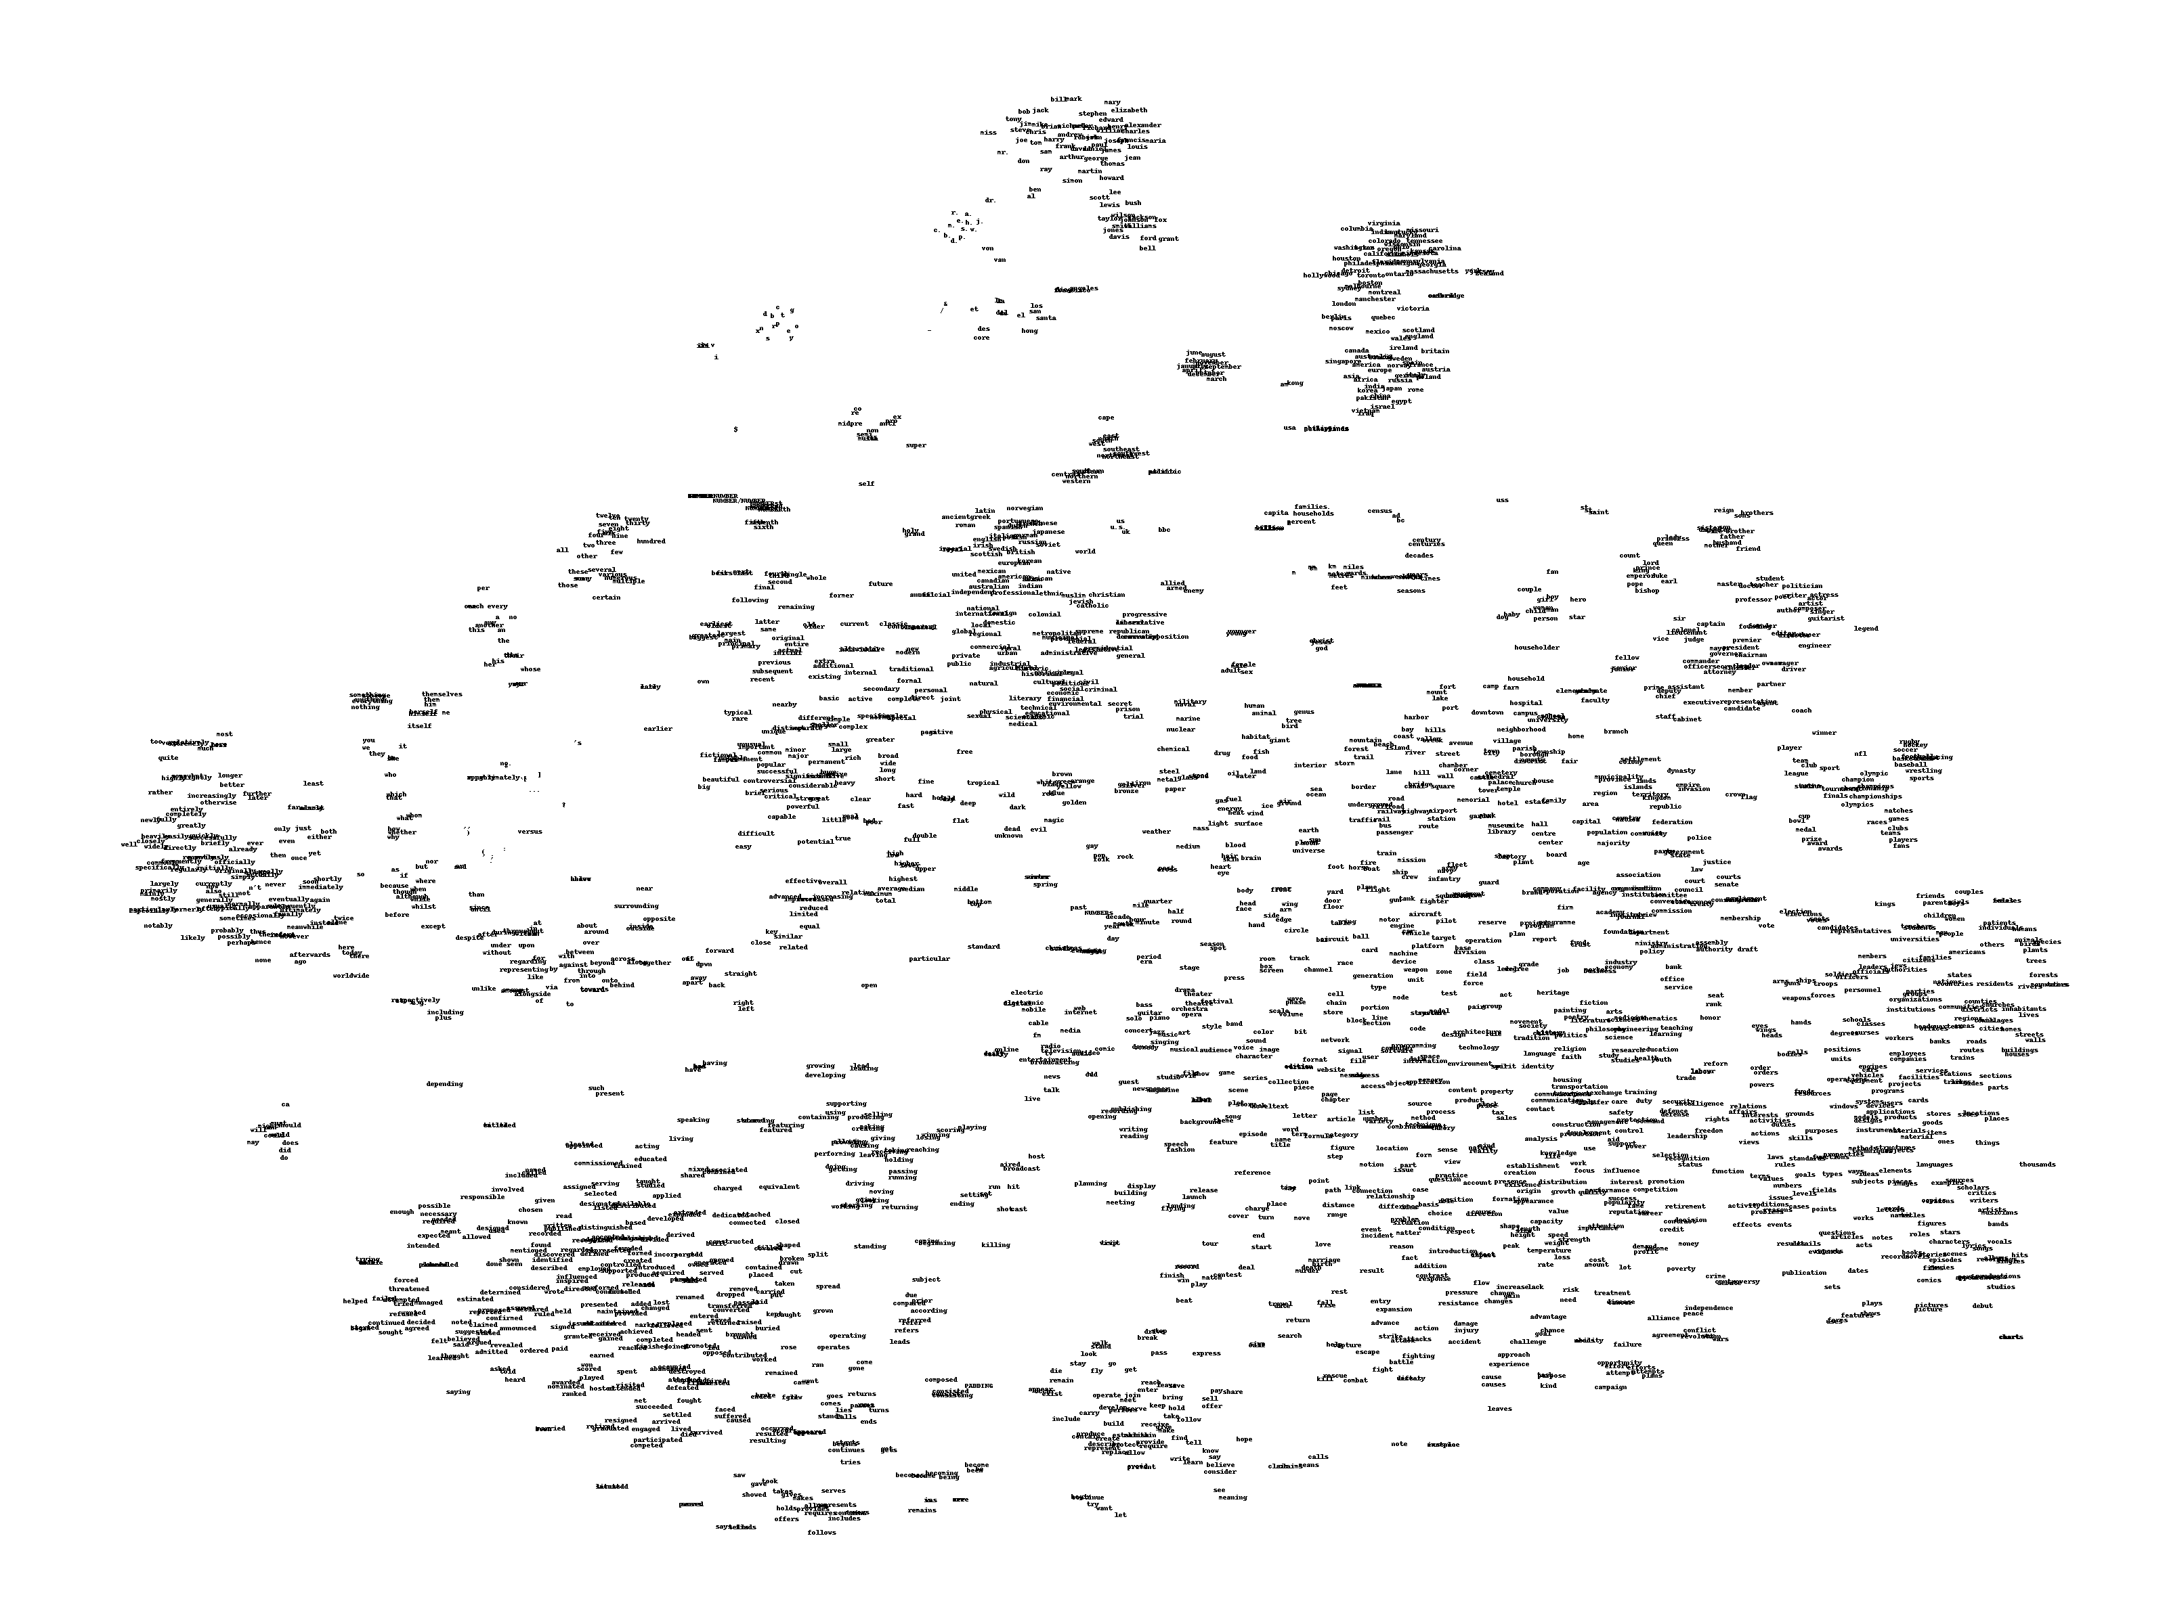
Text clustering
Word clustering
When talking about words with similar meaning, you often read about the distributional hypothesis in linguistics. This hypothesis states that words bearing a similar meaning will appear between similar word contexts. You could say “The box is on the shelf.”, but also “The box is under the shelf.” and still produce a meaningful sentence. On and under are interchangeable up to a certain extent.
This hypothesis is utilized when creating word embeddings. Word embeddings map each word of a vocabulary onto a n-dimensional vector space. Words that have similar contexts will appear roughly in the same area of the vector space. One of these embeddings was developed by Weston, Ratle & Collobert in 2008. You can see an interesting segment of the word vectors (reduced to two dimensions with t-SNE) here:

Slide 61
Text clustering
Word clustering
Notice how neatly months, names and locations are grouped together. This will come in handy for clustering them in the next step. To learn more about how exactly word embeddings are created and the interesting properties they have, take a look at this Medium article by Hunter Heidenreich
. It also includes information about more advanced word embeddings like word2vec.

Slide 62
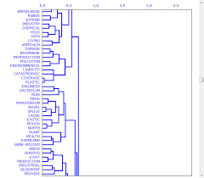
Text clustering
Word clustering is used to identify groups of words used together, based on frequency distance. It is a size reduction technique. It helps to group words into related clusters.
The word clusters are visualized with dendrograms.

Slide 63
Statistical Learning
Unsupervised Learning
Dimensionality reduction (e.g., principal component analysis)
Cluster analysis
PCA vs Clustering
Clustering looks for homogeneous subgroups among the observations.
PCA looks for a low-dimensional representation of the observations that explains a good fraction of the variance.

Slide 64
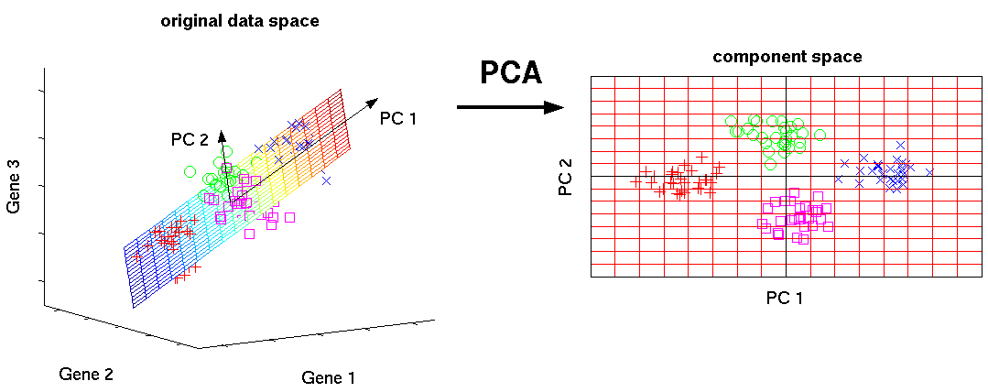
Unsupervised Learning
Principal Component Analysis
One of the most important objectives of the principal components analysis (PCA) is the reduction of the dimensionality of the data.
In practice, when p, the number of variables, is very high, we can opt for a reduction in the size of the dataset.
The idea is to transform the p original variables into k new variables (k = p).
PCA allows one to summarize this set with a smaller number of representative variables that collectively explain most of the variability in the original set
PCA is an unsupervised approach, since it involves only a set of features X₁, X₂ , . . . , X_{p}, and no associated response Y.

Slide 65
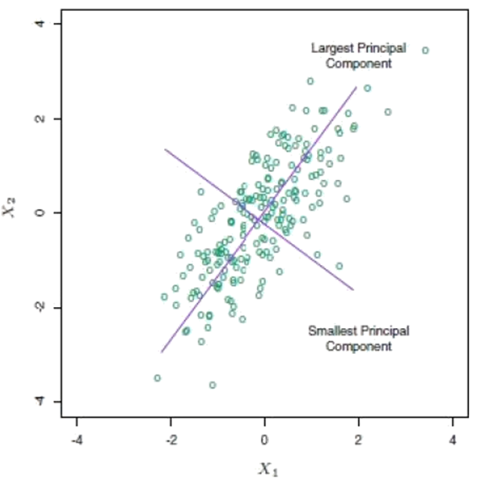
Unsupervised Learning
Principal Component Analysis
The new k variables are obtained as linear combinations of the original variables and are called principal components.
The linear combinations of the original variables are uncorrelated.
The k principal components are ordered according to the variability explained (the first explains the maximum variability, etc.)

Slide 66
Unsupervised Learning
Principal Component Analysis. Why?
Suppose that we wish to visualize n observations with measurements on a set of p variables, X₁,X₂, . . .,X_{p}, as part of an exploratory data analysis.
We would like to find a low-dimensional representation of the data that captures as much of the information as possible.
If we can obtain a two-dimensional representation of the data that captures most of the information, then we can plot the observations in this low-dimensional space.
PCA provides a tool to do just this.
Similarly to the cluster analysis, it is necessary to standardize the data.

Slide 67
Unsupervised Learning
Principal Component Analysis. Why?
Consider the data matrix X of standardized data with n rows and p columns.
The starting point is the correlation matrix S=Cor(X)
The S matrix has unit values on the main diagonal and the correlations outside the main diagonal and is a symmetric matrix
For example with p = 3,

Slide 68
Unsupervised Learning
Principal Component Analysis.
In the Plot 1A, the data are represented in the X-Y coordinate system. The dimension reduction is achieved by identifying the principal directions, called principal components, in which the data varies.
PCA assumes that the directions with the largest variances are the most “important” (i.e, the most principal).

Slide 69
Unsupervised Learning
Principal Component Analysis.
In the figure 1A, the PC1 axis is the first principal direction along which the samples show the largest variation. The PC2 axis is the second most important direction and it is orthogonal to the PC1 axis.
The dimensionality of our two-dimensional data can be reduced to a single dimension by projecting each sample onto the first principal component (Plot 1B).
Technically speaking, the amount of variance retained by each principal component is measured by the so-called eigenvalue.
Note that, the PCA method is particularly useful when the variables within the data set are highly correlated. Correlation indicates that there is redundancy in the data. Due to this redundancy, PCA can be used to reduce the original variables into a smaller number of new variables ( = principal components) explaining most of the variance in the original variables.

Slide 70
Unsupervised Learning
Principal Component Analysis.
Taken together, the main purpose of principal component analysis is to:
identify hidden pattern in a data set,
reduce the dimensionality of the data by removing the noise and redundancy in the data,
identify correlated variables

Slide 71
Unsupervised Learning
Interpretation of Principal Components.
The proportion of variance explained (PVE) by component i is
The overall importance of the first k principal components is given by
It represents the share of variability explained by the components and therefore the statistical information explained by the principal components.
It is a measure of overall importance of the first k principal components.
One of the difficult task associated to the application of the technique of the principal components is their interpretation.
Since each principal component is a linear combination of the observed variables they do not have a clear unit of measurement.
Let us define the overall importance and the relative importance of the principal components.

Slide 72
Unsupervised Learning
Interpretation of Principal Components. Relative Importance
The degree of relative importance of each principal component is given by the linear correlation between a principal component and an original variable,
The sign and the value of this correlation indicate the sign and the value of the link between the j-th principal component and the i-th original variable.
This facilitates the interpretation of each principal component by referring it mainly to the variables with which it has a high association (high correlation in absolute value).

Slide 73
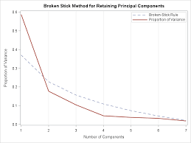
Unsupervised Learning
Number of the principal components.
A critical point of the method is the choice of the number of principal components, that is the choice of k.
There is no unique criterion
One of the most commonly used is to consider many principal components until a certain percentage of explained variability defined a priori is reached, for example 60% or 80%.
Alternatively, it is possible to use the graphical tool (scree-plot) which presents the number of components on the x-axis and the corresponding variance on the y-axis.
Therefore, we can choose that number of components in correspondence with a clear reduction in the variance.

Slide 74
Software
Throughout the course we will use the statistical software R.
  https://cran.r-project.org
RStudio is an integrated development environment (IDE) for R.
  https://rstudio.com

Slide 75
Useful web sites – Data repository
https://www.kaggle.com/datasets
https://datasetsearch.research.google.com
https://www.data.gov
http://ieee-dataport.org/datasets

Slide 76
MASTER MEIM 2021-2022
THANKS FOR YOUR ATTENTION AND REMENBER THAT “Without big data analytics, companies are blind and deaf, wandering out onto the Web like deers on a freeway»!

