Slide 1
Too many challenges today
1 challenge : the pitfalls of Pricing Algorithms (Harvard Business review)
2 A business Game (Harvard Business review) https://hbsp.harvard.edu/marketing/?icid=top_nav
3 a system dynamic simulation

Slide 2
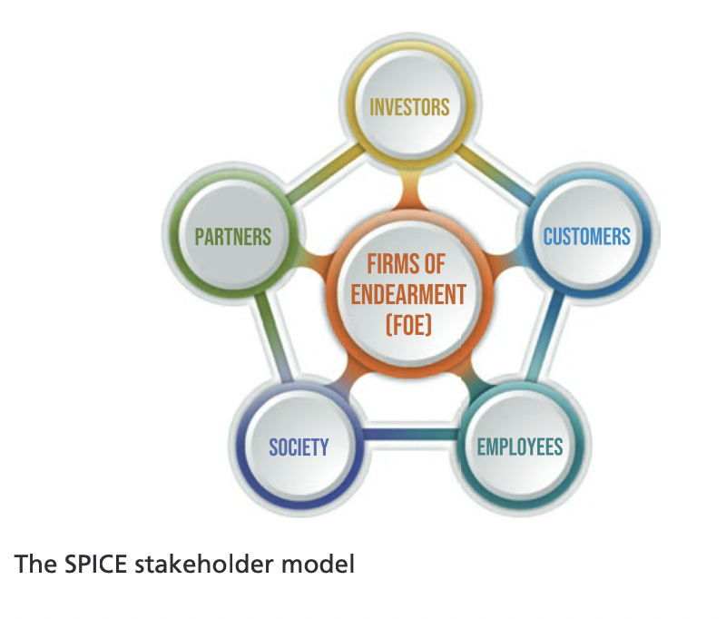
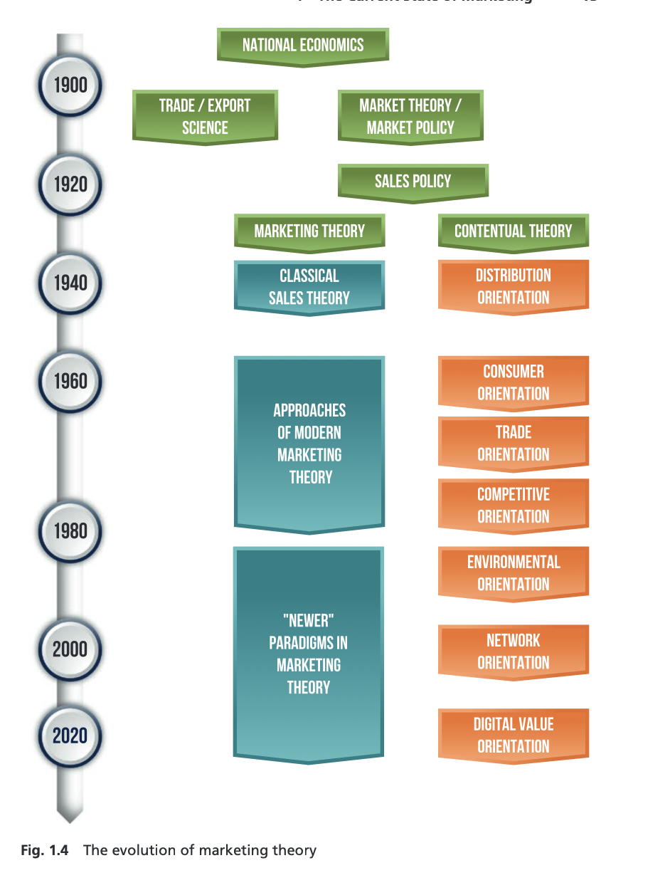
The evolution of marketing theory

Slide 3
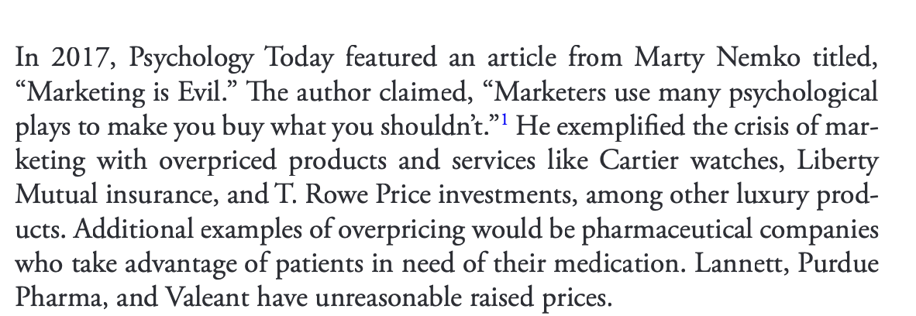
Marketing is Evil (2017 Psychology Today)

Slide 4
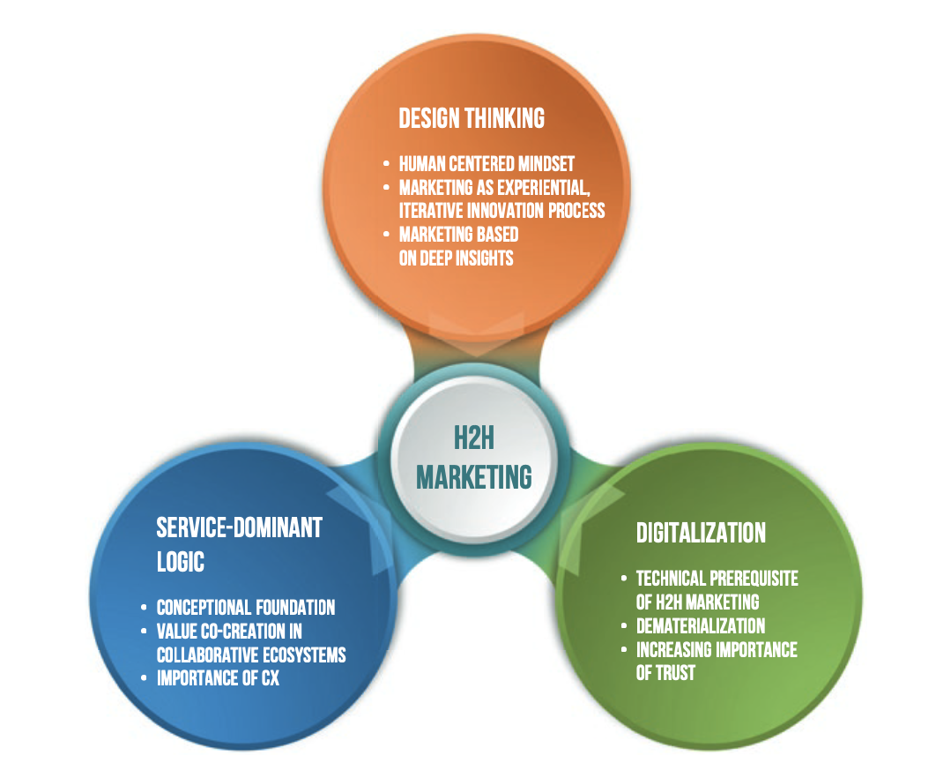
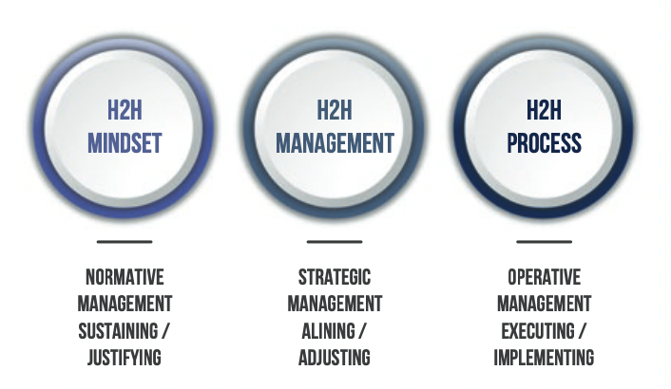
H2H Marketing Model (BANGALORE MODEL)
Conceptual framewrok
Implementation framework

Slide 5
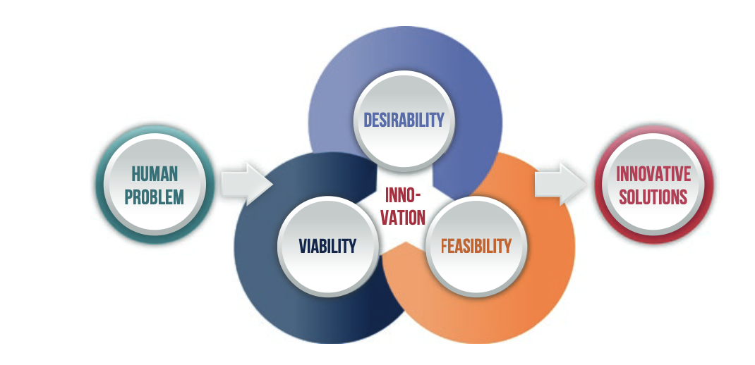
H2H framework
Human centered
Experimentation
Empathy
collaboration

Slide 6
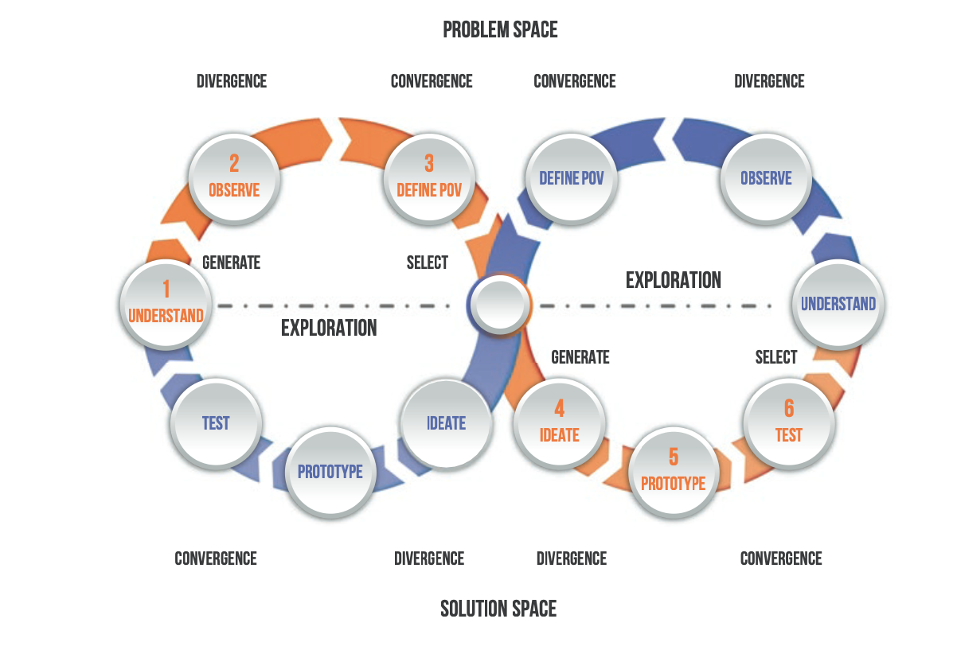
H2H problem/solution spaces

Slide 7
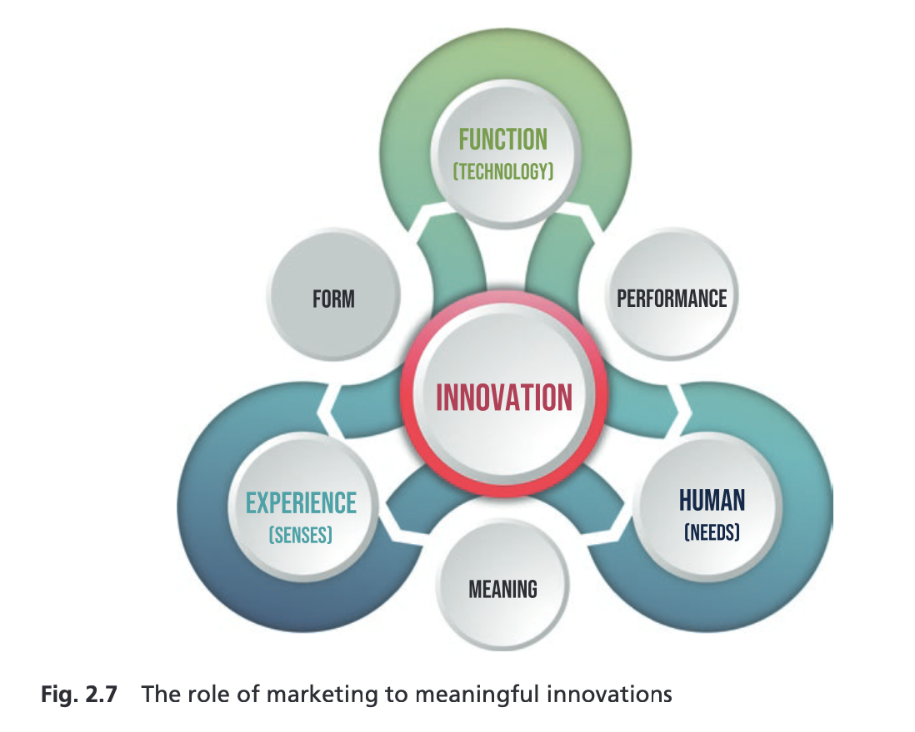
H2H: a meaningful innovation

Slide 8
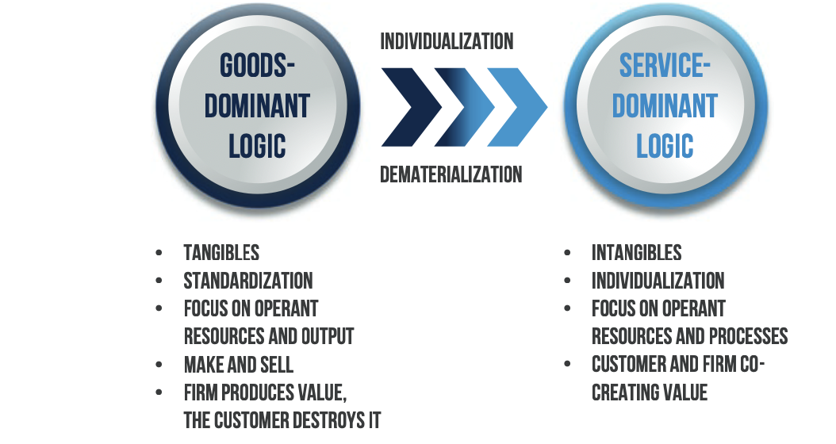
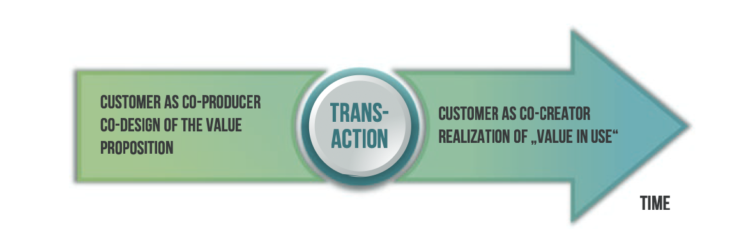
SD logic

Slide 9
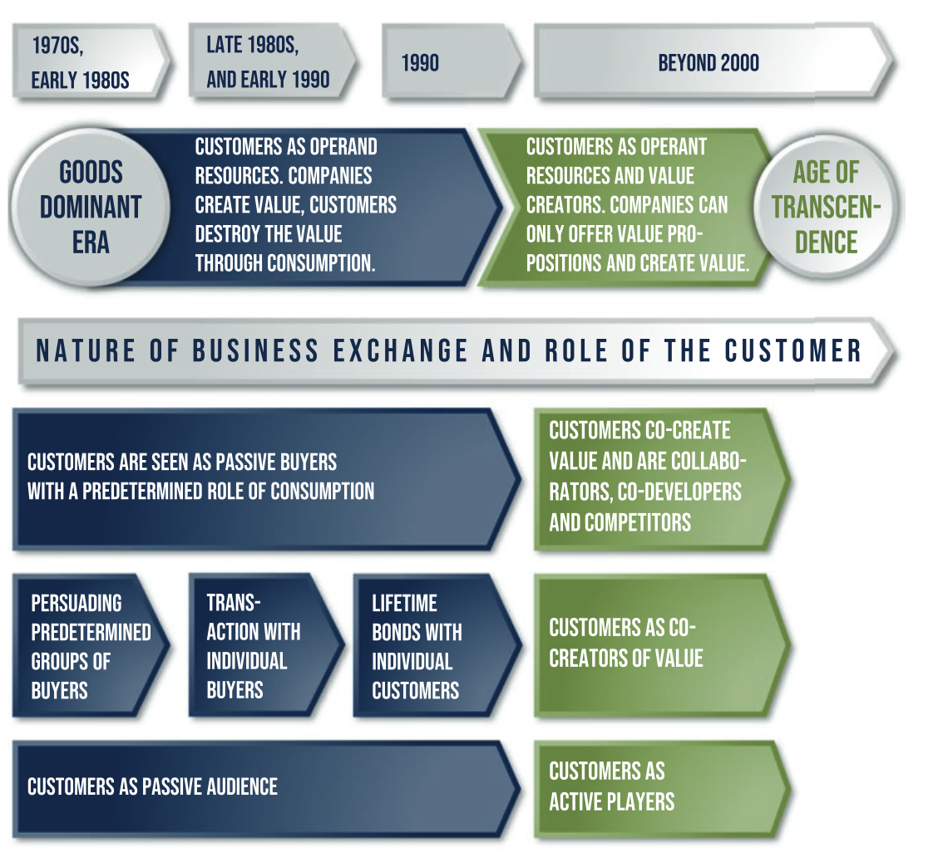
SD logic go in depth

Slide 10
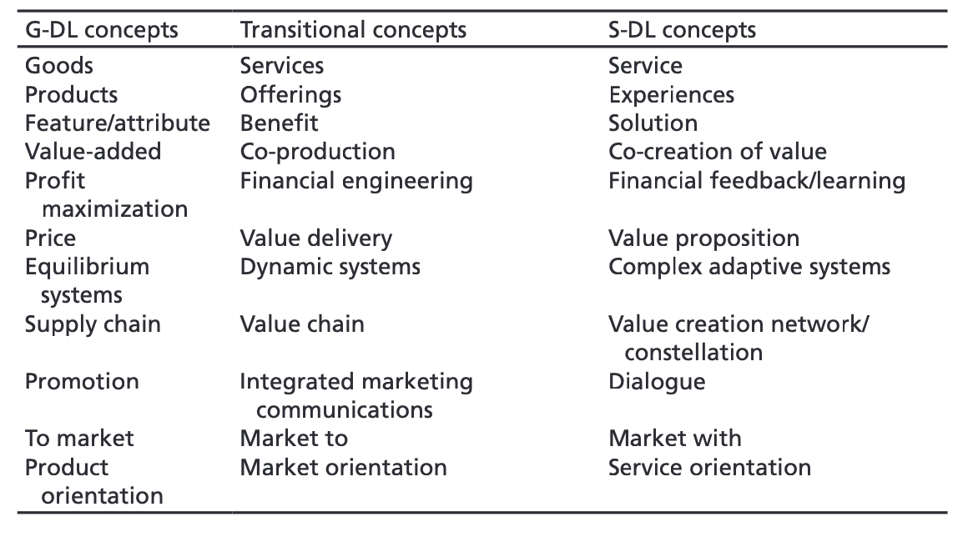
SDL main concepts

Slide 11
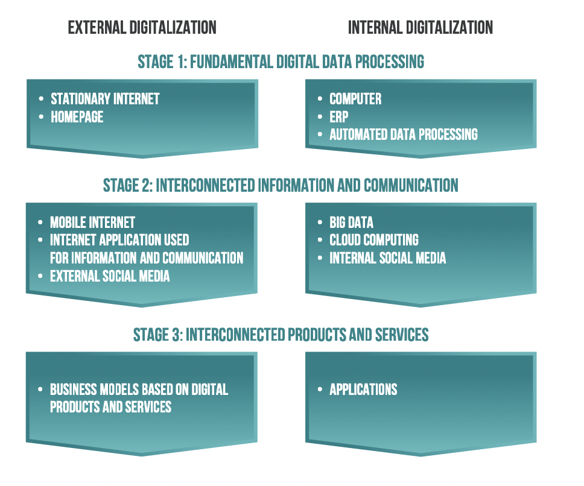
External/ internal digitalization

Slide 12
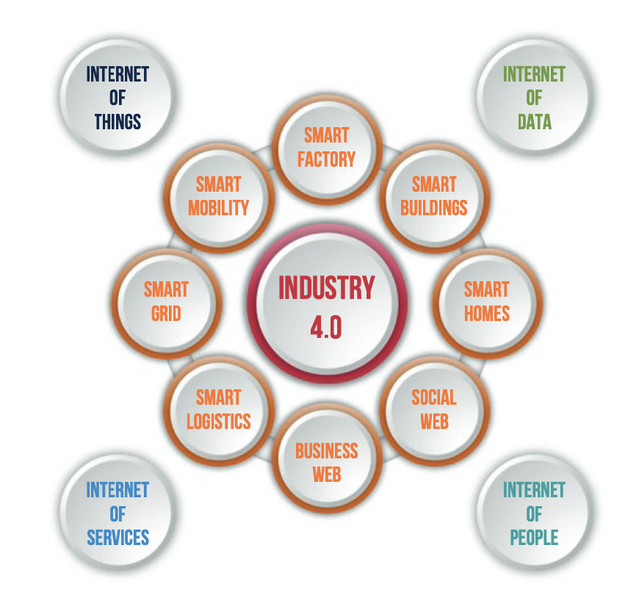
Industry 4.0

Slide 13
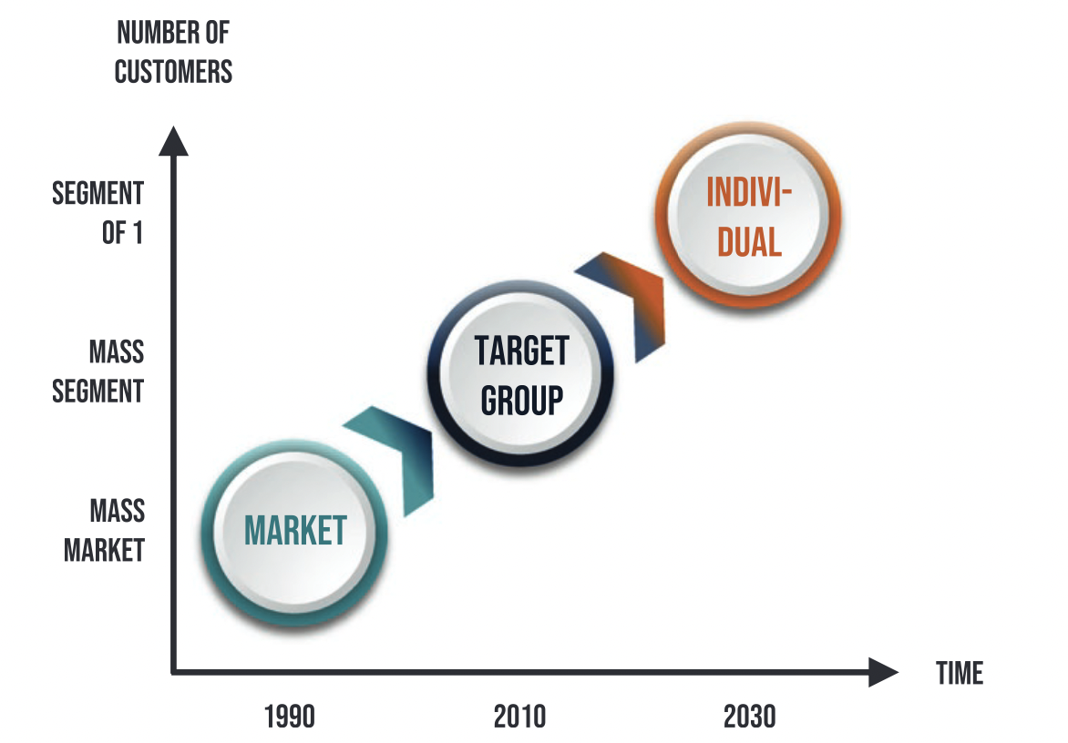
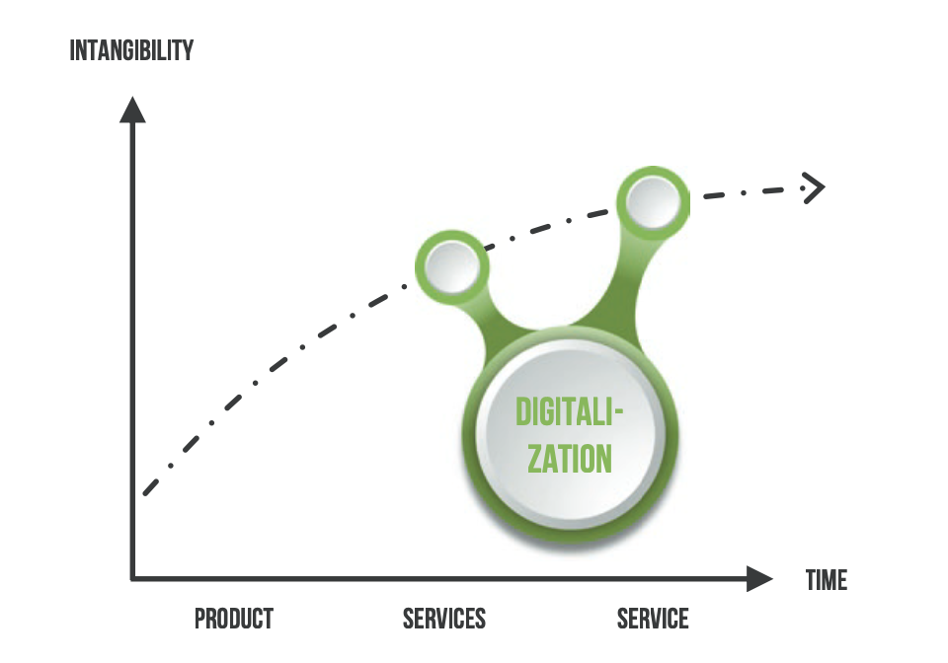
Individualization and dematerialization of value proposition

Slide 14

SO.LO.MO mindset
Decoupling of point of decision and point of sale
The new HOMO digital leads to a SO LO MO behaviour

Slide 15
Testing the value proposition

Slide 16
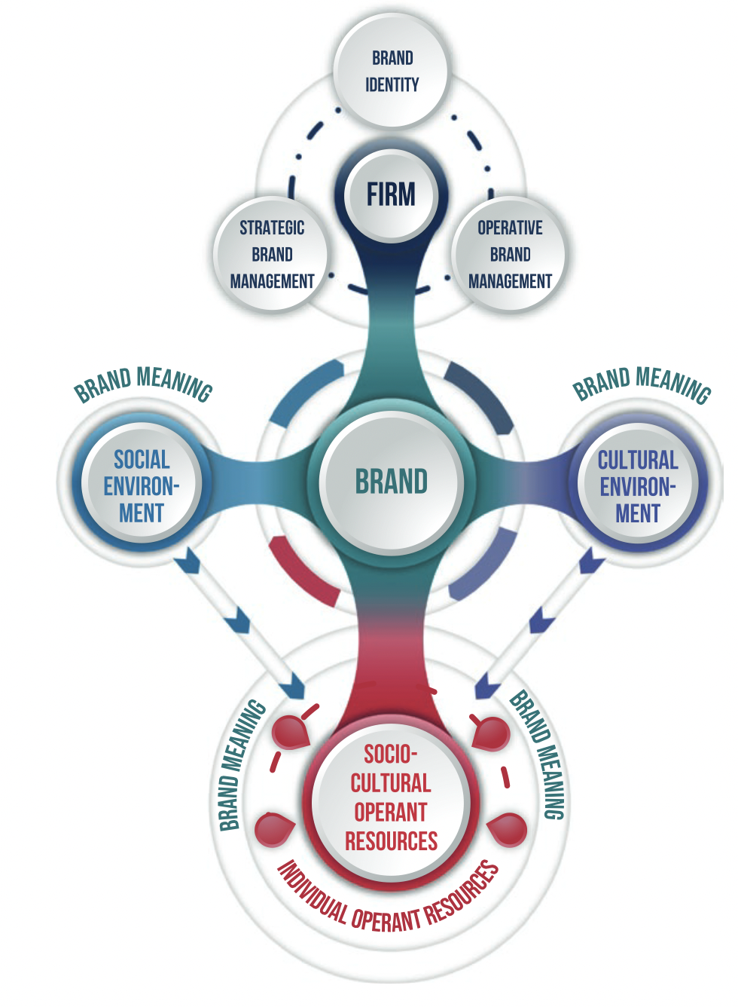
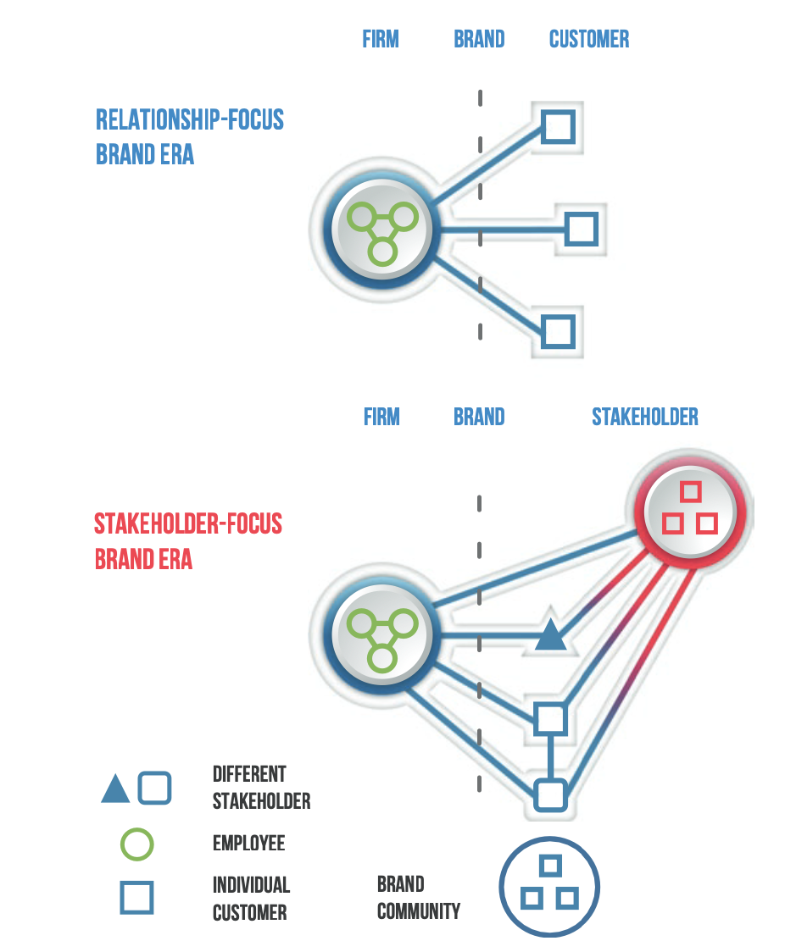
Having a look: H2H brand era

Slide 17
Partial Model Testing (BD 15.4)
Purpose
  Make sure each subsystem is working properly before connecting them together
Methods
  Switches in model
  Override for exogenous variables
Notes:
There are several forms of model testing that this assignment touches on. The first, that you deal with in part B, is partial model testing. Now this assignment is the first time you’re seeing a model with multiple sectors or sub-systems; this is actually quite common for medium or large sized models. And if you think about it, this reflects how the world often works – in a somewhat compartmentalised fashion, where each sector works in locally-rational ways but they’re connected by feedbacks across sectors.
[CLICK] Partial model testing is basically exploring how each module or sub-system works in isolation. You do this first to make sure it’s working properly, as it’s supposed to, and second to make sure you understand how it’s working.
[CLICK] What you do is essentially isolate each sector by cutting the feedbacks, and treating inputs from other sectors, which are actually endogenous in the full model, as exogenous in the partial model. Mechanically, you can do this with switches.

Slide 18
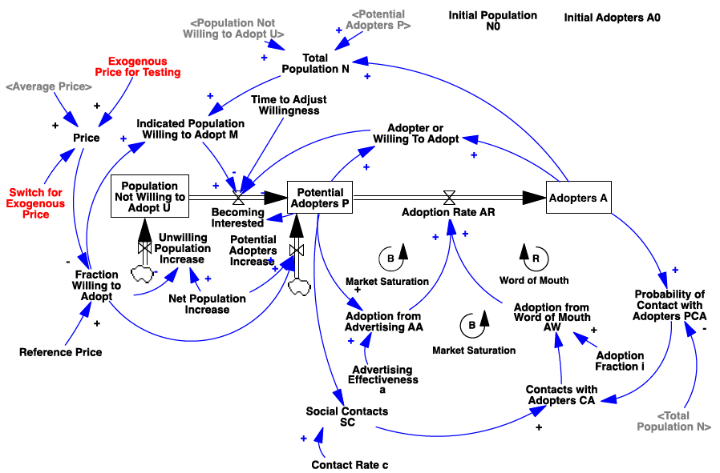

Notes:
… is something like this.
WTF does this all mean?!?!?!
Alright, calm down, everyone. Ideally you’ve already done part B of the assignment so you know what this means, but we’ll go through a bit of it anyway.
[0:10:00]

Slide 19
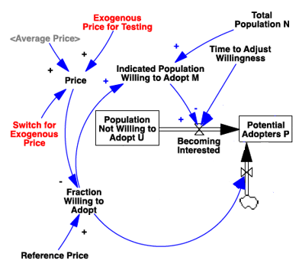
Switches
Price = Switch for Exogenous Price * Exogenous Price for Testing
+ (1-Switch for Exogenous Price) * Average Price
Notes:
So for instance in the adoption sector of this model, there is a ‘Price’ input. It’s endogenous in the full model, but we put in an exogenous price for testing. The Switch here is a variable that takes on a value of 1 or 0. So with Price formulated like this, what happens when the Switch has a value of 1? What about 0?
[WAIT]
Exactly. That’s why it’s a switch – it toggles between one input and another. Remember what I said earlier about building full models for ease of exploration and testing?

Slide 20
Partial Model Testing
Ramp: linear change from X to Y over time Z
Step: instantaneous change from X to Y at time Z
Pulse: instantaneous change from X to Y back to X at times Z and A
Notes:
Now for the exogenous input, obviously you can use a fixed value, and play around with that in Synthesim. But because we’re interested in behaviour over time, it’s often handy to use an input that varies predictably over time. So for instance you can have a ramp, that increases from one value to another linearly over a particular period of time – or a step, that increases at a single point in time – or a pulse, that changes to a higher level for a certain duration before dropping back down again – all these can be useful as test inputs.
Right click on variable in Synthesim, or use Equation Editor to insert appropriate function
DEMONSTRATE on PDCA model!
Any questions about partial model testing? [0:20:00]

Slide 21
Robustness & Sensitivity Analysis
Both important forms of model testing / analysis
  Similar but not identical!
Remember, SD modelling is NOT [usually] about making precise predictions or forecasts!
  Focus on insights about patterns and drivers of behavior
Notes:
Other ways we test models are with robustness checks and sensitivity analysis. These are really important and superficially somewhat similar – you’re basically testing the model with a wide range of inputs to see what happens. But they’re different in some key ways. We’ll get to that in a second, but as we think about model analysis in these ways, bear in mind the goal of most SD models – we’re not usually aiming for precise predictions and especially not for forecasts, at least not with most simple models – the goal is usually to get insights about patterns and drivers of behavior. It’s with that in mind that we do these analyses.

Slide 22


Robustness & Sensitivity Analysis
Robustness:
Testing the basic physics of the model
Use extreme conditions to try to ‘break’ the model
Identify formulations that need fixing
Sensitivity:
Testing the stability of model behavior
Use test conditions around operating range of the model
Identify inputs that need more precision
Notes:
Again, these are superficially similar, you’re ‘fuzzing’ the model with a range of inputs. But the aim is quite different.
Robustness is about whether the model is technically sound – extreme conditions especially important – sensitivity is about whether the insights and behavior are – sensitivity is especially useful for guiding further data gathering
Any questions about robustness checks and sensitivity analysis? [0:25:00]

Slide 23
Notes:
So with all that in mind let’s take a look at the VCR model again, starting with the adoption sector.

Slide 24
Extending the Bass Model:
Response of Total Market Size to Price
Total Population, N
Population Not Willing
to Adopt, N – PWA
Potential Adopters
P
Adopters
A
Population Willing to Adopt
=PWA
Notes:
What we have here is essentially an extension of the Bass model, with a third stock of population unwilling to adopt. So you have two simultaneous processes – the normal adoption from potential adopters to adopters, and also a market expansion as those unwilling to adopt become potential adopters.

Slide 25

Extending the Bass Model:
Response of Total Market Size to Price
FWA =
MAX(0,
MIN(1,
(Reference Price-Price)/Reference Price
))
Notes:
Let’s take a look at a couple of the formulations. First, the Fraction Willing to Adopt, which influences how many are potential or actual adopters vs. those unwilling to adopt. Here’s the formulation for it. Looks messy, right?
Can anyone explain what’s going on here?
Consider robustness of formulation – start with nested term, then look at MIN and MAX terms – consider extreme conditions
[0:30:00]

Slide 26
Extending the Bass Model:
Zooming in on Becoming Interested
Becoming Interested =
MAX(- Potential Adopters P,
Indicated Population Willing to Adopt M – Adopter or Willing To Adopt) /
Time to Adjust Willingness
Notes:
Okay, let’s look at another one – the flow between unwilling and potential adopters, called ‘Becoming Interested’. Take a few minutes, work with the person next to you, and talk through what’s going on here. I’ll give you three minutes to do that.
Consider robustness of formulation – discuss in pairs – remember extreme conditions
[WAIT]
Ask for meaning of each of various terms – then recap
Okay, any questions on the formulations so far? Is everyone comfortable with the idea of checking for robustness of formulations? [0:35:00]

Slide 27
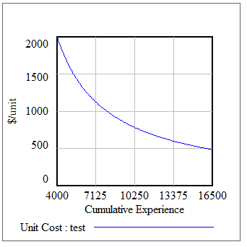
Learning Curve
Conceptually: as firms get more experience manufacturing a product, cost per unit goes down
Mathematically: cost per unit goes down at a fixed % for each doubling of experience
Key: cost reductions based on experience, not time
If initial cost is $2000, initial experience if 4000, and cost reduction per doubling of experience is 25%, what will the unit cost be after producing 8000 units?
Notes:
Alright, now let’s shift to another part of the model which is the Price & Learning Curve sector. A bit of background on the learning curve – this is a common concept in technology development, innovation, and other areas. Basically the idea is that costs of production go down with experience. Simple, right?
Mathematically, the convention is to express this learning process as a fixed percentage cost reduction per doubling of production experience. This isn’t a fundamental law of any kind, it’s actually based on empirical observation across a wide range of sectors – but the observed pattern is so common that it’s been expressed analytically in this way.
Remember that the cost reduction is driven by production experience, not simply the passage of time.
Try the question

Slide 28


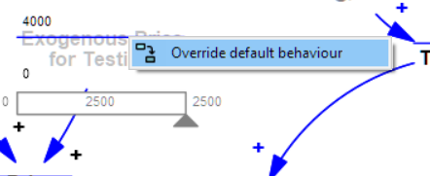
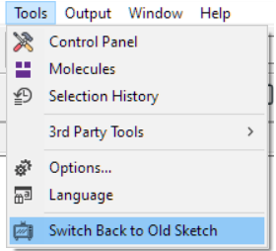
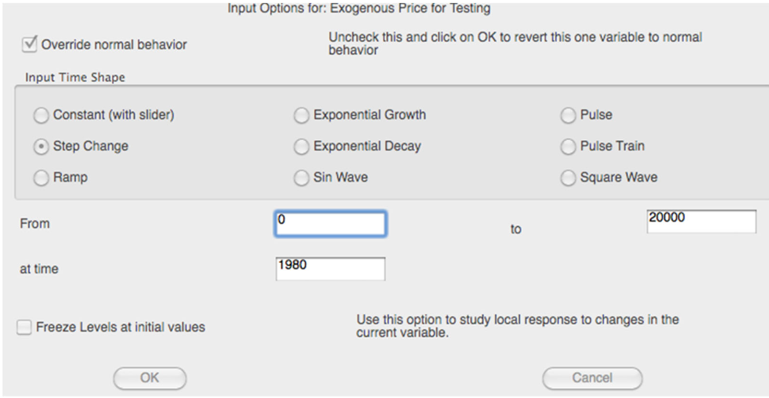
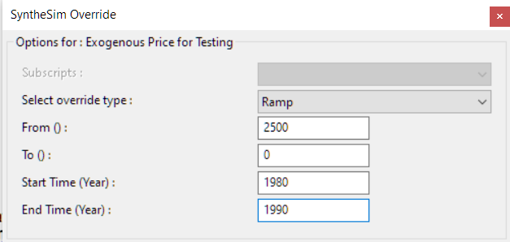
A Note on Version 9 and Synthesim
Version 9 of Vensim relabeled Synthesim and reorganized its dialog box
Option 1: Switch back to ‘Old Sketch’
Option 2: Learn how to use the new Sketch!
=
Option 2
Option 1

Slide 29
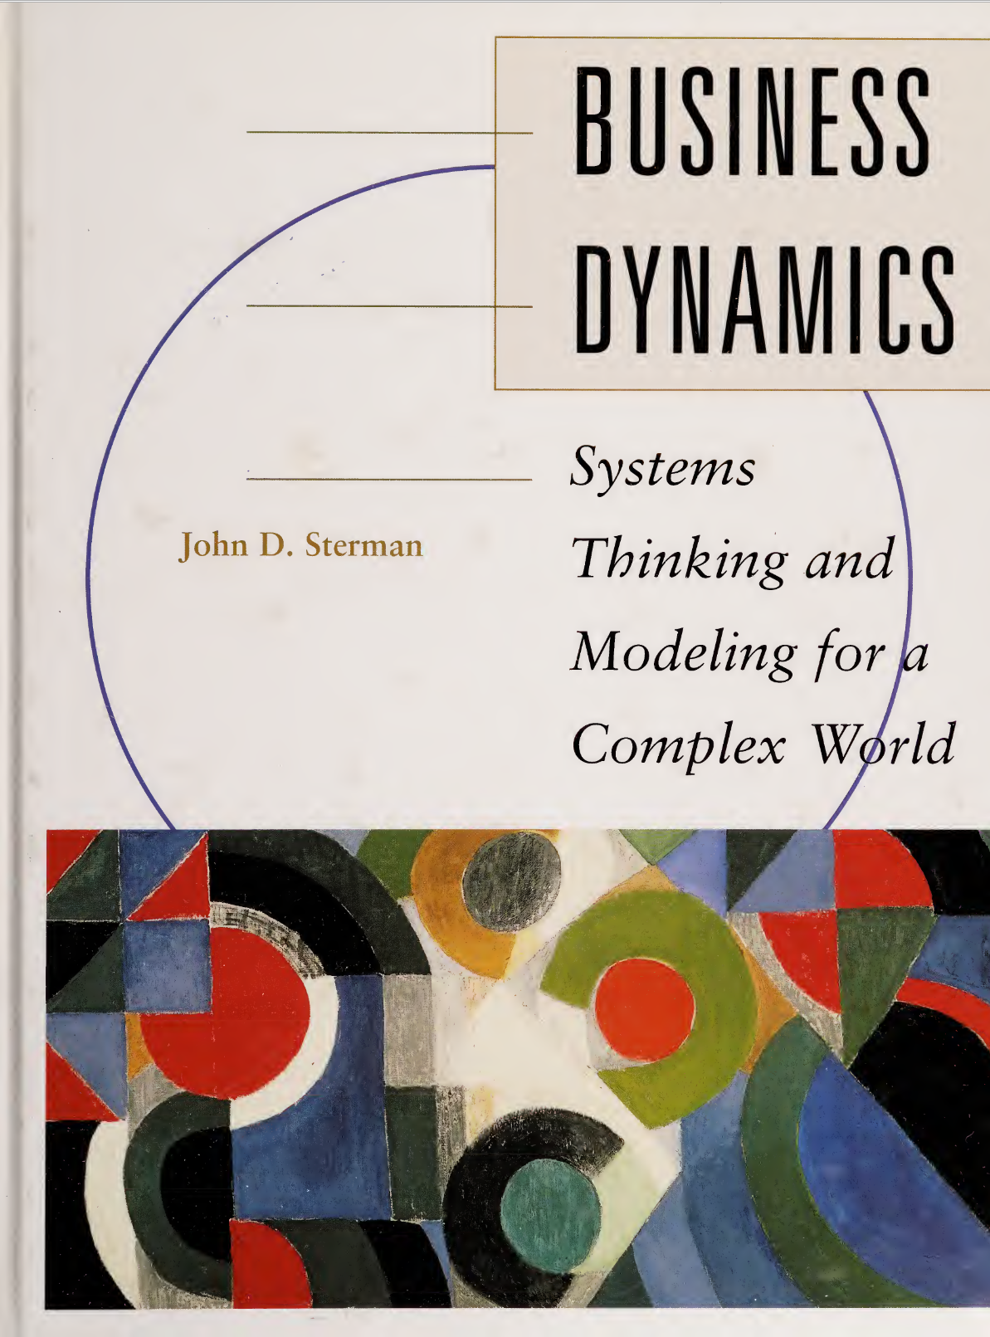
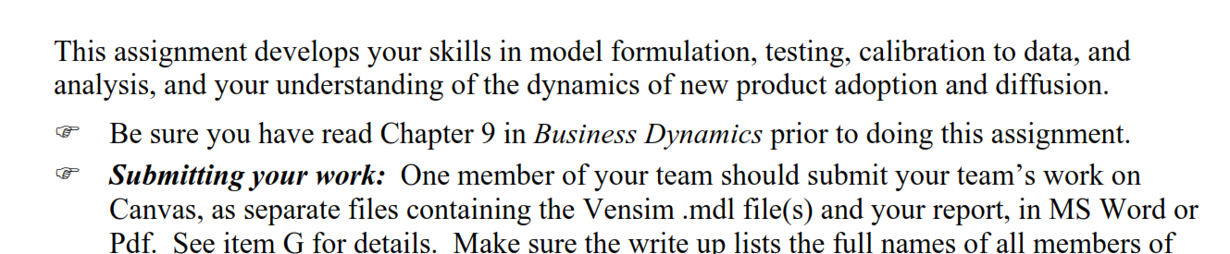
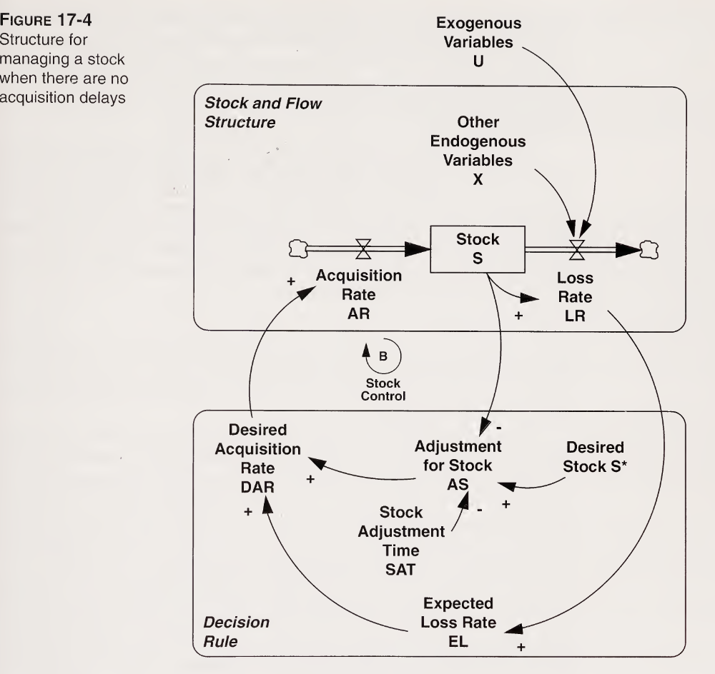
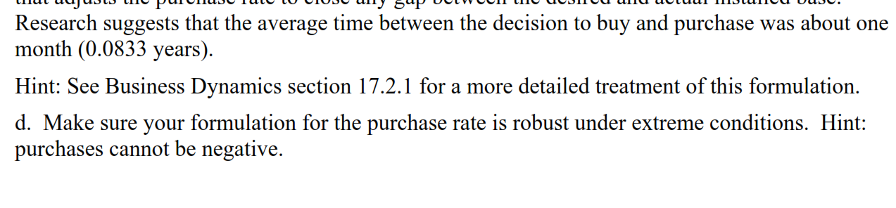
General A4 Advice
Read every sentence in the assignment
  Don’t just skim it!
Read the Book!
  Especially the parts called out in the assignment (Hint Hint!)

Slide 30
Tips and Tricks In Vensim
Sketching CLDs with Comments
Font, color adjustments
Pasting from Vensim into word processor
  Diagrams
  Graphs
Delay Marks
Setting parameters in Synthesim
How to load the runs you want to see to plot
Creating a fixed graph (vs. opening new each time)

Slide 32
More Learning Curve Fun!
Average Price = Unit Cost*(1+Markup)
Cost
C: Unit Cost
C₀: Initial Unit Cost
λ: the exponent Learning Curve Strength
E₀: initial experience
E: cumulative experience
C = C₀ (E/E₀)^{λ}
Experience
Notes:
Formulating the learning curve can be a bit tricky, so let’s look a bit at the mathematical definition here.
In the VCR model, price is based on cost plus some markup. Cost is in turn expressed as a function of cumulative experience – specifically it’s the initial cost, multiplied by the ratio of cumulative to initial experience, raised to some exponent which we call ‘Learning Curve Strength’.

Slide 33

Learning Curve
Logarithms refresher:
  Basic definition:
  $a^{x}=y$ → $\log_{a}{y}=x$
  Base change:
  $$\log_{b}{x}= \frac{\log_{k}{x}}{\log_{k}{b}}$$
Notes:
Now to understand the formulation, we need a quick refresher on logarithms.
Walk through it

Slide 34
Learning Curve
When E has doubled, costs have fallen by the fractional Cost Reduction per Doubling of Experience, f, so:
  (1 - f)C₀ = C₀(2E₀/E₀)^{λ}
  i.e. (1 - f) = 2^{λ}
  i.e. λ = log₂(1 - f) = ln(1 - f)/ln(2)
  f= 0.3 implies a 30% cost reduction for doubling
  every of cumulative experience (λ≈ 0.51)
Notes:
Now let’s look again at the formula for cost. Cost goes down by a factor of f, fractional cost reduction per doubling of experience, each time experience doubles.
Cancelling on both sides we see this means that (1-f) equals 2 to the lambda. With our logarithmic definition and a quick base change, we get the equation for ‘Learning Curve Strength’ – it’s equal to ln (1-f)/ln(2).
Everyone comfortable with how we got this?

Slide 35
BASS DIFFUSION MODEL
This model is used to present a rationale of the interaction between current and potential adopters of a new product. It states that there are two types of adopters - the innovators and imitators.
This model is mathematically defined as a Riccati equation with constant coefficients. In 1833, Everett Rogers published a highly influential study describing the different stages in product adoption that was titled Diffusion of Innovations.'
Then in 1969, a paper detailing a new model of productivity growth for consumer durables was published by Frank Bass, who contributed a few mathematical ideas to it.
This model was discovered to fit the data of a majority of product introductions even though there was a wide range of variables in terms of managerial decisions such as pricing and advertising.

Slide 36
The Bass model was originated by marketing professor Frank Bass. It is used to predict new product diffusion patterns. It is based on a mathematical model to predict new product adoption patterns adopted in a market. The model assumes that there are two main kinds of forces determining the diffusion pattern.
There are three key parameters in the Bass model - usually called m, p, and q.
§ The parameter m indicates the market size and provides the scale of the demand forecast. The other parameters p and q determine the shape of the adoption curve.
§ The parameter p is called the coefficient of innovation and represents the rate or probability that an innovator will adopt at time t.
§ The parameter q is called the coefficient of imitation and accounts for the “word of mouth” or “social contagion” effects.

Slide 37
Bass model is used to forecast the adoption of a new product and to predict the sales since it determines the shape of the curve of a model that represents the cumulative adoption of a new product. Bass model can further be used to address pre-launch, launch, and post-launch strategic decisions of the new product. Another advantage of Bass model is that it does not require previous unit sales data to predict a demand forecast of the product of interest, unlike other majority demand forecasting methods. The limitation of Bass model is as follows. Bass model considers past data from analogs, but this describes how successful innovations have diffused to the market and does not account for their chance of success. Another limitation is that Bass model can well estimate its parameters after observing several data from actual sales. However, this is usually after the firm has made its critical decisions toward the investment

Slide 38
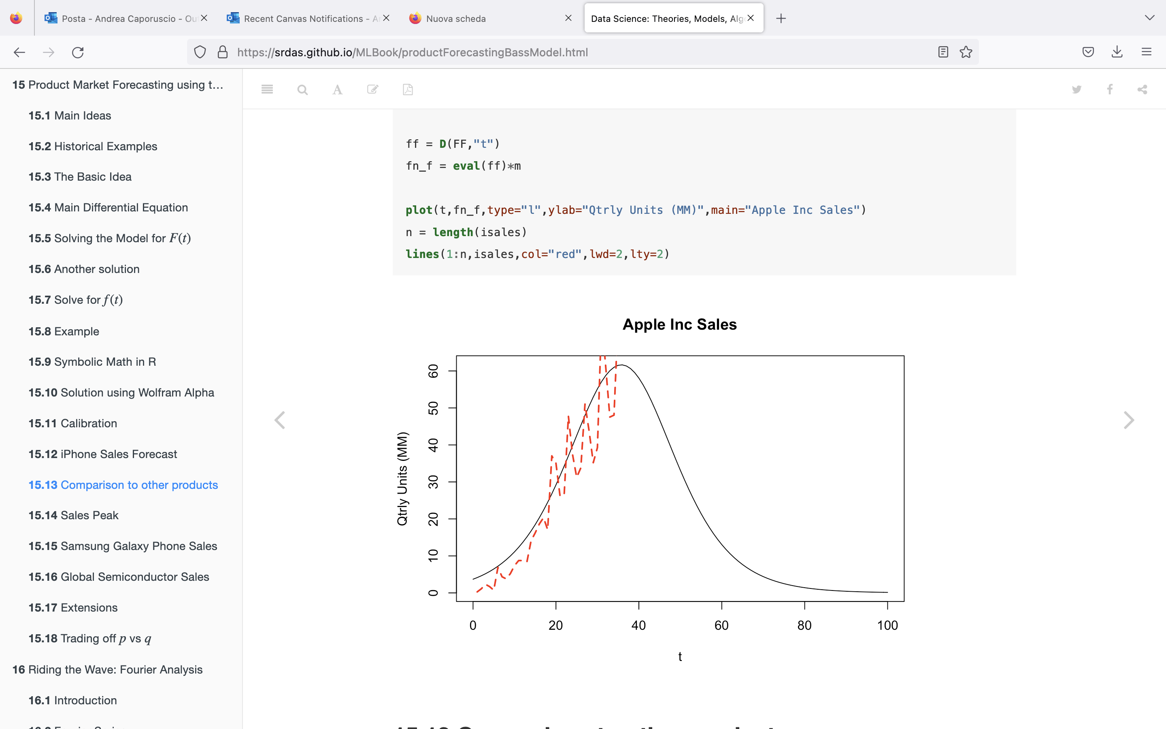

Slide 39
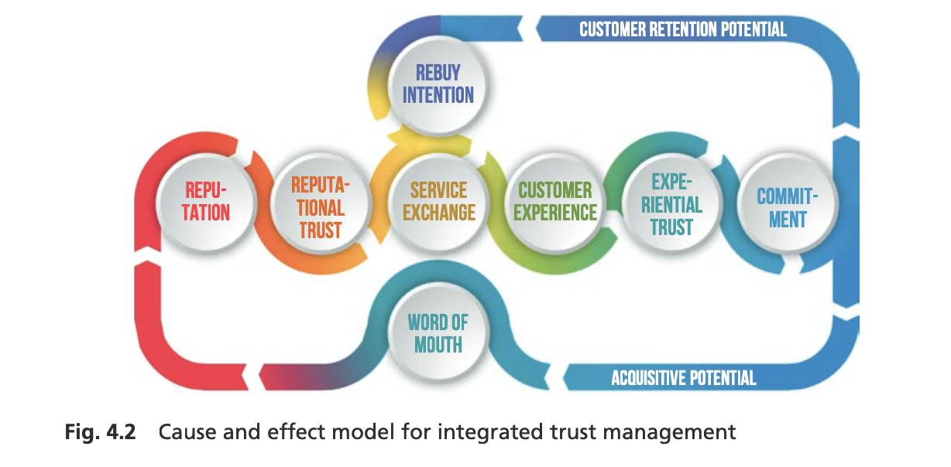
H2H trust management

Slide 40
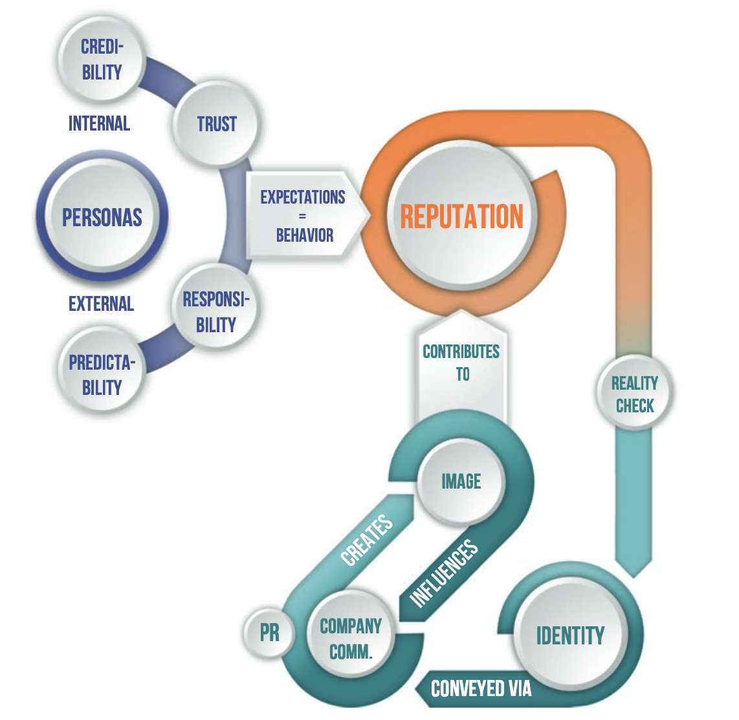
H2H Reputation

Slide 41
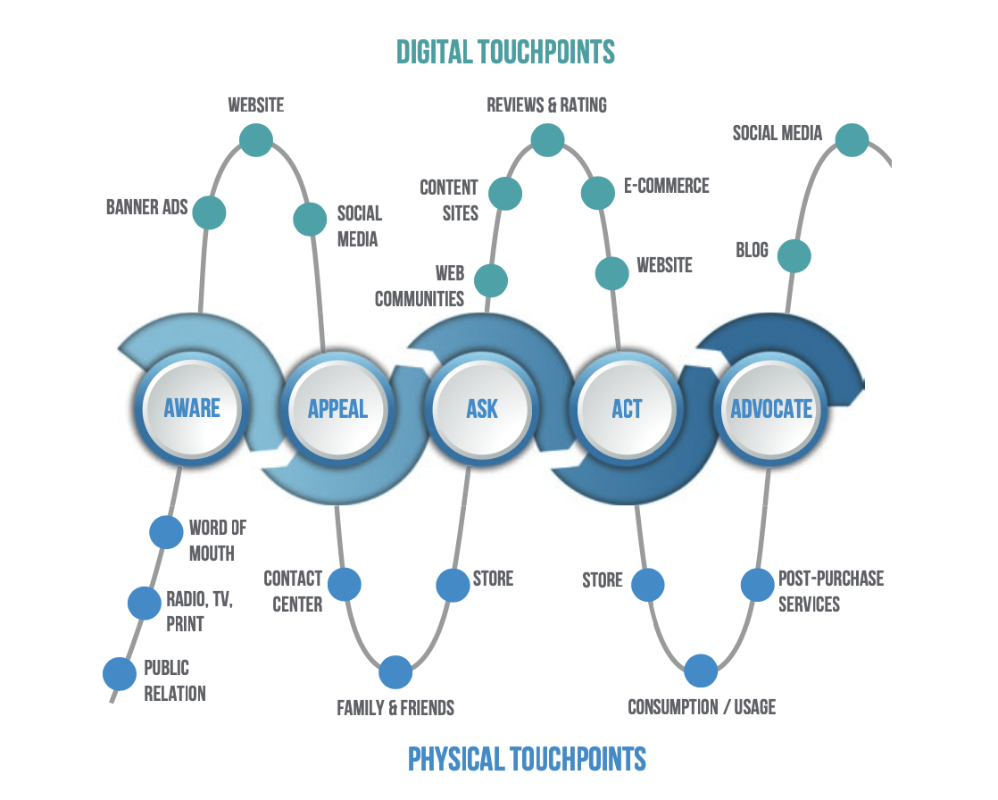
H2H digital touchpoints

