Slide 1
MASTER MEIM 2021-2022
Graphical models
Lession 2
Lesson given by prof. Angelo Ciaramella
Prof. of Machine Learning at the M.Sc. Applied Computer Science of University Parthenope of Naples

Slide 2
Introduction
Probabilistic graphical models (PGMs)
simple way to visualize the structure of a probabilistic model
properties of the model, including conditional independence properties, can be obtained by inspection of the graph
Complex computations in terms of graphical manipulations
Main approaches
Bayesian networks
Markov random fields
Factor graph

Slide 3
Probability Theory
A key concept in the field of pattern recognition is that of uncertainty
noise on measurements
finite size of data sets
Probability theory
provides a consistent framework for the quantification and manipulation of uncertainty
forms one of the central foundations for pattern recognition

Slide 4
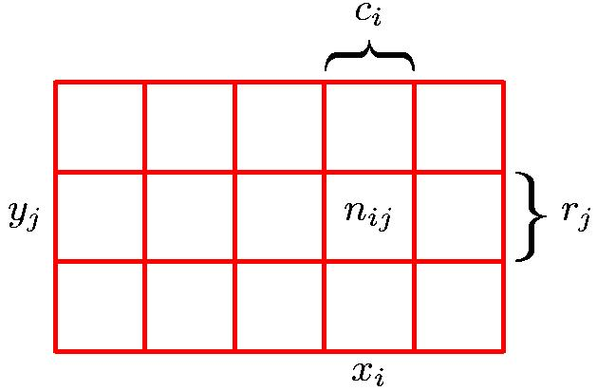
Probability Theory
X can take any of the values x_{i} where i = 1, . . . , M
Y can take the values y_{j} where j = 1, . . . , L
N trials in which we sample both of the
variables X and Y , and let the number of such trials in which X = x_{i} and Y = y_{j} be n_{ij}
Let the number of trials in which X takes the value x_{i} (irrespective of the value that Y takes) be denoted by c_{i}
Let the number of trials in which Y takes the value y_{j} be denoted by r_{j}
random variables X and Y

Slide 5
Probability Theory
Marginal Probability
Conditional Probability
Joint Probability

Slide 6
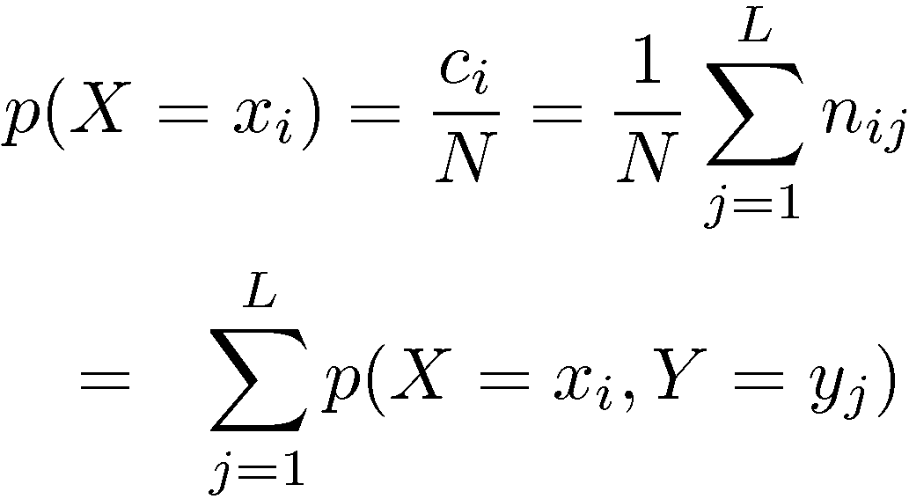
Probability Theory
Sum Rule
Product Rule

Slide 7
Probability Theory
Sum Rule
Product Rule

Slide 8
Bayes’ theorem
posterior ∝ likelihood × prior
normalization factor

Slide 9
PGMs
joint distribution
k-variables

Slide 10
Probabilistic GMs
Example of PGM

Slide 11
Classification example
Making decision
X-ray image x
P(y) probability that a person has cancer
P(y = 1 | x ) probablity that a person has cancer and P(y = -1 | x ) probablity that a person has not cancer after oberving information of X-ray

Slide 12
Generative vs Discriminative Models
Generative models
Assume some functional form for P( X | Y ), P(Y)
Estimate parameters of P(X | Y), P(Y) directly from training data
Use Bayes rule to calculate P(Y | X = x)
Discriminative models
Directly assume some functional form for P(Y|X)
Estimate parameters of P(Y|X) directly from training data

Slide 13
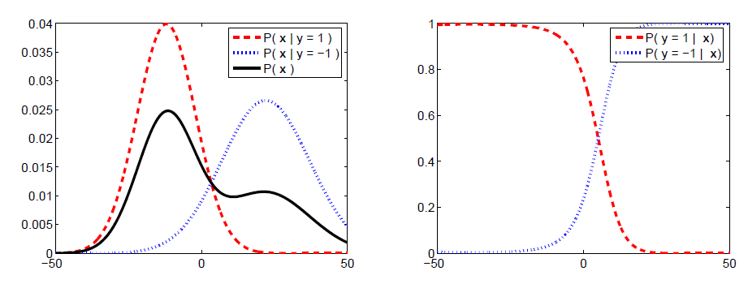
Classification example

Slide 14
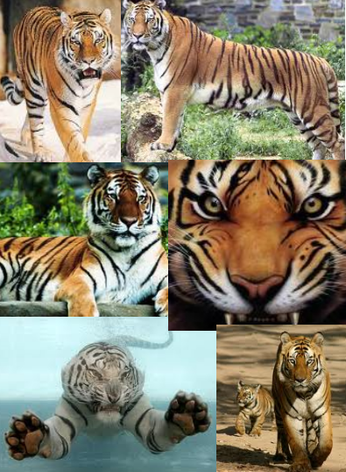
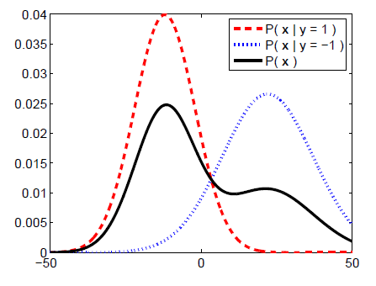
Generative Models
Color
Size
Texture
Weight
…

Slide 15
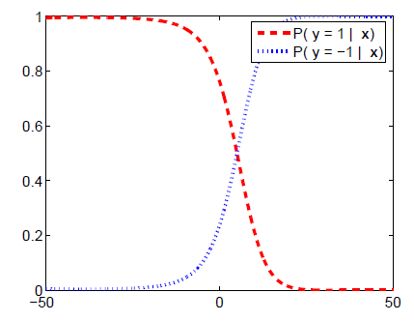
Discriminative Models
Color
Size
Texture
Weight
…
Logistic regression

Slide 16
Discriminative Models
$$P\left(C | X\right)$$
$$C=c_{1}, . . ., c_{L}$$
$$X=(X_{1}, …, X_{n})$$
$$P\left(c_{1} | x\right)$$
$$P\left(c_{2} | x\right)$$
$$P\left(c_{L} | x\right)$$
. . .
Discriminative Probabilistic Classifier
$$x=(x_{1}, x_{2}, …, x_{n})$$
. . .
$$x_{1}$$
$$x_{2}$$
$$x_{n}$$

Slide 17
Discriminative Models
$$P(x|c_{1})$$
$$P(x|c_{2})$$
$$P(x|c_{L})$$
Generative Probabilistic for Class 1
Generative Probabilistic for Class 2
. . .
Generative Probabilistic for Class L
. . .
. . .
. . .
$$x_{2}$$
$$x_{n}$$
$$x_{2}$$
$$x_{n}$$
$$x_{2}$$
$$x_{n}$$
$$x_{1}$$
$$x_{1}$$
$$x_{1}$$

Slide 18
Bayes classifier
Likelihood
Prior
Normalization Constant

Slide 19
Maximum A Posterior rule (MAP)
$$P\left(C=c^{∗} | X=x\right)>P\left(C=c \right|X=x)$$
$$c≠c^{∗}, c=c_{1}, …, c_{L}$$

Slide 20
Bayes classification
$$P\left(C | X\right)∝P\left(X\right|C)P(C)=$$
$$P\left(X_{1}, X_{2}, …, X_{N}\right|C)P(C)$$
Difficulty for learning the joint probability

Slide 21
Naïve Bayes
$$P\left(X_{1}, X_{2}, …, X_{N}\right|C)=P\left(X_{1}\right|X_{2}, …, X_{n};C)P(X_{2},…, X_{n}\left|C\right)=P\left(X_{1}\right|C) P(X_{2},…, X_{n}\left| C\right)=P\left(X_{1} | C\right)P\left(X_{2}\right|C) …P(X_{n}| C)$$
all input attributes are conditionally independent

Slide 22
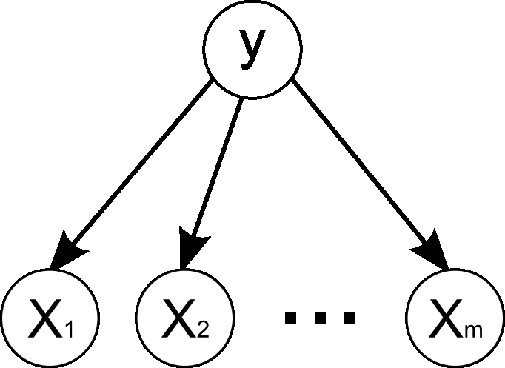
Naïve Bayes

Slide 23
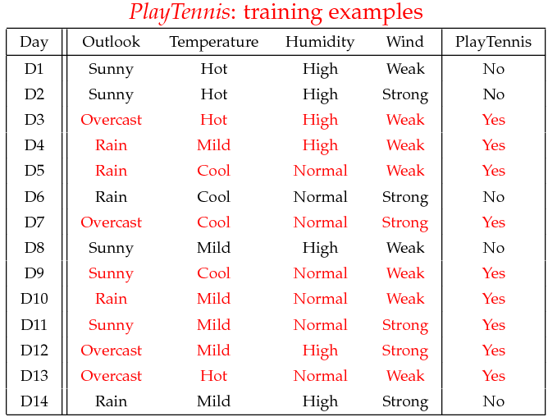
Example Naïve Bayes

Slide 24
Example Naïve Bayes
Learning phase
Outlook | Play=Yes | Play=No
Sunny | 2/9 | 3/5
Overcast | 4/9 | 0/5
Rain | 3/9 | 2/5
Temperature | Play=Yes | Play=No
Hot | 2/9 | 2/5
Mild | 4/9 | 2/5
Cool | 3/9 | 1/5
Humidity | Play=Yes | Play=No
High | 3/9 | 4/5
Normal | 6/9 | 1/5
Wind | Play=Yes | Play=No
Strong | 3/9 | 3/5
Weak | 6/9 | 2/5
P(Play=Yes) = 9/14
P(Play=No) = 5/14

Slide 25
Example Naïve Bayes
Test phase
New istance
x’=(Outlook=Sunny, Temperature=Cool, Humidity=High, Wind=Strong)
Look up table
P(Outlook=Sunny|Play=Yes) = 2/9
P(Temperature=Cool|Play=Yes) = 3/9
P(Huminity=High|Play=Yes) = 3/9
P(Wind=Strong|Play=Yes) = 3/9
P(Play=Yes) = 9/14
P(Outlook=Sunny|Play=No) = 3/5
P(Temperature=Cool|Play==No) = 1/5
P(Huminity=High|Play=No) = 4/5
P(Wind=Strong|Play=No) = 3/5
P(Play=No) = 5/14

Slide 26
Example Naïve Bayes
Test phase
MAP rule
P(Yes|x’): [P(Sunny|Yes)P(Cool|Yes)P(High|Yes)P(Strong|Yes)]P(Play=Yes) = 0.0053
P(No|x’): [P(Sunny|No) P(Cool|No)P(High|No)P(Strong|No)]P(Play=No) = 0.0206
Given the fact P(Yes|x’) < P(No|x’), we label x’ to be “No”

Slide 27
Continuous inputs
Normal distribution

