Slide 1


Slide 2
Climate Change vs
Fast Fashion
13 kg/y
62m tonnes/y
102m tonnes/y
15% waste
Global per capita production of textile increased from 5.9kg per year to 13kg per year
Global consumption of apparel has risen to an approximate 62 million tonnes per year
is projected to further reach 102 million tonnes by the year 2030
15% of fabric used in garment manufacturing is wasted
57% discard
x28 emission
35% microplastics
less than 10%
Textile recycling remains too low, with 57% of 150 million garments produced that are discarded clothing ending up in landfill
Burning release pollution and methane, a greenhouse gas that is at least 28 times more potent than carbon dioxide
The synthetic materials used are the primary reason for microplastics entering the oceans, accounting for 35% of all microplastics
Companies offers less than 10% of second-hand purchases

Slide 3

Useful links:
https://www.pmi.org/disciplined-agile/construction-goals/improve-quality -> TO CHECK THE PROCESS GOALS
Vector Icons and Stickers - PNG, SVG, EPS, PSD and CSS (flaticon.com) -> ICON AND STICKERS
Way of Working (WoW) (pmi.org) -> WoW
For any other info and need: ASK ME! ☺

Slide 4

CASE STUDY
SUIT UP! HELP THE WORLD WITH STYLE

Slide 5



Clothes Enough
Clothes enough is a social platform designed to encourage responsible and sustainable use of clothes
Now, avoiding throwing away old or used clothes is simple than ever, helping people in difficulty thanks to a direct relationship through clothes shops and voluntary associations
RETAIL
VOLUNTEER
NEEDY

Slide 6

Vision
SUIT UP! HELP THE WORLD WITH STYLE
To realize its Vision, ClothesEnough, for the first year, want reduce the distribution waste by 30% aiming to directly involve retail distributors and accredit a set of trusted associations
The connecting element between retail distributors and trusted associations is the SecondHand Bag
A SecondHand Bag represents the set of products that, from time to time, the retail distributor makes available to accredited associations
The SecondHand Bag managing process is developed through the following steps :
The retails distributor prepares a SecondHand Bag by registering it on the platform
Associations that have shown their interest in the area in which the retails distributor operates, are notified of the availability of the new SecondHand Bag
Interested associations see the SecondHand Bag and book it. Priority in booking is on a time basis
In this way, a trusted process is created between retails distributors and trusted associations

Slide 7
Business & Growth Model
Business Model
Growth Model
Clothes enough uses systems for advertising collection
( e.g. on the SecondHand Bag) and requests a retailer’s contribution of 0.99$ for each withdrawal agreement concluded
Consider that throwing away unsold clothes is a cost for the retailer, it is plausible to apply a cost to the operation. The involev trusted associations can also voluntarily contribute to the livehood of the platform
The growth model is viral : each retailer will indirectly advertise the initiative through word of mouth, as will the managers and the operators of the trusted associations

Slide 8
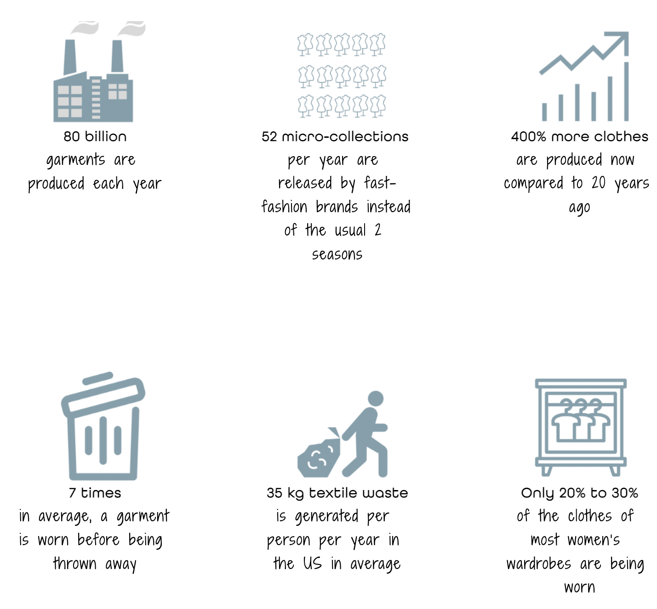
Reference Market
92 Million Tonnes of Textiles Waste is Produced Every Year
Of the 100 billion garments produced each year, 92 million tonnes end up in landfills. To put things in perspective, this means that the equivalent of a rubbish truck full of clothes ends up on landfill sites every second
Fashion’s Environmental Impacts
The fashion industry is the second largest polluter in the world just after the oil industry. And the environmental damage is increasing as the industry grows.
From a social and ethical point of view, textile waste represents an intorelable contradiction in the face of growing probles of climate change

Slide 9
ClothesEnough Today
Actual Situation :
After the first 6 months, the company has received widespread media attention and is preparing for the first official financing round
ClothesEnough is composed by :
Co-founders ( YOU)
5 platform developer ( Web & App)
1 customer care specialist
1 marketing specialist
All of this has increased the work amount and creating huge stress: problems are chasing and things seem not to improve
The most evident problems are :
A high conflict has arisen between colleagues
Customer care is insufficient to respond to all requests for support
Problems with the management of ClothesEnough, with its traceability
High times cause of the reach for various clothes/fabrics
Complain about new feautures on the platform
Overall there is an increasing complexity of problems and it is vital to introduce Agile Continous Improvement practices to effectively and efficiently deal with the probloem that emergers

Slide 10
PHASE 1.
DEFINE YOUR WAY OF WORKING (WOW)
Your task, like co-founders, is to use the raDAr and the DA Process Goal Diagrams to identify:
How to introduce the Agile Methodology into the company
What pratices should be adopted so that the continuous improvement has the immediate effect of improving workflow and generating more value
Define the operational and organizational model of your company

Slide 11
PHASE 2.
IMPROVE YOUR WoW
The company goes better, and you need to scale your chosen practices rethinking the maturity of each strategy and focusing on the right balance between practices associated with neighboring goals
Analyze the As is picture of the company and identify other possible vulnerabilities ( e.g. new competitors, stakeholders etc.)
Identify a new strategy to improve the business
Suggest to the company new innovative and technological tool to increase the business goal

Slide 12
PHASE 3.
PRESENTATION AND PITCH
Present your solution and your WoW to the company with a Power Point presentation
The presentation will count :
The Team
An Agenda
An Introduction of the Market Context
The understanding of the vision and the vulnerabilities of the company
Your solution through the WoW
Your innovative ideas to help the company growth
Any other idea will be welcomed
Prepare a 10 minutes pitch to convince the other CEOs of the company to choose your idea
Stay with 10 minutes. You can all be part of the speech or decide who has to talk

Slide 13
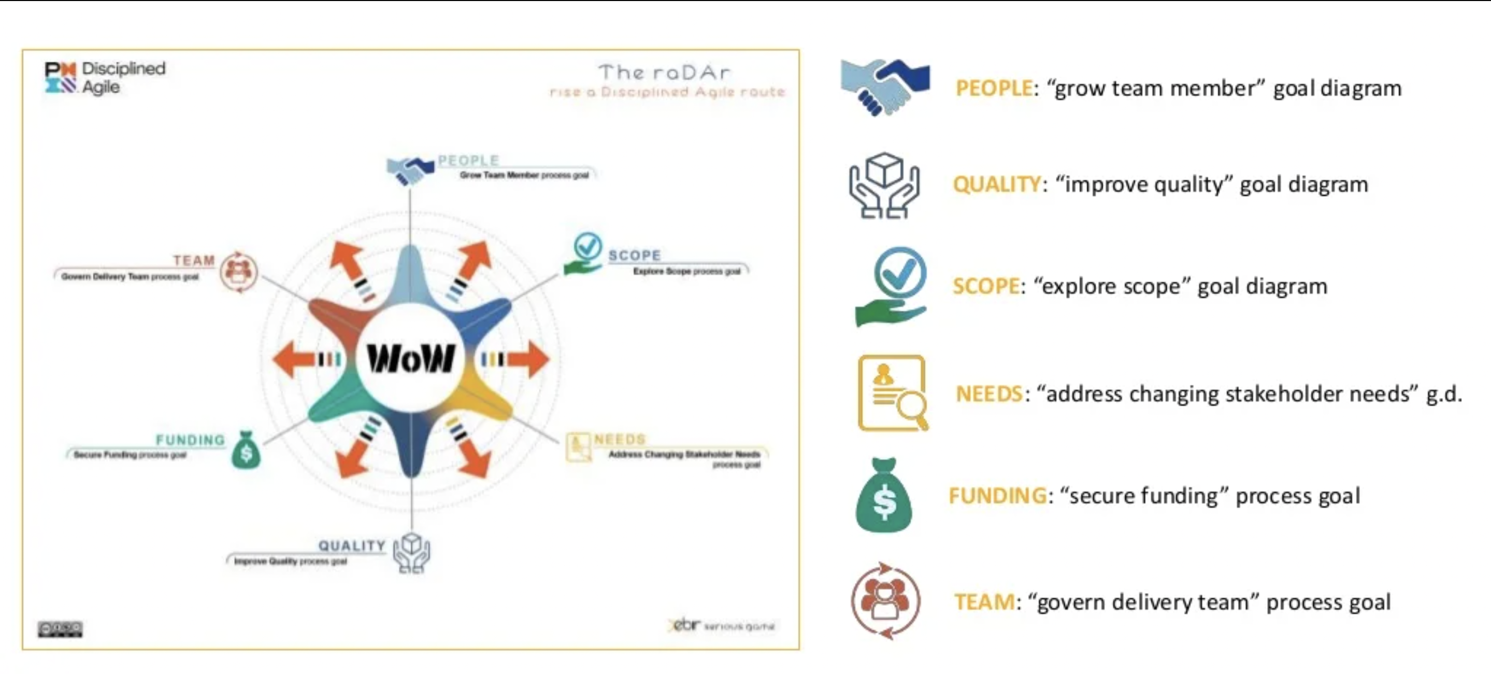
The raDAr
The raDAr ( rise a Disciplined Agile route) nis your primarly tool to achieve the goal of two phases.
For each main element : People, Scope, Needs, Quality, Founding and Team, choice the decision point from the related process goal and pick up an option from the list.

Slide 14
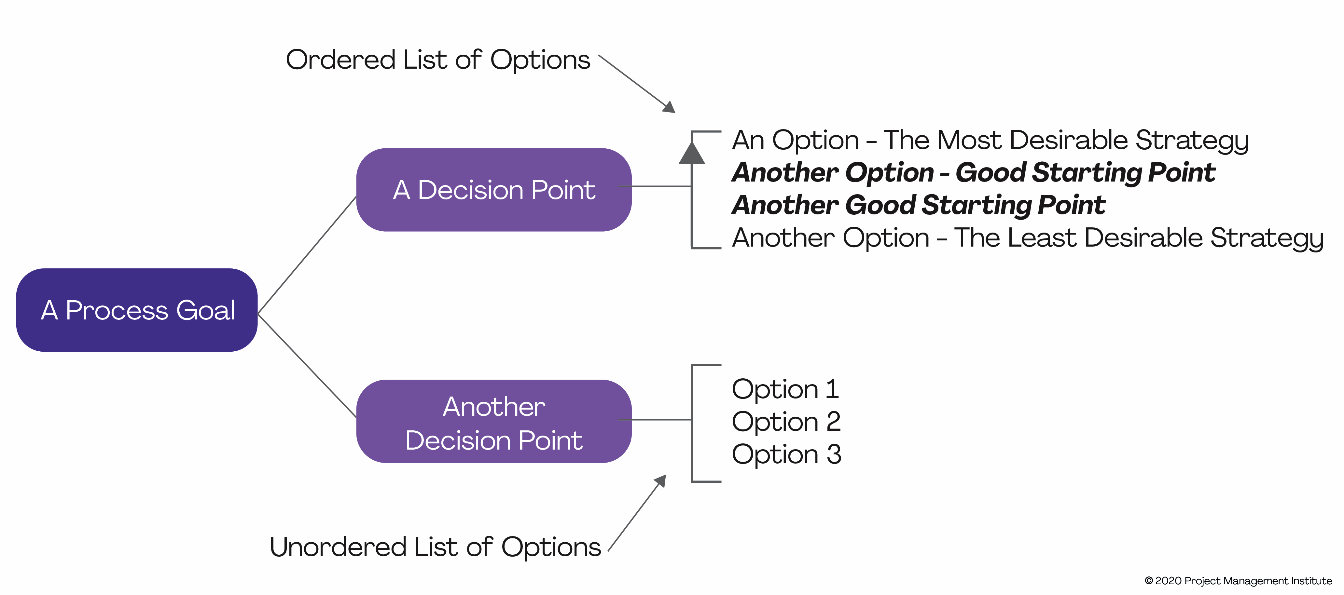
WoW Process diagram
Way of Working used with Disciplined Agile

Slide 15
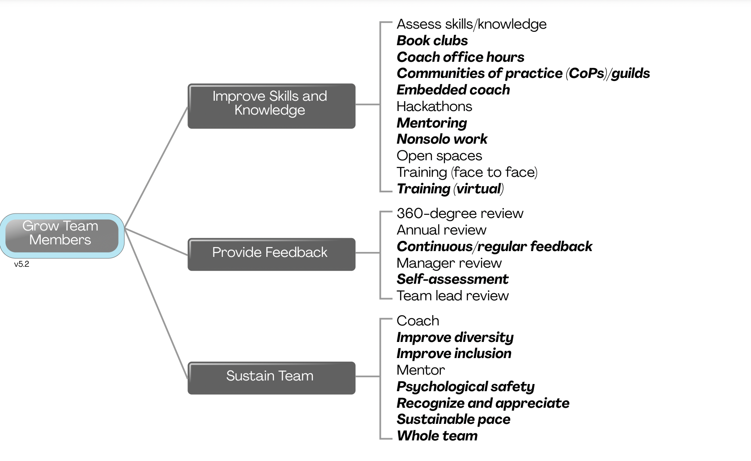
PEOPLE

Slide 16
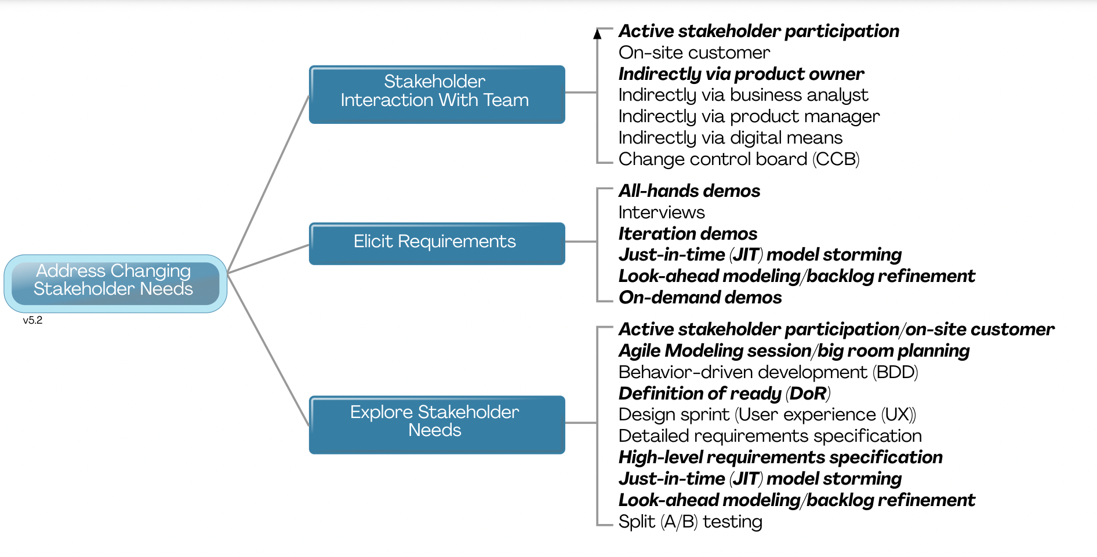
NEEDS

Slide 17
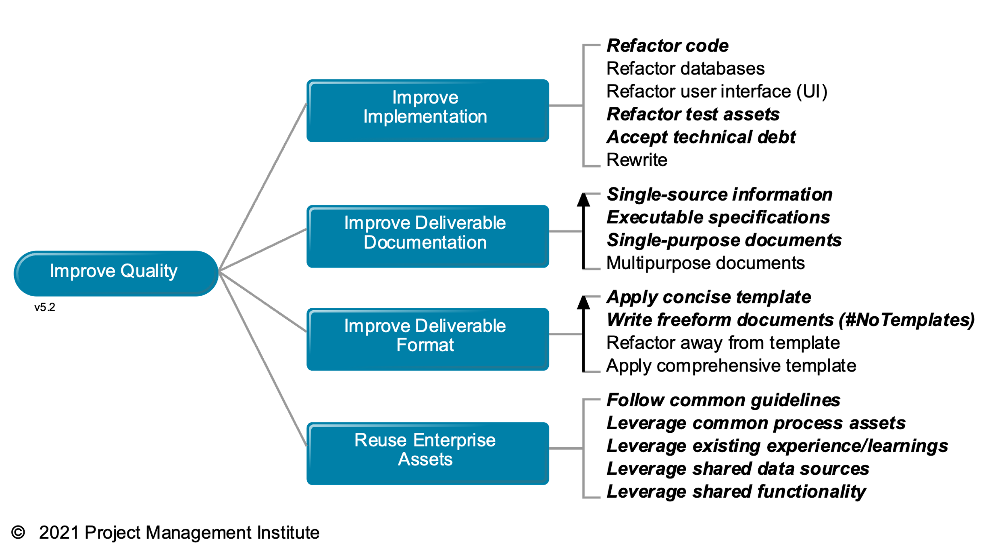
QUALITY

Slide 18
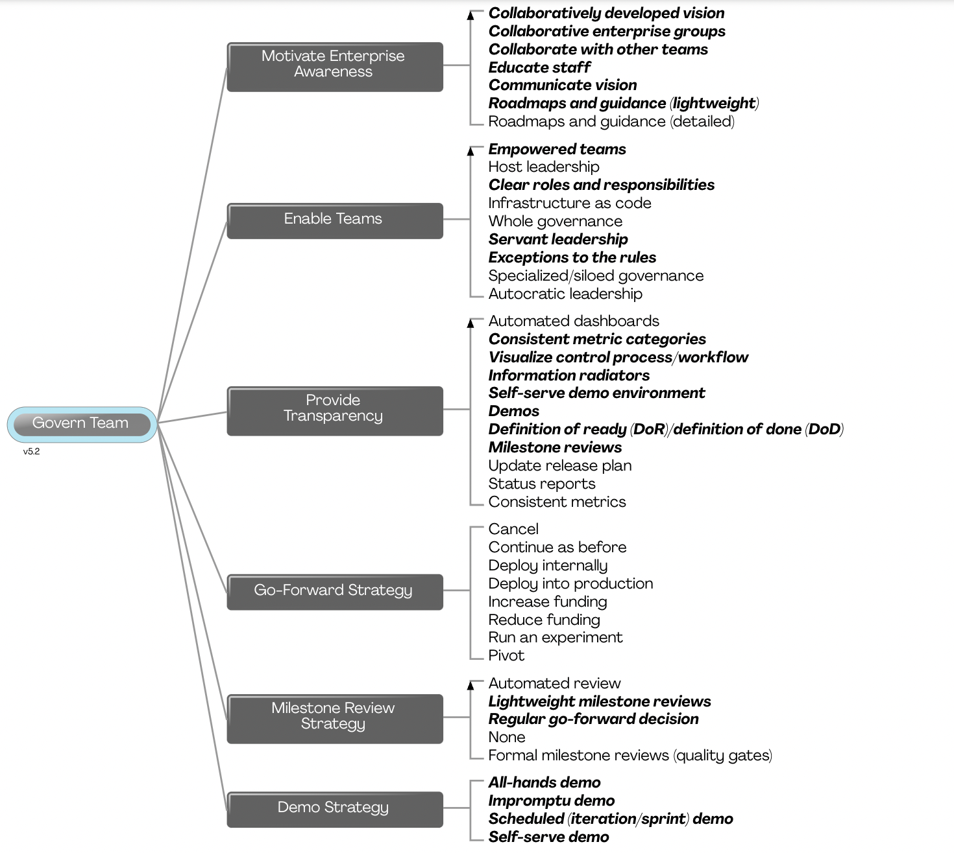
TEAM

Slide 19
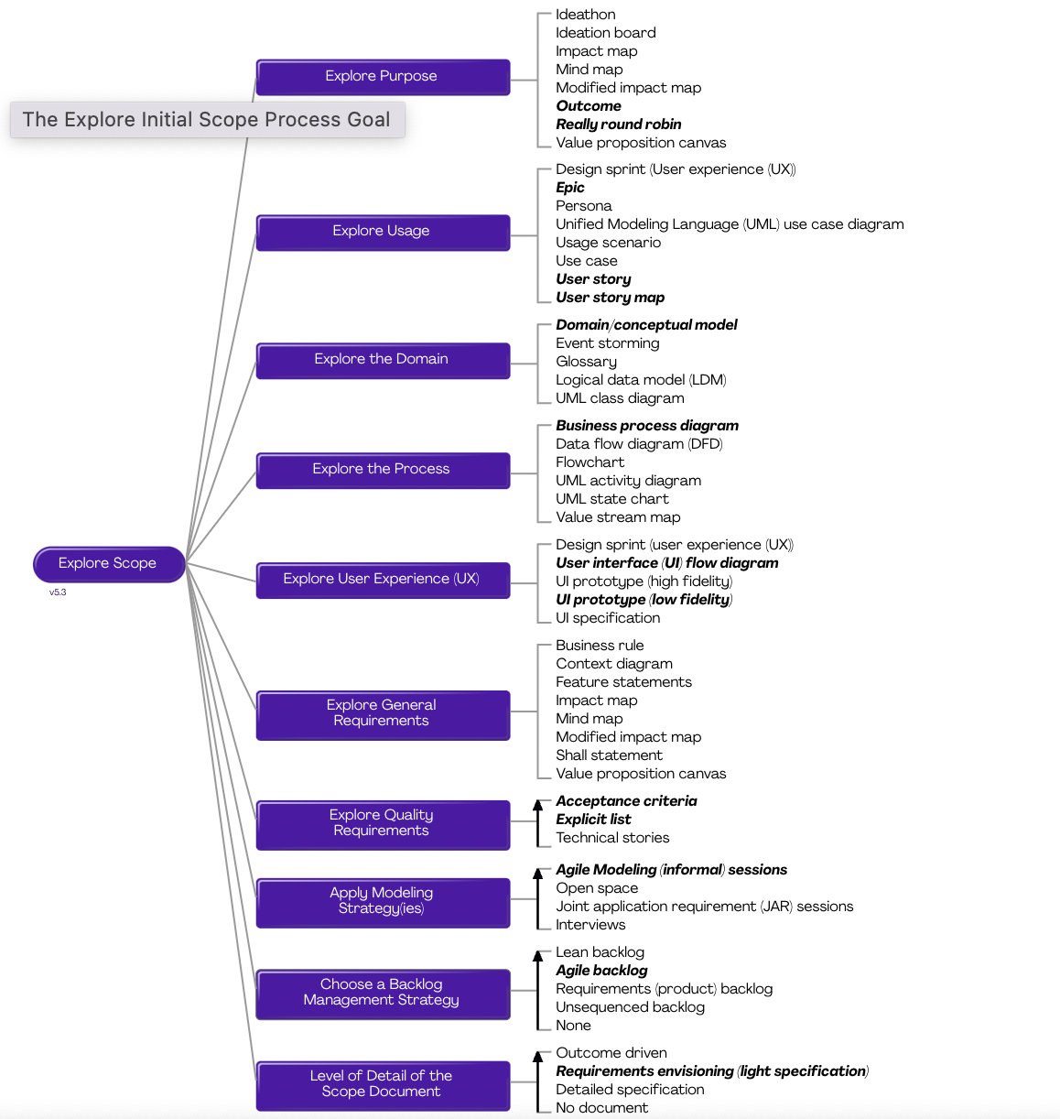
SCOPE

Slide 20
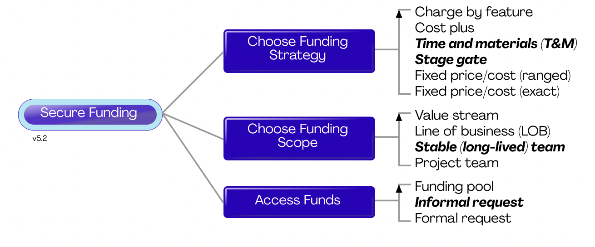
FUNDING

Slide 21
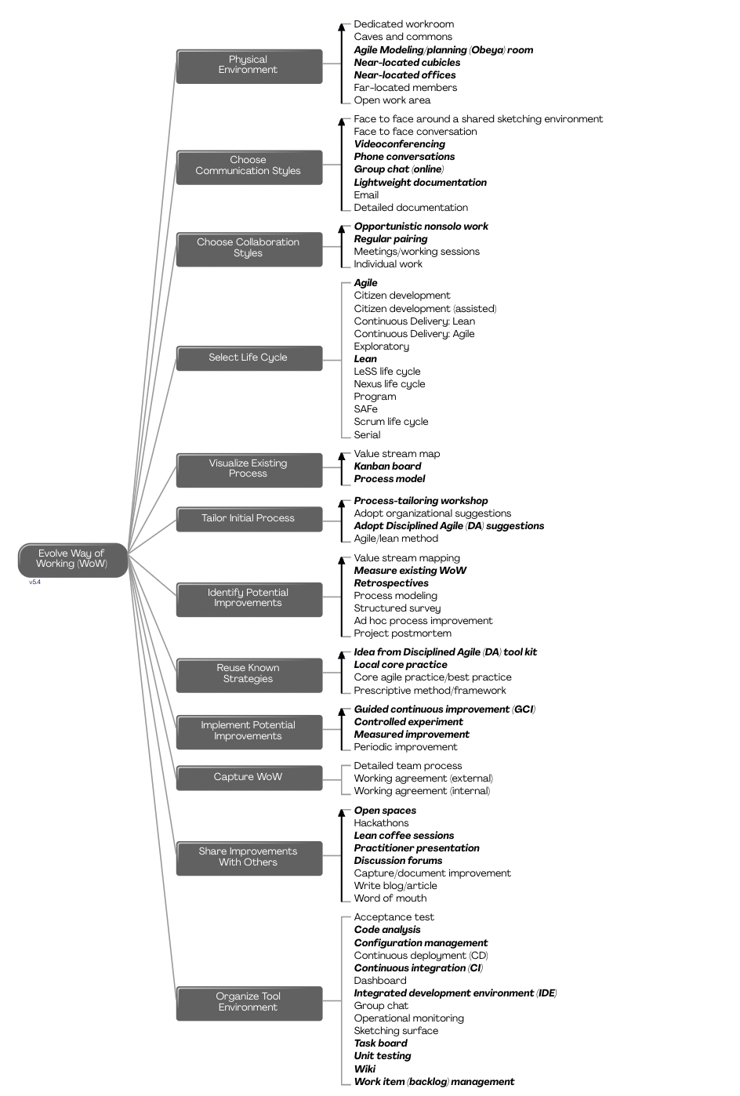
Evolve your Wow
The Evolve Way of Working (WoW) process goal provides options for identifying and evolving how we will work together as a team

Slide 23
Title
TITLE
Subtest
TITLE
Subtest
TITLE
Subtest
TITLE
Subtest

Slide 24
01
Meet the Team
02
Our Understanding
AGENDA
03
Our Solution
04
Innovative Proposal
05
Q&A

Slide 25
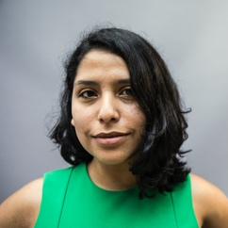
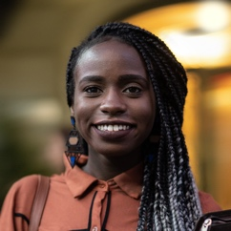
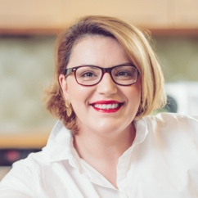
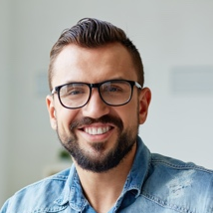
Meet the team
First, Last Name
Role or title email
First, Last Name
Role or title email
First, Last Name
Role or title email
First, Last Name
Role or title email
First, Last Name
Role or title email
First, Last Name
Role or title email
First, Last Name
Role or title email
First, Last Name
Role or title email
First, Last Name
Role or title email

Slide 26
Title
72%
90%
95%
Section
Description
Section
Description
Section
Description
MAIN POINT

Slide 27
Title
2%
4%
7%
13%
Section
Description
Section
Description
Section
Description
Section
Description
14%
16%
20%
25%
Section
Description
Section
Description
Section
Description
Section
Description

Slide 28
Title
TITLE
TITLE
TITLE
Despite being red, Mars is a cold
Despite being red, Mars is a cold
Despite being red, Mars is a cold
TITLE
TITLE
TITLE
Despite being red, Mars is a cold
Despite being red, Mars is a cold
Despite being red, Mars is a cold

Slide 29
Title
Lorem Ipsus
Lorem ipsus

Slide 30



Title
First
Integer elementum ex id molestie tempus. Vivamus eget dolor ex. Pellentesque ut libero lobortis, suscipit enim ut, semper orci. Nullam ullamcorper accumsan dui, sit amet accumsan tellus.
Second
Integer elementum ex id molestie tempus. Vivamus eget dolor ex. Pellentesque ut libero lobortis, suscipit enim ut, semper orci. Nullam ullamcorper accumsan dui, sit amet accumsan tellus.
Third
Integer elementum ex id molestie tempus. Vivamus eget dolor ex. Pellentesque ut libero lobortis, suscipit enim ut, semper orci. Nullam ullamcorper accumsan.

Slide 31
Our Solution

Slide 32
MASTER MEIM 2021-2022
Thank you

