Slide 1
Cloud Computing: Managing Data - Environmental Data
Prof. Raffaele Montella, Ph.D.
http://raffaelemontella.it raffaele.montella@uniparthenope.it

Slide 2
Outline - Managing Environmental Data in the Cloud
Introduction.
Multidimensional georeferenced data.
NetCDF - Network common data form.
Using Object store for NetCDF.
Data semantic.
Metadata cloud storage.
Conclusions.

Slide 3
Introduction
Monitoring and forecast the evolution of the environmental conditions (weather, hydrology, pollution, oceans) is a primary issue of decision making for mankind evolution and sustainability.
Computational environmental science applications are both compute and storage demanding.

Slide 4
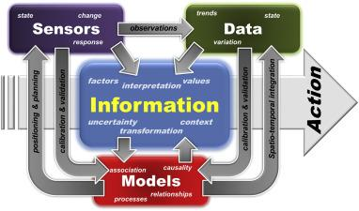
Introduction
Environmental monitoring, simulations, forecasting, nowcasting and predictions are a strategic issue.
The amount of collecting or produced data is skyrocketing.
Reducing data dimension is needed for information extraction.
Reis, Stefan, et al. "Integrating modelling and smart sensors for environmental and human health." Environmental Modelling & Software 74 (2015): 238-246.
Decision makers need for environmental data for natural hazard and accident responses, nature conservation and economic development.

Slide 5
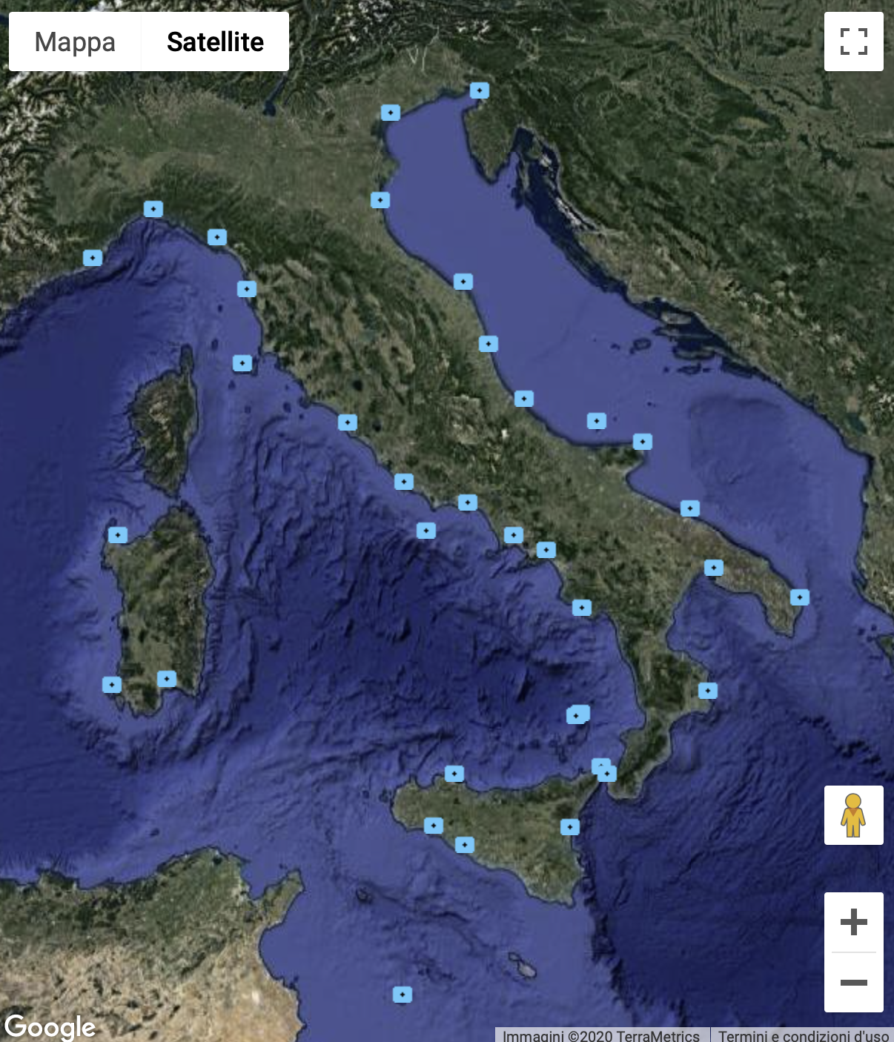
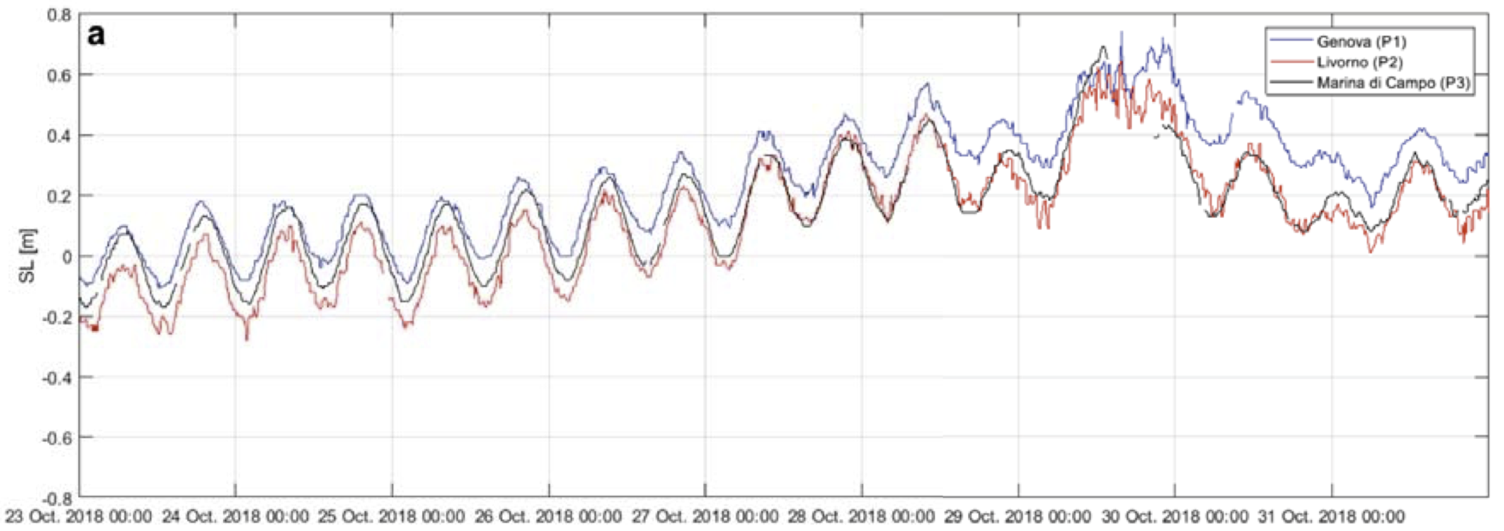
Context definitions: “Monitoring”
Monitoring: data sampling with a given space and time frequency.
Sensors aggregated in Instruments.
Point sensors (weather stations, air quality data loggers, buoys)
Wild, rural and urban zones.
Example: https://arrayofthings.github.io
Aerial sensors (satellites, airborne, shipborne, autonomous, radards).
Time series.
Multidimensional georeferenced data.
The National Tidegauge Network

Slide 6
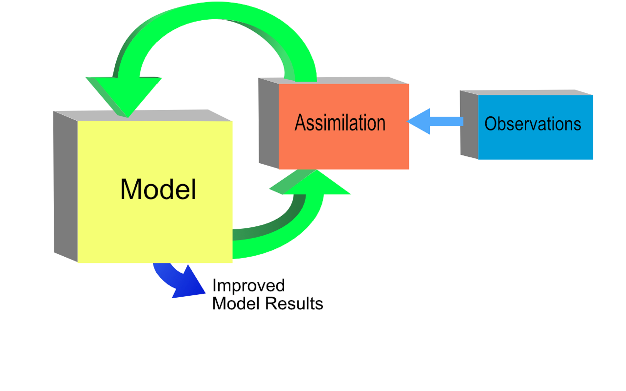
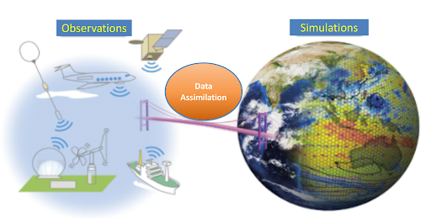
Context definitions: “Simulations”
Data produced by numerical models based on equations for physics, chemistry, …
The initial and boundary conditions are prepared from measured data from environmental monitoring.
Results affected by the initial and boundary conditions.
Compute intensive.
Wall clock time (usually) is not critical.
Multidimensional georeferenced data.
Simulation of scenarios (past, future).

Slide 7
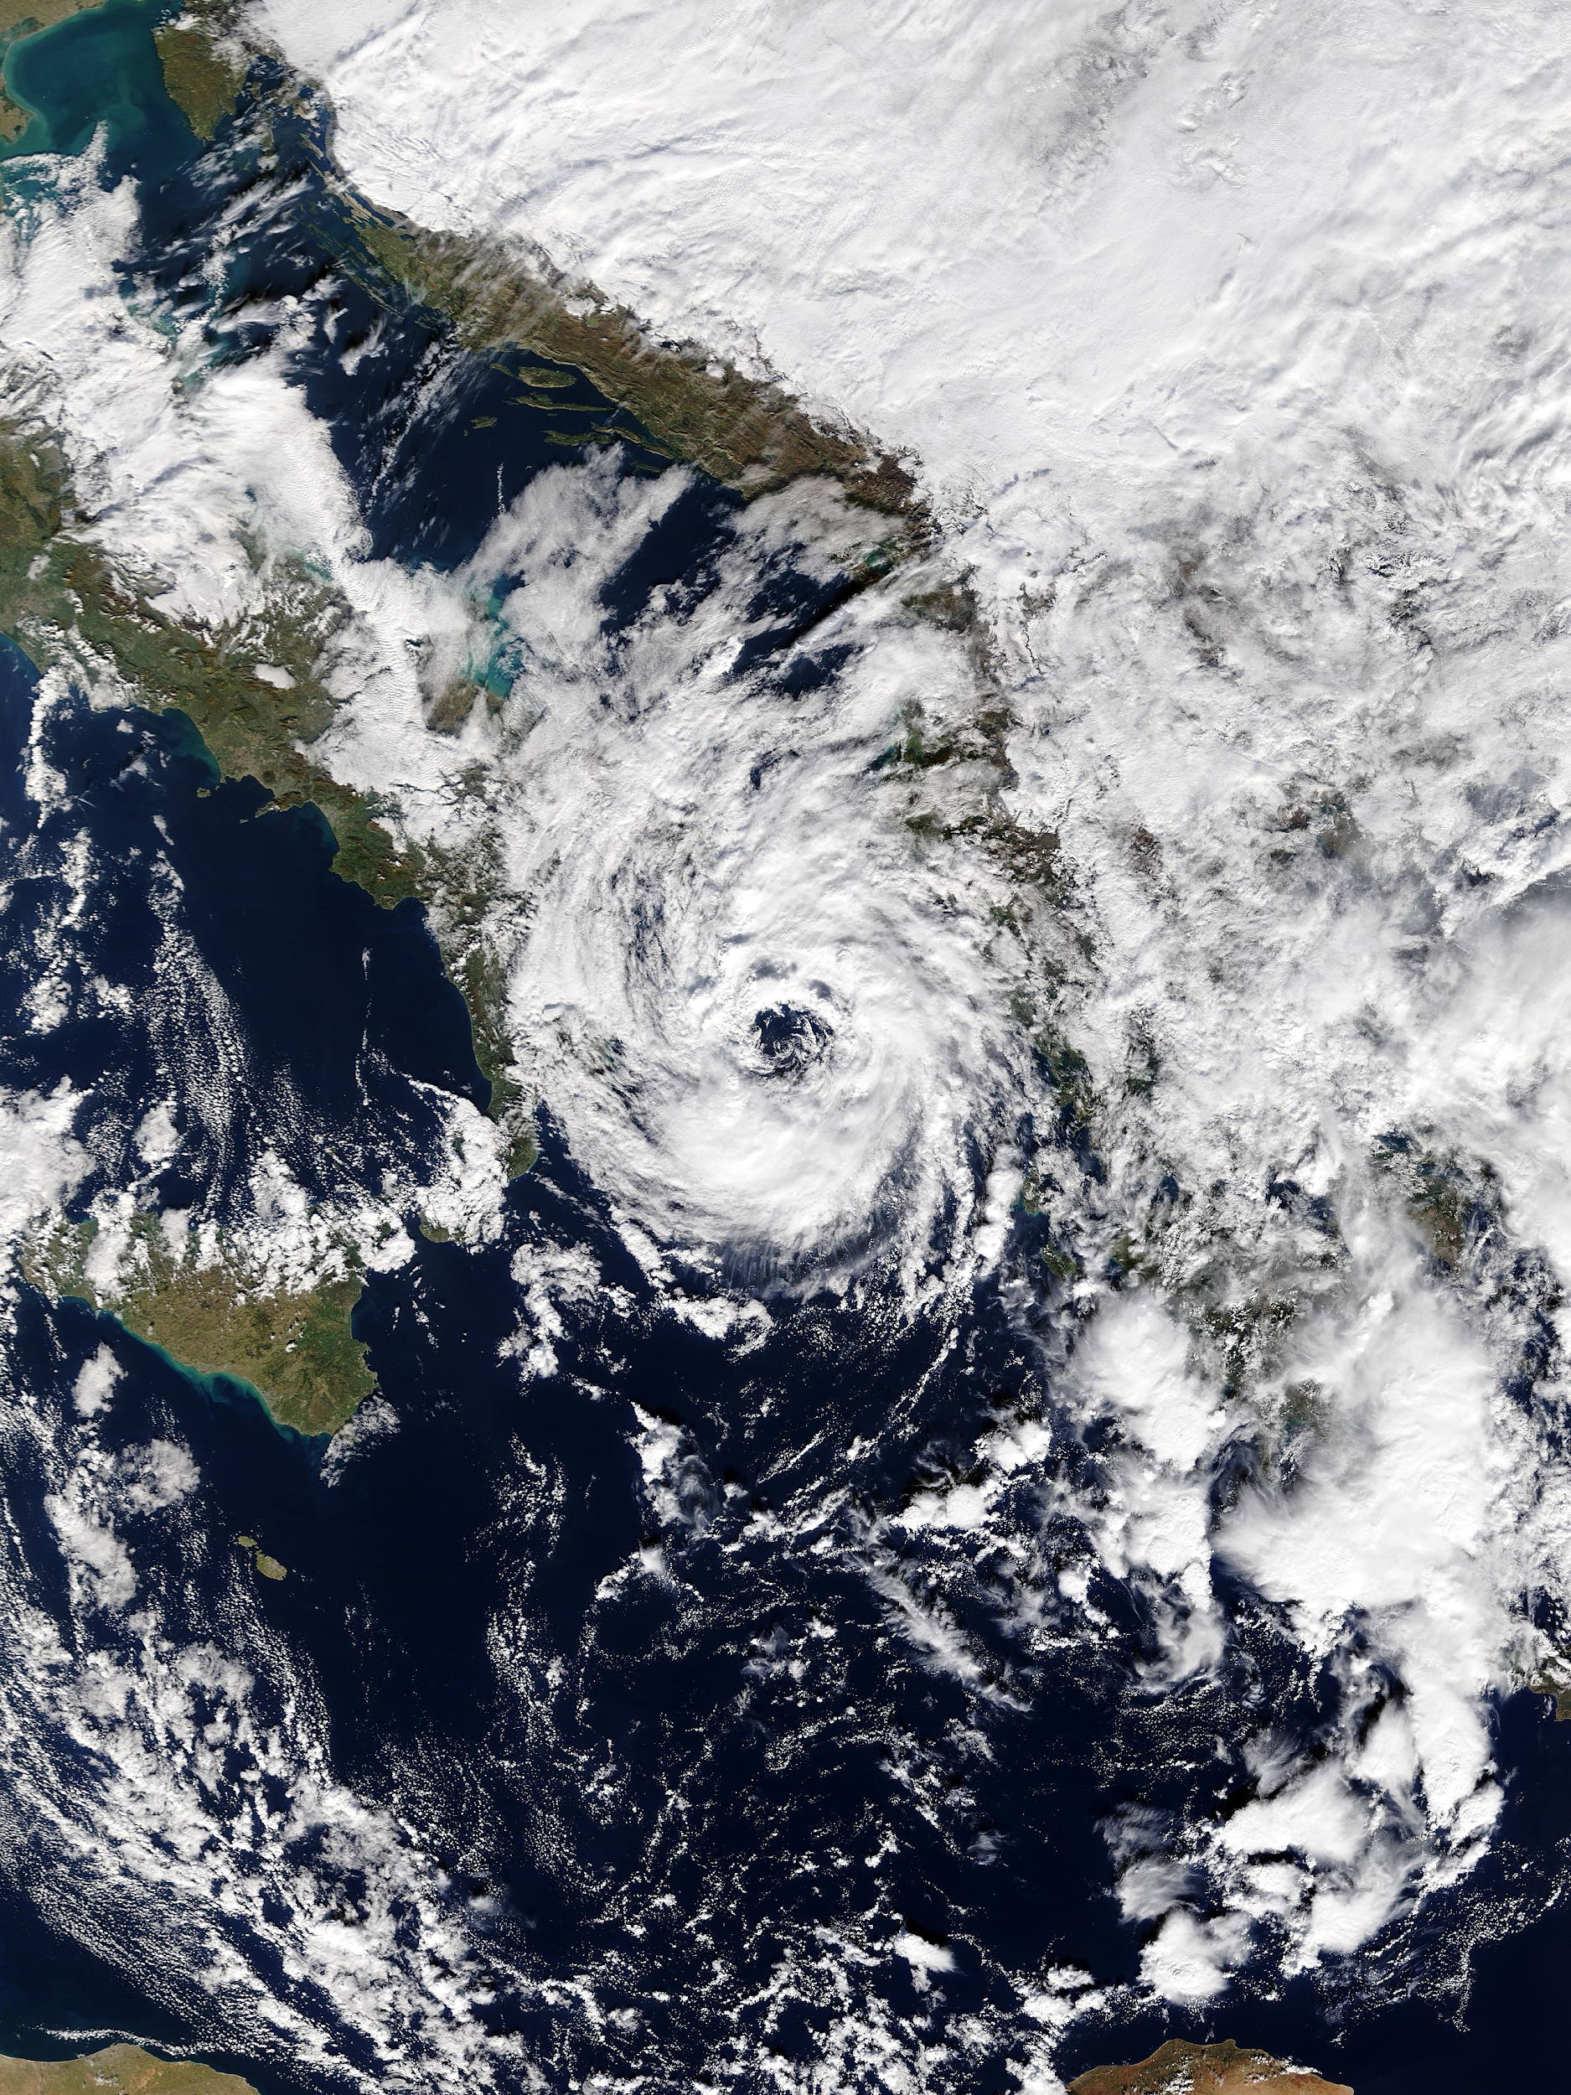
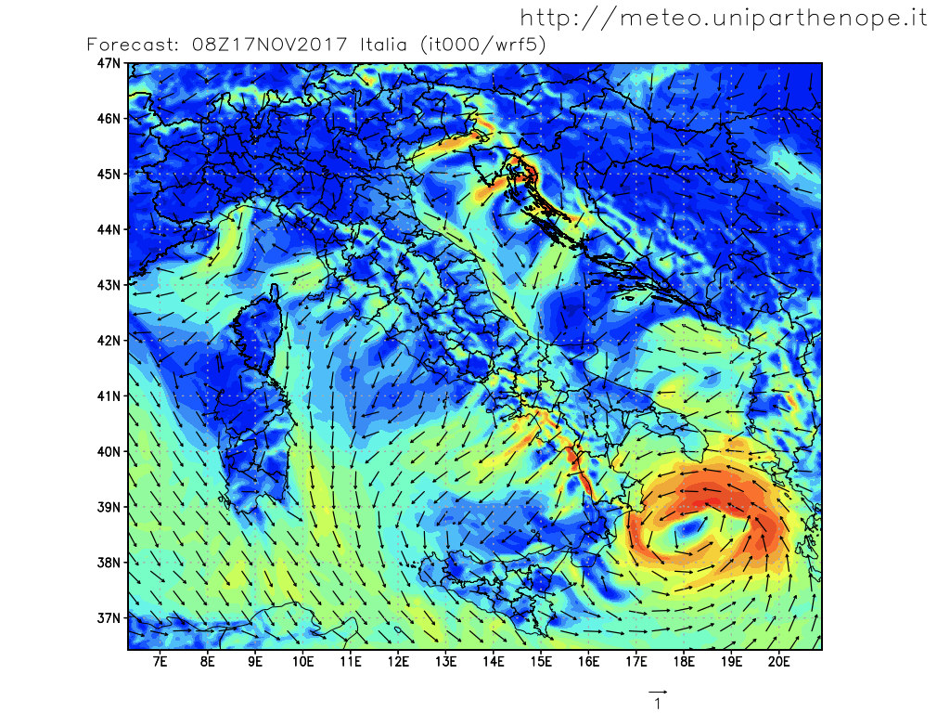
Context definitions: “Forecasting”
Data produced by numerical models based on equations for physics, chemistry, …
The initial and boundary conditions are prepared from global/larger scale models.
Results strongly affected by the initial and boundary conditions.
Compute intensive.
Wall clock time is critical: the forecasts must be produced on time.
Multidimensional georeferenced data.
Operational forecast (near future, days/weeks).
MODIS image captured by NASA’s Terra satellite
Weather Research and Forecasting (WRF) - Medicane NUMA

Slide 8
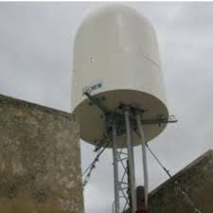
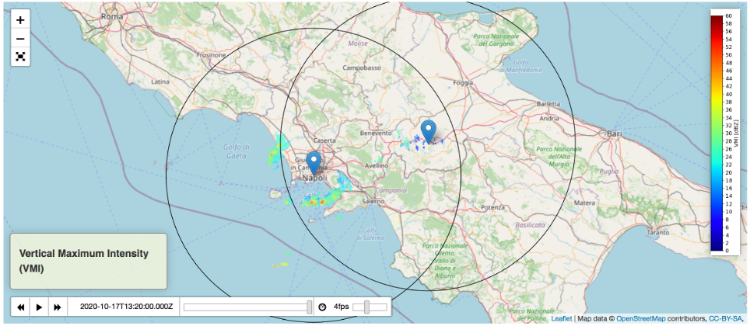
Context definitions: “Nowcasting”
Data produced by geographically distributed sensor networks, …
It shares the technology with environmental monitoring.
Data is processed by humans/machine learning tools.
Data labelling is crucial.
Wall clock time is critical: data collection, processing, visualization.
Multidimensional georeferenced data.
Operational forecasting (really near future, hours)
WR-10X Radar - meteo@uniparthenope

Slide 9
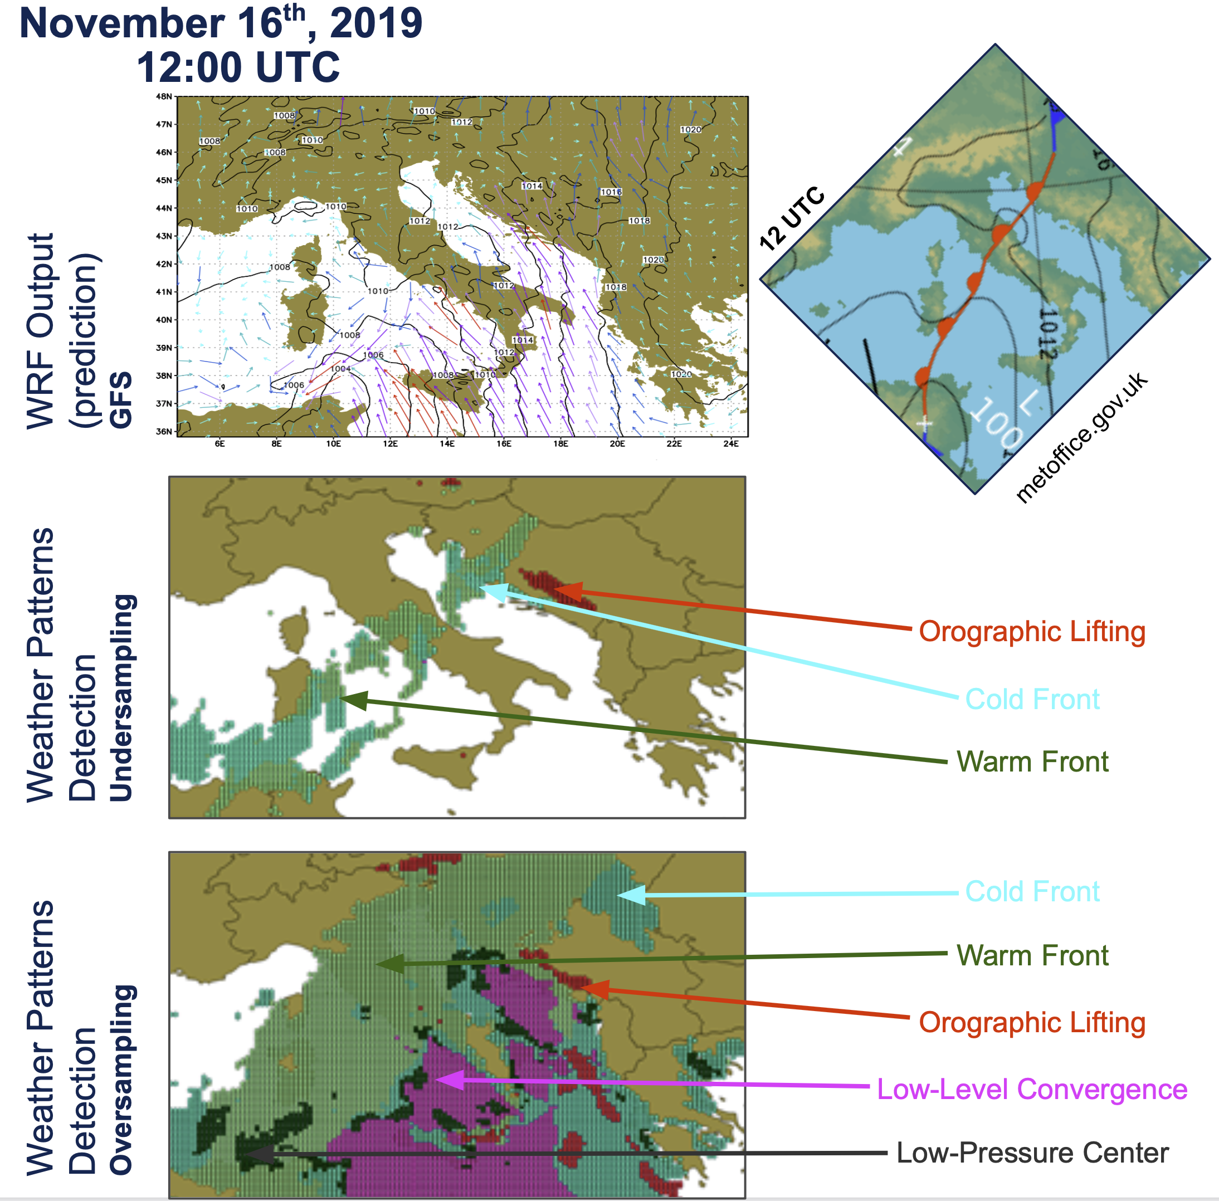
Context definitions: “Predictions”
Data produced by machine learning algorithms.
Data sources:
Sensors and Instruments: →predictions from observed data.
Numerical models: →predictions as numerical models improvement.
Dataset preparation and data labelling are crucial.
Diverse and different techniques.
Consume and produce multidimensional georeferenced data.
Simulations and operational forecasting.

Slide 10
Use Cases: Managing Environmental Data
UC1 “from models”: meteo@uniparthenope produces monthly about 5 TB of Network Common Data Form (NetCDF) that have to be stored for 3 years and be accessible using a portal.
UC2 “from sensors”: due to monitoring the Vesuvio activity, a seismic observatory collects 100 TB per measurement campaign of Comma Separated Values data.
UC3 “crowdsourced”: in a data crowdsourcing scenario DYNAMO users collect (totally) several thousands of records per seconds. While each record is small, the full collection management is challenging.

Slide 11
Multidimensional georeferenced data
Data point dimensions:
Ensemble (different set of values for the same data point).
Time reference (gregorian, julian, epoch based).
Level (depth/height, pressure, sigma).
Latitude (any north/south reference).
Longitude (any west/east reference).
Data point variables:
The values measured/calculated in the data point.
Have one, few or all data point dimensions (1D, 2D, …).
Attributes.

Slide 12
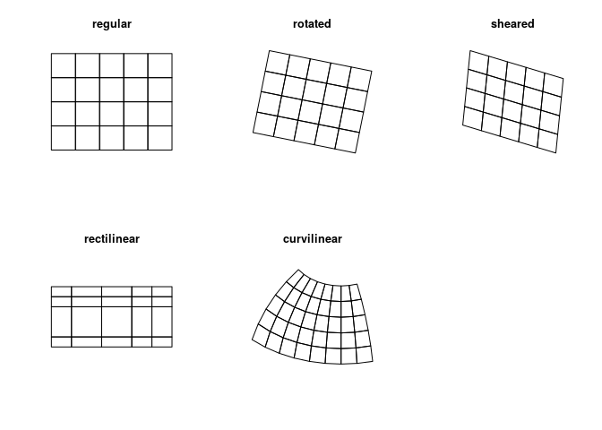
Multidimensional georeferenced data
Data distribution:
Regular grids.
Not regular grids.
Geographical projections:
None.
Projected.
EPSG4326.
Null values:
Handled by custom labels.

Slide 13
NetCDF: Network Common Data Form
Definition: “NetCDF (Network Common Data Form) is a set of software libraries and self-describing, machine-independent data formats that support the creation, access, and sharing of array-oriented scientific data”.
Hosted by the Unidata program at the University Corporation for Atmospheric Research (UCAR).
The format is an open standard.
NetCDF Classic and 64-bit Offset Format are an international standard of the Open Geospatial Consortium.

Slide 14
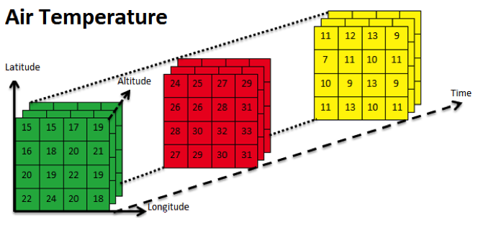
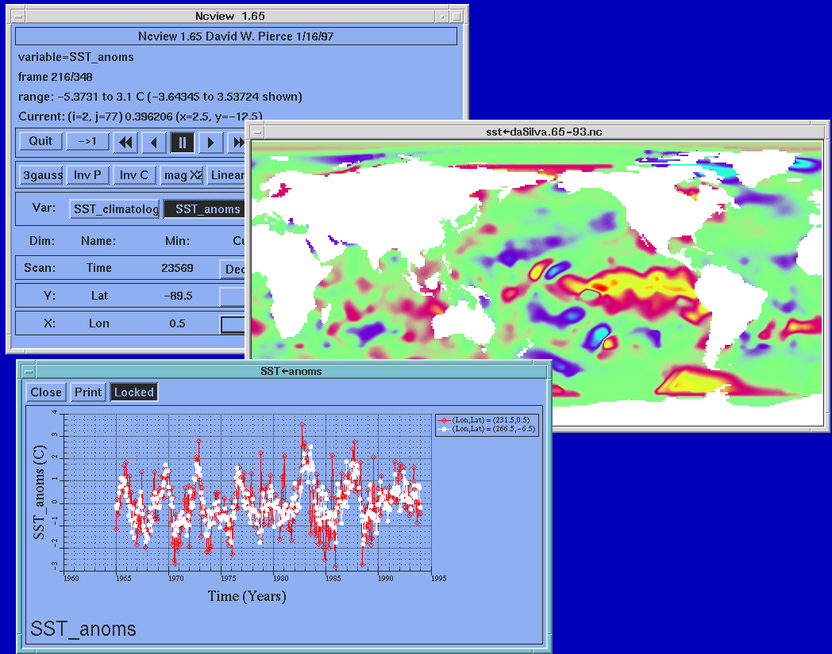
NetCDF: Network Common Data Form
Widespread file format for multidimensional environmental data.
Supports unstructured, regular and curvilinear grids.
Dimensions, variables and attributes.

Slide 15
NetCDF: Network Common Data Form
Self descriptive and conventions.
Huge amount of data sources, libraries, and tools.
Array oriented data format:
Multidimensional array variables.
Variables are typed (int, float, etc.).
Coordinates for the dimensions (time,lat,lon,height,etc.).

Slide 16
NetCDF: Network Common Data Form
Meta data for the variables (typed, including string).
Global metadata.
Can take a “slice” (subdomain) from an array.
https://www.unidata.ucar.edu/software/netcdf/

Slide 17
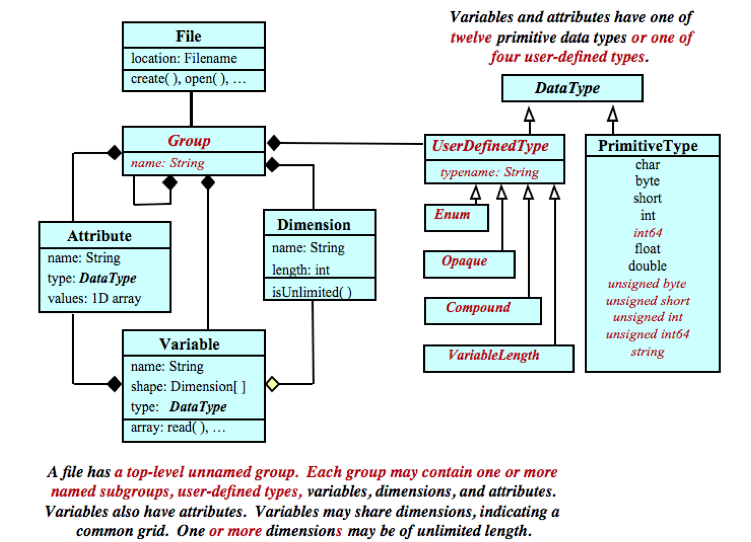
NetCDF Structure
https://www.unidata.ucar.edu/software/netcdf/docs/index.html

Slide 18
NetCDF Structure
ncdump -h <filename>

Slide 19
NetCDF: Data Hosting
NetCDF file format is a standard way to store and exchange environmental data.
Storing this kind of data in the cloud in an effective and efficient fashion is a challenge.

Slide 20
NetCDF: Data Hosting
Local storage (1990, File System, GlusterFS).
Data files are accessed locally.
NetCDF Libraries optimize disk access.
The file is randomly accessed.
Metadata are manually managed.
OPEnDAP Server (Version 4.3, 2010).
Data files are accessed using an OPEnDAP Client.
Data slices (variable[dimension_range] are downloaded from the server.
S3 Objects (Version 4.7, 2019).

Slide 21
NetCDF in the Cloud
S3 Objects (Version 4.7, 2019).
Montella R., Foster I. (2010) Using Hybrid Grid/Cloud Computing Technologies for Environmental Data Elastic Storage, Processing, and Provisioning. In: Furht B., Escalante A. (eds) Handbook of Cloud Computing. Springer, Boston, MA. https://doi.org/10.1007/978-1-4419-6524-0_26:
Enhancing the S3 APIs.
Enabling the NetCDF Java Interface to S3.
Cloud and Grid Hybridization: The NetCDF Service.

Slide 22
NetCDF in the Cloud
Enhancing the S3 APIs.
S3 is binary large object (BLOb) based.
Each object:
Is uniquely identified by an URL.
The maximum size of an object is limited.
The read/write operations are atomic.
Pros:
High reliability.
High availability.
High performance concurrent access.

Slide 23
NetCDF in the Cloud
The most basic operation performed on multidimensional environmental datasets is subsetting:
Extraction of scalars.
Arrays.
Matrices along one or more dimensions.
This operation requires random access to stored objects.
Storing each NetCDF file as an S3 object is inefficient.
Infeasible for files larger than the object size limitation.

Slide 24
Data Partitioning
Divide the NetCDF file in variables.
Separate the dimensions except the latitude and longitude.
Divide each variable on latitude and longitude in partitions.
Encode the name of partitions in S3 bucket URL.

Slide 25
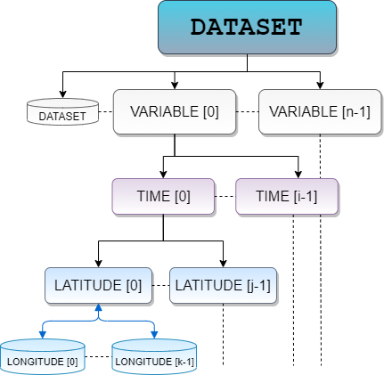
Data Partitioning
Store the partition as a compressed NetCDF file on S3.
Create a dummy NetCDF file containing:
The dimensions.
The metadata needed to access partitioned variables.
All not partitionable variables.
The global attributes.

Slide 26
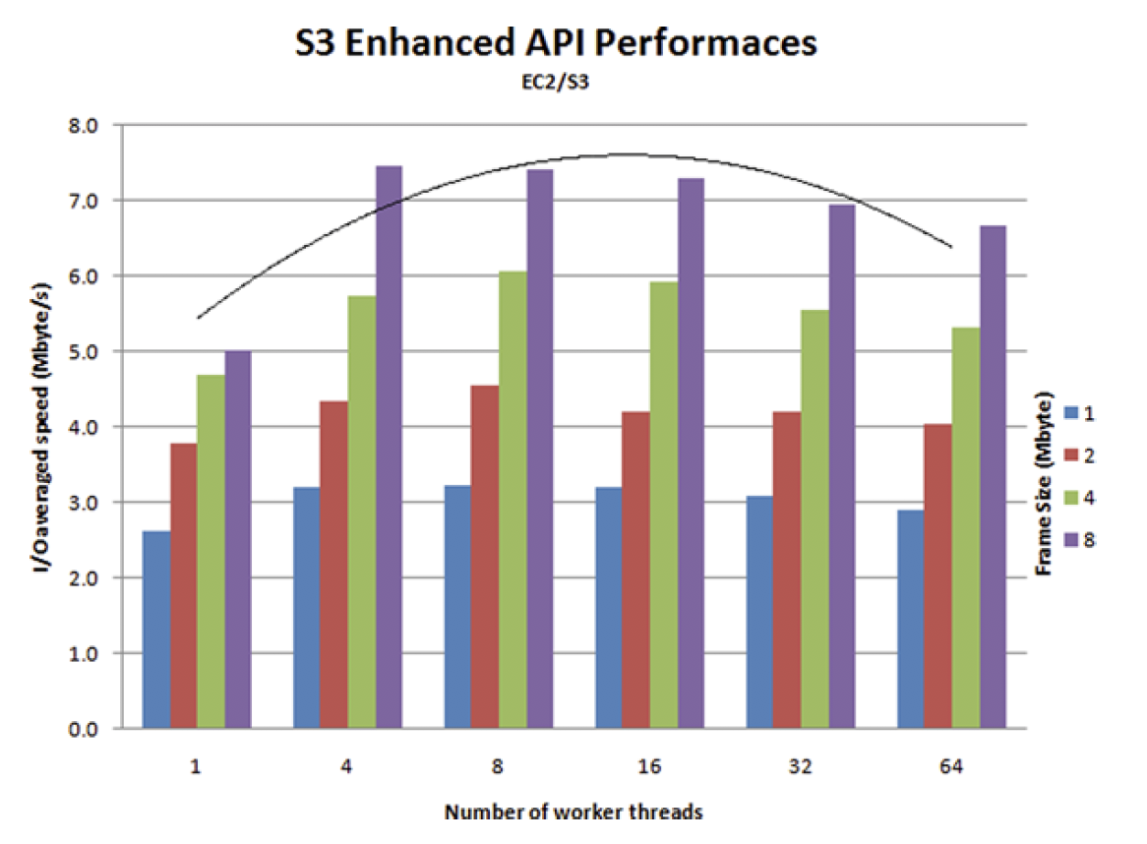
Data Partitioning
Partition criterion: size.
Experiment setup:
Partitions stored on S3 US.
Accessed by EC2 in EU.
Partition sizes: 1, 2, 4, 8 MB.
Accessed by 1-64 concurrent threads.
Best results:
Partition size: 8MB.
Writing: 8/16 threads.
Reading: 64 threads

Slide 27
ncdump -h wrf5_d01_20200416Z1200.nc (CF)
netcdf wrf5_d01_20200416Z1200 { Dimensions: time = 1 ; latitude = 273 ; longitude = 377 ;
Variables: int time(time) ; time:description = "Time" ; time:long_name = "time" ; time:units = "hours since 1900-01-01 00:00:0.0" ;
float longitude(longitude) ; longitude:description = "Longitude" ; longitude:long_name = "latitude" ; longitude:units = "degrees_east" ;
float latitude(latitude) ; latitude:description = "Latitude" ; latitude:long_name = "Latitude" ; latitude:units = "degrees_north" ;
float T2C(time, latitude, longitude) ; T2C:description = "Temperature at 2m in Celsius" ; T2C:units = "C" ;
float RH2(time, latitude, longitude) ; RH2:description = "Relative humidity at 2 meters" ; RH2:units = "%" ;
float UH(time, latitude, longitude) ; UH:description = "Updraft Helicity" ; UH:units = "m2 s-2" ;
float U10M(time, latitude, longitude) ; U10M:description = "grid rel. x-wind component" ; U10M:standard_name = "u-component" ; U10M:units = "m s-1" ;
float V10M(time, latitude, longitude) ; V10M:description = "grid rel. y-wind component" ; V10M:standard_name = "v-component" ;
T2C: bestY=3, bestX=29 29x3 = 87 splitted files
In our first sub-directory
/bucket/wrf5_d01_20200416Z1200/T2C/0/0/0.nc /bucket/wrf5_d01_20200416Z1200/T2C/0/0/1.nc
... /bucket/wrf5_d01_20200416Z1200/T2C/0/0/28.nc
/bucket/wrf5_d01_20200416Z1200/T2C/0/0/0.nc /bucket/wrf5_d01_20200416Z1200/T2C/0/1/0.nc /bucket/wrf5_d01_20200416Z1200/T2C/0/2/0.nc First files of every sub-directory

Slide 28
wrf5_d01_20200416Z1200.nc (Cloud Objcet Store)
netcdf wrf5_d01_20200416Z1200 { Dimensions: time = 1 ; latitude = 273 ; longitude = 377 ;
Variables: int time(time) ; time:description = "Time" ; time:long_name = "time" ; time:units = "hours since 1900-01-01 00:00:0.0" ;
float longitude(longitude) ; longitude:description = "Longitude" ; longitude:long_name = "latitude" ; longitude:units = "degrees_east" ;
float latitude(latitude) ; latitude:description = "Latitude" ; latitude:long_name = "Latitude" ; latitude:units = "degrees_north" ;
float T2C(time, latitude, longitude) ; T2C:description = "Temperature at 2m in Celsius" ; T2C:units = "C" ; T2C:_cos_split_latitude=3; T2C:_cos_split_longitude=29;
float RH2(time, latitude, longitude) ; RH2:description = "Relative humidity at 2 meters" ; RH2:units = "%" ;
float UH(time, latitude, longitude) ; UH:description = "Updraft Helicity" ; UH:units = "m2 s-2" ;
float U10M(time, latitude, longitude) ; U10M:description = "grid rel. x-wind component" ; U10M:standard_name = "u-component" ; U10M:units = "m s-1" ;
float V10M(time, latitude, longitude) ; V10M:description = "grid rel. y-wind component" ; V10M:standard_name = "v-component" ;

Slide 29
wrf5_d01_20200416Z1200/T2C/0
2,0
2,1
2,2
2,8
2,28
...
...
T2C [
0,12,30 :
0,25,105
]
1,0
1,1
1,2
1,8
1,28
...
...
0,0
0,1
0,2
0,8
0,28
0..90
...
...
The math behind the data tiles.
0..12
https://www.maptiler.com/google-maps-coordinates-tile-bounds-projection/

Slide 30
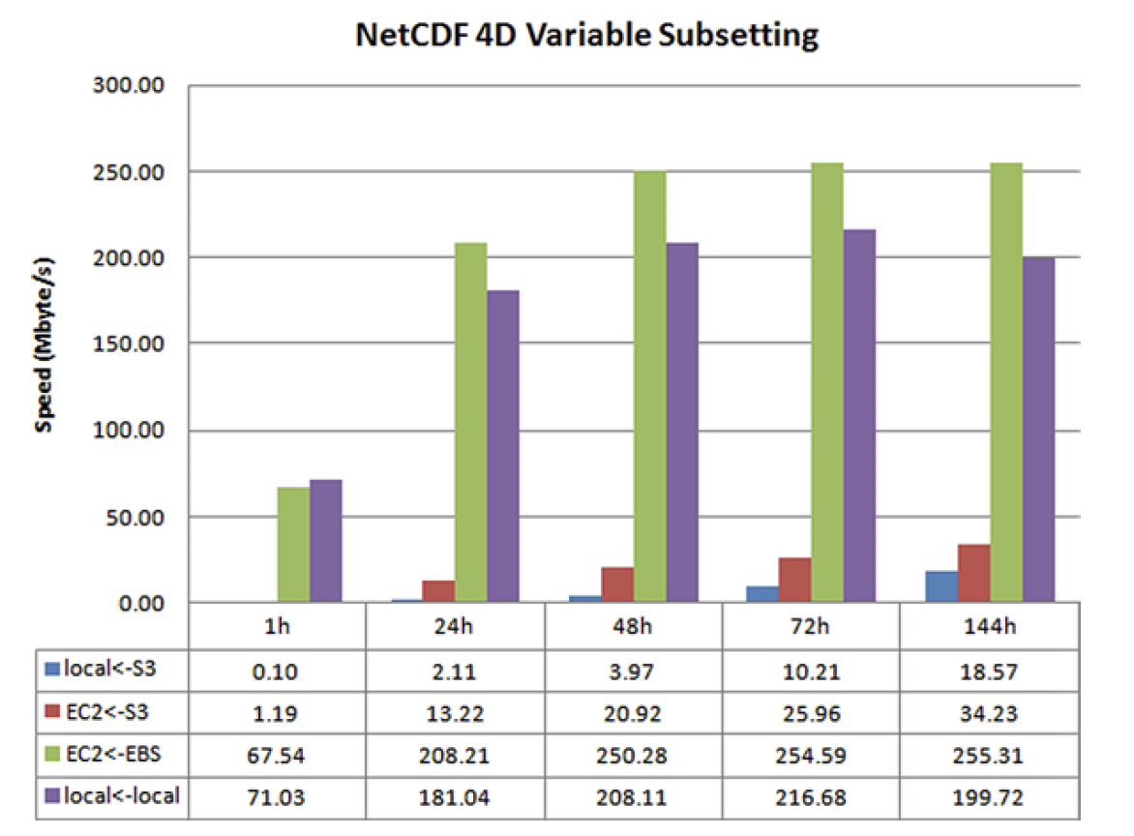
Data Partitioning: evaluation
Reading a single 4D variable.
1h, 24h, 48h, 72h, 144h of data (5.5MB, …, 768MB).
A machine in EU with the data on S3 in the US.
EC2 virtual machine with the data on S3 in the same zone.
An EC2 virtual machine with data on an attached EBS volume and a server outside the cloud with the data on that machine local disk.
Time in Seconds

Slide 31
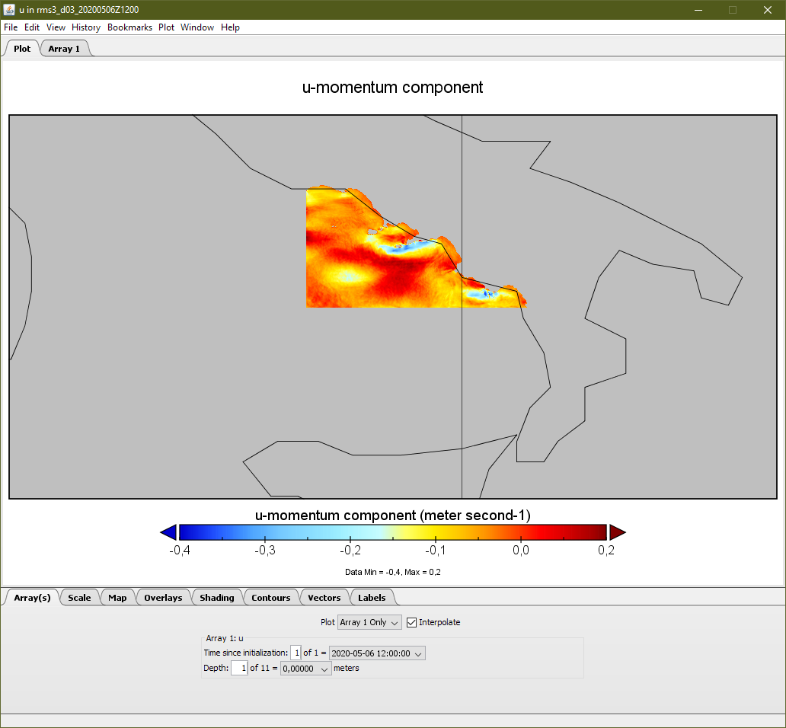
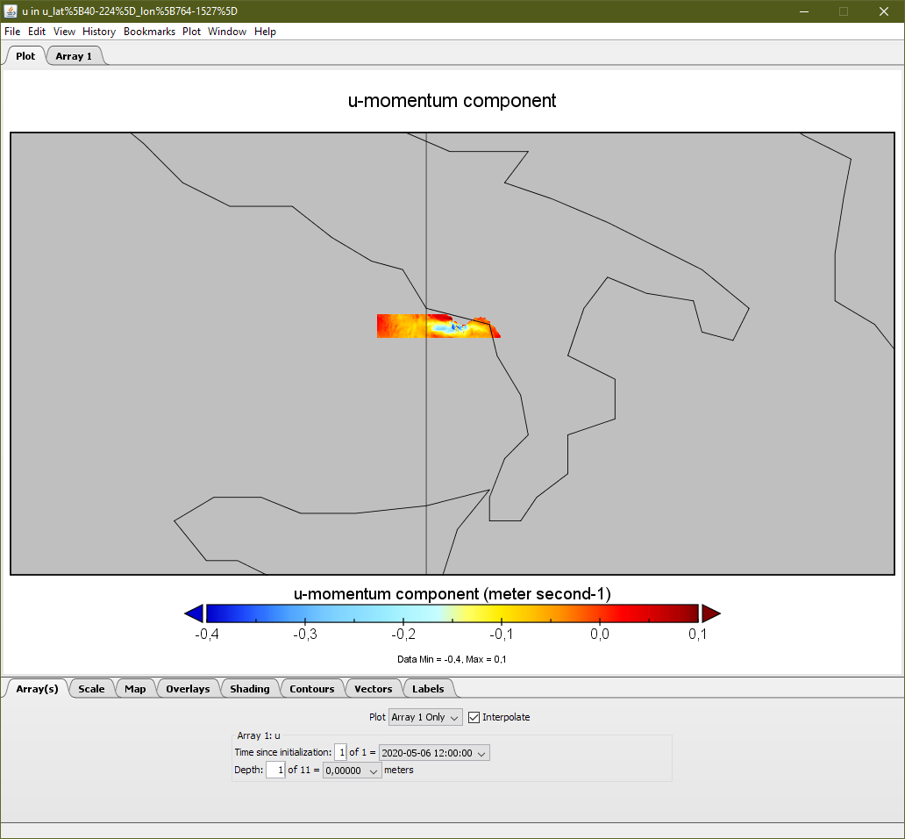
Data Partitioning: example

Slide 32
Data Semantic
The availability of NetCDF data (downloadable files, OPEnDAP) is abundant but often chaotic.
Despite the fact NetCDF are self descriptive and metadata rich, there is no “google for environmental data”.
The variable names and attributes can follow a standard convention. https://www.unidata.ucar.edu/software/netcdf/conventions.html

Slide 33
NetCDF Schema
A way to compare and match different NetCDF files.
Based on wide spread and stable technologies:
XML Schema.
NetCDF Markup Language.
Regular expressions.
.ncxsd
(NetCDF Schema)
NetCDF
file
NetCDF Schema Library (Python)

Slide 34
Data Semantic
The CF Conventions and Metadata is the suggested standard. http://cfconventions.org
The conventions for CF (Climate and Forecast) metadata are designed to promote the processing and sharing NetCDF data.

Slide 35
Data Semantic
Use CF convention to extract metadata from NetCDF files.
Convert metadata in JSON documents.
Store JSON documents in AWS DocumentDB.
Perform semantic queries and extract NetCDF URLs.
NetCDF CF File
URL
AWS DocumentDB
NcML Extraction
JSON Encoding
Query
JSON Document
+
NetCDF URL
URL

Slide 36
Conclusions
Collecting, storing, processing and disseminating environmental data is one of the most common usage of cloud data store.
Environmental data fit diverse and different cloud storage models.
Numerical models (forecast/simulation) produce data usually suitable for the object store approach.
Nevertheless, data indexing and access is critical alongside the data size is continuously increasing.

Slide 37
Conclusions
Managing the environment with computational enforcement is a key issue for decision makers.
The quick response to environmental or human generated disasters is fundamental in surviving on the planet.
The huge amount of environmental data and its augmentation using artificial intelligence tools is a gold coin in the current mankind scenario.

Slide 38
Conclusions
Storing NetCDF files on the cloud using a dynamical approach devoted to leverage on elasticity can be considered a cornerstone in the field of computational environmental science and earth sciences.
Processing selected data using a semantic approach enables the scientists (and the decision makers) to access a huge and distributed multidimensional data source in a effective way.

