Slide 1
Cross-cultural Skills
For management and enterprise
Notes:
FIRST ICEBREAKER: Name, a few words about yourself, which country do you dream to go, Monet related case studies: abroad assignment that fail, D&G Chinese campaign

Slide 2
About you
A short introduction
What you expect/wish from today
A place where you would like to travel!

Slide 3
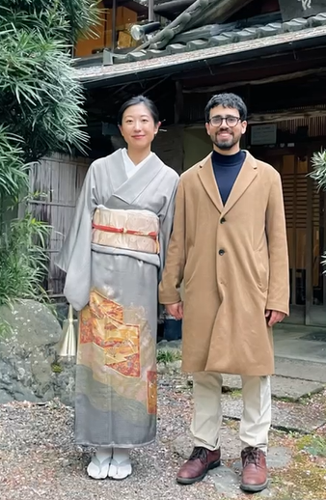
About me

Slide 4
I CARE
I Don ‘t CARE
You being successful managers and entrepreneurs
You avoiding costly mistakes when dealing with diverse others
Your acquisition of a set of skills for making better interpersonal interactions
To change your mind about political issues.
Your good/bad judgments about your own culture
Your personal interest about other cultures

Slide 5
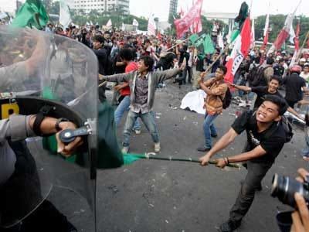

Slide 6
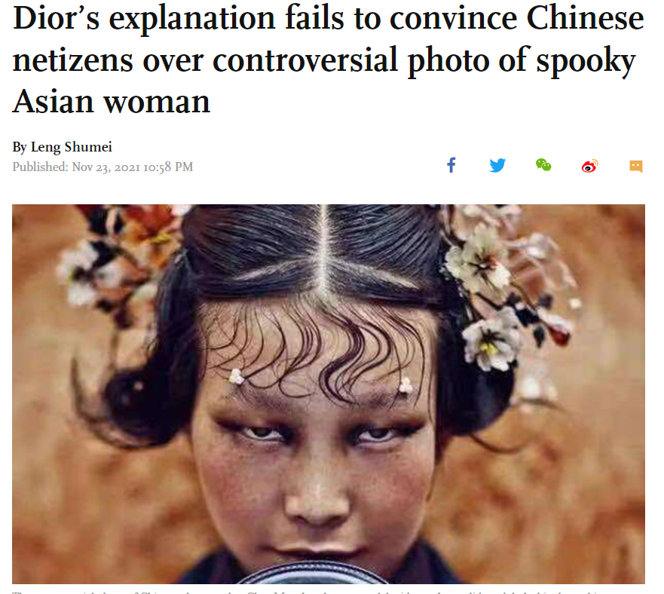
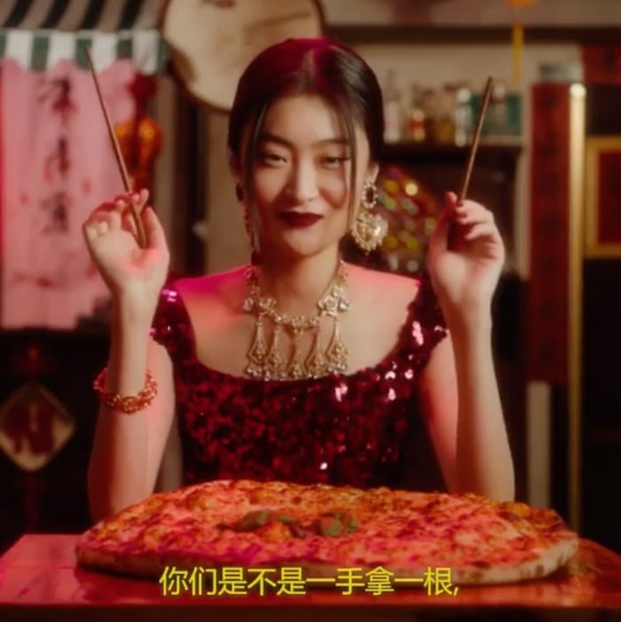

Slide 7
TODAY’s MENU
SUSPENSION OF JUDGMENT
CURIOSITY MINDSET
CROSS-CULTURAL COMMUNICATION
Culture and people
What is culture?
Q&A

Slide 8
Suspension of judgment

Slide 9
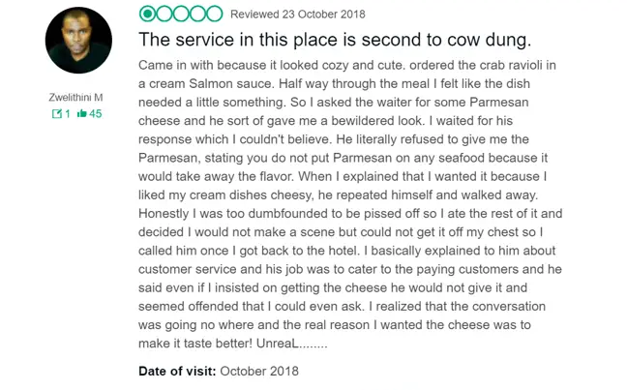

Slide 10
Why do we judge?
IDENTITY
VALUES
OTHER VALUES
EMOTION
TREATH

Slide 11
Communication

Slide 12
Notes:
Start at 00:30

Slide 13
Communication
SENDER
MESSAGE
RECEIVER
decoding
encoding
CULTURE

Slide 15
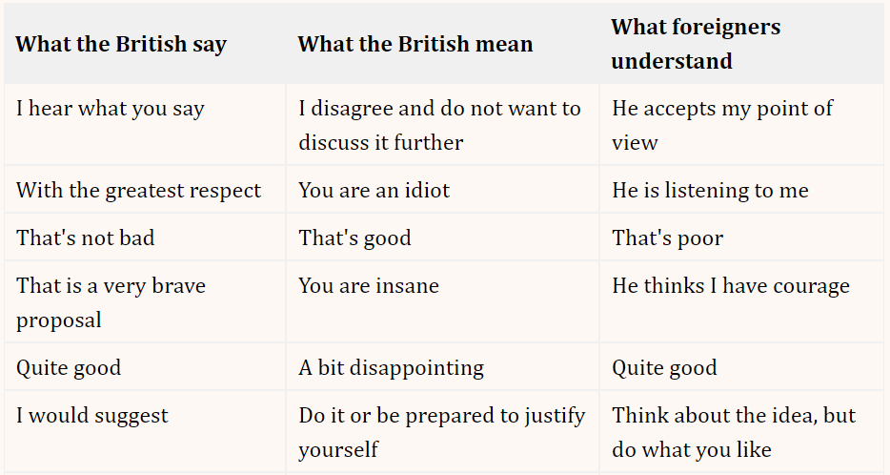
High Context vs Low context

Slide 16
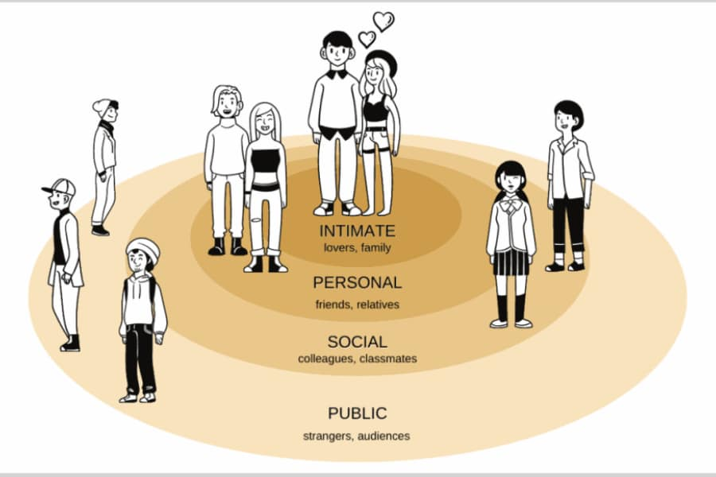
INTERPERSONAL DISTANCE

Slide 17
TIME (Polychronics vs Monochronics)

Slide 18
FACE
Notes:
30 seconds

Slide 19
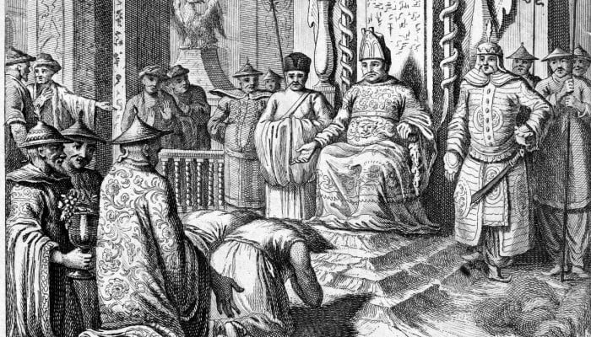
HIERARCHY

Slide 20
What is culture?

Slide 21
Notes:
2:25

Slide 23
Notes:
1:50 & 46:40

Slide 24
Curiosity Mindset

Slide 25
W.E.I.R.D.
Western (white) Educated Individualistic Rich Democratic

Slide 26
Exercise
Groups of 3
One person tells a story of a culture clash or judgment
One person plays the judgmental voice
One person plays the curiosity voice
The two voices tell the story to the next group

Slide 27
Case Study

Slide 28
Individuals in cultures

Slide 29
Notes:
11:00

Slide 30
exercise

Slide 31
You identify the most

Slide 32
Has changed most

Slide 33
You would like to explore

Slide 34
Q&A

