Slide 1
MASTER MEIM 2021-2022
Business Design and
Transient Competitive Advantage (TCA)
April, 13th 2022
Eva Panetti, PhD
Assistant Professor of Innovation & Business Design at Università degli Studi di Napoli Parthenope

Slide 2

The Holy Grail of Strategy
SUSTAINABLE COMPETITIVE ADVANTAGE
INNOVATION A
INNOVATION B
INNOVATION C
ADVANTAGE A
ADVANTAGE B
ADVANTAGE C
ADVANTAGE N
Market
Transformation A
Market
Transformation B
Market
Transformation C
Notes:
For too long the business world has been obsessed with the notion of building sustainable competitive advantage
That idea is at the core of most strategies adopted by many industry leaders. it’s important to a position in central to the success of companies on the “most admired” lists. it’s marvelous to compete in a way that others can’t imitate and even today there are companies that create a strong position and defend it for extended periods of time.
The Holy Grail of strategy for many years has been defined as sustainable competitive advantage: you find an opportunity, you throw up entry barriers like crazy and then you get to enjoy it for a long period of time. But increasingly, this no longer works well or even makes sense, thanks to globalization, digital disruptions, and so on.
Sustainable competitive advantage is the foundation to ensure the survival and development of enterprises amid the fierce market competition. For a long time, how to obtain and maintain sustainable competitive advantage has been the core issue in the field of strategic management.

Slide 3








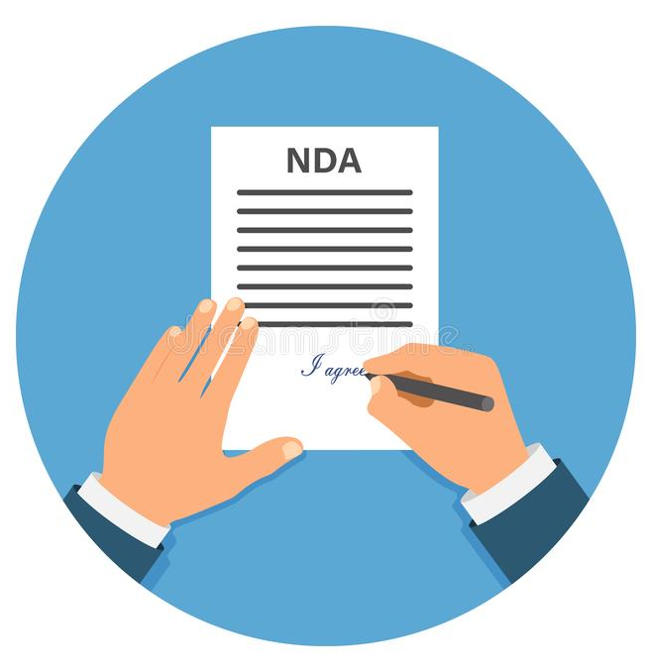
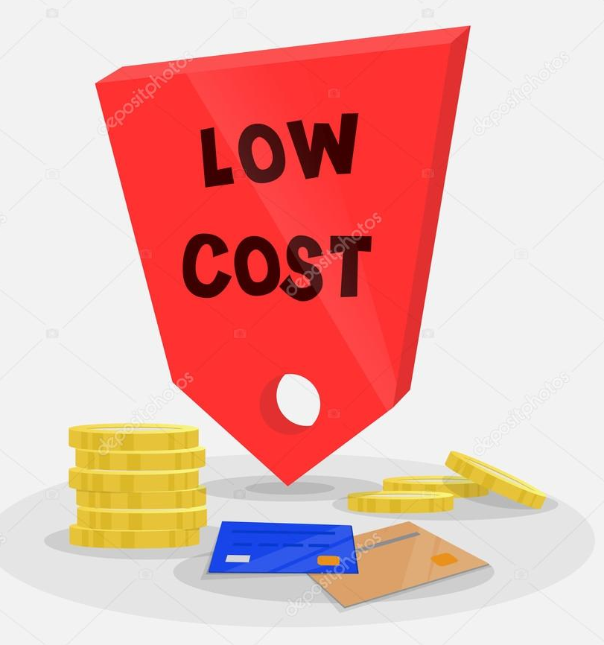
Sources of Sustainable Competitive Advantage
SUSTAINABLE COMPETITIVE ADVANTAGE
ACCESS TO NATURAL RESOURCES THAT ARE RESTRICTED FROM COMPETITORS
A UNIQUE GEOGRAPHIC LOCATION
BRAND IMAGE RECOGNITION
HIGHLY SKILLED LABOR
ABILITY TO MANUFACTURE
PRODUCTS AT THE LOWEST COST
ACCESS TO NEW OR
PROPRIETARY TECHNOLOGY

Slide 4
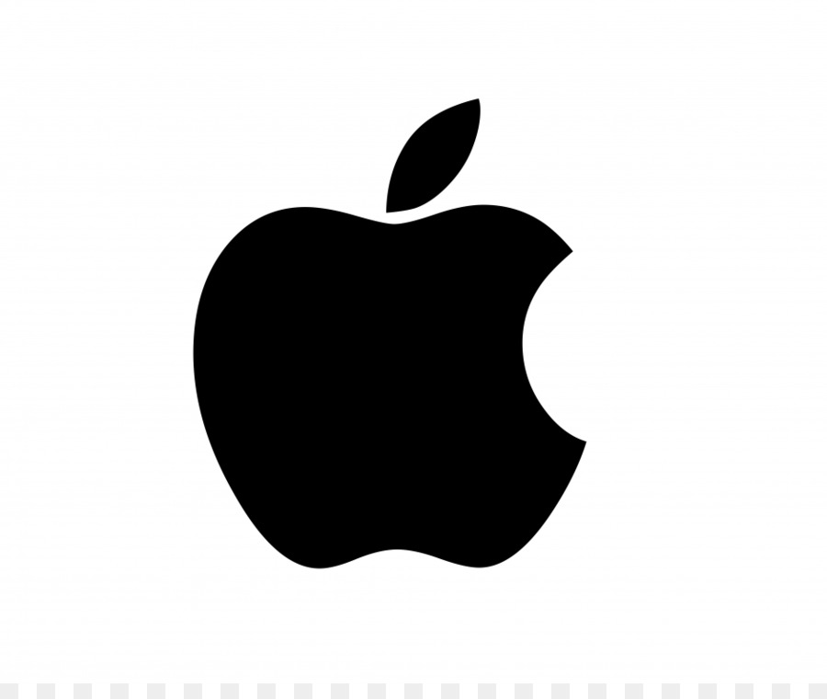
Which is Apple competitive advantage?

Slide 5
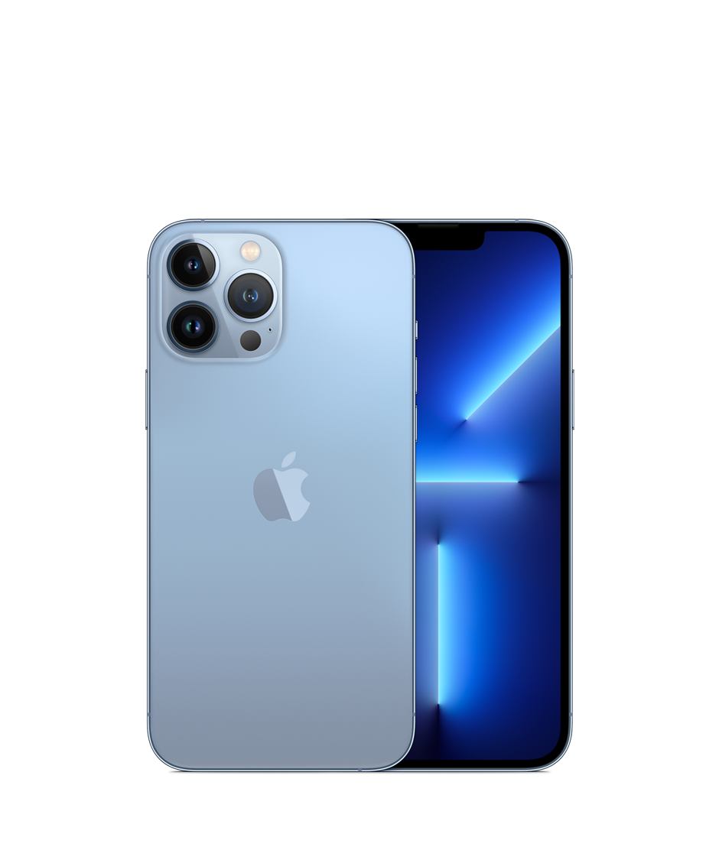
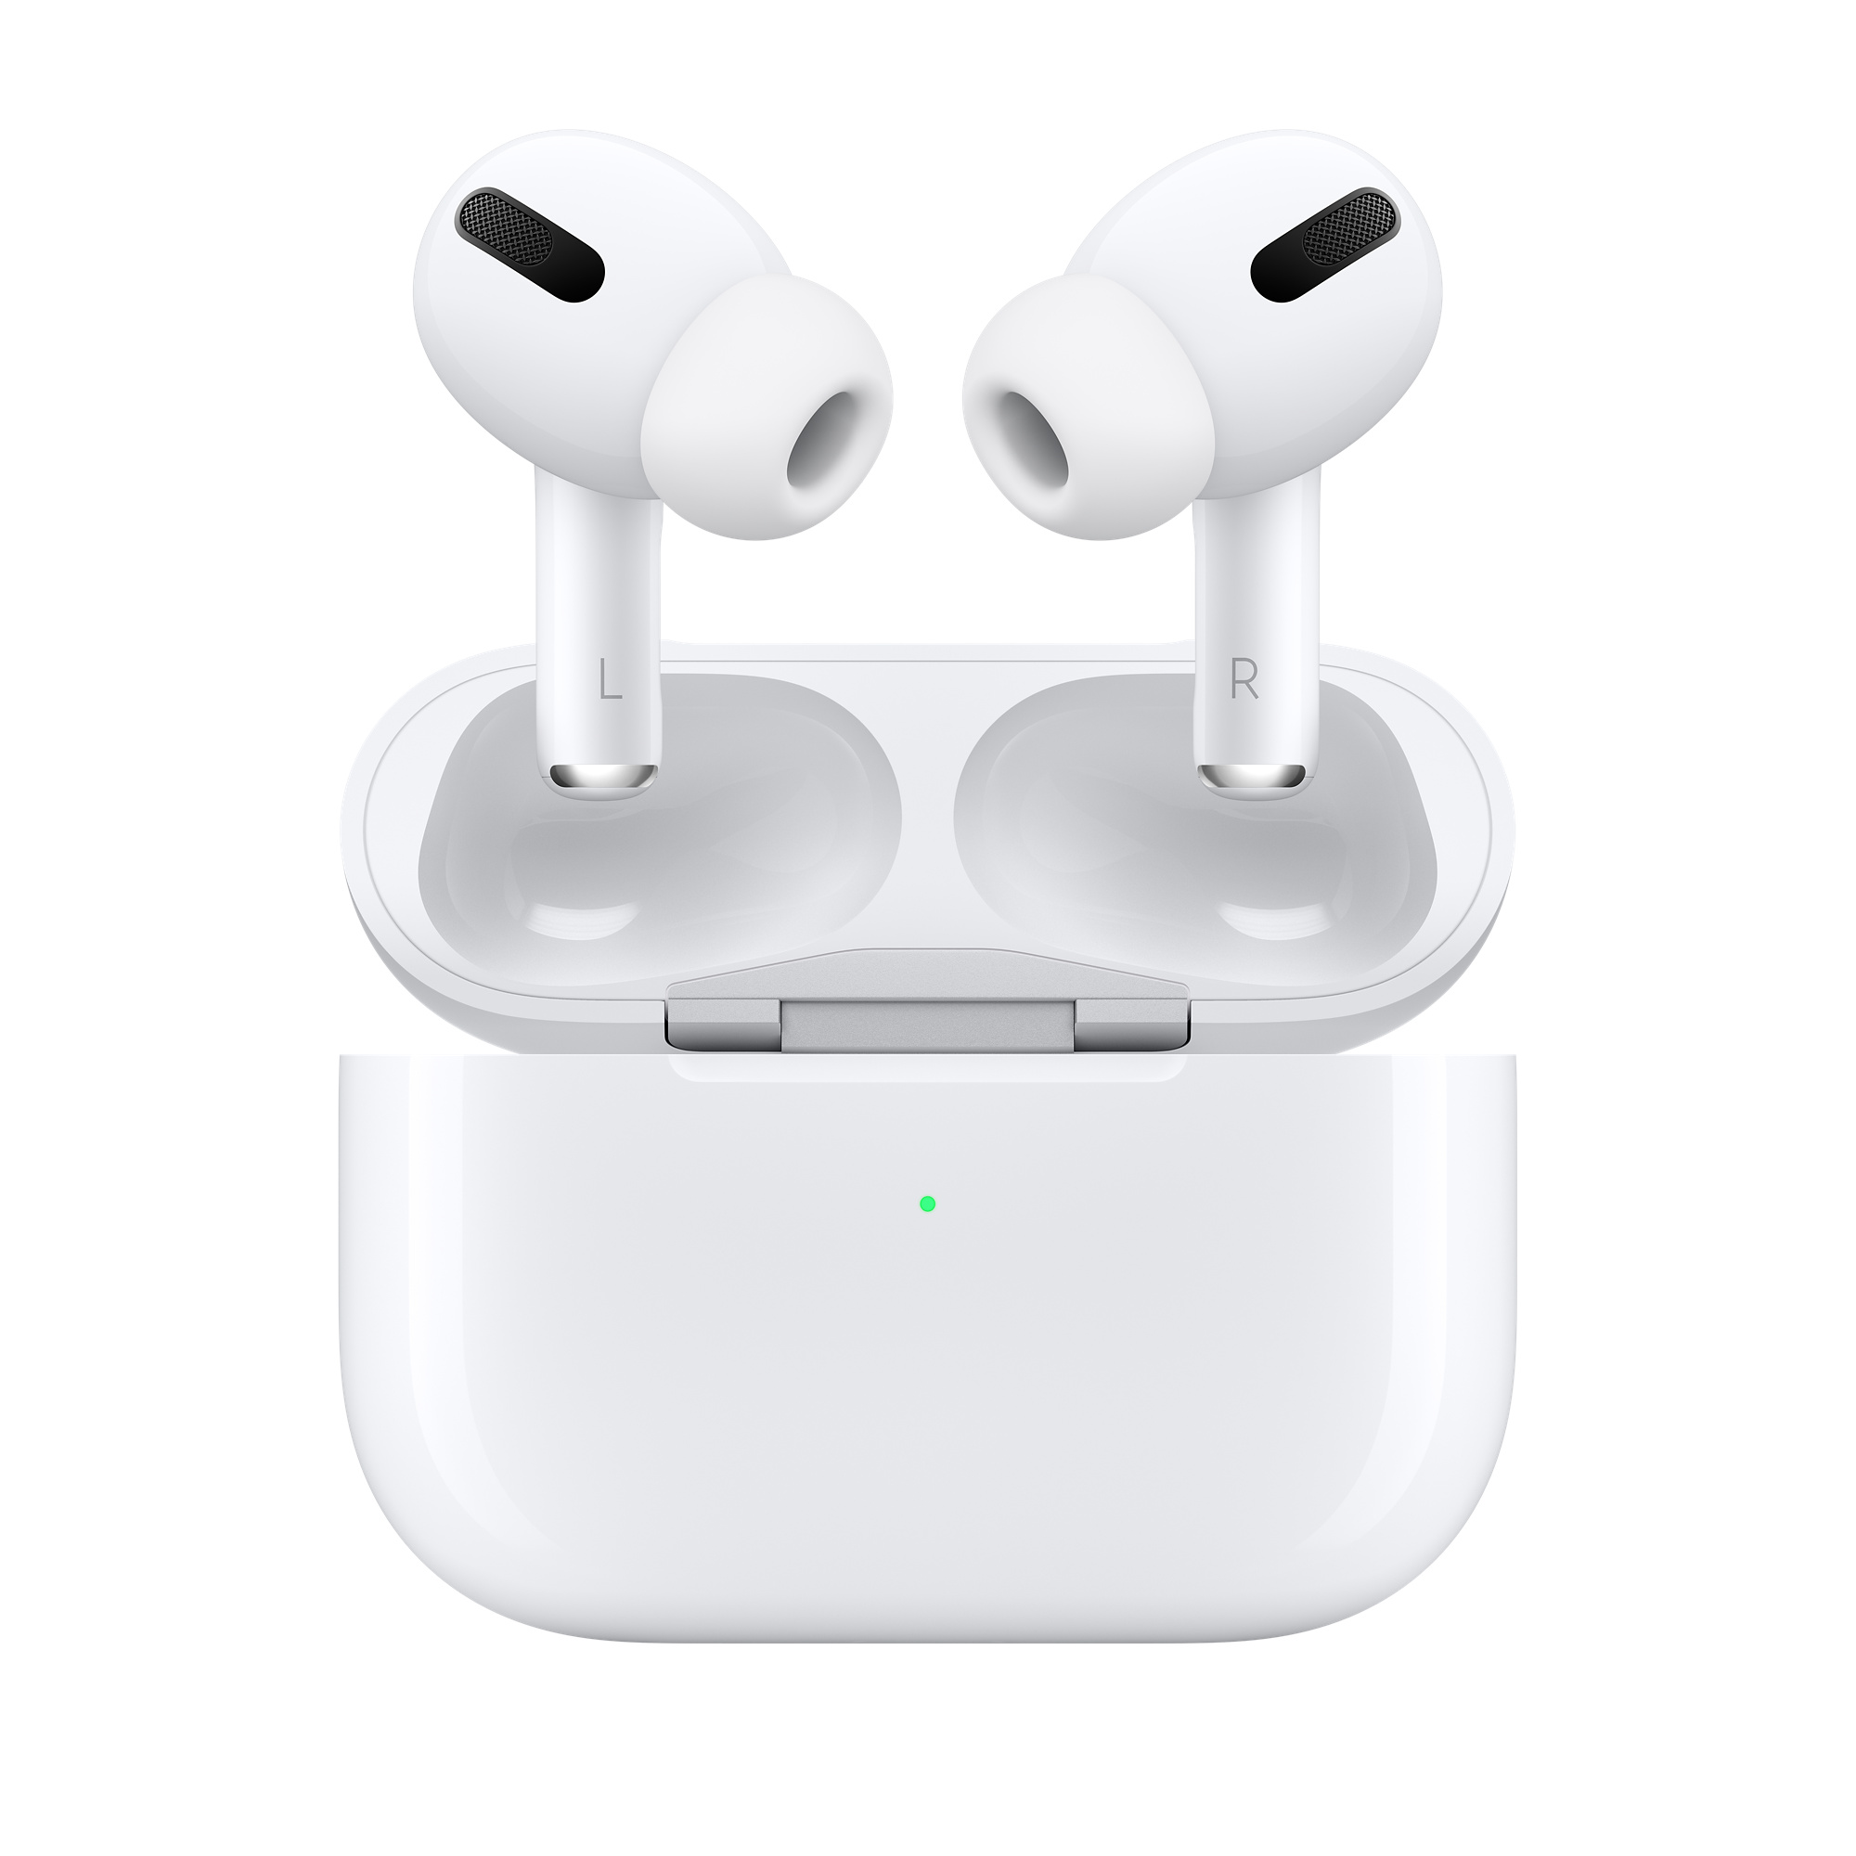

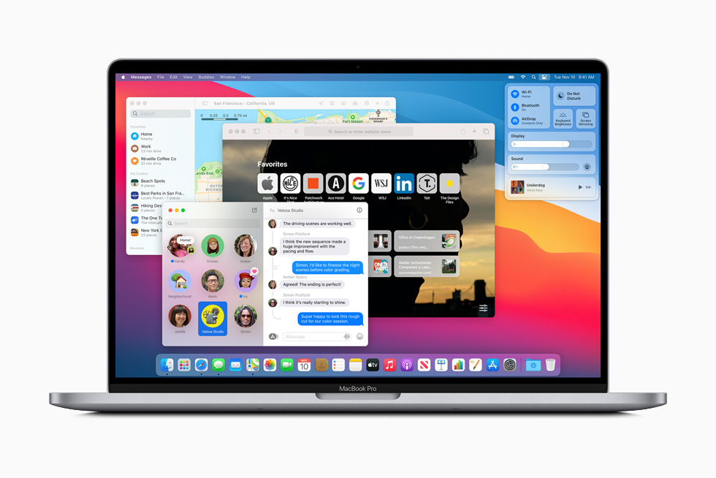
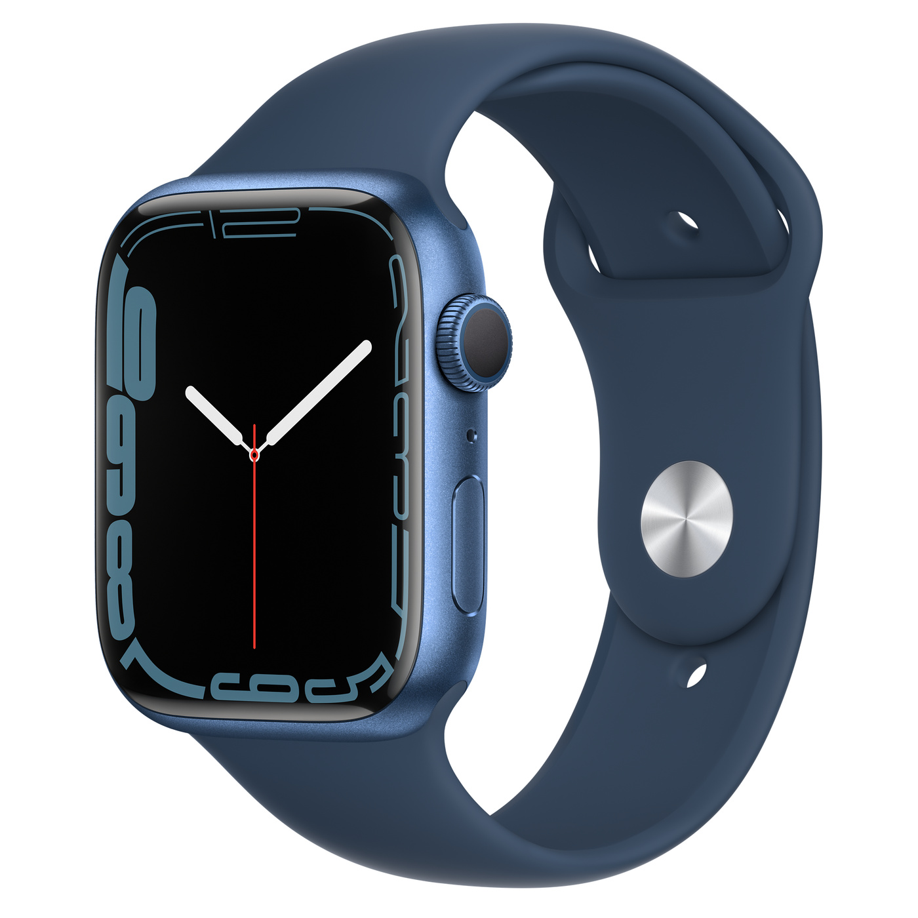

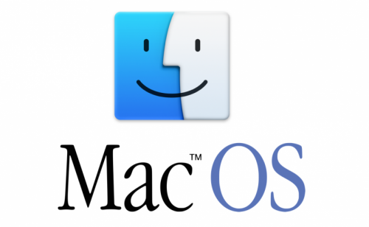

Apple’s portfolio of competitive advantages
DESIGN
BRAND RECOGNITION
PORTFOLIO OF COMPETITIVE ADVANTAGES
PRODUCT INTEGRATION
SOFTWARE & APPS

Slide 6












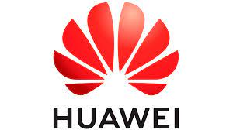






Where to compete?
MUSIC STREAMING PLATFORM
SOFTWARE & APPS
VIDEO STREAMING PLATFORM
SMARTPHONE
LAPTOPS
WEARABLE DEVICES
AUDIO DEVICES
OPERATIVE SYSTEMS

Slide 7


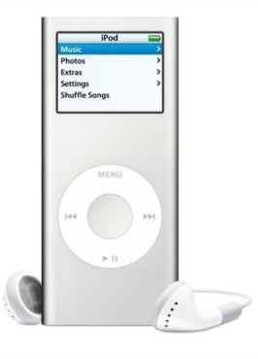

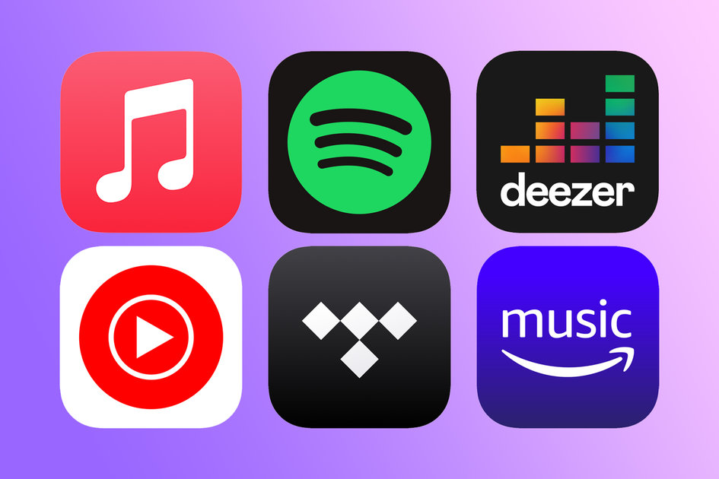
Competitive Advantages are often short-lived
2017
2003
USER-FRIENDLY PLATFORM; FREEMIUM MODEL AND ILLIMITED CATALOGUE OUTPERFORMED ITUNES
CA: DOWNLOAD OF SINGLE SONGS
THE RISE OF STREAMING
THE RISE OF DIGITAL MUSIC
WITH DOWNLOADS IN DECLINE ITUNES FAILED TO ADAPT
THE FIRST GENERATION IPOD MP3 PLAYER - WHICH STORED 1,000 TUNES - TRANSFORMED THE WORLD OF DIGITAL MUSIC.
Notes:
When Apple first unveiled iTunes alongside its inaugural iPod in 2001, the company wasn’t interested in selling music. The music player was a way for users to manage their own albums and upload songs onto their MP3 player. “What [Apple] wanted to do was sell iPods,” said Chris Cooke, Founder and Managing Director of CMU, a consultancy and news service for the music industry. “To do that, it needed to provide iPod owners with a legitimate way to access pop music in a digital format.”
In 2003, the tech giant introduced the iTunes Music Store, and the way people around the world bought and listened to music began to change. At the time, the store offered 200,000 songs for download at $0.99 (€0.89) each. Within the first week, more than a million songs were sold.
Nearly two decades since its launch, iTunes has helped to transform the global music industry. But as Apple looks to break the once-powerful music store up into newly designed apps for music, TV and podcasts, it is clear that the relevance of digital downloads is fading.
Digital music had until then existed in a culture in which pirate sites loomed large and illegal downloading was rife.
The file-sharing platform Napster, launched 20 years ago, had opened up an enormous, if illegal, network through which people could freely share music.
There was no longer any need to surreptitiously record off the radio on to a cassette - now, millions of tech-savvy music lovers had access to a vast library of tracks, straight from each other's hard drives.
But Napster was quickly sued by both music bodies and artists, including Metallica and Dr Dre, who suffered considerable revenue loss.
By April 2004, when the iTunes store arrived in the UK, Apple was able to report about 85 million songs had been legally acquired.
So confident was the tech giant about the success of its new service that in 2005 it launched the iTunes phone - although it was nowhere near as successful as the iPhone, which followed in 2007.
What went wrong?
As mobile and broadband capability improved, video, podcasts and e-books became more accessible and iTunes expanded to become much more than a music store.
However, it was criticised for growing overly bloated as a result.
Dismantling the one-stop-shop into three distinct market stalls could give Apple more of a competitive advantage, said Mark Mulligan, music industry analyst at Midia Research.
"Its role as a music app has already diminished... what Apple is doing is saying that to succeed in this world it has to specialise in everything - it can't be a generalist," he said.
"It's still number two to Spotify - if it's going to be the leading player, which is what it wants to be, it's got to unbundle all of these things and make each one a leader in its space."
The rise of streaming
The year 2017 was a bumper year for music streaming revenue, with global streaming generating $7.1bn (£5bn) for the music industry - more than CD and vinyl sales.
In 2018, 90 billion songs were streamed in the UK alone, according to figures released by music body the BPI - a 33.5% increase from 2017.

Slide 8
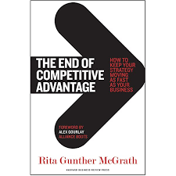
The end of (sustainable) competitive advantages

Slide 9




A Shift in the Paradigm
SUSTAINABLE COMPETITIVE ADVANTAGE
GLOBALIZATION
DISRUPTIVE
TECHNOLOGIES
Competitive Advantages are often Short-lived
TRANSIENT COMPETITIVE ADVANTAGE
PRIORITIZING FAST INNOVATION TO BUILD A PORTFOLIO OF COMPETITIVE ADVANTAGES
ADVANTAGE A
ADVANTAGE B
INNOVATION IS KEY
ADVANTAGE C
TRANSIENT COMPETITIVE ADVANTAGE (TCA) REFERS TO THE PRACTICE OF TAKING UP NEW STRATEGIC INITIATIVES BASED ON SHORT TERM OR TRANSIENT ADVANTAGES.
ADVANTAGE N

Slide 10

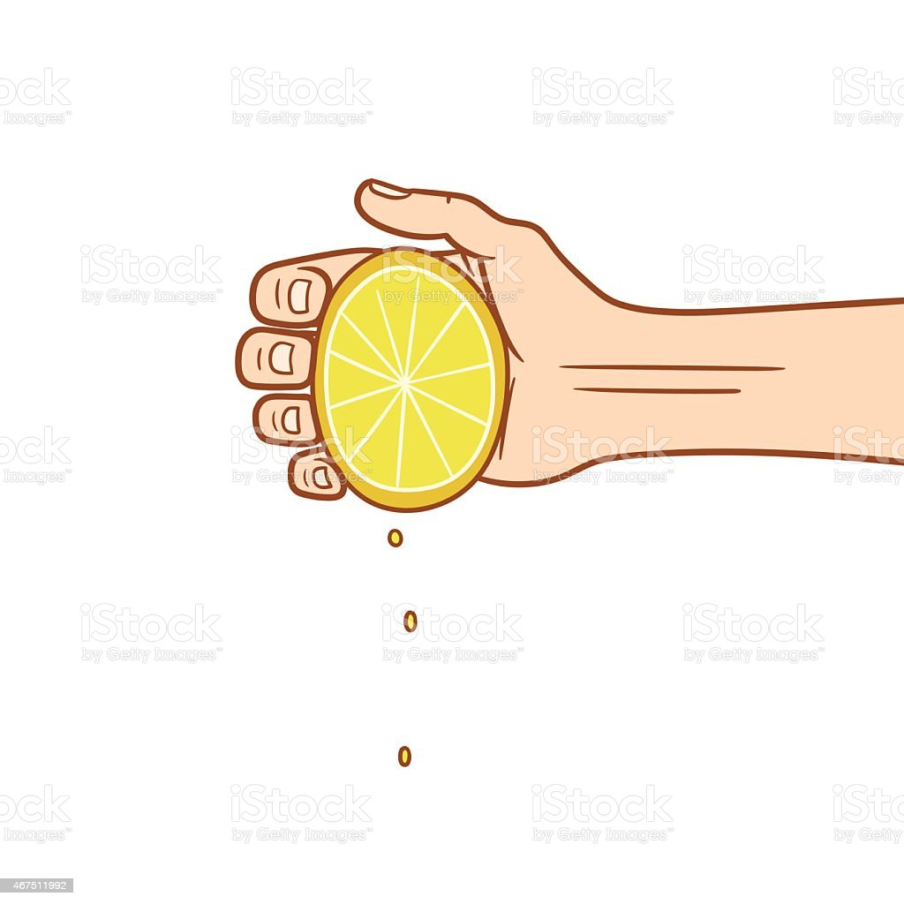



Transient Competitive Advantage (TCA) Strategy
THE FIRM IDENTIFIES AN OPPORTUNITY AND ORGANIZES ITS RESOURCES TO CAPITALIZE IT
THE FIRM SEEKS TO CAPTURE PROFITS AND MAXIMIZE MARKET SHARE. COMPETITORS ARE FORCED TO REACT
SOONER OR LATER, THE ADVANTAGE IS DILUTED AND THE ORGANIZATION MUST DIVEST THE INITIATIVE
LAUNCH
RAMP-UP
EXPLOIT
RECONFIGURE
DISENGAGE
AT THIS STAGE THE BUSINESS OPPORTUNITY BECOMES A QUALITY EXPERIENCE FOR CUSTOMERS
ON SUCCESS, COMPETITION INTENSIFIES AND SIMILAR OFFERINGS APPEAR, WHICH UNDERMINES THE ADVANTAGE. THUS, THE FIRM MUST RECONFIGURE THE BM TO MAINTAIN LEADERSHIP

Slide 11
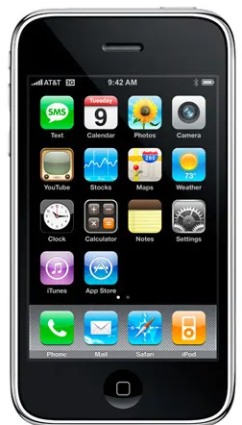

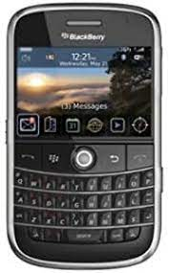
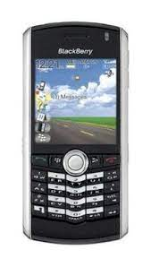

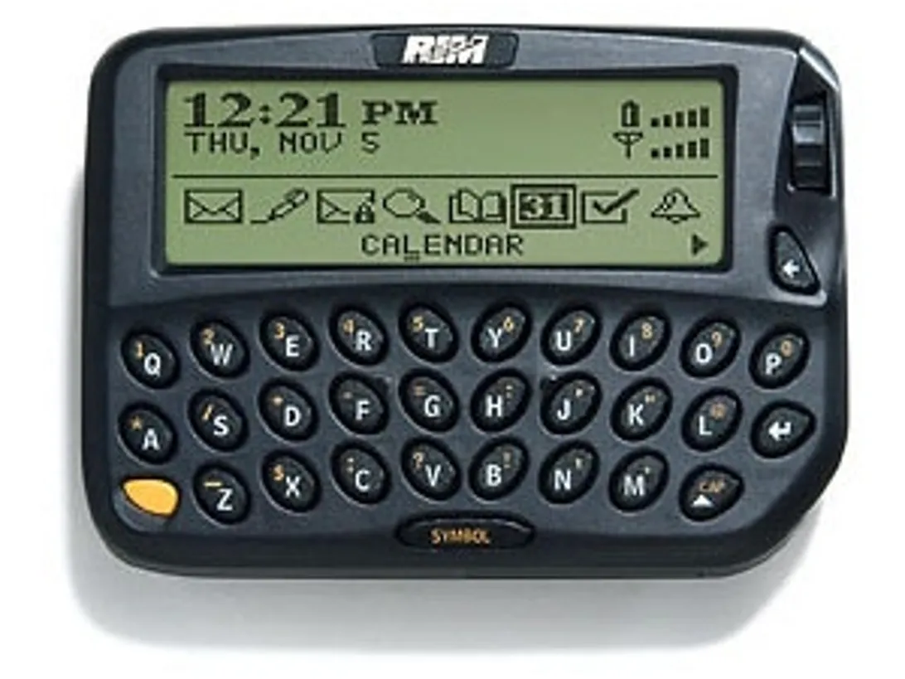
Rise and Fall of Research in Motion (RIM)
LAUNCH
RAMP-UP
EXPLOIT
RECONFIGURE
DISENGAGE
IN 1999, RIM INTRODUCED THE BLACKBERRY 850 PAGER. THE DEVICE COULD RECEIVE PUSH EMAIL FROM A MICROSOFT EXCHANGE SERVER USING ITS COMPLEMENTARY SERVER SOFTWARE, BLACKBERRY ENTERPRISE SERVER (BES)
RIM SOON BEGAN TO INTRODUCE BLACKBERRY DEVICES FOR THE CONSUMER MARKET
IN 2002, IT INTRODUCED ITS FIRST SMARTPHONE WITH FUNCTIONS AS E-MAILS, INSTANT MESSAGING, WEB BROWSING
WHILE THE BLACKBERRY WAS THE LEADING SMARTPHONE. THE ARRIVAL OF THE APPLE IPHONE (2007) AND LATER GOOGLE'S ANDROID PLATFORM CAUSED A SLOWDOWN IN BLACKBERRY GROWTH AND A DECLINE IN SALES IN SOME MARKETS (USA)
ON DECEMBER 8, 2016, BLACKBERRY ANNOUNCED THE RELEASE OF BLACKBERRY SECURE. BILLED AS A "COMPREHENSIVE MOBILE SECURITY PLATFORM FOR THE ENTERPRISE OF THINGS"

Slide 12


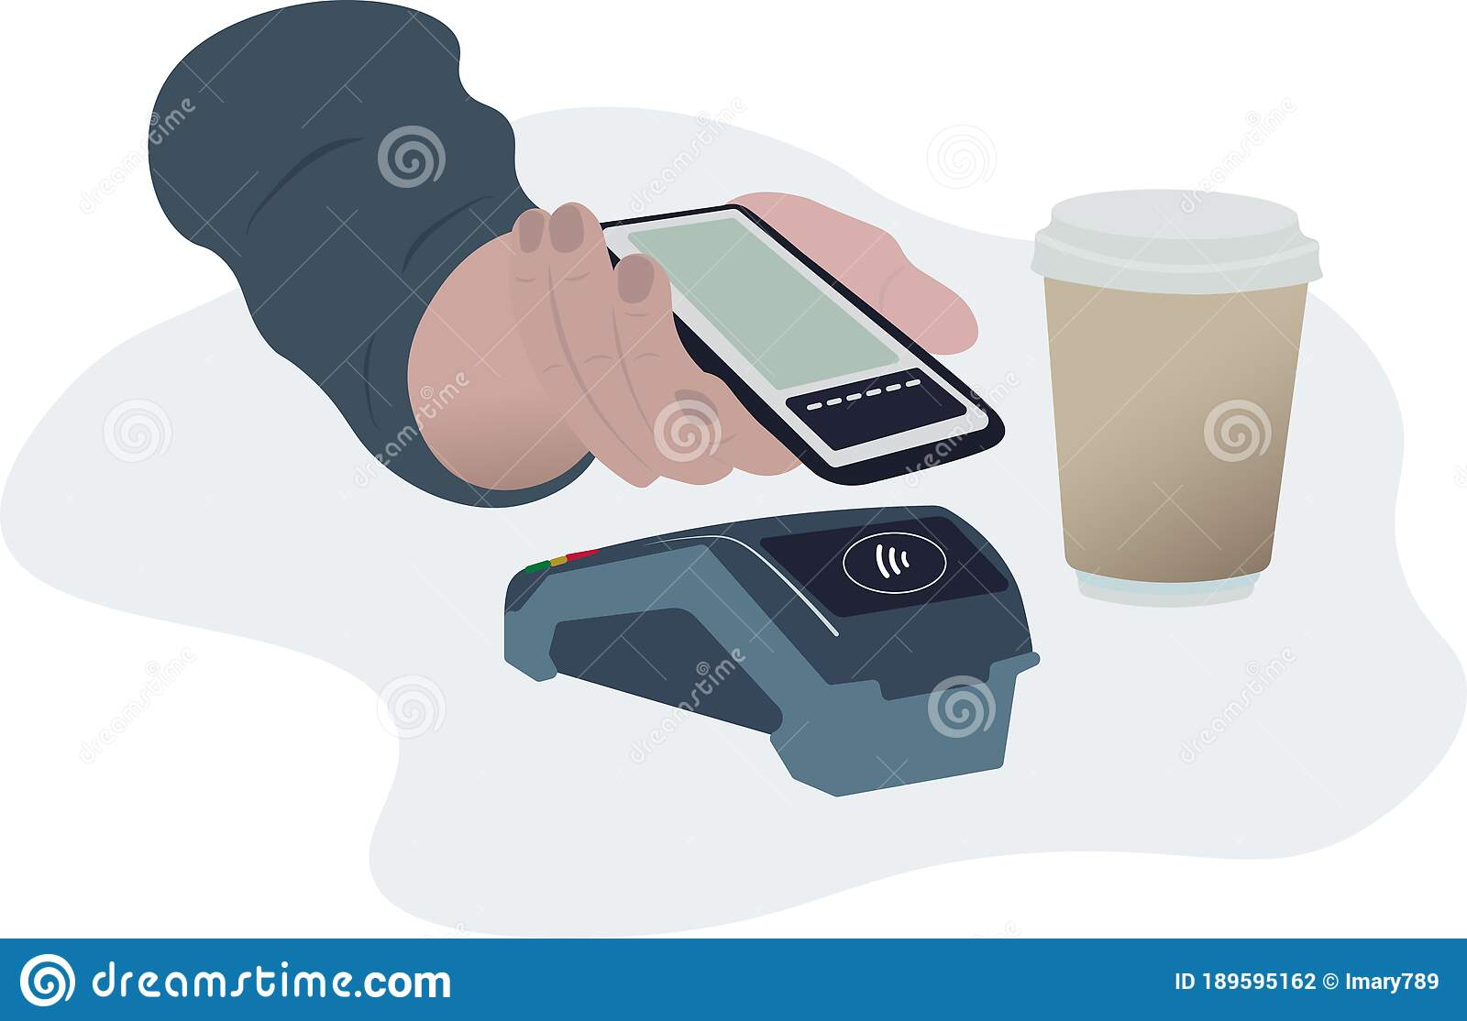
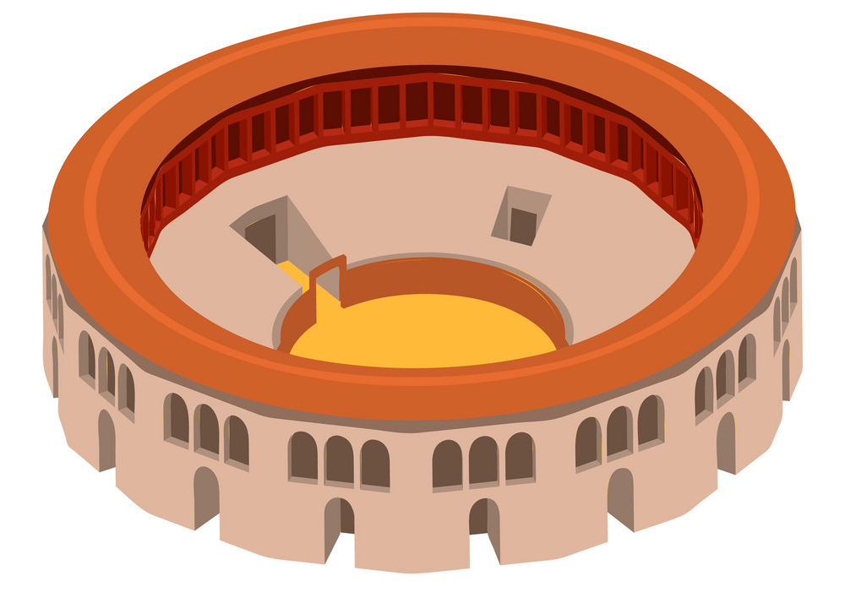


Where to compete: arenas, not industries
STOP THINKING OF WITHIN-INDUSTRY COMPETITION AS THE MOST SIGNIFICANT COMPETITIVE THREAT…
«the most substantial threats to a given advantage are likely to arise from a peripheral or nonobvious location»
ARENAS ARE CHARACTERIZED BY PARTICULAR CONNECTIONS BETWEEN CUSTOMERS AND SOLUTIONS, NOT BY THE CONVENTIONAL DESCRIPTION OF OFFERINGS THAT ARE NEAR SUBSTITUTES FOR ONE ANOTHER
vs
INDUSTRIES ARE STILL RELEVANT BUT USING INDUSTRY AS A BASIS TO ANALYSE COMPETITIVE FORCES IS NOT RELEVANT ANYMORE, THINK ABOUT ARENAS INSTEAD
Notes:
One of the biggest changes, says Professor McGrath is “to stop thinking of within-industry competition as the most significant competitive threat… This is a rather dangerous way to think about competition. In more and more markets, we are seeing industries competing with other industries, business models competing with business models even in the same industry, and entirely new categories emerging out of whole cloth.”
Today, competition can come from anywhere. It’s not just cheap substitutes to their products, capturing low-end customers, and then gradually move upmarket to pick off higher-end customers. Now entire product lines—whole markets—could be destroyed almost overnight as customers defect in droves by “big bang disruption.
A new level of analysis that reflects the connection between market segment, offer, and geographic location at a granular level is needed. She calls this "an arena".
The driver of categorization will in all likelihood be the outcomes that particular customers seek ('jobs to be done') and the alternative ways those outcomes might be met. This is vital, because the most substantial threats to a given advantage are likely to arise from a peripheral or nonobvious location.”
“The arena concept also suggests that conventional ideas about what creates a long-lived advantage will change. Product features, new technologies, and the 'better mousetrap' sorts of sources of advantage are proving to be less durable than we once thought. Instead, companies are learning to leverage more ephemeral things such as deep customer relationships and the ability to design irreplaceable experiences across multiple arenas. They will be focused on creating capabilities and skills that will be relevant to whatever arenas they happen to find themselves operating in. And they may even be more relaxed about traditional protections and barriers to entry, because competition will devolve around highly intangible and emotional factors."

Slide 13
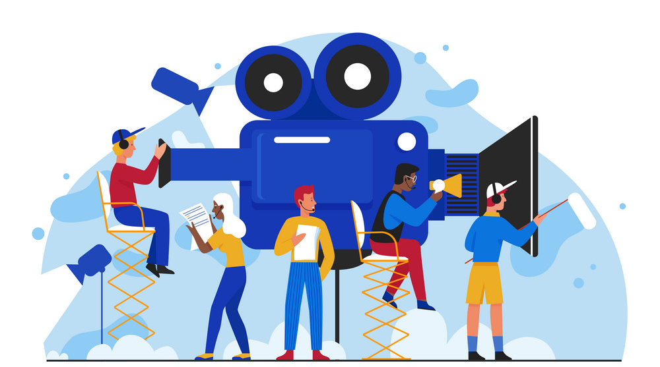

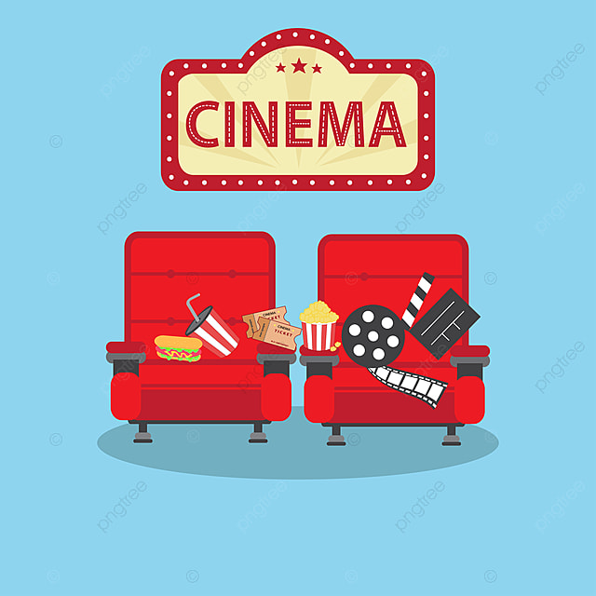

Arenas
«ARENA IS A POT OF ADDRESSABLE RESOURCES, CUSTOMERS AND OTHER STAKEHOLDERS WITH 'JOBS TO BE DONE,' AND DIFFERENT WAYS THAT THOSE JOBS CAN GET FULFILLED BY DIFFERENT KINDS OF PLAYERS.»
RITA MCGRATH
A COMBINATION OF A CUSTOMER SEGMENT, AN OFFER, AND A PLACE IN WHICH THAT OFFER IS DELIVERED
vs
vs

Slide 14
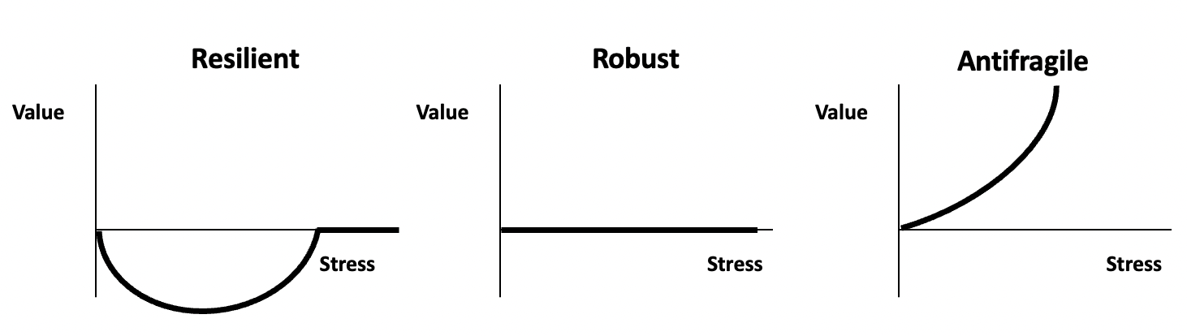



How to deal with TCAs?
DEVELOP AN ANTIFRAGILE MINDSET
*Stress=end of CA
Upside Gain
BY EXPERIMENTING WITH ALETRNATIVE BUSINESS MODEL TRANSFORMATIONS TO COMPETE IN
ALTERNATIVE BUSINESS ARENAS
SUCCESSFUL WAY OF DOING IT:
CONSIDER CHANGE AS THE “USUAL AND NORMAL THING”
BE ABLE TO “GRACEFULLY” EXIT DECLINING LINES OF BUSINESS
FOCUS ON ARENAS
ESTABLISH A ROUTINE FOR INNOVATION
Notes:
This strategy requires that firms avoid sticking to the same old playbook and start embracing new rules. First, companies should seek stability and abandon the assumption that, in business, stability (and rigidity) is the norm.
A corporate mindset should shift from considering change as the “unusual thing” to thinking of change as the “usual and normal thing”, in other words they should stick to the idea that change is the norm. This requires the inclusion of continuous reconfiguration as a strategic pattern rather than corporate changes happening irregularly and infrequently.
Secondly, companies should think about being able to “gracefully” exit declining lines of business, (i.e. lines of service, product categories). This is what McGrath defines as healthy disengagement, that is important in order to free up resources that could be useful to develop innovation, without incurring in a brutal restructuring resulting for example in destructive downsizing and mass firings.
Thirdly, companies should focus on separating out the power structure in the organization from the resource allocation process, which is hard because frequently powerful people in a company get to call the shots about where the financial resources are spent, i.e. separating resource allocation.
Fourth, instead of focusing on industries, managers should assess their strategic moves within the more blurred definition of arenas, i.e. a combination of a customer segment, an offer, and a place in which that offer is delivered. The shift to a focus on arenas means that industries are still relevant but using industry as a basis to analyse competitive forces is not relevant anymore. (Ex Bank and Apply pay ?)
Finally, managers should establish a routine for innovation, that is defining a regular way of developing innovations in the term short and pursue innovation proficiency, in other words companies should learn to be systematic about early-stage innovation.

Slide 15
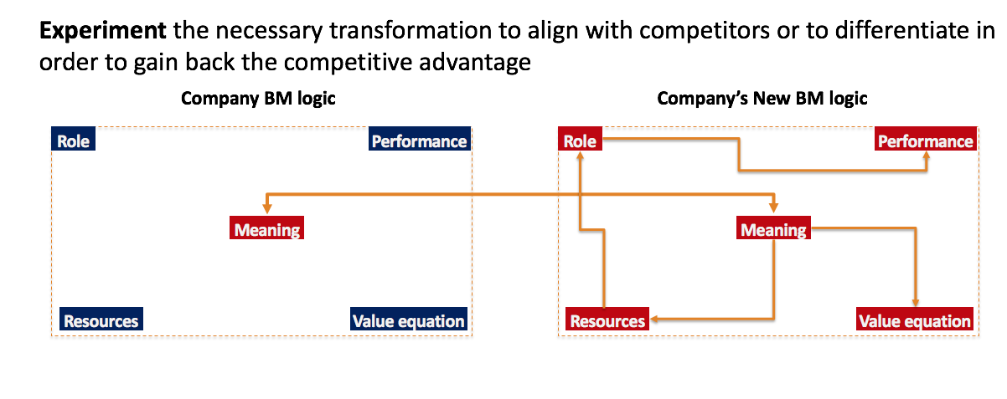
TCAs and Business Models
PRIORITIZING INNOVATION REQUIRES PROCESSES OF FAST EXPERIMENTATION OF NEW WAYS TO CREATE VALUES
*APPROACHES:
LOWERED/ZERO EFFORT
BUSINESS MODEL LOGIC’S REDESIGN* AS AN OPPORTUNITY TO FIND A NEW CA
ENHANCED ACCESS
INTELLIGENT ACTIVITIES
- Upside Gain
STAKEHOLDERS EMPOWERMENT
FOCUSING ON BUSINESS ARENAS MAY LEAD TO A TRANSFORMATION OF THE BUSINESS MODEL
ANTIFRAGILE COMPANIES CONTRIBUTE TO REINVENT THE FUTURE (REACTIVE/PROACTIVE APPROACH)

Slide 16
How did Apple Music redesign its Experience to gain back its CA after music streaming introduction?
Group Task
#3 EXPERIENCE REDESIGN : MUSIC DOWNLOAD EXPERIENCE VS. STREAMING EXPERIENCE
ITUNES EXPERIENCE
APPLE MUSIC EXPERIENCE
What can the user/customer do
In which way
Differently from ….
What can the user/customer do
In which way
Differently from ….

Slide 17

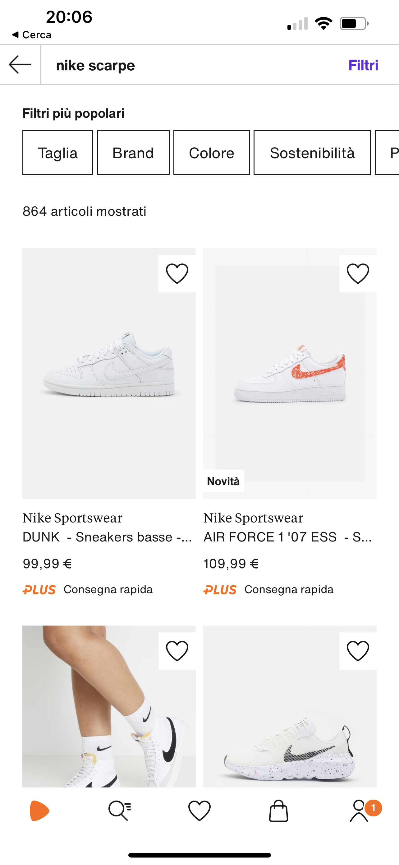



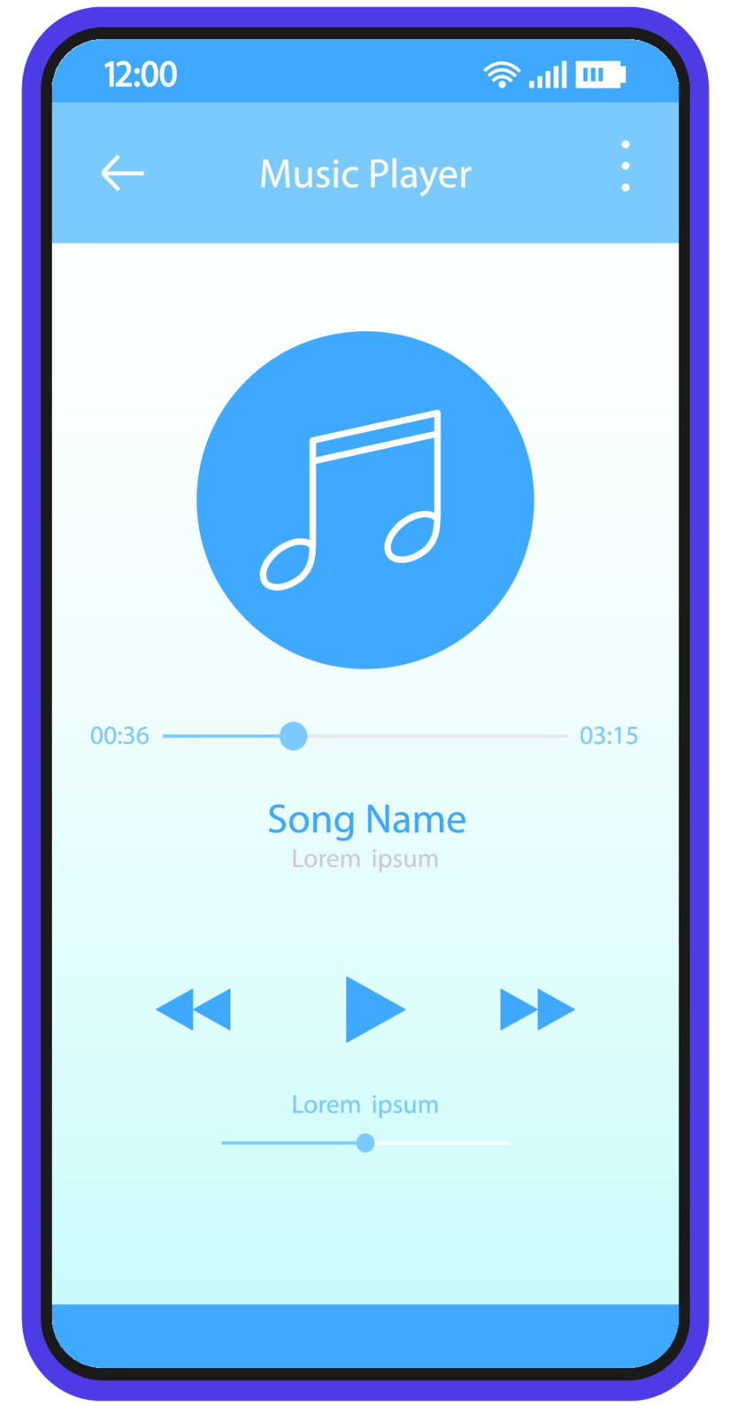

TCA & Business Models
COMPANIES MIGHT GAIN A COMPETITIVE ADVANTAGE BY UNBUNDLING/SEPARATING SOME OF THE BUILDING BLOCKS WITHIN VALUE CREATION PROCESSES THAT ULTIMATELY SPIN-OFF
IN NEW LINES OF BUSINESS.
THE KEY IS TO ZOOM INTO A SPECIFIC BUILDING BLOCK TO FOCUS EFFORTS FOR VALUE CREATION
TO COMPETE IN NEW ARENAS
zoom in: song
zoom in: article
zoom in: product
instead of the entire album
instead of the whole newspaper
instead of physical stores
Notes:
Apple’s iTunes unbundled albums
When Apple introduced iTunes it unbundled the CDs and albums. You no longer needed to buy an entire CD to listen to the single song you wanted. Therefore Apple‘s iTunes unbundled CDs by offering single songs at $99 cents.
Amazon’s e-commerce unbundled retail
When Amazon enabled consumers to buy at convenient price and selection on its platform it started to unbundle retail. In short, on Amazon, you could pick only what you wanted the most, by navigating through several online stores at once. This process is still ongoing and a powerful force.
Google unbundled newspapers
When Google indexed the whole web, it enabled readers to pick articles from several websites without having to go through part of them that they might have found less interesting (classified ads, job boards and so on). Therefore, in a way, Google worked as an unbundling force toward the publishing industry.
https://prezi.com/lsltaffxitx2/unbundling-business-model/

Slide 18

Unbundling business models
WHEN YOU BUY A MOBILE PHONE, YOU DON’T JUST BUY THE HARDWARE.
YOU BUY A BUNDLED PRODUCT, THAT INCLUDES:
THE HARDWARE
PRE-INSTALLED APPS
THE OPERATING SYSTEM
A SUBSCRIPTION TO A MOBILE NETWORK
ACCESS TO APP STORES
ONLINE/PAPER MANUAL
12 MONTH GUARANTEE
UNBUNDLING
THE OPERATING SYSTEM
NEW LINE OF BUSINESS

Slide 19
Business model redesign by Unbundling
AS PART OF THEIR TCA STRATEGY COMPANIES HAVE CREATED A PORTFOLIO OF BUSINESS MODELS BY UNBUNDLING ELEMENTS OF THEIR BML
COMPANY BML A
COMPANY CURRENT BML
COMPANY BML B
Activities
Experience
Activities
Experience
Activities
Experience
Meaning
Meaning
Meaning
Resources
Value equation
Resources
Value equation
Resources
Value equation
COMPANY BML C
*APPROACHES:
THE IDEA IS THAT EVERY ELEMENT OF THE BUSINESS MODEL LOGIC CAN BE A SOURCE OF COMPETITIVE ADVANTAGE & THEREFORE LEVERAGED TO DEVELOP NEW LINES OF BUSINESS & COMPETE IN DIFFERENT ARENAS
LOWERED/ZERO EFFORT
Activities
Experience
ENHANCED ACCESS
INTELLIGENT ACTIVITIES
Meaning
STAKEHOLDERS EMPOWERMENT
Resources
Value equation

Slide 20

Business model redesign by Unbundling
iOS Developer Academy
ENHANCED ACCESS
Apple traditional BM logic
Activities
Experience
Meaning
TECH PRODUCTS ARENA
Resources
Value equation
APPLE UNBUNDLED SOME KEY RESOURCES SUCH AS DEVELOPERS & SOFTWARE DESIGNERS TO OPEN DEVELOPER ACADEMICS WORLDWIDE TO TRANSFER KNOWLEDGE & ACQUIRE NEW IDEAS
iOS Academy BM logic
Activities
Experience
Meaning
TECH EDUCATION ARENA
Resources
Value equation

Slide 21
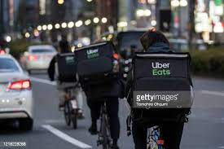


Business model redesign by Unbundling
Business model redesign by Unbundling
Uber Eats
STAKEHOLDERS EMPOWERMENT
Uber traditional BM logic
Activities
Experience
Meaning
RIDESHARING ARENA
Resources
Value equation
APPLE UNBUNDLED SOME KEY RESOURCES SUCH AS USER BASE & ITS APP TO LAUNCH A FOOD DELIVERY SERVICE
Uber Eats BM logic
Activities
Experience
Meaning
FOOD DELIVERY ARENA
Resources
Value equation

Slide 22
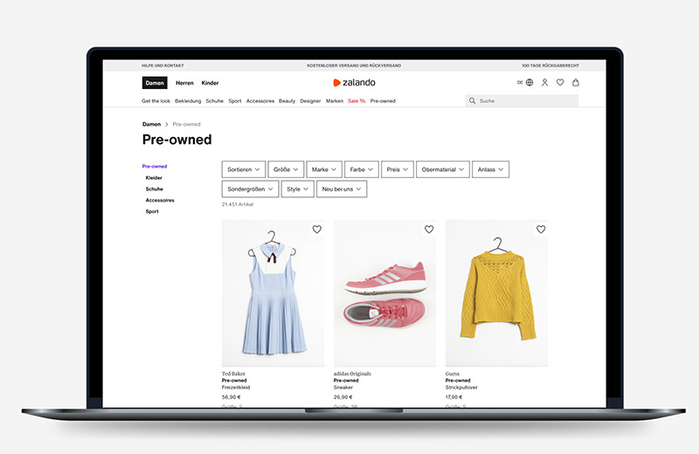

Business model redesign by Unbundling
Business model redesign by Unbundling
Zalando Secondhand marketplace
LOWERED/ZERO EFFORTS
Zalando traditional BM logic
Activities
Experience
Meaning
FAST-FASHION
ARENA
Resources
Value equation
ONLINE FASHION PLATFORMS ARE UNBUNDLING KEY ACTIVITIES AS THEIR LOGISTICS OPERATIONS TO RE-SELL PRE-OWNED ITEMS AND CONTRIBUTE TO CIRCULAR ECONOMY
Zalando Pre-owned BM logic
Activities
Experience
Meaning
SECOND-HAND ARENA
Resources
Value equation

Slide 23
Antifragile Business Design Challenge
STAY COMPETITIVE BY UNBUNDLING
https://www.ticketone.it/

Slide 24

Antifragile Business Design Challenge
2WATCH PIVOTING TO UNBUNDLING, FIND A NEW BUSINESS ARENA
#1 BUSINESS MODEL LOGIC «AS IS ANALYSIS»
ANALYSE 2WATCH CURRENT VALUE EQUATION (see the ppt) BY EXPLORING HOW THEIR BUSINESS MODEL CREATES VALUE
#2 CHOOSE A SOURCE OF A NEW COMPETITIVE ADVANTAGE
BY LOOKING AT ITS CURRENT BML ELEMENTS ZOOM INTO ONE OF THEM THAT YOU CONSIDER HAVING THE GREATEST POTENTIAL FOR A TCA STRATEGY
#3 BUSINESS MODEL LOGIC REDESIGN BY UNBUNDLING
REDESIGN THE BUSINESS MODEL LOGIC ELEMENT THAT YOU PICKED IN THE PREVIOUS STEP BY FOLLOWING ONE OF THE 4 APPROACHES (ENHANCED ACCESS; STAKEHOLDER EMPOWEREMENT, LOWERED/ZERO EFFORTS; INTELLIGENT ACTIVITIES) & pick the extended template for its definition
#4 REALIGN THE BML ELEMENTS
REALIGN OF THE BML ELEMENT TRANSFORMATIONS, WHAT IS THE NEW BUSINESS ARENA?
15 MINS PRESENTATION USING THE TEMPLATE PROVIDED

Slide 25

ABD framework in brief
Please, summarize the 5 elements of 2WATCH Business Model Logic
MEANING
EXPERIENCE
RESOURCES
ACTIVITIES
VALUE EQUATION

Slide 26
ABD framework in brief
Pick one element to be unbundled, and select the approach for its redesign
APPROACH:
MEANING
EXPERIENCE
RESOURCES
ACTIVITIES
VALUE EQUATION

Slide 27
ABD framework in brief
Realign the other elements and indicate the business arena in which you are competing now
MEANING
EXPERIENCE
RESOURCES
ACTIVITIES
VALUE EQUATION
APPROACH:

Slide 28
Meaning
BY WHO
IN WHICH WAY
Activities
Experience
Resources
WHY
Value equation
THROUGH WHAT
HOW MUCH

Slide 29
Meaning
People love 2WATCH because …………………………………………………
Why people buy/love a product/service?
How relevant is a product/service in people’s consumption system?

Slide 30
Experience
What can the user/customer do
In which way
Differently from ….

Slide 31
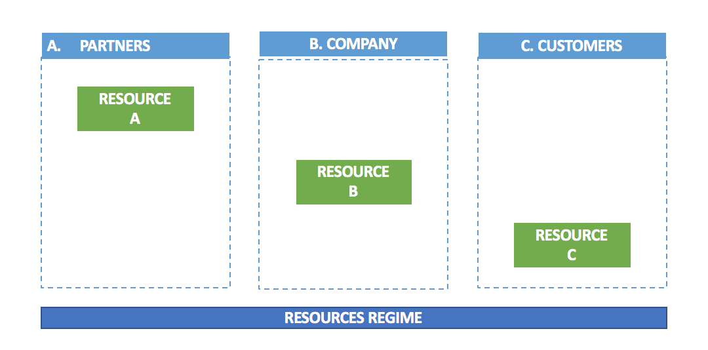
Resources

Slide 32



Activities
Onstage activities
Activity 1
Activity 2
Activity 3
Backstage
Activities
Activity 1
Activity 2
Activity 3
Support Activities
Activity 1
Activity 2
Activity 3
Who is responsible for the
key activities?
A. PARTNERS
B. COMPANY
C. CUSTOMERS

Slide 33
Value equation
Emotional
Relational
Functional
Monetary
Time
Psychophysical

Slide 34
MASTER MEIM 2021-2022
eva.panetti@uniparthenope.it

