Slide 1
MASTER MEIM 2022-2023
Entrepreneurial Finance
Master 2022-2023
Vincenzo Verdoliva
Associate Professor of Finance, Università degli Studi di Napoli Parthenope
vincenzo.verdoliva@uniparthenope.it

Slide 2
Agenda
Entrepreneurial Finance definition and market size
What we know about private equity and venture capital?
interactive section
How PE investors select investee firms
interactive section: using aida
Highlights of Business evaluation in the private equity industry
Case studies analysis
interactive section

Slide 3
Agenda
Entrepreneurial Finance definition and market size

Slide 4
Private equity and venture capital: theoretical background
90s
The term venture capital was used to define the contribution of share capital or the underwriting of securities convertible into shares by specialized operators, in a medium-long term perspective, carried out in relation to unlisted companies with high potential for development in terms of new products or services new technologies new market concepts

Slide 5
Private equity and venture capital: theoretical background
90s
Temporary participation
Minority shareholding
Contribution of know-how
Increase in value and possibility of achieving high capital gains

Slide 6
Private equity and venture capital: theoretical background
Today
USA taxonomy
PRIVATE EQUITY
Venture Capital
Buy-out

Slide 7
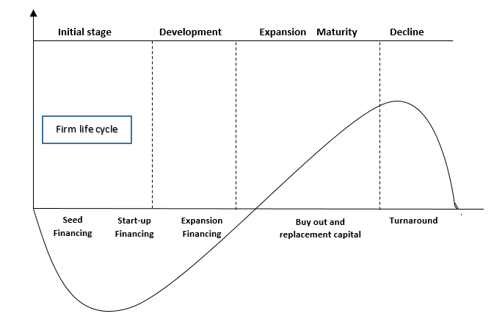
Private equity and venture capital: theoretical background
Firm life cycle

Slide 8
Private equity and venture capital: theoretical background
Today
Venture Capital
early stage financing
expansion financing

Slide 9
Private equity and venture capital: theoretical background
Today
early stage financing
Seed financing
start up capital

Slide 10
Private equity and venture capital: theoretical background
Today
Expansion financing
Business development

Slide 11
Private equity and venture capital: theoretical background
Today
Buyout
Replacement capital
Management buy-out
Management buy-in

Slide 12
Private equity and venture capital: theoretical background
START-UP
Venture capital
DEVELOPMENT
Private equity
Buy out
TOURNAROUND

Slide 13
Market size and evolution
1: foundrasing
2: investment
3: divestment

Slide 14
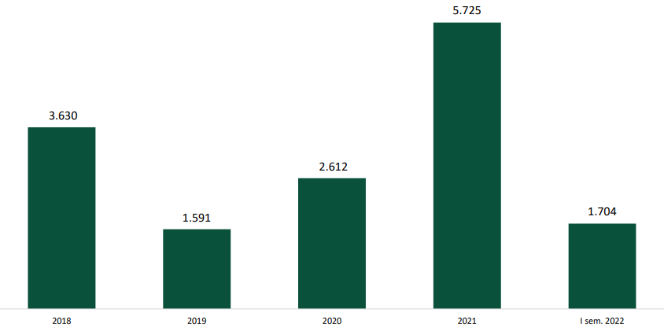
Foundrising evolution (euro mln)

Slide 15
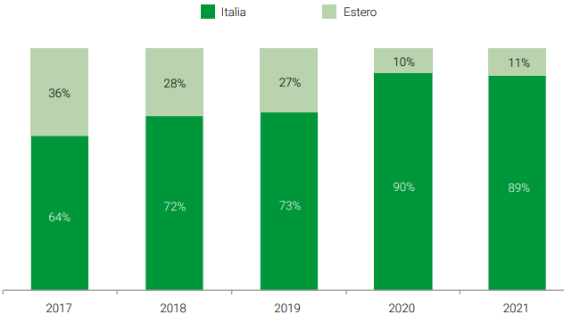
The geography of funds raised

Slide 16
Market evolution
2: investment

Slide 17
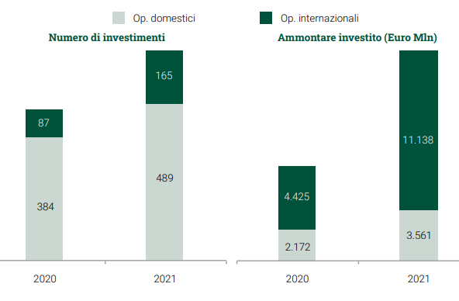
Investment evolution by origin of investors

Slide 18
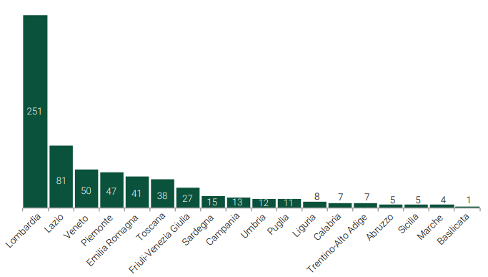
Distribution by region of number of investments occurred over 2021

Slide 19
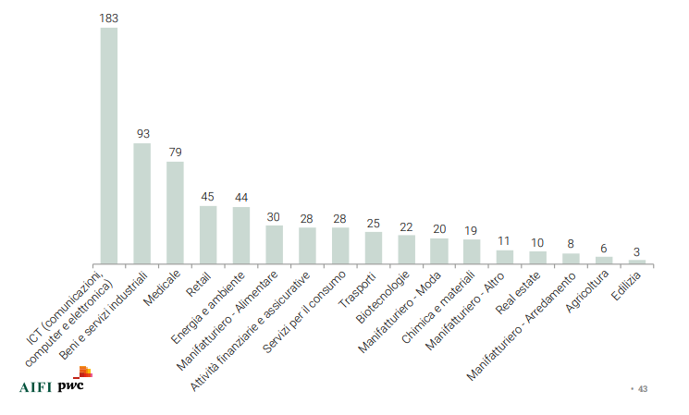
Distribution by sector of number of investments occurred over 2021

Slide 20
Market evolution
3: divestment

Slide 21
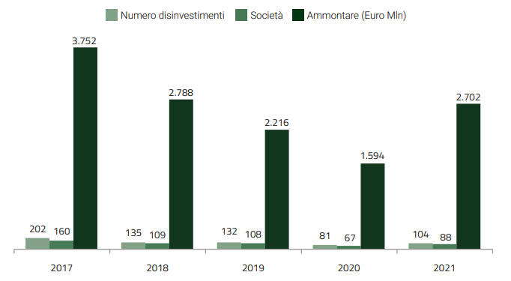
Evolution of divestment over 2017-2021

Slide 22
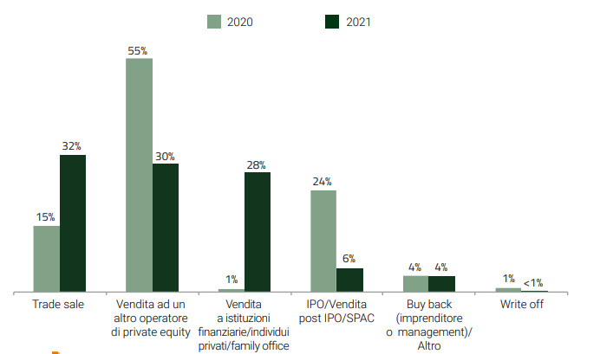
Distribution of divestment by typology. Data in % of total amount divested

Slide 23
Agenda
What we know about private equity and venture capital?
- interactive section

Slide 24
Ten milestones
Gompers, P. A. (1996). Grandstanding in the venture capital industry. Journal of Financial economics, 42(1), 133-156.
Krishnan, C. N. V., Ivanov, V. I., Masulis, R. W., & Singh, A. K. (2011). Venture capital reputation, post-IPO performance, and corporate governance. Journal of Financial and Quantitative Analysis, 46(5), 1295-1333.
Tian, X. (2012). The role of venture capital syndication in value creation for entrepreneurial firms. Review of Finance, 16(1), 245-283.
Megginson, W. L., & Weiss, K. A. (1991). Venture capitalist certification in initial public offerings. The Journal of Finance, 46(3), 879-903.
Gompers, P. A., Gornall, W., Kaplan, S. N., & Strebulaev, I. A. (2020). How do venture capitalists make decisions?. Journal of Financial Economics, 135(1), 169-190.
Croce, A., D’Adda, D., & Ughetto, E. (2015). Venture capital financing and the financial distress risk of portfolio firms: How independent and bank-affiliated investors differ. Small Business Economics, 44(1), 189-206.
Chemmanur, T. J., Krishnan, K., & Nandy, D. K. (2011). How does venture capital financing improve efficiency in private firms? A look beneath the surface. The Review of Financial Studies, 24(12), 4037-4090.
Gompers, P., & Lerner, J. (2001). The venture capital revolution. Journal of economic perspectives, 15(2), 145-168.
Kaplan, S. N., & Schoar, A. (2005). Private equity performance: Returns, persistence, and capital flows. The journal of finance, 60(4), 1791-1823.
Croce, A., Martí, J., & Murtinu, S. (2013). The impact of venture capital on the productivity growth of European entrepreneurial firms:‘Screening’or ‘value added’effect?. Journal of Business Venturing, 28(4), 489-510.

Slide 25
Assignment
Each of you will take one
Will read
Will prepare slides
2hs from now!
And will present and discuss to the class

Slide 26
Suggestions on how to make an effective presentation
Example of agenda

Slide 27
Agenda
How PE investors select investee firms
interactive section: using aida

Slide 28
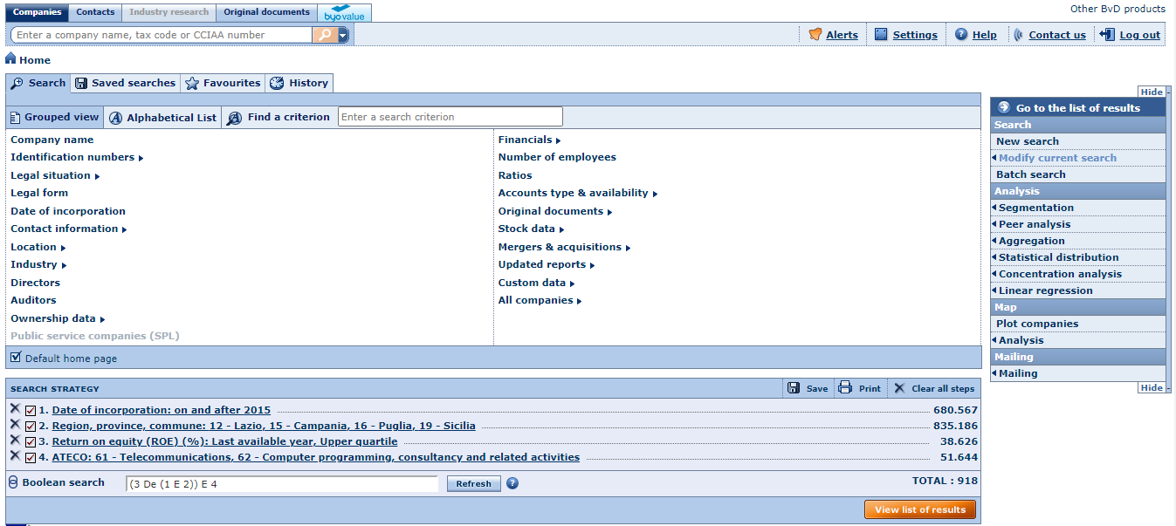
AIDA- In the shoes of PE investors: making a selection

Slide 29
AIDA- In the shoes of PE investors: making a selection
Make your choice!
https://biblioteca.uniparthenope.it/
Catalogo delle risorse online e a stampa
AIDA
Ensure being connected to EDUROAM

