Slide 1
MASTER MEIM 2022-2023
TRADEMARK LAW
Master 2022-2023
21/3/2023
Prof. Franco Trubiani
University of Naples «Parthenope»
franco.trubiani@uniparthenope.it

Slide 2
What is intellectual property law?
Intellectual Property (IP) law relates to the establishment and protection of intellectual creations such as inventions, designs, brands, artwork and music.
These rights are established, protected, enforced and promoted through means such as patents (usually for such things as technical inventions), trademarks (for goods and services), copyright (music, art and literature) and designs (products and logos).
The most noticeable difference between intellectual property and other forms of property, however, is that intellectual property is intangible, that is, it cannot be defined or identified by its own physical parameters. It must be expressed in some discernible way to be protectable.
Generally, it encompasses four separate and distinct types of intangible property namely — patents, trademarks, copyrights, and trade secrets, which collectively are referred to as “intellectual property”.

Slide 3
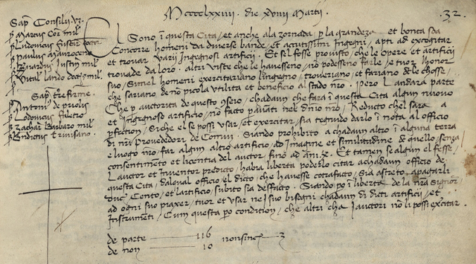
History of Intellectual Property
Venetian Patent Statute made the first systematic attempt to protect inventions by a form of patent
Between 1474 and 1788, the Venetian Senate granted about 2000 patents.
In the same century, the invention of movable type and the printing press by Johannes Gutenberg around 1450, contributed to the origin of the first copyright system in the world.
New ideals of industrialism, the emergence of stronger centralized governments, and nationalism led many countries to establish their modern Intellectual Property laws.

Slide 4
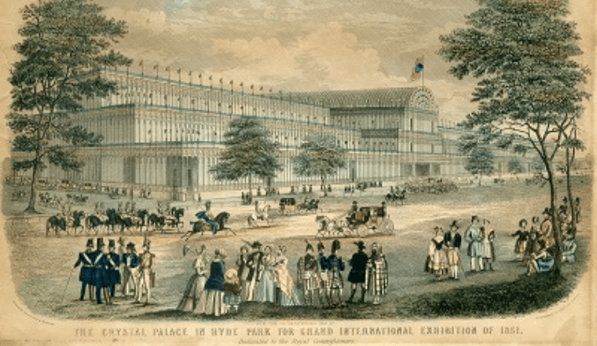
The modern age of IP Law
Paris Convention for the Protection of Industrial Property in 1883.
Berne Convention for the Protection of Literary and Artistic Works in 1886.
The Paris Convention is currently still in force.
The Convention establishing the World Intellectual Property Organization (1967) gives the following list of the subject matter protected by intellectual property rights: literary, artistic and scientific works; performances of performing artists, phonograms, and broadcasts; inventions in all fields of human endeavor; scientific discoveries; industrial designs; trademarks, service marks, and commercial names and designations; protection against unfair competition; and “all other rights resulting from intellectual activity in the industrial, scientific, literary or artistic fields”.

Slide 5
Agreement on Trade-Related Aspects of Intellectual Property Rights (TRIPS) (1994)
International legal agreement between all the member nations of the World Trade Organization (WTO).
The areas of intellectual property that it covers are:
(i) Copyright and related rights (i.e. the rights of performers, producers of sound recordings and broadcasting organisations);
(ii) Trademarks including service marks;
(iii) Geographical indications including appellations of origin;
(iv) Industrial designs;
(v) Patents including protection of new varieties of plants;
(vi) The lay-out designs (topographies) of integrated circuits;
(vii) The undisclosed information including trade secrets and test data.

Slide 6
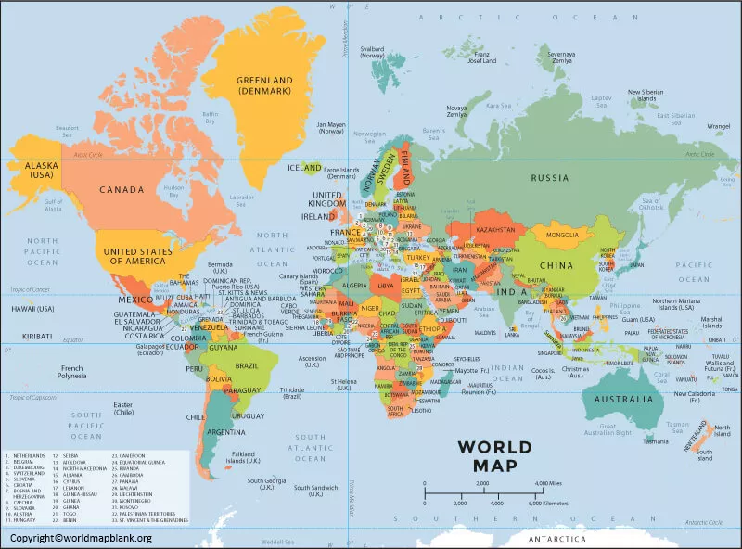
Some National Sources of Trademark Law
U.S.A. Lanham Act (1946)
People’s Republic of China PRC’s Trademark Law (2001)
Japan Trademark Act (商標法, Shōhyō-hō) (1958)
United Kingdom Trade Marks Act (1994)
India Trade Marks Act (1999)
Italy Codice della proprietà industriale (2005)

Slide 7
The concept of Trademark
A trademark is a type of intellectual property consisting of a recognizable sign, design, or expression that identifies products or services from a particular source and distinguishes them from others.
The trademark owner can be an individual, business organization, or any legal entity. A trademark may be located on a package, a label, a voucher, or on the product itself.
A trademark may be designated by the following symbols:
™ (the ‘trademark symbol’, which is the letters ‘TM’ in superscript, for an unregistered trademark, a mark used to promote or brand goods)
℠ (which is the letters ‘SM’ in superscript, for an unregistered service mark, a mark used to promote or brand services)
® (the letter ‘R’ surrounded by a circle, for a registered trademark)

Slide 8
The Functions of Trademark
The trademark represents the distinctive sign that is par excellence a customer collector, capable of attracting the attention of the consumer and differentiating the product made by the entrepreneur and put on the market.
At the same time, the trademark fulfils a dual function:
a distinctive (legal) function, identifying the subclass within a broader category of goods or services
a qualitative (economic) guarantee function, which encourages the manufacturer to maintain a high quality standard in the manufacture of its products.
stimulates the manufacturer to maintain a high quality standard in the production of the products placed on the market, so as not to disappoint the expectations of the loyal consumer who, in the light of the selling power (accreditation) achieved by the sign, will be led to trust the qualities of the good previously consumed in a satisfactory manner.

Slide 9
Trademark registration in Italy
Object of registration “All signs, in particular words, including names of persons, drawings, letters, figures, sounds, the shape of the product or its packaging, colour combinations or shades, may be registered as trademarks, provided that they are capable of: a) distinguishing the goods or services of one undertaking from those of other undertakings; and b) being represented in the register in such a way as to enable the competent authorities and the public to determine clearly and precisely the object of the protection conferred on the owner”.
To be validly registered, the trademark must satisfy four requirements:
a) Distinctive character of trademark (art. 13 c.p.i.)
b) Novelty of trademark (art. 12 c.p.i.)
c) Lawfulness of trademark (art. 14 c.p.i.)
d) Non-deceptiveness of trademark (art. 14 c.p.i.)

Slide 10
Trademark distinctiveness
A trademark may be eligible for registration, or registrable, if it performs the essential trademark function, and has distinctive character. Registrability can be understood as a continuum, with ‘inherently distinctive’ marks at one end, ‘generic’ and ‘descriptive’ marks with no distinctive character at the other end, and ‘suggestive’ and ‘arbitrary’ marks lying between these two points.
In some cases, moreover, the trademark acquires such a commercial accreditation as to become, in the mind of the consumer, synonymous with the product itself (e.g. ballpoint pens, nylon, cellophane, products that over time have in fact acquired the name of the company that produced them thanks to the selling power achieved), thus becoming a generic term for the entire category of goods.
At the same time, the trademark fulfils a dual function: (a) a distinctive (legal) function, identifying the subclass within a broader category of goods or services; and (b) a qualitative (economic) guarantee function, which encourages the manufacturer to maintain a high quality standard in the manufacture of its products so as not to disappoint the expectations of the loyal consumer who, in the light of the selling power (accreditation) achieved by the sign, will be led to trust the qualities of the good previously consumed in a satisfactory manner.
Trademarks rights must be maintained through actual lawful use of the trademark.

Slide 11
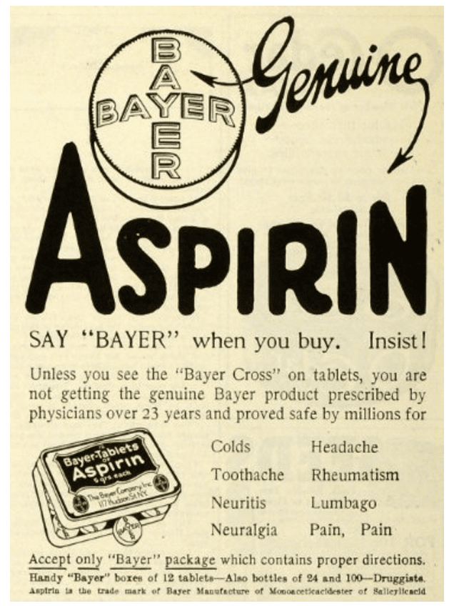
The spectrum of distinctiveness (1)
Generic terms the common name for the products or services in connection with which it is used, such as ‘salt’ when used in connection with sodium chloride.
A generic term is not capable of serving the essential trademark function of distinguishing the products or services of a business from the products or services of other businesses, and therefore cannot be afforded any legal protection.
Aspirin tablet is a registered trademark by Bayer AG. Aspirin is a generic word in many countries for the pain reliever acetylsalicylic acid.

Slide 12
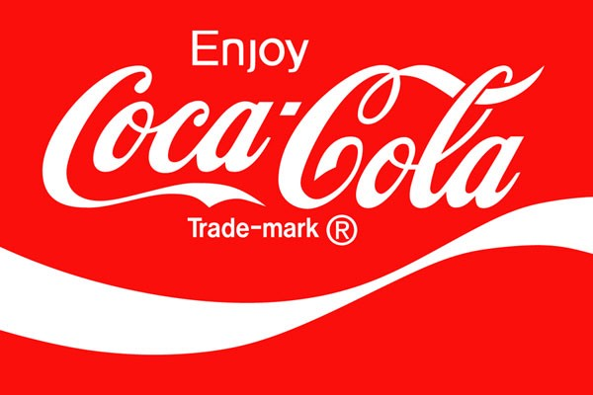
The spectrum of distinctiveness (2)
Descriptive marks a term with a dictionary meaning which is used in connection with products or services directly related to that meaning.
Examples:
Coca-Cola (made with ingredients from coca leaves).
Western Digital (located in California and sells tech products).
American Airlines (provides flight services in America).

Slide 13
The spectrum of distinctiveness (3)
Suggestive marks
A suggestive trademark is named after a characteristic of the product or service. There has to be an imaginative element to the trademark so that the consumers can make a connection with the goods or service.
Good examples of suggestive trademarks include Netflix and Microsoft. Netflix suggests online films in a suggestive and unique manner.
A potential problem with suggestive trademarks is that some of them can be seen as descriptive by others.
Putting this distinction into practice clearly is one of the most difficult and disputed areas of trademark law.

Slide 14
The spectrum of distinctiveness (4)
Arbitrary Marks
An arbitrary trademark is usually a common word which is used in a meaningless context (e.g. ‘Apple’ for computers).
Such marks consist of words or images which have some dictionary meaning before being adopted as trademarks, but which are used in connection with products or services unrelated to that dictionary meaning.
Apple is a fruit, but it doesn’t have any relation to computer hardware produced by Apple.
Arbitrary marks are also immediately eligible for registration.

Slide 15
Fanciful Trademark
Fanciful trademarks are something truly unique.
The word or words were created solely for use by the brand. The word ‘Exxon,’ for instance, was listed in no dictionary or industry publication prior to its registration. The name exists only to identify a specific oil and gas corporation. This essentially makes it impossible for any competitor to claim prior use over the trademark.
In addition to this, there are a variety of other benefits of fanciful trademarks:
True exclusive rights: Exclusive rights over a trademark typically only apply within an industry. Thanks to rules regarding dilution, protections for fanciful identifiers may be more extensive.
The best you can get: While other types of trademarks can become strong over time, fanciful properties start out with prima facie
Avoid cybersquatting: Domain squatters have purchased countless internet URLs in hopes of selling them to a company who owns rights over a trademark. Creating a fanciful trademark lets you purchase these domains before your brand identifier becomes public knowledge.
Injunctions likely: Courts are more likely to issue an injunction if a fanciful trademark is infringed.

Slide 16
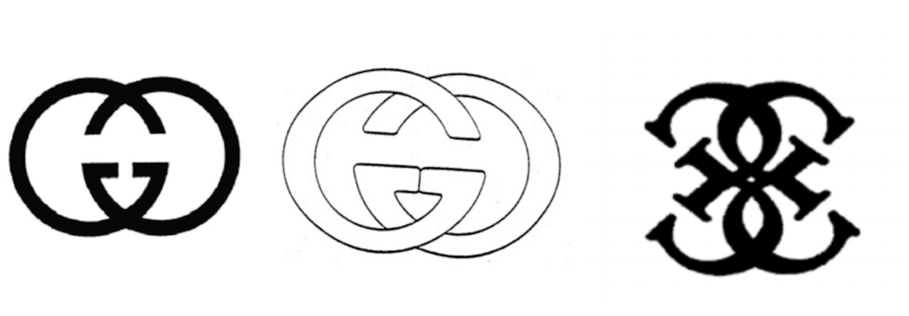
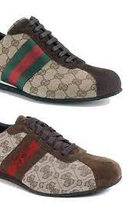
Trademark as a Communication Tool – Case Gucci vs. Guess
Court of Milan, 2nd of may 2013
The judge declared that not only was Guess not infringing Gucci’s trademarks, a number of Gucci’s trademarks, including its diamond-patterned G logo and Flora pattern trademarks, previously registered by Gucci in Italy and the European Union, were not valid.
There is no risk of “guccisation” of the brand!
The trademark ‘Guess’ cannot be confused, not even from the point of view of the risk of association, with the earlier trademark and patronymic “Gucci”, given that they are both well-known signs, profoundly different both in terms of their names and in terms of the characters and emphases used, and given the high level of attention of consumers in the relevant sector, that of high-end and high-priced clothing and accessories, the former referring to flashy products intended for a young public, the latter to elegant and “classy”.

Slide 17
Case Gucci vs. Guess all over the World
U.S. District Court - Southern District Of New York 21 may 2012 (Judge Scheindlin)
On the damages side, the judge held that Gucci failed to bring evidence of actual damages in the form of lost sales or harm to brand value and that the analysis for a reasonable royalty was highly speculative.
The Court established that Gucci was entitled to an accounting of profits but limited only to those profits gained in sales of products with the Quattro G pattern in brown/beige colorways and the GRG stripe, which were intentionally copied. Thus, out of a $120 million claim, the judge granted Gucci only $4,6 million in damages.
Tribunal de Grande Instance de Paris, 30 Janvier 2015
the Court of Paris ruled in Guess’ favor on all claims, rejecting each of Gucci’s claims of trademark infringement, counterfeiting and unfair competition
Nanjing Intermediate People's Court April 26 2013
It is worth noting how the Chinese court adopted a different standard of trademark inftingement, not looking at actual evidence of consumers’ confusion, but whether the marks looked subjectively similar, arguing that Chinese consumers are not as sophisticated as their American or European counterparts when distinguishing between the logos of foreign.
Jiangsu High People’s Court, August 31 2016
in 2016 the Jiangsu High People’s Court overturned the decision, finding for Guess.

Slide 18
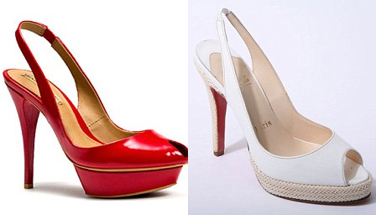
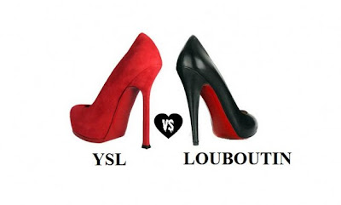
Case Louboutin vs. Yves Saint Laurent / vs. Zara France
Cour de cassation, civile, Chambre commercial, 30 mai 2012, 11-20.724
The Court did not recognise the distinctiveness of the trademark.
The registered sign appears two-dimensional, but with features and curvatures that had to be reproduced three-dimensionally and that make it impossible to understand whether the colour mark was applied on the inner or outer side of the sole.
U.S. Court of Appeals for the Second Circuit, Christian Louboutin S.A. v. Yves Saint Laurent Holding, Inc. 5 September 2012.
The Court recognised the distinctiveness of the trademark. However, this exclusivity can only be claimed if the red colour of the sole contrasts with another colour of the upper. In other words, if the entire shoe is red, like Yves Saint Laurent’s, the use of a sole of the same colour is permitted.

Slide 19
Puma vs. Sabel – Court of Justice EU, 11 november 1997, C-251/95
The stylised representations of the two signs were obviously a little different from each other but certainly similar in general perception (they were still fairly slim felines). However, the German Patent Office found no similarity and rejected the opposition filed by Puma, which was forced to appeal to the Bundespatentgericht (Federal Patent Court). The appeal was partially upheld for the ‘running puma’ mark.
The EU Court has ruled that there may be a likelihood of confusion on the part of the public, where the goods or services are identical, where the sign at issue consists of the juxtaposition of the name of the third party’s undertaking on the one hand and the registered trademark, which has normal distinctive character, on the other, and where the latter, without determining on its own the overall impression of the composite sign, retains an independent distinctive position within it.

Slide 20
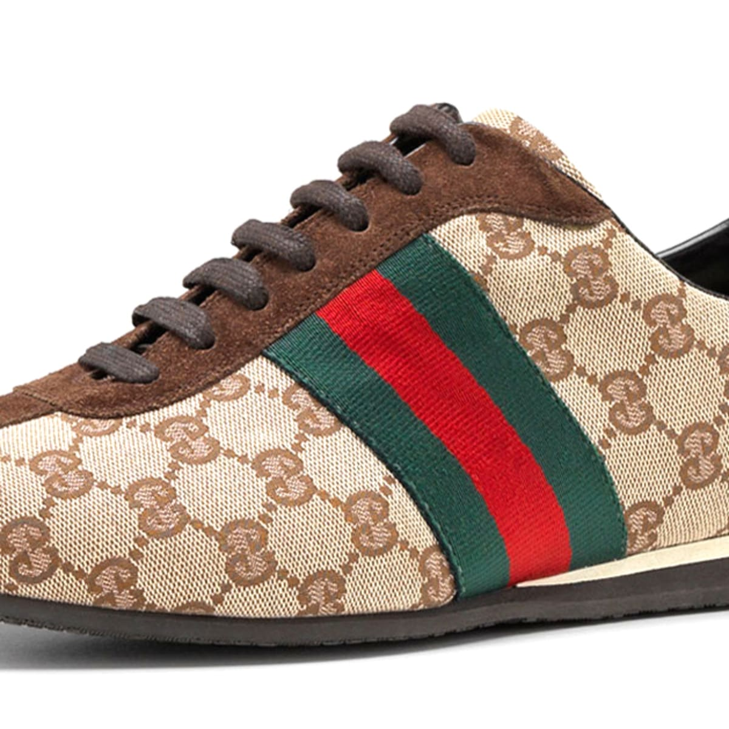
Colors: Can they be Trademarked?
Colors hold more power than we often may assign to them.
In order for a color to be marked, it requires that there be proof of a “secondary meaning”. This means that a color can only be trademarked in connection with a good or service if, through the use of the color over time, the public has come to associate that color with a particular brand.
Secondary meaning can be extremely difficult to prove, unless the color or color combination is not widely used for other goods and services, is unusual, or is elaborate. One of the best ways to demonstrate this is by providing a high volume of advertising in which the color mark has been used.
Gucci stripes (green – red – green) Court of Milan, 10 january 2013
The Court held that the Gucci trademark depicting the 'green-red-green' ribbon was valid, as it can be attributed undoubtedly distinctive force and its suitability to identify exactly the origin of the goods concerned from a particular undertaking'. green-red-green' ribbon, since 'it can be attributed undoubtedly distinctive force and its suitability for identifying exactly the provenance of the goods concerned from a particular undertaking'.

Slide 21
Reputation Capital – Brand Equity
When we talk about a trademark, we refer first of all to a sign, that is, an element of language capable of communicating a message.
However, the trademark has something more than just a sign: this quid pluris consists in the capacity of the sign to be an instrument of communication of a message, but of a specific and not generic message (which is what makes the sign ‘distinctive’).
The attractive value of the brand, its suggestive charge, able to evoke further sensations, suggestions, through which the purchase of a given product does not end with it but at the same time involves an investment, as mentioned above, in reputation capital.
SWANN-DAVIS, Dilution, an Idea Whose Time Has Gone; Brand Equity as Protectible Property, the New/Old Paradigm, in The Trademark Reporter, 1994 (84), p. 282, «The basic fact is that many trademarks are no longer mere words indicating source but are symbols with independent value and are entitled to be protected like any other corporate asset» …
p. 299 «A brand, quite simply, stakes out an image, defined by associational markers in the consumer’s mind, and to the extent that another ‘poaches’ on the metes and bounds of the image, the brand owner is entitled to seek protection».
Brand equity from the consumer perspective is based on brand loyalty, which is a measure of the propensity of customers to repurchase a brand and brand awareness, which identifies the degree to which the target audience is aware of the brand.
The recognisability of the trademark underlines the boundaries of ownership!

Slide 22
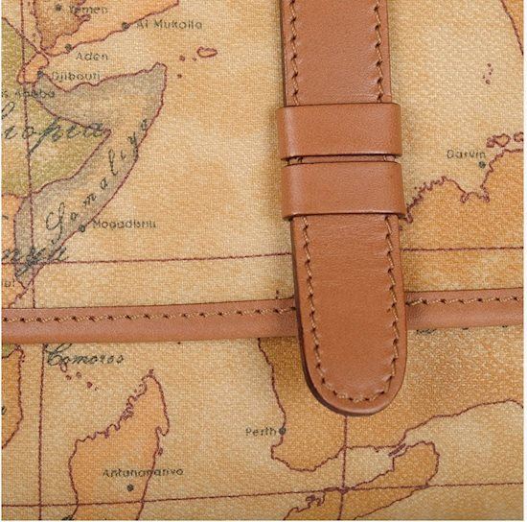
Alviero Martini Geo Case (1)
The designer, founder of Alviero Martini S.p.a., was the owner of a number of trademarks, some of which were substantial and included his own patronymic name ‘Alviero Martini’ (including ‘Alviero Martini Prima Classe’), which, following the exit of the designer from the company, due to the now compromised relationship with the majority shareholders, were sold by ‘Maestro’ Martini, in the context of a broader settlement agreement, together with his shareholding, to Alviero Martini S.p.a.
The stylist’s claim of his right provided for by art. 8, par. 3, C.p.i., both on the name Alviero Martini, his patronymic, and on the “Geo”, to be considered notorious signs and as such, reserved for the author of them.
Court of Milan, 8 april 2014
The Court has therefore affirmed, also in case-law, that well-known signs, first and foremost the patronymic of a famous person, are protected against any parasitic exploitation aimed at exploiting the market value of these signs as a means of communication.

Slide 23
Alviero Martini Geo Case (2)
The Court held that the use ‘of the sole patronymic of the designer as a (de facto) trademark by Alviero Martini s.p.a. - certainly a well-known person not only in the fashion industry ... - was expressly without the consent of Alviero Martini on the basis of the content of the transaction itself, and therefore in violation of the sui generis right granted to the stylist, it being instead excluded, in the opinion of the court, that such a prohibition affected ‘the rights of the registered signs 1st Class Alviero Martini owned by the defendant company’. The court, in fact, stated that only in the first case ‘such use integrates a distinctive purpose unduly detached from the union with the name 1a Class, thus making concrete and indisputable - also because of the particular evidence that the designer’s name presents in the overall appearance of the garment - the conduct contrary both to the contractual agreements and to the provisions of art. 8, paragraph 3 c.p.i.’.
The Court states that there is no obligation on the transferee to ‘repudiate its past’ but on the contrary it is possible to bind itself to it and to enhance it.
We could only add that even such use must in any event be in conformity with the principles of professional correctness, this provision being a general canon of conduct on the market.

Slide 24
Trademark infringement
‘Likelihood of confusion’ is the central focus of any trademark infringement claim.
A likelihood of confusion exists when consumers viewing the allegedly infringing trademark would probably assume that the product or service it represents is associated with the source of a different product or service identified with a similar mark. Courts conducting a likelihood of confusion analysis will apply 2 different standards, depending on whether the accused item directly competes or does not directly compete with the trademarked item.
U.S. Court of Appeals for the Third Circuit - 237 F.3d 198 (3d Cir. 2000)
Miraclesuit swimwear vs. “The Miracle Bra” swimwear Victoria’s Secret Catalogue
1. When the accused item directly competes with the trademarked item in the goods and services provided:
the trial court will rarely look beyond the trademark itself; infringement will usually be found if the two trademarks at issue are so sufficiently similar that consumer confusion can be expected.
2. If the goods in question are completely unrelated in the goods and services which provided:
the court will typically find that confusion is unlikely, and therefore there is no infringement .
If the goods in question are related but do not directly compete for sales, the likelihood of confusion analysis becomes more complex.

Slide 25
Lapp Test
The Lapp Test is the standard used to determine whether a likelihood of confusion exists between two trademarks. Under the Lanham Act, liability for trademark infringement is essentially based on a finding that the use of one trademark causes a likelihood of confusion with another previously established trademark. A likelihood of confusion exists when an allegedly infringing trademark is likely to cause an appreciable number of reasonably prudent purchasers to be confused as to the source or origin of the products or services it is used to identify.
The Lapp test is a multi-factored test used to establish the existence of a likelihood of confusion.
The Lapp factors include: (1) similarity of the marks; (2) strength of plaintiff’s mark; (3) sophistication of consumers when making a purchase; (4) intent of defendant in adopting the mark; (5) evidence of actual confusion (or lack thereof); (6) similarity of marketing and advertising channels; (7) extent to which the targets of the parties’ sales efforts are the same; (8) product similarity; identity/function/use; and (9) other factors suggesting that consumers might expect the prior owner to manufacture both products, or expect the prior owner to manufacture a product in defendants market , or expect the prior owner is likely to expand into defendant’s market.
The Lapp test is a non-exhaustive list of factors relevant to assessing the likelihood of confusion. Not all factors will be relevant in all cases, and the different factors may properly be accorded different weights depending on the circumstances of each particular case.
No single factor is dispositive and a finding of a likelihood of confusion does not require a positive finding on a majority of the factors listed. The Lapp factors are intended as a guide; a court is free to consider any other relevant factors in determining whether a likelihood of confusion exists.

Slide 26
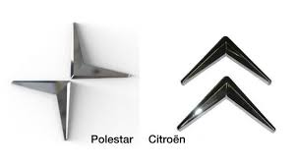
Citroën vs. Polestar case (1)
Cour d’appel de Paris, Pôle 5 – chambre 1, nr 20/12598 (Citroën vs. Polestar) [14 December 2021]
In this logo dispute, the Paris Court of Appeal upheld the judgment of the court of first instance, holding that the use of the Polestar logo infringes the exceptional reputation of Citroën’s two French trademarks (Article L. 713-3 du Code de la Propriété intellectuelle, Article 10(2)(c) D(EU) 2015/2436). Building on a rich set of EU Court of justice’s case-law, the French Court applied all the conditions specific to the protection of a registered trademark with reputation, while bearing in mind the peculiarities of the automotive industry.
During the proceedings, Citroën argued that by registering two European trademarks, Polestar had made use of them in the course of trade in France. But the Court confirmed that the mere application for registration of a sign as a trademark does not constitute an act of infringement, and therefore cannot be characterised as an infringement of a reputed trademark either. However, the Court also ruled that there were elements leading to a conclusion that Polestar had made use of the contested signs in the course of trade that were likely to constitute a serious risk of the alleged infringement of Citroën’s reputed trademarks.

Slide 27
Citroën vs. Polestar case (2)
Polestar then claimed that there was no link between the contested signs and the alleged reputed trademarks. They argued that the degree of similarity between the signs was not sufficient – the signs being visually and conceptually different – for the public to establish such a link between the signs. To support the lack of a link in this case, they also relied on the relevant public’s high level of attention arising from the high price of the products, the infrequency of the purchases, the particular interest of buyers, and the distribution channels (exclusive dealerships).
However, the Paris Court of Appeal sided with the first instance’s judge and held that the reputation of Citroën trademark was infringed despite a weak degree of similarity, on the ground of the exceptional reputation of the ‘chevron’ trademarks among the French public and its strong degree of distinctiveness acquired through use. The Court ordered Polestar to pay Citroën EUR 150.000 in damages. The Court also prohibited Polestar from using the litigious signs in France during 6 months, under penalty of a fine of EUR 1.000 per day.

Slide 28
Remedies for infringement in EU, in U.S.A…
Where an EU trademark court finds infringement, the primary remedy is an order prohibiting further infringement or threatened infringement, accompanied by measures aimed at ensuring that the prohibition is complied with (eg, a penalty payment).
Damages and other remedies are governed by national law and may vary. In general, there are usually quantified damages in the form of compensation of the claimant’s loss, disbursement of the profits made by the defendant or payment of hypothetical royalties. Under civil law, punitive damages are not usually awarded, but they are possible and are increasingly sought.
Other remedies include claims for seizure and destruction of the infringing products, disclosure of information, rendering of accounts and publication of the judgment.
As a rule, infringement of an EU trademark entitles the owner to remedies across the whole European Union if the relevant EU trademark court has the jurisdiction to grant pan-EU relief. However, pan-EU remedies are limited where, for linguistic or other reasons, there is no infringement in a certain part of the European Union.
The remedies for infringement under the Lanham Act are statutory and consist of: injunctive relief; an accounting for profits; damages, including the possibility of treble damages when appropriate; attorney’s fees in "exceptional cases;" and costs.

Slide 29
…and in Italy
In order to identify the sum to be compensated, the loss of profit was calculated by referring to 1) the turnover of the infringer, according to an approach criticised because it identified an equivalence between the loss of one and the gain of the other, which is not necessarily the exclusive result of infringing conduct, thus breaking the etiological link according to which only the necessary and direct consequence of the offence is compensated (and further criticism can be made in relation to the fact that counterfeiting leads to a minimal diversion of customers, since the purchasers of the counterfeit product would not have bought the original product anyway); or 2) to the contraction of the entrepreneur’s turnover following the infringement, according to a criterion which is also considered unsatisfactory in that even those decreases in the infringer's turnover deriving from factors other than the infringement would be automatically attributed to the infringer, thus ending up configuring a hypothesis of strict liability on the part of the infringer.
In order to remedy these problems, article 125 c.p.i. identified the criteria for compensation, going beyond the jurisprudential practice of determining compensation on an equitable basis by identifying a lump sum to be paid by the damaging party: however, the rule does not appear easy to interpret as the legislator has for the first time positivised innovative aspects with respect to our legal tradition.
The liquidation of the lost profit, is carried out in the form of:
- 1) Virtual royalty, whereby the infringer shall be required to pay to the infringing entrepreneur the royalties that he would have had to pay him for the exploitation of the trade mark if he had concluded a regular licence agreement, with a quantification of the same carried out by means of a market survey.
- 2) Reversal of profits, whereby the damage is quantified in the sum of the profits received by the infringer during the time of the commission of the offence and which he must pay.

Slide 30
Final remedies in the Italian Legal System (1)
The remedies available against a trademark infringer are a final injunction with a penalty, cancellation of the infringer’s trademark if registered, withdrawal of the infringing goods from the market, destruction or assignment to the trademark holder of the infringing goods, publication of the decision and damages.
Permanent injunction: There must generally be a risk of future infringements to justify a permanent injunction. However, it is disputed whether such a risk still exists where the infringer has voluntarily ceased the infringing activities, or whether at least a formal undertaking by the infringer is required in order to exclude the risk or repetition.
A permanent injunction, like a preliminary injunction, is usually coupled with a monetary penalty payable by the defendant in the case of non-compliance or delay in compliance. The injunction, as well as the removal from the market, whether final or provisional, can be ordered against the infringer or any intermediary who is party to the proceedings and whose services have been used to commit the infringement. Therefore, only suppliers and customers that were parties to the proceedings will be bound by the injunction.
In addition to the above, violating an injunction can also constitute a crime under the Italian Criminal Code (Article 650).
Cancellation of the infringer’s trademark
If the infringer's trademark was registered, the court will declare its invalidity and order that a copy of the decision is transmitted to the IPTO to be recorded in the trademark register.

Slide 31
Final remedies in the Italian Legal System (2)
Delivery up or destruction of infringing goods
The destruction of the infringing goods cannot be ordered if it is prejudicial to the national economy, in which case the trade mark holder is only entitled to damages (Article 124(3), CIP). If the infringing goods can be lawfully used subject to their modification, the court can order their provisional recall with the possibility of putting them back on the market when modified, instead of their destruction.
Publication of the decision
The court on request by the winning party can order the publication of the decision or of part of it on one or more newspapers or internet websites, with costs to be borne by the losing party.
Recall order
Together with the declaration of infringement, the court can also order permanent recall from the market of the infringing goods.
If the infringing goods can be lawfully used after being modified, the court can alternatively order their provisional recall with the further possibility to reintroduce them on the market once modified.

Slide 32
MASTER MEIM 2022-2023
THANKS FOR ATTENTION!

