Slide 1
MASTER MEIM 2022-2023
TRADEMARK LAW
Master 2022-2023
21/3/2022
Jacopo Baieri
jacopo.baieri@chiomenti.net

Slide 2
MASTER MEIM 2022-2023
2. IP agreements
TM license agreements

Slide 3
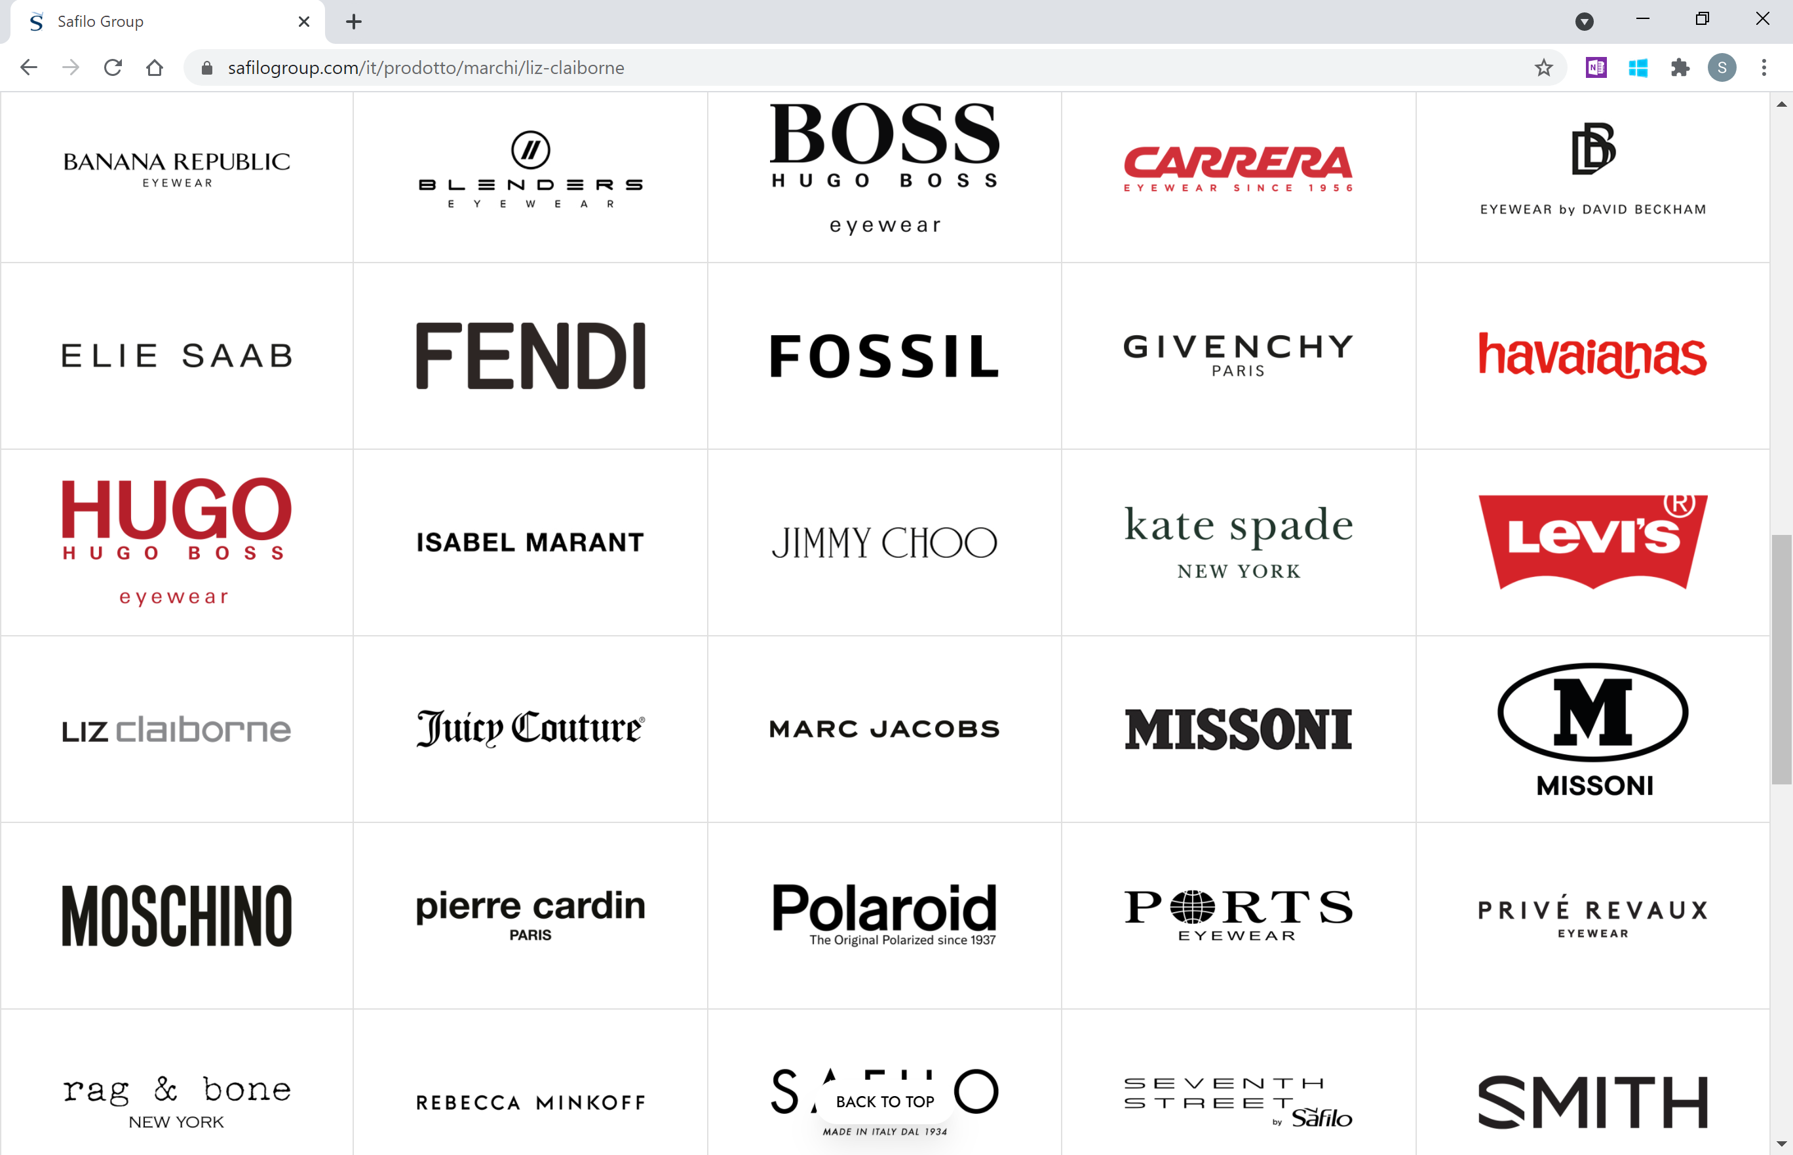
The business of license

Slide 4
Legal framework
Art. 23
Italian IP Code
Art. 2573
Italian Civil Code
Art. 25
Reg. (EU) 2017/1001
A license is an agreement whereby the owner of an IP right (e.g., a trademark) grants a third party the right to commercially exploit it (usually, against a fee) while retaining its ownership

Slide 5
Nature of license agreements
Exclusive
No one (including owner-licensor) other than the licensee can exploit the relevant IP right
Non-exclusive
The licensee(s) is/are granted the right to use the IP right, but the licensor remains free to exploit the same IP rights and to grant other licensees with the same right of exploitation
Sole
The license is formally non-exclusive but substantially exclusive, since licensor – while reserving full rights to exploit the IP right itself – is limited in that it cannot grant the IP right to any licensees other than the “sole” licensee

Slide 6
Scope 1/5
(IP) object
Usually, the licensed IP rights are listed in an Annex, which indicates all relevant necessary information.
“Licensor hereby grants to Licensee, and Licensee hereby accepts, a [exclusive/non-exclusive/sole], non-sublicensable, non-assignable, non-transferrable, license to use the IP rights listed in Annex A within the Territory (as defined below)”.

Slide 7
Scope 2/5
Goods - services
&
Limitations
Especially in case of TMs, licenses can either be granted with respect to the overall goods or services covered by the sign or for a portion of them only.

Slide 8
Scope 3/5
Activities
Indication of the activities granted to the licensee (e.g., manufacturing, packaging, distribution, advertising, promotion, sale)

Slide 9
Scope 4/5
Territory
Precise indication of the specific countries with respect to which the license is granted.
Usually, this list is included in an Annex.

Slide 10
Scope 5/5
Term
Duration of the agreement and specification of possible automatic renewals mechanisms.

Slide 11
Economics
Fixed amount
"As consideration for this Agreement, Licensee shall pay Licensor a lump sum of Euro [●] for each year of the license, upon receipt of the relevant invoice to be issued by Licensor. The fee will be paid through a bank account at the coordinates provided by Licensor"
Royalty
"Licensee shall pay to Licensor for each contract year an amount equal to [●]% of the Net Sales of the Licensed Products sold and invoiced by Licensee for such contract year ("Royalty")"
%
Guaranteed minimum + royalty
"Licensee shall pay to Licensor a percentage of [●]% to be calculated on Net Sales ("Royalties"), subject to Licensee's commitment to pay minimum non-refundable Royalties equal to [●]% to be calculated on the Minimum Net Sales ("Guaranteed Minimum Royalties")"
%

Slide 12
Licensee’s obligations 1/3
“Licensee shall keep accurate books of account and records covering all transactions relating to the license hereby granted, all of which books and records shall be kept separate from Licensee’s books and records relating to transactions outside of the scope of this Agreement and kept in such detail so as to enable Licensor to monitor the obligations of Licensee.
Licensor, upon thirty (30) days’ notice given to Licensee shall have the right, during normal business hours, to examine the books of account, records and all other documents, materials and inventories in the possession or under the control of Licensee and shall have full access thereto for said purposes”.
Record keeping
&
Audit

Slide 13
Licensee’s obligations 2/3
“Licensee shall submit to Licensor's prior approval any advertising materials, as well as any further prospective advertising or promotional activities in connection with the Trademark and/or Products“ → [●]% of the Net Sales (or different amounts) to be dedicated to such activities
Promotional activities
“Licensee shall genuinely use the Trademarks throughout the Territory for the purposes described herein, also in order to prevent any risk of forfeiture, wholly or partly, of any Trademarks in any part of the Territory"
Use of IP rights
(esp. TMs)

Slide 14
Licensee’s obligations 3/3
“Licensee shall notify Licensor in writing of any infringement, misappropriation or imitation of the IP rights by any third party, promptly after any of the foregoing comes to Licensee’s attention.
Licensor shall have the right to commence or prosecute any claims or suits in its own name or in the name of Licensee or join Licensee as a party thereto in order to address such infringement, misappropriation or imitation related to any of the IP rights. If Licensor brings an action to discontinue such infringement, misappropriation or imitation, such action shall be at Licensor’s cost, with Licensee providing such reasonable cooperation as Licensor may request in writing.
If Licensor declines to bring an action, Licensee may do so at Licensee’s sole cost”.
Protection of the licensed IP rights & cooperation

Slide 15
Confidentiality 1/2
“During the term of this Agreement and for a period of [●] years thereafter, or unless and until the information properly comes into the public domain, each Party shall maintain the secrecy and confidentiality of any Confidential Information and shall use Confidential Information only for the purposes specified in this Agreement, and shall not disclose to any third party or person any Confidential Information at any time without the prior written consent of the Party disclosing such Confidential Information”.
Confidentiality

Slide 16
Confidentiality 2/2
Information in the public domain at the time of disclosure or later other than through a breach of any obligation of confidentiality;
Information for which the receiving Party can provide documentary evidence that it was
in its lawful possession prior to disclosure to it by the disclosing Party; or
independently developed by the receiving Party without prior knowledge of any Confidential Information
Exceptions

Slide 17
Focus – Franchising 1/3
What is a «franchising» agreement?

Slide 18
Focus – Franchising 2/3
Set of IPRs
Franchisee is granted a license to use various IP rights (trademarks, insignias, designs, know-how, patents, etc.), along with services provided by franchisor (e.g., staff training, technical and commercial consultancy, etc.)
Sales network
Franchisee is included in a system being a network of franchisees within a certain territory, bearing the same “entrepreneurial flag”, following clear-cut standards inhering to the set of IPRs and commercializing products/services of the franchisor
Independence
Franchisee remains legally and economically independent from the franchisor

Slide 19
Focus – Franchising 3/3
Art. 2
Directive (EU) 2016/943
Art. 98-99
Italian IP Code
Confidentiality obligations
=
legal steps
“Confidentiality obligations shall survive termination of this agreement for 5 (five) years or the longer period of protection under articles 98-99 of the Italian IP Code"
Undisclosed know-how and business information (“trade secrets”) is protected under IP statutes if – inter alia – it has been subject to reasonable steps under the circumstances, by the person lawfully in control of the information, to keep it secret

Slide 20
Termination 1/2
“Licensor is entitled to early terminate in all or in part this Agreement - at any time and for any reason whatsoever - by giving Licensee a [6 (six) months] prior written notice"
For convenience
“Licensor may early terminate this Agreement, with immediate effect and without payment of any compensation for services not yet rendered, in case of a material breach by Licensee of any of the following articles [●] which, if curable, Licensee has failed to cure within 15 (fifteen) days after receipt of a written notice from Licensor"
For cause

Slide 21
Termination 1/2
“Any sum accrued, including sums by way of Guaranteed Minimum Royalties, Royalties or any other sum due to Licensor under the Agreement, shall become immediately due and payable without prejudice, in any event, to Licensor's right to compensation for damages suffered by Licensor"
Consequences
"Licensee shall immediately stop the use of the IP right, in whatever form and manner, and shall remove within [●] days all existing uses in whatever material medium and means made. For each day of delay on the deadline, the Licensee is obliged to pay a daily penalty equal to [●], without prejudice to the greater damage" → Sell-off"
“All Designs, Projects, Advertising Materials, and any other IP right items may no longer be used in any manner by Licensee and shall be returned free of charge to Licensor or destroyed at Licensee's expense at Licensor's request within the time specified by Licensor, with Licensee's obligation to provide proof of destruction"

Slide 22
Law and Jurisdiction
Law
“This Agreement and the rights and obligations of the Parties hereunder shall be governed by, construed and interpreted in accordance with, the laws of [●]”
Jurisdiction
Identification of a Court that shall have exclusive jurisdiction over any dispute arising out or in connection with the agreement;
Chamber of Arbitration;
Mediation process.

Slide 23
MASTER MEIM 2022-2023
Thank you and … Good luck!

