Slide 1
MASTER MEIM 2022-2023
TRADEMARK LAW
Master 2022-2023
21/3/2023
Sara Molina
sara.molina@chiomenti.net

Slide 2
MASTER MEIM 2021-2022
3. A focus on TMs case law
& relevant criteria

Slide 3
What is a trademark?
Trademarks are the signs used in trade to identify a company’s products.
Trademarks are the symbols customers use to pick a company’s product out. They distinguish each company from its competitors.
In some countries, such as Italy, protection is granted even if a trademark is not registered, as long as it is used.

Slide 4
Examples of trademark (1/4)
Word
Figurative
Shape/3D
«Unconventional»
colour
sound
motion
position
multimedia
hologram
pattern
olfactory

Slide 5
Examples of trademark (2/4)
Word
Figurative

Slide 6
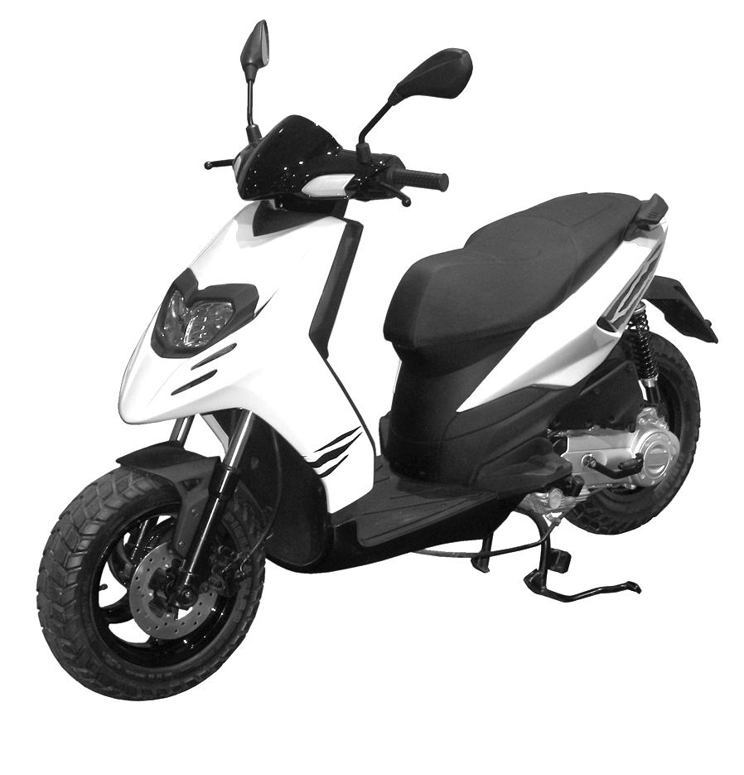
Examples of trademark (3/4)
Word + Figurative
Shape

Slide 7
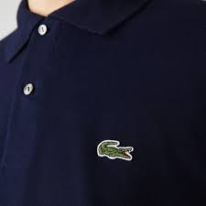
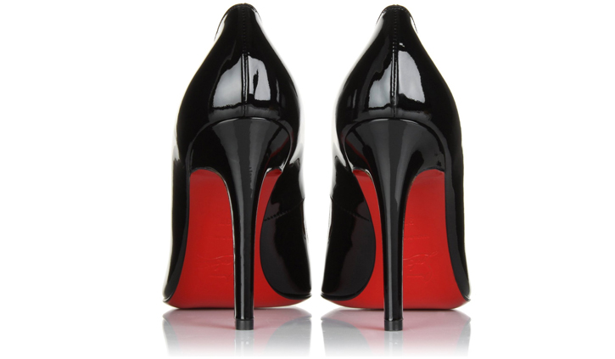
Examples of trademark (4/4)
Color
Position

Slide 8
TMs infringement: EU Law
Upon opposition by the proprietor of an earlier trademark, the trademark applied for shall not be registered:
(a) if it is identical with the earlier trademark and the goods or services for which registration is applied for are identical with the goods or services for which the earlier trademark is protected;
(b) if, because of its identity with, or similarity to, the earlier trademark and the identity or similarity of the goods or services covered by the trademarks there exists a likelihood of confusion on the part of the public in the territory in which the earlier trademark is protected; the likelihood of confusion includes the likelihood of association with the earlier trademark - Art. 8 EU Reg. 2017/1001

Slide 9
TMs infringement: Italian Law
The TM owner has the right to prohibit third parties from using, in the course of business, a sign which is identical or similar to its registered trademark for identical or similar goods or services, if - because of the identity or similarity of the signs and the identity or similarity of the goods or services - there exists a likelihood of confusion on the part of the public, which may also consist of a likelihood of association between the two signs - (Art. 20 (1) (b) Italian IP Code

Slide 10
TMs infringement: the ‘risk’ criteria
Risk of confusion means the risk that the average consumer might believe that the products or services come from the same company
Risk of association means the risk that the average consumer might think there is an economic link between the companies of the two brands in suit

Slide 11
TMs infringement: assessment criteria (1/7)
“The likelihood of confusion between two conflicting trademarks cannot be assessed on the basis of an abstract comparison of the conflicting signs and the goods and services covered by those signs. The assessment of the likelihood of confusion must, rather, be based on the perception which the relevant public has of the signs and the goods and services at issue” (24/05/2011, T-408/09, Acotel, § 29).
“The global appreciation of the visual, aural or conceptual similarity of the marks in question must be based on the overall impression given by the marks, bearing in mind, in particular, their distinctive and dominant components” (11/11/1997, C-251/95, Sabèl, EU:C:1997:528, § 23).

Slide 12
TMs infringement: assessment criteria (2/7)
These factors should be taken into account: nature; intended purpose; method of use; complementarity; competition; distribution channels; relevant public; the usual origin of the goods/services.
Identical
Goods and/or Services
A functional link between goods/services will usually be a strong indication of complementarity: for instance when one product or service is required for the proper functioning of the other, one enables the use of the other, or one cannot be used without the other.
There is complementarity between goods and services only when the consumers of the goods and services concerned may think that the same undertaking is responsible for producing those goods or providing those services
Similar or complementary

Slide 13
TMs infringement: assessment criteria (3/7)
In the comparison of retail services in stores of all kinds of foodstuffs, especially patisserie and confectionery contained in Class 35, with various kinds of foodstuffs falling within Classes 29, 30 and 31, the retail services relate to a relatively broad category of goods that includes the goods covered by the other mark. Consequently, the retail services and the goods covered by the other mark were found to be complementary (05/05/2015, T‑715/13, Castello (fig.) / Castelló y Juan S.A. (fig.) et al., EU:T:2015:256, § 29-31).
Similarity or complementarity in goods and/or services
Skis (Class 28) and ski boots (Class 25) are complementary because the use of one is indispensable for the use of the other. The relevant public may think that the production of these goods lies with the same undertaking. In addition, they share the same public and distribution channels. These goods are consequently considered similar.

Slide 14
TMs infringement: assessment criteria (4/7)
Visual perspective
Phonetic perspective
Conceptual perspective

Slide 15
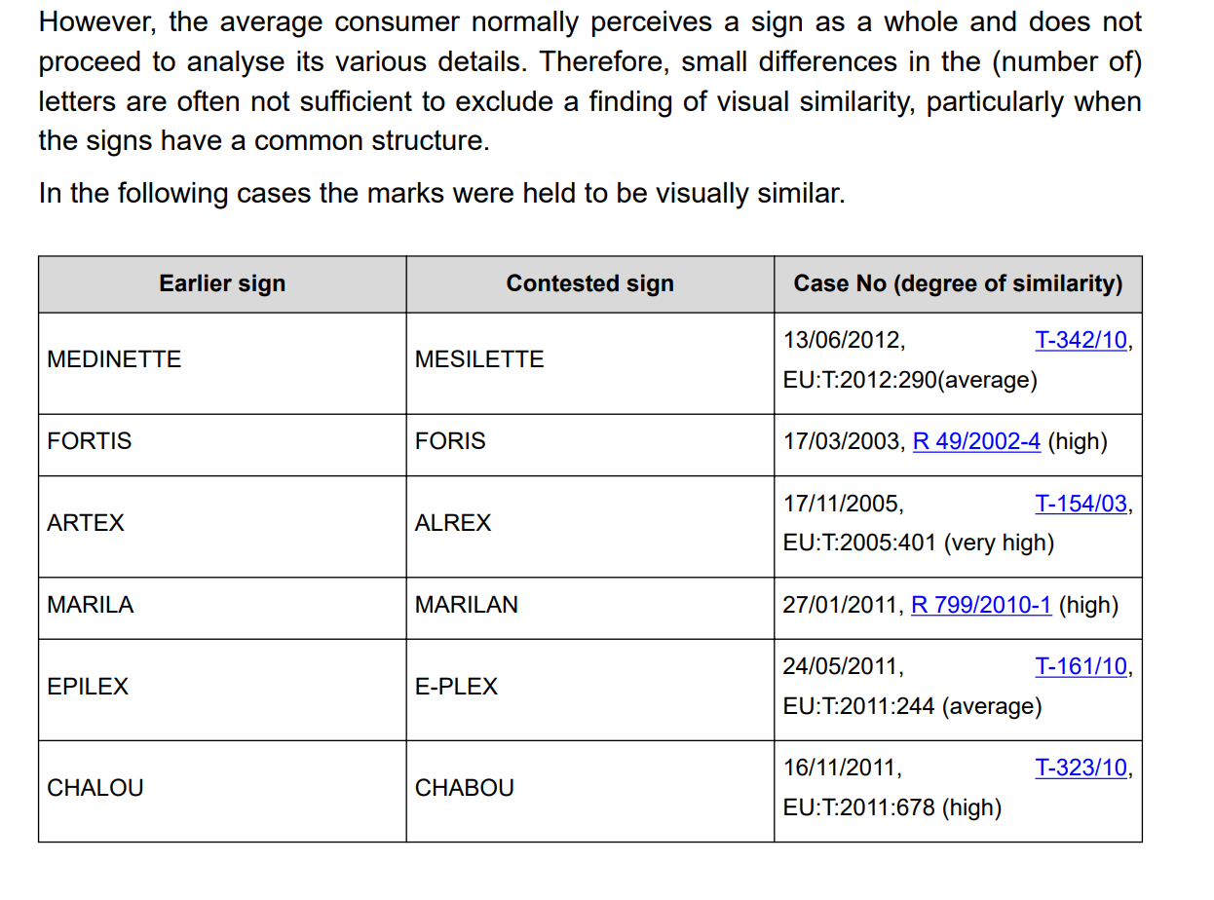
TMs infringement: assessment criteria (5/7)
Visual perspective
https://guidelines.euipo.europa.eu

Slide 16
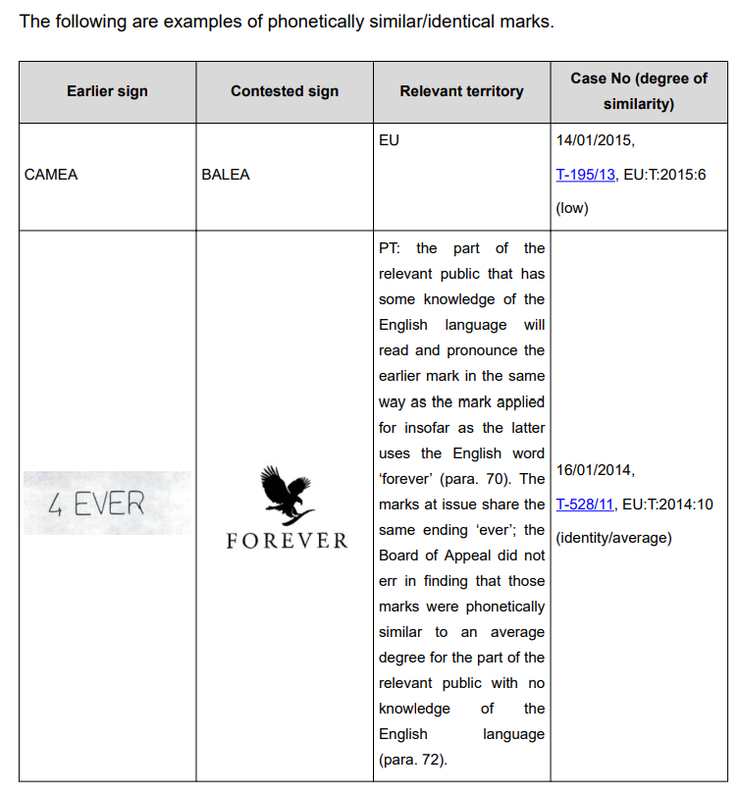
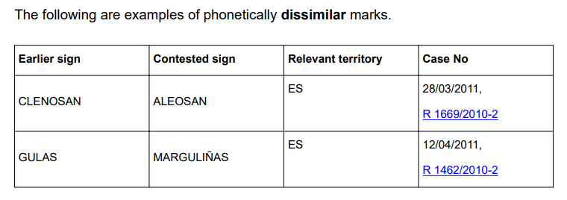
TMs infringement: assessment criteria (6/7)
Phonetic perspective
https://guidelines.euipo.europa.eu

Slide 17
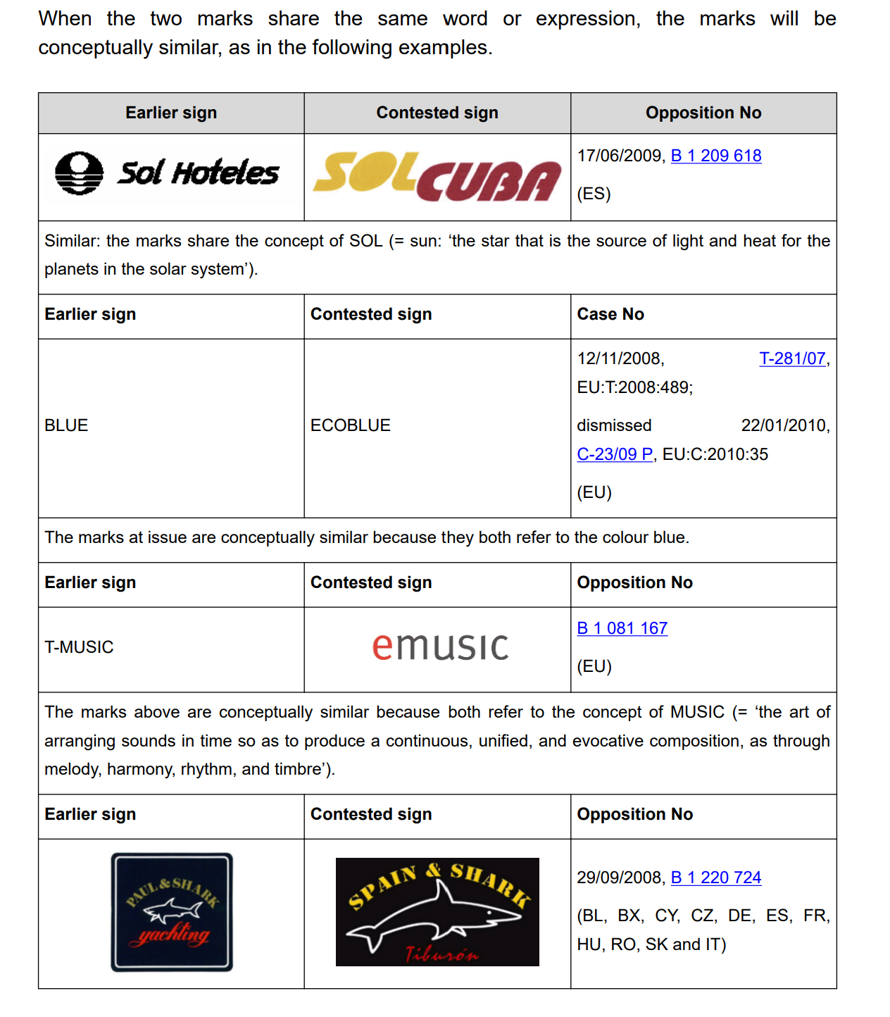
TMs infringement: assessment criteria (7/7)
Conceptual perspective
https://guidelines.euipo.europa.eu

Slide 18
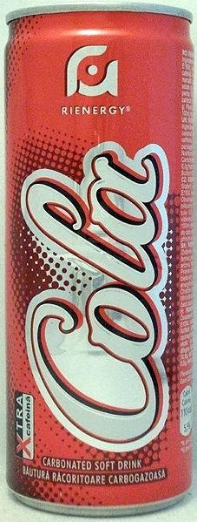
TMs infringement: case law (1/5)

Slide 19
TMs infringement: case law (2/5)
“The earlier mark displays a similar red background to that of the later mark, although the former is held within a circular border while the latter is contained in a rectangular border. The identical word ‘COLA’ appears in a highly similar white cursive script in both marks. Although the challenged mark includes the word ‘RIENERGY’, this term cannot be allocated a significant role in the visual comparison, given its diminutive size and marginalized position, appearing little more than an adventitious component…Clearly, the marks are highly similar with respect to a number of elements: the red background, the word ‘COLA’, the white script – but dissimilar with respect to the other key element ‘COCA’ and to a lesser extent the word ‘RIENERGY’”.
Visual perspective

Slide 20
TMs infringement: case law (3/5)
“taking into account the likelihood that ‘RIENERGY’ in the applicant’s mark will be overlooked by the consumer, the marks still differ in the number of syllables. The words ‘CO-CA CO-LA’ in the earlier mark possess four syllables, while ‘CO-LA’ of the later mark possesses two. Nevertheless, although he two syllables ‘CO-CA’ of the earlier mark have no parallel in the later mark, both marks contain the identical syllables ‘CO-LA’, producing – as found in the contested decision – a degree of similarity”.
Phonetic perspective

Slide 21
TMs infringement: case law (4/5)
“Conceptually, for many consumers, the earlier signs designate a fizzy drink
tasting of ‘coca’ leaves and ‘cola’ nuts. The later sign designates a fizzy cola
drink. Hence there is a conceptual convergence based on the meaning of the
common element ‘COLA’”.
Conceptual perspective

Slide 22
TMs infringement: case law (5/5)
“there is a risk of confusion between this earlier mark and the mark applied for, since the signs are similar and the services are identical. The Board recalls that a lesser degree of similarity between the signs is offset by a greater degree of similarity – in this case, there is actual identity – between the goods. In other words, since based on the identical presence of the fanciful word ‘COLA’ in each sign, the relevant consumers – even bearing in mind their professional status – will believe that the identical services derive from the same trader” (OHIM – Second Board of Appeal, 6 May 2013).
Likelihood of confusion

Slide 23
TMs infringement: examples (1/2)

Slide 24
TMs infringement: examples (2/2)

Slide 25
MASTER MEIM 2022-2023
Thank you and … Good luck!

