Slide 2
Question 31
Computational Intelligence
Question
  A Fuzzy System is based on
    linguistic variables
    random variables
    stocastic variables

Slide 3
Introduction
Soft Computing
  as opposed to traditional computing, deals with approximate models and gives solutions to complex real-life problems
  principal constituents
    Fuzzy Logic (FL)
    Evolutionary Computation (EC)
    Swarm Intelligence (SI)
    Artificial Immune Systems (AIS)
    Machine Learning (ML)
    Probabilistic Reasoning (PR)
      belief networks and parts of learning theory

Slide 4
Introduction
Computational Intelligence
  refers to the ability of a computer to learn a specific task from data or experimental observation
  synonym of Soft Computing

Slide 5
AI Methodologies
Machine Learning
  Neural Networks
    Shallow Neural Networks
    Deep Neural Networks
  Support Vector Machine
  Bayesian Nets
  Statistical learning
Soft Computing
  Fuzzy Logic
  Neuro-Fuzzy
  Evolutive Approaches
    Genetic algorithms
    Swarm optimization
    Anton Colony
    Bee Colony

Slide 6
Fuzzy Logic
Fuzzy Logic is used to describe and operate with vague definitions
  Example (control of a cement plant)
    if the temperature is high add a little cement and increase the water a lot
Fuzzy logic is a form of many-valued logic
  the truth values of variables may be any real number between 0 and 1 inclusive

Slide 7
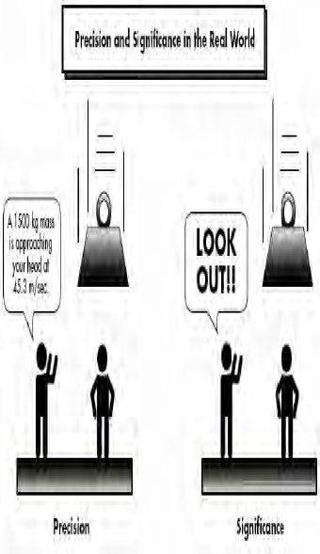
Meaning vs precision
Difference between meaning and precision
Notes:
IP fornisce un servizio best-effort: fa il massimo sforzo per recapitare i datagrammi il più velocemente possibile, senza fornire però nessuna assicurazione in merito
al ritardo
all’entità del jitter di pacchetti
Essendo la telefonia internet e la videoconferenza in tempo reale particolarmente sensibili a questi aspetti, l’assenza di garanzie crea notevoli problemi alla progettazione ti tali applicazioni.
Per fortuna, i progettisti possono introdurre svariati meccanismi che consentono di preservare una buona qualità audio e video, almeno nei casi in cui ritardi, jitter e perdite non siano eccessivi.
Tratteremo il caso della telefonia Internet.

Slide 8
In brief …
Boolean logic
  Boole (1854)
Classical set theory (1900)
  traditional sets (boolean belonging) and set operations
Multivariate logic
  Russell (1920)
  Lukasiewicz (1930)
Fuzzy Logic theory
  Zadeh (1965)
  extension of traditional sets (non boolean belonging) and operations on the elements
Neutrosophic logic
  Smarandache (1998)

Slide 9
Crisp vs Fuzzy sets
Fuzzy logic is a set of mathematical principles for representing knowledge based on the degree of belonging to a set

Slide 10
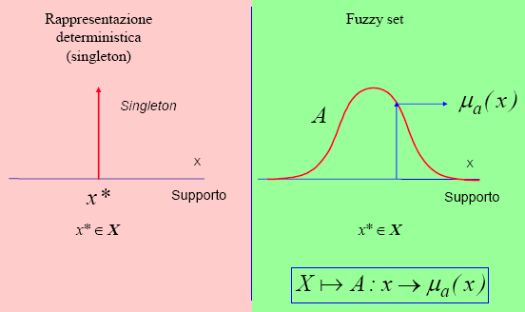
Crisp vs Fuzzy

Slide 11
Linguistic variables
A linguistic variable is a label that defines a concept
This corresponds to a membership function (qualifier)
It determines the degree of truth μ of any support value

Slide 12
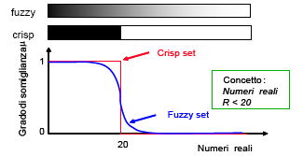
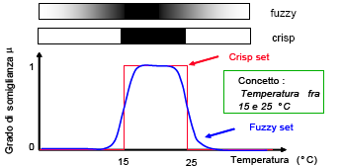
Linguistic variables
Numeri reali
Temperatura

Slide 13
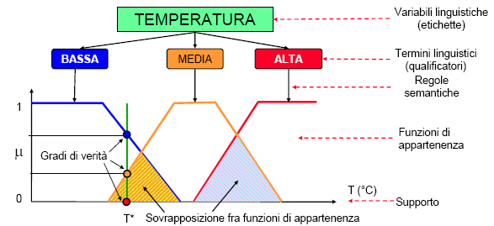
Linguistic variables
Esempio di fuzzificazione

Slide 14
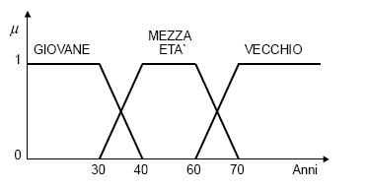
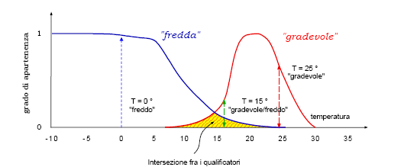
Linguistic variables examples
Linguistic variable “anni”
Linguistic variable
“temperatura”

Slide 15
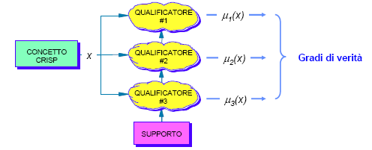
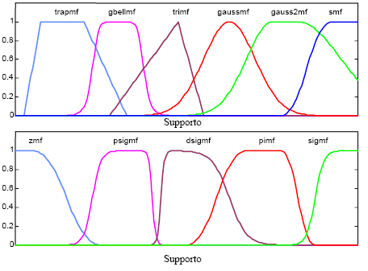
Fuzzification
Fuzzification phase
Kinds of memberships

Slide 16
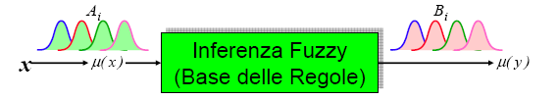

Inference system

Slide 17
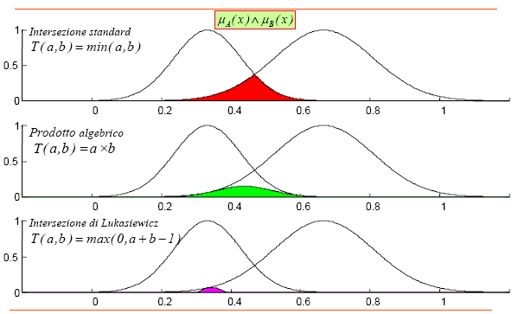
Operators
Intersection operators

Slide 18
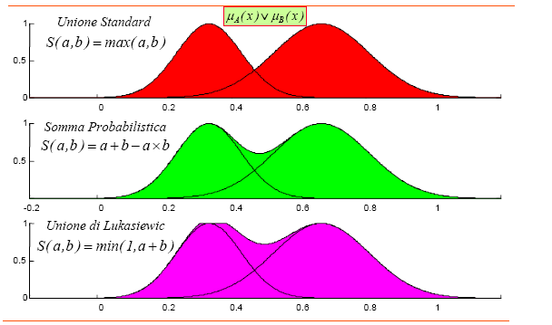
Operators
Union operators

Slide 19
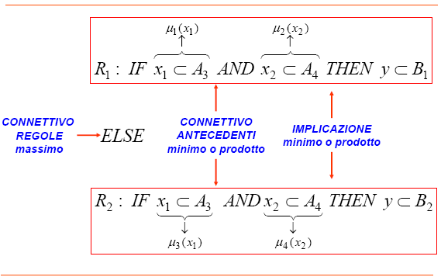
Inference rules

Slide 20
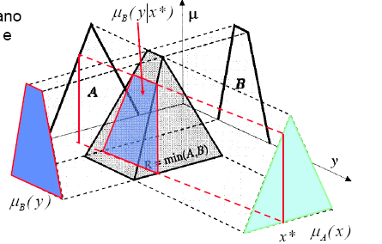
Mappe 3D
Operatori di intersezione in 3D

Slide 21
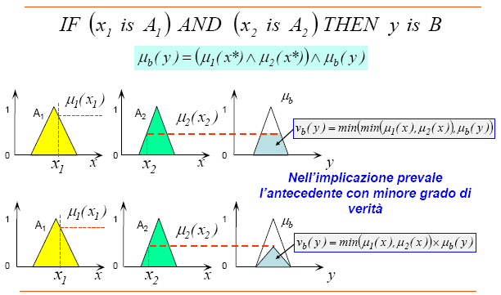
Inference (Mamdani)
Mamdani based inference

Slide 22
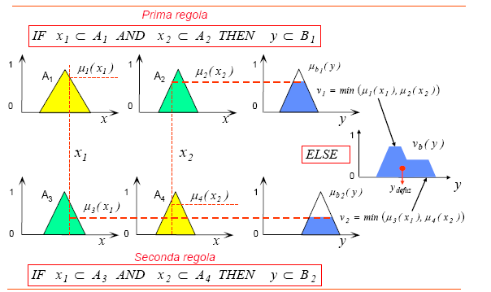
Defuzzification
Inference and defuzzification

Slide 23
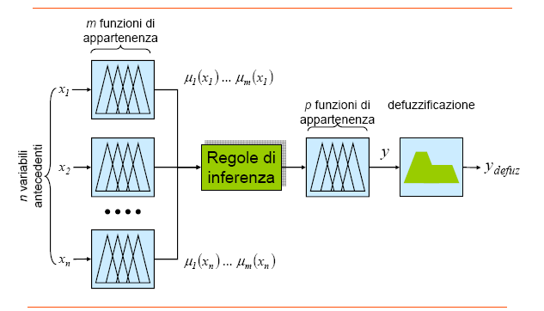
Fuzzy systems
… neuro-fuzzy systems

Slide 24
ANFIS
ANFIS model

Slide 25

FRNN
x₁
A₁
B₁
F
R₁
.
.
.
.
.
.
B
x_{n}
A_{n}
B_{n}
F
R_{n}
Fuzzificazione
Relazioni
Composizione
Defuzzificazione
Fuzzy Relation Neural Network Model

Slide 26

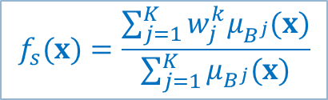

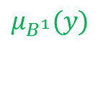

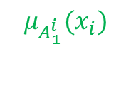
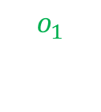

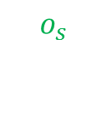
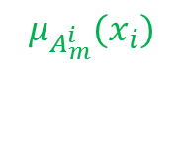
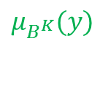


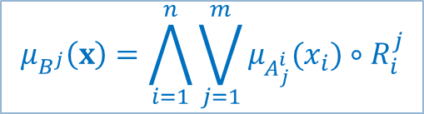
FRNN
…
…
…
…
…
…
…
…
…
…

Slide 27
Granulation
Class C₁
x₂
Class C₂
C1
FBFNN
C2
C2
C1
C1
x₁

Slide 28
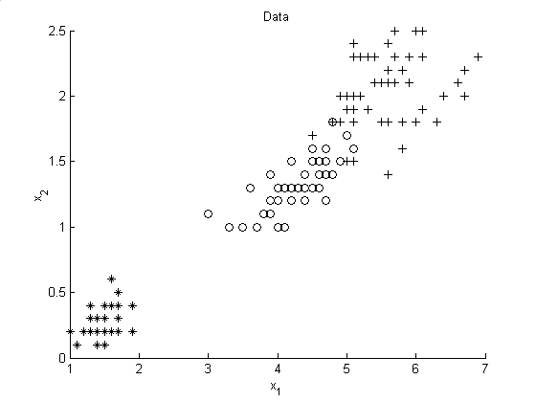
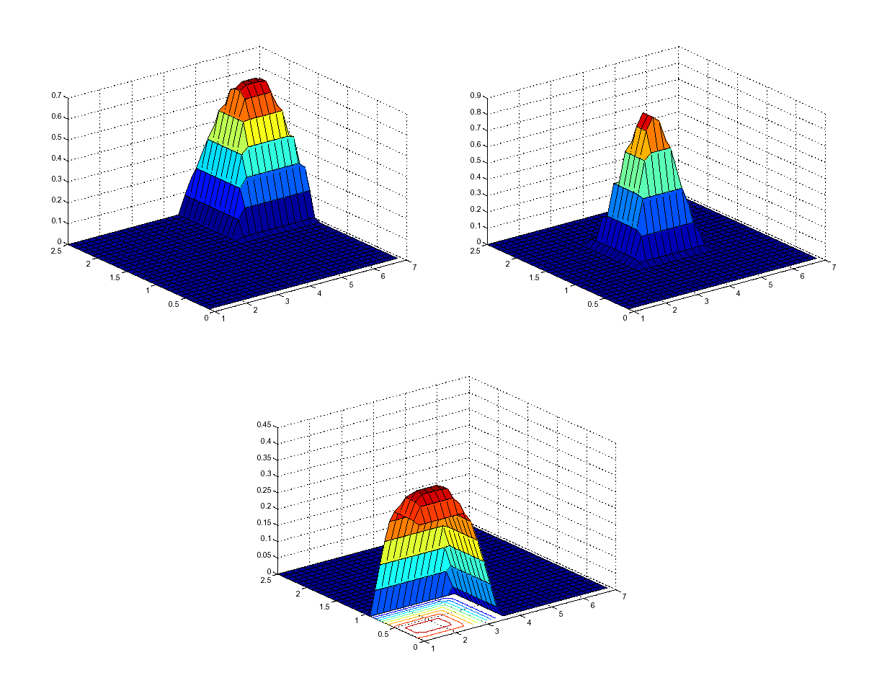
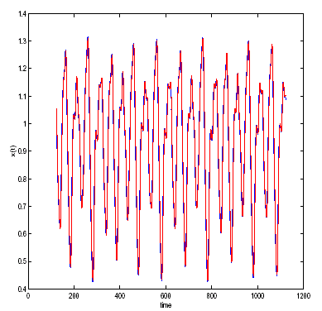
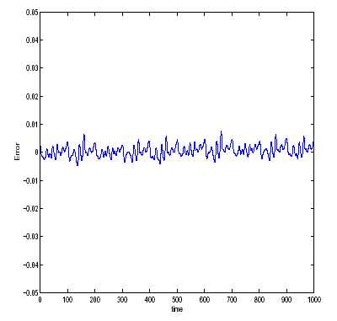
Some results
IRIS data set
Memberships
Mackey-Glass chaotic time series
Residum

Slide 29
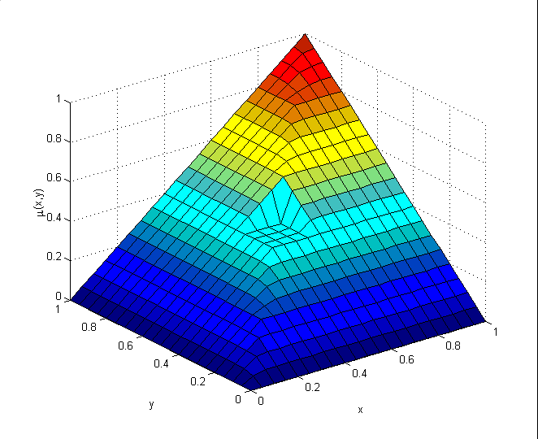
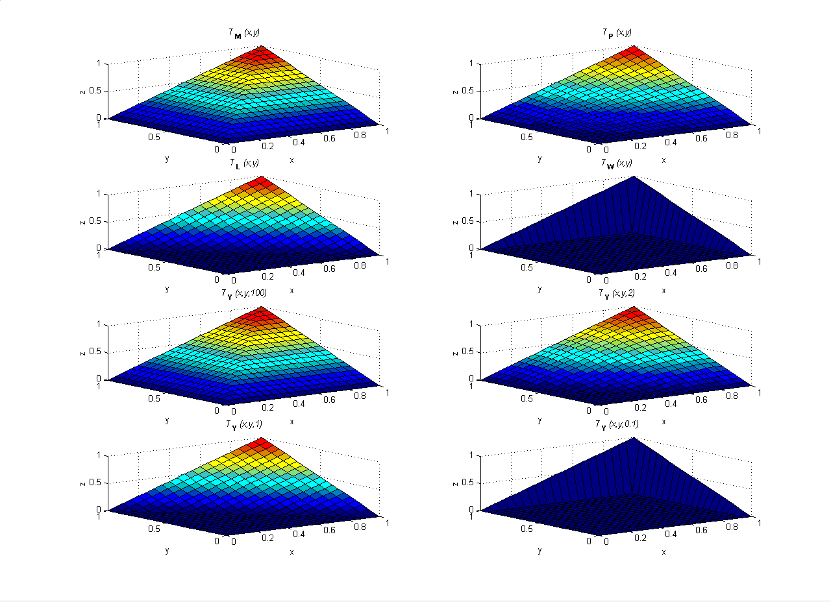
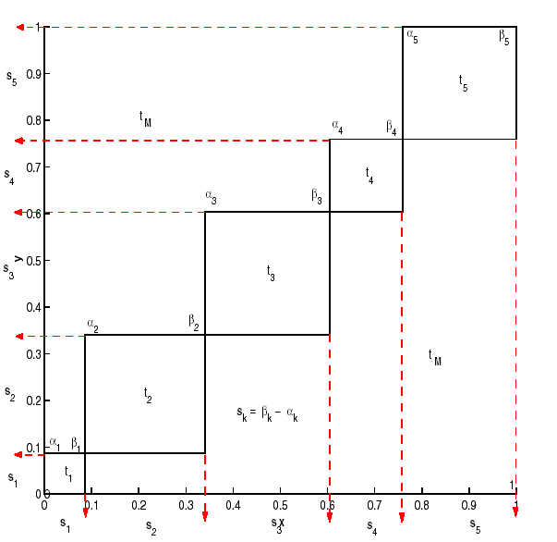
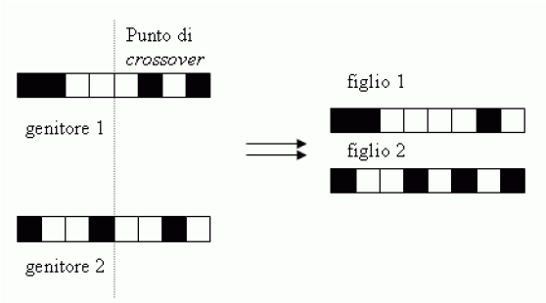
Norm generalization
Ordinal sums
t-norms and t-conorms
Chromosome
Parameters of Ordinal Sums

Slide 30
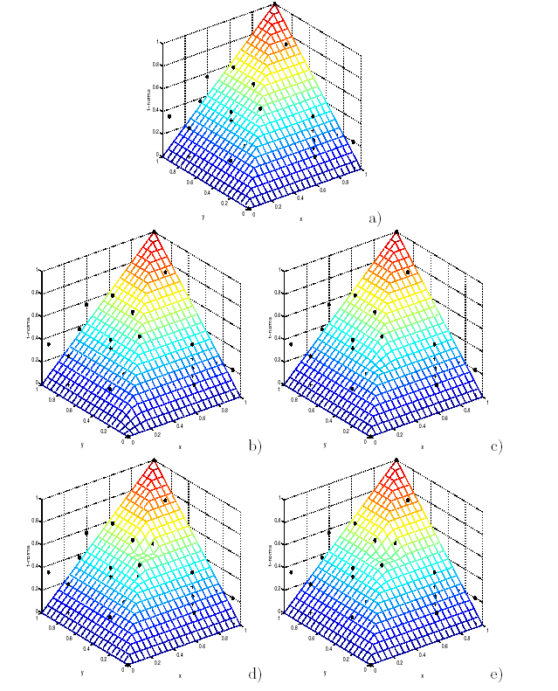
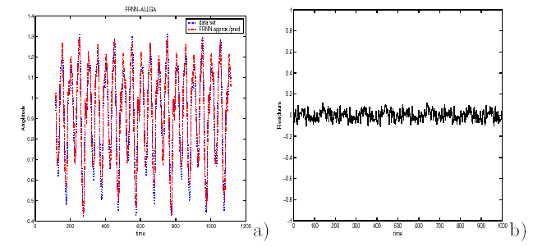
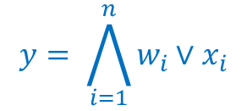
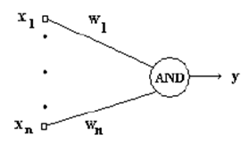
Neuron generalization
FRNN inference system
Zimmermann and Zysno data set
AND/OR neuron based on OS

Slide 31
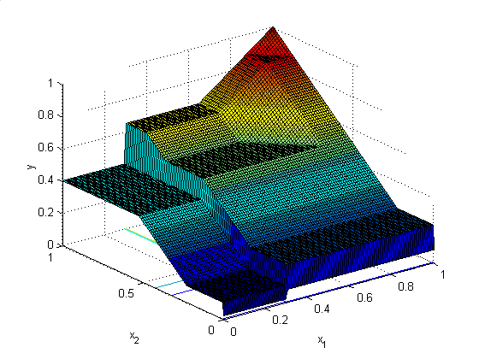
Uninorm
Uninorm representation
Uninorm based neuron

Slide 32
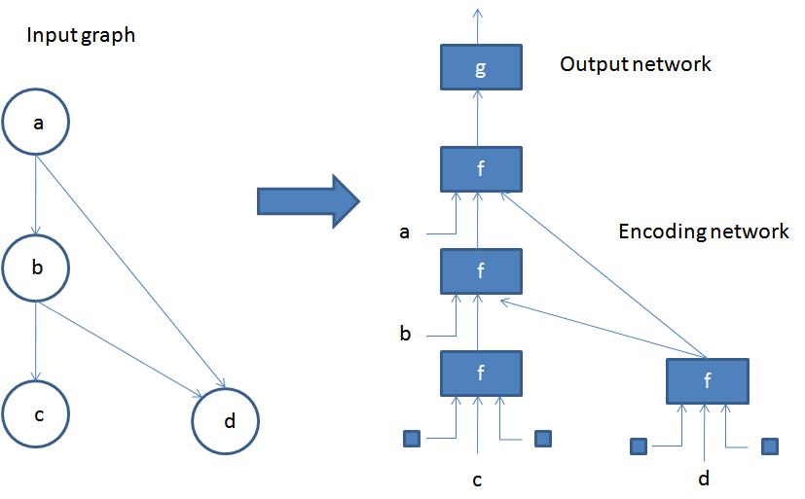
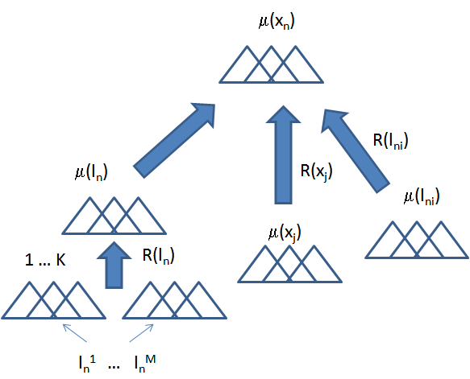
Structured data
state
Graph mapping
fuzzy state
Uninorm
Relations
State composition

