Slide 2
Question 27
Graphical models
Question
  The discriminative models
    directly assume some functional form
    indirectly assume functional forms
    assume Gaussian distributions

Slide 3
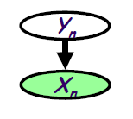
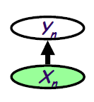
Generative vs Discriminative Models
Generative models
  Assume some functional form for P(X|Y), P(Y)
  Estimate parameters of P(X|Y), P(Y) directly from training data
  Use Bayes rule to calculate P(Y|X= x)
Discriminative models
  Directly assume some functional form for P(Y|X)
  Estimate parameters of P(Y|X) directly from training data

Slide 4
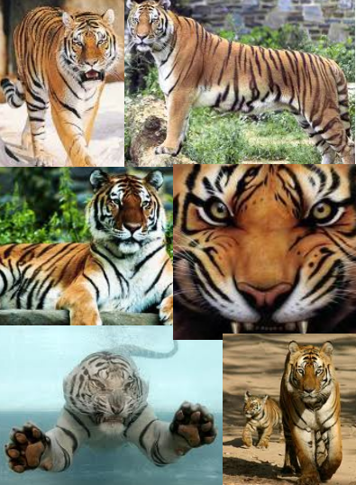

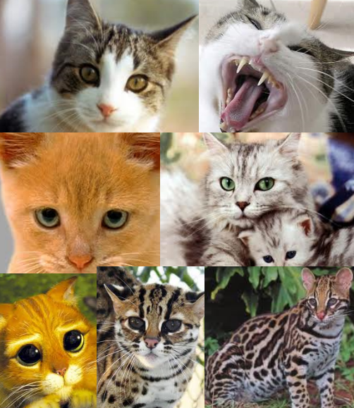
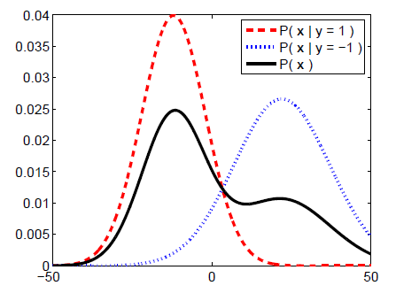
Generative Model
Color
Size
Texture
Weight
…

Slide 5
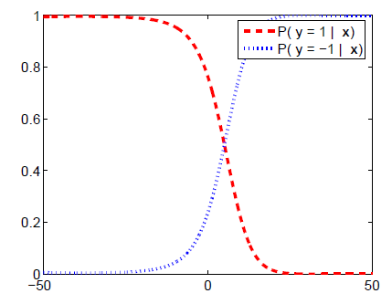
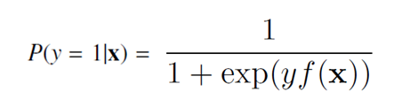
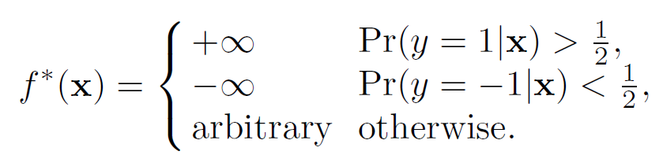
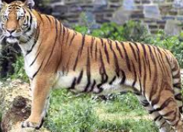
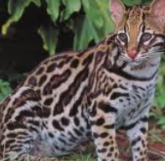
Discriminative Model
Logistic regression
Color
Size
Texture
Weight
…

Slide 6
Discriminative model
Discriminative
Probabilistic Classifier

Slide 7
Discriminative model
Generative
Probabilistic Model
for Class 1
Generative
Probabilistic Model
for Class 2
Generative
Probabilistic Model
for Class L

Slide 8
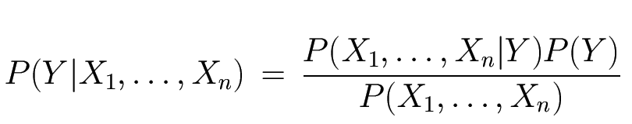
Bayes classifier
Bayes rule
Likelihood
Prior
Normalization Constant

Slide 9
MAP classification rule
Maximum A Posterior rule
Generative classification

Slide 10
MAP classification rule
Bayes classification
Naïve Bayes
Difficulty for learning the joint probability
all input attributes are conditionally independent

Slide 11
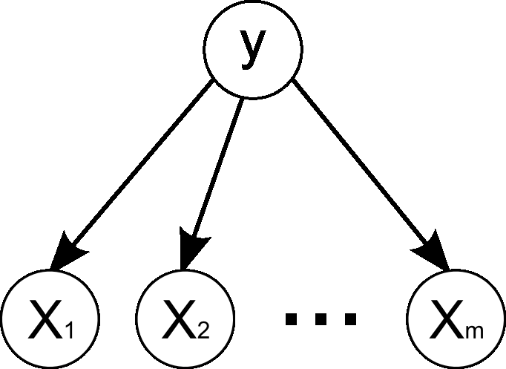
Naïve Bayes

Slide 12
Naïve Bayes
Learning phase (given a training set S)
Test phase
unknown istance

Slide 13
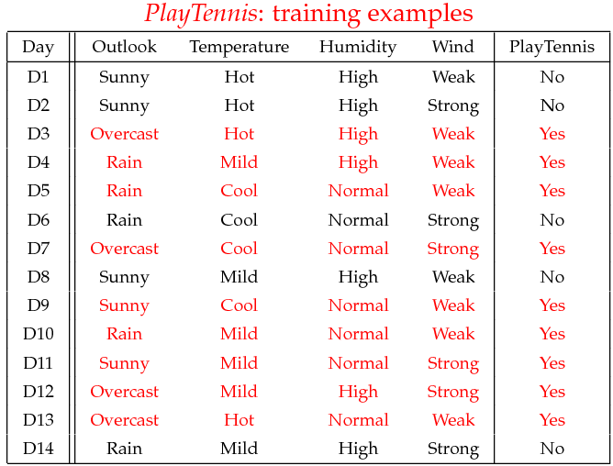
Example

Slide 14
Learning phase
Outlook | Play=Yes | Play=No
Sunny | 2/9 | 3/5
Overcast | 4/9 | 0/5
Rain | 3/9 | 2/5
Temperature | Play=Yes | Play=No
Hot | 2/9 | 2/5
Mild | 4/9 | 2/5
Cool | 3/9 | 1/5
Humidity | Play=Yes | Play=No
High | 3/9 | 4/5
Normal | 6/9 | 1/5
Wind | Play=Yes | Play=No
Strong | 3/9 | 3/5
Weak | 6/9 | 2/5
P(Play=Yes) = 9/14
P(Play=No) = 5/14

Slide 15
Test phase
New istance
Look up table
MAP rule
  x’=(Outlook=Sunny, Temperature=Cool, Humidity=High, Wind=Strong)
P(Outlook=Sunny|Play=Yes) = 2/9
P(Temperature=Cool|Play=Yes) = 3/9
P(Huminity=High|Play=Yes) = 3/9
P(Wind=Strong|Play=Yes) = 3/9
P(Play=Yes) = 9/14
P(Outlook=Sunny|Play=No) = 3/5
P(Temperature=Cool|Play==No) = 1/5
P(Huminity=High|Play=No) = 4/5
P(Wind=Strong|Play=No) = 3/5
P(Play=No) = 5/14
P(Yes|x’): [P(Sunny|Yes)P(Cool|Yes)P(High|Yes)P(Strong|Yes)]P(Play=Yes) = 0.0053
P(No|x’): [P(Sunny|No) P(Cool|No)P(High|No)P(Strong|No)]P(Play=No) = 0.0206
Given the fact P(Yes|x’) < P(No|x’), we label x’ to be “No”.

Slide 16
Continuous inputs
Normal distribution

Slide 17
References
Material
  Slides
  Video Lessons
Books
  I. Goodfellow, Y. Bengio, A. Courville, Deep Learning, MIT Press, 2016

