Slide 2
Question 25
Recurrent Neural Networks (CNN)
Question
Long Short-Term Memory
creats paths through time that have derivatives that neither vanish nor explode
creats paths through time that have constant derivatives
creats paths that change through time

Slide 3
Long-Term dependendencies
Vanishing/Exploding Gradients in RNN
Weight Initialization Methods
Constant Error Carousel
Echo State Networks
Identity-RNN
np-RNN
LSTM
GRU

Slide 4
Long-Term dependendencies
Random W_{h} initialization of RNN has no constraint on eigenvalues
vanishing or exploding gradients in the initial epoch
Careful initialization of W_{h} with suitable eigenvalues
allows the RNN to learn in the initial epochs
hence can generalize well for further iterations

Slide 5
Long-Term dependendencies
Trick #1(IRNN)
W_{h} initialized to Identity
Activation function: ReLU
Trick# 2 (np-RNN)
Wh positive definite (+ve real eigenvalues)
At least one eigenvalue is 1, others all less than equal to one
Activation function: ReLU

Slide 6
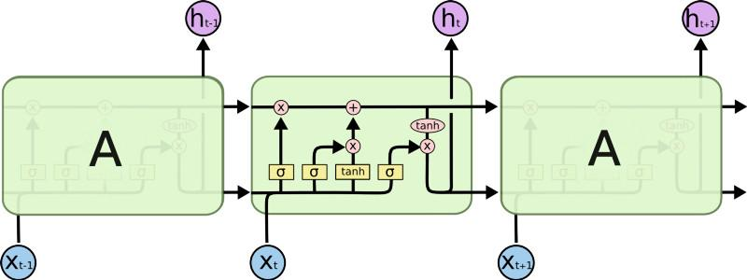
Long Short-Term Memory

Slide 7
Gated RNNs
Gated RNNs
Long Short-Term memory
Gated Recurrent Unit
Idea
creating paths through time that have derivatives that neither vanish nor explode

Slide 8
Gated RNNs

Slide 9
LSTM cell
This sigmoid gate
determines how much
information goes thru
Output gate
Controls what
goes into output
This decides what info
Is to add to the cell state
C_{t-1}
h_{t-1}
Forget input
gate gate
The core idea is this cell state C_{t}, it is changed slowly, with only minor linear interactions. It is very easy for information to flow along it unchanged.
Why sigmoid or tanh:
Sigmoid: 0,1 gating as switch.
Vanishing gradient problem in
LSTM is handled already.

Slide 10
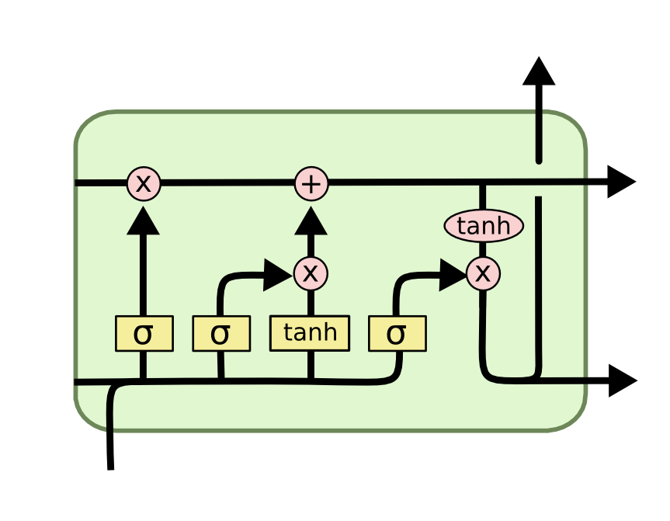
LSTM cell
i_{t} decides what component
is to be updated.
C’_{t} provides change
contents

Slide 11
LSTM cell
Updating the cell state
Decide what part of
the cell state to output

Slide 12
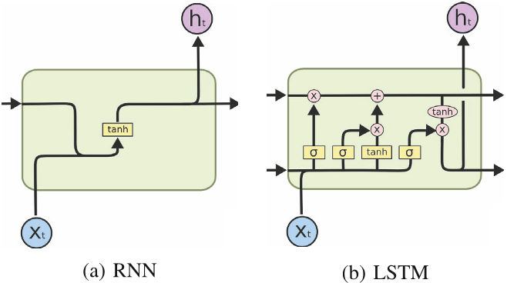
RNN vs LSTM

Slide 13
Peephole LSTM
Allows “peeping into the memory”. Can learn the fine distinction between
sequences of spikes separated by either 50 or 49 discrete time steps

Slide 14
Gated Recurrent Unit (GRU)
reset gate
Update gate
It combines the forget and input into a single update gate.
It also merges the cell state and hidden state. This is simpler
than LSTM. There are many other variants too.

Slide 15
Clipping gradients
parameter gradient is very large
“landscape” in which one finds “cliffs”
Clipping the gradient

Slide 16
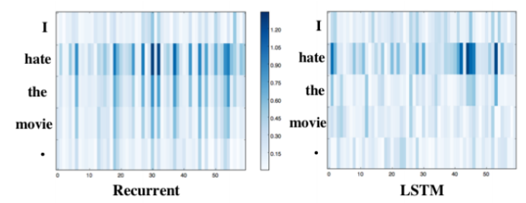
RNN vs LSTM
Saliency Heatmap
Recent words more salient

Slide 17
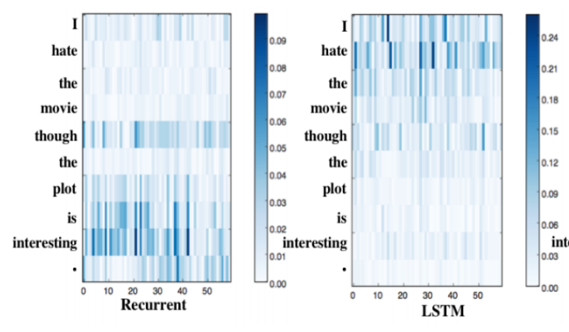
RNN vs LSTM
Saliency Heatmap
LSTM captures long term dependencies

Slide 18
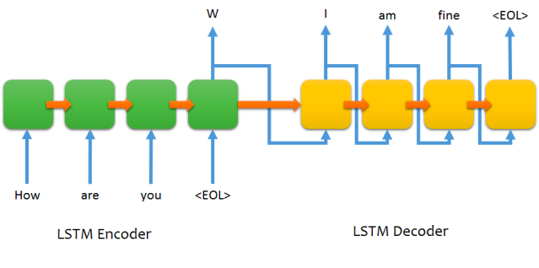
Sequence to sequence chat model

Slide 19
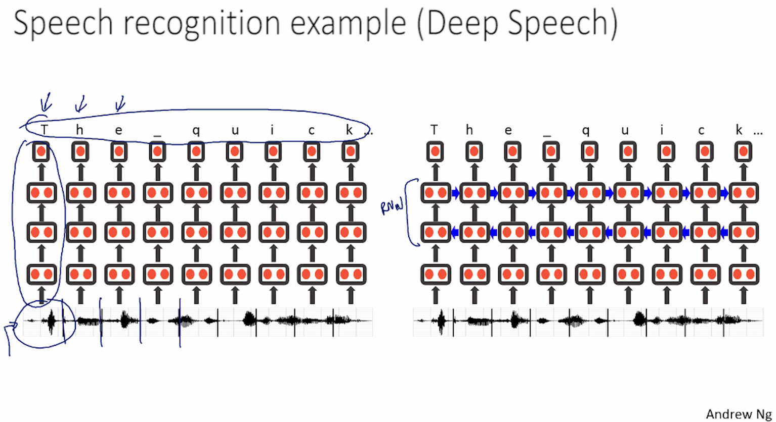
Speech recognition RNN

Slide 20
References
Material
Slides
Video Lessons
Books
I. Goodfellow, Y. Bengio, A. Courville, Deep Learning, MIT Press, 2016

