Slide 2
Question 24
Recurrent Neural Networks (CNN)
Question
  Which of these is not a problem related to RNNs?
    vanishing gradient
    exploding gradient
    normalization gradient

Slide 3
Recurrent Neural Networks
Dynamical system (reccurrent expression)
Example
State of the system
Unfolded computational graph

Slide 4
Recurrent Neural Networks
Dynamical system driven by an external signal
RNNs
state of the hidden units of the network

Slide 5
Recurrent Neural Networks
A RNN with no outputs
Circuit diagram
delay of 1 time step
This recurrent network just processes information from the input x by incorporating it into the state h that is passed forward through time

Slide 6
Recurrent Neural Networks
Representation of the unfolded recurrence

Slide 7
Recurrent Neural Networks
universal –
any function computable
by a Turing machine can be
computed by such a
recurrent network of a finite
size
Correct output
Recurrent networks that produce an output at each time step and have recurrent connections between hidden units

Slide 8
Recurrent Neural Networks
Recurrent networks that produce an output at each time step and have
recurrent connections only from the output at one time step to the hidden units at the next time step

Slide 9
Recurrent Neural Networks
Recurrent networks with recurrent connections between hidden units, that read an entire sequence and then produce a single output

Slide 10
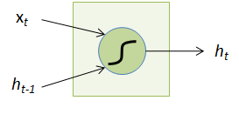

Vanilla RNN cell
x_{t}: Input at time t
h_{t-1}: State at time t-1
next time step

Slide 11
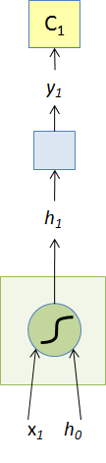
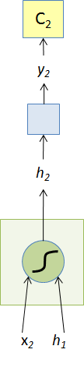
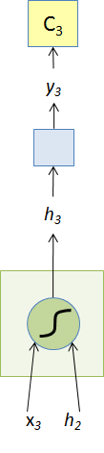
Unfolding
Weights shared over time!

Slide 12
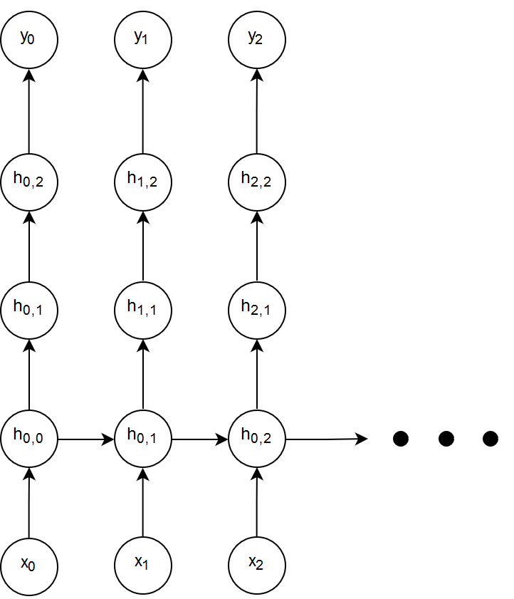
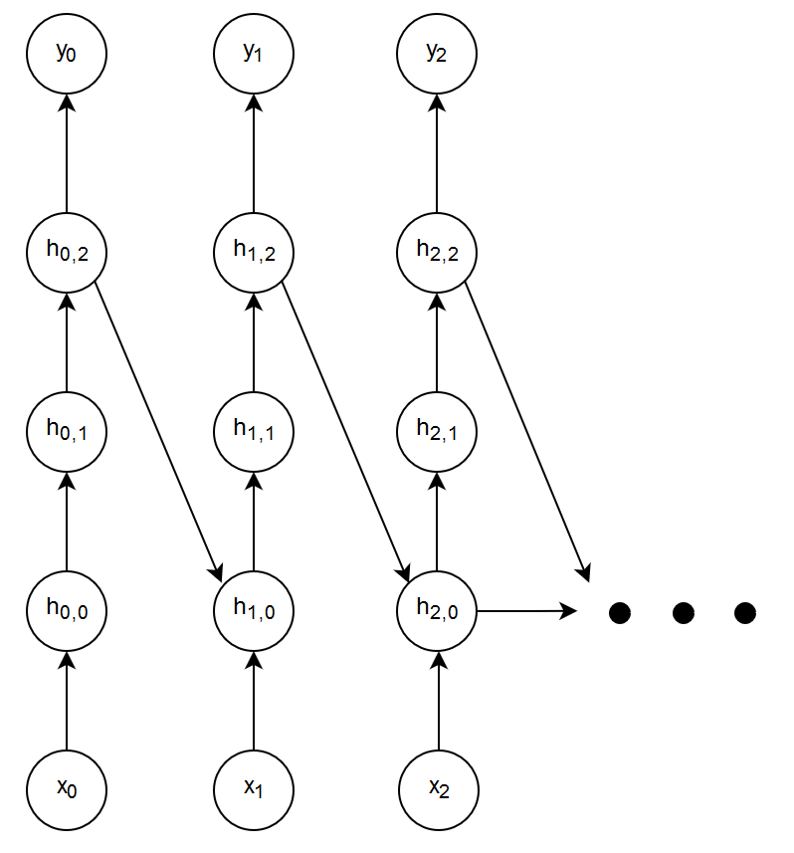
Deep RNN
High level feature!
Feedforward depth = 4
Recurrent depth = 3

Slide 13
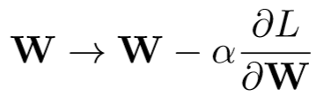
Backpropagation Trough Time (BPTT)
Objective is to update the weight matrix:
Issue: W occurs each timestep
Every path from W to L is one dependency
Find all paths from W to L!
(note: dropping subscript h from W_{h} for brevity)

Slide 14
Backpropagation Trough Time (BPTT)
How many paths exist from W to L through L₁?
Just 1. Originating at h₀.

Slide 15
Backpropagation Trough Time (BPTT)
How many paths from W to L through L₂?
2. Originating at h₀ and h₁.

Slide 16
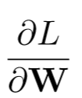
Backpropagation Trough Time (BPTT)
And 3 in this case.
Origin of path = basis for Σ
The gradient has two summations:
1: Over L_{j}
2: Over h_{k}

Slide 17
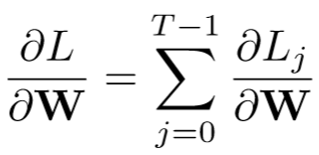
Backpropagation Trough Time (BPTT)
First summation over L

Slide 18
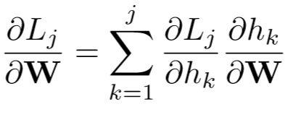
Backpropagation Trough Time (BPTT)
Second summation over h: Each L_{j} depends on the weight matrices before it
L_{j} depends on all h_{k} before it.

Slide 19
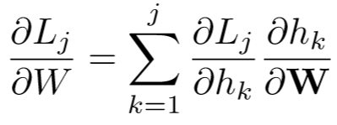
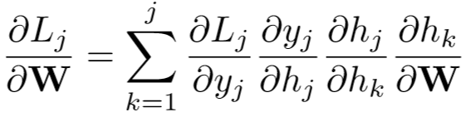
Backpropagation Trough Time (BPTT)
j
No explicit of L_{j} on h_{k}
Use chain rule to fill missing steps
k

Slide 20
Backpropagation Trough Time (BPTT)
j
No explicit of L_{j} on h_{k}
Use chain rule to fill missing steps
k

Slide 21
Backpropagation Trough Time (BPTT)
j
No explicit of L_{j} on h_{k}
Use chain rule to fill missing steps
k

Slide 22
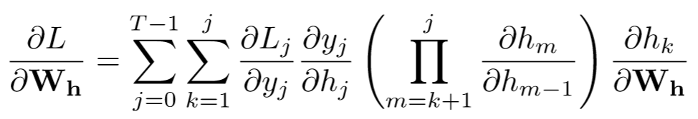
Backpropagation Trough Time (BPTT)
The final Backpropagation equation

Slide 23
Backpropagation Trough Time (BPTT)
j
Often, to reduce memory requirement, we truncate the network
Inner summation runs from j-p to j for some p ==> truncated BPTT
k

Slide 24
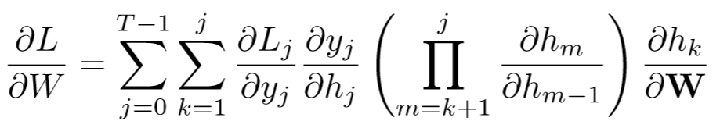

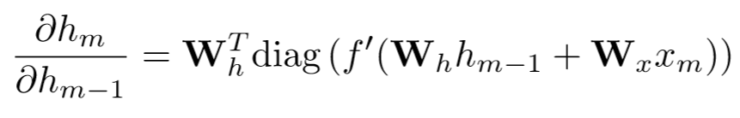
Backpropagation Trough Time (BPTT)
Expanding the Jacobian

Slide 25
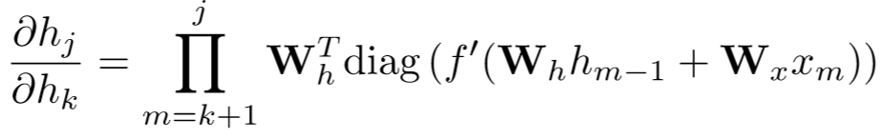
Backpropagation Trough Time (BPTT)
Weight Matrix
Derivative of activation function
Repeated matrix multiplications leads to vanishing and exploding gradients.

Slide 26
Vanishing gradients
Considerations
Smaller weight parameters lead to faster gradients vanishing
Very big initial parameters make the gradient descent to diverge fast (explode)

Slide 27
Exploiding gradients

Slide 28

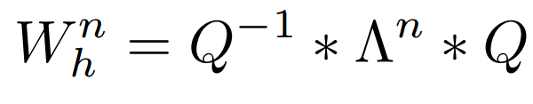
Eigenvalues and Stability
Consider identity activation function
If Recurrent Matrix W_{h} is a diagonalizable:
Q matrix composed of eigenvectors of W_{h}
Λ is a diagonal matrix with eigenvalues placed on the diagonals
Computing powers of W_{h} is simple:

Slide 29
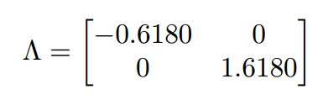
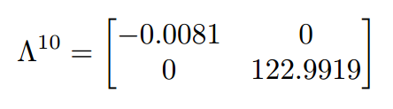
Eigenvalues and Stability
Vanishing gradients
Exploding gradients

Slide 30
References
Material
  Slides
  Video Lessons
Books
  I. Goodfellow, Y. Bengio, A. Courville, Deep Learning, MIT Press, 2016

