Slide 2
Question 22
Convolutional Neural Networks (CNN)
Question
Pooling can be used for having a CNN
dipendent to transformations of the input
invariant to transformations of the input
invariant to models of the input

Slide 3
Operations
Three operations
Convolution
like matrix multiplication
Take an input, produce an output (hidden layer)
Deconvolution
like multiplication by transpose of a matrix
Used to back-propagate error from output to input
Reconstruction in autoencoder / RBM
Weight gradient computation
Used to backpropagate error from output to weights
Accounts for the parameter sharing

Slide 4
Sparse interactions
sparse
(kernel of width 3)
Dense connections
no longer sparse

Slide 5
Sparse interactions
sparse
(receptive field)
Dense
connections
no longer sparse

Slide 6
Sparse interactions
even though direct connections in a convolutional net are very sparse, units in the deeper layers can be indirectly connected to all or most of the input image

Slide 7
Parameter sharing
Goal
rather than learning a separate set of parameters for every location, we learn only one set
layers have a property called equivariance to translation
if the input changes, the output changes in the same way
f(x) is equivariant to a function g if f (g(x)) = g(f(x))
if we let g be any function that translates the input,
i.e., shifts it, then the convolution function is equivariant to g

Slide 8
Parameter sharing
The black arrows indicate uses of the central element of a 3-element kernel in a convolutional model. Due to parameter sharing, this
single parameter is used at all input locations.

Slide 9
Parameter sharing
Input
Output
Kernel
Efficiency of edge detection

Slide 10
Stages

Slide 11
Rectified Linear Units
ReLU activation function

Slide 12
Rectified Linear Units
ReLU generalizations
Slope
Absolute value rectification

Slide 13
Leaky ReLU
max(αz, z)

Slide 14
Pooling
Pooling function
replaces the output of the net at a certain location with a summary statistic of the nearby outputs
helps to make the representation become approximately invariant to small translations of the input
Max pooling
maximum output within a rectangular neighborhood
Average of a rectangular neighborhood
L² norm of a rectangular neighborhood

Slide 15
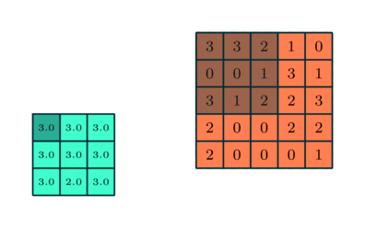
Pooling

Slide 16
Pooling
Invariance –
half of the values in the top
row have changed

Slide 17
Pooling
Invariance -invariant to transformations of the input

Slide 18
Pooling
Pooling with downsampling. Max-pooling with a pool width of three and a stride between pools of two. It reduces the representation size by a factor of two, which reduces the computational and statistical burden on the next layer

Slide 19
References
Material
Slides
Video Lessons
Books
I. Goodfellow, Y. Bengio, A. Courville, Deep Learning, MIT Press, 2016

