Slide 2
Question 21
Convolutional Neural Networks (CNN)
Question
Explain the convolutional process in CNN

Slide 3
Convolutional Neural Networks
Scale up neural networks to process very large images / video sequences
Sparse connections
Parameter sharing
Automatically generalize across spatial translations of inputs
Applicable to any input that is laid out on a grid (1-D, 2-D, 3-D, …)

Slide 4
Introduction
Convolutional Neural Networks (CNN)
processing data that has a known grid-like topology
e.g., time series and image data
use convolution in place of general matrix multiplication in at least one of their layers
Everything else stays the same
Maximum likelihood
Back-propagation
etc.

Slide 5
CNN

Slide 6
Convolution
Convolution operation
Discrete convolution

Slide 7
Convolution
2D convolution operation
Commutative
Cross-correlation
flipping the kernel

Slide 8
Images

Slide 9
Convolution
2D convolution
example

Slide 10
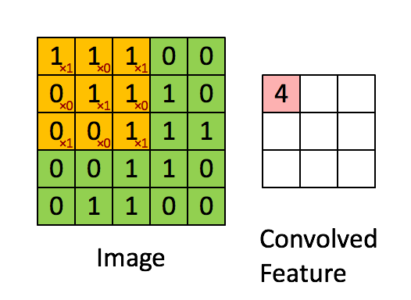
Convolution
Movement of the kernel
Convolution example

Slide 11
References
Material
Slides
Video Lessons
Books
I. Goodfellow, Y. Bengio, A. Courville, Deep Learning, MIT Press, 2016

