Slide 2
Question 12
Optimization algorithms
Question
  Explain the convergence of the gradient descent and the momentum

Slide 3
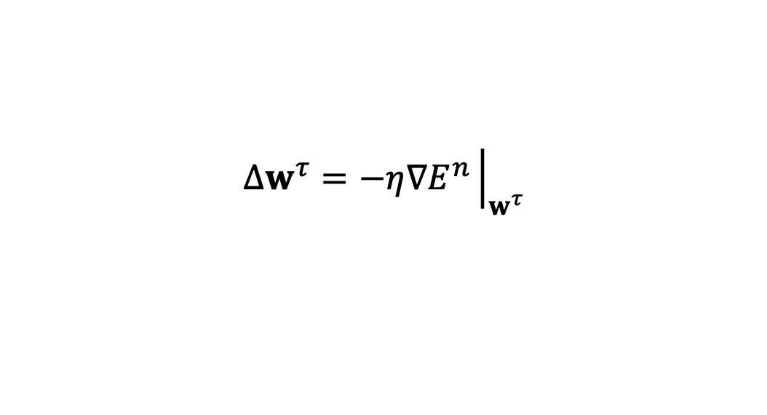
Gradient descent
Learning approach
Gradient descent
Limitations
  To choose a suitable value for the learning rate
$$w^{τ+1}=w^{τ}+∆w^{τ}$$
$$∆w^{τ}=−η∇E^{n}{\left.​\right|}_{w^{τ}}$$

Slide 4
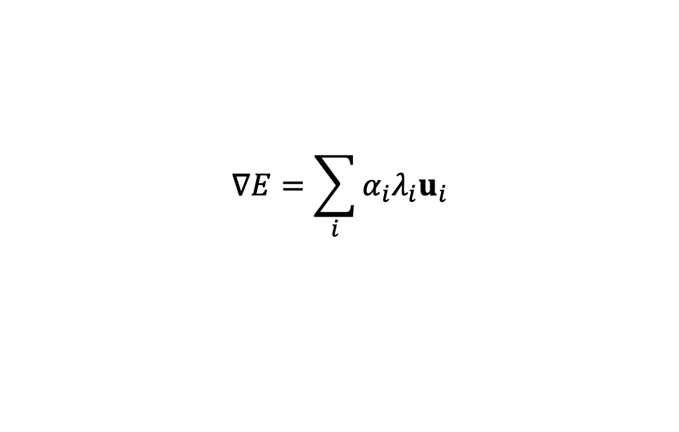
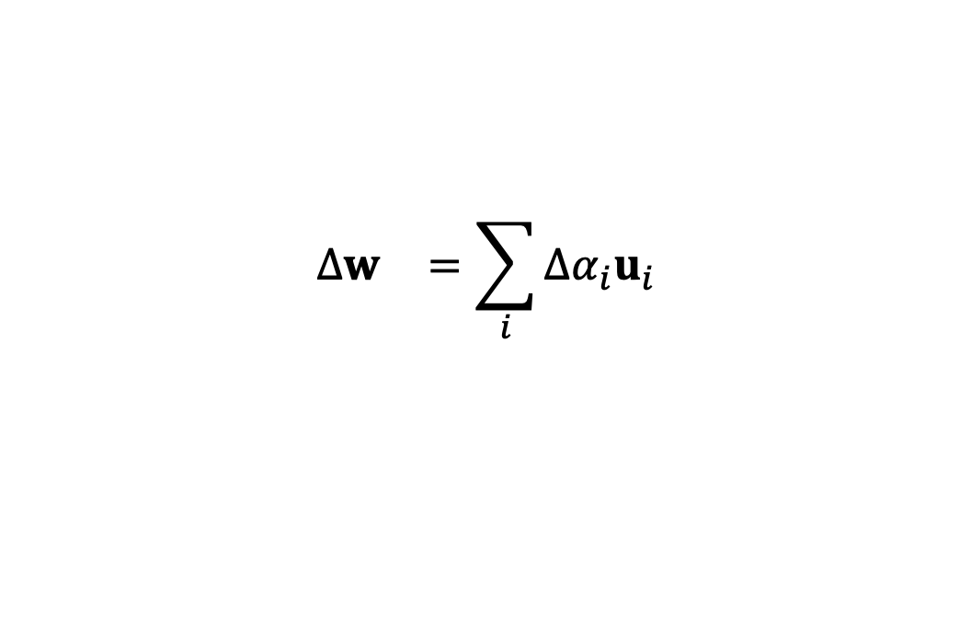
Convergence
Gradient approximation
moreover
Learning algorithm
$$∇E=\sum_{i}{α_{i}λ_{i}u_{i}}$$
$$∆w^{}=\sum_{i}{∆α_{i}u_{i}}$$
$$∆α_{i}=−ηα_{i}λ_{i}$$
$$α_{i}^{new}=(1−ηλ_{i})α_{i}^{old}$$

Slide 5
Convergence
Distance to the minimum and linear convergence
After T step
$$u_{i}^{T}\left(w−w^{∗}\right)=α_{i}$$
$$α_{i}^{(T)}={{\left(1−ηλ_{i}\right)}^{T}α}_{i}^{(0)}$$
$$\left|1−ηλ_{i}\right|<1$$

Slide 6
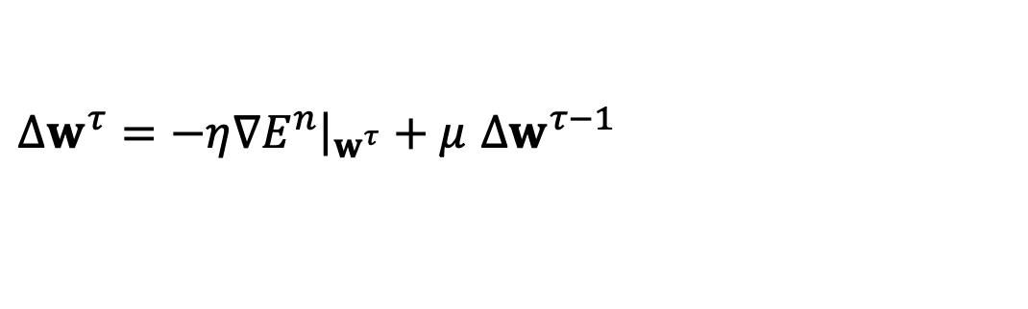
Momentum
Modified gradient formula
Iteratively
  Increse the effective learning rate
$∆w^{τ}=−η∇E^{n}{\left.​\right|}_{w^{τ}}+μ$ $∆w^{τ−1}$
$∆w^{}=−η∇E\left\{1+μ+μ^{2}+…\right\}=−\frac{η}{1−μ}$ $∇E$

Slide 7
Momentum

Slide 8
References
Material
  Slides
  Video Lessons
Books
  J. C. Bishop, Neural Networks for Pattern Recognition, Oxford University Press, 1995
  J. C. Bishop, Pattern Recognition and Machine Learning, Springer, 2006

