Slide 2
Question 11
Optimization algorithms
Question
  Countours of costant error are
    sinusoids
    rectangles
    ellipses

Slide 3
Introduction
Goal
  find weight vector which minimizes the error function
$$E(w)$$
A - local minimum
B - global minimum

Slide 4
Error function
A - local minimum
B - lacal maximum
C - saddle point
D - global minimum

Slide 5
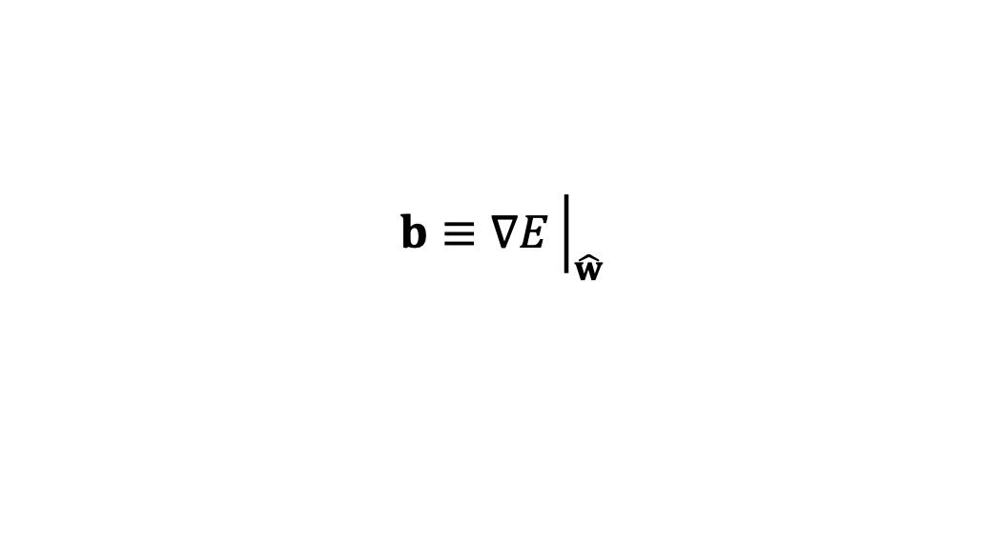
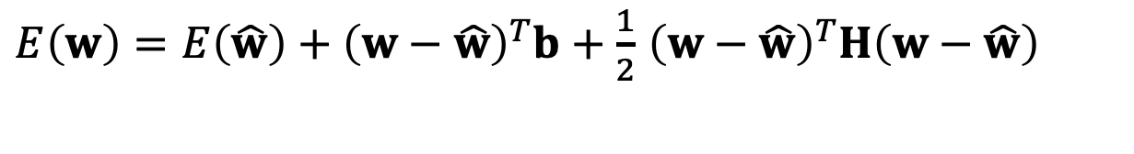

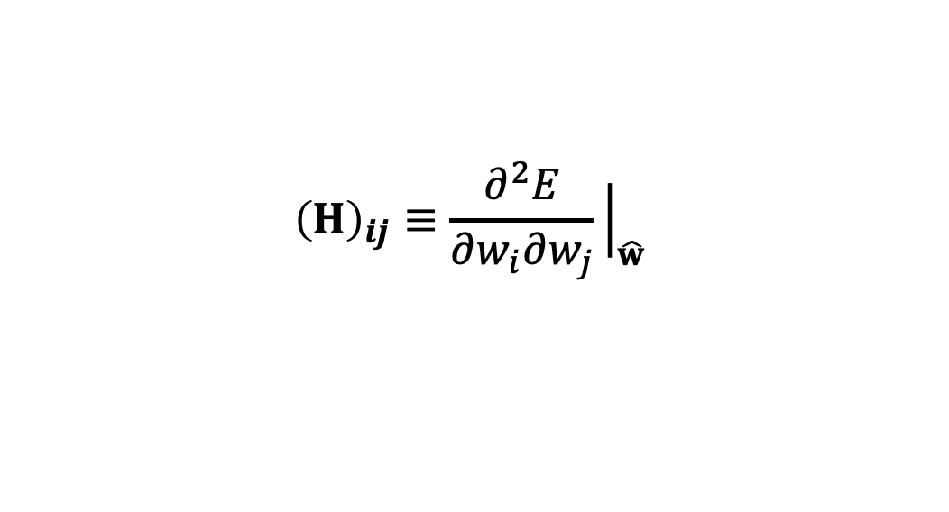
Local quadratic approximation
Taylor exapansion around some point in weight space
where
Local approximation of the gradient
$E\left(w\right)=E\left(\hat{w}\right)+{\left(w−\hat{w}\right)}^{T}b+\frac{1}{2}$ ${\left(w−\hat{w}\right)}^{T}H{\left(w−\hat{w}\right)}^{}$
$${\left(H\right)}_{ij}≡\frac{∂^{2}E}{∂w_{i}∂w_{j}}{\left.​\right|}_{\hat{w}}$$
$$b≡∇E{\left.​\right|}_{\hat{w}}$$
Hessian matrix
$$∇E=b+H{\left(w−\hat{w}\right)}^{}$$

Slide 6

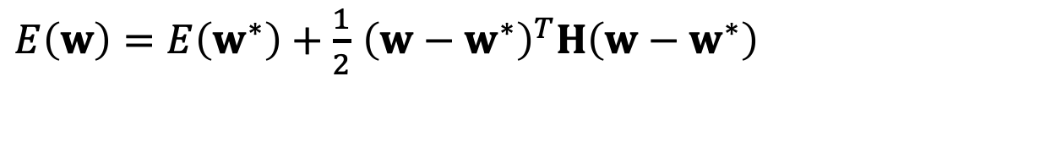


Local quadratic approximation
Local quadratic approximation around a point
where
eigenvalues and eigenvectors of Hessian matrix
$E\left(w\right)=E\left(w^{∗}\right)+\frac{1}{2}$ ${\left(w−w^{∗}\right)}^{T}H{\left(w−w^{∗}\right)}^{}$
$$∇E=0$$
$$Hu_{i}=λ_{i}u_{i}$$
$$u_{i}^{T}u_{j}=δ_{ij}$$

Slide 7
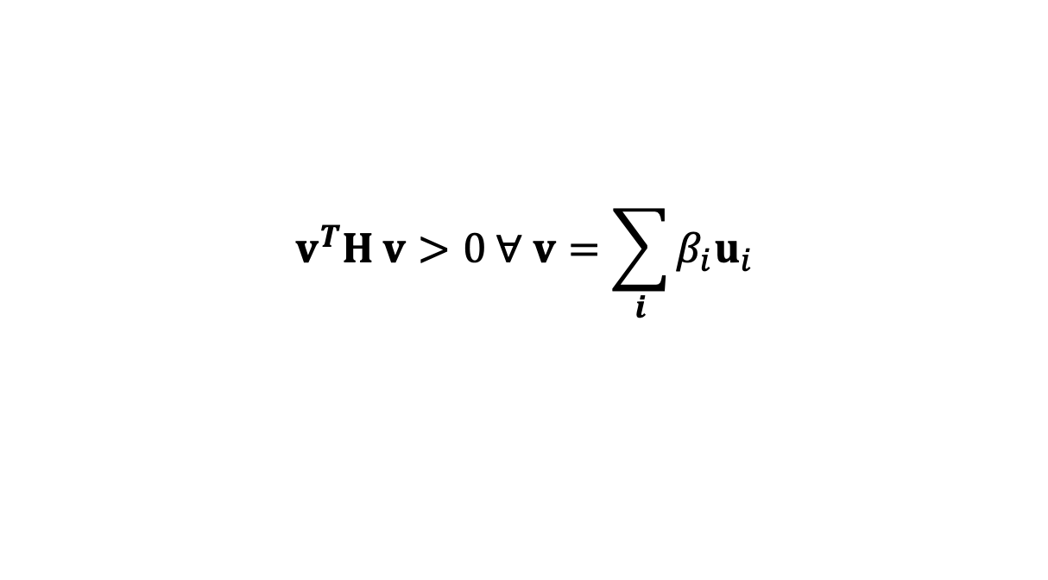
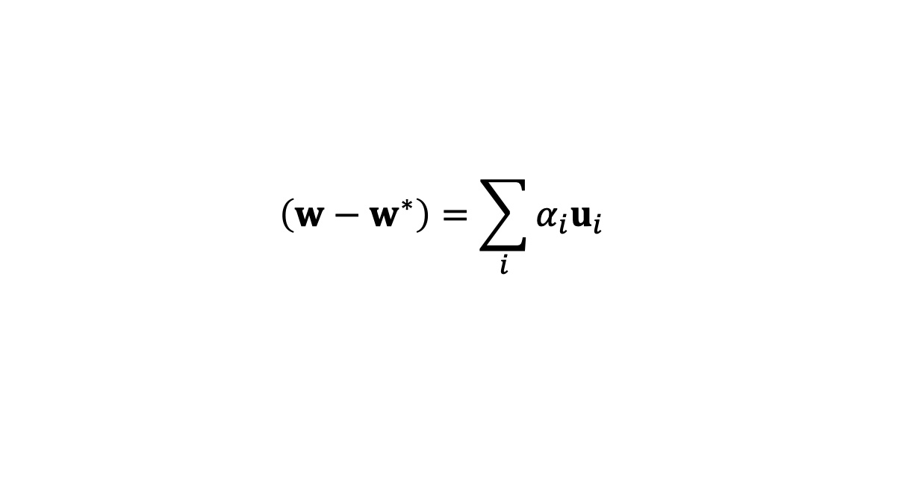
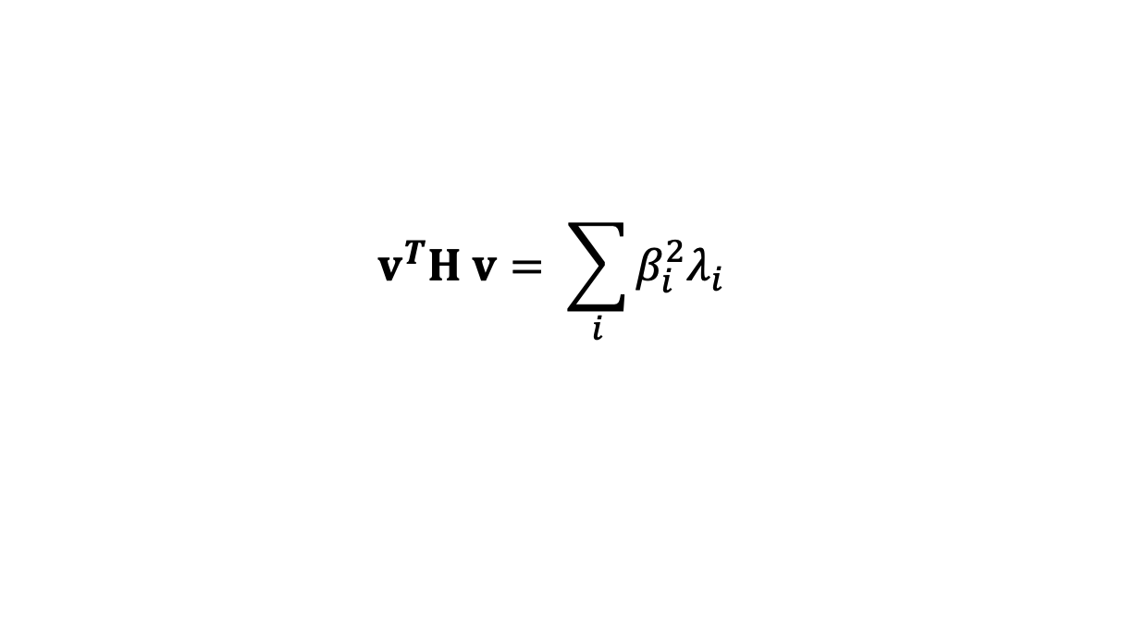
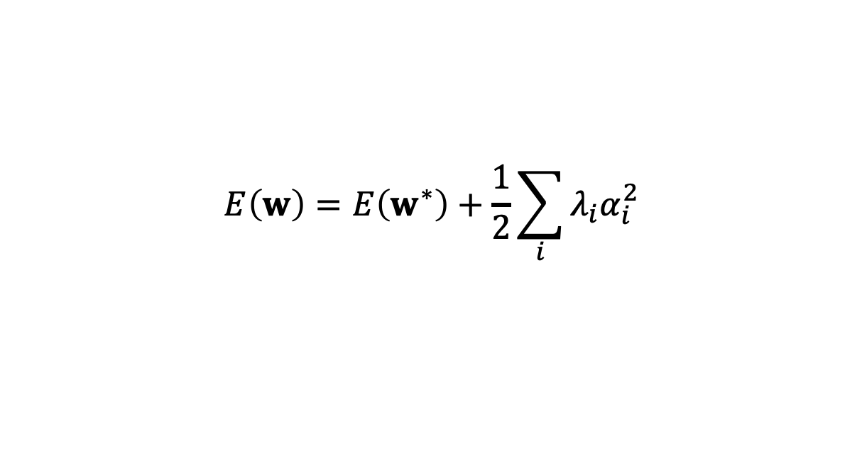
Local quadratic approximation
from expansion
where
Moreover, Hessian matrix is positive definite when
$${\left(w−w^{∗}\right)=\sum_{i}{α_{i}u_{i}}}^{}$$
$$E\left(w\right)=E\left(w^{∗}\right)+\frac{1}{2}\sum_{i}{{λ_{i}α}_{i}^{2}}$$
$$v^{T}H v>0 ∀ v=\sum_{i}{β_{i}u_{i}}$$
$$v^{T}H v= \sum_{i}{β_{i}^{2}λ_{i}}$$

Slide 8
Local quadratic approximation
Result
  Countours of costant error are ellipses whose axes are aligned with the eigenvetors of the Hessian matrix, with length inversely proportional to the square roots of the corresponding eigenvectors

Slide 9
References
Material
  Slides
  Video Lessons
Books
  J. C. Bishop, Neural Networks for Pattern Recognition, Oxford University Press, 1995
  J. C. Bishop, Pattern Recognition and Machine Learning, Springer, 2006

