Slide 2
Question 9
Radial Basis Functions Neural Network
Question
  Which of the following is a property of RBF NN?
    Best approximation
    Universal approximation
    Compact approximation

Slide 3
Introduction
Regression
  regression models based on linear combinations of fixed basis functions
Radial Basis Functions find f such that

Slide 4
RBF NN
Architecture of RBF NN

Slide 5

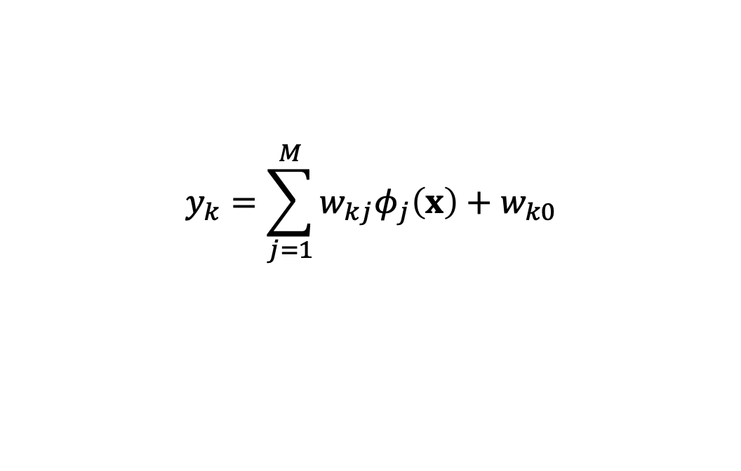
RBF NN
Outputs
For the case of Gaussian functions
$$y_{k}=\sum_{j=1}^{M}{w_{kj}φ_{j}\left(x\right)+w_{k0}}$$
$${φ_{j}\left(x\right)=exp\left(−\frac{{\left\|x−μ_{j}\right\|}^{2}}{2σ_{j}^{2}}\right){}}_{}$$

Slide 6
RBF NN
Result
  Best approximation - in the set of approximating functions there is one function which has minimum approximating errore for any given function to be approsimated (Girosi and Poggio, 1990)
  This property is not shared by MLP

Slide 7
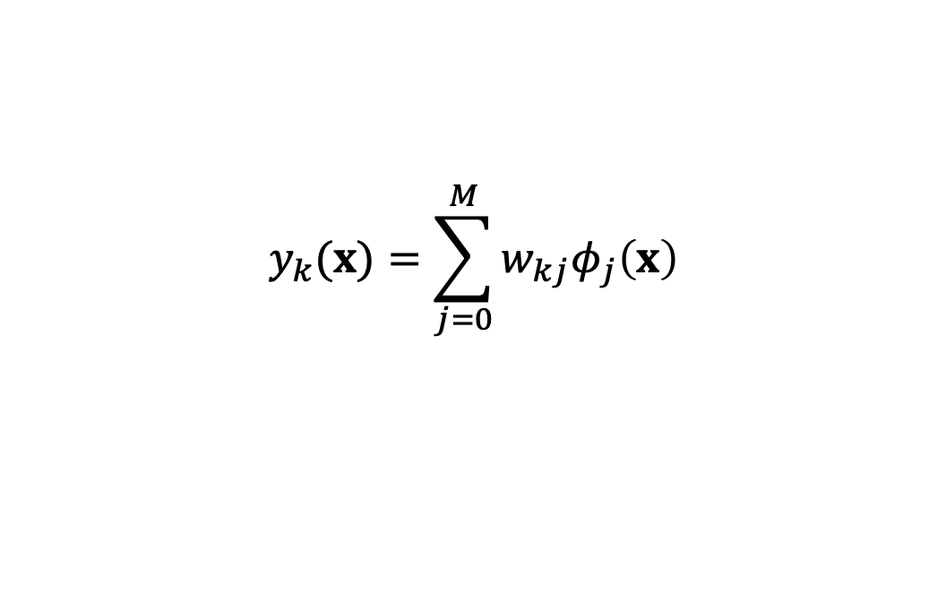
RBF NN training
Basis functions
  Unsupervised learning (e.g., clustering)
Network mapping
Matrix notation
$$y_{k}(x)=\sum_{j=0}^{M}{w_{kj}φ_{j}\left(x\right)}$$
$$y_{k}(x)=WΦ$$

Slide 8
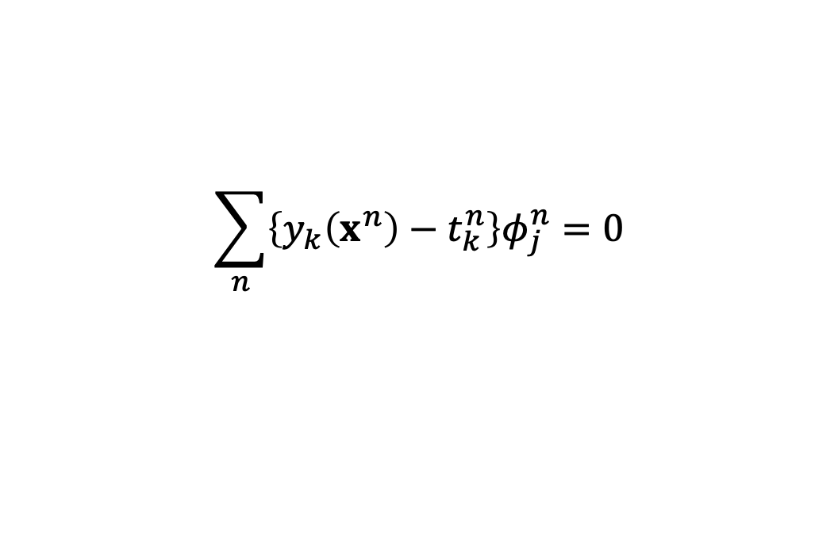
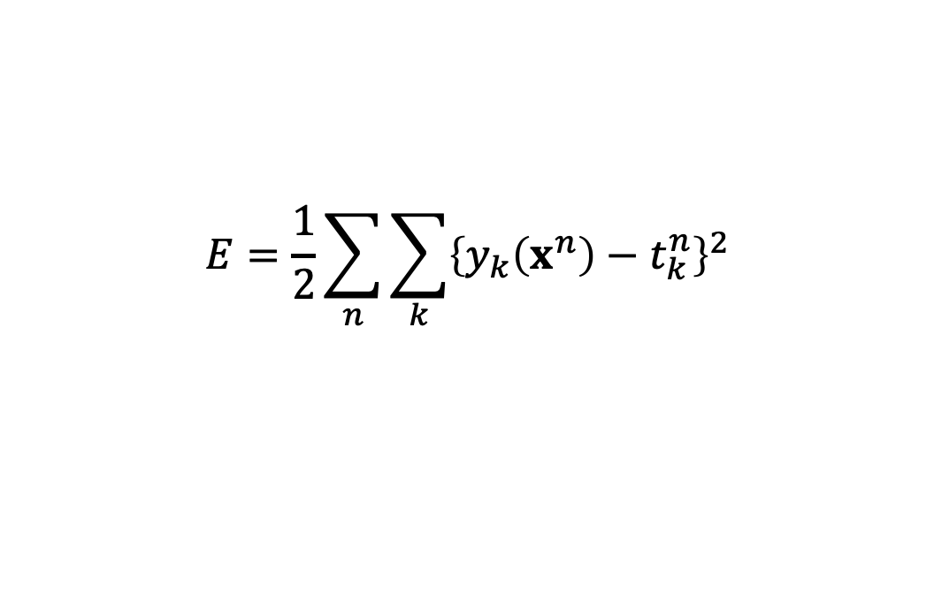
RBF NN training
Sum-of-squares error
Differentiating with respect w_{kj} and setting the derivative to zero
Matrix notation
$$E=\frac{1}{2}\sum_{n}{\sum_{k}{{\left\{y_{k}\left(x^{n}\right)−t_{k}^{n}\right\}}^{2}}}$$
$$\sum_{n}{\left\{y_{k}\left(x^{n}\right)−t_{k}^{n}\right\}φ_{j}^{n}=0}$$
$$\left(Φ^{T}Φ\right)W^{T}=Φ^{T}T$$

Slide 9

RBF NN training
Providing the matrix is non-singular we may invert
Pseudo-inverse
Pseudoinverse property
  If the matrix is not singular equation does not have a unique solution
  In practical, use a SVD (Singular Value Decomposition) methodology
$$W^{T}=Φ^{∤}T$$
$$Φ^{∤}={\left(Φ^{T}Φ\right)}^{−1}Φ^{T}$$
$$Φ^{∤}Φ=I$$
$$Φ^{T}Φ$$

Slide 10
References
Material
  Slides
  Video Lessons
Books
  J. C. Bishop, Neural Networks for Pattern Recognition, Oxford University Press, 1995
  J. C. Bishop, Pattern Recognition and Machine Learning, Springer, 2006

