Slide 2
Question 7
Multi-Layer Neural Network
Question
  Which of these networks has the universal arpproximation property?
    one hidden layer with non-linear functions
    two hidden layers with non-linear functions
    three hidden layers with non-linear functions

Slide 3
General feed-forward topology
MLP architecture

Slide 4
Architecture
MLP architecture

Slide 5
Neurons’ activation
Combination of input variables (first hidden level)
Activation of the hidden unit
Combiantion of hidden units

Slide 6
Neurons’ activation
Output unit
Overall function network

Slide 7
Neurons’ activation
Absorbing bias
MLP are general parametric non-linear functions

Slide 8
Function approximation

Slide 9
Classification problem

Slide 10
Number of layers
Decision boundary by
  Continuous input variables
  Units with threshold activation functions
Single layer of weights
hyperplane

Slide 11
Number of layers
Two layers of weights
Convex region of the input
space
AND of hyperplanes

Slide 12
Two-layer net
Hidden units
  Divides the input space with a hyperplane
    z = 0 and z = 1
Logical AND
  M hidden neurons and bias = -M
  output unit has 1 only if all the hidden units have oputput 1

Slide 13
Number of layers
Three layers of weights
Non-convex and disjoint regions
OR of hyperplanes
AND of hyperplanes

Slide 14
Three-layer nets
Result
  Three-layer of weights can generate arbitrary decision regions, which may be non-convex and disjoint (Lippmann, 1987)
Topolgy of NN

Slide 15
Three-layer nets
Input space
  divided into a fine grid of hypercubes labelled as classes C₁ or C₂
First hidden layer
  One group of fisrt-layer units is assign to each hypercube which corresponding to C₁
Second hidden layer
  units generate AND
Output
  The output unit has a bias = -1 for computing OR

Slide 16
Relaxing AND in two-layers NN
Non-convex region
bias = - 3.5
Non-convex region
bias = - 4.5

Slide 17
Two-layers of weights
Decision boundary which cannot be produced
by a network having two layers of threshold
units

Slide 18

Sigmoidal units
Logistic sigmoid activation function
$$g\left(a\right)=\frac{1}{1+e^{−a}}$$
Logistic sigmoid
activation
function

Slide 19

tanh units
tanh activation function
$$g\left(a\right)≡\tanh\left(a\right)≡\frac{e^{a}−e^{−a}}{e^{a}+e^{−a}}$$
tanh
activation
function

Slide 20
Three-layer nets
Result
  Three-layer of weights and sigmoidal activation functions can approximate, to arbitrary accuracy, any smooth mapping (Lepedes and Farber, 1988)
Topology of NN

Slide 21
Three-layer nets
Input space
  two dimensions
First hidden layer
$$z={g(w}^{T}x+w_{0})$$

Slide 22
Three-layer nets
First hidden layer
  Orientation of the sigmoid is determined by the diretion of w and location by –w₀
  Linear cobinations of functions
Two functions
d functions

Slide 23
Three-layer nets
third hidden layer
  sigmoid function isolate the central bump
Intiuitive idea
  Any reasonsble function can be approximated to arbitrary accuracy by a linear superposition of sufficientrly large number of localized «bump» functions
Bump function

Slide 24
Two-layer nets
Result
  Two-layer nets can approximate arbitrarily well any functional (one-one or many-one) continuous mapping from one finite-dimensional space to another, provided a number M of hidden units is sufficiently large (universal approximation)

Slide 25
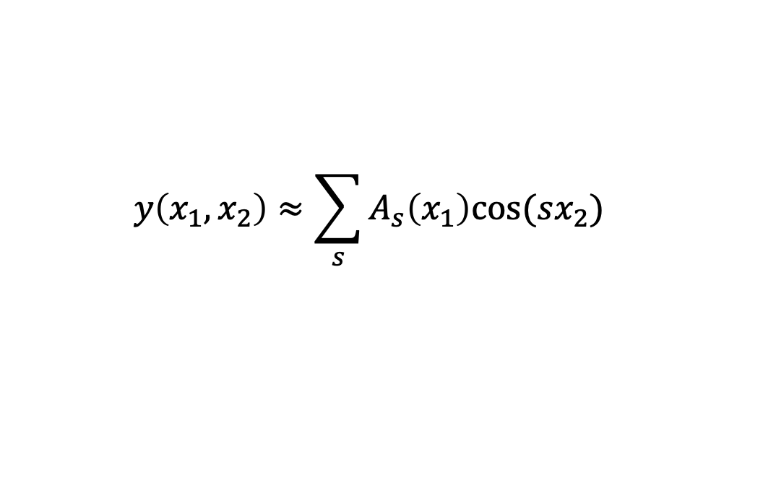
Two-layer nets
Input
  x₁ and x₂
Output
  y(x₁ , x₂)
Approximation by Fourier decomposition
$$y\left(x_{1},x_{2}\right)≈{\sum_{s}{A_{s}\left(x_{1}\right)cos⁡(sx_{2})}}^{}$$

Slide 26
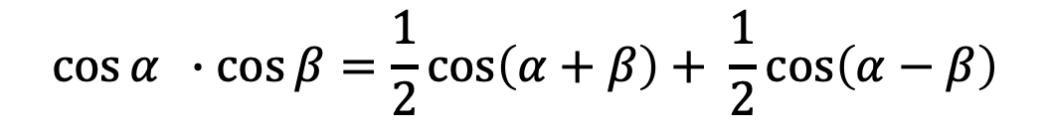
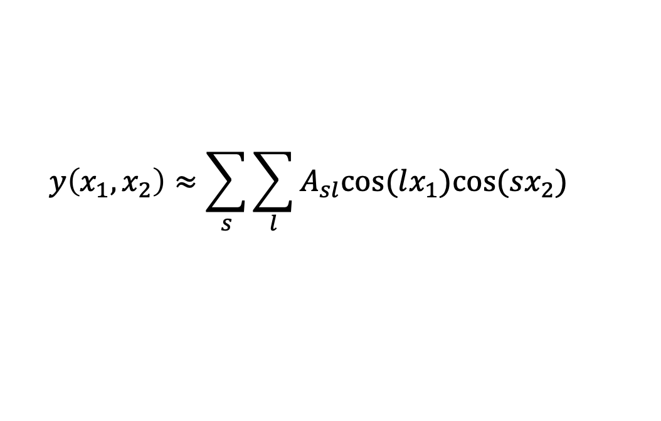
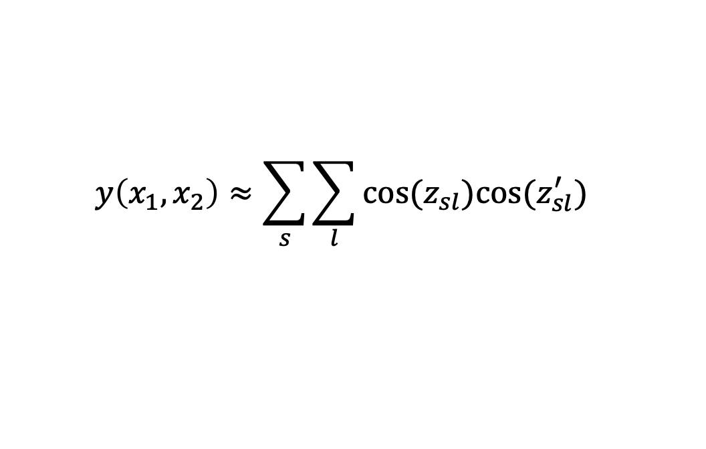
Two-layer nets
Fourier decomposition
Trigonometric identity
Linear combination
$$y\left(x_{1},x_{2}\right)≈{\sum_{s}{{\sum_{l}{A_{sl}cos(lx_{1})cos⁡(sx_{2})}}_{}}}^{}$$
$$\cos{α} ∙\cos{β}=\frac{1}{2}\cos\left(α+β\right)+ \frac{1}{2}\cos\left(α−β\right)$$
$$y\left(x_{1},x_{2}\right)≈{\sum_{s}{\sum_{l}{cos(z_{sl})cos⁡(z_{sl}^{′})}}}^{}$$
$$z_{sl}=lx_{1}+sx_{2} z_{sl}^{′}=lx_{1}−sx_{2}$$

Slide 27
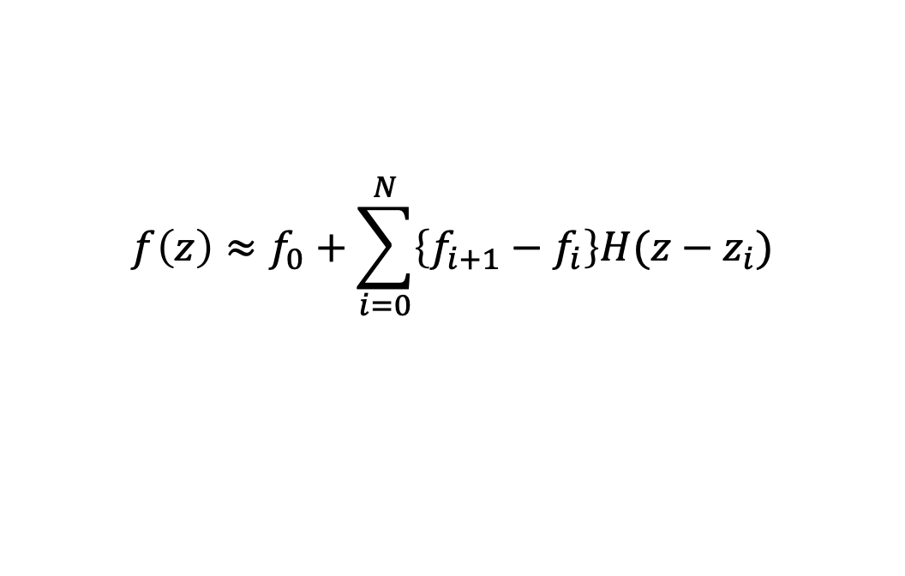
Two-layer nets
cos(z) approximation
$$f\left(z\right)≈f_{0}+\sum_{i=0}^{N}{\left\{f_{i+1}−f_{i}\right\}H(z−z_{i})}$$
Heaviside step
function
Approximation of
a function

Slide 28
Two-layer nets
cos(z) approximation
Result
  function y(x₁ , x₂) can be expressed as a linear combination of step functions whose arguments are linear combinations of x₁ and x₂
  function y(x₁ , x₂) can be approximated by a two-layer NN with threshold hidden units (can be approximated by sigmoidal functions)
$$f\left(z\right)≈f_{0}+\sum_{i=0}^{N}{\left\{f_{i+1}−f_{i}\right\}H(z−z_{i})}$$
Heaviside step
function

Slide 29
Approximation example
Examples of functions approximations

Slide 30
References
Material
  Slides
  Video Lessons
Books
  J. C. Bishop, Neural Networks for Pattern Recognition, Oxford University Press, 1995
  J. C. Bishop, Pattern Recognition and Machine Learning, Springer, 2006

