Slide 2
Question 6
Single Layer Neural Network
Question
  The perceptron algorithm converge
    if the training data set is correlate
    if the training data set is linearly separable
    if the training data set is independent

Slide 3
Introduction
Linear discriminant functions
  Linear functions of the input variables
Generalization
  Consider a non-linear function

Slide 4
Linear discriminant function
activation function
$$y\left(x\right)={σ(w}^{T}x+w_{0})$$
output
y
weights
w₀
...
w_{n}
bias
x₀
...
x_{n}
inputs
- bias is a threshold

Slide 5
Multiple linear discriminant
K > 2 classes
$$yk\left(x\right)={σ(wk}^{T}x+{wk}_{0})$$
outputs
y₁
y_{c}
weights
w₁₀
...
w_{cn}
bias
x₀
...
x_{n}
inputs
- bias is a threshold

Slide 6
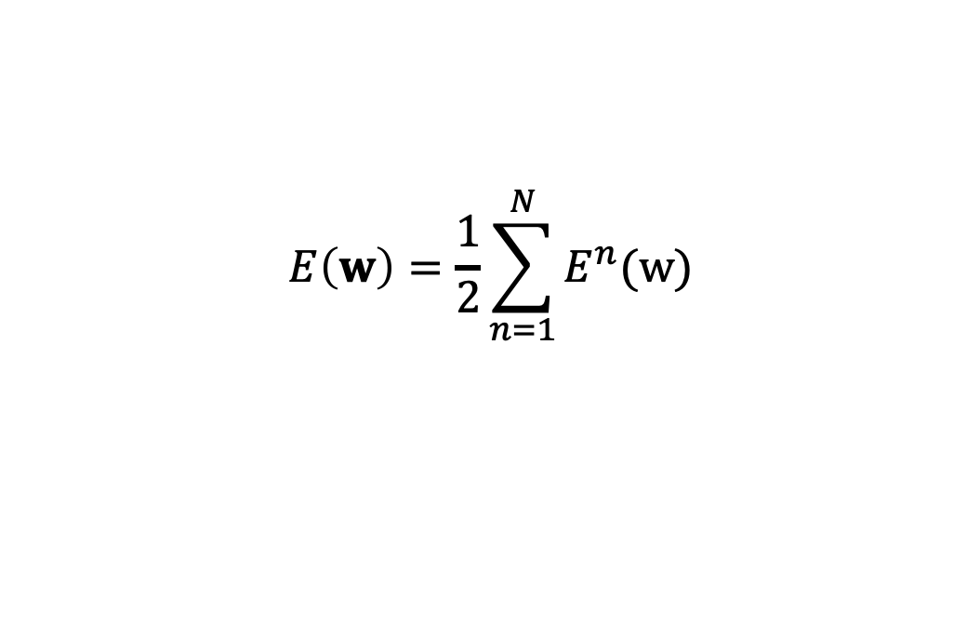

Gradient descent
Error function
Stocchastic gradient descent algorithm
$$E\left(w\right)=\frac{1}{2}\sum_{n=1}^{N}{E^{n}(\text{w})}$$
$$w^{(τ+1)}=w^{(τ)}−η∇E^{n}$$
$$w^{(τ+1)}=w^{(τ)}−η\frac{∂E^{n}}{∂w}$$

Slide 7
The perceptron algorithm
Output
Activation function

Slide 8
The perceptron algorithm
Classification
Perceptron criterion

Slide 9
The perceptron algorithm
Gradient descent algorithm
Perceptron convergence theorem
  if there exists an exact solution (if the training data set is linearly separable) then the perceptron learning algorithm is guaranteed to find an exact soultion in a finite number of steps

Slide 10
The perceptron algorithm

Slide 11
Linear separability
Linearly separble
  The points can be classified correclty by a linear decision boundary
No linearly separable
  exclusive-OR (XOR) problem

Slide 12
References
Material
  Slides
  Video Lessons
Books
  J. C. Bishop, Neural Networks for Pattern Recognition, Oxford University Press, 1995
  J. C. Bishop, Pattern Recognition and Machine Learning, Springer, 2006

