Slide 2
Question 5
Hebbian learning and competitive learning
Question
  The Voronoi tessellation is
    a partition of the space according to the Manhattan distance
    a tassellation of the the Euclidean metric
    a partition of the space according to the nearest-neighbour rule based on the Euclidean metric
    .

Slide 3
Competitive learning
competitive learning
  neurons compete among themselves to be activated
  only a single output neuron is active at any time
  neuron that wins the «competition» is called the winner-takes-all neuron
  The basic idea of competitive learning was introduced in the early 1970s
  In the late 1980s, Teuvo Kohonen introduced a special class of artificial neural networks called self-organising feature maps

Slide 4
Self Organizing Map
Human brain
  Dominated by the cerebral cortex
  Very complex structure of billions of neurons and hundreds of billions of synapses
  The cortex includes areas that are responsible for different human activities (motor, visual, auditory, somatosensory, etc.), and associated with different sensory inputs.
  Each sensory input is mapped into a corresponding area of the cerebral cortex
  The cortex is a self-organising computational map in the human brain

Slide 5
Self Organizing Map

Slide 6
The Kohonen Net
Kohonen Neural Network
  provides a topological mapping (topographic map)
  places a fixed number of input patterns from the input layer into a higher-dimensional output or Kohonen layer
  Training in the Kohonen network begins with the winner’s neighbourhood of a fairly large size
  as training proceeds the neighbourhood size gradually decreases

Slide 7
Architecture

Slide 8
Connections
The lateral connections are used to create a competition between neurons.
The neuron with the largest activation level among all neurons in the output layer becomes the winner
  neuron that produces an output signal
  the activity of all other neurons is suppressed in the competition
lateral feedback connections produce
  excitatory or inhibitory effects, depending on the distance from the winning neuron
  Mexican hat function which describes synaptic weights between neurons in the Kohonen layer

Slide 9
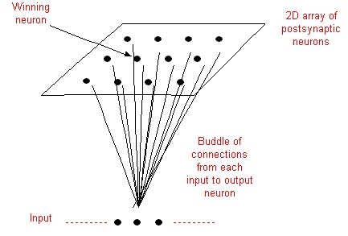
Winning neuron

Slide 10
Mexican hat function

Slide 11
Learning rule
Competitive learning rule
The winning neuron (Best Matching Unit)

Slide 12
Best Meatching Unit
X(1)
neurons (m_{i})
BMC(1)
BMC(2)
X(2)

Slide 13
Example
Learning example

Slide 14
Example
weight vector W₃ of the wining neuron 3 becomes closer to the input vector X with each iteration

Slide 15
Algorithm
Step 1: Initialization
  Set initial synaptic weights to small random values, say in an interval [0, 1], and assign a small positive value to the learning rate parameter
Step 2: Activation and Similarity Matching

Slide 16
Algorithm
Step 3: learning
neighbourhood function

Slide 17
Algorithm
Step 4: Iteration
  Increase iteration p by one, go back to Step 2 and continue until the minimum-distance Euclidean criterion is satisfied, or no noticeable changes occur in the feature map

Slide 18
Learning example
consider the Kohonen network with 100 neurons arranged in the form of a two-dimensional lattice with 10 rows and 10 columns
The network is required to classify two-dimensional input vectors
The network is trained with 1000 two-dimensional input vectors generated randomly in a square region in the interval between –1 and +1
The learning rate parameter is equal to 0.1

Slide 19
Initial random weights

Slide 20
Net after 100 iterations

Slide 21
Net after 1000 iterations

Slide 22
Net after 10.000 iterations

Slide 23
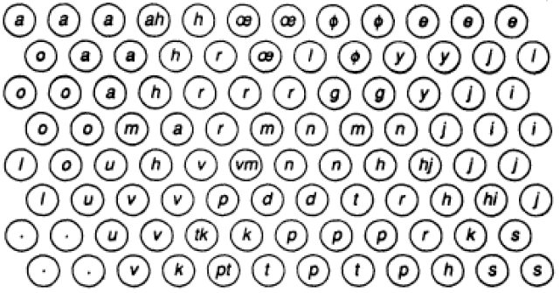
Presenting SOM

Slide 24
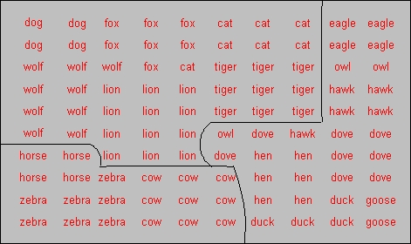
Examples

Slide 25
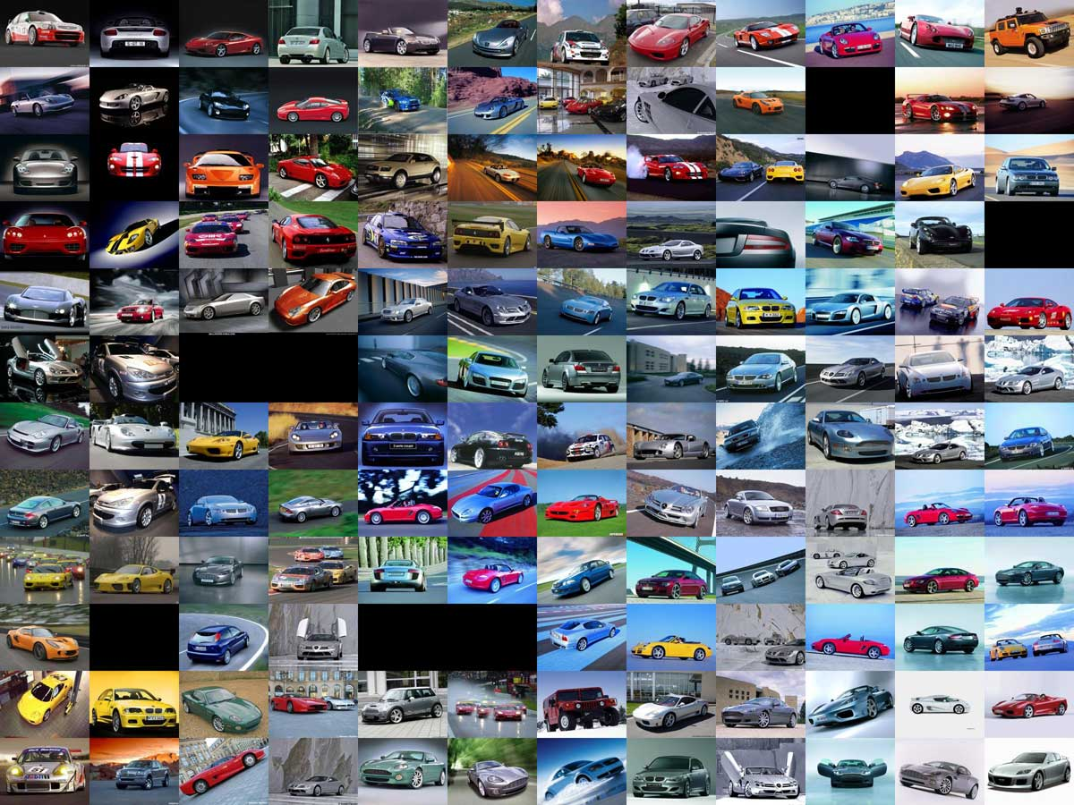
Examples

Slide 26
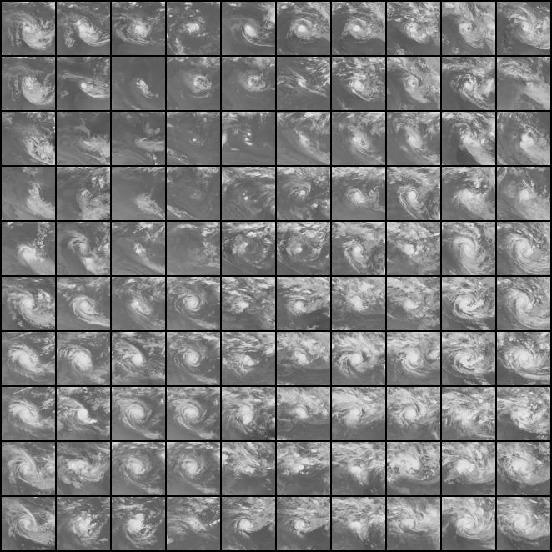
Examples

Slide 27
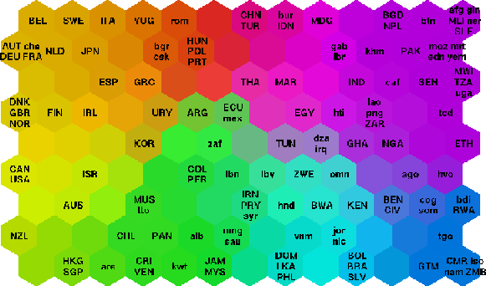
Examples

Slide 28
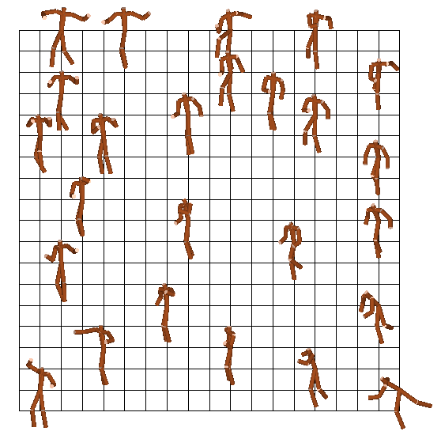
Examples
16 dance styles

Slide 29
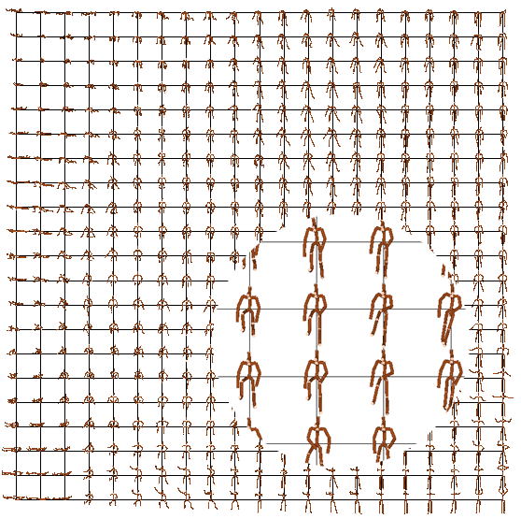
Examples
436 posture samples

Slide 30
Vector Quantization
Vector Quantisation
  technique that exploits the underlying structure of input vectors for the purpose of data compression
  input space is divided in a number of distinct regions and for each region a reconstruction (representative) is defined
  new input vector
    the region in which the vector lies is first determined
    represented by the reproduction vector for this region
  The collection of all possible reproduction vectors is called the code book of the quantizer and its members are called code words

Slide 31
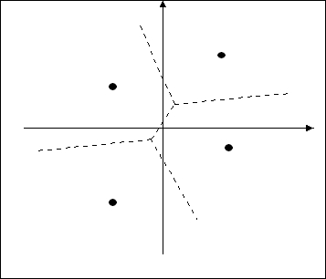
Voronoi tassellation
A vector quantizer with minimum encoding distortion
  Voronoi tassellattion or nearest-neighbour quantizer
  partition of the space according to the nearest-neighbour rule based on the Euclidean metric

Slide 32
Voronoi tassellation

Slide 33
Learning Vector Quantization
SOM
  provides an approximate method for computing the Voronoi vectors in an unsupervised manner
Learning Vector Quantisation
  supervised learning technique that uses class information to move the Voronoi vectors slightly, so as to improve the quality of the classifier decision regions

Slide 34
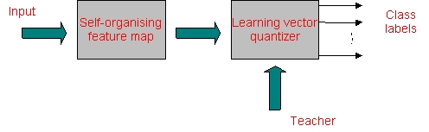
Learning Vector Quantization

Slide 35


Learning Vector Quantization
LVQ algorithm
$$wc\left(n+1\right)=wc\left(n\right)+α(x_{i}−w_{c}(n))$$
$$C_{xi}=C_{wc}$$
$$wc\left(n+1\right)=wc\left(n\right)−α(x_{i}−w_{c}(n))$$
$$C_{xi}≠C_{wc}$$

Slide 36
References
Material
  Slides
  Video Lessons
Books
  D. Floreano, Manuale sulle Reti Neurali, Il Mulino, 1996
  J. C. Bishop, Pattern Recognition and Machine Learning, Springer, 2006

