Slide 2
Question 2
Hebbian learning
Question
  In the Hopfield Neural Network for linearment independent patterns the storage capability is
    N/M patterns
    N-1 patterns
    M/N patterns
.

Slide 3
Introduction
Hopfield Neural Network
  1982 - John Hopfield
  based on concept of statistical mechanics
    Energy function
Extension
    Boltzmann Machine

Slide 4
Learning
Weights adaption
  Activations change based on the outputs of other units
  Finite states sequence up to the stability point
  The point of stability is the state of equilibrium
Aim
  storage and recognition
  learn a series of patterns
  after the training phase the network is able to recover an original pattern from one incomplete or corrupted by noise

Slide 5


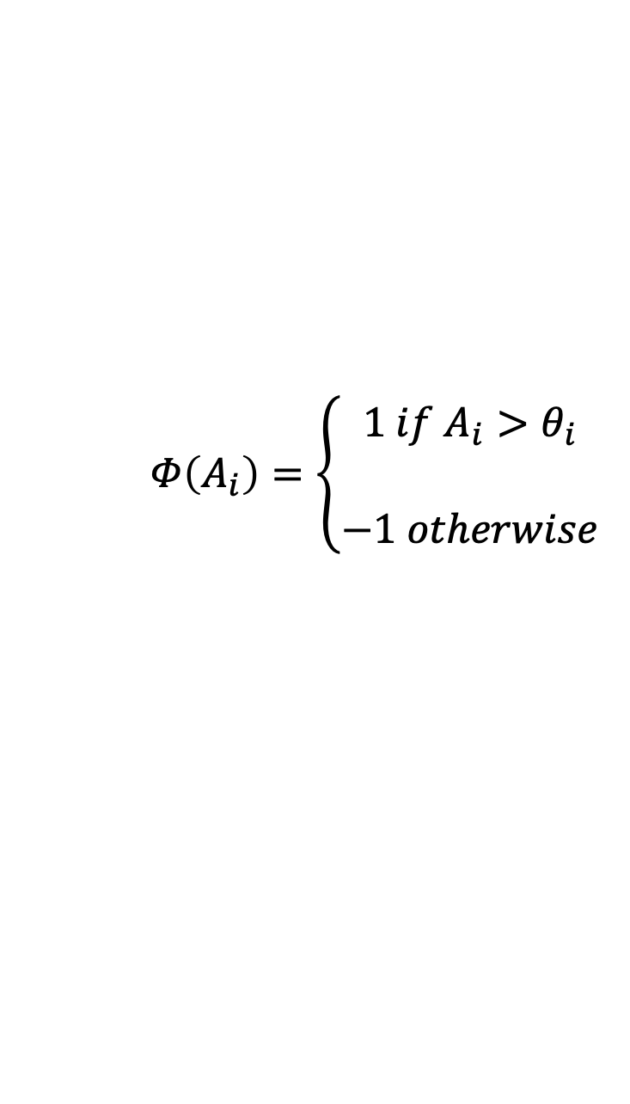
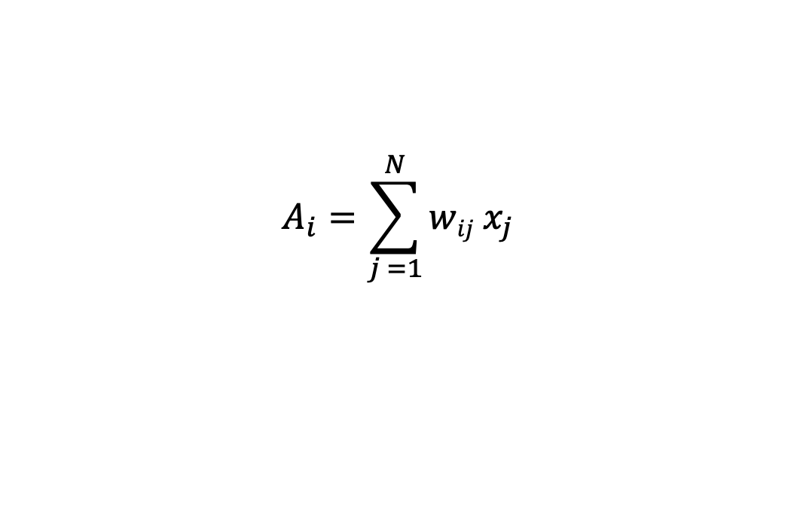

Hopfield NN
$$w_{ii}=0$$
$$w_{ij}=w_{ji}$$
$$θ_{i}=0$$
N bipolar units
$$A_{i}=\sum_{j =1}^{N}{wij x_{j} }$$
$Φ\left(A_{i}\right)=$ $\left\{\begin{aligned}1 if A_{i}>θ_{i} \\ \\ −1 otherwise \end{aligned}\right.$
neuron activation
function
neuron activation

Slide 6
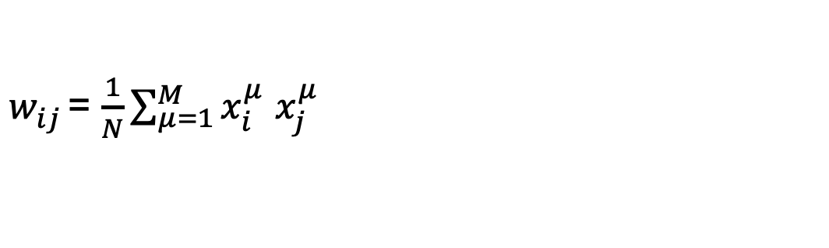
Hebb’s rule
Each input unit performs input and output functions
Pattern di input
Hebb’s rule
$$p=[p_{1}, …,p_{N}]$$
$$x_{i}= p_{i}$$
1/N Constant of proportionality
$∆w_{ij}^{μ}$= $x_{i}^{μ}$ $x_{j}^{μ}$
$w_{ij}^{}$= $\frac{1}{N}\sum_{μ=1}^{M}{x_{i}^{μ} x_{j}^{μ}}$
For M patterns

Slide 7
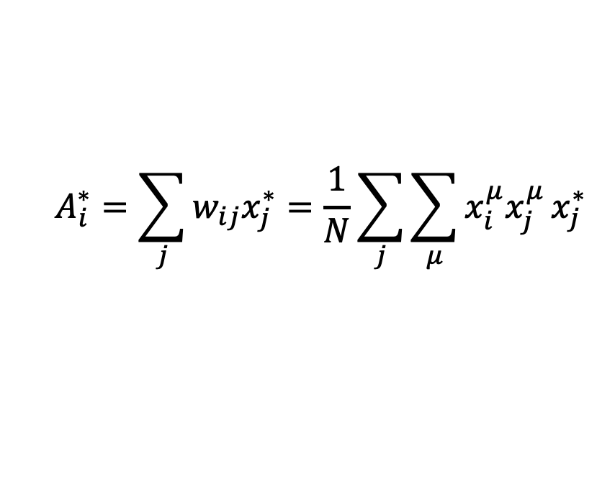
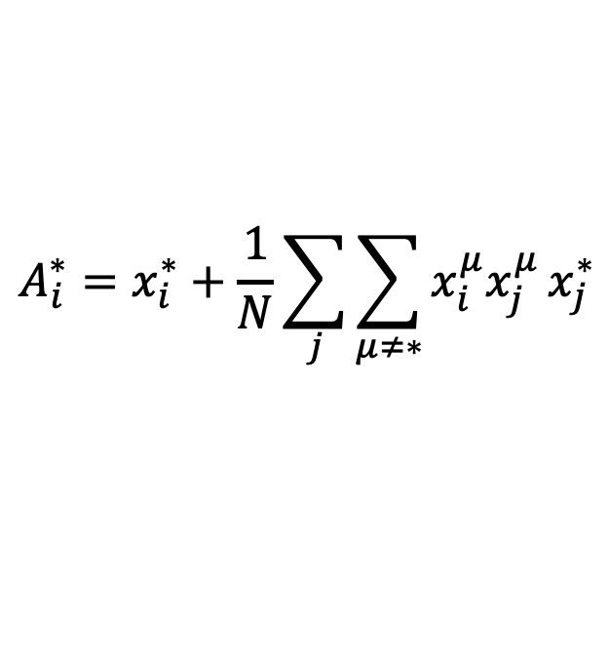
Moemorization of patterns
Stability of a pattern
Without pattern p*
${Φ\left(A_{i}^{∗}\right)= p_{i}^{∗} ∀i}_{}$
$$A_{i}^{∗}=\sum_{j}{w_{ij}x_{j}^{∗}}=\frac{1}{N}\sum_{j}{\sum_{μ}{x_{i}^{μ}x_{j}^{μ}}x_{j}^{∗}}$$
$$A_{i}^{∗}=x_{i}^{∗}+\frac{1}{N}\sum_{j}{\sum_{μ≠∗}{x_{i}^{μ}x_{j}^{μ}}x_{j}^{∗}}$$
Interference (crosstalk)

Slide 8
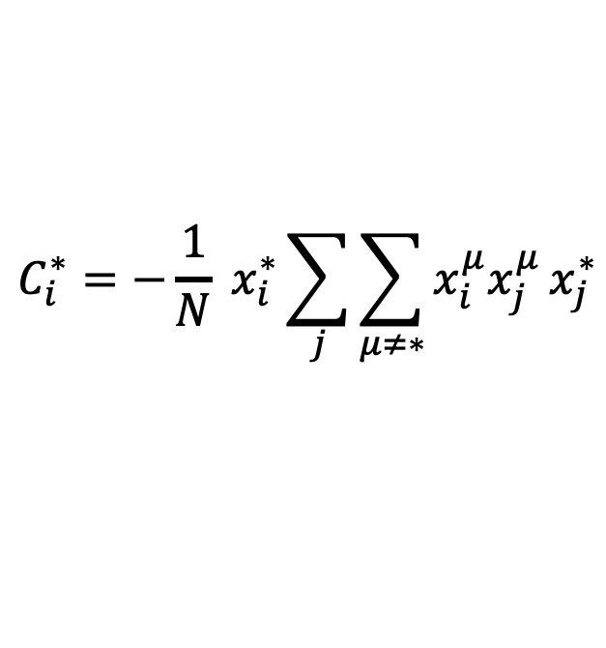

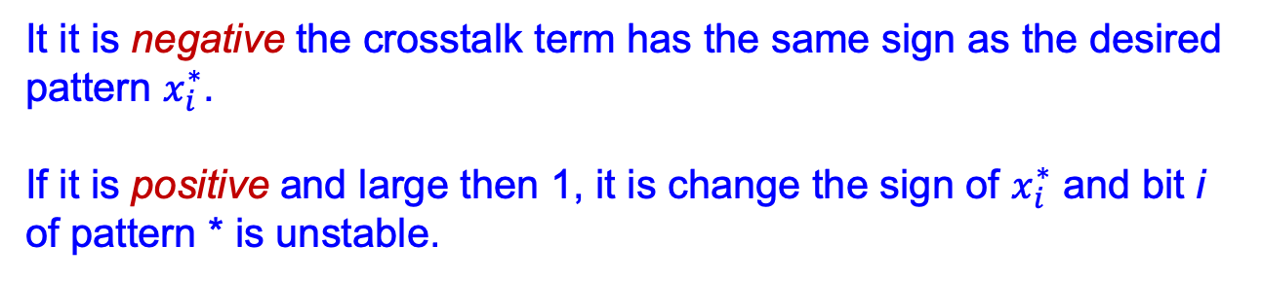
Net capability
NN storage capability
Storage quantity
patterns
$$\frac{M}{N}$$
nodes
$$C_{i}^{∗}={−\frac{1}{N} x}_{i}^{∗}\sum_{j}{\sum_{μ≠∗}{x_{i}^{μ}x_{j}^{μ}}x_{j}^{∗}}$$
It it is negative the crosstalk term has the same sign as the desired
pattern $x_{i}^{∗}$.
If it is positive and large then 1, it is change the sign of $x_{i}^{∗}$ and bit i
of pattern * is unstable.

Slide 9
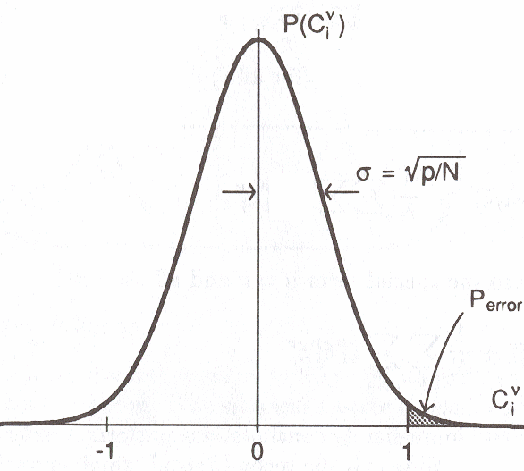
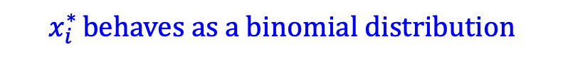



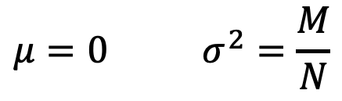
Net capability
For random patterns
Binomial distribution
$$x_{i}^{∗ }behaves as a binomial distribution$$
$$P_{error} ={Prob( x}_{i}^{∗}>1)$$
P($x_{i}^{∗}$)
$$μ=0 σ^{2}=\frac{M}{N}$$
$$x_{i}^{∗}$$
$For large M∗N approximation (Gaussian)$

Slide 10
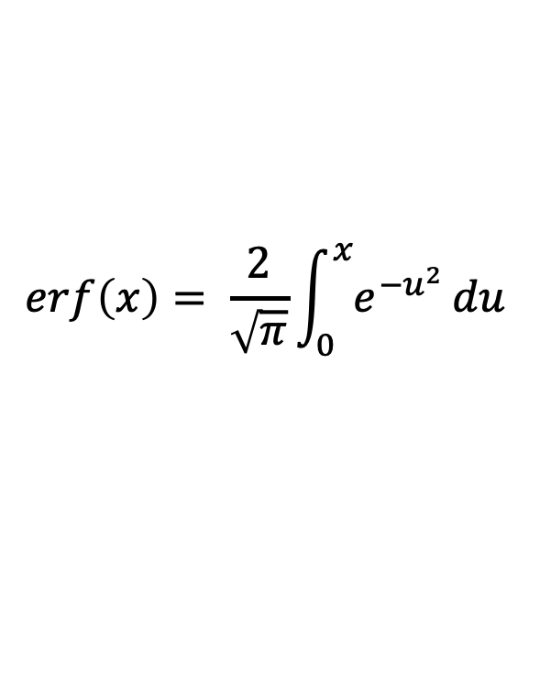
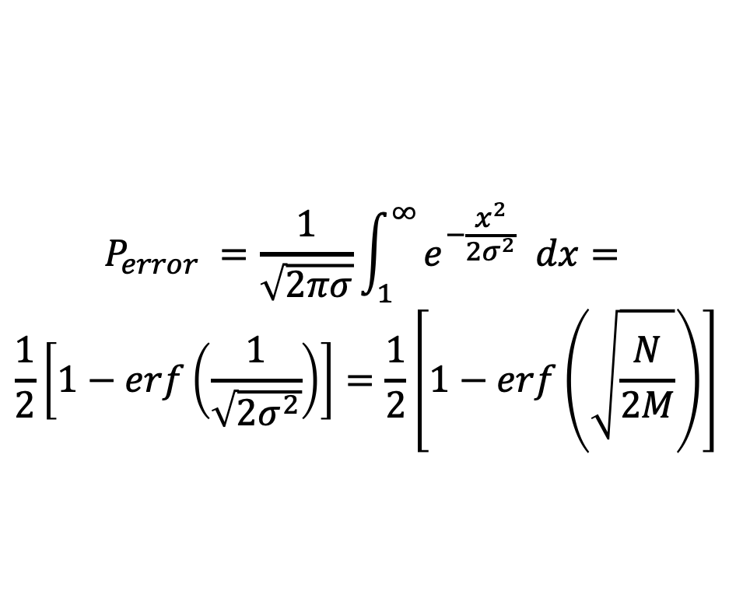
Net capability
Gaussian distribution
$$P_{error} =\frac{1}{\sqrt{2πσ}}\int_{1}^{∞}{e^{−\frac{x^{2}}{2σ^{2}}} dx}=$$
$$\frac{1}{2}\left[1−erf\left(\frac{1}{\sqrt{2σ^{2}}}\right)\right]=\frac{1}{2}\left[1−erf\left(\sqrt{\frac{N}{2M}}\right)\right]$$
$$\operatorname{erf}\left(x\right)= \frac{2}{\sqrt{π}}\int_{0}^{x}{e^{−u^{2}}}du$$

Slide 11
Net capability
Error and limitation
For linearment independent patterns
  Pseudoinversion method
  Storage capability N-1 patterns
M
Small percentage of error

Slide 12
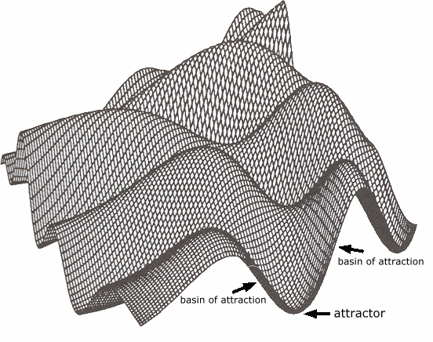
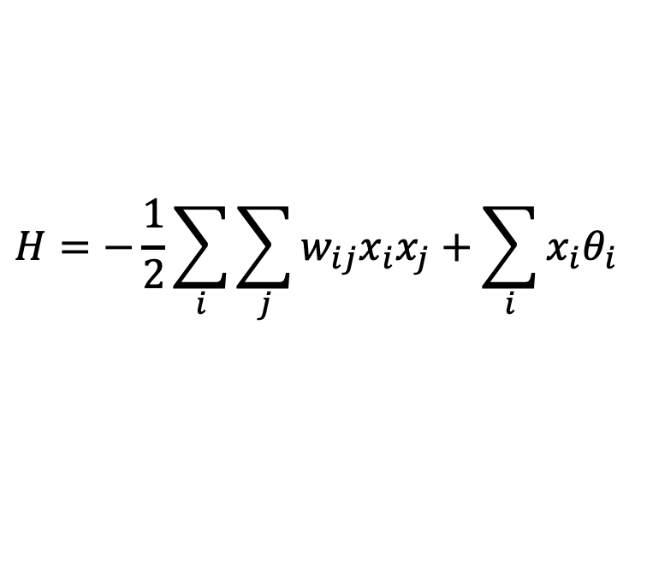
Energy function
$$H=−\frac{1}{2}\sum_{i}{\sum_{j}{w_{ij}x_{i}x_{j}+\sum_{i}{x_{i}θ_{i}}}}$$
Energy function

Slide 13
Energy function
Energy function

Slide 14
Storage examples
Images reconstruction examples

Slide 15
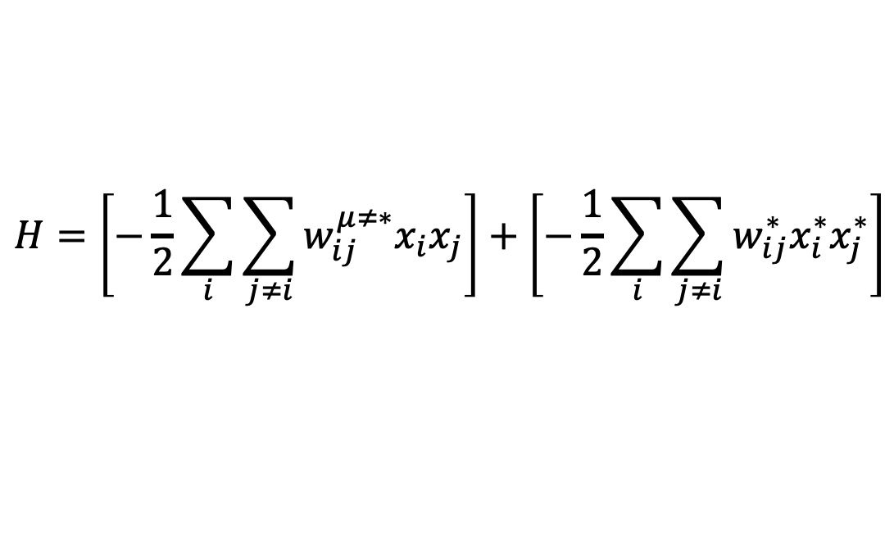
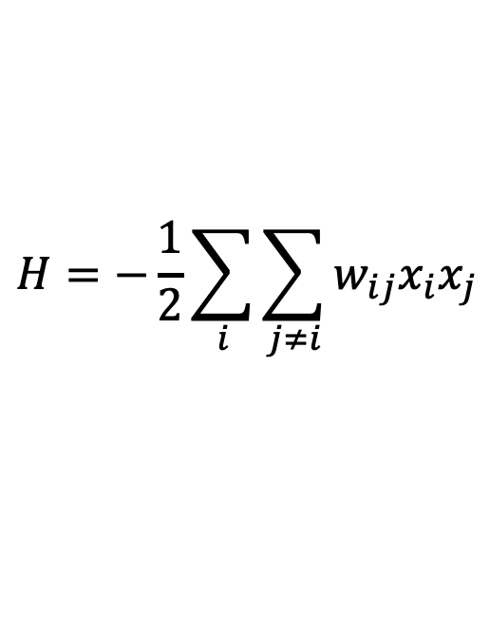
Storage and energy reduction
For random patterns
New pattern
$$H=−\frac{1}{2}\sum_{i}{\sum_{j≠i}{w_{ij}x_{i}x_{j}}}$$
$$H=\left[−\frac{1}{2}\sum_{i}{\sum_{j≠i}{w_{ij}^{μ≠∗}x_{i}x_{j}}}\right]+\left[−\frac{1}{2}\sum_{i}{\sum_{j≠i}{w_{ij}^{∗}x_{i}^{∗}x_{j}^{∗}}}\right]$$

Slide 16

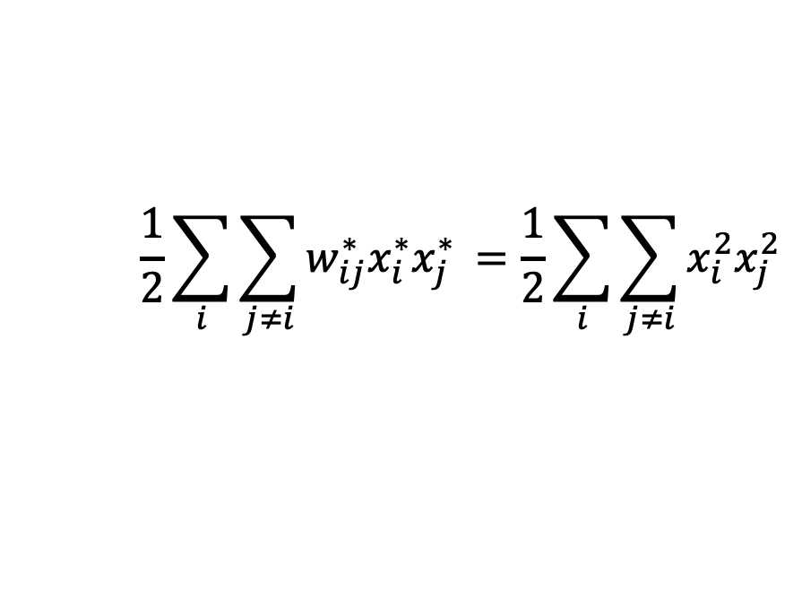
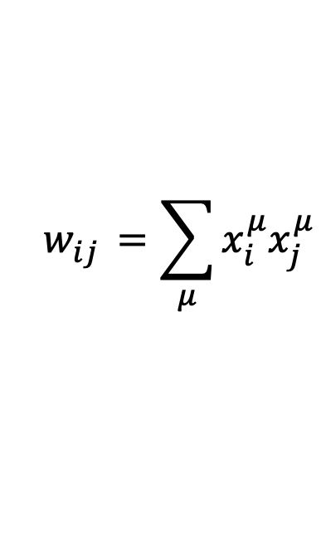
Storage and energy reduction
Optimum of the second term
Hebbian learning rule
Positive values
$$\frac{1}{2}\sum_{i}{\sum_{j≠i}{w_{ij}^{∗}x_{i}^{∗}x_{j}^{∗ }=\frac{1}{2}\sum_{i}{\sum_{j≠i}{x_{i}^{2}x_{j}^{2 }}}}}$$
$$w_{ij}^{}=\sum_{μ}{x_{i}^{μ}x_{j}^{μ}}$$
$$w_{ij}^{∗}=x_{i}^{∗}x_{j}^{∗}$$

Slide 17
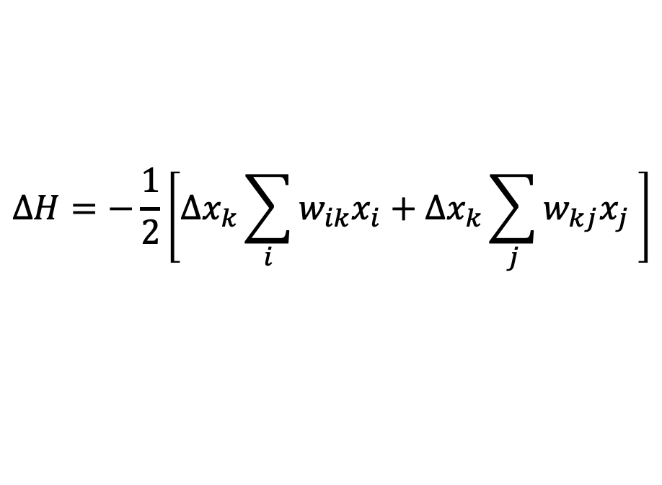
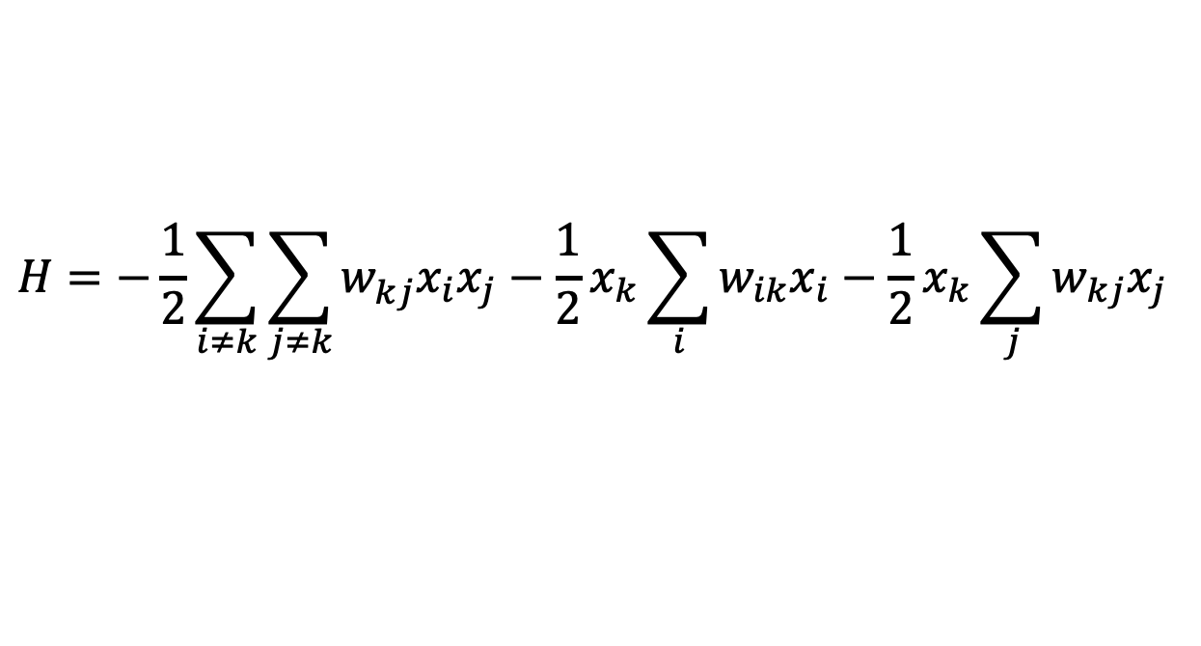
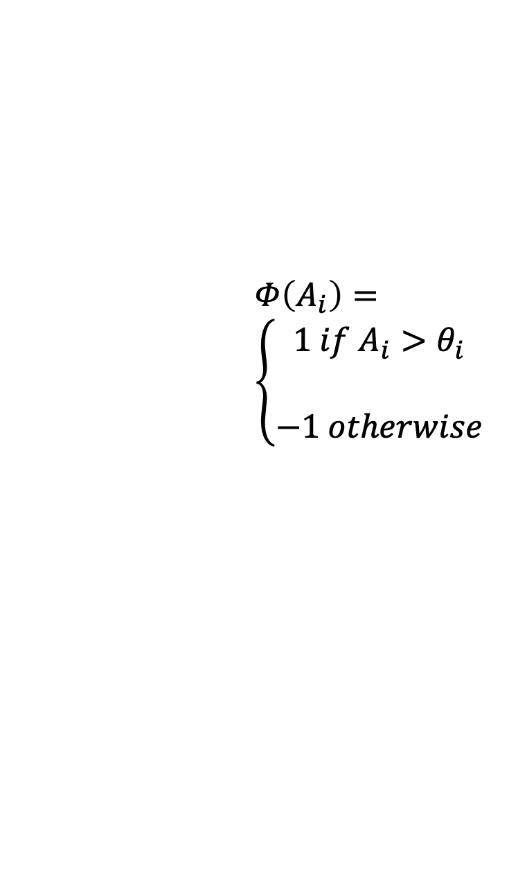
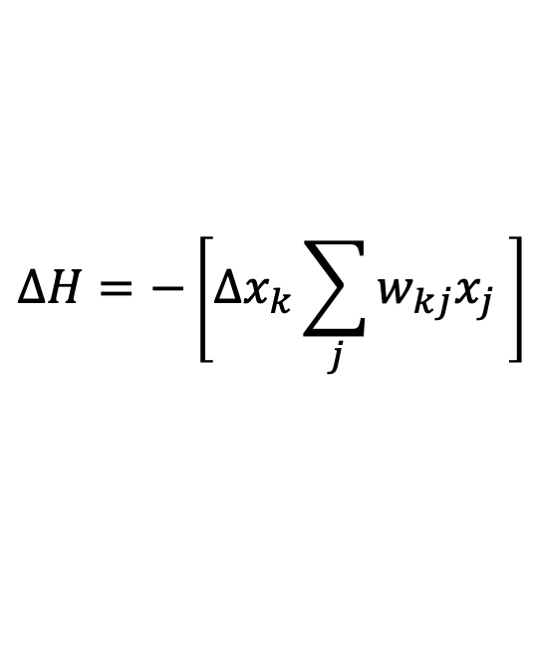
Pattern recovering and energy reduction
k-th unit
Reduction of the energy
For symmetry (Hebbian learning)
$$H=−\frac{1}{2}\sum_{i≠k}{\sum_{j≠k}{w_{kj}^{}x_{i}x_{j}}}−\frac{1}{2}x_{k}\sum_{i}{w_{ik}x_{i}−\frac{1}{2}x_{k}\sum_{j}{w_{kj}x_{j} }}$$
$$∆H=−\frac{1}{2}\left[{∆x}_{k}\sum_{i}{w_{ik}x_{i}+∆x_{k}\sum_{j}{w_{kj}x_{j} }}\right]$$
$Φ\left(A_{i}\right)=$ $\left\{\begin{aligned}1 if A_{i}>θ_{i} \\ \\ −1 otherwise \end{aligned}\right.$
$$∆H=−\left[∆x_{k}\sum_{j}{w_{kj}x_{j} }\right]$$

Slide 18
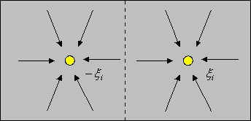
Attractors
Configuration space is symmetrically divided into two basins of attraction

Slide 19
Spurious states
Hebb
  dynamical system which has attractors (the minima of the energy function)
  desired patterns which have been stored and are called retrieval states
Other attractors
  reversed states
  mixture states
  spin glass states

Slide 20

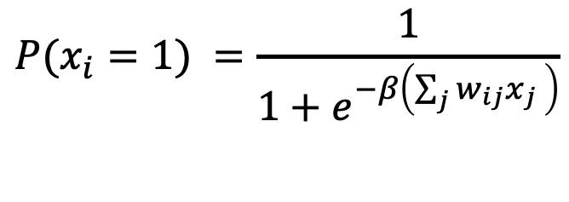
Stochastic units
Biased random decisions
  Replace the binary threshold units by binary stochastic units
  The “temperature” controls the amount of noise
  Decreasing all the energy gaps between configurations is equivalent to raising the noise level
  Simulated annealing
$$P(x_{i}=1) =\frac{1}{1+e^{−β\left(\sum_{j}{w_{ij}x_{j} }\right)}}$$
$$β=\frac{1}{kT}$$
k is the Boltzamnn constant

Slide 21
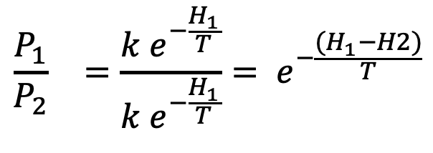
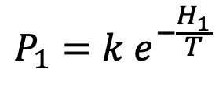

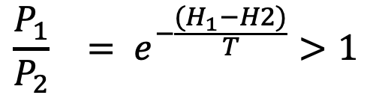

Stochastic units
Probability of the states
  Boltzmann distribution
Probability of the state
$${\frac{P_{1}}{P_{2}}}_{}=\frac{k e^{−\frac{H_{1}}{T}}}{k e^{−\frac{H_{1}}{T}}}= e^{−\frac{{(H}_{1}−H2)}{T}}$$
$$P_{1}=k e^{−\frac{H_{1}}{T}}$$
$$H_{1}<H_{2}$$
$${\frac{P_{1}}{P_{2}}}_{}= e^{−\frac{{(H}_{1}−H2)}{T}}>1$$
$$P_{1}>P_{2}$$

Slide 22
References
Material
  Slides
  Video Lessons
Books
  D. Floreano, Manuale sulle Reti Neurali, Il Mulino, 1996
  J. C. Bishop, Pattern Recognition and Machine Learning, Springer, 2006

