Slide 2
Question 1
Artifical Neural Networks (ANNs) are at the very core of Deep Learning
Question
  In the linear single layer Neural Network the bias is correlated with
    the normal distance from the origin to decision surface
    the direction of decision surface
    The distance between two points on on the decision surface
.

Slide 3
Biological neuron
The biological neurons
  behave in a rather simple way
  are organized in a vast network of billions of neurons
  each neuron typically connected to thousands of other neurons
Neural networks
  Highly complex computations can be performed by a vast network of fairly simple neurons

Slide 4
Biological neuron
Example of biological neuron

Slide 5
Biological Neural Network
Multiple layers in a biological neural network (human cortex)

Slide 6
Linear models for classification
Classification
The classes are taken to be disjoint
  the input space is divided into decision regions whose boundaries are called decision boundaries
  for linear models
    (D-1)-dimensional hyperplanes within the D-dimensional input space
$$x → C_{k} k=1, .. , K$$

Slide 7

Target values
K = 2 classes
K > 2 classes
$$C_{1}→1$$
$$C_{2}→0$$
$$t∈ \left\{0,1\right\}$$
$$t={\left(0, 1, 0 , 0 , 0\right)}^{T}$$
1-of K coding (K = 5)

Slide 8
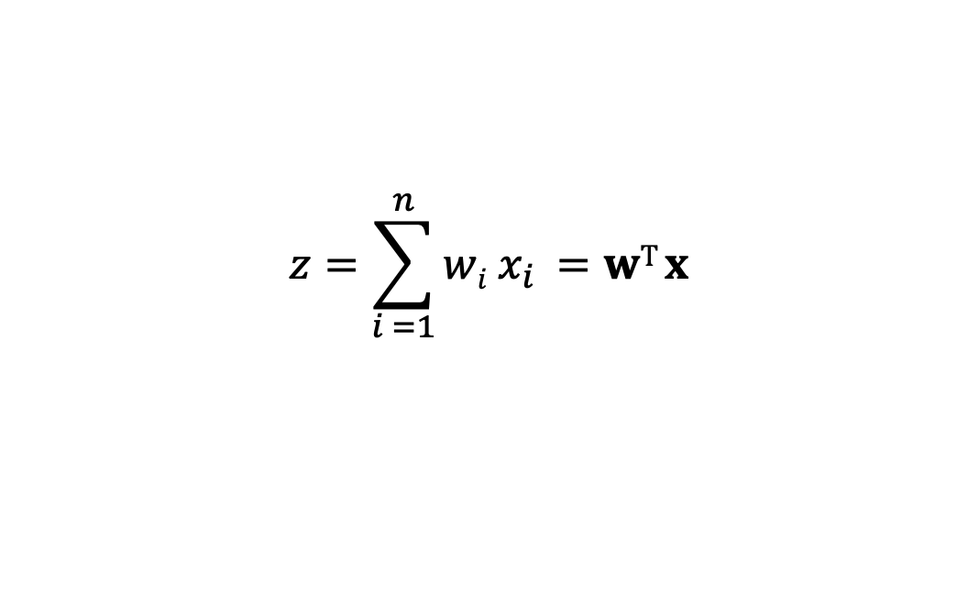
Linear discriminant function
$$z=\sum_{i =1}^{n}{wi x_{i} }=wT x$$
$$y\left(x,w\right)=w^{T}x+w_{0}$$
output
y
weights
w₀
...
w_{n}
bias
x₀
...
x_{n}
inputs
- bias is a threshold

Slide 9
Decision surface orientation
Decision boundary
Two points
$$y\left(x,w\right)=0$$
$$y\left(xA,w\right)=0$$
$$w^{T}(xA −xB)=0$$
$$y\left(xB,w\right)=0$$
w is orthogonal to every vector within
the decision surface determining the
orientation of the decision surface

Slide 10


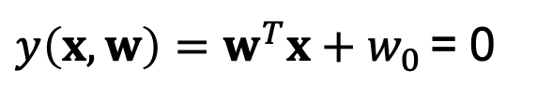
Decision surface distance
point x on
$y\left(x,w\right)=w^{T}x+w_{0}$ = 0
normal distance from the
origin to decision surface
$$\frac{w^{T}x}{\left\|w\right\|}=−\frac{w_{0}}{\left\|w\right\|}$$
norm
$\left\|w\right\|$=$\sqrt{ww^{T} }=\sqrt{w_{1}^{2}+w_{2}^{2}+…+w_{n}^{2}}$
w₀ determines the location of the decision surface

Slide 11


Decision surface point distance
arbitrary point x
$$x=x⊥+ r\frac{w}{\left\|w\right\|}$$
Multiplying both sides by w^{T} and adding w₀
$$r=\frac{y(x)}{\left\|w\right\|}$$
r perpendicular distance

Slide 12
Linear discriminant function
K = 2 classes

Slide 13
Multiple classes
Approaches
  one-versus-the rest
  one-versus-one

Slide 14

Multiple linear discriminant
K > 2 classes
$$yk\left(x,wk\right)={wk}^{T}x+{wk}_{0}$$
$$yk\left(x,wk\right)>yj\left(x,wj\right)$$
$$for all j≠k →Ck$$
outputs
y₁
y_{c}
weights
w₁₀
...
w_{cn}
bias
x₀
...
x_{n}
inputs
- bias is a threshold

Slide 15
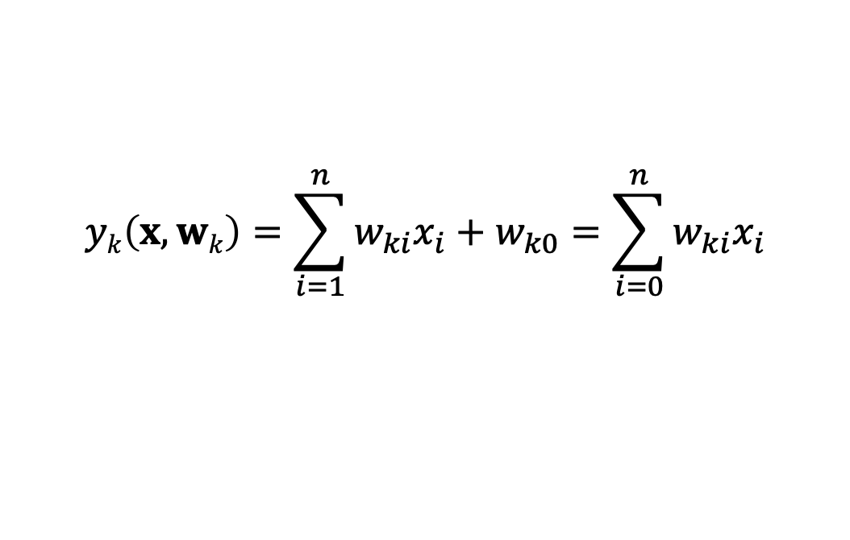
Multiple linear discriminant
K > 2 classes
The decision regions are always singly connected and convex
x₀ = 1
$$yk\left(x,wk\right)=\sum_{i=1}^{n}{w_{ki}x_{i}+w_{k0}=\sum_{i=0}^{n}{w_{ki}x_{i}}}$$
$$\hat{x}=λx^{A}+\left(1−λ\right)x^{B}$$
from the linearity
$$y_{k}(\hat{x)}=λ{y_{k}(x}^{A})+\left(1−λ\right){y_{k}(x}^{B})$$

Slide 16

Multiple linear discriminant
$ℛ$_{k} is singly connected and convex

Slide 17
References
Material
  Slides
  Video Lessons
Books
  J. C. Bishop, Neural Networks for Pattern Recognition, Oxford University Press, 1995
  J. C. Bishop, Pattern Recognition and Machine Learning, Springer, 2006

