Slide 2
Question 35
PCA can be defined as the principal subspace such that the variance of the projected data is maximized
Question
The hierarchical PCA NN is
Deep NN
Single Layer NN
Mulit-Layer NN

Slide 3
Unsupervised Neural Networks
Typically Hebbian type learning rules are used
There are two type of NN able to extract the Principal Components:
Symmetric (Oja, 1989)
Hierarchical (Sanger, 1989)
Notes:
IP fornisce un servizio best-effort: fa il massimo sforzo per recapitare i datagrammi il più velocemente possibile, senza fornire però nessuna assicurazione in merito
al ritardo
all’entità del jitter di pacchetti
Essendo la telefonia internet e la videoconferenza in tempo reale particolarmente sensibili a questi aspetti, l’assenza di garanzie crea notevoli problemi alla progettazione ti tali applicazioni.
Per fortuna, i progettisti possono introdurre svariati meccanismi che consentono di preservare una buona qualità audio e video, almeno nei casi in cui ritardi, jitter e perdite non siano eccessivi.
Tratteremo il caso della telefonia Internet.

Slide 4
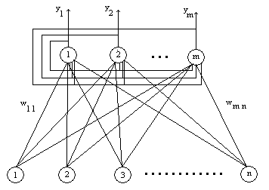
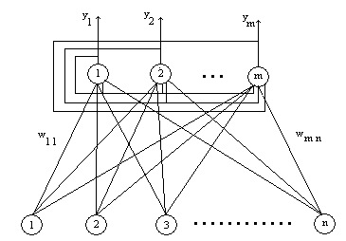
PCA and Unsupervised Neural Network
Single layer Neural Network
Symmetric PCA NN
Objective function
Hierarchical PCA NN

Slide 5
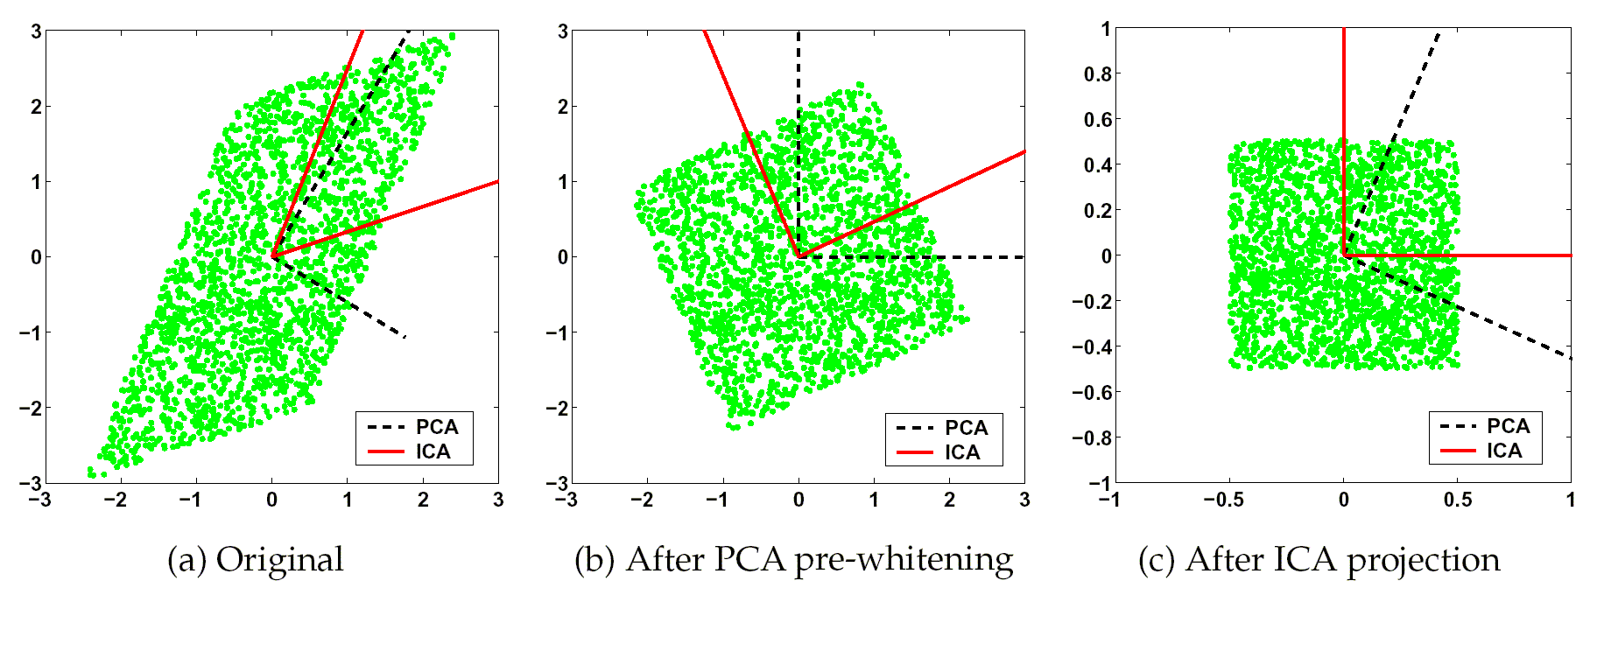
ICA versus PCA
PCA maximises the variance and projections onto the basis vectors are mixtures. ICA correctly finds the two vectors onto which the projections are independent.

Slide 6
Mixing matrix

Slide 7
Non-linear objective function
Maximization
w (weights)
L-dimensional vector
where E is the expectation with respect to the (unknown) density of x and f(.) is a continue function (e.g. ln cosh(.))
Taylor series
That is dominating, and
the kurtosis is optimized

Slide 8
Unsupervised Neural Network
Standard PCA
Robust PCA
Nonlinear PCA
Descendent gradient algorithm

Slide 9
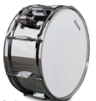
Cocktail party
Sources
Mixtures
Estimated-Sources
s A x W y

Slide 10
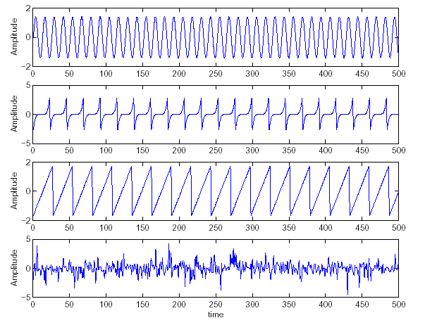
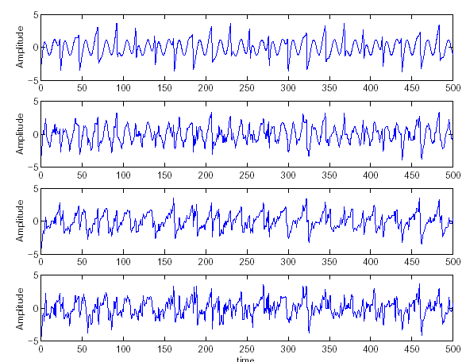
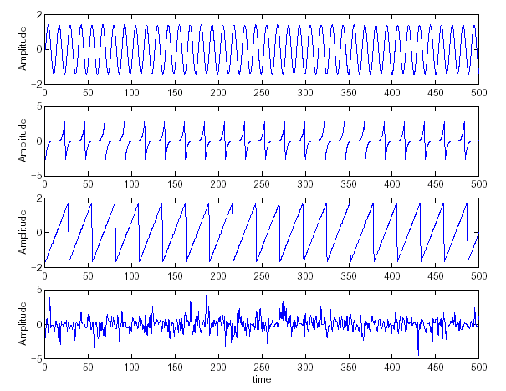
Source estimation
Source signals
Mixed signals
Estimated signals
x₁(t), x₂(t),x₃(t) are the observed signals,
s₁(t), s₂(t), s₃(t) the source signals
y₁(t), y₂(t),y₃(t) are the separated signals

Slide 11
References
Material
Slides
Video Lessons
Books
Independent Component Analysis, A. Hyvärinen, J. Karhunen, E. Oja, John Wiley & Sons, 2001

