Slide 2
Question 33
Compressive Sensing (CS) is a new sensing modality, which compresses the signal being acquired at the time of sensing
Question
  Sparse Modeling are used for
    eliminating representative objects
    Introducing redoundance
    finding representative objects

Slide 3
Dictionay learning
Goal
  Given training data
  learn a dictionary D
  where s_{i} are sparse

Slide 4
Dictionay learning
Optimization approach
Non-convex constraint
Bilinear in D and S
Non-convex constraint
Bilinear in D and S

Slide 5
Dictionay learning
Optimization approach
Biconvex in D and S
Non-convex constraint
Bilinear in D and S
  Given D, the optimization problem is convex in s_{k}
  Given S, the optimization problem is a least squares problem

Slide 6
Dictionay learning
K-SVD
  Solve using alternate minimization techniques
    Start with D = wavelet or DCT bases
    Additional pruning steps to control size of the dictionary
Sparse Modeling for Finding Representative Objects

Slide 7
Finding Representative Objects

Slide 8



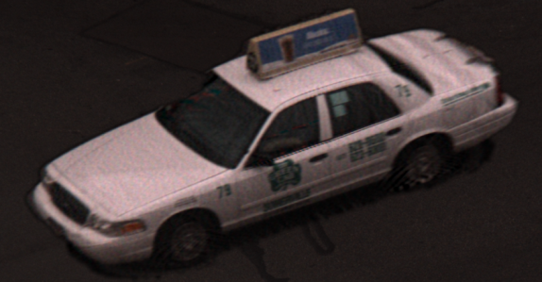
Deblurreing
Blurred Photos
Deblurred Result

Slide 9
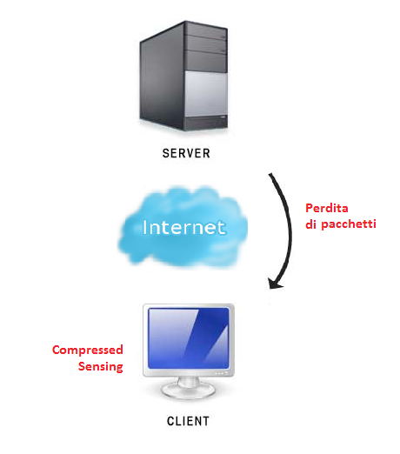
First scenario
Packet loss
Compressed
Sensing

Slide 10
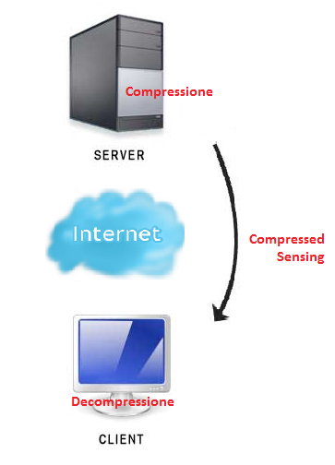
Second Scenario
Coding
Compressed
Sensing
Decoding

Slide 11
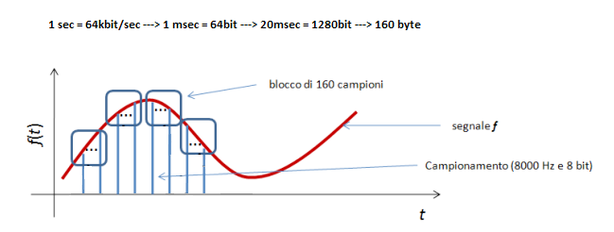
Packet loss
160 samples block
signal
sampling (8 KHz, 8 bit)

Slide 12
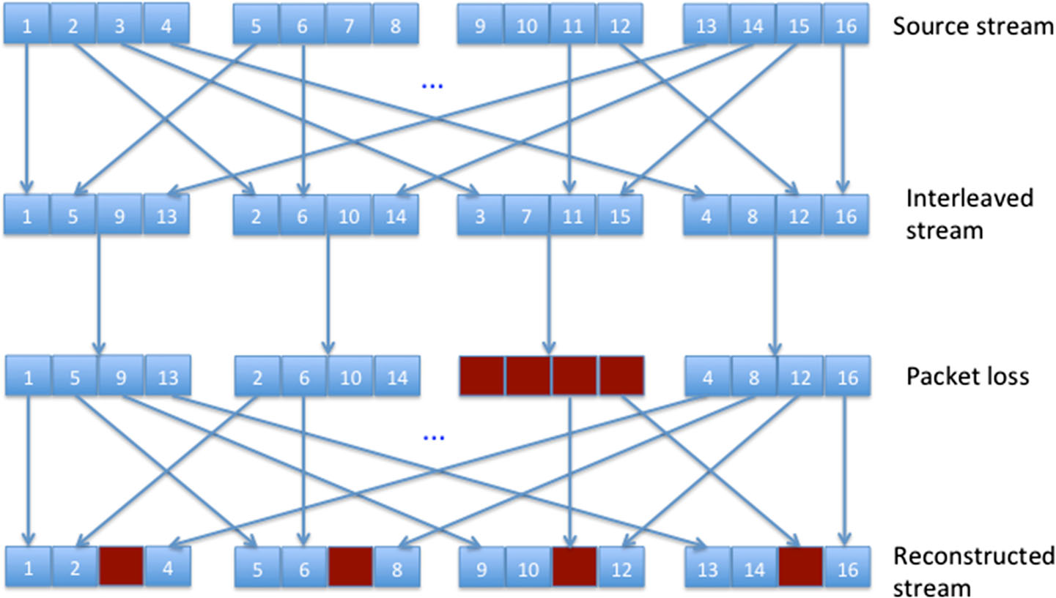
Interleaving

Slide 13
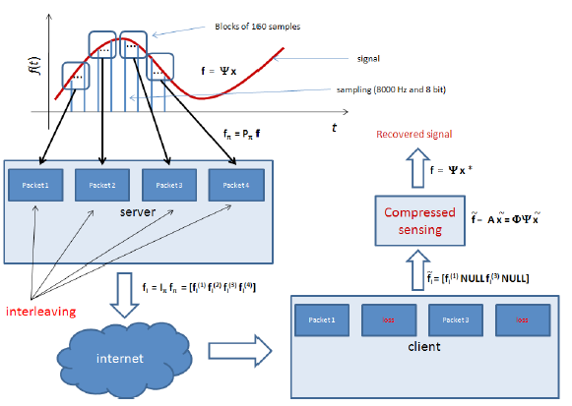
Reconstruction scheme

Slide 14
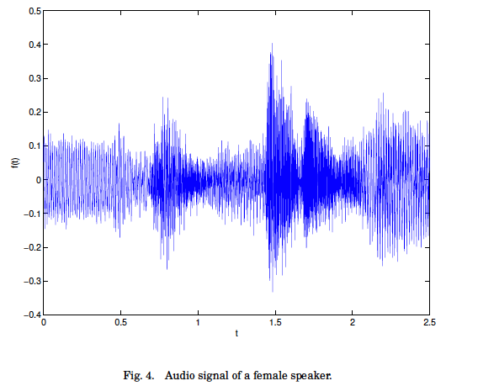
Experimental results

Slide 15
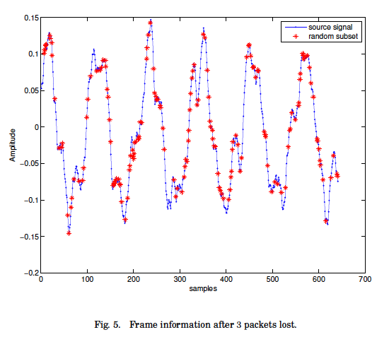
Experimental results

Slide 16
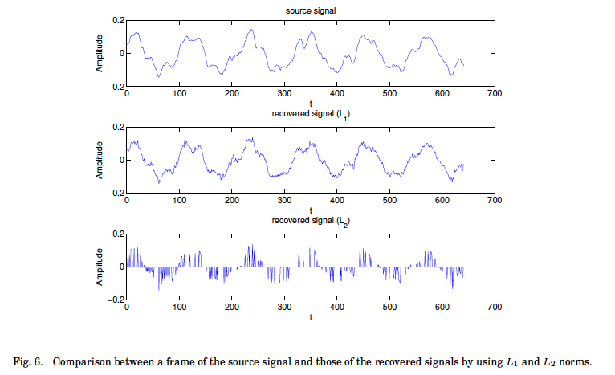
Experimental results

Slide 17
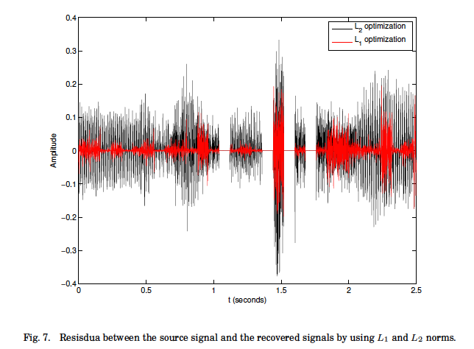
Experimental results

Slide 18
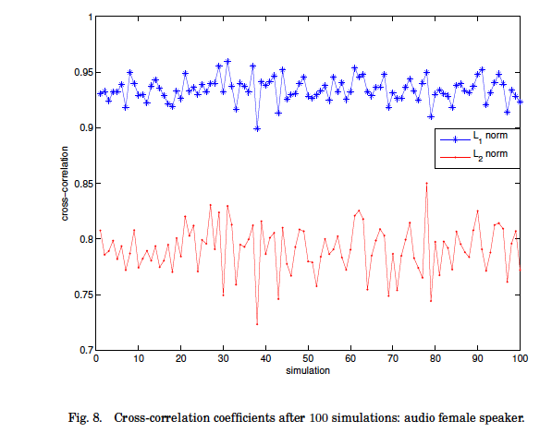
Experimental results

Slide 19
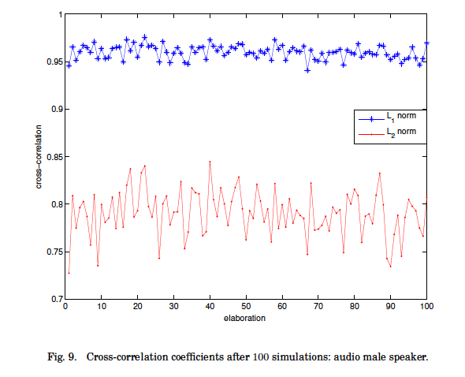
Experimental results

Slide 20
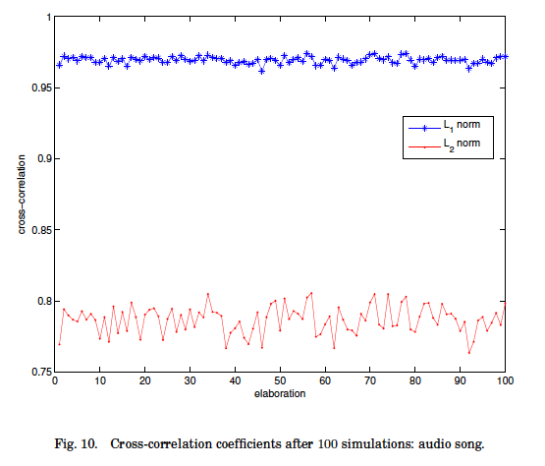
Experimental results

Slide 21
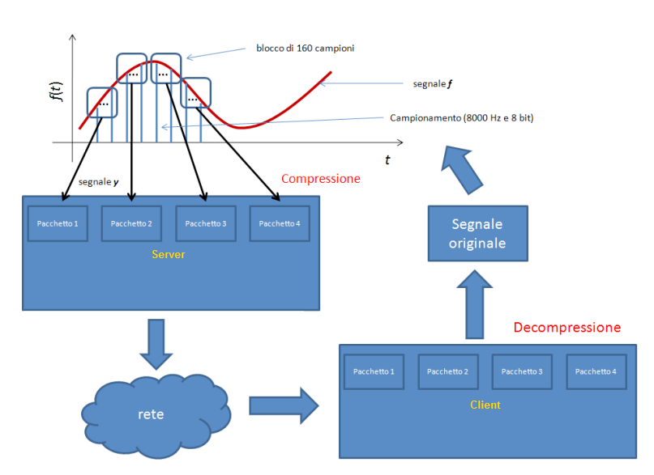
Compression scheme

Slide 22
References
Material
  Slides
  Video Lessons
Books
  A Mathematical Introduction to Compressive Sensing, S. Foucart , H. Rauhut, 2013

