Slide 2
Question 32
Compressive Sensing (CS) is a new sensing modality, which compresses the signal being acquired at the time of sensing
Question
  Compressive Sensing use
    the coherence misure
    the independent misure
    the covariance misure

Slide 3
Introduction
Compressive Sensing (o Compressed Sensing) technique
client-server architecture
Compressice Sensing for
  compression
  packet loss reconstruction

Slide 4
Compressive Sensing
Compressive Sensing (CS)
  is a new sensing modality, which compresses the signal being acquired at the time of sensing
  Signals can have sparse or compressible representation either in original domain or in some transform domain
  Relying on the sparsity of the signals, CS allows us to sample the signal at a rate much below the Nyquist sampling rate
  the varied reconstruction algorithms of CS can faithfully reconstruct the original signal back from fewer compressive measurements

Slide 5
Compressive Sensing
CS was introduced by Donoho, Candès, Romberg, and Tao in 2004

Slide 6
Compressive Sensing
Emerging technique for signal processing
  acquisition/reconstruction that violates the Nyquist-Shannon limit
    less samples
A signal can have sparse/compressible representation either in original domain or in some transform domains
  Fourier transform, cosine transform, wavelet transform, etc. A few examples of signals having sparse
Domains
  natural images which have sparse representation in wavelet domain
  speech signal can be represented by fewer components using Fourier transform
  better model for medical images can be obtained using Radon transform
  etc.

Slide 7
Linear inverse problems
Many classic problems in computer can be posed as linear inverse problems
Notation
  Signal of interest
  Observations
  Measurement model
  Problem definition: given , recover
measurement matrix
measurement noise

Slide 8
Linear inverse problems
Scenario 1
Scenario 2
  Measurement matrix has a (N-M) dimensional null-space
  Solution is no longer unique
  Under-sampling ratio M/N

Slide 9
Compressive Sensing
A comparision of sampling techniques: (a) traditional sampling, (b) compressive sensing.

Slide 10



Sparsity
Sparse signal
  only K out of N coordinates nonzero
  Model – union of k-dimensional
  subspaces

Slide 11


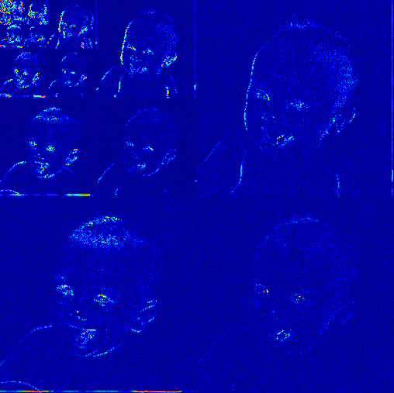
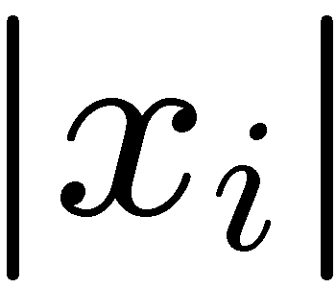


Sparsity
Compressible signal
  sorted coordinates decay rapidly with power-law
  Model based on
power-law
decay
sorted index

Slide 12









Compressive Sampling
non full rank
measurements
sparse
signal
nonzero
entries

Slide 13
How can it work?
columns
columns

Slide 14






Restricted Isometry Property
Design Φ so that each of its MxK submatrices
are full rank (ideally close to orthobasis)
  Restricted Isometry Property (RIP)
Preserve the structure of sparse/compressible signals
K-dim subspaces

Slide 15
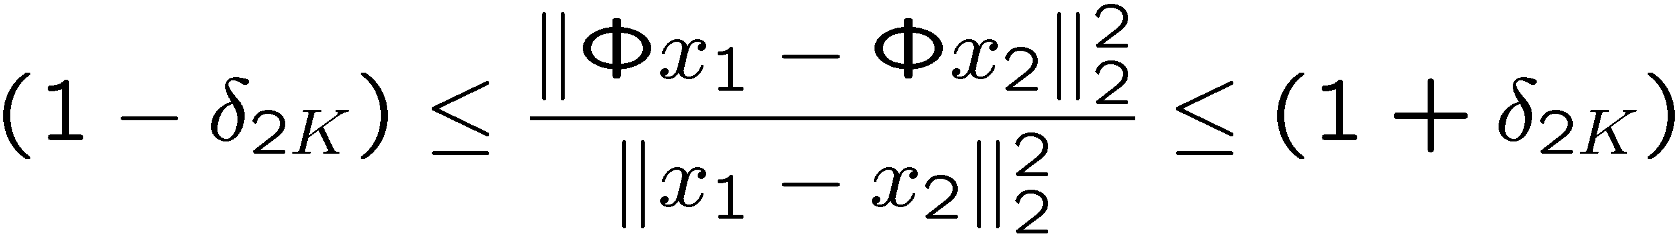
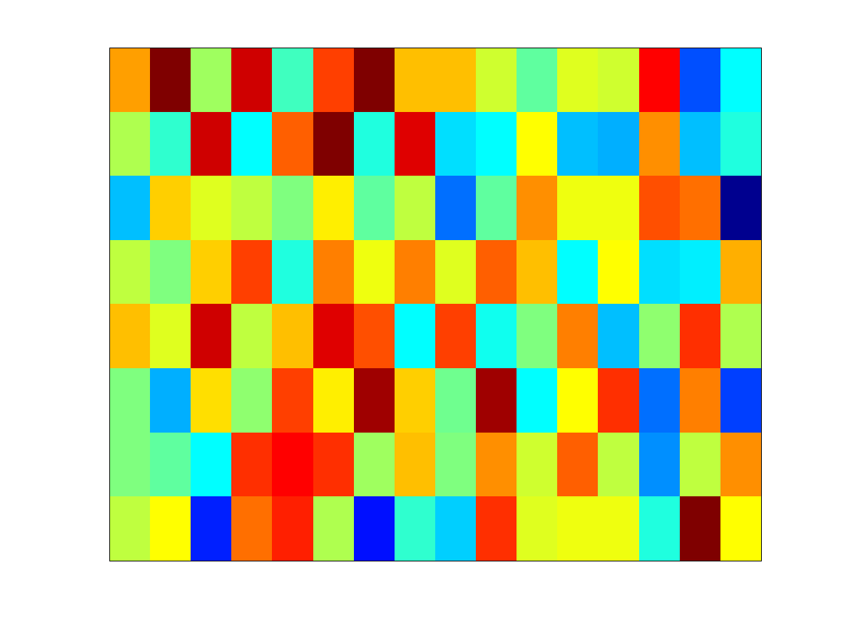
Restricted Isometry Property
RIP of order 2K implies
  for all K-sparse x₁ and x₂
  Ensure that
  Draw Φ at random
    iid Gaussian
    iid Bernoulli
columns

Slide 16
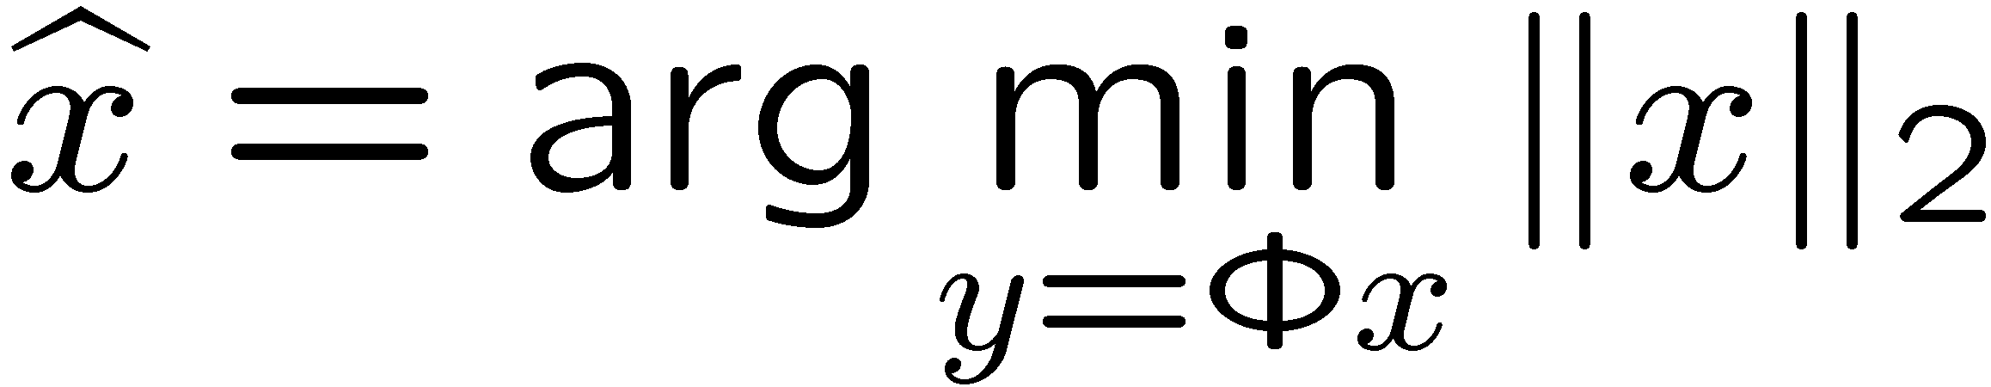



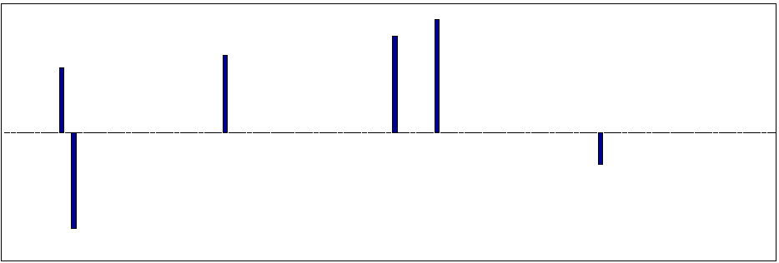
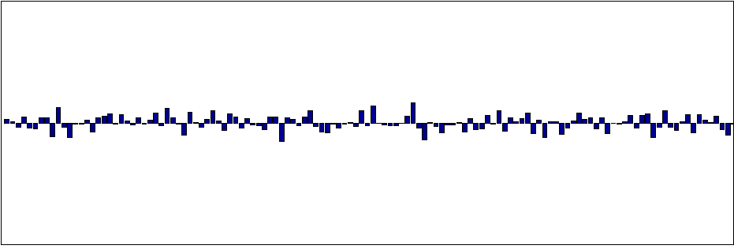
L₂ signal recovery

Slide 17
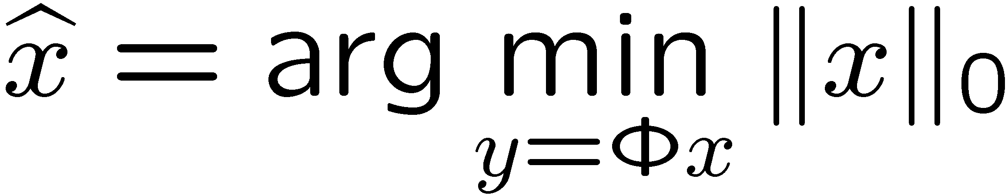
L₀ signal recovery
NP-Complete

Slide 18
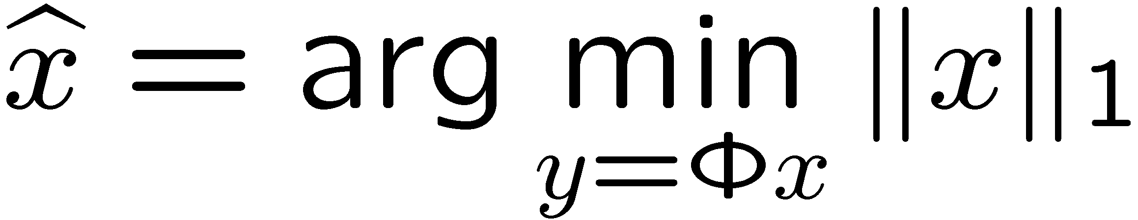
L₀ signal recovery
Polynomial time alg
(linear programming)

Slide 19



Compressive Sensing
observed signal
sensing matrix
source signal
orthonormal basis matrix
sparse representation
coherence misure

Slide 20
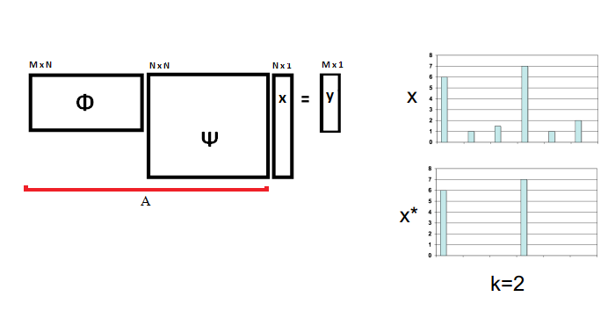
Compressive Sensing

Slide 21

Optimization algorithm
l₀ -minimization
problem is NP-hard
reconstruction
Convex optimization algorithm
https://statweb.stanford.edu/~candes/l1magic/#code

Slide 22
N unknowns
Frame 1
Coded Strobing
Frame M
t
Frame Integration Period T_{S}
Observed Intensity
Signal
y
=
A
x

Slide 23
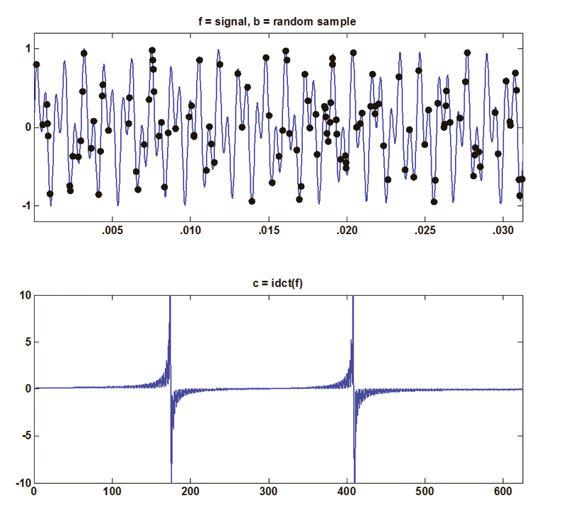
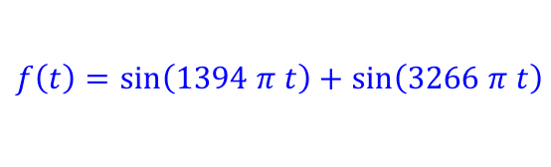
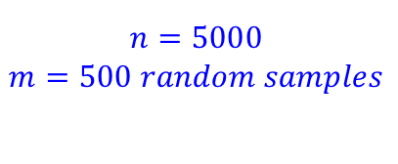

Introduction
1/8 of esecond at 4 kHz
A DCT based dictionary is used
Top: Random samples of the original signal generated by the “A” key on a touch-tone phone. Bottom: The inverse discrete cosine transform of the signal.

Slide 24
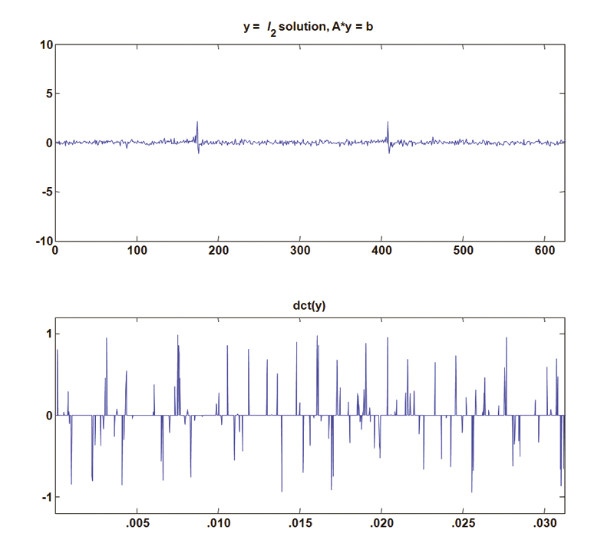
Introduction
Results by uisng L₂ norm

Slide 25
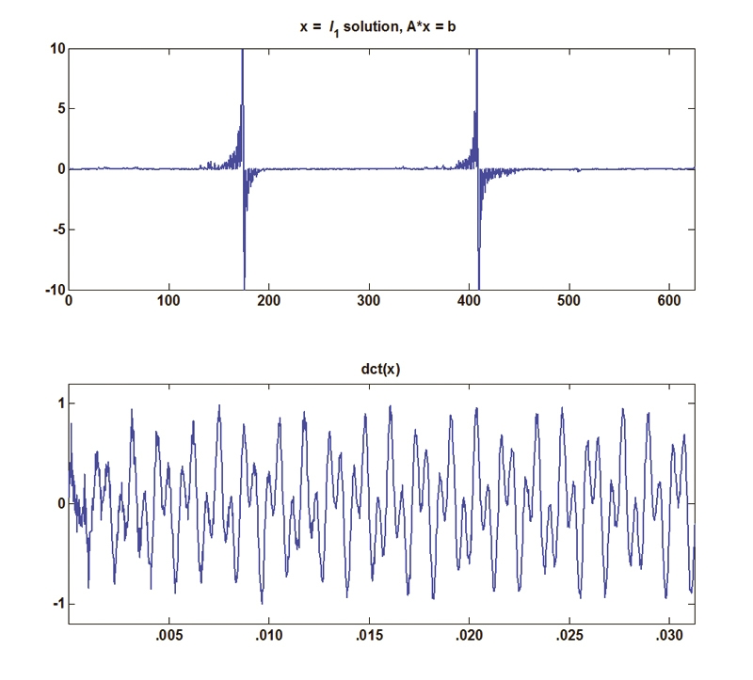
Introduction
Results by uisng L₁ norm

Slide 26
Optimization algorithms
Signal recovery via iterative greedy algorithm
  (orthogonal) matching pursuit
  iterated thresholding
  CoSaMP

Slide 27



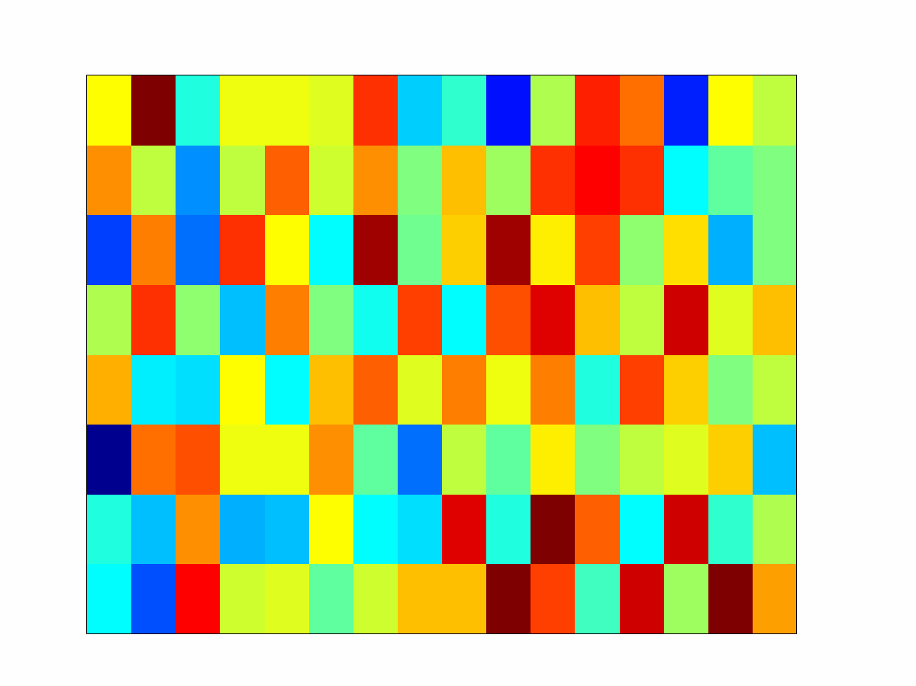
Universality
sparse
coefficient
vector
nonzero
entries
Random measurements can be used for signals sparse in any basis: DCT/FFT/Wavelet/Learned Dictionary

Slide 28
References
Material
  Slides
  Video Lessons
Books
  A Mathematical Introduction to Compressive Sensing, S. Foucart , H. Rauhut, 2013

