Slide 2
Question 30
Multimedia Networking
Question
Describe the Diffserv and Intserv mechanisms

Slide 3
Diffserv
Diffserv
provides service differentiation
the ability to handle different classes of traffic in different ways within the Internet in a scalable manner
Edge functions
packet classification and traffic conditioning
Core function
forwarding

Slide 4
Diffserv
A simple Diffserv network example

Slide 5
Diffserv
A simple Diffserv network example

Slide 6
Diffserv
marking
r
scheduling
.
b
.
.
Diffserv network example

Slide 7
Intserv
to be guaranteed a given QoS
Resource reservation
resources are reserved
Call admission
network must have a mechanism for calls to request and reserve resources
Call setup signaling
protocol is needed to coordinate these various activities (call setup protocol)
ReSerVation Protocol (RSVP)

Slide 8
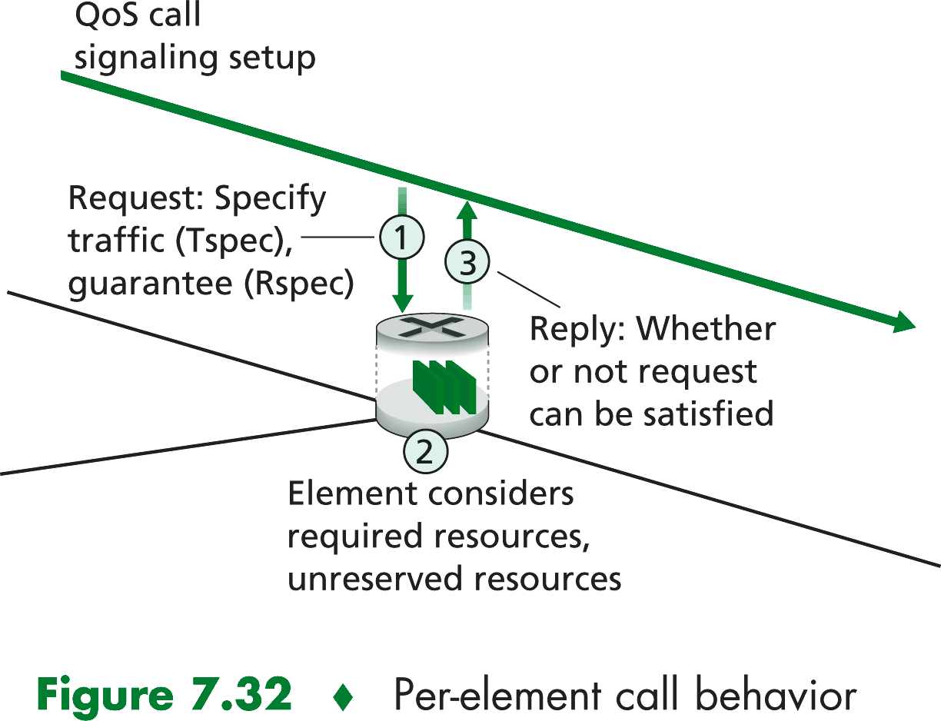
Intserv
The call setup process

Slide 9
Intserv
Resources reservation
Call Setting Message (RSVP)
Traffic Characterization and
Specification of QoSAdmission of single call
request/
response
QoS
(es., WFQ)

Slide 10
References
Material
Slides
Video Lessons
Books
Computer Networking: A Top-Down Approach, J. F. Kurose, K. W. Ross, Pearson, 6 edition, 2013

