Slide 2
Question 27
Multimedia Networking
Question
For the QoS
elimiating process is needed
admission process is needed
filtering process is needed

Slide 3
Introduction
simplest enhancement to the one-size-fits-all best-effort service
divide traffic into classes
parameters are to be used to guide the selection of the actual service parameters when transmitting a datagram through a particular network
Type-of-Service (ToS) field in the IPv4 header

Slide 4
Networking scenario
Competing audio and http applications

Slide 5
Multiple Classes of Service
Insight 1
Packet marking allows a router to distinguish among
packets belonging to different classes of traffic
Insight 2
It is desirable to provide a degree of traffic isolation among classes so that one class is not adversely
affected by another class of traffic that misbehaves
Audio 1.5 Mbps or higher (policing)

Slide 6
Networking scenario
Marking and Policing
the audio and http
traffic classes

Slide 7
Networking scenario
Logical isolation of audio and http traffic classes

Slide 8
Multiple Classes of Service
Insight 3
While providing isolation among classes or flows, it is desirable to use resources (for example, link
bandwidth and buffers) as efficiently as possible

Slide 9
Multiple Classes of Service
Two competing audio applications overloading the R1-to-R2 link

Slide 10
Multiple Classes of Service
Insight 4
If sufficient resources will not always be available, and QoS is to be guaranteed , a call admission process is needed in which flows declare their QoS requirements and are then either admitted to the network (at the required
QoS) or blocked from the network (if the required QoS cannot be provided by the network)

Slide 11
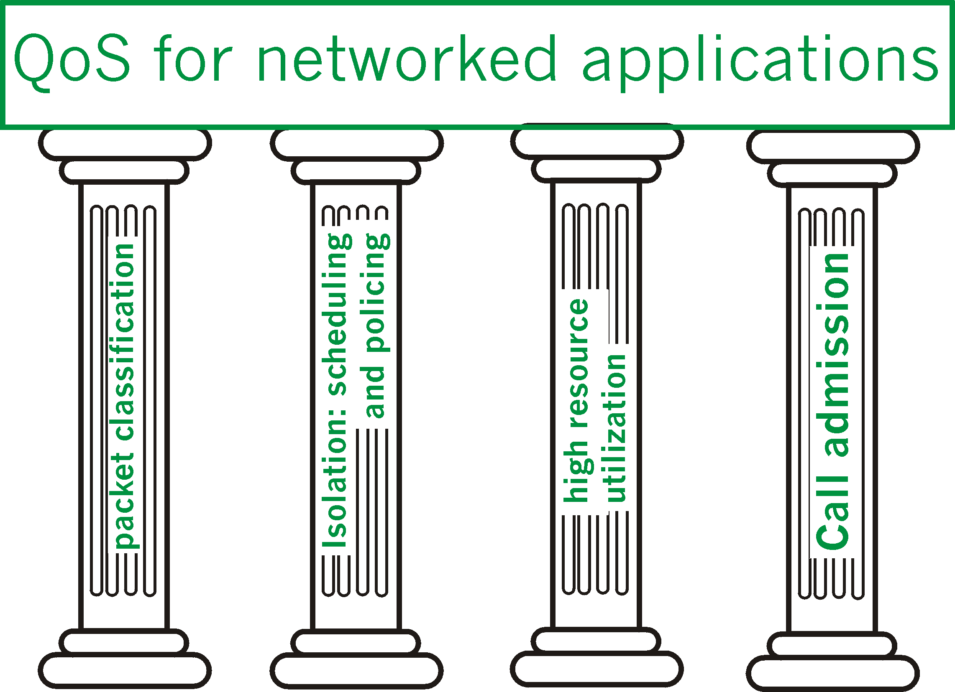
Quality of Service
4 pillars of QoS

Slide 12
References
Material
Slides
Video Lessons
Books
Computer Networking: A Top-Down Approach, J. F. Kurose, K. W. Ross, Pearson, 6 edition, 2013

