Slide 2
Question 26
Multimedia Networking
Question
Error concealment schemes
attempt to produce a replacement for a lost packet that is different to the original
attempt to produce a new packet for replacing the original
attempt to produce a replacement for a lost packet that is similar to the original

Slide 3
Introduction
Internet telephony
commonly called Voice-over-IP (VoIP)
Limitations
IP provides best-effort service
delay bound
percentage of packets lost
Scenario
sender generates bytes at a rate of 8,000 bytes per second
every 20 msecs the sender gathers these bytes into a chunk
a chunk and a special header are encapsulated in a UDP segment, via a call to the socket interface
the number of bytes in a chunk is 20 msecs
a UDP segment is sent every 20 msecs
the receiver can simply play back each chunk as soon as it arrives

Slide 4
Packet loss
UDP segment
is encapsulated in an IP datagram
datagram wanders through the network
it passes through router buffers
It is possible that one or more of the buffers in the path from sender to receiver is full
IP datagram may be discarded
Loss elimination
sending the packets over TCP
unacceptable for conversational real-time audio applications such as VoIP
UDP is used by Skype unless a user is behind a NAT or firewall that blocks UDP segments (in which case TCP is used)

Slide 5
Packet loss
Packet loss ratios
between 1 and 20 percent can be tolerated
packet loss concealment
packet loss exceeds 10 to 20 percent (for example, on a wireless link
no acceptable audio quality

Slide 6
End to end delay
End-to-end delay
accumulation of transmission, processing, and queuing delays
VoIP
end-to-end delays smaller than 150 msecs are not perceived by a human listener
delays between 150 and 400 msecs can be acceptable but are not ideal
delays exceeding 400 msecs can seriously hinder the interactivity in voice conversations

Slide 7
Packet jitter
Packet jitter
varying delays
the time from when a packet is generated at the source until it is received at the receiver can fluctuate from packet to packet
e.g., different queues for different rooters

Slide 8
Removing jitter
Fixed playout delay

Slide 9
Adaptive Playout Delay
Estimate of the average network delay
Estimate of the average deviation of the network delay
costant 4
Playout of the packets

Slide 10
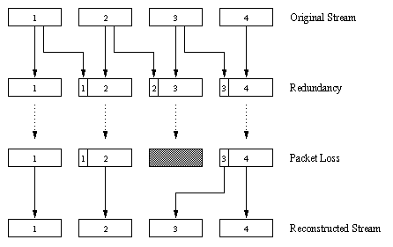
Forward Error Correction
FEC - FEC mechanism is to send a lower-resolution audio stream as the
redundant information

Slide 11
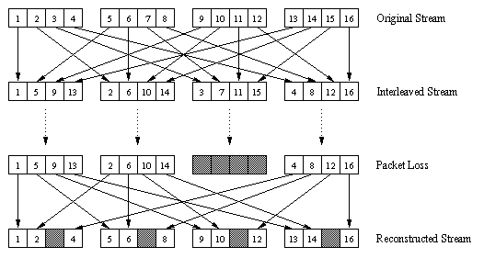
Interleaving
Sending interleaved audio

Slide 12
Error Concealment
Error concealment schemes
attempt to produce a replacement for a lost packet that is similar to the original
the simplest form of receiver-based recovery is packet repetition
methodology based on compressive sensing

Slide 13
References
Material
Slides
Video Lessons
Books
Computer Networking: A Top-Down Approach, J. F. Kurose, K. W. Ross, Pearson, 6 edition, 2013

