Slide 2
Question 25
Disk scheduling strategy for multimedia content
Question
Describe the disk scheduling of multimedia processes

Slide 3
Dynamic disk scheduling
different data rates
different movies may now have different data rates
it is not possible to have one round every 33.3 msec and fetch one frame for each stream
selecting the next disk request
deadlines and cylinders
scan-EDF algorithm (Reddy and Wyllie, 1994)

Slide 4
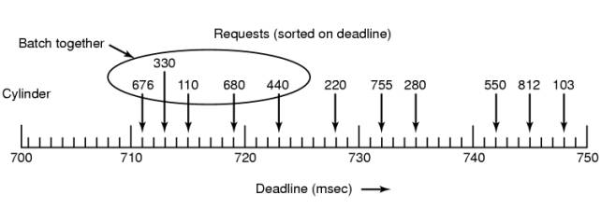
Scan-EDF algorithm
Basic idea
collect requests whose deadlines are relatively close together into batches and process these in cylinder order
The scan-EDF algorithm uses deadlines and cylinder numbers for scheduling

Slide 5
Scan-EDF algorithm
When different streams have different data rates
should the customer be admitted?
If there is enough of each left (disk bandwidth, memory buffers, CPU time) for an average customer, the new one is admitted
If the server has enough capacity for the specific film the new customer wants, then admission is granted; otherwise it is denied

Slide 6
References
Material
Slides
Video Lessons
Books
Modern Operating Systems, A. S. Tanenbaum, Pearson, 4th edition , 2015,

