Slide 2
Question 22
Lossy compression for digital images
Question
In MPEG 4 standard which of the following facilitates the composition of media objects in the scene?
BGG
BIFD
BIFS

Slide 3
MPEG-4
Besides compression, it pays great attention to user interactivity
allows a larger number of users to create and communicate their multimedia presentations and applications on new infrastructures
Internet, mobile/wireless networks, …
adopt a new object-based coding approach
media objects are entities
media objects (audio and visual objects) can be either natural or synthetic
bitrate covers a large range, between 5 kbps and 10 Mbps

Slide 4
MPEG-4
Composition and manipulation of MPEG-4 videos (VOP = Video object plane)

Slide 5
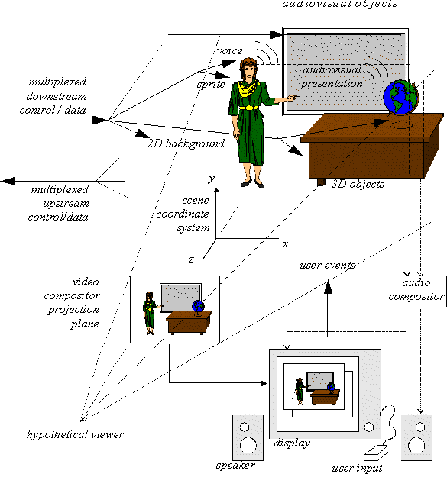
MPEG-4
Example of a MPEG-4
scene

Slide 6
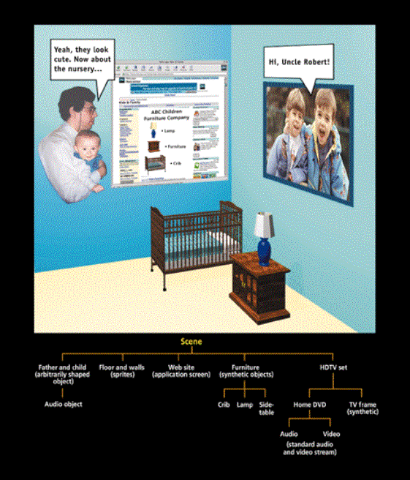
MPEG-4
Example of a MPEG-4
scene
Hierachical scene composition

Slide 7
MPEG-4
MPEG-4 reference model

Slide 8
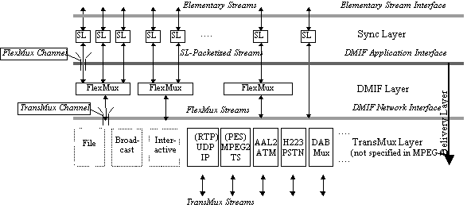
MPEG-4
Layers of the system

Slide 9
BIFS
BIFS - Binary Format for Scenes
facilitates the composition of media object in the scene
scene graph
nodes – audiovisual primitives and attributes
graph structure – spatial and temporal relationship of objects in the scene
enhancement of Virtual Reality Modeling Language (VRML)

Slide 10
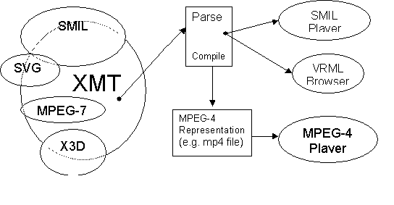
BIFS
BIFS interfaces

Slide 11
MPEG-J
MPEG-J
programming environment
Java applications can access Java packages and APIs and enhance users’ interactivity

Slide 12
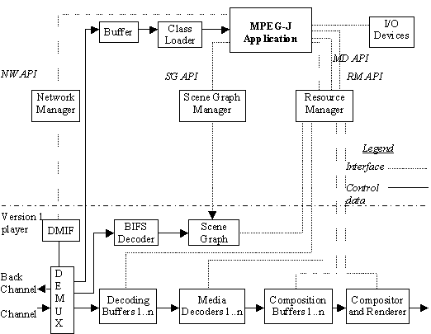
MPEG-J
MPEG-J interfaces

Slide 13
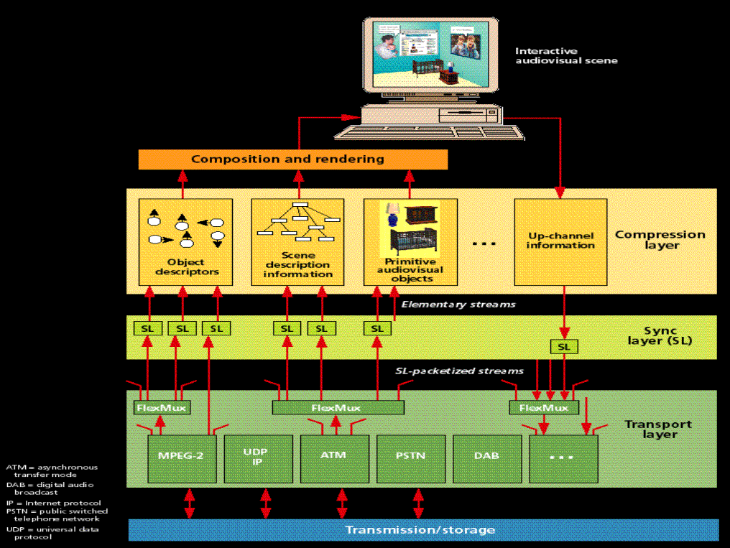
MPEG-4
MPEG-4 components and layers

Slide 14
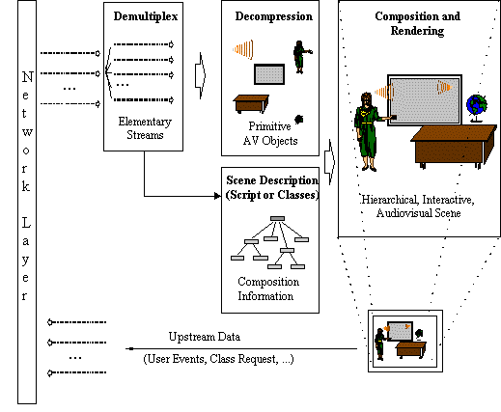
MPEG-4
Decoding, composition and rendering

Slide 15
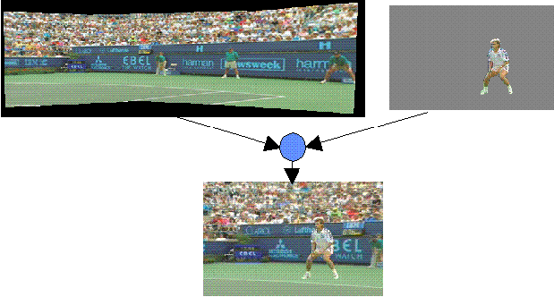
Sprite coding
Example of sprite coding to compose an image

Slide 16
Synthetic objects
2D Mesh object plane encoding process

Slide 17
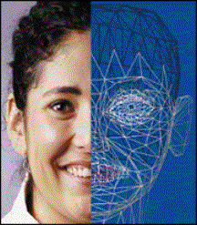
Synthetic objects
Examples of mashes applications in MPEG-4 (avatar)

Slide 18
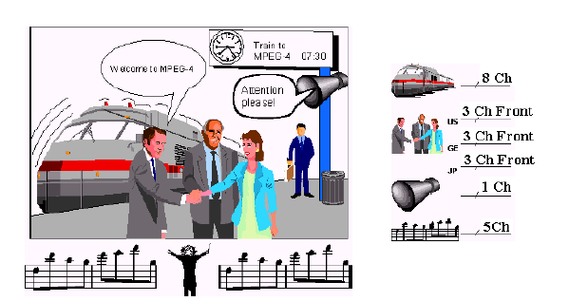
MPEG 4
MPEG 4 considers each audio as an independent object

Slide 19
MPEG 4 – Speech Signal
Speech signal
Synthesis Decoding Code Excited Linear Predictive (CELP)
Bitrate from 4 to 24 Kbit/s
Harmonic vector eXcitation Coding (HVXC)
Bitrate from 2 to 4 Kbit/s

Slide 20
General Audio
General Audio
Transform-domain Weighted Interleaved Vector Quanrization (TwinVQ)
less than 16 Kbit/s
AAC for greater bitrates

Slide 21
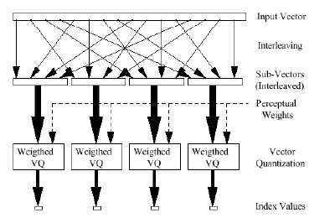
General Audio
TwinVQ scheme

Slide 22
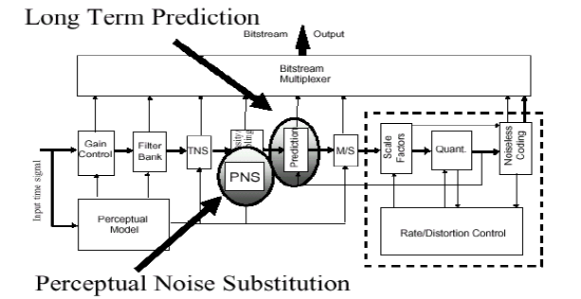
AAC
TwinVQ scheme

Slide 23
Synthesized Speech
Text to Speech
production of a sound voice from a text
Interface for compressed data

Slide 24
Synthesized Audio
Structured Audio Orchestra Language (SAOL)
Set of musical instruments for reproducing
Structured Audio Score Language (SASL)
what to produce

Slide 25
References
Material
Slides
Video Lessons
Books
Fundamentals of Multimedia, Z.-N. Li, M. S. Drew, J. Liu, Springer, 2021

