Slide 2
Question 21
Lossy compression for digital images
Question
In the MPEG 2 AAC samplig frequency is
from 8 to 96 Hz for each channel
from 8 to 96 KHz for each channel
from 8 to 96 MHz for each channel

Slide 3
MPEG-2
MPEG-2
generic coding of moving pictures and associated audio information
combination of lossy video compression and lossy audio data compression methods
storage and transmission of movies using currently available storage media and transmission bandwidth
MPEG-2 is used in Digital Video Broadcast
and DVDs.
The MPEG transport stream, TS, and MPEG
program stream, PS, are container formats

Slide 4
MPEG-2
The standard consists of 9 Parts
ISO/IEC 13818-1 (2000)
Systems
ISO/IEC 13818-2 (2000)
Video
ISO/IEC 13818-3 (1998)
Audio
ISO/IEC 13818-4 (1998)
Conformance Testing
ISO/IEC 13818-1 (1997)
Software simulation

Slide 5
MPEG-2
The standard consists of 9 Parts
ISO/IEC 13818-6 (1998)
Extensions for DSM-CC
ISO/IEC 13818-7 (1997)
Advanced Audio Coding (AAC
ISO/IEC 13818-8 (1996)
Extension for real time interface for systems decoders
ISO/IEC 13818-9 (1999)
Conformance extensions for Digital Storage Media Command and Control (DSM-CC)

Slide 6
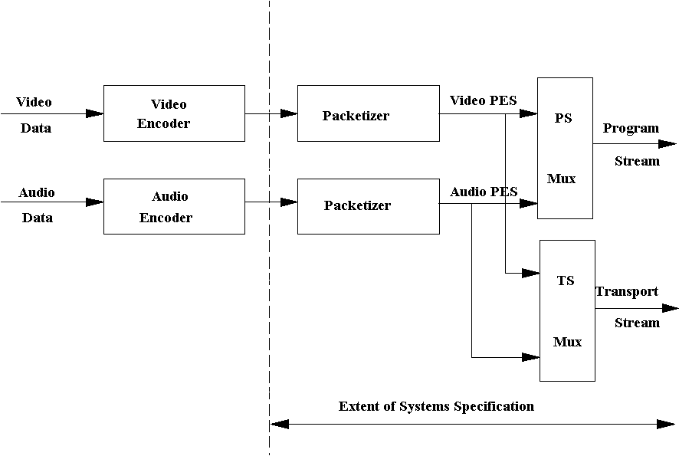
MPEG-2 - System
ISO/IEC 13818 - System

Slide 7
MPEG-2 - Video
Video encoding
similar to the previous MPEG-1 standard
provides support for interlaced video, the format used by analog broadcast TV systems
MPEG-2 Video and Systems are also used in some HDTV transmission systems

Slide 8
MPEG-2 - Audio
Audio encoding
MPEG-2 introduces new audio encoding methods compared to MPEG-1
MPEG-2 Part 3
enhances MPEG-1's audio by allowing the coding of audio programs with more than two channels, up to 5.1 multichannel
MPEG-2 Part 7
specifies a rather different, non-backwards-compatible audio format
is referred to as MPEG-2 AAC (Advanced Audio Coding)
AAC is more efficient

Slide 9
MPEG 2 - AAC
Adanced Audio Coding (AAC)
improvement for multichannel encoding
48 channels
samplig frequency from 8 to 96 KHz for each channel

Slide 10
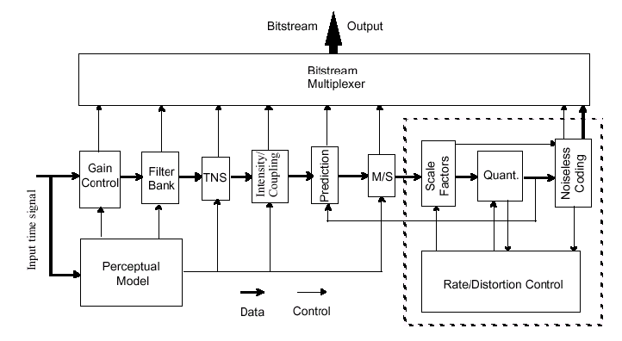
MPEG 2 - AAC
AAC encoding scheme

Slide 11
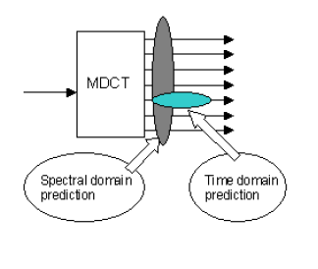
MPEG 2 - AAC
Main concept – prediction
Prediction
Temporal Noise Shaping (TNS)

Slide 12
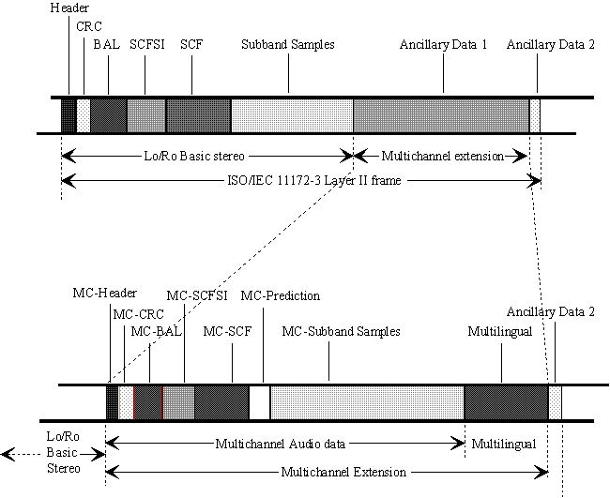
MPEG-2 - Audio
Multichannel Audio information

Slide 13
References
Material
Slides
Video Lessons
Books
Fundamentals of Multimedia, Z.-N. Li, M. S. Drew, J. Liu, Springer, 2021

