Slide 2
Question 20
Lossy compression for digital images
Question
In the MPEG 1 standard the B-frame
make predictions using both the previous and future frames
make predictions using future frames
make predictions using the previous frames

Slide 3
DV standard
DV standard
each frame is encoded with JPEG
high compression rate
Source | Mbps | GB/ora
MPEG-2 (640x480) | 4 | 1.76
DV (720x480) | 25 | 11

Slide 4
MPEG
Moving Picture Experts Group (MPEG)
working group of authorities that was formed by ISO and IEC
standards for audio and video compression and transmission
established in 1988 by the initiative of
Hiroshi Yasuda (Nippon Telegraph and Telephone)
Leonardo Chiariglione
The first meeting was in May 1988 in Ottawa, Canada

Slide 5
MPEG-1
MPEG-1
standard for lossy compression of video and audio
designed to compress VHS-quality raw digital video and CD audio down to 1.5 Mbit/s (26:1 and 6:1 compression ratios respectively)
without excessive quality loss
video CDs
digital cable/satellite TV
digital audio broadcasting (DAB)

Slide 6
MPEG-1
The standard consists of five Parts
ISO/IEC 11172-1 (1993)
System
ISO/IEC 11172-2 (1993 )
Video
ISO/IEC 11172-3 (1993)
Audio
ISO/IEC 11172-4 (1995)
Compliance Testing
ISO/IEC TR 11172-5 (1998)
Software simulation

Slide 7
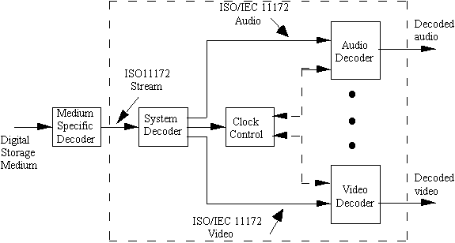
MPEG-1 - System
ISO/IEC 11172-1: System

Slide 8
MPEG-1 - Video
MPEG-1 has several frame/picture types
I-frame (Intra-frame)
decoded independently of any other frames
can be considered effectively identical to baseline JPEG images
also in H.261 encoding standard
P-frame (Predicted-frame)
also be called forward-predicted frames
improve compression by exploiting the temporal redundancy in a video
store only the difference in image from the frame (either an I-frame or P-frame) immediately preceding it (anchor frame)
the difference between a P-frame and its anchor frame is calculated using motion vectors on each macroblock of the frame
Motion vector data will be embedded in the P-frame for use by the decoder
also in H.261 encoding standard

Slide 9
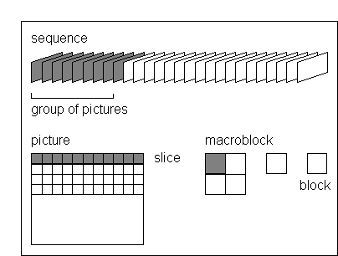
MPEG-1 - Video
Sequence of pictures and macroblocks

Slide 10
MPEG-1 - Video
I-frame coding

Slide 11
MPEG-1 - Video
P-frame coding based on motion compensation

Slide 12
MPEG-1 - Video
MPEG-1 has several frame/picture types
B-frame (Bidirectional-frame)
make predictions using both the previous and future frames (i.e. two anchor frames)
requires larger data buffers and causes an increased delay on both decoding and during encoding
D-frame
independent images (intra-frames) that have been encoded using DC transform coefficients only
very low quality
are only used for fast previews of video, for instance when seeking through a video at high speed

Slide 13
MPEG-1 - Video
MPEG frame sequence

Slide 14
MPEG-1 - Video
The need for bidirectional frame

Slide 15
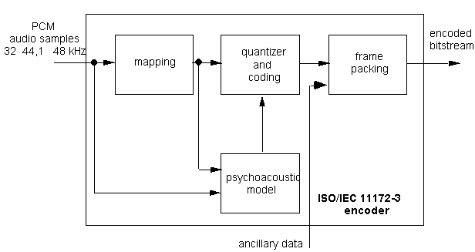
MPEG-1 - Audio
Audio encoding

Slide 16
MPEG-1
Part 4
procedures for testing conformance
provides two sets of guidelines and reference bitstreams for testing the conformance of MPEG-1 audio and video decoders, as well as the bitstreams produced by an encoder
Part 5
Reference software
C reference code for encoding and decoding of audio and video, as well as multiplexing and demultiplexing

Slide 17
References
Material
Slides
Video Lessons
Books
Fundamentals of Multimedia, Z.-N. Li, M. S. Drew, J. Liu, Springer, 2021

