Slide 2
Question 19
Lossy compression for digital images
Question
The JPEG compression algorithm is based on the
FFT
DFT
DCT

Slide 3
JPEG standard
JPEG (Joint Photographic Expert Group)
developed by experts on behalf of the ISO-IEC
International Standard 10918
lossy compression for digital images
images produced by digital photography
degree of compression can be adjusted
tradeoff between storage size and image quality.
typically achieves 10:1 compression with little perceptible loss in image quality

Slide 4
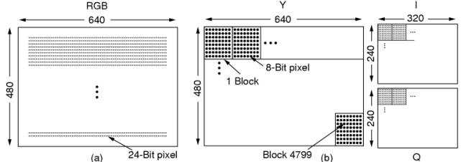
JPEG encoding – step 1
averaging 2x2 block pixels
128 is subtract
JPEG encoding – YIQ Block preparation

Slide 5
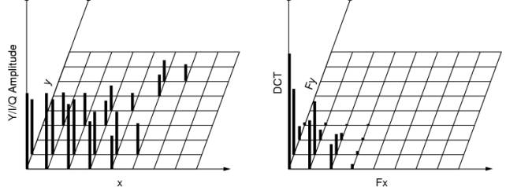
JPEG encoding – step 2
averaging coefficients
JPEG encoding – DCT coefficients

Slide 6
JPEG encoding – step 3
JPEG encoding – quantization

Slide 7
JPEG encoding – step 4
The coefficient (0,0) is substituted by the difference with the same coefficient of the adjacency matrix
a low value since the coefficients are similar

Slide 8
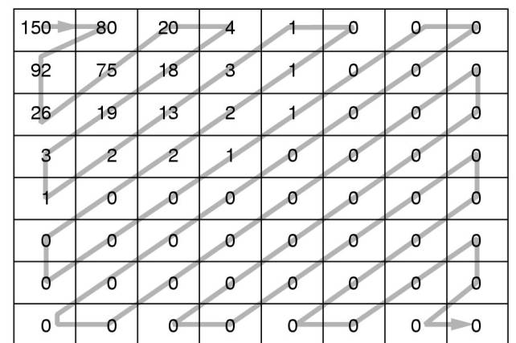
JPEG encoding – step 5
JPEG encoding – matrix linearization
RLE is used

Slide 9
JPEG encoding – step 6
A Huffman encoding scheme is used
Decoding is obtained by inverting the steps

Slide 10
References
Material
Slides
Video Lessons
Books
Fundamentals of Multimedia, Z.-N. Li, M. S. Drew, J. Liu, Springer, 2021

