Slide 2
Question 18
To be transmitted over the network multimedia content must be digitized and compressed
Question
  In the mp3 compression the bit allocation for each subband is based on
    SNR = NMR + SMR
    NMR = SNR – SMR
    NMR = SMR * SNR

Slide 3
Perceptual coding
psychoacoustic models
  exploit the characteristics of the human ear
  only the perceptual characteristics are transmitted
Main aspects
  frequency masking
  temporal masking

Slide 4
General scheme
x(n)
Time/Frequency Analysis
Quantization
Coding
Lossless compression
Psychoacoustic
Analysis
Bit alloacation
Bitstream
x(n)
Synthesis
Band reconstruction
Bitstream
decoding

Slide 5
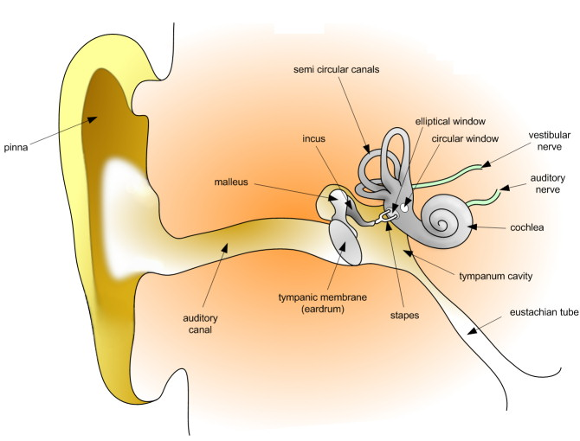
Auditory perception

Slide 6
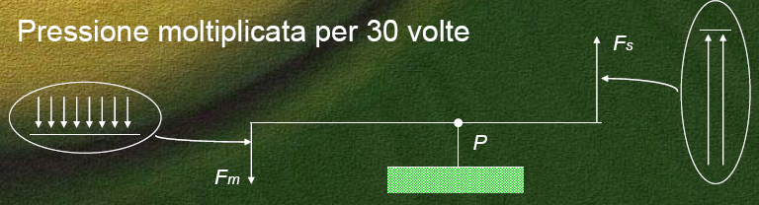
Middle ear
Vibration propagation
Amplification of the signal

Slide 7
Cochlea

Slide 8
Corti organ

Slide 9
Basilar membrane
Bank of filters

Slide 10
Basilar membrane
Herman
von Helmholtz

Slide 11
Basilar membrane
Basilar membrane
  25 critical bands
  non-linear behaviour (logartitmic)
  pass-band bank filters
1 2 3 4 5 6 7 … 23 24 25
Non-linear basilar membrane critical bands

Slide 12

Bark scale
Bark scale
  $f<500 Hz f_{bark}=\frac{f}{100}$
  $f≥500 Hz f_{bark}=9+4\log{\frac{f}{100}}$

Slide 13
Fletcher – Munson Diagram
Equal-loudness contours for the human ear determined experimentally

Slide 14
Fletcher – Munson Diagram
Example of phones

Slide 15
Hearing threshold
Normal Treshold of Hearing

Slide 16
Simultaneous masking
Masking threshold
Example of simultaneous masking

Slide 17
Temporal masking
Example of temporal masking

Slide 18
MPEG Audio Encoders
Perceptual coding
  unnecessary information eliminated
  psychoacoustic model
  masking mechanism
    number of quantization bits

Slide 19
MPEG
Moving Picture Experts Group (MPEG)
  working group of authorities that was formed by ISO and IEC
  standards for audio and video compression and transmission
  established in 1988 by the initiative of
    Hiroshi Yasuda (Nippon Telegraph and Telephone)
    Leonardo Chiariglione
  The first meeting was in May 1988 in Ottawa, Canada

Slide 20
MPEG-1
MPEG-1
  standard for lossy compression of video and audio
  designed to compress VHS-quality raw digital video and CD audio down to 1.5 Mbit/s (26:1 and 6:1 compression ratios respectively)
  without excessive quality loss
    video CDs
    digital cable/satellite TV
    digital audio broadcasting (DAB)

Slide 21
MPEG 1
MPEG 1
  Layer 1
    Compressed bit rate: 32-448 Kbps
  Layer II
    Compressed bit rate: 32-192 Kbps
  Layer III
    Compressed bit rate: 64 Kbps
    mp3

Slide 22
MPEG 1 – Layer 1
  psychoacoustic
  model
masking
SMR and
bit alloc.
…
…
1
Q1
Filter
bank
(DFT)
bitstream
audio
2
PCM
Q2
Frame
…
…
…
32
Q3
subbands samples
Quantized
subbands
samples

Slide 23
MPEG 1 – Layer 1
  Definition of segments

Slide 24
Psychoacoustic model
A 1024 points FFT is used
Global masking thresholds

Slide 25
Global bit allocation
  Bit allocation for each subband (NMR = SNR - SMR)
Then the subbands are placed in order of lowest to highest mask-to-noise ratio, and the lowest subband is allocated the smallest number of code bits and this process continues until no more code bits can be allocated

Slide 26
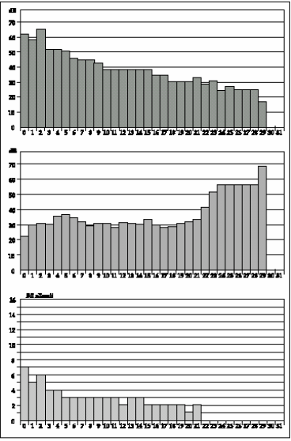
Global bit allocation
  Amplitude spectrum
  Global masking threshold
  Subbands bit allocation

Slide 27
Decoder
1
DQ1
Bank
filters
(IDFT)
1
Demultiplex
12 x 32
subbands
+
bit allocation
Decod.
PCM
2
2
DQ2
…
…
…
audio
32
32
DQ32
bitstream
PCM
samples
Subbands
samples
Bit allocation

Slide 28
MPEG – Layer 3
Analysis
Polyphase
Filter bank
MDCT
Nonuniform
quantization
FFT
1024
Psychoacoustic
Model

Slide 29
MPEG – Layer 3
Huffman encoding
Bitstream Formating
CRC word generation
Coding of side Information

Slide 30
References
Material
  Slides
  Video Lessons
Books
  Signal Processing Book (Ciaramella)
    free download on the e-learning platform
  Fundamentals of Multimedia, Z.-N. Li, M. S. Drew, J. Liu, Springer, 2021
  Digital Signal Processing, J. Proakis, D. Manolakis, Prentice Hall, 4 edition, 2006

