Slide 2
Question 12
Spectrum estimation
  the content of the signals can be estimated both in time and frequency
Question
  The Discrete Wavelet Transform is based on
    one high pass filter and one low pass filter
    one high pass filter
    one low pass filter

Slide 3
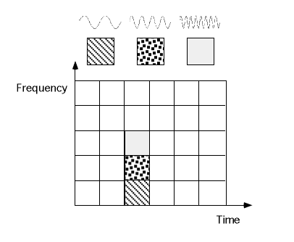
Short Time Fourier Transform
Short Time Fourier Transform (STFT)
  resolution in both time and frequency domains
window
DFT
frames
STFT

Slide 4

STFT
$$k$$
Spectrogrm
# of coefficients
window
frame
frequency
overlap

Slide 5
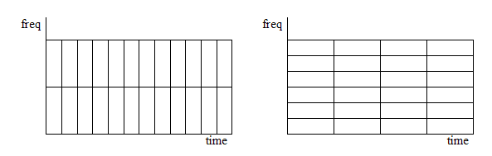


STFT Uncertainty
spectrogram behaviour
  similar to the $Heisenberg uncertainty principle$
  higher time resolution imply worse frequencies resolution and vice versa
$$∆t∆ω≥\frac{1}{2}$$
worse
high
high
worse

Slide 6

STFT Uncertainty
$$∆t∆ω≥\frac{1}{2}$$

Slide 7
STFT of Sonar data
Single ping of sonar data

Slide 8
Wavelet
Wavelet Transform
  solves the resolution problem
  the signal is analyzed at different frequencies ans resolutions
    High frequencies
      High time resolution, low frequencies resolution
    Low frequencies
      High frequencies resolution, low time resolution

Slide 9
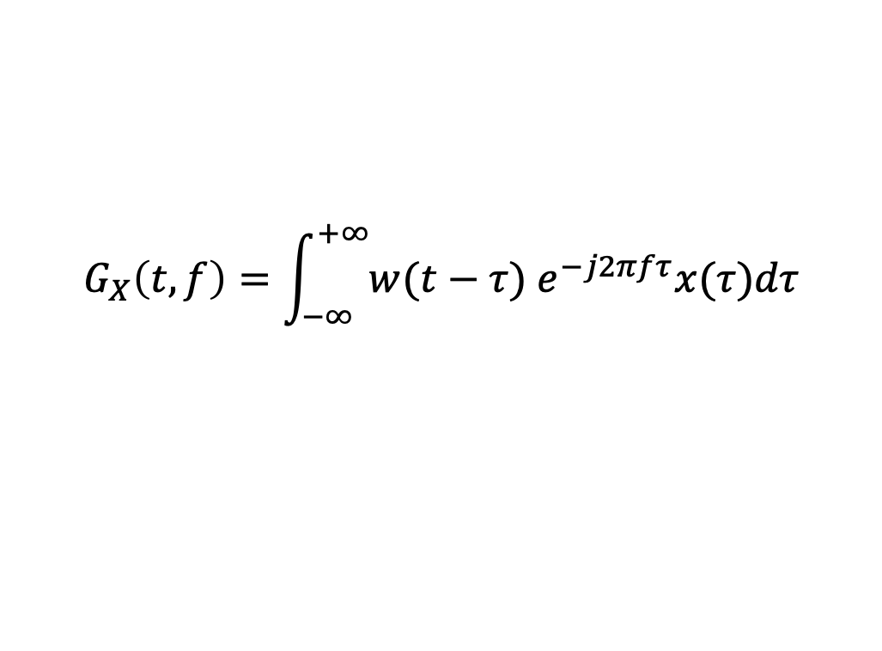
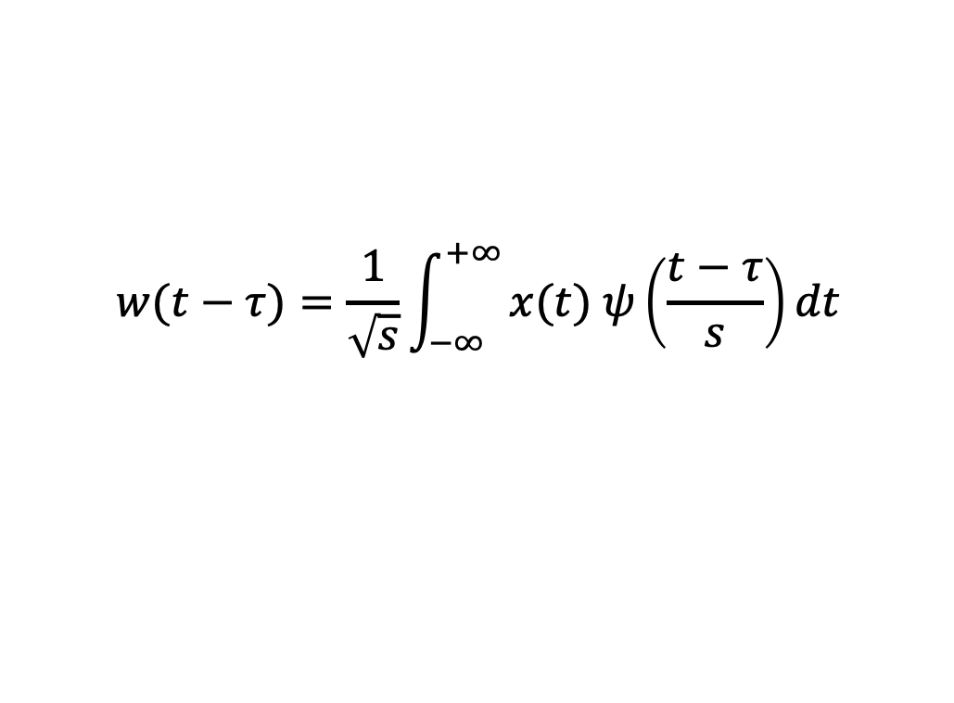
Wavelet Analysis
$$G_{X}\left(t,f\right)=\int_{\begin{aligned}−∞ \\ \end{aligned}}^{+∞}{w(t−τ) e^{−j2πfτ}x(τ)dτ}$$
Mother Wavelet
$$w(t−τ)=\frac{1}{\sqrt{s}}\int_{\begin{aligned}−∞ \\ \end{aligned}}^{+∞}{x(t) ψ\left(\frac{t−τ}{s}\right)dt}$$
shift
scale
The wavelet transform is simply a kind of correlation function between the mother wavelet scaled and shifted, and the input signal
Scale factor
  s>1: dilated
  s<1: compressed

Slide 10
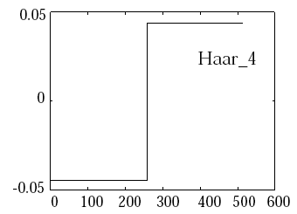
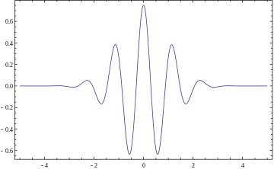
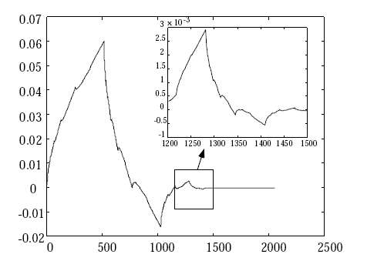
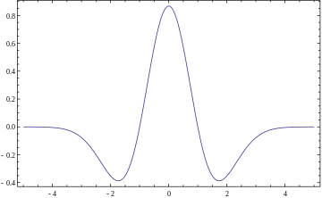
Mother Wavelet
Haar
Morlet
Mexican hat
Daubechies (fractal)

Slide 11
Resolutions
Fast changes: low frequency resolution, high time resolution
Slow changes: high frequency resolution, low time resolution

Slide 12
Resolutions
Low (time) scales is equivalent to study low frequency components, i.e. the rough features of the signal
High (time) scales is equivalent to study high frequency components, i.e. the details in the signal

Slide 13
Mother Wavelet
decreasing
frequency
decreasing scale

Slide 14
Wavelet Transform
Signal
Step 1
Step 2
*
*
Step N

Slide 15
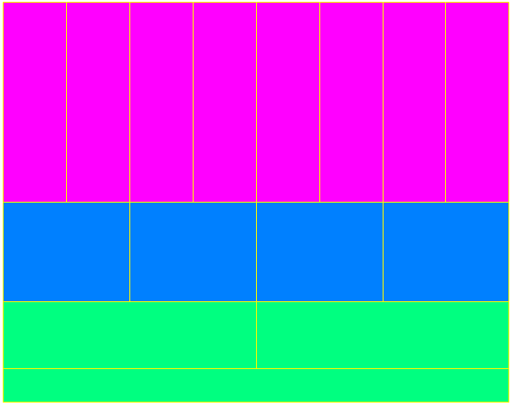
Resolution
High
time
resolution
Frequencies
High frequencies
resolution
Time

Slide 16
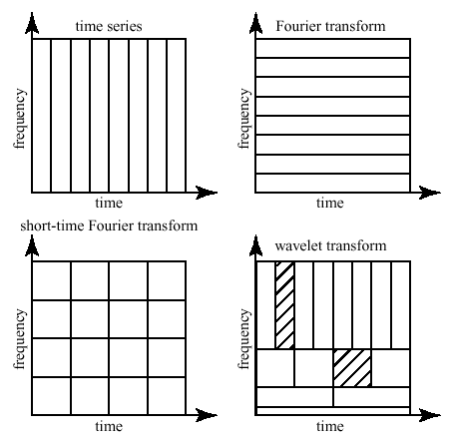
STFT vs CWT
From http://www.cerm.unifi.it/EUcourse2001/Gunther_lecturenotes.pdf, p.10

Slide 17
Discrete Wavelet Transform (DWT)
Sub-bands encoding
  High pass filters
    impulse response g[n]
  Low pass filters
    impulse response h[n]

Slide 18
DWT
filtering
Filtering and downsampling

Slide 19
DWT
Analysis
Synthesis
high-pass filter
Details
g
↓
2
↓
2
g’
+
h
↓
2
↓
2
h’
low-pass filter
approximation
Coefficients

Slide 20
Mallat’s algorithm
Details Level 1
Coefficients
Level 1
HPF
↓
2
↓
2
HPF
g
f[n]
f[n]
HPF
HPF
↓
2
↓
2
g’
+
LPF
...
LPF
↓
2
+
↓
2
h
Scaling coefficients
Level 1
LPF
↓
2
↓
2
LPF
Approximations
Level 1
h’
Scaling coefficients
Level 2
Analysis
Synthesis

Slide 21
Mallat’s algorithm

Slide 22


Mallat’s algorithm
0-1000 Hz
256
X[n]512
Filter 1
D₁: 500-1000 Hz
256
Filter 2
D₂: 250-500 Hz
S
S
A₁
128
A₁
D₁
128
Filter 3
D₃: 125-250 Hz
A₂
64
A₂
D₂
A₃: 0-125 Hz
A₃
D₃
64

Slide 23
Wavelets
HAAR
DAUBECHIES
SYMMLET
COIFLET

Slide 24
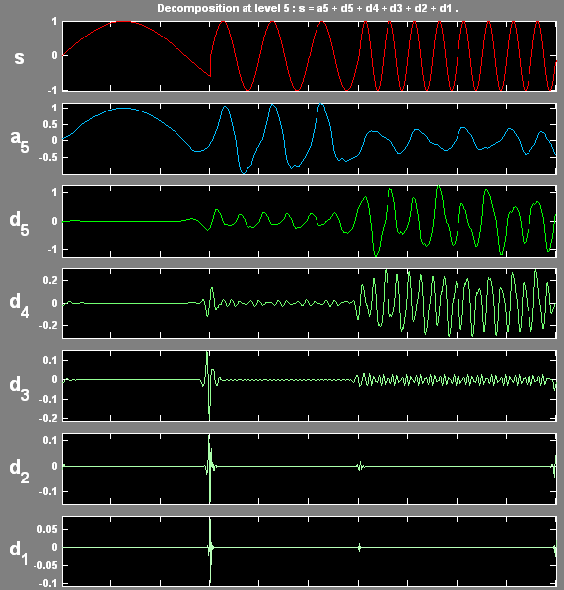
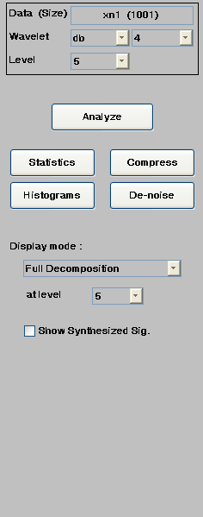
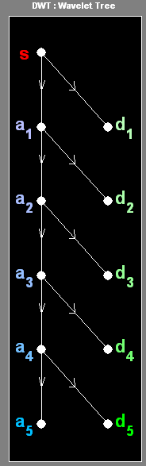
Example – 1D signal
f_{L}
Signal:
0.0-0.4: 2 Hz
0.4-0.7: 10 Hz
0.7-1.0: 20Hz
Wavelet: db4
Level: 6
f_{H}

Slide 25
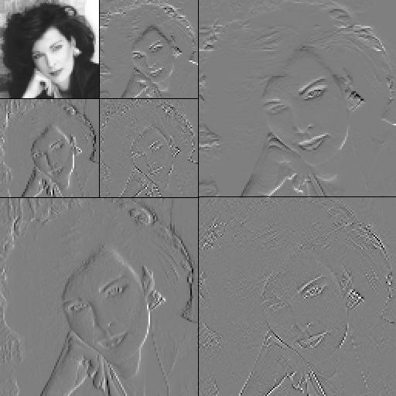
Example – 2D signal

Slide 26
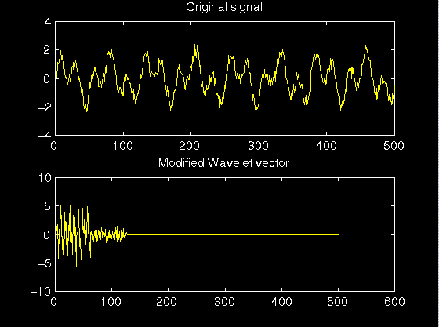
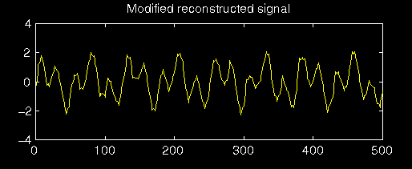
Example – 1D signal denoising

Slide 27
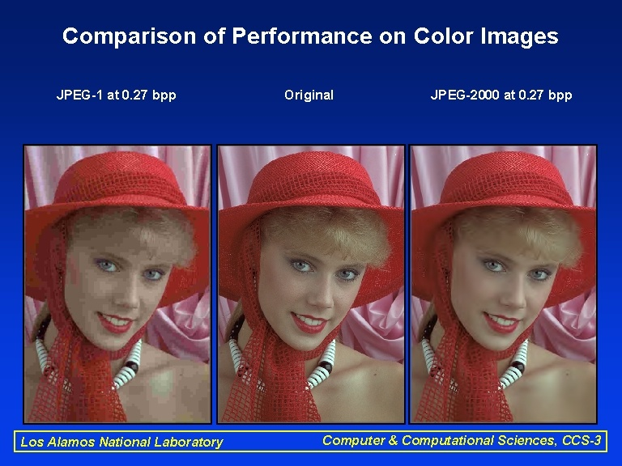
Example – compression

Slide 28
References
Material
  Slides
  Video Lessons
Books
  Digital Signal Processing, System Analysis and Design, P. S. R. Diniz, E. A. B. da Silva, S. L. Netto, Cambridge University Press, 2012

