Slide 2
Question 11
Spectrum estimation
the frequency content of the signals can be estimated
Question
In the MUSIC algorithm
The p principal components span the noise space
The p principal components span the signal space
The p principal components span the overall space
.

Slide 3
Spectrum estimation techniques

Slide 4
Periodogram
DTFT of a sequence x(n)
Periodogram

Slide 5
Periodogram
Source signal

Slide 6
Periodogram
Estimated Periodogram

Slide 7
Considerations
The Periodogram
We have problems with increasing the N
The variance does not approach zero as the data length N increases
The periodogram is not a consistent estimator (i.e. converges in some sense to the true value)
Why does the variance not decrease with increasing N?
Increasing N means increasing the number of individual frequencies (instead of increasing the accuracy of each frequency)
“smoothed” Periodograms are defined

Slide 8
Bartlett’s method
A sequence x(n) is divided in K segments of M samples (N = KM)
K Periodograms are calculated

Slide 9
Bartlett’s method
Estimation of the spectrum

Slide 10
Welch’s method
A window w(n) is applied

Slide 11
Welch
Estimated Periodogram

Slide 12
MUSIC
Very important are the methods based on the decomposition by eigenvectors and eigenvalues
Methods
Pisarenko
MUltiple Signal Classification (MUSIC)
Estimation of Signal Parameters via Rational Invariance Technique (ESPRIT)
Applications
Spectral estimation
Direction Of Arrival (DOA)

Slide 13
MUSIC
The sequence x(n) is
Autocorrelation matrix

Slide 14
MUSIC
We write the autocorrelation matrix as
The p principal components span the signal space

Slide 15
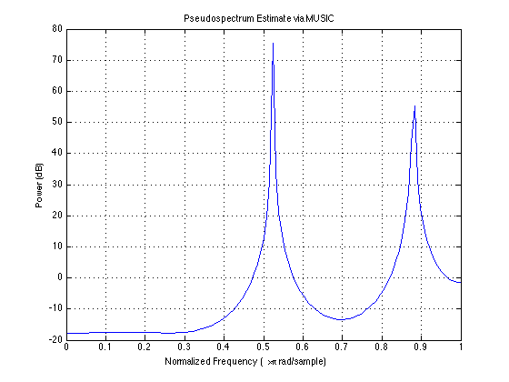
Example
Estimated Periodogram

Slide 16
References
Material
Slides
Video Lessons
Books
Signal Processing Book (Ciaramella)
free download on the e-learning platform
Discrete-time signal processing, A. V. Oppenheim, R. W. Schafer, J.R. Buck, Upper Saddle River, N.J., Prentice Hall, 1999, ISBN 0-13-754920-2
Digital Signal Processing, J. Proakis, D. Manolakis, Prentice Hall, 4 edition, 2006

