Slide 2
Question 6
Question
In the convolutional theorem
a convolution in the time domain corresponds to a product in the frequency domain
a product in the time domain corresponds to a convolution in the frequency domain
a convolution in the time domain corresponds to a convolution in the frequency domain

Slide 3
Fourier theorem
Theorem
any continuous periodic signal can be obtained by the superposition of simple sine waves, each with its amplitude and phase, and whose frequencies are harmonics of the fundamental frequency of the signal
Continuous periodic signal with period T₀
Fourier series

Slide 4
Fourier transform
Real environments
non-periodic signals
Inverse Fourier Transform
(Analysis)
Direct Fourier Transform
(Syntesis)

Slide 5
Discrete Time Fourier Transform
For a discrete sequence x(n)
DTFT
Trasformata di Fourier
a tempo discreto inversa

Slide 6
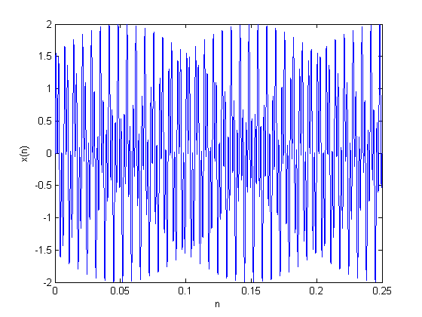
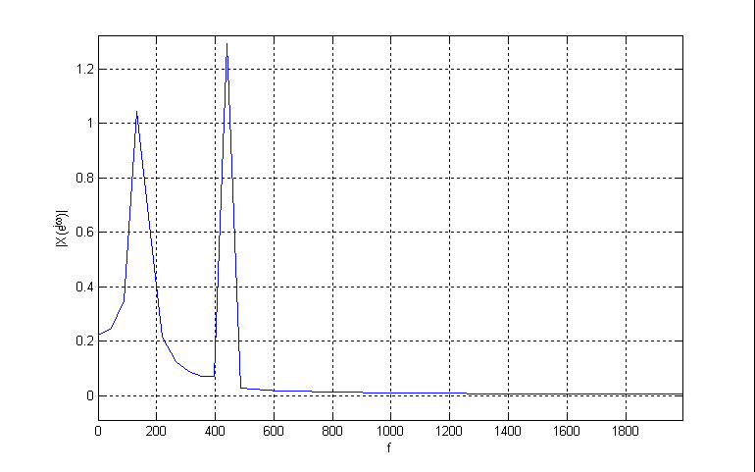
DTFT example
Sequence with two pure tones
with 150 and 440 Hz, respectively.
Sampling frquence of 44100 Hz.
Absolute value of the DTFT
0 ≤ ω ≤ π → 0 ≤ f ≤ 22050

Slide 7
Convolution theorem
F
Highlighting
A convolution in the time domain corresponds to a product in the frequency domain
x(n)
Transform
F
h(n)

Slide 8
Modulation theorem (windowing)
F
Highlighting
The DTFT of the product of sequence corresopnds to a periodic convolution of the single DTFTs
e.g., FIR con windowing
x(n)
F
w(n)

Slide 9
Teorema di Parseval
Energy
|X(e^{jω} )|² Energy Spectral Density
F
x(n)

Slide 10
References
Material
Slides
Video Lessons
Books
Signal Processing Book (Ciaramella)
free download on the e-learning platform
Discrete-time signal processing, A. V. Oppenheim, R. W. Schafer, J.R. Buck, Upper Saddle River, N.J., Prentice Hall, 1999, ISBN 0-13-754920-2
Digital Signal Processing, J. Proakis, D. Manolakis, Prentice Hall, 4 edition, 2006

