Slide 1
Differentiation and paradox marketing
A focus on customer experience management
Annarita Sorrentino
annarita.sorrentino@uniparthenope.it

Slide 2
My areas of research
Consumer Behaviour
Analysing the antecedents and consequences of consumption experiences
Measuring consumer insights to design memorable experience
Customer experience management
Combining CES and CEM
Determinant that qualify a customer-centric firm
Re-designing the service experience in healthcare
Tourism marketing
The effects of servicescape on cruisers’ experience
The role of mega-events in destination marketing strategies
Mapping the endless customer journey for cruisers
Most used methodologies
Quantitative approach survey based
Multivariate and SEM
Neuromarketing experiment
Qualitative and mixed meth

Slide 3
And you?

Slide 4
Agenda
Differentiation and paradox marketing
CEM as a level of differentiation
Discussion
Work group

Slide 5



Competitive strategies
Cost strategy
differentiation
Differentiation leadership focuses in providing benefits that add value for consumers.
Superior product quality
Branding
You become a quality leader
No-frills strategy based on costs reduction thanks to high productivity
You become a cost leader

Slide 6
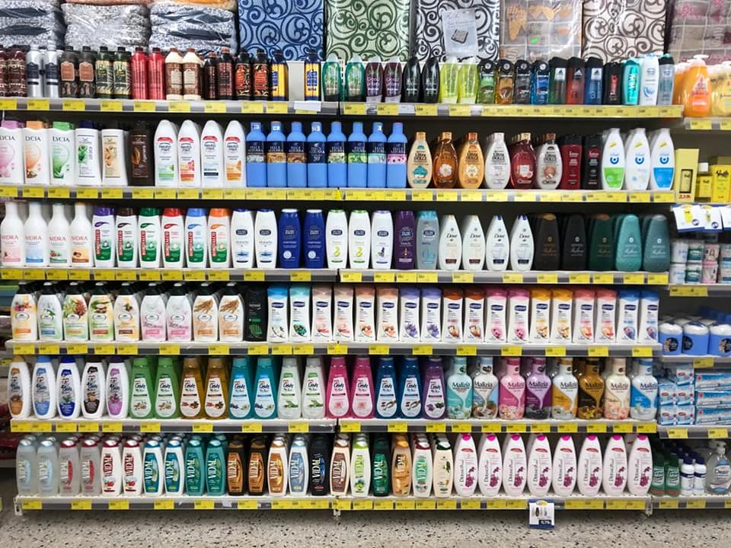
Where we are and where we are going
In an attempt to differentiate themselves, they all end up looking alike and the consumer becomes cynical about the whole category
COMMODITIZATION

Slide 7
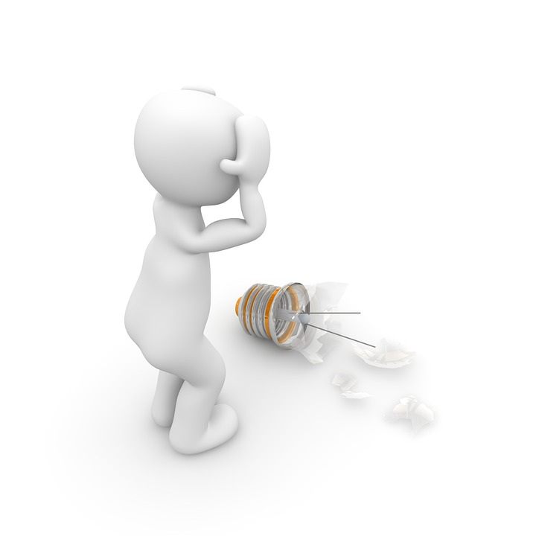
Possible solution to emerge from the quagmire

Slide 8
Learning from Schumpeter (1947)
The introduction of innovative products or more efficient production processes are precisely the most used by firms to compete.
Customers cannot be reached only with lower prices but, above all, they must be reached with goods more attractive.
So, the traditional interpretation of the competition based only on the price doesn’t represent for Schumpeter a satisfactory description of what happens in the real world of business. In this world, entrepreneurs do not fight only with prices but also with other weapons such as innovation

Slide 9
Economic evolution as the process of creative destruction
In the real world, says Schumpeter, firms doesn’t always produce the same goods with techniques unchanged but sometimes they introduce new products, improve the quality of existing ones and adopt new production technologies as well as new models of work organization.
Initial equilibrium
Innovation
Renewed equilibrium through creative destruction

Slide 10
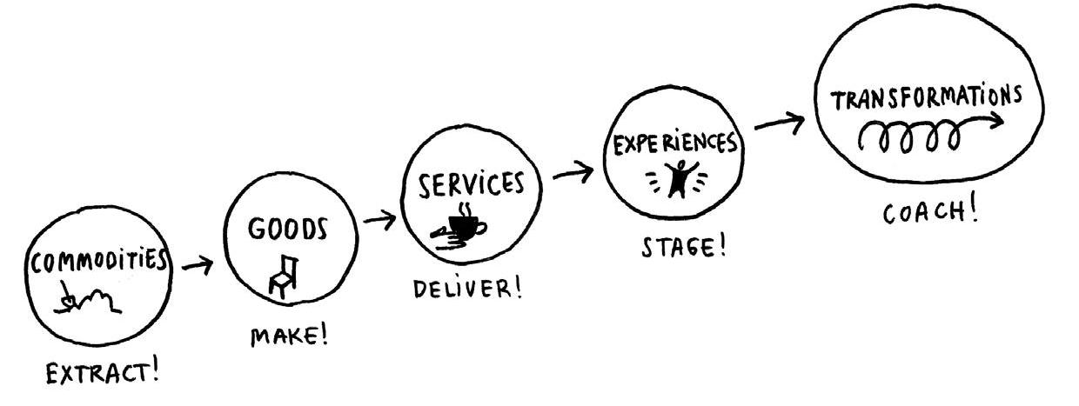
Economic evolution as the process of creative destruction
In the real world, says Schumpeter, firms doesn’t always produce the same goods with techniques unchanged but sometimes they introduce new products, improve the quality of existing ones and adopt new production technologies as well as new models of work organization.
Initial equilibrium
Innovation
Renewed equilibrium through creative destruction
Pine and Gilmore, 2011

Slide 11
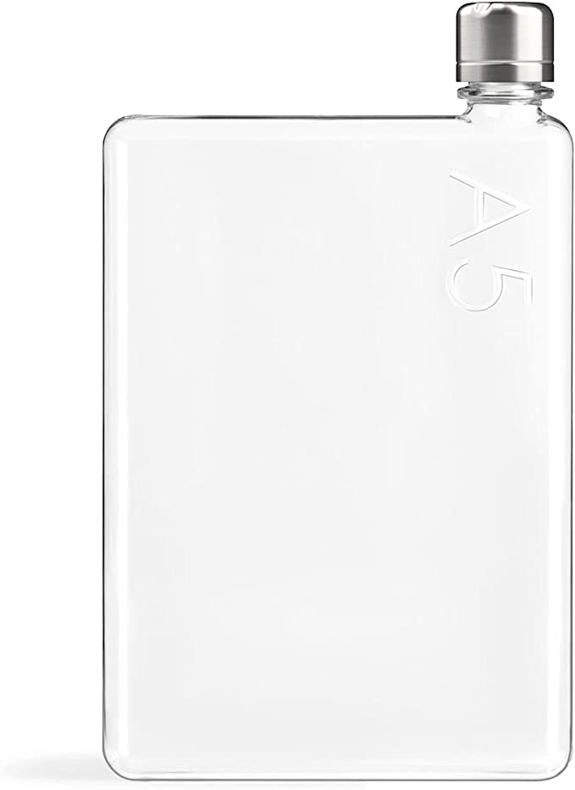
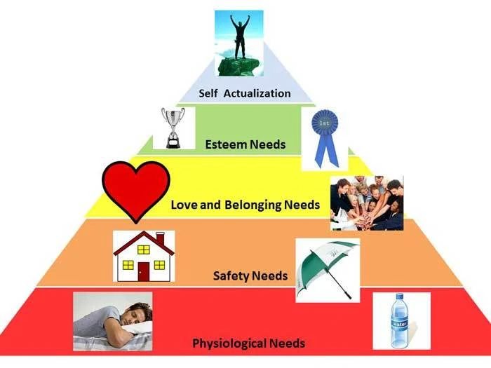

Slide 12
The current stage of experience economy
In the Experience Economy, businesses and brands curate memorable encounters, thus the ‘experience’ becomes the product.
In the Transformation Economy, consumers are seeking more than mere experience. They crave something authentic and meaningful - some call it the 'soul' of the business - to which they can connect on the most personal level and, in doing so, undergo an actual sense of transformation.
Consumers are desperate to connect with themselves. Brands that can offer them a meaningful route to that soulful luxury will be the ones that stay ahead of the game.

Slide 13
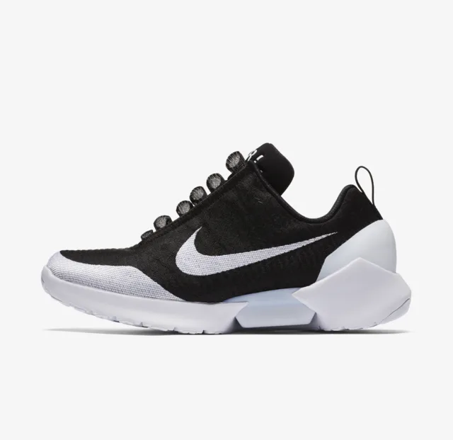
The case of Nike
HyperAdapt 1.0
It adapts electronically to the profile of the foot
E.A.R.L. the system that adapts the lacing to the profile of the foot.

Slide 14
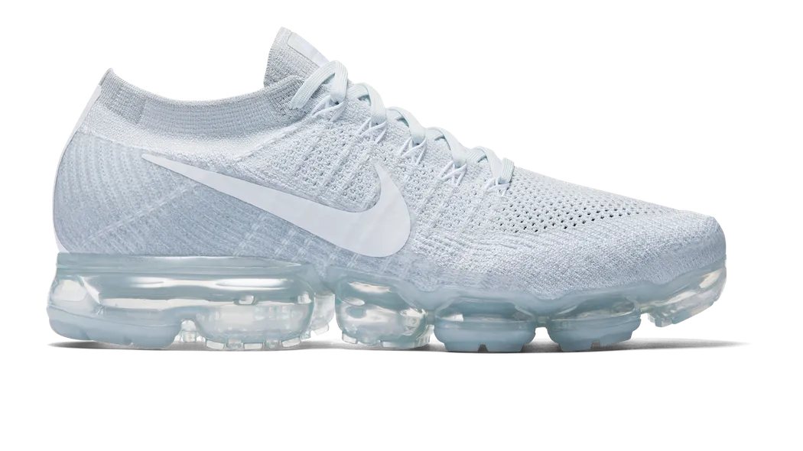
The case of Nike
Nike VaporMax Air
The entire sole of the Air VaporMax is made up of air.
The airbags are positioned in exactly the places needed to improve performance: nothing is left to chance.
The bearings don't wear out and the feeling of the trainee remains the same even after thousands of miles.

Slide 15
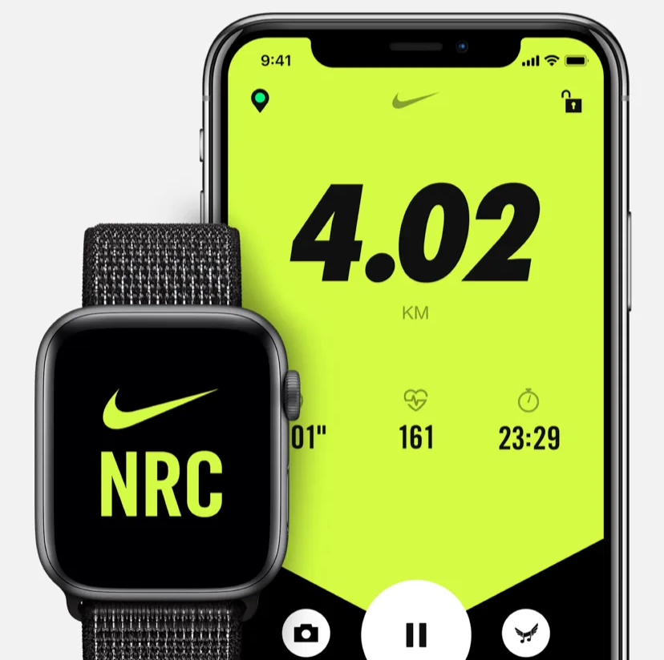
The case of Nike
The Nike Run Club app
It motivates you to run constantly, with a community that keeps you company and entertained.
Just started running? We are here. Do you need a coach to keep up or a friend to keep you company? Here we are. Want us to track your stats while you think about the scenery? No problem.
Even if you don't feel like running today, Nike Run Club has wellness tips that will help you prepare for tomorrow. Start when and where you want: we will always be with you.

Slide 16

The case of KAMALAYA KOH SAMUI
When many of our clients are looking for a nurturing environment where they can step back from their frenetic lifestyle and have the space and support to really understand themselves and what they want in life
“The management at Kamalaya has truly understood this need and has even introduced an “Embracing Change” programme that guides their guests to fulfil their purpose and potential.”
https://www.thehealthyholidaycompany.co.uk/programmes/kamalaya-embracing-change/

Slide 17
Experience innovation (1/4)
The way to connect demand-side and supply-side perspectives
Innovation can relate to any idea, practice or material artefact which is regarded as novel by members of a social system (Lancaster & Taylor, 1988).
As well, the innovation theory has been developed by extending the research approach to innovation in the manufacturing industries to embrace innovations in services as well (Gallouj & Weinstein, 1997).
The increase in innovation makes it possible to meet new consumer needs, reduce costs and improve the performance of various product-linked services (Tomala & Senechal, 2004).
The types of innovation include product/service innovation, architectural innovations, innovations based on modifications to a product or service, process and organisational innovations and innovations in methods and management (Gallouj, 1998).

Slide 18
Experience innovation (2/4)
The way to connect demand-side and supply-side perspectives
Bitner (1992) identified three primary dimensions of the servicescape that influence customers’ holistic perceptions of the servicescape and their subsequent internal and external responses.
These dimensions are:
ambient conditions: for example, weather, temperature, air quality, noise, music and odours;
2. spatial layout and functionality: for example, the way in which equipment and furnishings are arranged, and the ability of those items to facilitate consumers’ enjoyment;
3. signs, symbols and artefacts: for example, signage and decoration used to communicate and enhance a certain image or mood, or to direct customers to desired destinations.

Slide 19
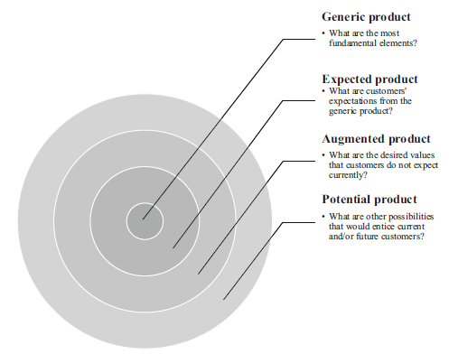

Slide 20



Slide 21
Experience innovation
The way to connect demand-side and supply-side perspectives
Consumers (demand-side) (Brakus, Schmitt, Zarantonello, 2009; Mody, Suess & Lehto,2018; Servidio & Ruffolo, 2016)
Innovation (Rogers, 2003; Wang et al., 2008)
Firms (supply-side) (Lemon and Verhoef, 2016; Homburg, Jozic and Kuehnl, 2017)

Slide 22
Limitations of traditional approach (1/2)
Focus on product attributes and benefits
Consumers seen as rational individuals
Market research is an analytical and verbal activity and it is seen as unreliable and ineffective
Marketing actions are implemented through the 4Ps
Measurement of Satisfaction
Customer Relationship Management

Slide 23

MODEL SAVE
SOLUTION rather than PRODUCT
ACCESSIBILITY rather than PLACE
VALUE rather than PRICE
EDUCATION rather than COMMUNICATION
Notes:
Prof. J.J. Lambin
23

Slide 24
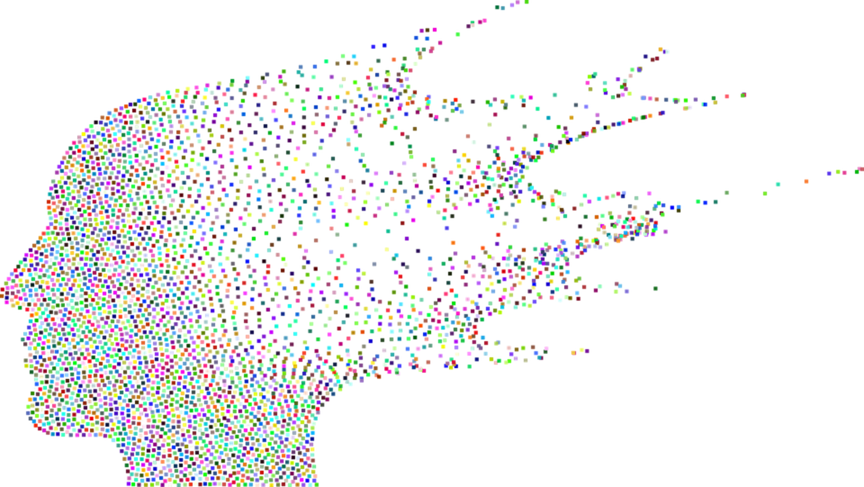
How we can implement this approach
Analysis of the target audience and design of the user personas
Identification of the steps of the customer journey
Definition of touchpoints
Making the gears work towards a seamless experience
Notes:
Più che una ricetta, vediamo quale può essere un buon metodo per immaginare, disegnare e gestire una buona customer experience. Vi riassumo i principali momenti con l’aiuto di uno schema sintetico: Il primo step è l’analisi del nostro cliente ideale: è importante riuscire a sapere il più possibile, incluse le sue paure, le sue emozioni, ciò che pensa, i suoi obiettivi e cercare di idealizzarlo attraverso una configurazione concreta che definiamo buyer personas. Questo step sarà funzionale per iniziare ad immaginare un’esperienza creata ad hoc per questo cliente. In questa fase è importante tracciare i momenti consapevoli ed inconsapevoli che portano a desiderare quello che offriamo, in sostanza bisogna tracciare il customer journey. Philip Kotler, descrive il journey del cliente con un modello che definisce 5 fasi: AWARE (LO CONOSCO), APPEAL (MI PIACE), ASK (MI CONVINCE), ACT (LO COMPRO), ADVOCATE (LO CONSIGLIO).

Slide 25
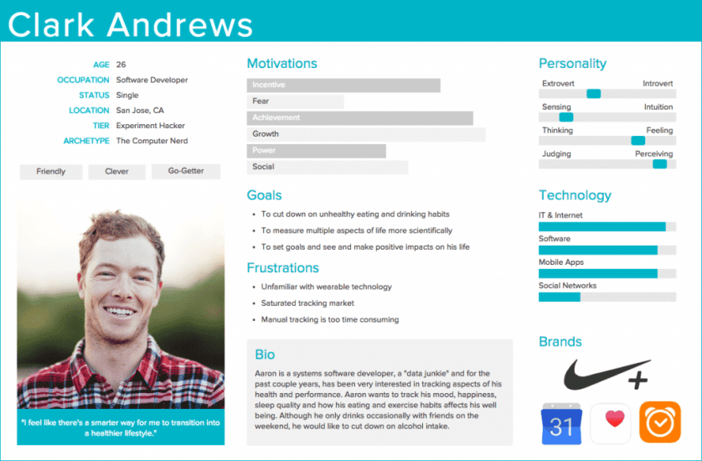
STEP I
Notes:
Proiettare quando parlo di EMPHATY MAP

Slide 26
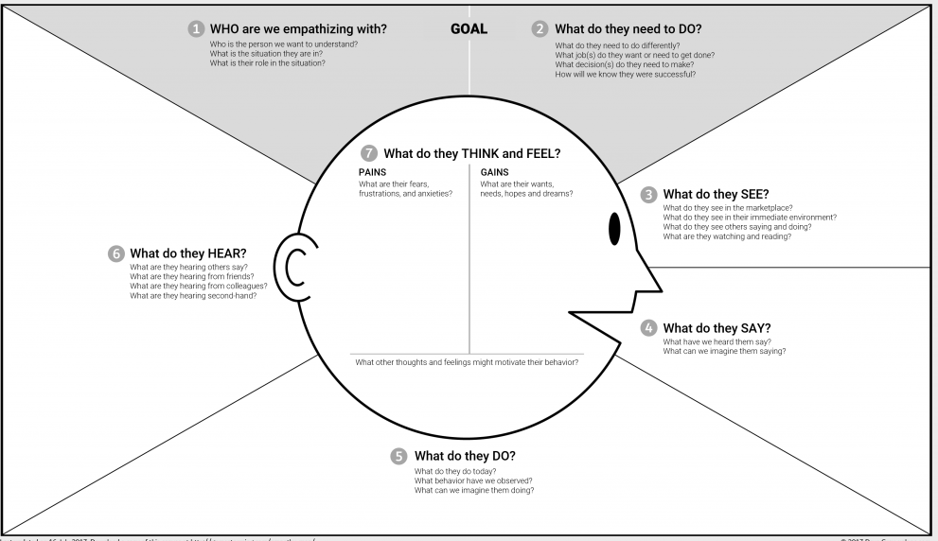
Useful tip
Notes:
Proiettare quando parlo di EMPHATY MAP

Slide 27
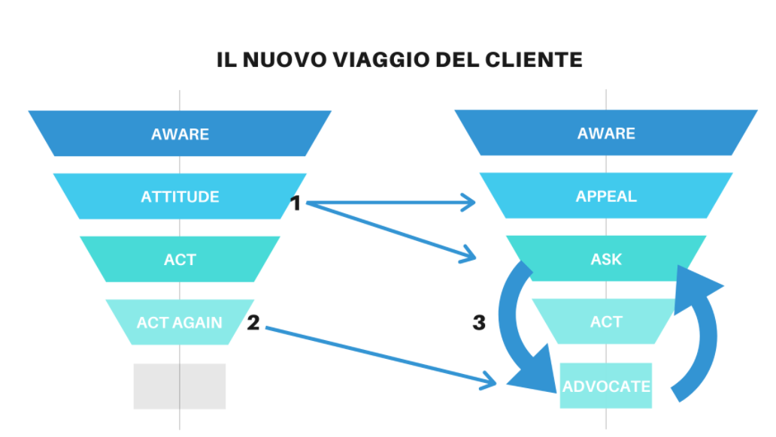
STEP II
Aware: Customers are exposed to brand messages through advertising and past experiences.
Appeal: customers receive brand messages and feel attraction or rejection towards them, depending on their experience or sensation.
Ask: attraction leads to curiosity and therefore the search for more information or opinions on the shopping experience provided by loyal customers.
Act: convinced by the responses received, customers decide to buy a certain product, use it and experience customer service.
Advocate: customers who have a particularly positive experience tend to become attached to the brand and recommend it to other people, also helping those who are in the Ask phase.
Notes:
Nella fase di Aware: i clienti sono esposti ai messaggi dei brand attraverso la pubblicità e le esperienze passate.
Nella fase di Appeal: i clienti recepiscono i messaggi dei brand e provano attrazione o rifiuto verso gli stessi, a seconda della loro esperienza o sensazione.
Nella fase di Ask: l’attrazione porta alla curiosità e quindi alla ricerca di maggiori informazioni o opinioni sull'esperienza d’acquisto fornite dai clienti fidelizzati.
Nella fase di Act: convinti dalle risposte ricevute, i clienti decidono di acquistare un determinato prodotto, lo utilizzano e fanno esperienza con il servizio clienti.
Nella fase di Advocate: i clienti che vivono un’esperienza particolarmente positiva tendono ad affezionarsi al brand e a consigliarlo ad altre persone, aiutando anche coloro che si trovano nella fase Ask. Ricordiamoci a questo punto di non lasciare nulla al caso ma di fissare degli obiettivi SMART in ogni fase.

Slide 28
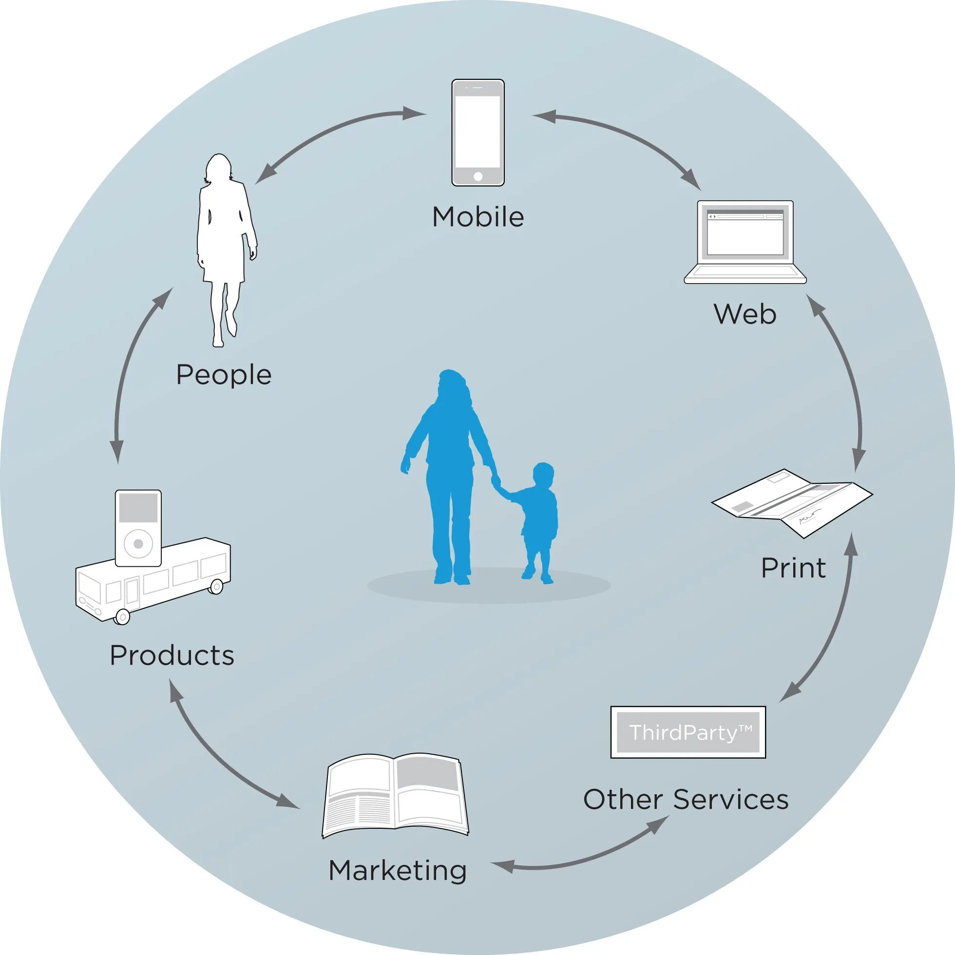
STEP III definition of touchpoints
Notes:
Nella fase di Aware: i clienti sono esposti ai messaggi dei brand attraverso la pubblicità e le esperienze passate.
Nella fase di Appeal: i clienti recepiscono i messaggi dei brand e provano attrazione o rifiuto verso gli stessi, a seconda della loro esperienza o sensazione.
Nella fase di Ask: l’attrazione porta alla curiosità e quindi alla ricerca di maggiori informazioni o opinioni sull'esperienza d’acquisto fornite dai clienti fidelizzati.
Nella fase di Act: convinti dalle risposte ricevute, i clienti decidono di acquistare un determinato prodotto, lo utilizzano e fanno esperienza con il servizio clienti.
Nella fase di Advocate: i clienti che vivono un’esperienza particolarmente positiva tendono ad affezionarsi al brand e a consigliarlo ad altre persone, aiutando anche coloro che si trovano nella fase Ask. Ricordiamoci a questo punto di non lasciare nulla al caso ma di fissare degli obiettivi SMART in ogni fase.

Slide 29
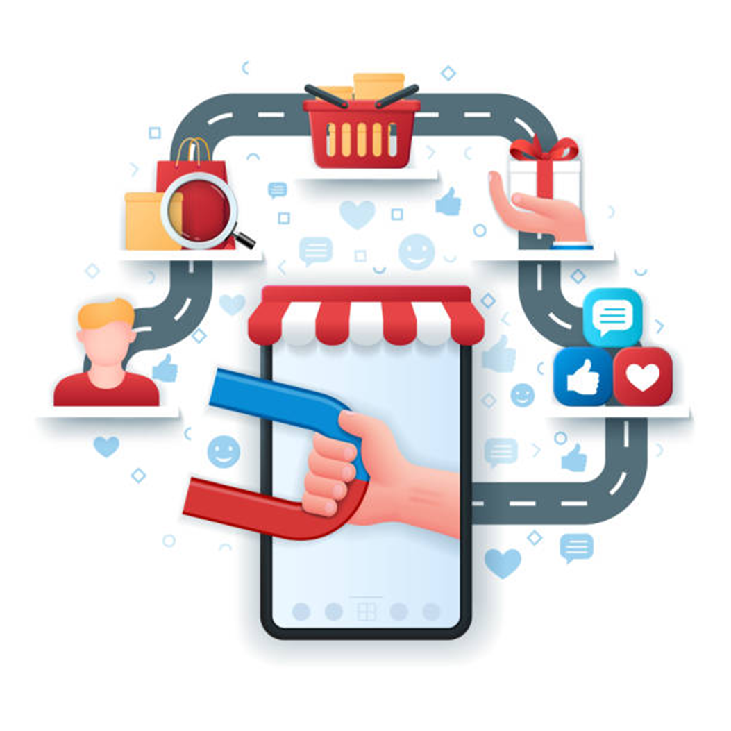
STEP IV
The overall perception that customers experience
throughout their relationship with the company

Slide 30
Experience is…(1/2)
“The accumulation of knowledge or skill that results from direct participation in events or activities”
“…provides sensory, emotional, cognitive, behavioural and relational values that replace functional values”. (Schmitt, 1999)
The feelings of emotions and sensations as opposed to thinking and involvement in what is happening rather than abstract reflection on an event (American Heritage Dictionary of the English Language, 2006)
“…the content of direct observation or participation in an event” (Collins, 2007)
“…occurs when a customer has any sensation or knowledge acquisition resulting from some level of interaction with different elements of a context created by the service providers” (Vajic, 2000)

Slide 31
Experience is…(2/2)
According to Lemon and Verhoef (2016, p. 71), customer experience can be defined as “the cognitive, emotional, behavioural, sensorial and social responses during the entire journey”, so it begins with the first interaction with the firm and seamlessly continues through to the period after the consumption.
According to Homburg, Jozic and Kuehnl (2017, p. 384), customer experience is the evolvement of a person’s sensorial, affective, cognitive, relational, and behavioural response to a firm or brand by living through a journey of touchpoints along prepurchase, purchase and postpurchase situations and continually judging this journey against response thresholds of co-occurring experiences n a person’s related environment.
Richardson (2010) has defined the customer journey as a “diagram that illustrates the steps and touchpoints that customers go through in engaging with companies”. As Norton and Pine (2013, p. 12) have pointed out, if companies want to be customer-centric, they need to understand and shape the sequence of these steps in line with their product offering (Vakulenko, 2019).

Slide 32
What Customer Experience Management is and what is not...
CEM can be defined as the strategic management process of the entire customer experience with a product or company. It is a truly customer-focused management concept, not a marketing concept (Ferraresi & Schmitt, 2018)
CEM refers to the cultural mindsets toward CEs, strategic directions for designing CEs, and firm capabilities for continually renewing CEs, with the goals of achieving and sustaining long-term customer loyalty (Homburg, Jozic and Kuehnl, 2017)

Slide 33
Innovative process to define,
measure and manage consumers behaviour
Sorrentino,2020

Slide 34
Innovative process to
measure consumers behaviour
Behavioural
level
BIG Data
ANALYTICS
Declared
level
SMALL Data
SURVEY
SMART Data
Perceived
level
NEUROMARKETING
Sorrentino, Caratù, 2019

Slide 35
What are the opportunities
Loyalty in repurchase
Cross selling
Price sensitivity reduction
Positive word of mouth
Lower customer acquisition costs
Stable relationship with the customer
Increase in sales
Reputation growth

Slide 36
Theoretical framework (1/2)
 | Market orientation (MO) | Customer Relationship Management (CRM) | CEM
Cultural mindset | Customer orientation, cross-functional, coordination and competitor orientation |  | Experiential response, touchpoints journey, alliance orientation
Strategic directions |  |  | Thematic cohesion, consistency, context sensivity, and connectivity of touchpoint journey as key elements of loyalty-driving Ces.
Firm capabilities | Effective use of market data through generating, interpreting, and disseminating relevant data within the organization | Multichannel integration and personalized customer interactions as key elements of profitable customer relationships | Effective use of market data through the continual design, prioritization, monitoring, and proactive adaptation of CEs
Primary goals | Customer satisfaction and market performance | Customer retention and profit maximization | Customer loyalty and long-term growth
Homburg, Jozic and Kuehnl (2017)

Slide 37
CEM for KPMG
Customization
Customize the experience to create a unique emotional relation
Integrity
Be believable and Inspire loyalty
Expectations
Knowing, managing and overcome the expectations
Resolution
Transform a basic experience in a wow experience
Time and Commitment
Reduce the time required to the customer through easy process
Empathy
Understand the expectations to create deep relationships
KPMG, 2020

Slide 38

Time for a little bit of discussion

Slide 39
Let’s work!
Read the manuscript
Focus on the three approaches
Verify POP and POD
Present each approach with a support of a case study

Slide 40
Let’s work!
Read the manuscript
Focus on the Carrefour case study and its peculiarities
Verify POP and POD in large distribution and reply to the following question: How can Carrefour emerge from the quagmire?

Slide 41

Keep’n touch
If I can be useful, I’m easy to be used ☺
Just email me at
annarita.sorrentino@uniparthenope.it

