Slide 1
MASTER MEIM 2021-2022
Strategy: a Dynamic Capabilities Based View (2)
March 02, 2022
Business strategy implementation
Instructor: Enrico Viceconte
The Project Management Institute

Slide 2
While the resource-based view of the firm focuses on the bringing together of assets that meet the four key criteria defined by Barney (1991) for resources and capabilities that can support durable competitive advantage - valuable, rare, imperfectly imitable, and non-substitutable (VRIN) - this is only one part of a process.
The VRIN resources must be harnessed to a coherent strategy and a sound business model. Most successful business models, however, will eventually be imitated to some extent by other firms, and VRIN assets associated with a model can provide at least some protection against inroads by competitors.
The design and operation of business models are dependent on a firm's capabilities. The crafting, refinement, implementation, and transformation of business models are outputs of high-order (dynamic) capabilities.
Dynamic capabilities, which are underpinned by organizational routines and managerial skills, are the firm's ability to integrate, build, and reconfigure internal competences to address, or in some cases to bring about, changes in the business environment (Teece et al., 1997; Teece, 2007). The strength of a firm's dynamic capabilities is vital in many ways to its ability to maintain profitability over the long term, including the ability to design and adjust business models.

Slide 3
Business Strategy Implementation
Strategy Implementation is a Project Management problem:
“delivering what’s planned or promised on time, on budget, at quality, and with minimum variability—even in the face of unexpected events and contingencies."

Slide 4
New Product Development: a Vaccine

Slide 5
New Product Development: a Vaccine

Slide 6
New Product Development: an Airplane

Slide 7
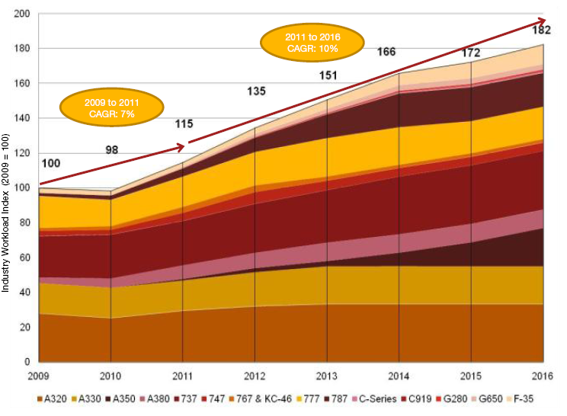
New Product Development: an Airplane

Slide 8
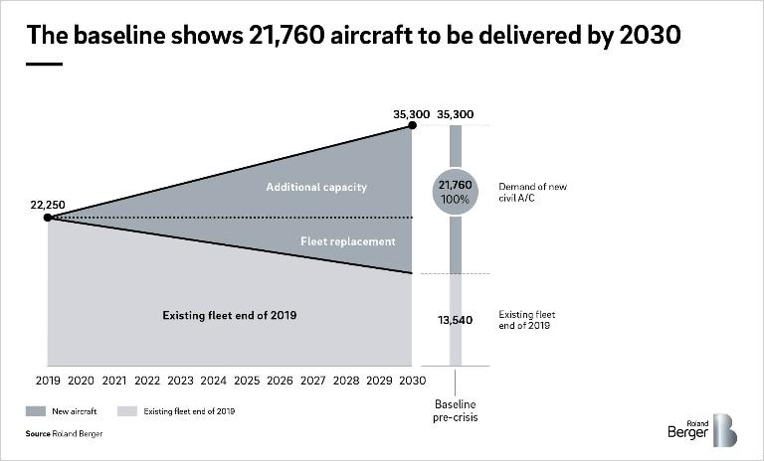
New Product Development: an Airplane

Slide 9
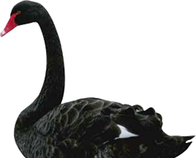
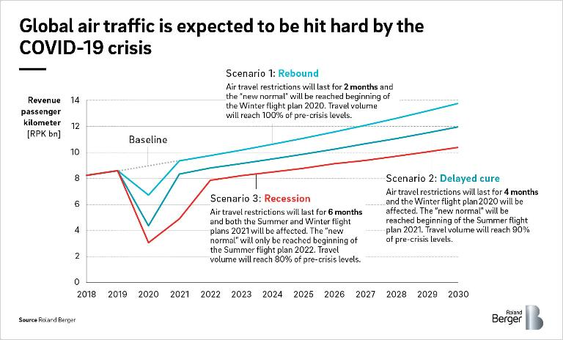
New Product Development: an Airplane

Slide 10
Despite their differences, all four schools of strategy represent attempts to resolve the same basic underlying problem:
the tension between two conflicting business realities.
The first reality: advantage is transient
The second reality: Corporate identity is slow to change.

Slide 11
Brainstorming
Give us some words related to the sentence: “advantage is transient”

Slide 12
Advantage is transient
Even the most formidable market position can be vulnerable to technological disruptions, upstart competition, shifting capital flows, new regulatory regimes, political changes, and other facets of a chaotic and unpredictable business environment.
This turbulence can never level off into stability; as companies copy and outdo one another’s proficiencies, the game of business continually becomes more challenging.
Rapid economic growth in emerging markets has made advantage even more transient, bringing billions of people into the global economy, along with hundreds of energetic new business competitors.
One might assume that the answer is to become completely resilient, and agile, morphing to match the changing demands of the market.

Slide 13
Brainstorming
Give us some words related to the sentence: “Corporate identity is slow to change”

Slide 14
Corporate identity is slow to change
The innate qualities of an organization that distinguish it from all others — its operational processes, culture, relationships, and distinctive capabilities — are built up gradually, decision by decision, and continually reinforced through organizational practices and conversations.
Very few companies have thoroughly reinvented themselves, and those that have managed it have typically had to force many people out, including top executives, and to replace them with new recruits chosen for a different set of attitudes and skills.
Even when leaders recognize the need for change or know that the company’s survival is at stake, this identity is difficult to shift; if no deliberate effort is made to refresh it, it can stagnate to the point where it erodes advantage from within.

Slide 15
A question for you
Is the “stickiness” of a company’s identity a weakness or a strength?

Slide 16
Arguments in favor of stability
No company can survive long, let alone distinguish itself, without a rich body of capabilities and a resonant corporate culture.
The fundamental enabler of strategy — the source of competitive advantage — is a distinctive, coherent corporate identity.
This is the quality that attracts customers, investors, employees, and suppliers.
It is grounded in internal capabilities (that is, the things your company can do with distinction) and in market realities (that is, the games in which your company chooses to play).

Slide 17
Arguments in favor of adaptation (and resilience)
Things are changing faster and faster (Acceleration) inside and outside the markets
There are more and more disruptions, discontinuities and transitions
Stability rhimes with Fragility

Slide 18
The yin and yang of strategy: agility and stability
The movement of business leadership from one trend to another over the past 50 years — has often led companies to make incoherent and ineffective moves.
The answer is not to keep adopting new theories in hopes of finding the right answer, but to develop your own capabilities-driven strategy: your own theory of coherence for your business.

Slide 19
The yin and yang of strategy: agility and stability
How do you capture value, now and in the future, for your chosen customers?
What are your most important capabilities, and how do they fit together?
How do you align them with your portfolio of products and services?
The more clearly and strongly you make these choices, the better your chances of creating a corporate identity that gives you the right to win in the long run.

Slide 20
Case study: Consumer Packaged Goods
Some strategic concepts, lead an entire industry in the wrong direction.
Two of the most influential strategy ideas are so widely held, so intuitively appealing, and so apparently true in practice that they are very hard to give up.
“bigger is better.”
“consolidation is inevitable.”
Yet they can also be quite dangerous to follow.

Slide 21
“bigger is better.”
Since the 1980s, CPG companies have tried hard to expand. The conventional wisdom said that the best shareholder returns would accrue to companies with huge brands and the scale to compete in developing markets.

Slide 22
“consolidation is inevitable.”
For years, experts have predicted that most consumer packaged goods segments would end up like carbonated beverages, shaving products, and disposable diapers — dominated by just two or three big players that took advantage of their scale to acquire or crowd out rivals, while a handful of niche players battled over the scraps.

Slide 23
Case study: Consumer Packaged Goods
Companies that follow the two strategic principles end up sacrificing performance.
There are categories where scale matters, where one or two players dominate.
But many food and consumer products sectors are fragmenting instead, with room for many profitable entrants.
These days, the best-performing consumer products companies — whether large or small — are those with the greatest coherence.
Their market strategy, capabilities system, and product lineup all fit together. They invest their capital and attention in just three to six differentiated capabilities, supporting all the products they offer. This gives them a level of efficiency and effectiveness that most of their competitors can’t match.
In the end, the problem with strategy concepts is not that they’re wrong; they are, in fact, often right.
But they are not universal. Beware any strategic idea that most other companies find beguiling. The right strategic destination is different for every company, even in a mature industry like consumer packaged goods.

Slide 24
DYNAMIC CAPABILITIES
Dynamic capability is “the firm’s ability to integrate, build, and reconfigure internal and external competences to address rapidly changing environments” (David J. Teece, Gary Pisano, and Amy Shuen).

Slide 25
Distinction between dynamic capabilities and ordinary capabilities
Dynamic capabilities are closely related to the concept of ordinary capabilities as they both are organizational capabilities, yet both are distinct in nature.
The resource-based view of the firm and the dynamic capabilities view (DCV) have focused on two broad categories of organizational capabilities that are essential for firm performance:
zero-order ordinary capabilities needed to exploit a firm's current strategic assets through day-to-day operations
higher-order dynamic capabilities required to explore and change a firm's resource base by integrating, building, and reconfiguring competences
Ordinary and dynamic capabilities are needed in different contexts and situations.

Slide 26
Distinction between dynamic capabilities and ordinary capabilities
Dynamic capabilities can be distinguished from operational or “ordinary” capabilities, which pertain to the current operations of an organization.
Dynamic capabilities, by contrast, refer to “the capacity of an organization to purposefully create, extend, or modify its resource base”.
The basic assumption of the dynamic capabilities framework is that core competencies should be used to modify short-term competitive positions that can be used to build longer-term competitive advantage.

Slide 27
Processes
Three dynamic capabilities are necessary in order to meet new challenges.
Organizations and their employees need the capability to learn quickly and to build strategic assets.
New strategic assets such as capability, technology, and customer feedback have to be integrated within the company
Existing strategic assets have to be transformed or reconfigured.

Slide 28
Learning
Learning requires common codes of communication and coordinated search procedures.
The organizational knowledge generated resides in new patterns of activity, in “routines,” or a new logic of organization.
Routines are patterns of interactions that represent successful solutions to particular problems.
These patterns of interaction are resident in group behavior, and certain sub-routines may be resident in individual behavior.
Collaborations and partnerships can be a source for new organizational learning, which helps firms to recognize dysfunctional routines and prevent strategic blind spots.
Similar to learning, building strategic assets is another dynamic capability. For example, alliance and acquisition routines can enable firms to bring new strategic assets into the firm from external sources.

Slide 29
New assets
The effective and efficient internal coordination or integration of strategic assets may also determine a firm’s performance.
Quality performance is driven by special organizational routines for gathering and processing information, linking customer experiences with engineering design choices, and coordinating factories and component suppliers.
Increasingly, competitive advantage also requires the integration of external activities and technologies: for example, in the form of alliances and the virtual corporation.

Slide 30
Transformation of existing assets
Fast-changing markets require the ability to reconfigure the firm’s asset structure and accomplish the necessary internal and external transformation (Amit and Schoemaker, 1993).
Change is costly, and so firms must develop processes to find high-payoff changes at low costs.
The capability to change depends on the ability to scan the environment, evaluate markets, and quickly accomplish reconfiguration and transformation ahead of the competition.
This can be supported by decentralization, local autonomy, and strategic alliances.

Slide 31
Co-specialization
Over time, a firm’s assets may become co-specialized, meaning that they are uniquely valuable in combination.
An example is where the physical assets (e.g., plants), human resources (e.g., researchers), and intellectual property (e.g., patents and tacit knowledge) of a company provide a synergistic combination of complementary assets.
Such co-specialized assets are therefore more valuable in combination than in isolation.
The combination gives a firm a more sustainable competitive advantage (Teece, 2009; Douma and Schreuder, 2013).

Slide 32
Asset orchestration
If capabilities are dependent on co-specialized assets, it makes the coordination task of management particularly difficult.
Managerial decisions should take the optimal configuration of assets into account.
Asset orchestration refers to the managerial search, selection, and configuration of resources and capabilities.
The term intends to convey that, in an optimal configuration of assets, the whole is more valuable than the sum of the parts.

Slide 34
The 5 Forces are the basis
Porter’s Five Forces framework (Porter, 1980), which applied the structure-performance paradigm of industrial organization economics to strategy, focused on evaluating suppliers, customers, and the threat of new entrants and/or substitute products.
This framework is useful, but it’s not enough today.

Slide 35
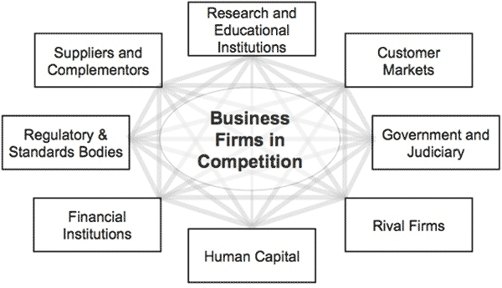
An echo-systemic view
Firms need to take a more comprehensive view of the environment in which they must compete.
Not only buyers and suppliers but the local market for skilled workers (since they are not entirely mobile internationally), universities (for access to both highly educated talent and faculty research), financial institutions (especially venture capital), the legal system (especially intellectual property law and employment law), and the domestic political situation.

Slide 36
From knowledge assets to dynamic capabilities
In order to embrace these new elements of competition, the Dynamic Capabilities Framework has emerged.
It offers a comprehensive, multidisciplinary approach to managerial decision-making.
The Dynamic Capabilities Framework helps identify the factors likely to impact enterprise performance.
It is gradually developing into a (interdisciplinary) theory of the modern corporation (Teece, 2010).

Slide 37
From knowledge assets to dynamic capabilities
The Dynamic Capabilities perspective goes beyond a financial-statement view of assets to emphasize the “soft assets” that management needs to orchestrate resources both inside and outside the firm.
This includes the external linkages that have gained in importance, as the expansion of trade has led to greater specialization.
It recognizes that to make the global system of vertical specialization and co-specialization work, there is an enhanced need for the business enterprise to develop and maintain asset alignment capabilities that enable collaborating firms to develop and deliver a joint “solution” to business problems that customers will value.

Slide 38
From knowledge assets to dynamic capabilities
Dynamic capabilities can usefully be thought of as belonging to three clusters of activities and adjustments:
identification and assessment of an opportunity (sensing);
mobilization of resources to address an opportunity and to capture value from doing so (seizing);
continued renewal (transforming).

Slide 39
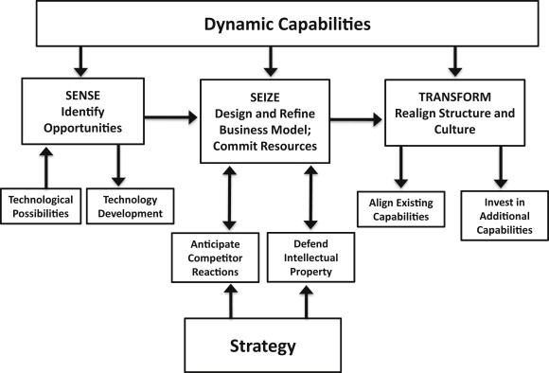

Slide 40
From knowledge assets to dynamic capabilities: Sensing (peripheral view)
is an inherently entrepreneurial set of capabilities that involves exploring technological opportunities, probing markets, and listening to customers, along with scanning the other elements of the business ecosystem.
It requires management to build and “test” hypothesis about market and technological evolution, including the recognition of “latent” demand.
Ex. Starbucks

Slide 41
From knowledge assets to dynamic capabilities: Seizing
capabilities include designing business models to satisfy customers and capture value.
They also include securing access to capital and the necessary human resources.
Employee motivation is vital. Good incentive design is a necessary but not sufficient condition for superior performance in this area.
Strong relationships must also be forged externally with suppliers, complementors, and customers.

Slide 42
From knowledge assets to dynamic capabilities
Companies that successfully build and orchestrate assets within the ecosystem stand to profit handsomely. Apple retained an estimated 40 percent of the gross profits from the entirety of the value chain on its hard drive-based iPods, despite manufacturing no part of the product itself (Linden et al., 2009). This is not counting the revenue from licensing makers of iPod accessories or sales from the iTunes Music Store.

Slide 43
From knowledge assets to dynamic capabilities: Transforming
Transforming capabilities are needed most obviously when radical new opportunities are to be addressed.
But they are also needed periodically to soften the rigidities that develop over time from asset accumulation, standard operating procedures, and insider misappropriation of rent streams.
A firm’s assets must also be kept in alignment to achieve the best strategic “fit”: firm with ecosystem, structure with strategy, and assets with each other.
Complementarities need to be constantly managed (reconfigured as necessary) to achieve evolutionary fitness, avoiding loss of value should market leverage shift to favor external complements.

Slide 44
Case Study: Apple
Apple has proved to be a paradigmatic practitioner of dynamic capabilities as it has created and transformed a series of markets.
Each of its major product introductions reflected aspects of the major categories of dynamic capabilities.
In particular, Apple’s strategy implementation has created and shaped markets.

Slide 45
 | Sensing | Seizing | Transforming
iPod | existing mp3 players were too “geeky” | create an aesthetically appealing portable device with a simple interface over an accelerated product development cycle; later: improve appropriability with exclusive FairPlay DRM in the iTunes Music Store | port iTunes software to rival Windows platform; expand into content distribution with the iTunes Music Store; shift company emphasis from computers to consumer electronics
iPhone | existing “smart phones” retained an awkward interface too close to their cell phone roots. | create a multimedia phone with a large screen and an intuitive interface; promote complementary asset creation with the App Store infrastructure. | develop telephony capabilities; enter the regulated telephony market
iPad | “netbooks” provide an unsatisfying computing experience and “E-readers” provide limited functionality. | scale up the iPhone interface to provide a richer multimedia platform without phone functionality. | extend the “simple interface” aesthetic to a computing platform.

Slide 46
The growing importance of intangible assets
As a result of the greater ability to outsource almost anything and everything, the traditional competitive sources of differentiation based on economies of scale and scope have been eroded.
If your market is too small to capture scale economies for an input or even a whole product, then you should source from companies that have achieved them already.

Slide 47
The growing importance of intangible assets
Fortunately, there are other bases of competitive advantage unrelated to scale.
The prime example is the generation, ownership, and management of intangible assets, which have risen to overshadow economies of scale in importance for enabling the enterprise to build and sustain a successful position.

Slide 48
Intangible assets: Know-How
Know-how and other intangibles are increasingly the “bottleneck assets” that allow innovating firms to differentiate and establish some degree of competitive advantage.
They cause barriers.
Value can flow to the enterprise from creation, combination, transfer, accumulation, and protection of intangible assets.
Such assets are the new “natural resources” of the global economy.

Slide 49
Intangible assets: the business model
Another intangible asset of central importance (besides knowhow) is a firm’s business model for a given market, i.e., the structure of a firm’s value proposition for its customers (Chesbrough and Rosenbloom, 2002; Teece, 2010a) and the design of the business that will deliver a solution to the customer. Business-model innovations are critical to success in unsettled markets where traditional revenue and pricing models are no longer applicable. The Internet allows and requires business model innovation.
In particular, the Internet requires new pricing structures because users are accustomed to getting information for free. Information providers are challenged to think of ways of charging for ancillary or premium services (so-called “fremium” approaches) while not running afoul of Internet users’ expectations of receiving free information.

Slide 50
The growing importance of intangible assets
Another intangible asset of central importance (besides knowhow) is a firm’s business model for a given market, i.e., the structure of a firm’s value proposition for its customers (Chesbrough and Rosenbloom, 2002; Teece, 2010a) and the design of the business that will deliver a solution to the customer. Business-model innovations are critical to success in unsettled markets where traditional revenue and pricing models are no longer applicable. The Internet allows and requires business model innovation.
In particular, the Internet requires new pricing structures because users are accustomed to getting information for free. Information providers are challenged to think of ways of charging for ancillary or premium services (so-called “fremium” approaches) while not running afoul of Internet users’ expectations of receiving free information.

Slide 51
The Business Ecosystem

Slide 52
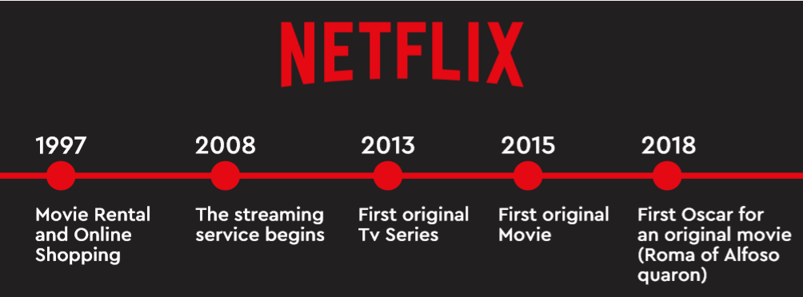

Slide 53
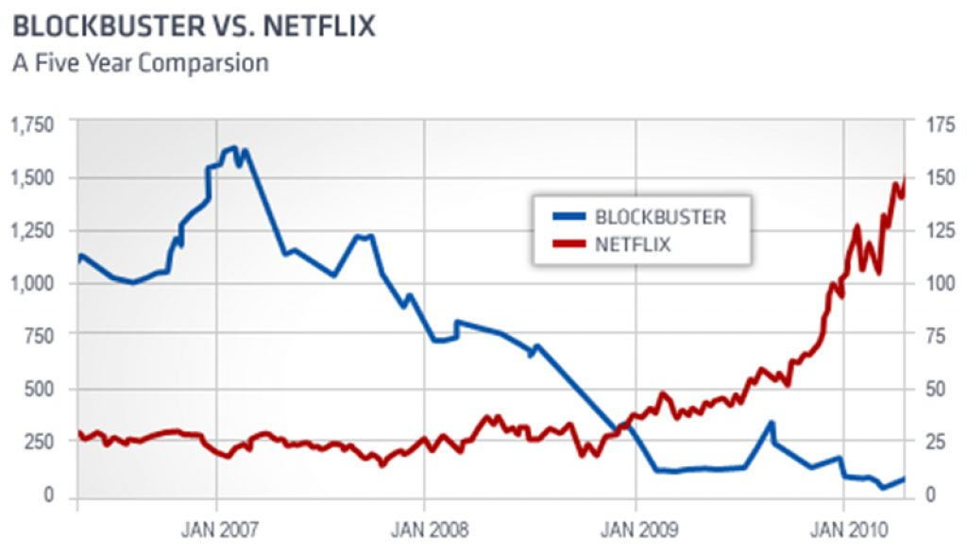

Slide 54
PRODUCT LIFECYCLE OF BLOCKBUSTER
DECLINE
PRODUCT LIFECYCLE OF NETFLIX
EXPONENTIAL GROWTH

Slide 55
Flow of revenues
?
2008
2010
PRODUCT LIFECYCLE OF BLOCKBUSTER
time
PRODUCT LIFECYCLE OF NETFLIX

Slide 56
Strategy Implementation
Strategy implementation is the process of turning plans into action to reach a desired outcome. Essentially, it’s the art of getting stuff done. The success of every organization rests on its capacity to implement decisions and execute key processes efficiently, effectively, and consistently. But how do you ensure that implementing a strategy will be successful?

Slide 57
Strategy Implementation
Strategy Implementation is a Project Management problem:
“delivering what’s planned or promised on time, on budget, at quality, and with minimum variability—even in the face of unexpected events and contingencies."

Slide 58
7 KEY STEPS IN THE IMPLEMENTATION PROCESS
1. Set Clear Goals and Define Key Variables
The first step of the process is straightforward: You must identify the goals that the new strategy should achieve.
Without a clear picture of what you’re trying to attain, it can be difficult to establish a plan for getting there.

Slide 59
7 KEY STEPS IN THE IMPLEMENTATION PROCESS
2. Determine Roles, Responsibilities, and Relationships
Build a roadmap for achieving those goals, set expectations among your team, and clearly communicate your implementation plan, so there’s no confusion.

Slide 60
7 KEY STEPS IN THE IMPLEMENTATION PROCESS
3. Delegate the Work
Once you know what needs to be done to ensure success, determine who needs to do what and when.
Refer to your original timeline and goal list, and delegate tasks to the appropriate team members.
You should explain the big picture to your team so they understand the company's vision and make sure everyone knows their specific responsibilities. Also, set deadlines to avoid overwhelming individuals. Remember that your job as a manager is to achieve goals and keep your team on-task, so try to avoid the urge to micromanage.

Slide 61
7 KEY STEPS IN THE IMPLEMENTATION PROCESS
4. Execute the Plan, Monitor Progress and Performance, and Provide Continued Support
Next, you’ll need to put the plan into action. One of the most difficult skills to learn as a manager is how to guide and support employees effectively. While your focus will likely be on delegation much of the time, it’s important to make yourself available to answer questions your employees might have, or address challenges and roadblocks they may be experiencing.

Slide 62
7 KEY STEPS IN THE IMPLEMENTATION PROCESS
5. Take Corrective Action (Adjust or Revise, as Necessary)
Implementation is an iterative process, so the work doesn’t stop as soon as you think you’ve reached your goal. Processes can change mid-course, and unforeseen issues or challenges can arise. Sometimes, your original goals will need to shift as the nature of the project itself changes.

Slide 63
7 KEY STEPS IN THE IMPLEMENTATION PROCESS
6. Get Closure on the Project, and Agreement on the Output
Everyone on the team should agree on what the final product should look like based on the goals set at the beginning. When you’ve successfully implemented your strategy, check in with each team member and department to make sure they have everything they need to finish the job and feel like their work is complete.

Slide 64
7 KEY STEPS IN THE IMPLEMENTATION PROCESS
7. Conduct a Retrospective or Review of How the Process Went
Once your strategy has been fully implemented, look back on the process and evaluate how things went. Ask yourself questions like:
Did we achieve our goals?
If not, why? What steps are required to get us to those goals?
What roadblocks or challenges emerged over the course of the project that could have been anticipated? How can we avoid these challenges in the future?
In general, what lessons can we learn from the process?

Slide 65
Execution Premium

Slide 66
The Strategy-Focused Organization
The strategy-oriented business is centered on five managerial principles:
mobilize change through managerial leadership;
translate the strategy into operational terms
align the organization with the strategy;
motivate to make everyone feel responsible for the implementation of the strategy;
governing in order to make the strategy a permanent process.

Slide 67
How to control the execution of the strategy
Strategy Maps: translate strategy into operational terms
in objectives that are connected, in cause-effect relationships, with the four perspectives of the Balanced Scorecard
financial
of the customer
Internal processes
of learning / growth.
The structure aligns processes, people, technology and culture with the value proposition for customers and the objectives of the shareholders

Slide 68
What is strategic alignment
Alignment (tr. it. Allineamento strategico: come usare la Balanced Scorecard per aumentare la competitività, ISEDI, Torino, 2006))
The third principle is explored in depth and shown how to use strategic maps and scorecards to align organizational units - both line business units and corporate staff units - with an overall business strategy.
The organizational alignment allowed the company to appropriate the synergies resulting from the operation of multiple units within the same business entity.
The last chapter of Alignment describes the application of the fourth principle: communicating the strategy and aligning individual objectives and incentives to the objectives of the business unit and of the company.

Slide 69
1. Premium execution, the key points
Develop your own strategy by clarifying its objectives and conducting a strategic analysis
Plan the strategy by choosing purposes, targets, initiatives and performance control methods
Align organizational units and collaborators with the strategy
Plan priorities and resource allocation
Monitor execution and learn from mistakes
Test and adapt the strategy.

Slide 70
2. Develop the strategy
We start with the definition of the mission, values and vision of the company and carry out a strategic analysis of both the external context (for example using the PESTEL scheme) and the internal environment.
Strengths and weaknesses as well as opportunities and threats are identified (SWOT analysis).
Then we move on to the formulation of the strategy keeping in mind the critical issues that emerged in the analysis.
Here you can use different tools depending on the type of company and the background of the top management.
Already at this stage, the strategic map can help in selecting the most appropriate strategic options.

Slide 71
3. Plan the strategy
Use of the strategic map and balanced scorecard to plan the strategy.
The previously formulated strategy is translated into a strategic map organized into "strategic themes", where objectives, linked together through cause-effect relationships, describe how value is created within each theme.
Once the objectives have been defined, the measures to monitor the progress achieved and the targets to consider an objective achieved are defined in the balanced scorecard.
The authors emphasize the distinctiveness of their approach. While other approaches to strategic management emphasize the "what", they focus on the "how".

Slide 72
4. Strategic initiatives
Kaplan and Norton address the issue of "how" by defining the strategic initiatives to be implemented to support the pursuit of the desired objectives.
Applying Newton's Second Law to Organizations:
"strategic initiatives represent the force that accelerates the organizational mass in action, overcoming inertia and resistance to change".
The three "key processes" to be carried out in defining the "how":
Select strategic initiatives appropriately
finance them adequately
determine who is "accoutable" for their execution

Slide 73
5. Aligning organizational units and employees
The third stage of the proposed strategic management system consists in aligning the organizational units and all human resources with the strategy through the construction of strategic maps and balanced scorecard in cascade at various organizational levels.
Vertical alignment defines how each unit can contribute to the overall success of the business.
The horizontal alignment allows to realize synergies within the company and to avoid sub-optimizations.

Slide 74
6. Plan operations: align process improvement programs
the fourth stage of the strategy management system relates to the alignment of process improvement programs.
Strategy execution requires, for Kaplan and Norton, the alignment and execution of both strategic initiatives and process improvement programs.

Slide 75
7. Plan operations: sales forecasts, resource capacity, dynamic budget
How to create and execute an operational plan with a structured process in five phases to effectively translate the strategic intentions into a detailed operational plan starting from the quarterly sales forecasts for the following periods.

Slide 76
8. Operational and strategy review meetings
Periodic strategy and operations review meetings can help organizations stay in line with strategy and achieve great results.
While the operational review meetings are aimed at highlighting and solving emerging operational problems, the strategic control meetings, generally monthly or quarterly, are aimed at evaluating the performance obtained from the execution of the strategy and guiding its future implementation phases.

Slide 77
9. Meetings to test and adapt the strategy
Kaplan and Norton point out the difference between strategy review meetings and meetings to adapt strategy to new conditions.
The former allow an evaluation of the execution of the strategy and the latter an evaluation of the strategic assumptions and decisions made on the basis of these assumptions.
These are annual meetings where the validity of the strategy is assessed, taking into account not only the internal data (balanced scorecard) but also the changes that have occurred in the external competitive context.

Slide 78
10. The Strategy Management Office
The role of the new Strategy Management Office as an extension of the strategic planning office.
No individual or department has the visibility necessary to coordinate and integrate the various processes of strategic management, therefore, for the authors, it is necessary to set up a specific team to facilitate the planning of the strategy, its implementation, verification and review.
The team is gathered in the strategy management office

Slide 79
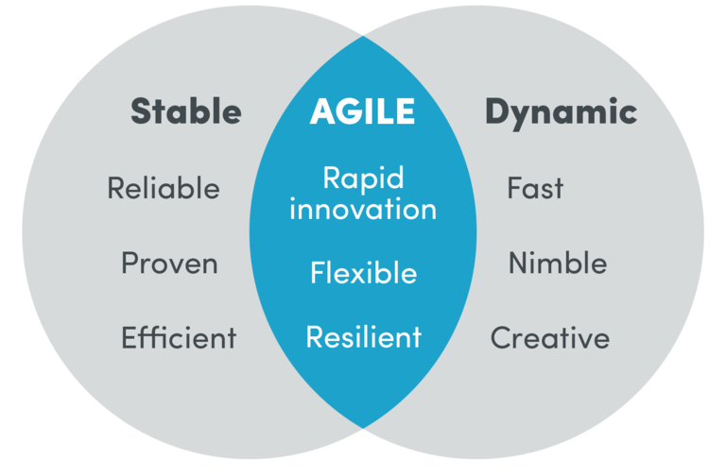

Slide 80
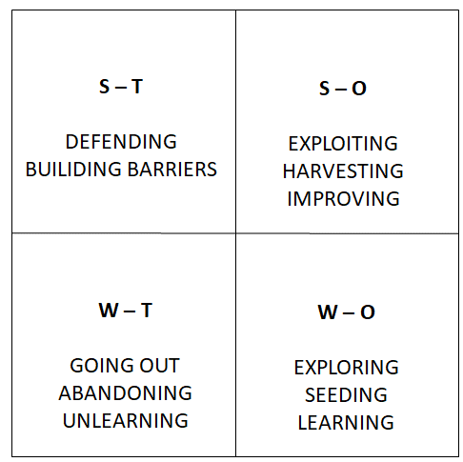
Resolving a contradiction with ambidexterity
Focusing implementation on Efficiency (Exploitation)
Focusing implementation on Innovation (Exploration)
Exploitation and exploration compete for resources

Slide 81
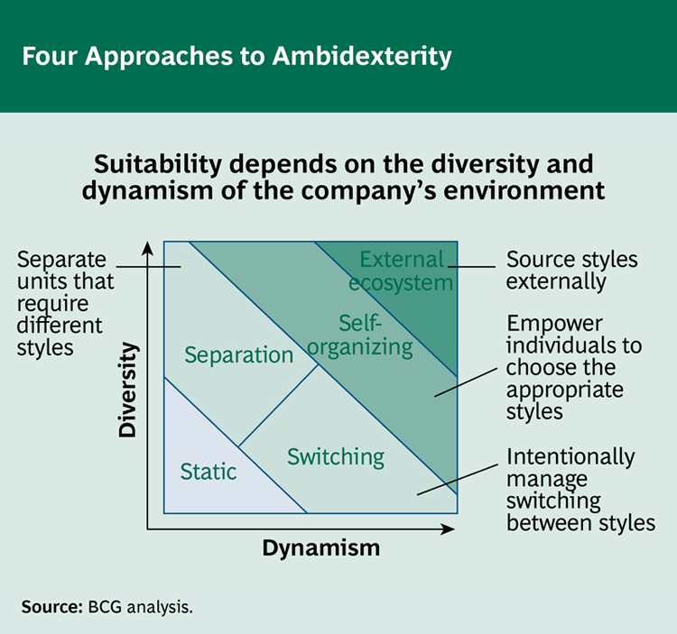
Companies in stable, simple environments do not require ambidexterity—they can thrive by emphasizing operating efficiency.
But most others will need to pursue it.
Ambidexterity can be achieved through four distinct approaches:
Separation
Switching,
Self-organizing,
External ecosystem

Slide 82
Separation
Separation is appropriate for companies facing environments that are diverse but relatively stable over time.
It involves structurally separating units that need to deploy different strategy styles.
A company might, for example, separate its mature business, which requires efficiency and disciplined execution, from its emerging business, which needs to be innovative and flexible.

Slide 83
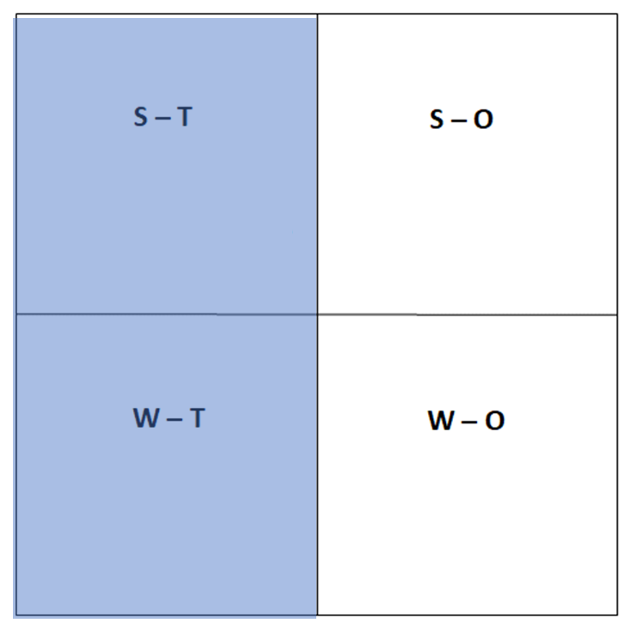
SEPARATION
EXPLOITATION
B.U.1
B.U.2
EXPLORATION

Slide 84
Exemples of Separation
In 1943, Lockheed Martin, faced with the task of creating an advanced fighter while at the same time mass producing its established Hudson bomber, opted to create two fully separate units (marking the birth of what would become the company’s famous Skunk Works), each with its own physical location, resources, and culture.

Slide 85
Exemples of Separation
in 2000, IBM separated its established businesses, where a focus on execution and operating metrics was appropriate, from its emerging-businesses unit, which the company used to explore new opportunities and markets.

Slide 86
Problems with Separation
Separation creates barriers al siloes that prevent information and resource flow among units, potentially impeding their ability to change emphasis or style when required.

Slide 87
Switching
Dynamic environments require instead a switching approach.
Here, a company changes its style over time as its environment changes, similar to the way in which new companies evolve.
Initially, an organization must deploy an exploratory style as it looks for a breakout product, service, or technology.
Over time, however, it must transition to a more exploitative style in order to scale up and secure a profitable market position.

Slide 88
SWITCHING
EXPLOITATION
B.U.
EXPLORATION

Slide 89
SWITCHING
EXPLOITATION
B.U.
EXPLORATION

Slide 90
Exemple of Switching
Amazon was able to rapidly switch from exploration to exploitation.
In only two years, it went from exploring (out of Jeff Bezos’s garage) the use of the Internet for retailing to exploiting and industrializing its operations, opening its first distribution center, and going public.

Slide 91
Problems with Switching
Switching requires resources and information to flow readily across organizational boundaries.
This can be problematic because when senior management makes the decision to change styles, some organizations respond slowly, resource conflicts erupt between units, and staff resist the change, fearful of the consequences of moving to a new project that might not succeed.
Startups are particularly good at switching—but that does not mean that a similar culture cannot exist in a large organization.

Slide 92
Self organization
When a company needs to deploy multiple styles simultaneously—and the styles are changing over time—a self-organizing approach is called for, since managing the switching process in a top-down manner becomes complex and infeasible. Here, individuals or small teams can choose for themselves which style to employ and switch between them over time.

Slide 93
SELF ORGANIZATION
EXPLOITATION
EXPLORATION

Slide 94
SELF ORGANIZATION
EXPLOITATION
EXPLORATION

Slide 95
Exemple of self organization
Chinese consumer-goods company Haier successfully employs a self-organizing approach. Seeking to improve its ability to deliver customer value, the global conglomerate flattened its organization structure and developed 2,000 self-governing units.
Each unit functions like an autonomous company, with its own profit-and-loss statement, operations, innovation program, and motivation.
This approach has helped Haier go from near bankruptcy in the 1980s to market leadership today.

Slide 96
Probelms with self organization
A self-organizing approach has its drawbacks, however.
It incurs significant costs from duplication, the lack of scale of the individual units, and the additional costs of enforcing the local rules of interaction and keeping score.
Hence the approach is only appropriate in highly diverse and dynamic environments.

Slide 97
External ecosystem
In the most complex cases, companies may need to orchestrate a diverse ecosystem of external parties in order to source the strategy styles they require.

Slide 98
EXTERNAL ECOSYSTEM
EXPLOITATION
EXPLORATION

Slide 99
EXTERNAL ECOSYSTEM
EXPLOITATION
EXPLORATION

Slide 100
Exemple of External ecosystem
Apple has used it with great success in the smartphone arena, where winning requires multiple strategy styles.
For example, content creation and app development require rapid adaptation to changing consumer needs and fast-moving competition, while component manufacturing and assembly are scale intensive and require a more classical approach.
The industry is also highly dynamic.
Rather than trying to deploy all strategy styles itself, Apple chooses to shape and orchestrate an ecosystem of companies that exercise the strategy styles it needs.

Slide 101
Problem with External ecosystem
This approach is only appropriate in the most complex cases because of the high costs and risks of cooperation—the cost of building platforms such as Apple’s iTunes, the profits the company must give away to incentivize third parties to participate, and the risks associated with dilution of control over the company’s operations.

Slide 102
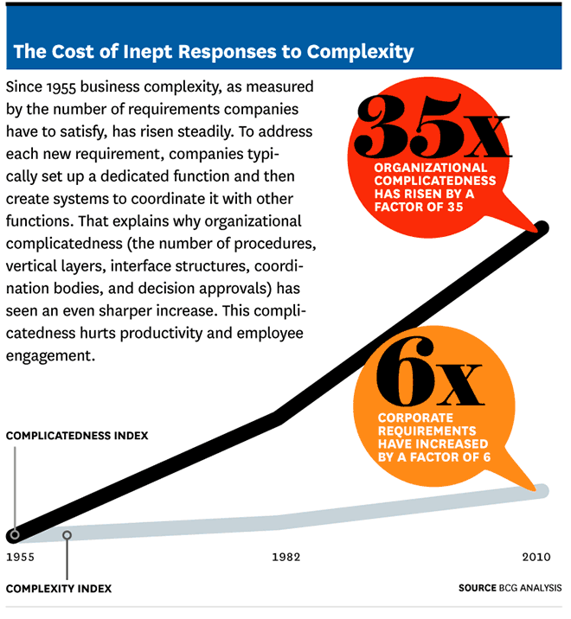
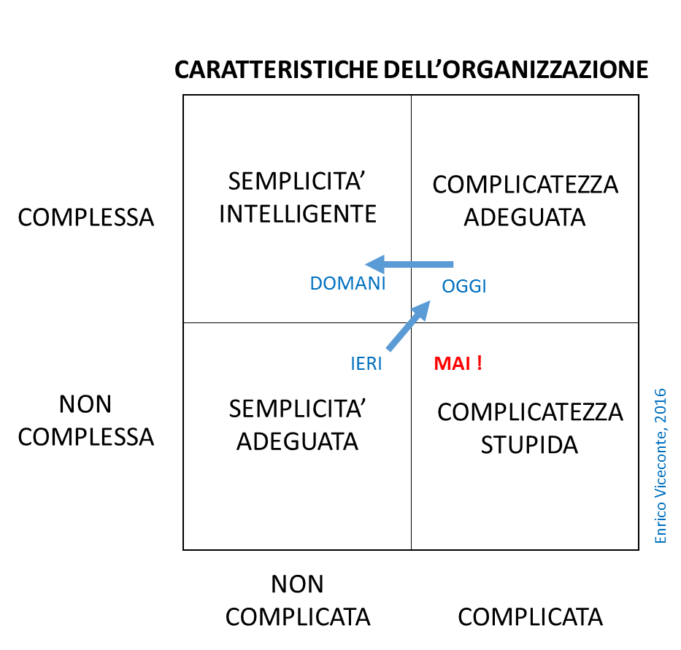

Slide 104
Business models, dynamic capabilities, and strategy are interdependent.
The strength of a firm's dynamic capabilities help shape its proficiency at business model design.
Through its effect on organization design, a business model influences the firm's dynamic capabilities and places bounds on the feasibility of particular strategies.

Slide 105
tEECE
https://www.youtube.com/watch?v=LmcG0zxLlnk
https://www.youtube.com/watch?v=stG6-nPZapU

