Slide 1
a text-to image AI generated this picture
December 19 2022
Resources, competencies, dynamic capabilities, and competitive advantage
(…in a Creative Economy)
Enrico Viceconte

Slide 2
A trip to 2137 AD to stimulate our creative vision of the business

Slide 3
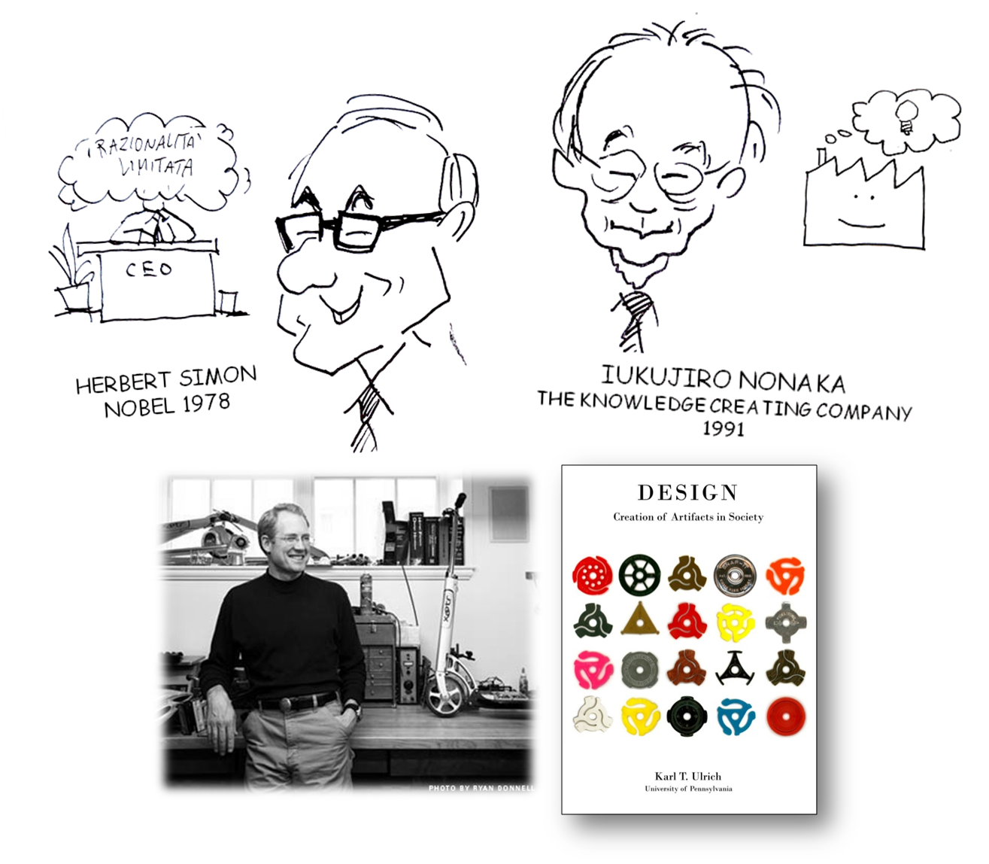

Slide 5
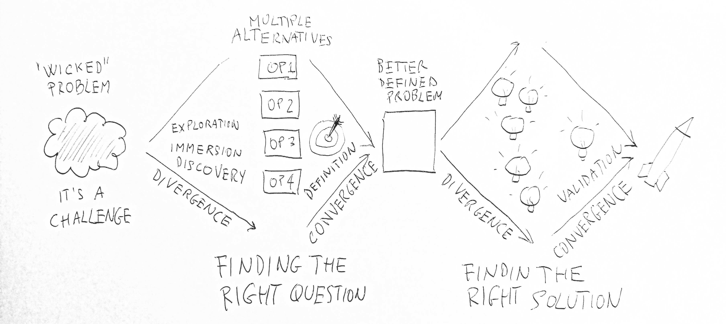

Slide 6
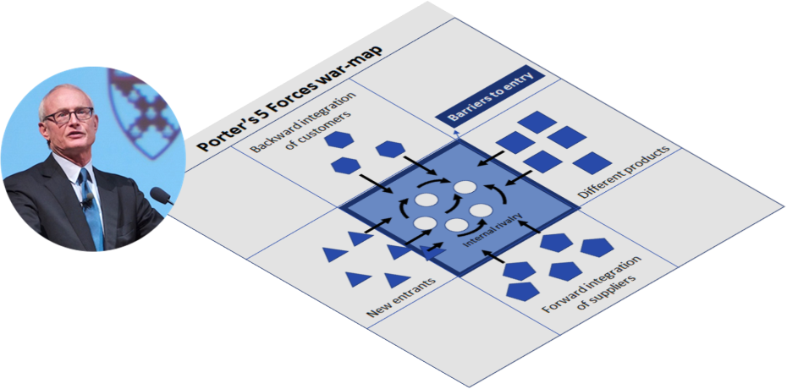
Analyze the present situation:
Outside (risks and opportunities)
Inside (strong and weak capabilities)
Find your basic “way to play” among:
Differentiation
Cost leadership
Product range
THE FABULOUS FOUR FRAMEWORKS
Analyze the attractiveness of the industry by assessing:
the strength of competitive threats
the opportunities related to capabilities based barriers
Analyze your growth opportunities based on your own capabilities:
market diversification
product diversification
market and product diversification

Slide 7
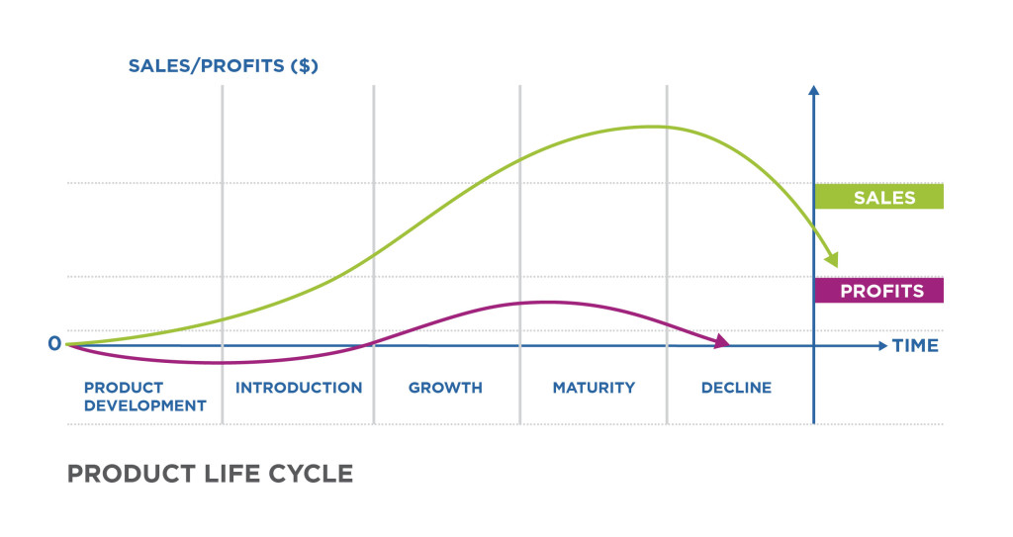
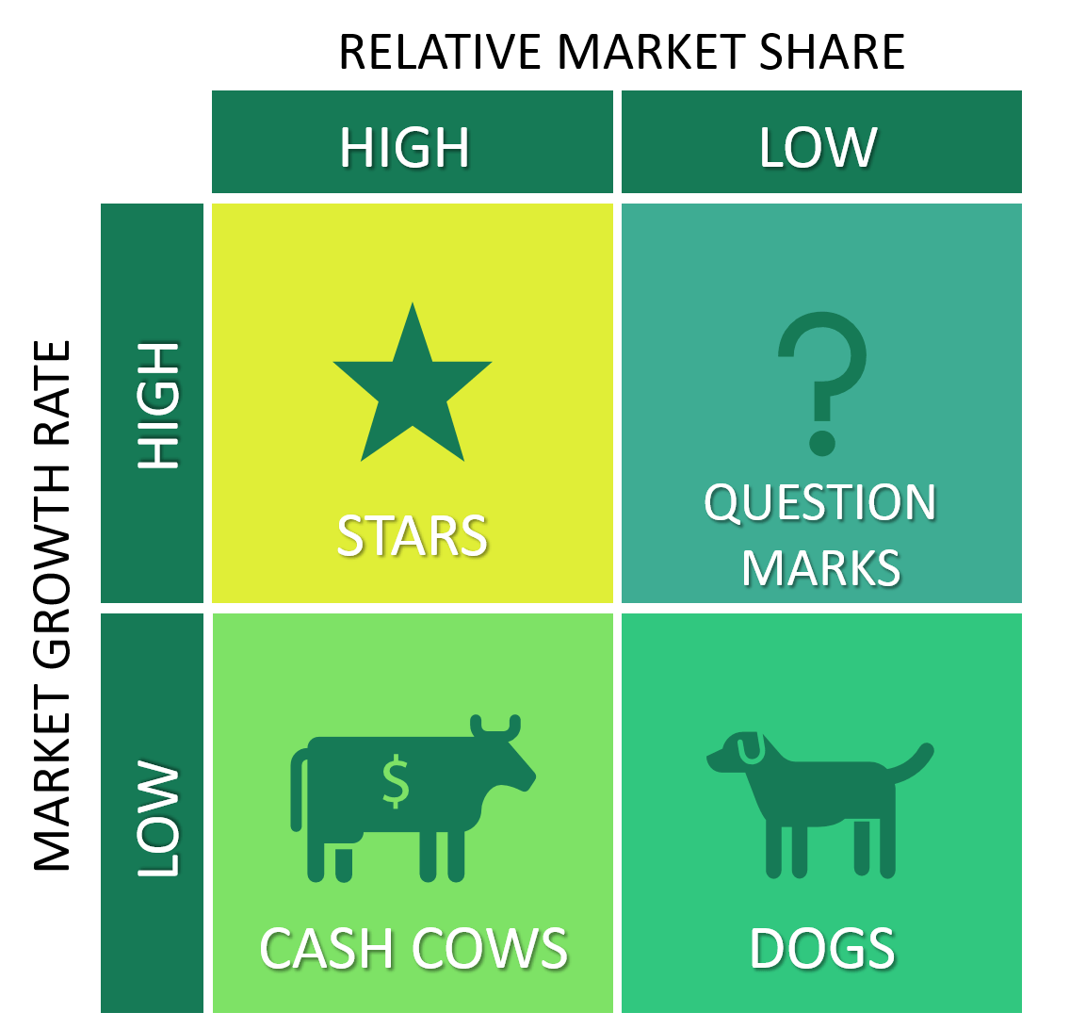
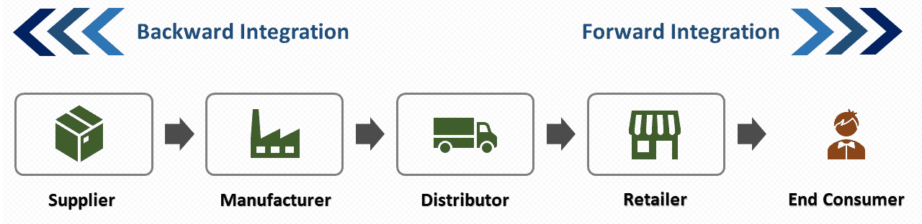
The 7 Magnificents

Slide 8
Living in a new kind of Economy

Slide 9
Focus on:
1. Platforms, Not Just Products
2. Services, Not Just Products (or Platforms)
3. Capabilities, Not Just Strategy
4. Pull, Don’t Just Push
5. Scope, Not Just Scale
6. Flexibility, Not Just Efficiency

Slide 12
Industry Platform Definition
A foundation technology (or service) used beyond a single firm, whose value increases geometrically with the addition of more users and complementary products & services – A phenomenon known by various names: positive feedback, bandwagon effect, network externality or network effect
Historical Examples: Railroad Network, Telegraph, Electric Power System, Radio, TV

Slide 13
What a good platform should be?
A platform generally brings multiple participants or “sides” of a market together to do something in common.
But to do that well, the platform has to be relatively open, so the building blocks inside of it are accessible to outside companies.
The architecture of the platform has to be relatively modular so that companies can come in and extend it.

Slide 15
1. Platforms. Not Just Products
In many markets today, companies need to think in terms of platforms, not just stand-alone isolated products.
iPhone is at the center of an ecosystem of hundreds of thousands of companies that are building applications or services for it.
This is an example of a platform, not just a product.

Slide 16
Services, Not Just Products (or Platforms)
Firms in a variety of product industries have experienced commoditization and the value of their products is often shifting to complementary services or service-like versions of their products.

Slide 17
Capabilities. Not Just Strategy
Managers need to think in terms of capabilities, not just strategy or strategic planning.
They should be building strategy on top of distinctive capabilities, whether that capability is in software technology, product design, or quality management.
Strategies need to change over time, but more enduring are the unique skills and knowledge that enable a company do things that competitors cannot easily do, and to do things that customers value.

Slide 18
Pull, Don’t Just Push
The model for this idea was the original Toyota lean production system, which devised what we now call “Just-in-Time” inventory management.
This principle is important also in terms of product development such as by creating prototypes and other opportunities for feedback from customers to adjust what a team is doing.

Slide 19
Pull, Don’t Just Push
Cusumano suggests “pull versus push” in marketing, planning, and R&D.
The goal is to create systems that are “dynamic”: flexible and responsive to new information on customers, competitor behavior, technological changes, or potential natural disasters.

Slide 20
Scope, Not Just Scale
Customers today want variety; they want products and services put together in creative ways and tailored somewhat to their individual needs.
Companies have to figure out how to do this efficiently, which requires utilizing knowledge, technology, and designs across different products and different kinds of customers.
It is really about leveraging knowledge, not about making many copies of a particular product and trying to win over customers through better economies of scale.

Slide 21
Flexibility, Not Just Efficiency
For example, if a company builds a factory that can make ten different products rather than just one, and if the market declines for some of those other products, managers can switch easily to the products that are selling.
It may cost more to create a flexible factory in terms of machinery, worker training, and supplier management, but it protects the firm against changes in the market.
We can also think about this kind of flexibility in other areas such as research, product development, strategic planning systems, and service delivery.

Slide 22
“Winner Take All” (or Most) if it
Very strong direct or indirect network effects
Little room to distinguish among different platforms (few niches or differentiation opportunities for your competitors)
Difficult or costly to use more than one platform (“multi-homing” rare for users & app developers or advertisers)

Slide 23
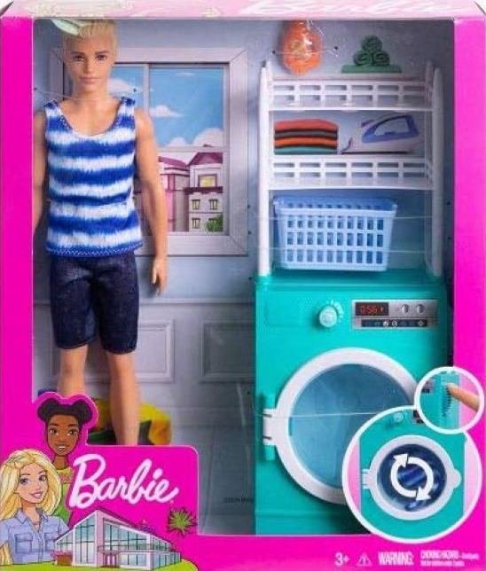
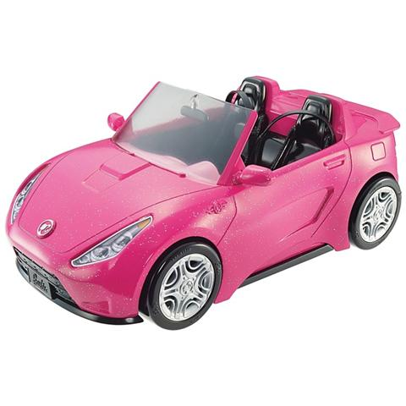
Barbie is an innovation platform

Slide 25
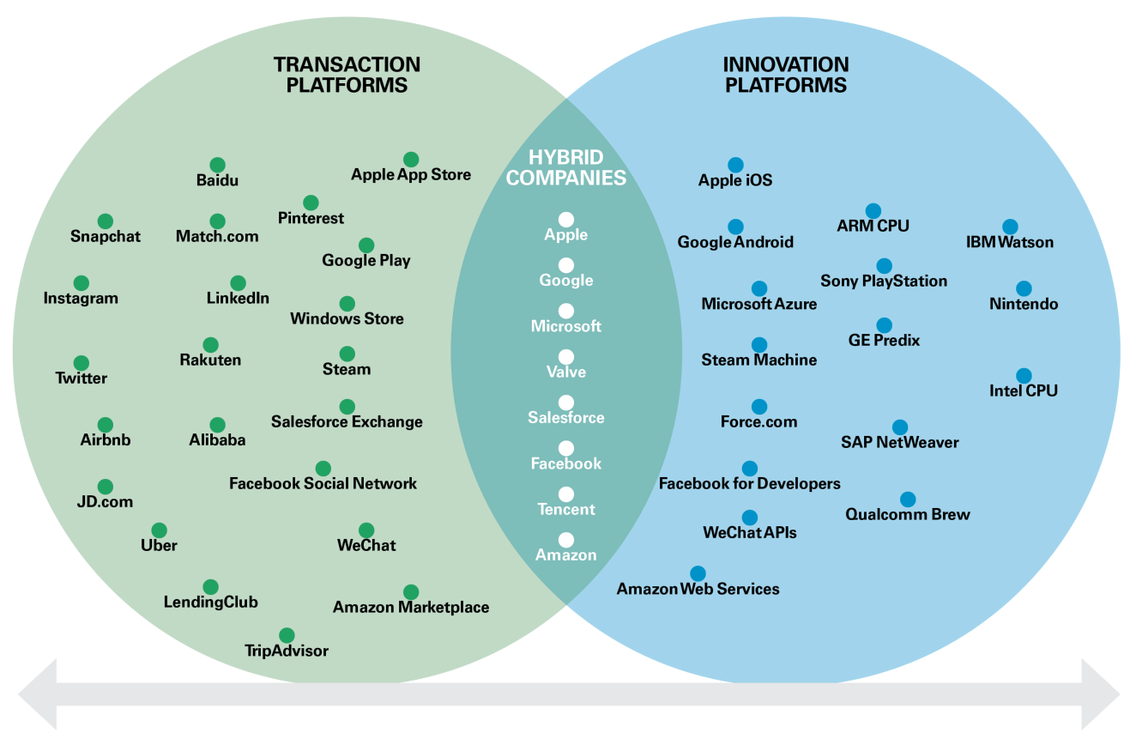

Slide 28
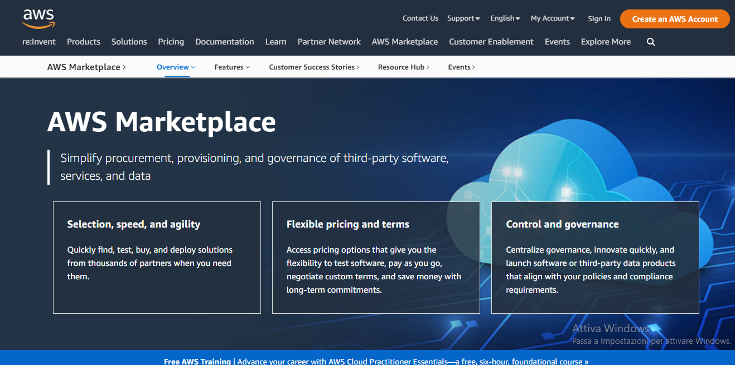

Slide 29
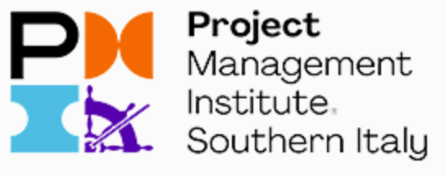
Resources, competencies, capabilities, and competitive advantage (6 hours)
Resource Based View; assess your essential “capabilities” for strategic analysis.
Dynamic Capabilities
(4 hours)
How to implement and execute a dynamic capability driven strategy
DISRUPTIVE
CAPABILITIES
DYNAMIC CAPABILITIES
STATIC CAPABILITIES

Slide 30
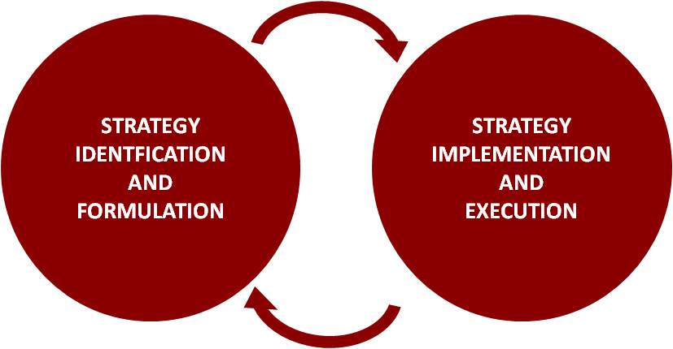
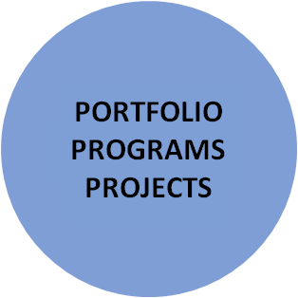

Slide 31
STRATEGY
IS ABOUT
FOCUS
Key message:
Attention of leaders focused on the essential aspects of “wicked” problems
in problem finding
in problem framing
in problem solving

Slide 32
discussion
Your expectations

Slide 33
“Innovation” and “innovation projects”
INNOVATION
PRIORITIES
COMPETITIVE
SITUATION
DELIVERABLES
CHANGES
BENEFITS
COMPETITIVE
ADVANTAGE
INNOVATION OPTIONS
PORTFOLIO
OF PROGRAMS
AND PROJECTS
B.A.
BUSINESS MANAGER
PROJECT MANAGER

Slide 34
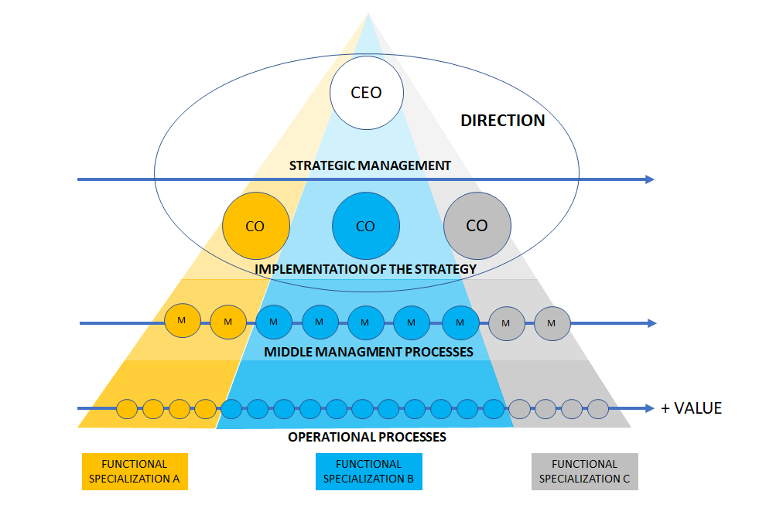
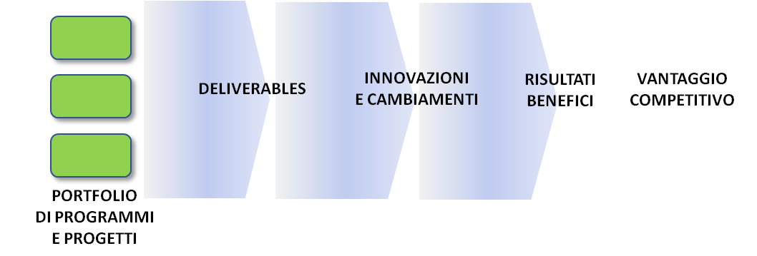
INDETERMINAZIONI
IMPREVISTI
OPPORTUNITA’
PROBABILITA’
INCERTEZZE
RISCHI
INCOMPRENSIONI
FUTURO

Slide 35
OPTION
OPTION
OPTION
OPTION
OPTION
OPTION
It’s 8 a.m. in the executive conference room of a large global packaged-foods manufacturer.
For the past two months, a team made up of 15 senior people has been exploring options for growth, winnowing them down to three basic strategies.
Each is now summed up in a crisp 20-minute presentation.
OPTION
OPTION
OPTION
OPTION
OPTION
TODAY WE ARE GOING TO DECIDE

Slide 36
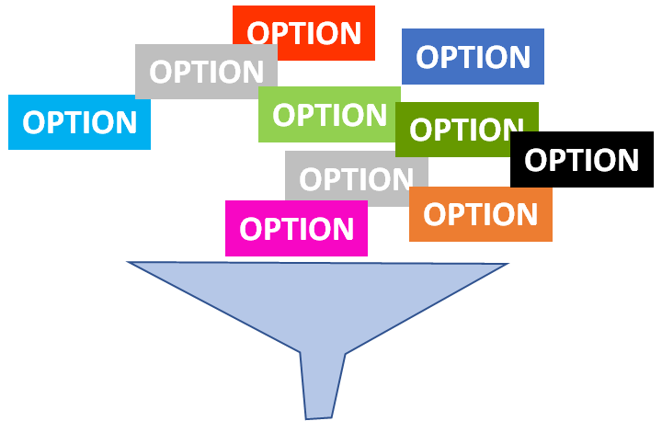
TODAY WE ARE GOING TO DECIDE
Growth
CapEx
OpEx
Learning
Profits
OPTION 1
OPTION 2
OPTION 3
Compliance
Risks
C-level Decisions

Slide 37
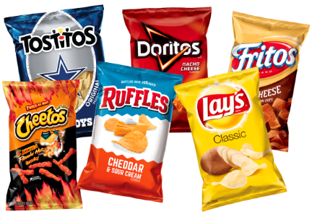
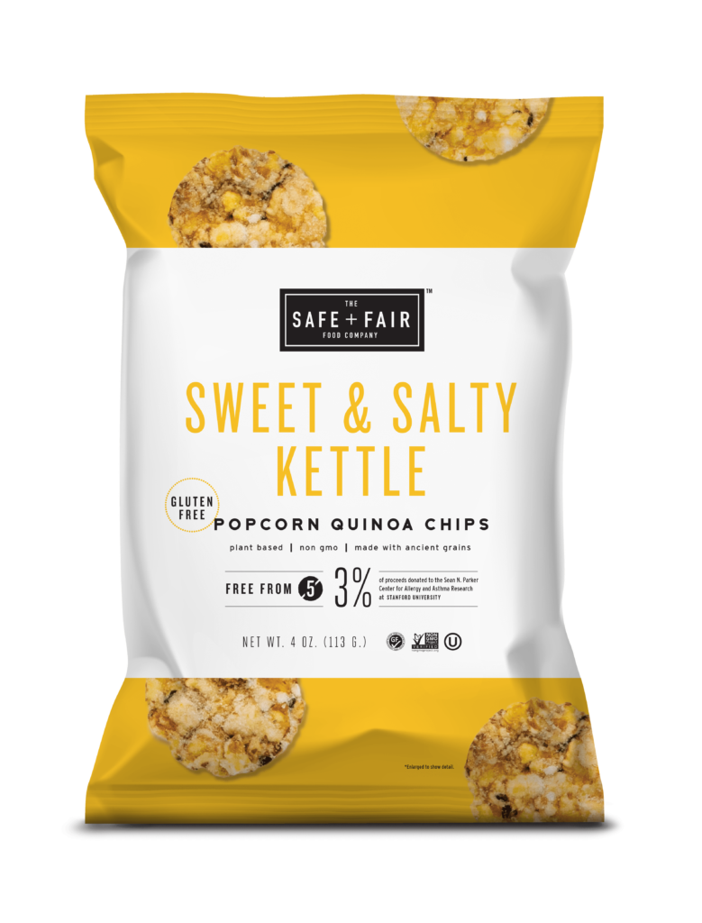
The first option
It focuses on innovation.
The company would rapidly develop and launch many new types of snacks and foods, packaged in new and interesting ways, offering leading-edge nutrition and convenience.

Slide 38
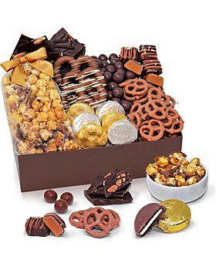
The second option
the company would get closer to its customers, producing the food people
ask for.
It could incorporate ideas gathered online into its offerings and provide busy working families with customizable, convenient, and well-balanced meals.

Slide 39
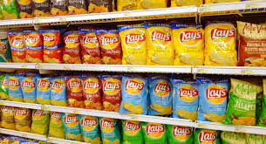
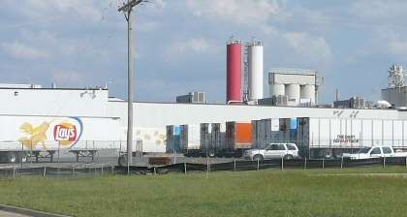
The third option
It would involve transforming the dynamics of the relevant food sectors by competing more aggressively.
The company would become a category leader by investing in new process technology, rightsizing operations to push costs down, and completing key acquisitions.

Slide 40
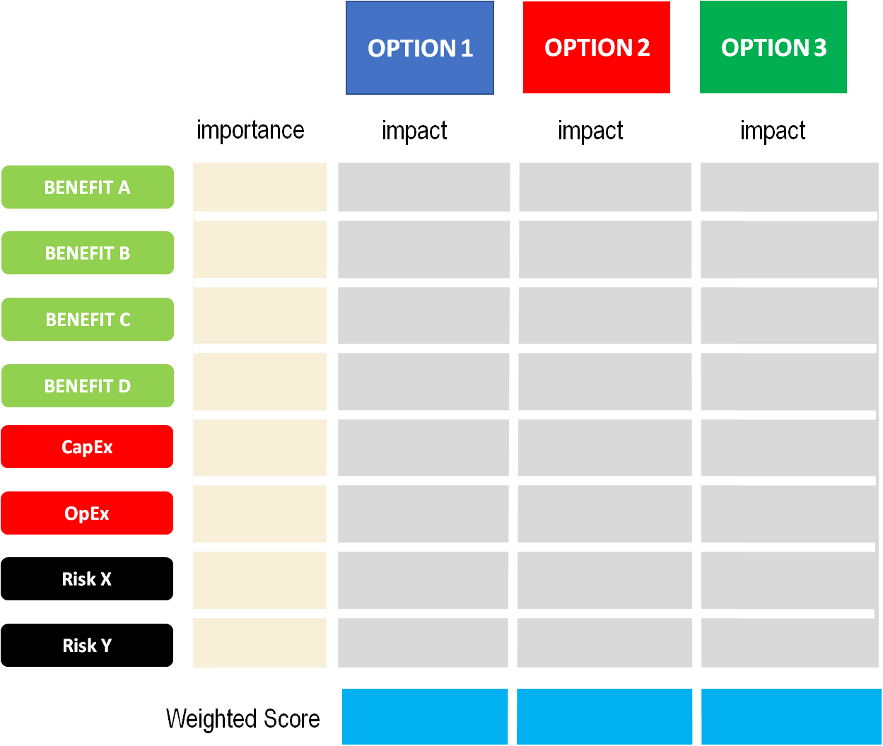
C-level Decisions

Slide 41
“Which strategy would give us the greatest right to win?”
OPTION 1
OPTION 2
OPTION 3

Slide 42
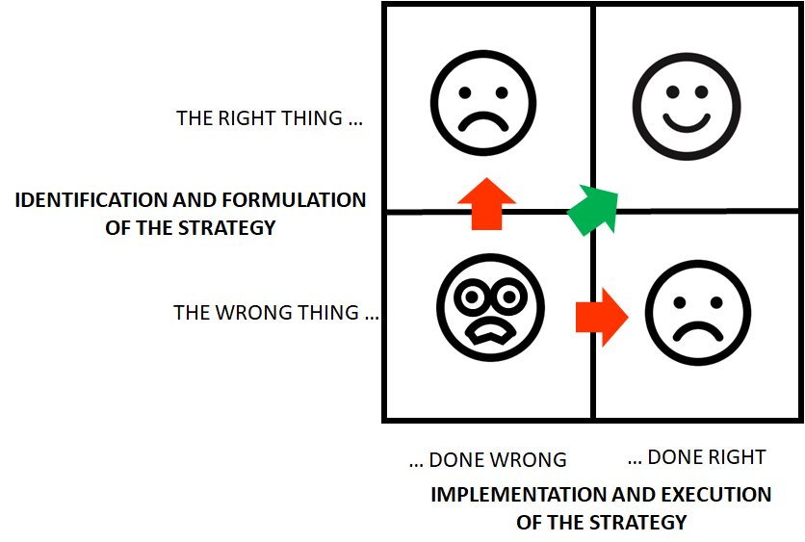

Slide 43
STRATEGY
IS ABOUT FOCUS
THE RIGHT
THING TO DO

Slide 44
STRATEGY
IS ABOUT FOCUS
STRATEGY
THE RIGHT
THING TO DO

Slide 45
STRATEGY
IS ABOUT FOCUS
BAD
STRATEGY
THE RIGHT
THING TO DO
EXECUTION
IMPLEMENTATION

Slide 46
STRATEGY
IS ABOUT FOCUS
GOOD
STRATEGY
THE RIGHT
THING TO DO
EXECUTION
IMPLEMENTATION

Slide 47
STRATEGY
IS ABOUT FOCUS
GREAT
GREAT
STRATEGY
STRATEGY
THE RIGHT
THING TO DO
EXECUTION
IMPLEMENTATION
EXECUTION
IMPLEMENTATION

Slide 48
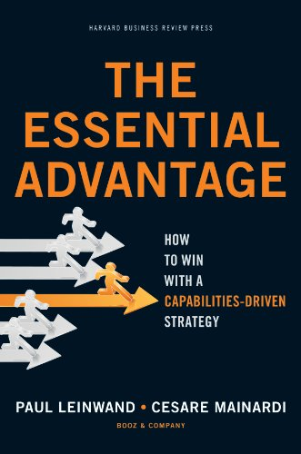
“Which strategy would give us the greatest right to win?”
Business strategy is at an evolutionary crossroads. It’s time to resolve the long-standing tension between the inherent identity of your organization and the fleeting nature of your competitive advantage.
Cesare Mainardi, managing director of Booz & Company’s.
He is coauthor, with Paul Leinwand, of The Essential Advantage: How to Win with a Capabilities-Driven Strategy
(Harvard Business Press, 2010).
STRATEGY
IS ABOUT FOCUS

Slide 49
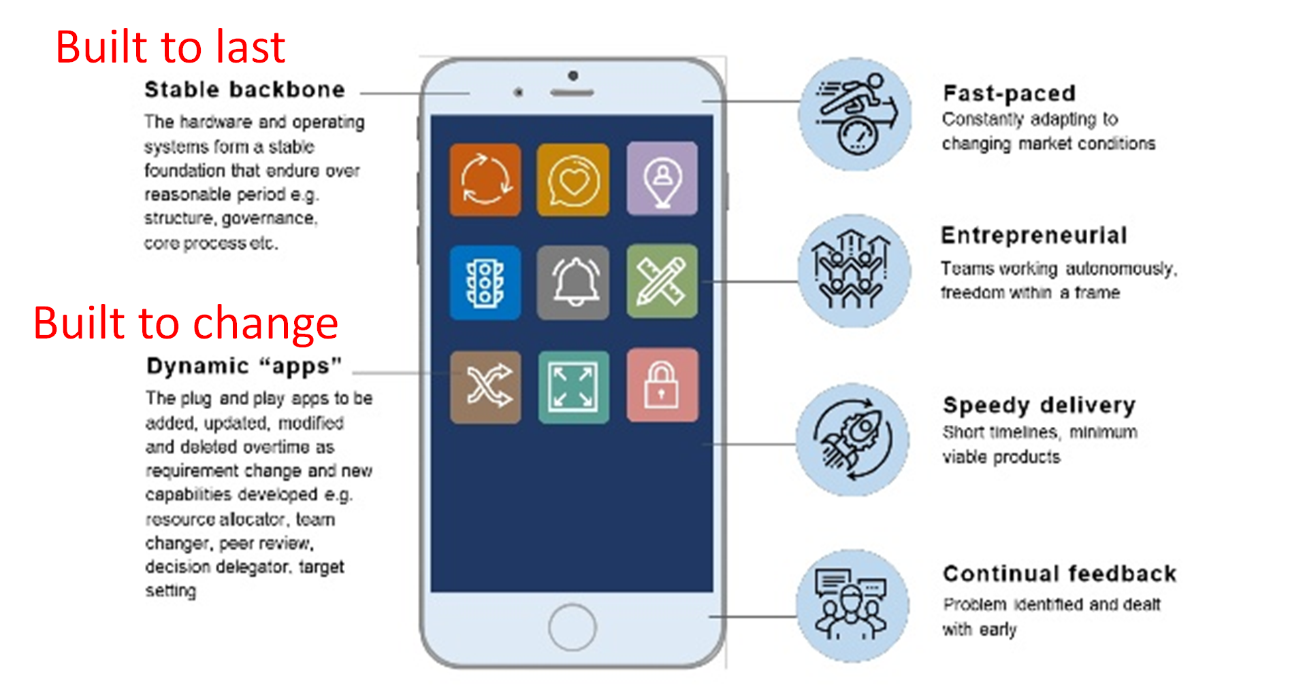
In which direction are we going?

Slide 50
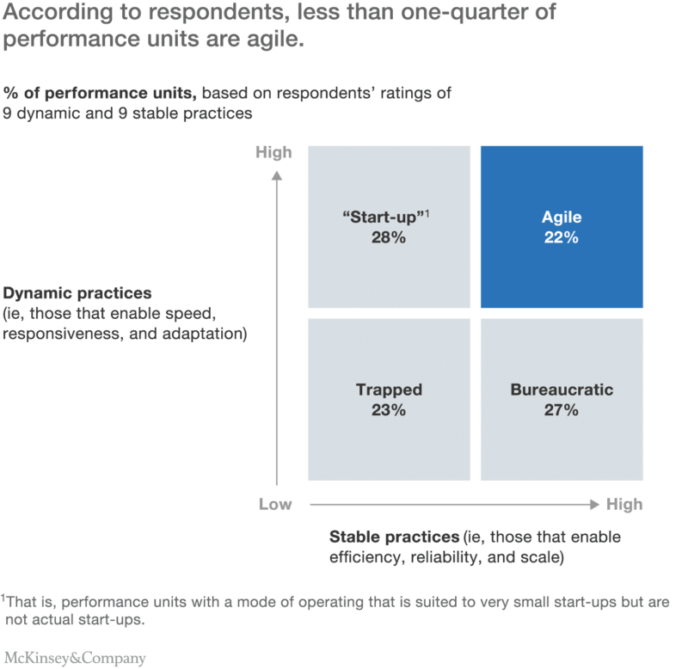
AND
SPEED
SCOPE
INNOVATION
RESPONSIVENESS
ADAPTATION
EFFICACY
STABILITY
SCALE
IDENTITY
ENDURANCE
SETTING STANDARDS
EFFICIENCY
OR
NOR

Slide 51
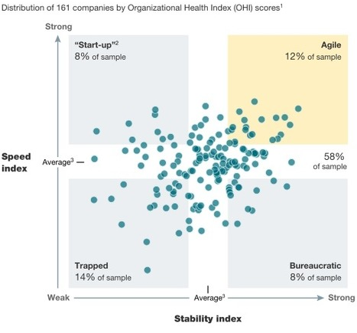
Ambidextrous
Organizations
EXPLOITING +
EXPLORING
EXPLORING
Organizations
EXPLOITING
Organizations

Slide 52
What is strategy? (definition by Hax and Majluf)
1. it is a coherent, unitary and well integrated set of decisions;
2. defines and explains the long-term objectives of the company, the lines of action to pursue them and the criteria for allocating resources;
3. select the strategic business areas in which the company must or must be present;
4. aims to achieve a sustainable competitive advantage in each of the strategic business areas, responding appropriately to the threats and opportunities - expressed by the environment - which must be coherently combined with the strengths and weaknesses of the organization;
5. Aligns, motivates and involves all hierarchical levels of the organization (top managers of the company, product and function managers, etc.);

Slide 53
Strategy and uncertainty
The time horizon of strategic decisions is medium to long.
Therefore, strategic decisions are characterized by a high degree of uncertainty, because the future is largely unpredictable.
PRESENT
FUTURE

Slide 54
Alignment
CEO
CFO
COO
CMO
CSO
CPO
SATURATION OF THE PRODUCTION CAPACITY
RELATIONSHIP
WITH THE CUSTOMERS
VOLUME
OF SALES
RETURN ON
INVESTMENTS
PEOPLE
ENGAGEMENT

Slide 55
Alignment
CEO
CFO
COO
CMO
CSO
CPO
SATURATION OF THE PRODUCTION CAPACITY
RELATIONSHIP
WITH THE CUSTOMERS
VOLUME
OF SALES
RETURN ON
INVESTMENTS
PEOPLE
ENGAGEMENT

Slide 56
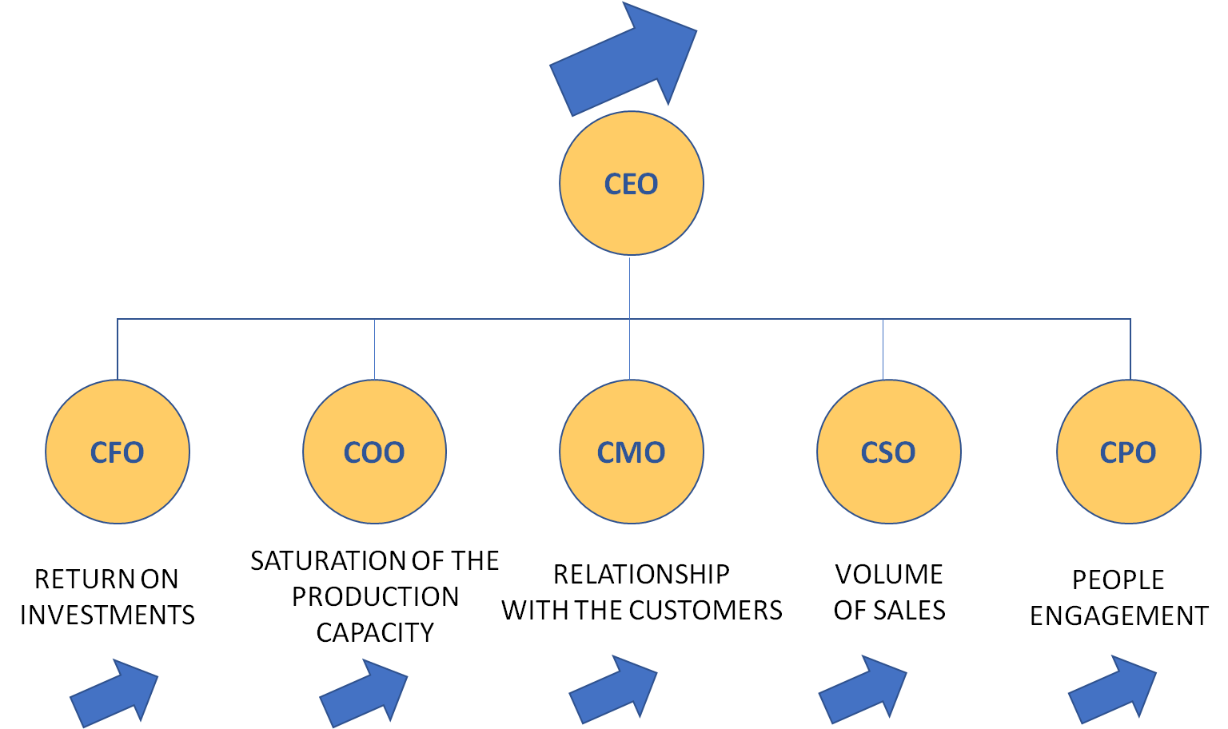
Corporate strategies
Business Strategies
Functional Strategies
In the different technical domains of the functional specializations, strategy will be "implemented" (designing structures, processes and systems) and "executed" (managing technical and managerial processes).

Slide 57
Strategic problem solving
is a circular and recursive process that raises two types of issues:
Starting from what the market wants (market needs), what are we able to design, produce and communicate better than our competitors (our resources and competences)?
Starting from what we can design, produce and communicate better than our competitors (our resources and competences), what the market might want to buy (market needs)?

Slide 58
what the market wants
WHAT IS THE MARKET DEMANDING?
WHAT ARE OUR CAPABILITIES?
what we can design, produce and communicate better than our competitors

Slide 59
Our capabilities: resources + competencies
capabilities: resources + competences
My capabilities identify what I’m able do in order to produce value for someone.
A “Capability” is the result of the presence of some “Resources” and of the “Competences” to use them in the best way.

Slide 60
The Resource Based View Approach
Identify the firm's potential key resources.
Evaluate whether these resources fulfill the following criteria (also known as VRIN criteria):
Valuable - they enable a firm to implement strategies that improve its efficiency and effectiveness.
Rare - not available to other competitors.
Imperfectly imitable - not easily implemented by others.
Non-substitutable - not able to be replaced by some other non-rare resource.
Develop, nurture and protect resources that pass these evaluations.

Slide 61
The classical definition of Resources and Capabilities
Resources
all assets, capabilities, organizational processes, firm attributes, information, knowledge, etc. controlled by a firm that enable the firm to conceive of and implement strategies that improve its efficiency and effectiveness
Capabilities
Capabilities are "a special type of resource, specifically an organizationally embedded non-transferable firm-specific resource whose purpose is to improve the productivity of the other resources possessed by the firm.

Slide 62
Core Competencies
Core competencies are related to a firm's product portfolio via core products.
Prahalad and Hamel (1990) defined core competencies as the engines for the development of core products and services.
Competencies are the roots of which the corporation grows, like a tree whose fruit are end products.

Slide 63
Core Competencies
Core products contribute "to the competitiveness of a wide range of end products.
They are the physical embodiment of core competencies.
A product (or business) portfolio should be built with respect to core competencies and vice versa.

Slide 64
Core Competencies
"a harmonized combination of multiple resources and skills that distinguish a firm in the marketplace" and therefore are the foundation of companies' competitiveness.
C. K. Prahalad and Gary Hamel.
Core competencies fulfill three criteria:
Provides potential access to a wide variety of markets.
Should make a significant contribution to the perceived customer benefits of the end product.
Difficult to imitate by competitors.

Slide 65
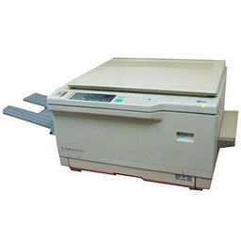
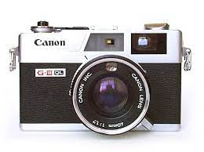
Core Competencies
For example, a company's core competencies may include precision mechanics, fine optics, and micro-electronics.
These help it build cameras, but may also be useful in making other products that require these competencies.

Slide 67
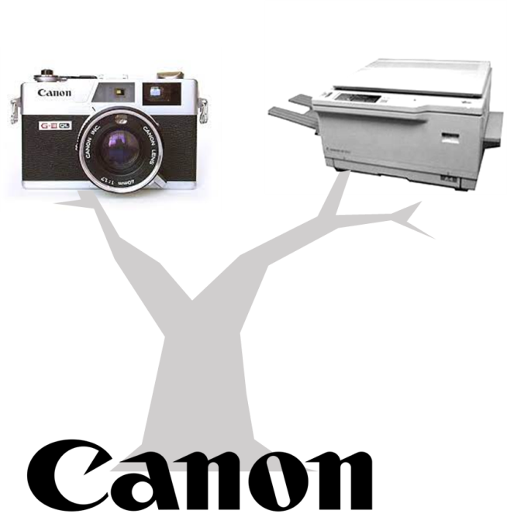

Slide 68
PRODUCT PORTFOLIO
B2C
Photography
B2B
Office
B2B
Medical
B2B-B2C
Computers
BUSINESS PORTFOLIO
Optics
B2B
Mechanics
Service

Slide 69
How to clarify Core competencies?
When you clarify competencies, your entire organization knows how to support your competitive advantage—and readily allocates resources to build cross-unit technological and production processes

Slide 70
How to assess Core competencies?
Articulate a strategic intent that defines your company and its markets
Identify core competencies that support that intent.
Ask:
How long could we dominate our business if we didn’t control this competency?
What future opportunities would we lose without it?
Does it provide access to multiple markets? (Casio’s core competence with display systems let it succeed in calculators, laptop monitors, and car dashboards.)
Do customer benefits revolve around it? (Honda’s competence with high-revving, lightweight engines offers multiple consumer benefits.)

Slide 71
How to build Core Competencies?
Once you’ve identified core competencies, enhance them: Invest in needed technologies.
Citicorp trumped rivals by adopting an operating system that leveraged its competencies—and let it participate in world markets 24 hours a day
Infuse resources throughout business units to outpace rivals in new business development.
3M and Honda won races for global brand dominance by creating wide varieties of products from their core competencies.
Results? They built image, customer loyalty, and access to distribution channels for all their businesses
Forge strategic alliances.

Slide 72
How to cultivate a core competency mindset?
Competency-savvy managers work well across organizational boundaries, willingly share resources, and think long term.
To encourage this mind-set: Stop thinking of business units as sacrosanct.
That imprisons resources in units and motivates managers to hide talent as the company pursues hot opportunities.

Slide 73
How to implement a competence based strategy?
Identify projects and people who embody the firm’s core competencies. This sends a message: Core competencies are corporate— not unit—resources, and those who embody them can be reallocated. (When Canon spotted opportunities in digital laser printers, it let managers raid other units to assemble talent.)
Gather managers to identify next-generation competencies.
Decide how much investment each needs, and how much capital and staff each division should contribute.

Slide 74
Core Capabilities
More recently Christensen introduced the concept of capabilities, which he defined as resources, processes, and priorities.

Slide 76
Resources (Christensen)

Slide 77
Processes (Christensen)

Slide 78
Priorities (Christensen)

Slide 79
What is a Capability?
https://www.youtube.com/watch?v=umGHmyXJ6qk
Watch Frito-Lay use one of its capabilities, direct store delivery, to provide a defined outcome.
By aligning a number of processes, systems and tools, skills, knowledge and behaviors, and organizational structures around direct story delivery, the company connects its firm strategy and execution to create value for customers

Slide 80
Our definitions
“Resources”; is an endowment of industrial goods, technologies, financial and human resources that are assigned to a project or a business unit.
“Competences”: is a set of knowledge (tacit or explicit) and skills
"Capabilities“: is the integrated and synergistic set of resources and competences that make us adequate for achieving critical levels of performance.

Slide 81
Dynamic Capabilities
Teece introduced the concept of dynamic capabilities, which are about changing, adapting, and learning.

Slide 82
Our capabilities: resources + competencies
“Distinctive” capabilities are those which I possess to a greater extent than potential competitors.
“Distinctive” capabilities create a "competitive advantage" because they require, by the competitors, relevant and focused efforts and investments to equip themselves with the same level of resources and competences.

Slide 83
Our capabilities: resources + competences
My resources and competences are the result of my previous experiences (learning), and they are the results of investments that I have made.
To build them, I have dedicated continuous development, maintenance and improvement activities.

Slide 84
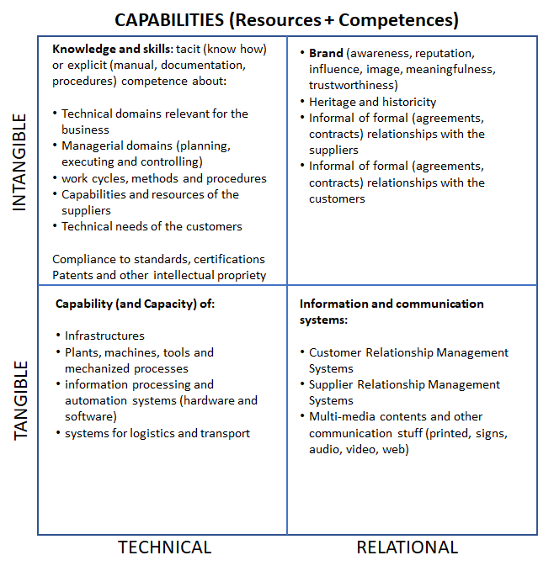
Our capabilities: resources + competences
We have two types of capabilities:
Technical capabilities
Relational capabilities
They can be based on:
Tangible assets
Intangible assets

Slide 85
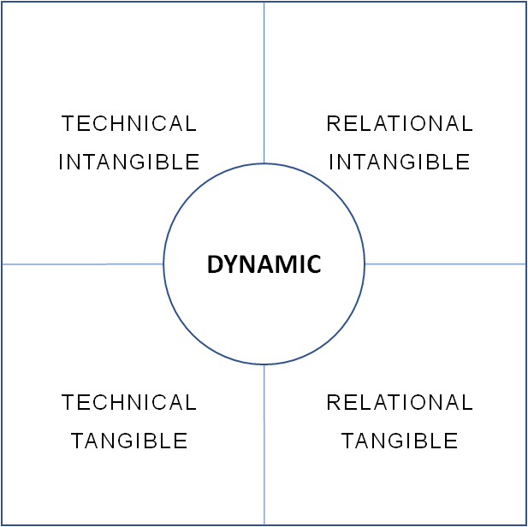
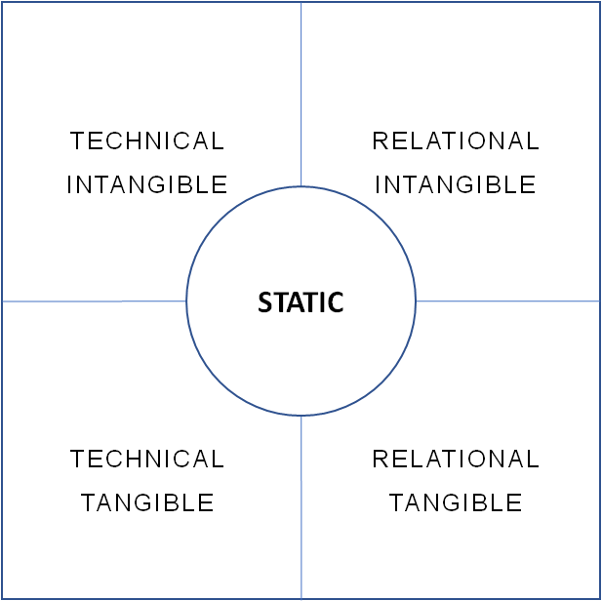
GROWING SPEED OF CHANGE

Slide 86
^{What is an “asset”?}
An asset is a resource owned by the organization from which future economic benefits are expected to flow to the organization. There are tangible assets and intangible assets.
A house that I own, that I can rent out for an income, is an example of a tangible asset.
My good reputation, that can turn into a profitable job with a good salary, is an example of an intangible asset that I own.
A good brand that I own is an intangible asset that produces value for the customer and money for me.

Slide 87
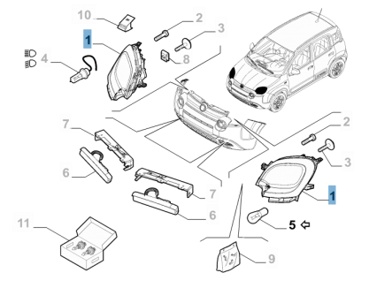
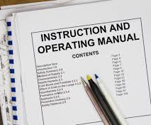
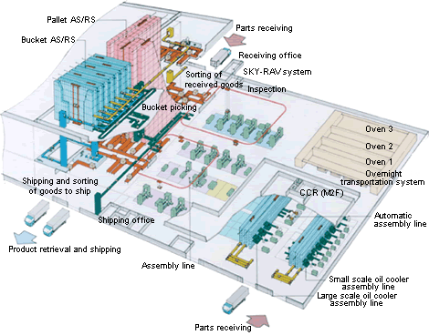
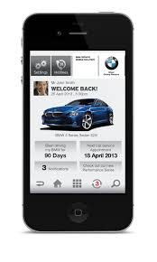
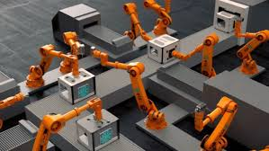
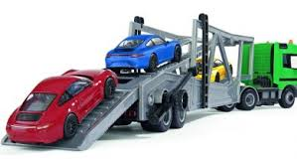
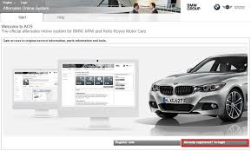

Slide 88
Technical and intangible capabilities

Slide 89
Technical and tangible capabilities

Slide 90
Relational and intangible capabilities

Slide 91
Relational and tangible capabilities

Slide 92
Some Technical Capabilities
"Capacity", which is the possibility of producing the requested quantity (volume) of products at a cost compatible with the “unit price” that the market accepts for that product;
"Elasticity", which means the ability of the company’s process to satisfy the changes in volumes required in an economically sustainable way;
"Flexibility", which means the possibility that the production processes implemented can adapt, without excessive costs, to a demand for different products (varieties). The opposite of flexibility is rigidity.

Slide 93
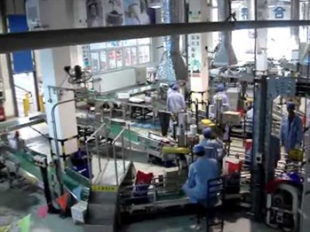
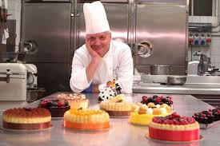
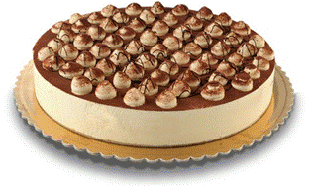
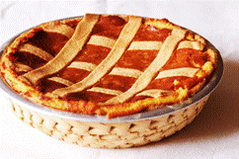
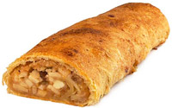
Examples of Technical Capabilities
A distinctive capability of a manufacturer in a market that demands high volumes of product at a low unit price is to have a higher capacity of its processes than that of competitors.
A distinctive capability of a manufacturer in a market that demands a large variety of differentiated products is to have greater flexibility in its processes than its competitors.

Slide 94
Examples
MARKET DEMAND
UNDERCAPACITY
Demand
is not met
PRODUCER’S CAPACITY
OVERCAPACITY
Too much production
A distinctive capability of a manufacturer in a market whose volume of demand is fluctuating over time is a higher elasticity of its processes.
Low elasticity of processes
TIME
Higher elasticity of processes
TIME

Slide 95
Questions about technical capabilities
Strategic Marketing, as well as Operations Strategy, as well as Strategic Design must be able to answer the question:
what does the market need?
Volume, standardization and low price?
Flexibility and variety of products?
Variable or seasonal supplies?

Slide 96
Distinctive Capabilities
My capabilities (resources and competences ) identify what I am capable to do
to produce value for someone.
“DISTINCTIVE” are those CAPABILITIES
which I possess to a greater extent than potential competitors.
What I’m great at!

Slide 97
Competitive Advantage
“Distinctive” capabilities (resources and competences) create a
"competitive advantage“
because they require, by the competitors, relevant and focused efforts and investments to equip themselves with the same level of resources and competences.
COMPETITIVE ADVANTAGE

Slide 98
Competitive Advantage
Distinctive Cababilities + Great Strategy = Competitive Advantage
COMPETITIVE ADVANTAGE

Slide 99
Alignment of operations and strategy
Different kind of processes
Discontinuous processes
of single, unique, tailored, outputs
Variety of possible outputs
Flexibility of process
Small quantity of outputs
NO
PROCESSS
HERE!
Process flows
Uniformity of outputs
Rigidiy of processe
Large quantity of outputs
Continuous rigid flow of production of many identical outputs
NO
PROCESSS
HERE!
Discontinuity of flow
Continuity of flow

Slide 100
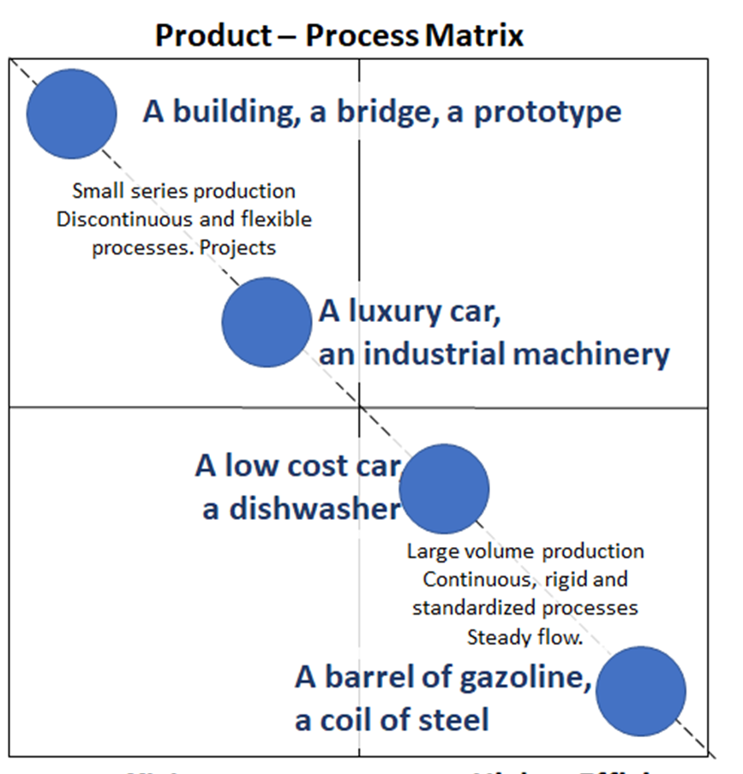
Operations Strategy decisions about volume and flexibility of processes
The "products-processes" matrix shows the different types of production according to the needs of the market and the differentiation strategies of the companies.

Slide 101
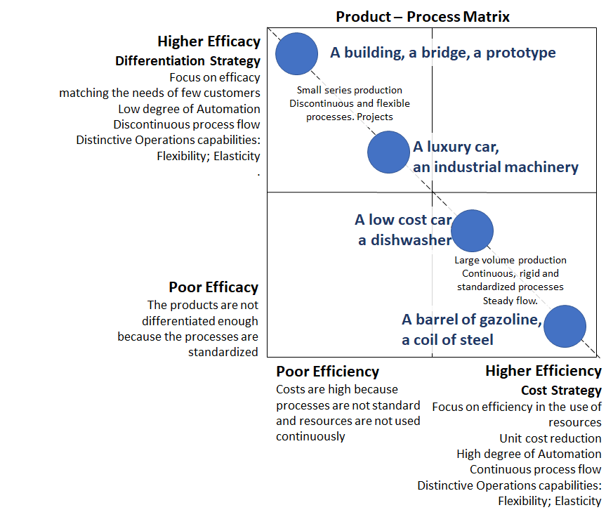

Slide 102
Internal and external focus for the formulation of the strategy

Slide 103
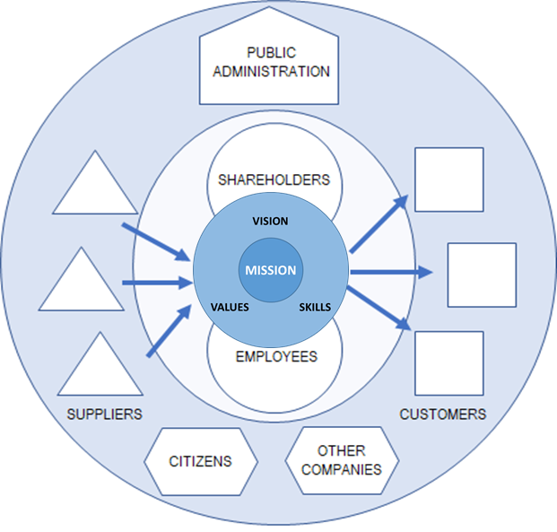

Slide 104
Decisions about how to grow
Why to grow?
Growth offers the company, in addition to the increase in profits, several other advantages. Above all the following three.
The first and most important advantage derives from the greater efficiency due to the economy of scale: the incidence of fixed costs on the cost of the product tends to decrease as the volumes produced grow. Greater efficiency means greater profit.
The second reason that encourages growth is the possibility of seeing both prestige and bargaining power increase in all the ratios that the company maintains with the supply and sales markets.
The third reason is that some functions, such as research and development, in which profits are invested, represent a percentage share of the turnover. With the same percentage of investment in research and development, the largest company will invest more in absolute value. So it will have a critical mass of investment to generate more innovation.

Slide 105
Decisions about how to grow
How to grow?
We can increase the number of customers who buy our products.
We can sell new kind of products to our traditional customers.
We can sell the traditional kind of products to new kind of customers.
We can sell new kind of products to new kind of customers.

Slide 106
Analyze the present situation:
Outside (risks and opportunities)
Inside (strong and weak capabilities)
Find your basic “way to play” among:
Differentiation
Cost leadership
Product range
THE FABULOUS FOUR FRAMEWORKS
Analyze the attractiveness of the industry by assessing:
the strength of competitive threats
the opportunities related to capabilities based barriers
Analyze your growth opportunities based on your own capabilities:
market diversification
product diversification
market and product diversification

Slide 107
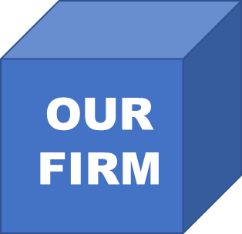

Slide 108
OUR INDUSTRY
CUSTOMERS
SUPPLIERS
COMPETITORS

Slide 109
ECONOMY
ENVIRONMENT
DEMOGRAPHY
OTHER
INDUSTRIES
RULES AND LAWS
POLITICS
CULTURE
TECHNOLOGY

Slide 110
Michael Porter’s Generic Strategies Framework
Find your basic “way to play” among:
Differentiation
Cost leadership
Product range

Slide 111
The SWOT Analisys
also known as
«Situational Analisys»
Analyze the present situation:
Outside (risks and opportunities)
Inside (strong and weak capabilities)
Albert S. Humphrey

Slide 112
Michael Porter’s 5 Forces Framework
Analyze the attractiveness of the industry by assessing:
the strength of competitive threats
the opportunities related to capabilities based barriers

Slide 113
Igor Ansoff’s Growth Framework
Analyze your growth opportunities based on your own capabilities:
market diversification
product diversification
market and product diversification

Slide 116
What is a Capability?
https://www.youtube.com/watch?v=umGHmyXJ6qk
Watch Frito-Lay use one of its capabilities, direct store delivery, to provide a defined outcome.
By aligning a number of processes, systems and tools, skills, knowledge and behaviors, and organizational structures around direct story delivery, the company connects its firm strategy and execution to create value for customers

Slide 117
What is a capabilities system?
https://www.youtube.com/watch?v=K5VLW4XXRVo
For capabilities to deploy their full potential, they need to work in a reinforcing system. Watch how Frito-Lay combines three of its differentiating capabilities — direct-store delivery, continuous innovation of new products, and consumer marketing — into a successful system.

Slide 118
How does capabilities coherence create value?
https://www.youtube.com/watch?v=-wIWs0Yuf5c
Watch how companies succeed by mutually reinforcing the alignment of a deliberate way to play, a supportive capabilities system, and a relevant portfolio of products and services.

Slide 120
Way to Play
Right To
Win
Capabilties
System
Product &
Service Fit

Slide 121
STRATEGY
IS ABOUT
FOCUS
Attention of leaders focused on the essential aspects of a problem
in problem finding
in problem framing
in problem solving
Way to Play
Way to Play
Right To
Win
Right To
Win
Capabilties
System
Product &
Service Fit
Capabilties
System
Product &
Service Fit
LESS FOCUSED AND COHERENT STRATEGY
MORE FOCUSED AND COHERENT STRATEGY

Slide 127
127

Slide 128
Right to win
A right to win is the ability to engage in any competitive market with a better-than-even chance of success — not just in the short term, but consistently.

Slide 129
“You have the right to win out there.”

Slide 130
“You are the right player, in the right type of contest, with the precise capabilities needed to meet this particular challenge.”

Slide 131
Of course, the contestant will lose at times, but over the years, a consistent innate advantage will establish itself, giving this contestant the ability to win.
This essential advantage is particularly rare in business — a more free-form and unpredictable game than sports.
But it is increasingly important at a time of unprecedented competitiveness.

Slide 132
Right to win
No company has this kind of assurance handed to it.
The right to win cannot be taken for granted.
It must be earned.
You earn it by making a series of pragmatic choices that align your most distinctive and important capabilities with the way you approach your chosen customers, and with the discipline to offer only the products and services that fit.
We call this approach a capabilities-driven strategy
Only high levels of coherence — among market strategy, capabilities systems, and a company’s portfolio of offerings — can give any firm the right to win.

Slide 133
Does your strategy give you a right to win?
https://www.strategyand.pwc.com/gx/en/unique-solutions/capabilities-driven-strategy.html
In these rapidly-changing times, and with constant pressure to compete, it’s easy for business leaders to overlook a basic principle:
Build from your strengths. When you understand what you’re great at, and design your capabilities and strategy accordingly, you can define how you want to compete, and shape your own future. See how an unconventional speed-skating champion has an important lesson for business leaders.
https://www.youtube.com/watch?v=ik3dZB7_zAg&t=97s

Slide 134
Gain sustainable advantage using a capabilities-driven strategy
We know why strategies fail:
They fail when companies don’t give sufficient attention and weight to their differentiating capabilities and how these capabilities should fit together to form a mutually reinforcing system.
Because this blind spot is so common in corporate strategy, the rewards are all the more immense for companies that manage to align their key capabilities.

Slide 135
Gain sustainable advantage using a capabilities-driven strategy
Only a coherent company — one that pursues a clear strategic direction, builds a system of differentiating capabilities consistent with that direction, and sells products and services that thrive within that system — can reliably and sustainably outpace competitors.

Slide 136
Is your company disciplined enough to focus intensely on what it does best?
Sustainable, superior returns accrue to companies that focus on what they do best.
The truth is that simple, and yet it’s incredibly hard to internalize.
It is the rare company indeed that focuses on “what we do better than anyone” in making every operating decision across every business unit and product line.
Rarer still is the company that has aligned its differentiating internal capabilities with the right external market position. We call such companies “coherent.”

Slide 137
Is your company disciplined enough to focus intensely on what it does best?
We’re not suggesting that companies disregard market signals; all strategy is set within that vital context.
We are suggesting, however, that companies start from the opposite direction, figuring out what they’re really good at and then developing those capabilities (three to six at most) until they’re best-in-class and interlocking.
From there, strategy becomes a matter of aligning that distinctive capabilities system with the right marketplace opportunities — and the market rewards them with outsize returns. We call this the “coherence premium,” and we’ve measured it.

Slide 138
Way to play
A company’s “way to play” is an approach to creating value for its customers. A well-defined way to play is broad enough to allow flexibility and growth, but narrow enough to focus strategy and decision making.
It may involve being an innovator, a value player, or an experience provider. More than any other single factor, the way to play distinguishes a company from its competitors.
Example: Walmart, the largest retail chain in the world, has taken its leading position with a precise and inspiring way to play: being a big-box provider of everything from groceries to electronics to houseplants at “everyday low prices,” without special sales or discounts.

Slide 140
Capabilities System
A company’s primary source of advantage is a system of three to six mutually reinforcing capabilities that together allow it to fulfill its way to play. A capability is a key strength of your business that customers value and competitors can’t beat. It’s not a generic activity, but a specific intersection of people, knowledge, IT, tools, and processes where your organization consistently out-performs competitors and that delivers a central aspect of your way to play.
Example: Walmart’s capabilities system includes:
Efficient supply chain management, aggressive vendor management, expert point-of-sale data analytics, superior logistics, and working-capital management
Mastery of real estate selection and acquisition
Sophisticated retail conception and design

Slide 141
Product and Service fit
Most companies make the mistake of composing product and service portfolios based on short-term financial performance and shoehorn a strategy to fit around that portfolio, rather than create a portfolio that aligns with their strategy.
Example: Walmart knows the importance of aligning every product and service it sells with its way to play. Walmart does not sell big-ticket items like large furniture and appliances, where it has no cost advantage.

Slide 142
Right to win
A company’s right to win means its ability to compete in a particular area with the confidence to succeed and create value. It belongs to coherent companies, those that focus on what they do best in making every decision across every business and that align their way to play with their capabilities system and their product and service fit.
Example: Walmart has a well-defined way to play: an unbeatable system of capabilities that reinforce one another, and a portfolio of products and services that thrive within that system.
.

Slide 148
Case study
STATIC
CAPABILITIES
SYSTEM
PRODUCT
FIT
WAY
TO PLAY
RIGHT
TO WIN

Slide 149
TODAY WE ARE GOING TO DECIDE
OPTION A
OPTION B
OPTION C
OPTION D
OPTION E
OPTION F

Slide 150
MASTER MEIM 2021-2022
Thank you!
More questions?

