Slide 1
MASTER MEIM 2021-2022
ANALYSING AND INTERPRETING FINANCIAL STATEMENTS
RATIO ANALYSIS
Prof. Mariano D’Amore
Full Professor of Economia aziendale, Parthenope University of Naples

Slide 2
Syllabus
Notion and usefulness of ratio analysis
A look at international financial statements
Dimensions of a business’s financial health and related financial ratios
Study cases: Calculation of financial ratios and discussion of conclusions
Limitations of ratio analysis

Slide 3
Financial ratios
Relate one figure appearing in the financial statements to
another figure appearing there (i.e. operating profit in relation to sales revenue)
non-financial resources of the business (i.e. operating profit per employee)
Remarks
No generally accepted list of ratios
No standard method of calculation for many ratios
Measure relative financial position and performance

Slide 4
Usefulness of ratio analysis
Multiple ratios analysis support assessment of the financial health of the business
Aid to understanding what the financial statements mean
Enable comparison of the financial position and performance of different businesses by eliminating differences in scale of operations
Individual ratios can be tracked to detect trends (i.e. by plotting them on a graph)
Ratios analysis can be used to detect signs of overtrading (i.e. insufficient finance to fund the level of trade receivables and inventories needed to support a certain level of sales revenue)
Ratios can be used to predict financial failure
(univariate analysis uses a single ratio at a time in an attempt to predict financial failure whereas multiple discriminate analysis combines various ratios within a model, i.e. Z-score models)

Slide 5
Statements of financial position (balance sheets) as at 31 March
Alexis plc operates a wholesale carpet business

Slide 6
Current/non current assets (IAS 1)
Par. 66 An entity shall classify an asset as current when:
(a) it expects to realise the asset, or intends to sell or consume it, in its normal operating cycle;
(b) it holds the asset primarily for the purpose of trading;
(c) it expects to realise the asset within twelve months after the reporting period; or
(d) the asset is cash or a cash equivalent (as defined in IAS 7) unless the asset is restricted from being exchanged or used to settle a liability for at least twelve months after the reporting period.
An entity shall classify all other assets as non-current.
Par 68 The operating cycle of an entity is the time between the acquisition of assets for processing and their realisation in cash or cash equivalents. When the entity’s normal operating cycle is not clearly identifiable, it is assumed to be twelve months. Current assets include assets (such as inventories and trade receivables) that are sold, consumed or realised as part of the normal operating cycle even when they are not expected to be realised within twelve months after the reporting period. Current assets also include assets held primarily for the purpose of trading (examples include some financial assets that meet the definition of held for trading in IFRS 9) and the current portion of non-current financial assets.

Slide 7
Current/non current liabilities (IAS 1)
Par. 69 An entity shall classify a liability as current when:
(a) it expects to settle the liability in its normal operating cycle;
(b) it holds the liability primarily for the purpose of trading;
(c) the liability is due to be settled within twelve months after the reporting period; or
(d) it does not have the right at the end of the reporting period to defer settlement of the liability for at least twelve months after the reporting period.
An entity shall classify all other liabilities as non-current
Par 70 Some current liabilities, such as trade payables and some accruals for employee and other operating costs, are part of the working capital used in the entity’s normal operating cycle. An entity classifies such operating items as current liabilities even if they are due to be settled more than twelve months after the reporting period. The same normal operating cycle applies to the classification of an entity’s assets and liabilities. When the entity’s normal operating cycle is not clearly identifiable, it is assumed to be twelve months.

Slide 8
Current/non current liabilities (IAS 1)
Par. 71 Other current liabilities are not settled as part of the normal operating cycle, but are due for settlement within twelve months after the reporting period or held primarily for the purpose of trading. Examples are some financial liabilities that meet the definition of held for trading in IFRS 9, bank overdrafts, and the current portion of non-current financial liabilities, dividends payable, income taxes and other non-trade payables. Financial liabilities that provide financing on a long-term basis (i.e. are not part of the working capital used in the entity’s normal operating cycle) and are not due for settlement within twelve months after the reporting period are non- current liabilities, subject to paragraphs 74 and 75.

Slide 9
Income statements for the year ended 31 March

Slide 10
Statement of cash flows for the year ended 31 March

Slide 11
Notes
The market value of the shares of the business at the end of the reporting period was £2.50 for 2018 and £1.50 for 2019.
All sales and purchases are made on credit.
The cost of sales figure can be analysed as follows:
At 31 March 2017, the trade receivables stood at £223 million and trade payables at £183 million.
A dividend of £40 million had been paid to the shareholders in respect of each of the years.
The business employed 13,995 staff at 31 March 2018 and 18,623 at 31 March 2019.
The business expanded its capacity during the year to 31 March 2019 by setting up a new warehouse and distribution centre.
At 1 April 2017, the total of equity stood at £438 million and the total of equity and non-current liabilities stood at £638 million.

Slide 12
Key dimensions of financial health (1)
Profitability
Financial
ratios
Investment
(Market)
A&Ls turnover
(Efficiency)
Liquidity
Financial
gearing

Slide 13
Key dimensions of financial health (2)
Dimensions of financial health | Concerned with
Profitability | Effectiveness at generating profit
A&Ls turnover (Efficiency) | Efficiency of using assets/resources
Liquidity | Ability to meet short-term obligations
Financial gearing | Relationship between equity and debt financing
Investment (Market) | Returns to shareholders
Concerned with effectiveness at generating profit

Slide 14
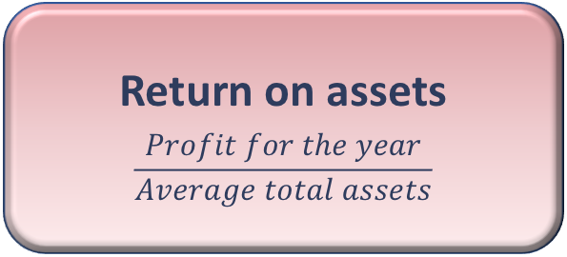
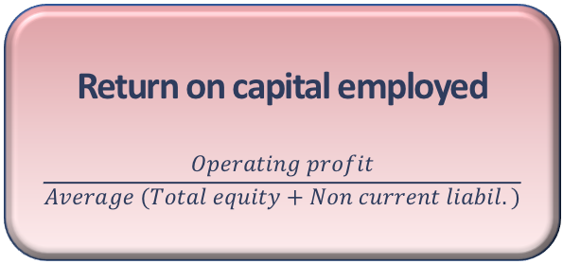
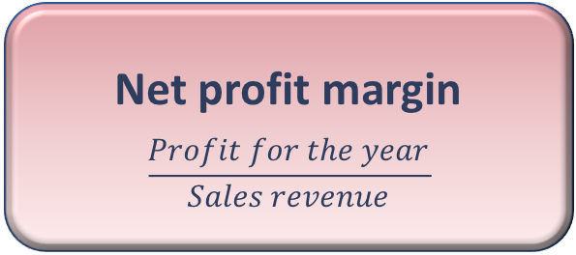
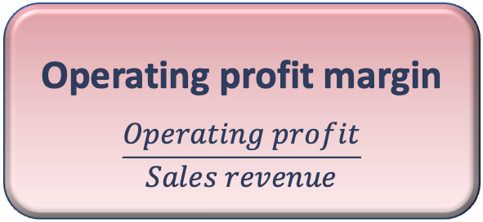
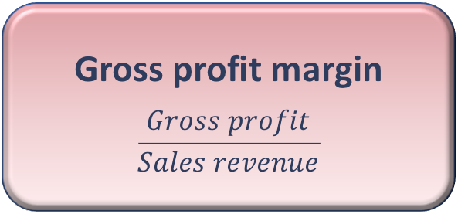
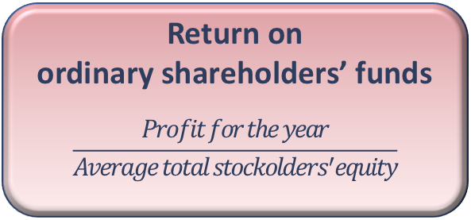
Profitability ratios
Return on capital employed
$$\frac{Operating profit}{Average (Total equity+Non current liabil.)}$$
Net profit margin
$$\frac{Profit for the year}{Sales revenue}$$
Return on assets
$$\frac{Profit for the year}{Average total assets}$$
Profitability
ratios
Operating profit margin
$$\frac{Operating profit}{Sales revenue}$$
Return on
ordinary shareholders’ funds
$$\frac{Profit for the year}{Average total stockolders^{′}equity}$$
Gross profit margin
$$\frac{Gross profit}{Sales revenue}$$

Slide 15
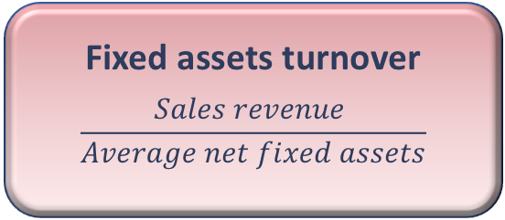
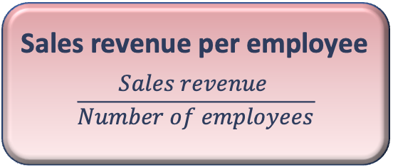
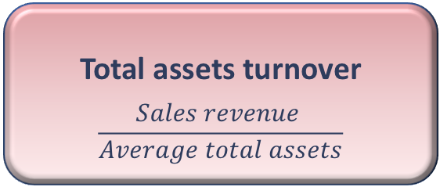
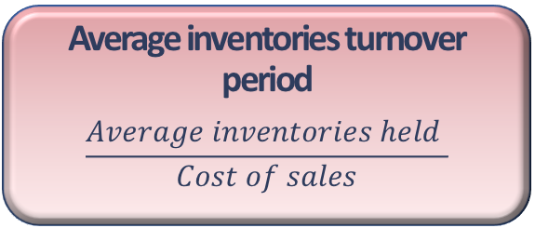
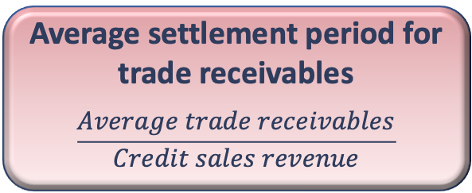
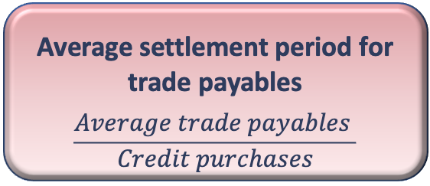
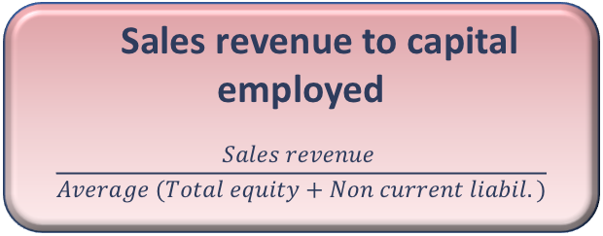
A&Ls turnover ratios
Fixed assets turnover
$$\frac{Sales revenue }{Average net fixed assets}$$
Sales revenue per employee
$$\frac{Sales revenue }{Number of employees}$$
Average inventories turnover period
$$\frac{Average inventories held }{Cost of sales}$$
Efficiency
ratios
Sales revenue to capital employed
$$\frac{Sales revenue }{Average (Total equity+Non current liabil.)}$$
Average settlement period for trade receivables
$$\frac{Average trade receivables}{Credit sales revenue}$$
Total assets turnover
$$\frac{Sales revenue }{Average total assets}$$
Average settlement period for trade payables
$$\frac{Average trade payables }{Credit purchases}$$

Slide 16

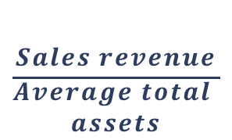


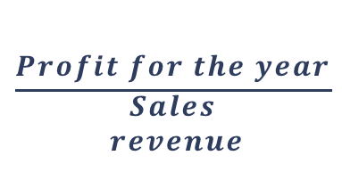

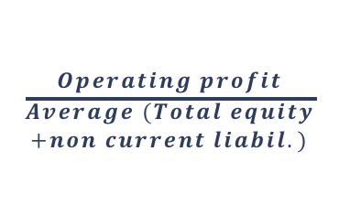

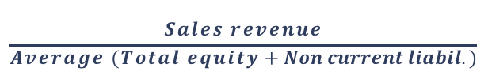
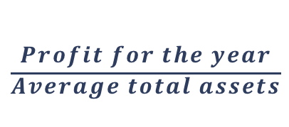
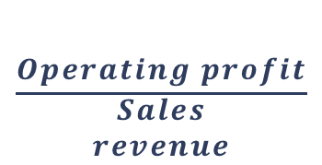
Profit driver analysis
ROA
Net profit
margin
Total asset
turnover
$$=$$
$$×$$
$$\frac{Profit for the year}{\begin{aligned}Average total assets \\ \end{aligned}}$$
$$\frac{Profit for the year}{\begin{aligned}Sales \\ revenue\end{aligned}}$$
$$\frac{Sales revenue}{\begin{aligned}Average total \\ assets\end{aligned}}$$
$$=$$
$$×$$
ROCE
Operating profit
margin
Sales revenue to capital employed
$$=$$
$$×$$
$$\frac{Operating profit}{\begin{aligned}Average (Total equity \\ +non current liabil.) \\ \\ \end{aligned}}$$
$$\frac{Operating profit}{\begin{aligned}Sales \\ revenue\end{aligned}}$$
$$=$$
$$×$$
$$\frac{Sales revenue}{Average (Total equity+Non current liabil.)}$$

Slide 17
Activity
Show how the ROCE ratio for the Alexis plc can be analysed into the two elements for each of the years 2018 and 2019, and draw conclusions from your figures

Slide 18
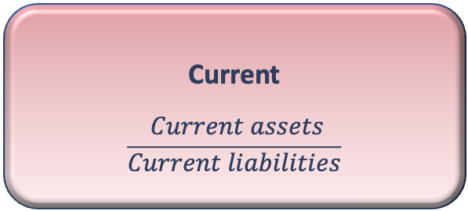
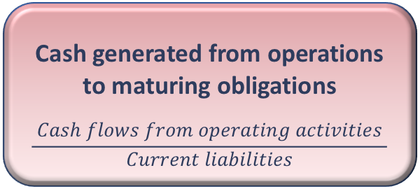
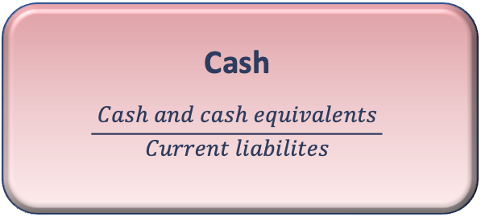
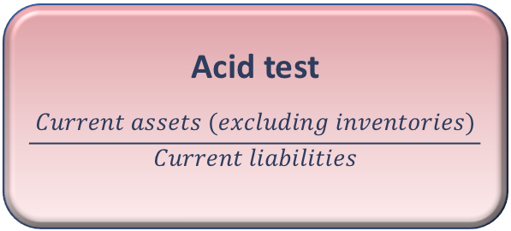
Liquidity ratios
Current
$$\frac{ Current assets}{Current liabilities}$$
Liquidity
ratios
Acid test
$$\frac{ Current assets (excluding inventories) }{Current liabilities}$$
Cash generated from operations to maturing obligations
$$\frac{ Cash flows from operating activities }{Current liabilities}$$
Cash
$$\frac{ Cash and cash equivalents }{Current liabilites}$$

Slide 19
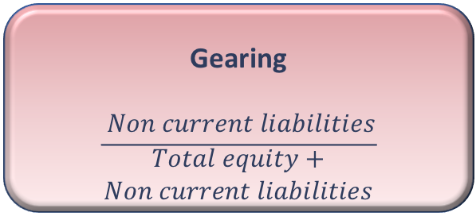
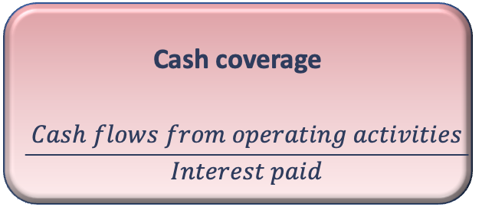
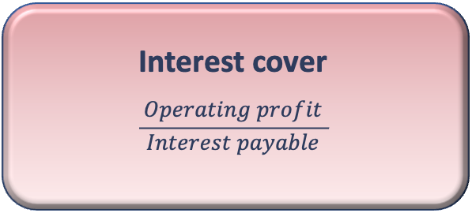
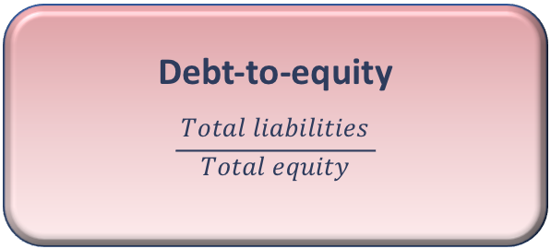
Gearing ratios
Gearing
$$\frac{ Non current liabilities}{\begin{aligned}Total equity+ \\ Non current liabilities\end{aligned}}$$
Gearing ratios
Debt-to-equity
$$\frac{ Total liabilities }{Total equity}$$
Cash coverage
$$\frac{ Cash flows from operating activities }{Interest paid}$$
Interest cover
$$\frac{ Operating profit }{Interest payable}$$

Slide 20
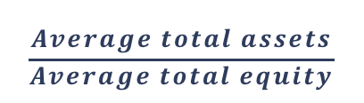

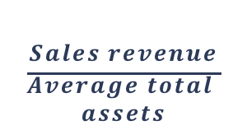

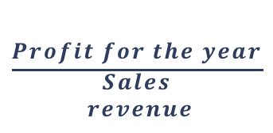
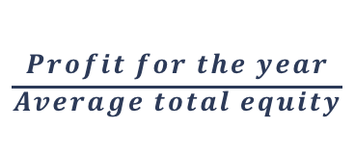



Dupont Model
ROE
Net Profit
Margin
Total Asset
Turnover
Financial
Leverage
$$=$$
$$×$$
$$×$$
$$\frac{Profit for the year}{\begin{aligned}Average total equity \\ \end{aligned}}$$
$$\frac{Profit for the year}{\begin{aligned}Sales \\ revenue\end{aligned}}$$
$$\frac{Sales revenue}{\begin{aligned}Average total \\ assets\end{aligned}}$$
$$=$$
$$×$$
$$×$$
$$\frac{Average total assets}{Average total equity}$$

Slide 21
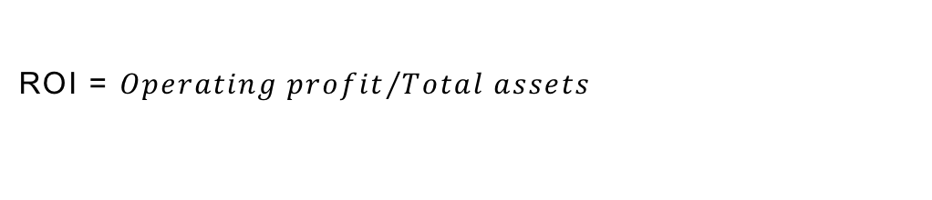
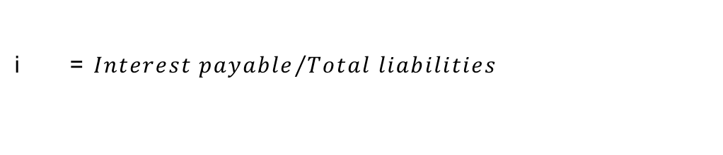
Leverage equation
$ROE= \left[ROI+\frac{Total liabilities}{Total equity}\left(ROI −i\right)\right]$ (1-t)
ROI = ${Operating profit}/{Total assets}$
i = ${Interest payable}/{Total liabilities}$
t = $Tax rate$

Slide 22
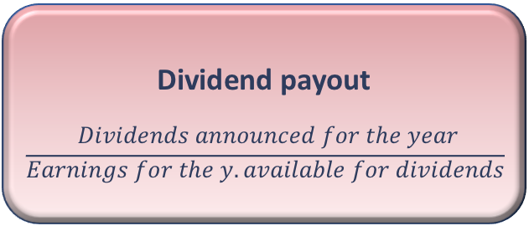
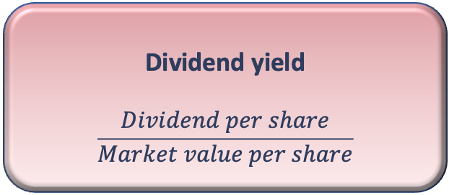
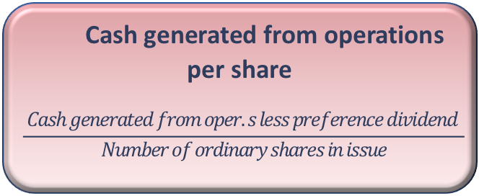
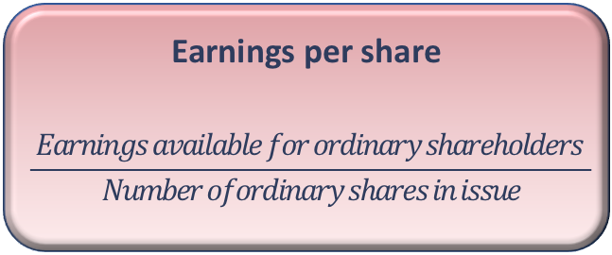
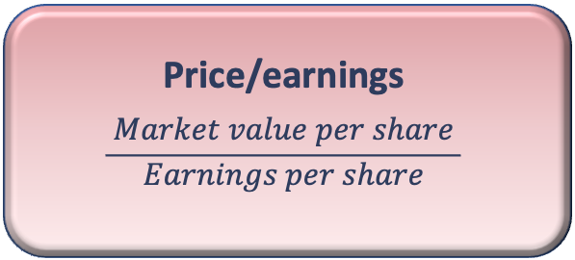
Investment (market) ratios
Dividend payout
$$\frac{ Dividends announced for the year}{Earnings for the y. available for dividends}$$
Investment ratios
Price/earnings
$$\frac{ Market value per share }{Earnings per share}$$
Dividend yield
$$\frac{ Dividend per share }{Market value per share}$$
Earnings per share
$$\frac{ Earnings available for ordinary shareholders }{Number ofordinary shares in issue}$$
Cash generated from operations per share
$$\frac{ Cash generated from oper.s less preference dividend }{Number of ordinary shares in issue}$$

Slide 23
Statements of financial position as at 30 June 2019
Both Ali plc and Bhaksar plc operate wholesale electrical stores throughout the UK.
The financial statements of each business for the year ended 30 June 2019 are as follows:

Slide 24
Income statements for the year ended 30 June 2019

Slide 25
Notes
The market values of a share in Ali plc and Bhaskar plc at the end of the year were £6.50 and £8.20, respectively.
All sales and purchases were made on credit.
Required
For each business, calculate two ratios that are concerned with each of the following aspects:
Profitability
Efficiency
Liquidity
Gearing
Investment
Provide your conclusions from the ratios you have calculated.

Slide 26
Limitations of ratio analysis
Ratios are only as reliable as the financial statements from which they derive
Inflation can distort the information
Inexact science - results must be interpreted cautiously
Ratios give a restricted view
‘Snapshot' nature of the statement of financial position, and ratios derived from there
Need for an overview of the financial reports to provide insights that may not be revealed by ratios and/or may help in their interpretation
Performance for past periods, similar businesses and/or planned performance to be used as benchmark (it can be difficult to find a suitable benchmark to compare with)
Starting point for further analysis of the factors affecting financial health

Slide 27
References:
McLaney, E., Atrill, P., Accounting and Finance. An Introduction, 10th edition, Pearson, 2020, Chapter 7
Ughetto, E., Accounting and Corporate Finance, McGraw-Hill Education Create, 2020, Chapter 9
Thanks for attention!
mariano.damore@uniparthenope.it

