Slide 1
MASTER MEIM 2021-2022
Use Case:
High-Performance Computing on the Cloud
High Performance Cloud Computing and Cloud Native: Proposing a new paradigm for marine environmental modelling.
Prof. Raffaele Montella - raffaele.montella@uniparthenope.it http://raffaelemontella.it
Associate Professor of Computer Science

Slide 2

Native Cloud Computing
Is an approach in software development that utilizes cloud computing to build and run scalable applications in modern, dynamic environments such as public, private, and hybrid clouds.
Involved technologies: containers, microservices, serverless functions, and immutable infrastructure.
Cloud Native applications are deployed via declarative code.
Loosely coupled systems: resilient, manageable, observable, scalable.
Cloud Native Computing Foundation https://github.com/cncf
Any chance to leverage those approaches to design a new paradigm for malleable and democratically deployable HPC applications?

Slide 3
The (expected) twofold advantages
Developing and optimizing WaComM++
(Lagrangian inert tracers transport & diffusion heterogeneously hierarchical parallel model):
  High Performance Computing (HPC)
  GPU and multiGPU
  High Performance Cloud Computing (HPCC)
New paradigm High Performance Cloud Native Computing (HPCNC)
This work is a contribution to the MytilAI research project (CUP I65F21000040002). It was supported by the H2020 EuroHPC project "Adaptive multi-tier intelligent data manager for Exascale (ADMIRE)" (CUP I25F20000250002).
We thank Amazon AWS HPC Europe for the generous support with the grant PS_R_FY2021_Q4_Napoli_1500.

Slide 4
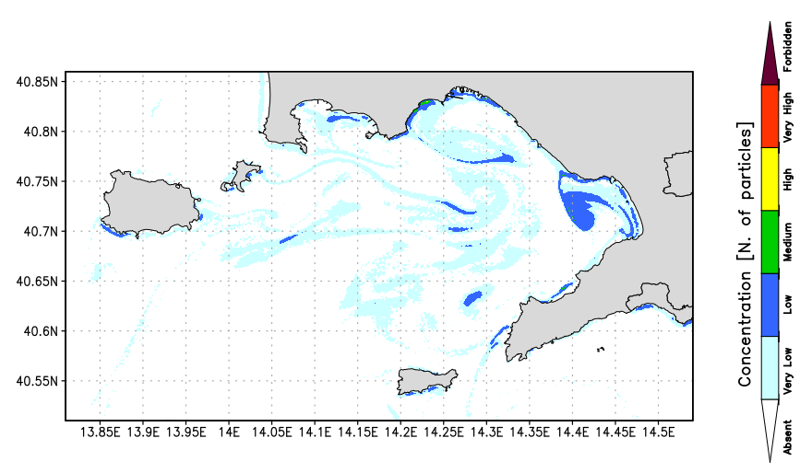
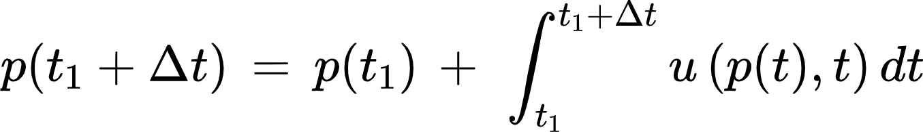
WaComM++: Water quality Community Model
Lagrangian model for the transport and
diffusion of passive tracers.
Hierarchical and Heterogenic parallelization.
Restart particles and Sources.
Different and numerous applications.
(pollutant concentration, search and rescue, ...)
C++ 17 Language
Transport and diffusion Lagrangian model

Slide 5
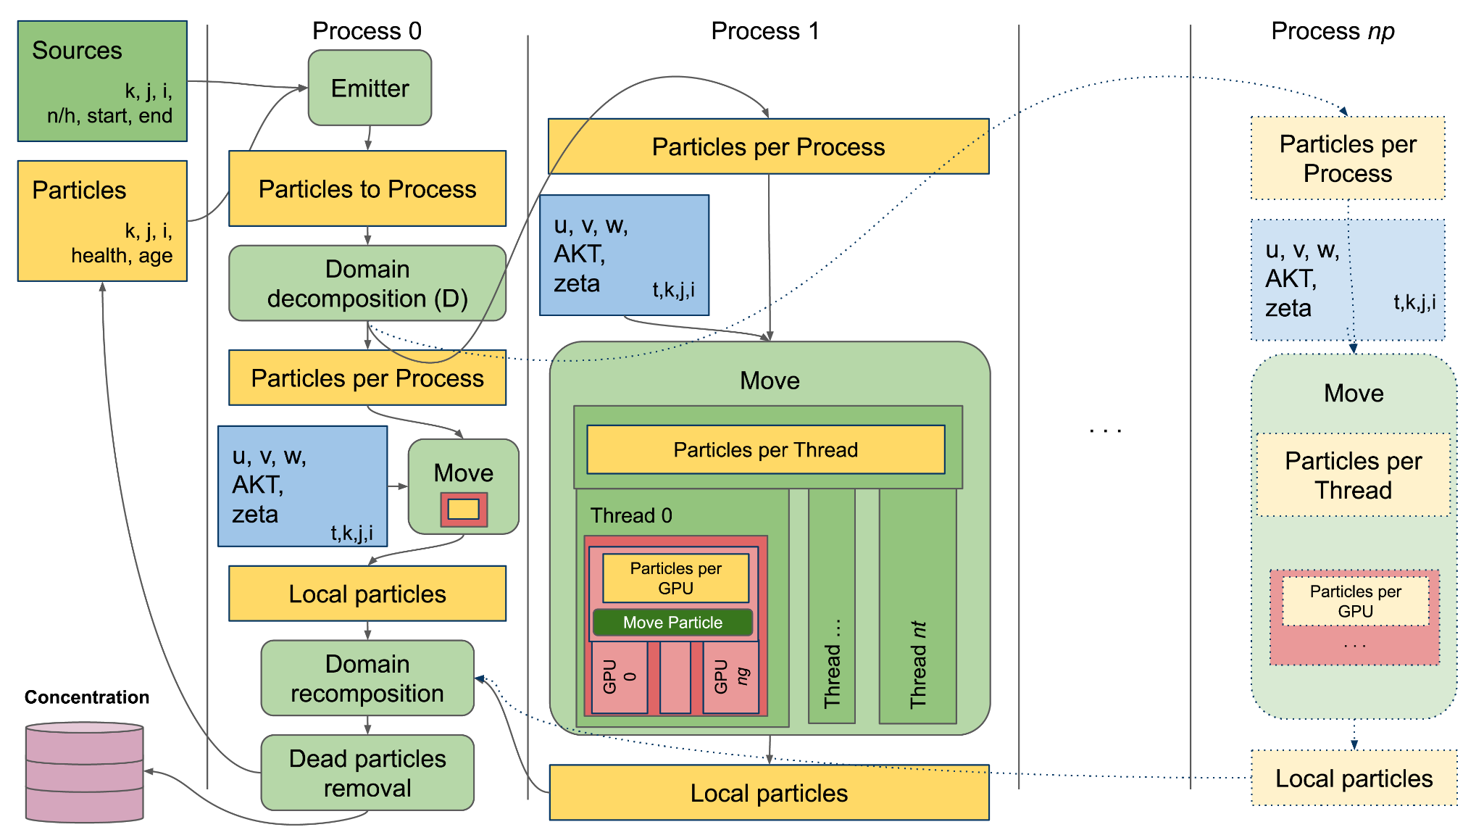
High-Performance Parallelization Schema

Slide 6
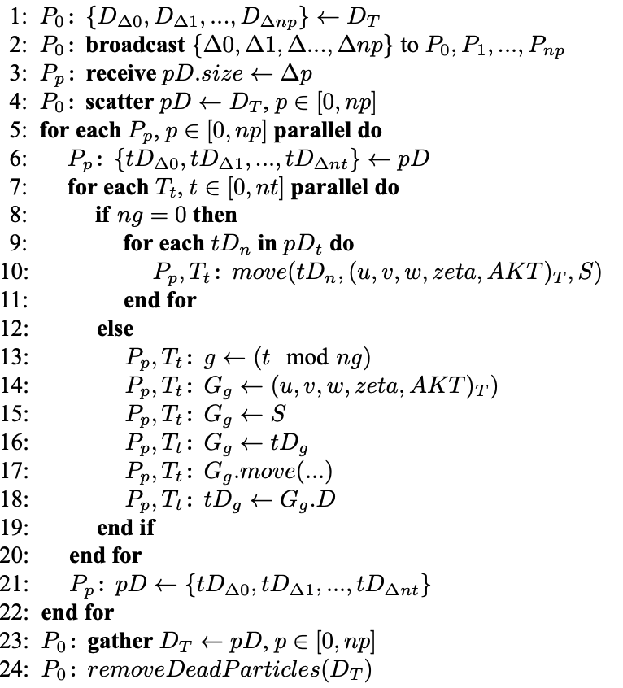
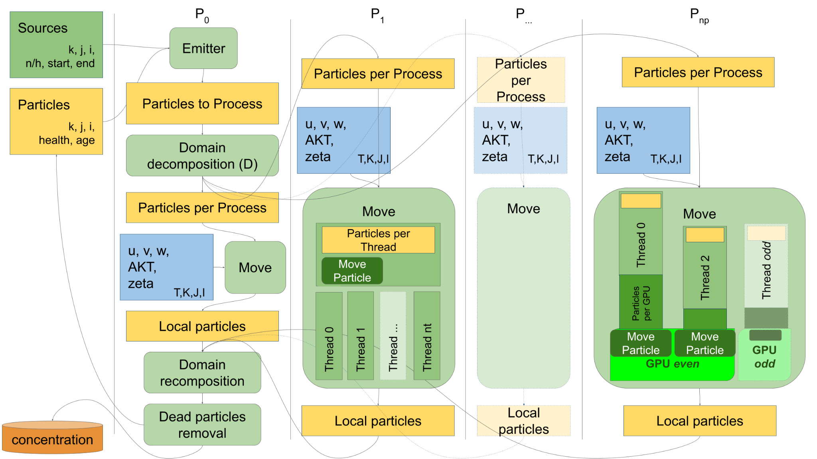
Parallel Algorithm Steps 1/4

Slide 7
Parallel Algorithm Steps 2/4

Slide 8
Parallel Algorithm Steps 3/4

Slide 9
Parallel Algorithm Steps 4/4

Slide 10
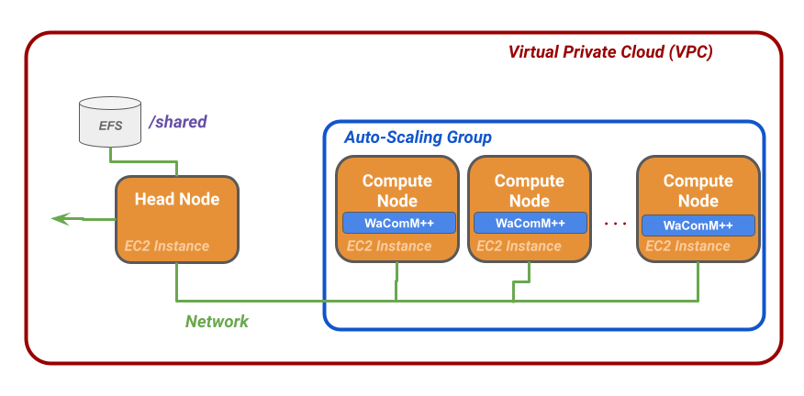
High-Performance Cloud Computing
Cloud based Infrastructure-as-a-Service (IaaS) approach for High Performance Computing.
Elastic resources used on-demand.
Virtual clusters builded matching a customer’s specific requirements.
Head Node: distributes data
over the compute nodes
Compute Nodes: elaborate the data

Slide 11
The (expected) twofold advantages
Developing and optimizing WaComM++
(Lagrangian inert tracers transport & diffusion heterogeneously hierarchical parallel model):
  High Performance Computing (HPC)
  GPU and multiGPU
  High Performance Cloud Computing (HPCC)
New paradigm High Performance Cloud Native Computing (HPCNC)
This work is a contribution to the MytilAI research project (CUP I65F21000040002). It was supported by the H2020 EuroHPC project "Adaptive multi-tier intelligent data manager for Exascale (ADMIRE)" (CUP I25F20000250002).
We thank Amazon AWS HPC Europe for the generous support with the grant PS_R_FY2021_Q4_Napoli_1500.

Slide 12
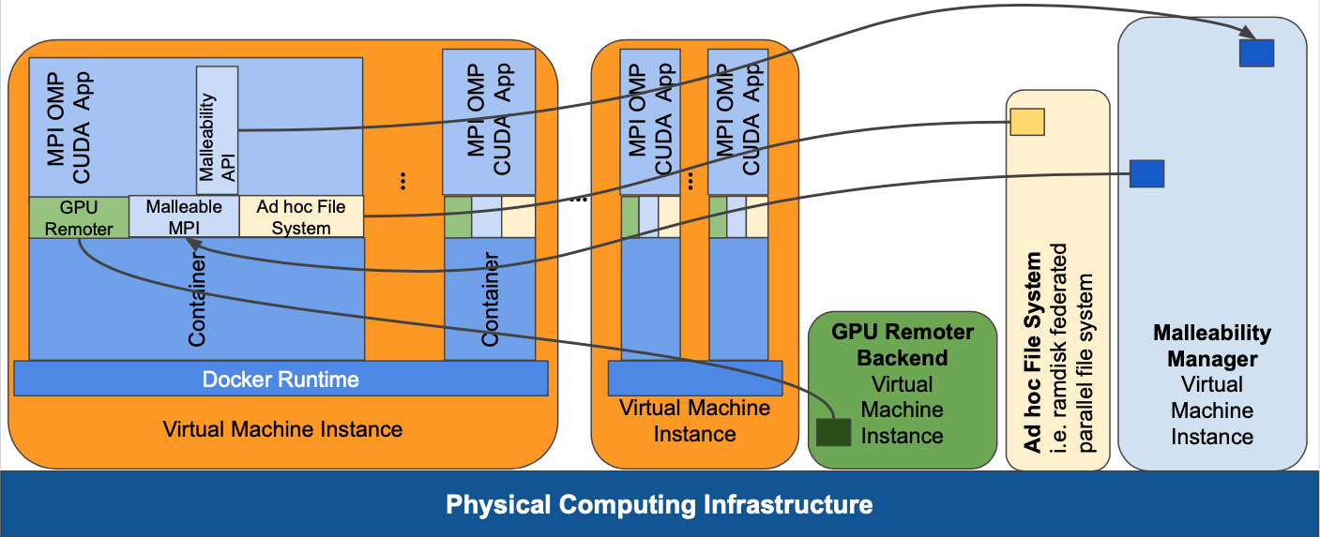
High-Performance Cloud-Native Computing

Slide 13
High-Performance Cloud-Native Computing
Cloud Native application: an application that cannot perform its life-cycle if not supported by a cloud environment.
Is an evolution of the HPCC framework.
No need to allocate computational resources previously.
Based on the usage of containers.
Possibility to change resources on-the-go.
Containers
Efficient and simple model to implement a cluster.
Grant software isolation.
High security.
Container can be executed almost immediately.
Modularity: can be splitted in smaller containers.
Portability: containers work in almost
every system.

Slide 14
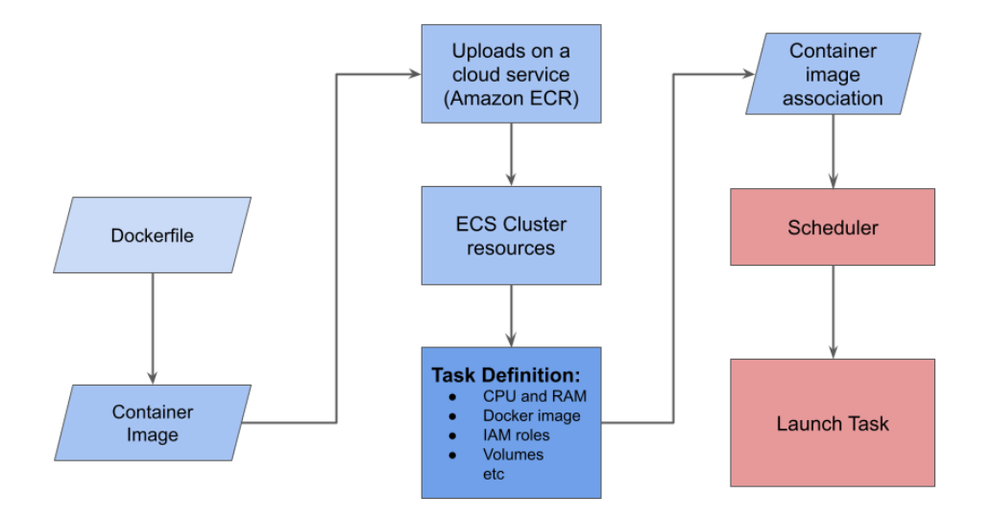
High-Performance Cloud-Native Computing
Workflow
Amazon Web Service based prototype

Slide 15
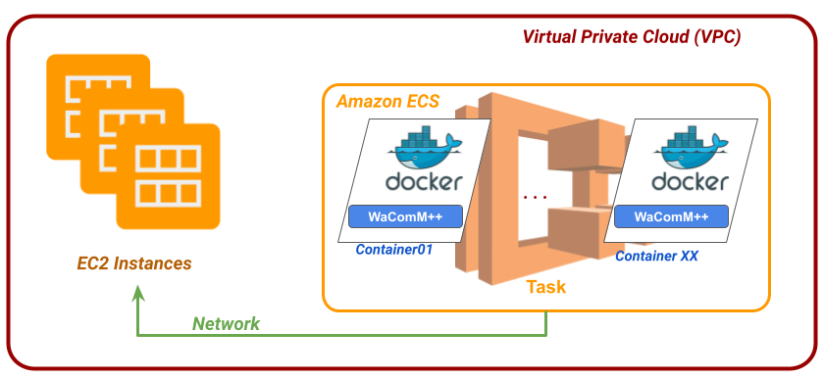
High-Performance Cloud-Native Computing
Container created with
Docker (Dockerfile).
Amazon ECR to upload container image.
Amazon ECS to schedule container tasks that will
run on Amazon EC2
instances.
ECR: Amazon Elastic Container Repository
ECS: Amazon Elastic Container Service
EC2: Amazon Elastic Compute Cloud

Slide 16


HPC vs HPCC/HPCNC
HPC
User submit a job and select computational amount of physical resources needed.
The job waits for queue process.
Waste of time and resources.
HPCC and HPCNC
Non-physical resources allocated on-demand and released with an optimized policy.
The job starts immediately.
Cost-effective using small number of supercomputers.

Slide 17


Evaluation: test beds
PurpleJeans (HPC Tests):
2 Intel(R) Xeon(R)Gold 5218 CPU@2.30GHz
4 Nvidia Tesla V100­SXM2­32GB
Apple M1 (Docker Test):
Apple MacBook Pro ­ M1 2021
Apple(R) M1:
4 (2,06 GHz Efficiency Core)
4 (3,20 GHz Performance Core),
GPU - 8 Graphics Core
NPU - 16 Neural Engine cores.
PurpleJeans Supercomputer
https://rcf.uniparthenope.it
Amazon EC2 Instances (HPCC Test):
t3.2xlarge
8 vCPUs
32 Gb RAM

Slide 18

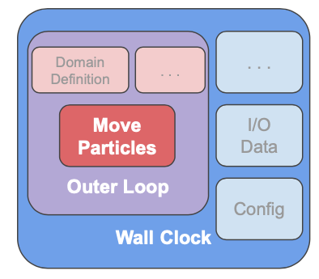
Evaluation: setup & metrics
Setup:
24 hour simulation, 1 million particles emitted the first hour.
One emission source: Sarno river
Different evaluation metrics:
Execution Time:
  Wall Clock: a complete software
  execution.
  Outer Loop: time of main operations.
  (MoveParticles, etc)
  Move Particles: time spent for simulating
  particles movement.
Particles per Second (Throughput):
  Outer Loop
  Move Particles

Slide 19
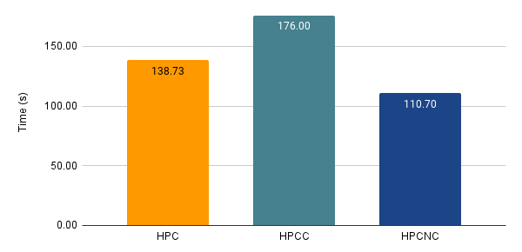
Evaluation: baseline
Sequential Run:
No shared or distributed or CUDA acceleration active.
Baseline used to compare experiments results.
Necessary to compute speedup and efficiency.

Slide 20
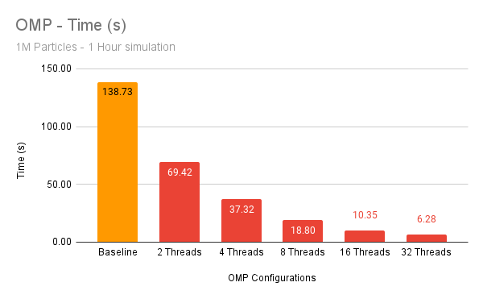
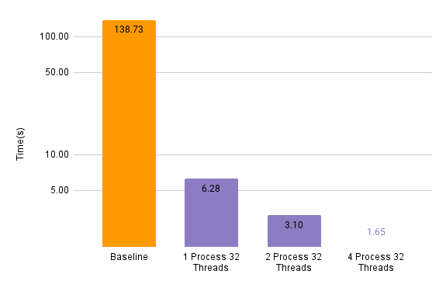
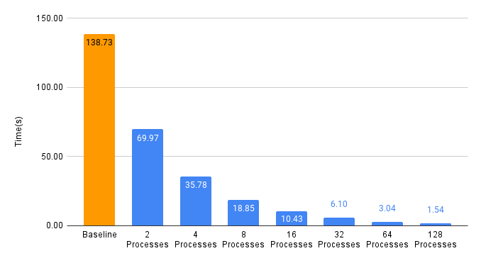
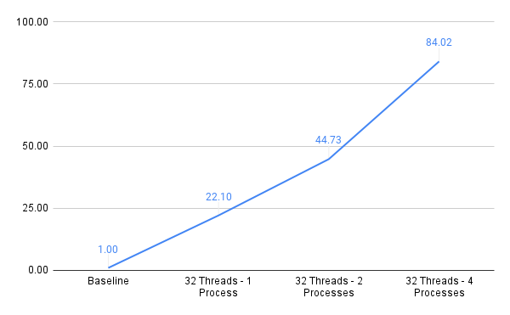
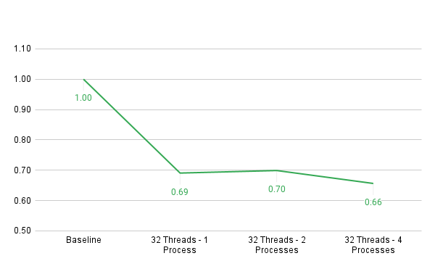
Evaluation: results, purpleJeans
Shared Memory
Shared and Distributed Memory
On premises
No GPUs
1 million of particles
Distributed Memory
SpeedUp
Efficiency

Slide 21
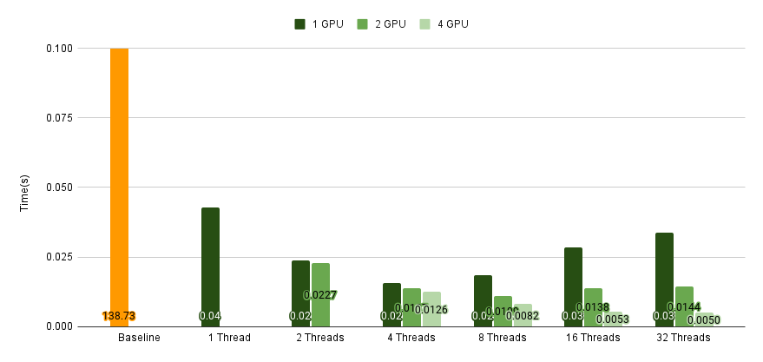
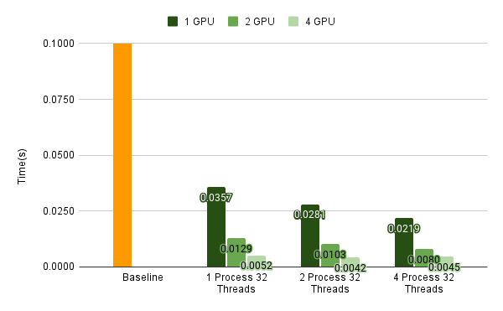
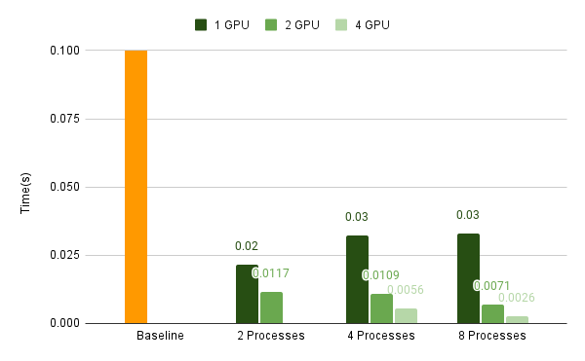
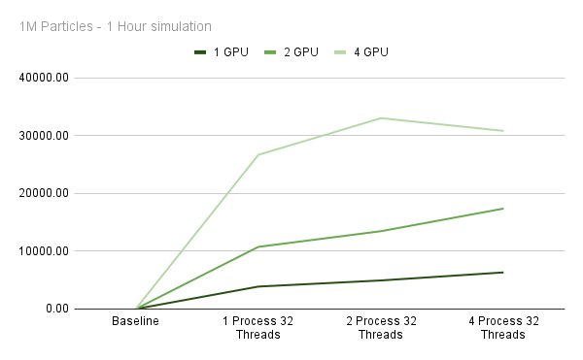
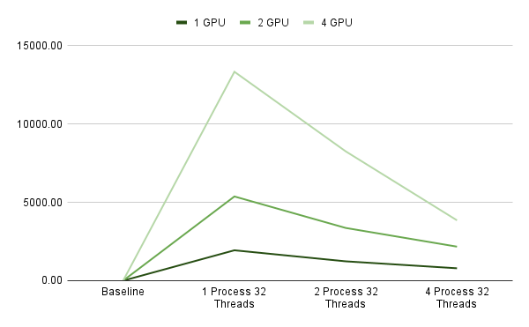
Evaluation: results, purpleJeans
Shared Memory
Shared and Distributed Memory
On premises
GPUs
1 million of particles
Distributed Memory
SpeedUp
Efficiency

Slide 22
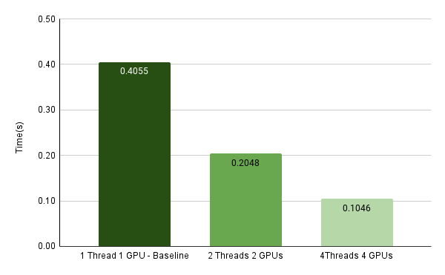
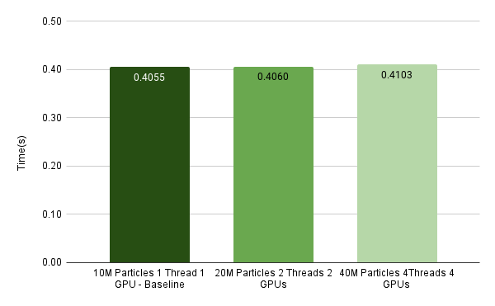
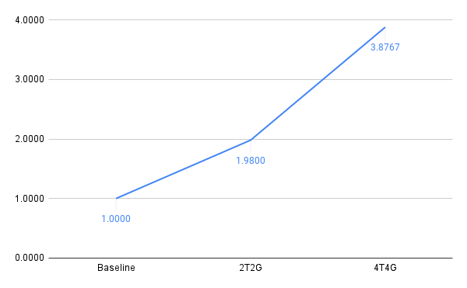
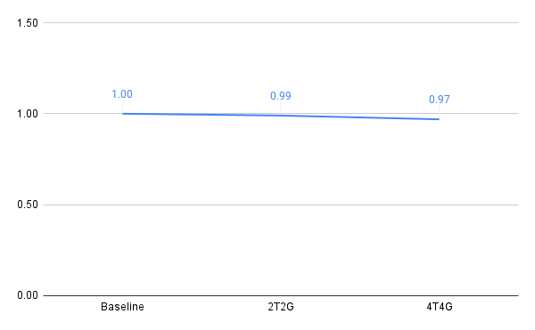
Evaluation: results, purpleJeans
On premises
CPUs & GPUs
10 millions of particles
Execution Time
Execution Time
Speed Up
Efficiency
Configurations | Move Particle - Time (s)
1 GPU - 10M Particles | 0.4055
2 GPU - 20M Particles | 0.4060
4 GPU - 40M Particles | 0.4103
GPUs
Scalability - Hard Test

Slide 23
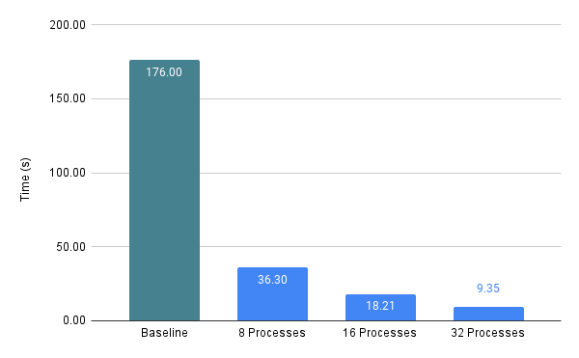
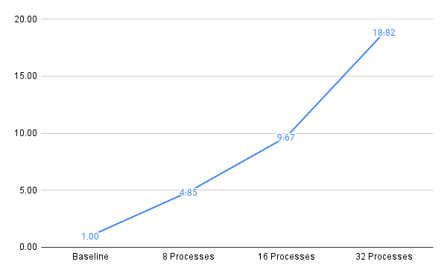
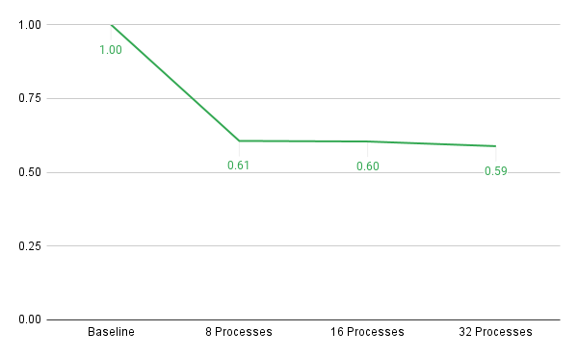
Evaluation: results, HPC on AWS
Distributed Memory
Experiment:
Testing distributed memory to confirm good scalability between nodes in a cloud environment.
4 Nodes (8 vCPU) were used.
SpeedUp
Efficiency

Slide 24
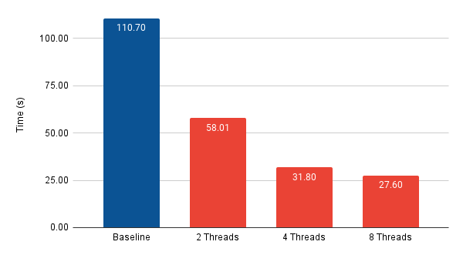
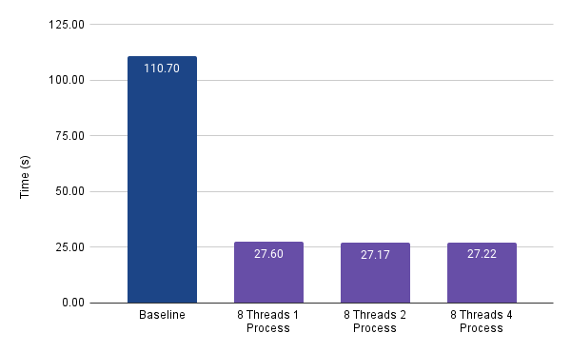
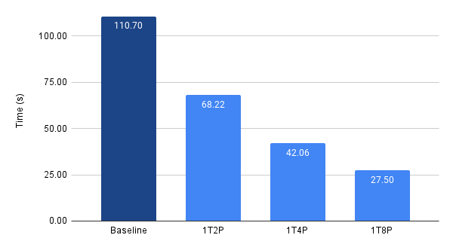
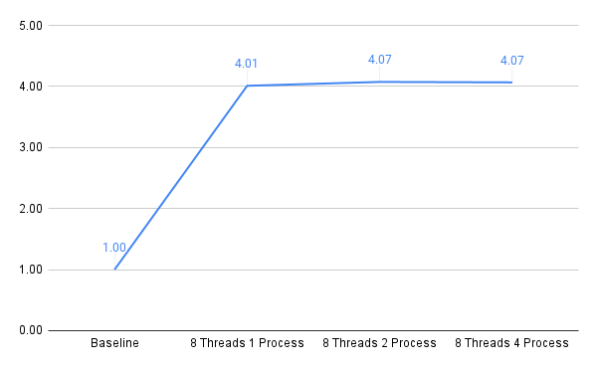
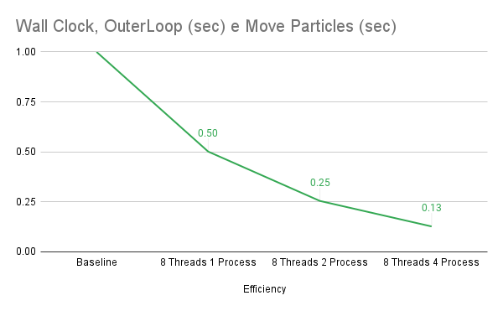
Evaluation: results, docker on a laptop(!)
Shared Memory
Shared and Distributed Memory
Experiment:
Testing distributed memory to confirm good scalability on Apple Silicon M1
Distributed Memory
SpeedUp
Efficiency

Slide 25
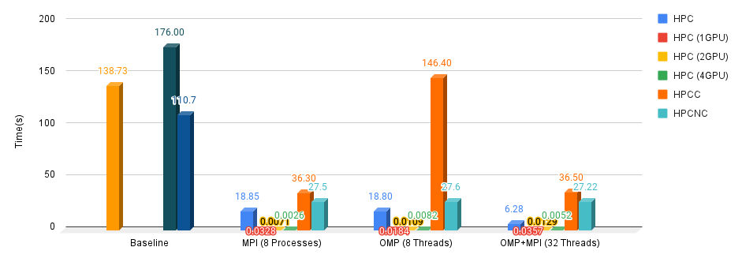
Evaluation: all around

Slide 26

Conclusions and future trends
PROs:
Malleability:
Load balance on-the-go
Based on Containers.
Extension of the HPCC paradigm.
CONs:
Mixing malleable and un-malleable resources.
Not easy to deploy and managed.
Network burden reduce performances on sharing volumes.
Not easy-coupled with GPUs.
…future features…
FlexMPI: Malleabilty to computing resources
GVirtus: GPU Virtualization
Ad-Hoc Filesystem

Slide 27






MASTER MEIM 2021-2022
https://github.com/CCMMMA/wacommplusplus
The results shown about the presented use case are part of a contribution to the MytilAI research project (CUP I65F21000040002).
The research is partially supported by the H2020 EuroHPC project "Adaptive multi-tier intelligent data manager for Exascale (ADMIRE)" (CUP I25F20000250002).
Finally, we thank Amazon AWS HPC Europe for the generous support with the grant PS_R_FY2021_Q4_Napoli_1500.
H2020

